Slide 1
ITER physics priorities for WP PrIO in 2022
R. A. Pitts
On behalf of the Science Division Science, Controls and Operation Department
ITER Organization, Route de Vinon-sur-Verdon, CS 90 046, 13067 St. Paul Lez Durance Cedex, France
The views and opinions expressed herein do not necessarily reflect those of the ITER Organization.

Slide 2
Caveat
WP PrIO different to the other new WPs with direct link to ITER Physics
Many areas not covered by ITER Physics → WP PrIO Leaders have been in separate contacts with IO staff in relevant areas
Will comment here only on programmatic areas related to Science Division
IO notes the inclusion of some new proposed activities compared to the original plans initially discussed with Science Division

Slide 3
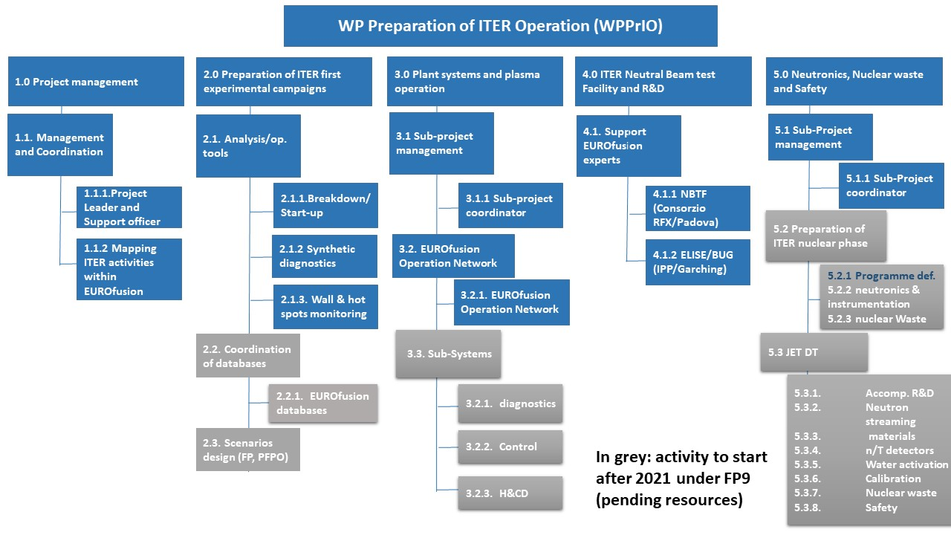
Strongest connection to IO Science Division
Courtesy X. Litaudon

Slide 4
SP 2.2.1.: Breakdown/start-up (1)
Already good collaboration between the IO and the WP → very important area for ITER
Participation of IO experts (P. De Vries, T. Wauters, R. A. Pitts) in the 2 meetings held so far in 2021
Expect this to continue → important priority for 2022 onwards (ITER First Plasma preparations)
Some remarks on proposed activities (IO welcomes many of the specific items listed for near term development):
Very much welcome adaptation of simulation codes into IMAS, but note GRAY already “IMASified” (M. Schneider et al., submitted to Nuclear Fusion).

Slide 5
SP 2.2.1.: Breakdown/start-up (2)
Remarks continued:
Strongly support ongoing development of plasma evolution module in DYON (also DYON into IMAS if possible eventually) → to see what the consequences are of making fixed volume prescription in codes like SCENPLINT (used for ITER breakdown studies and being incorporated in the ITER PDS)
Strong interest in providing a tool in which a more accurate role of ECH in breakdown can be established → particularly the issue of general RF pre-ionization → start codes with specified pre-ionization fraction and self-consistently include ECH plasma heating
Essential question: how much ECH power required for effective pre-ionization? → very strong link also to ECWC power requirements → currently large uncertainty (multi MW) in projected P_{ECH} requirement for ITER

Slide 6
SP 2.2.1.: Breakdown/start-up (3)
Remarks continued:
Regarding “operational window” for ITER breakdown → unclear what exactly is meant here → very large parametric study already performed for ITER with SCENPLINT and good benchmark with BKD0 and DYON (Kim et al., NF 60 (2020) 126049) for many key parameters (e.g. breakdown pressure) → requires more elaboration with IO in subsequent programme development

Slide 7
SP 2.2.2.: Synthetic diagnostics (WAVS)
Strongly support efforts to prepare more advanced tools for 2D visible image treatment, but require good interaction with IO:
We have performed many studies of Be erosion/migration for ITER (along with EU contractors) → avoid unnecessary repetition
There is a strong effort in synthetic diagnostic development with the RF-DA for main chamber spectroscopy system (see e.g. V. Neverov, PPCF 62 (2020) 115014) → also been applied to some WAVS views

Slide 8
SP 2.2.3.: Real time wall protection (WAVS)
An area of very strong interest to IO and high priority item
Wall protection has been deliberately removed from upcoming Framework Contract for PCS PFPO-1 design and will be largely performed in-house
Strongly encourage development synergy between WP PrIO and IO in this area Key question: what is the “best” (easiest and most robust) way to go about wall protection?
Definition of areas of interest (e.g. JET), more sophisticated methods?
Definition of differences in protection to be performed by the PCS and the APS (Advanced Protection System)
Note that approach is step-wise → more advanced features to be added to PCS for PFPO-2 design
Clear need is production of synthetic diagnostic for IR WAVS → covered by PrIO proposal and a major undertaking (note also LECAD link between IO and CEA)

Slide 9
SP 2.1.: general comments on simulation tools (1)
Could benefit from more clarity on WP PrIO role in development of “European Plasma Simulator”
We assume this is more a “High Fidelity Plasma Simulator”? → uses “Python workflow” → we are interested in more details
Current state of HFPS development at IO is adaptation of JINTRAC to IMAS and coupling to DINA (now also in IMAS) – see talk by S. Pinches at WP AC meeting
Big difference between an HFPS and a more “operational tool” adapted to pulse design

Slide 10
SP 2.1.: general comments on simulation tools (2)
PDS development at IO
A tool to rapidly design and simulate ITER pulses and ensure they operate with physics scenario and plant system limits
Essentially an IMAS workflow with data exchange through IDS
Now getting off the ground → first contract underway to rewrite and implement the TRANSMAK code (which contains the SCENPLINT transport module) for IMAS compliance → for simulation of ITER First Plasma scenarios
Smooth transition after early breakdown phase to DINA-IMAS for full discharge simulation (later PDS development phase)
Second contract call to be launched (~2 weeks) to develop initial PDS workflow, GUI and interfaces to CODAC Configuration, Verification and Validation Framework (CVVF) to ensure compliance with specified operating limits and conditions

Slide 11
SP 2.1.: general comments on simulation tools (3)
WP PrIO contribution in simulation area:
Seems to us best suited to contributions to the PDS
Provision of alternative modules (IMAS compatible) for breakdown/plasma initiation studies → already underway within SP 2.2.1
Provision of reduced models in the scenario development area more suited to a tool which can run rapidly
For SP 2.3: scenario design for first ITER campaigns
We are interested to hear which tools will be used and how this will link to the scenario design efforts already undertaken and underway at ITER
Current ITER IMAS Scenario Database contains ~2000 ITER simulations (see https://confluence.iter.org/display/IMP/Scenario+Database – requires ITER account)

Slide 12
SP 2.2.1.: databases
IO welcomes this initiative
We would be happy to hear more detailed communication as to how this will be done
Are IDS extensions required?
How will the databases be hosted?
Policy for extension outside the EU → transfer to the ITPA (of which IO is a member) → what timescales?
IO happy to be involved/help

