Slide 1
ITER Priorities for WP - TE
Alberto Loarte (presented by R. A. Pitts)
On behalf of the Science Division
Science, Controls and Operation Department

Slide 2
Outline of talk
R&D priorities to support ITER Research Plan
Priorities for WP-TE
Conclusions
@2021 ITER Organization
WPSA EUROfusion planning meeting - 8th September 2021

Slide 3
R&D Topics for IRP
  R&D for design completion (DMS, Diagnostics, etc.)
  Disruption characterization, prediction and avoidance
  Stationary H-mode plasmas, ELMs, ELM control and impact on H-mode and power fluxes
  Characterization and control of stationary power fluxes
  Plasma material/component interactions and consequences for ITER operation
  Start-up, ohmic and L-mode scenario development
  Conditioning, fuel inventory control
  Basic scenario control and commissioning of control systems
  Transient phases of scenarios and control
  Complex scenario control during stationary phases
  Validation of scenario modelling and analysis tools
  Heating and Current Drive and fast particle physics
  Long pulse/enhanced confinement scenario issues

Slide 4
Categories for IRP R&D issues
Categories
  1 → Outcome of R&D can have major impact on system design or on the ITER Research Plan (e.g. modifying overall experimental strategy in each phase or the objectives of the phases themselves)
  2 → Outcome of R&D expected to have medium impact on system design or on the ITER Research Plan (e.g. modifying significant details of experimental strategy to achieve objectives in each phase)
  3 → Outcome of R&D expected to optimize details of ITER Research Plan experimental strategy to achieve objectives in each phase by providing relevant experience

Slide 5
High Priority Cat. 1 and Cat. 2 R&D Topics (next ~ 3 years)
Support of DMS baseline design (Shattered Pellet Injection, SPI)
Resolution of diagnostic design issues
He H-mode operation and/or H+10% He operation for Pre-Fusion Power Operation
3rd harmonic ECH heating validation for 1.8 T operation in PFPO
Low <n_{e}> ECH heated H-modes for operation in PFPO-1
Electron Cyclotron Wall Conditioning (ECWC) for use in PFPO-1
ECH-assisted and ohmic start-up for First Plasma (FP) and PFPO-1
Disruption loads characterization in PFPO
Strategy for ELM control
n = 1 and n = 2 error fields and correction
Divertor lifetime appropriateness to allow operation until well into the Fusion Power Operation (FPO) phase with the first tungsten divertor
3-D field ELM suppressed H-mode as integrated scenario for ITER high Q scenarios
Specific issues for Q = 5 steady-state scenarios in ITER with NBI + ECH

Slide 6
Support to DMS (SPI) design
DMS design next steps are PDR in 2022 and FDR in 2024 to be ready for installation and exploitation by start of PFPO-1
A.1. SPI-single injector. Pellet injection optimization for RE avoidance (incl. TQ and CQ mitigation) → optimization of shard size, velocity, amount, gas vs. shard fraction, composition (D + impurity) to achieve RE avoidance with optimum TQ, CQ (incl. wall loads)
A.2. SPI-single injector demonstration for runaway mitigation → determination of feasibility to dissipate the energy of formed runaway beams (amount, assimilation) and to improve scheme
A.3. SPI-multiple injections → determination of effectiveness of multiple injections to achieve RE avoidance with optimum TQ, CQ (incl. wall loads) compared to single injections (incl. timing requirements)
A.10. SPI-single injector. Pellet injection geometry optimization for RE avoidance (incl. TQ and CQ mitigation) → optimization of injection direction to achieve RE avoidance with optimum TQ, CQ (incl. wall loads)

Slide 7
He and H + 10% He operation in PFPO
Additional heating level to plasma in PFPO makes H-mode operation in hydrogen not possible or marginal → He H-modes provide robust operational space (H + 10% He could be an alternative)
B.2.1. He H-mode operation with W PFCs and ELM control → Compare He H-mode plasmas with W PFCs pedestal behaviour, ELM control and W operational issues (W accumulation, PWI issues) with D H-modes (highest priority with 3-D fields, but other ELM control schemes such as hydrogen pellet pacing and vertical movements are also important)
B.2.2. Mixed H + ~ 10 % He H-mode operation and ELM control. Establish H H-mode plasmas with a range of He concentrations to determine the requirements for H-mode access and sustainment and for ELM control schemes compared to H plasmas
B.4.1. Be wall erosion in He plasmas → He plasma discharges to determine if expected increased of Be wall erosion leads to coating of the divertor
B.4.2. He plasma modification of W mechanical properties at high fluences → Long-term exposure of W PFCs to He plasmas and characterization of exposed PFCs
B.4.3. Formation of fuzz by He/W interaction and critical fuzz thickness → Exposure of W PFCs to He plasmas, measurement of fuzz and impact on plasma operation

Slide 8
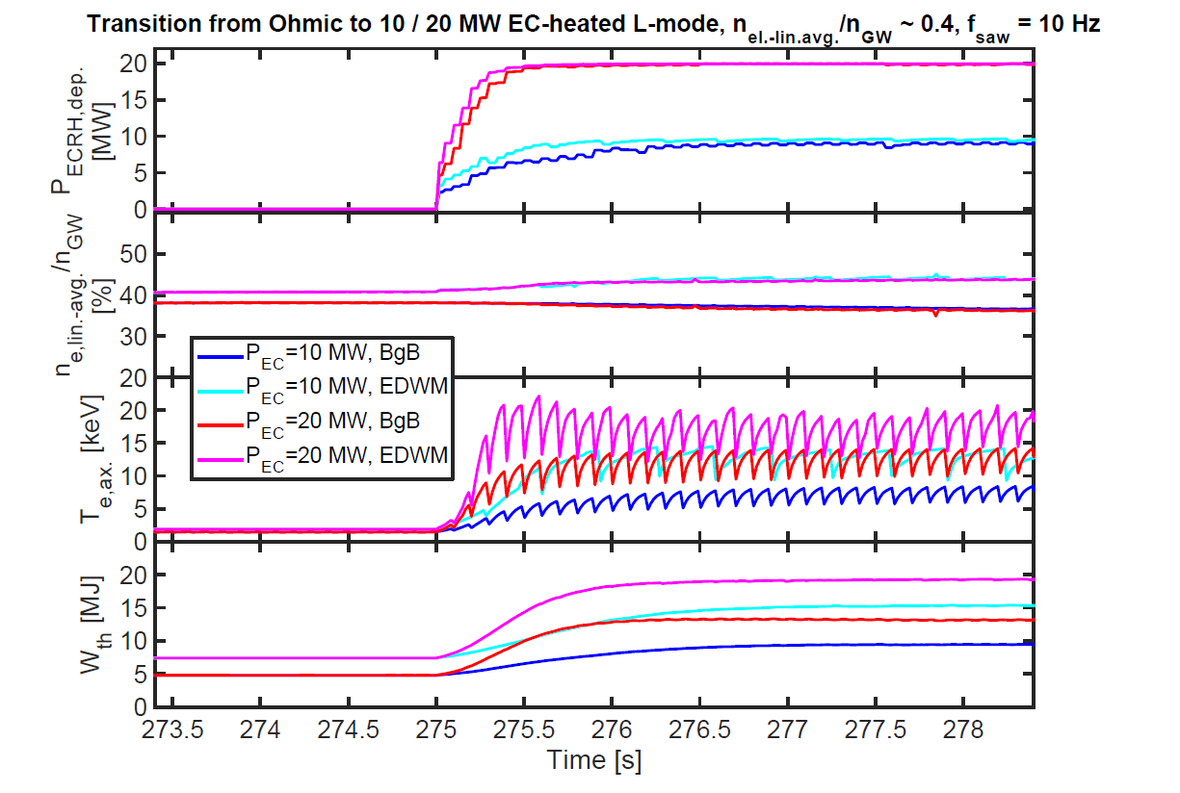
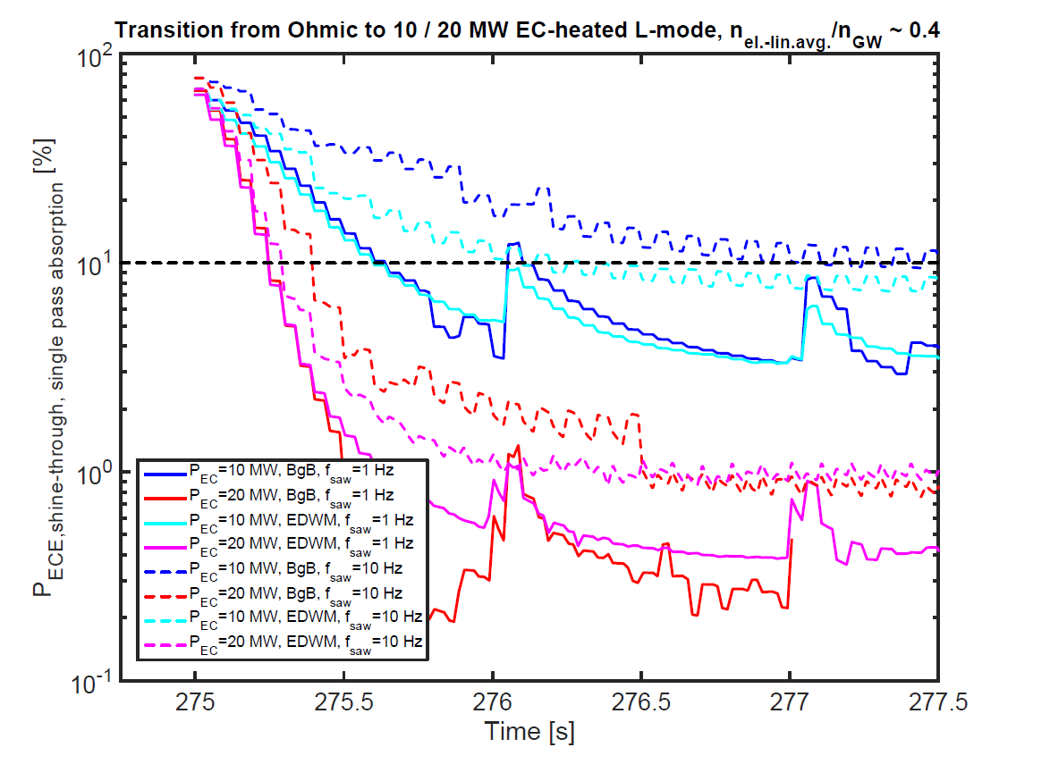
3rd harmonic ECH heating validation for 1.8 T operation in PFPO
B.11.6. Validation of models for ECH absorption in 3rd harmonic operation at 5 MA/ 1.8 T plasmas
Quantitative experimental evidence on 3rd harmonic absorption in conditions similar to those in 5 MA / 1.8 T plasmas and validate modelling predictions (PFPO-1 H-modes)
  Perform ITER-like experiments with 3rd harmonic ECH → start in plasmas with low ~ 10-20% absorption and study the temporal increase of the absorption for various levels of ECH powers
Modelling of 1.8 T ITER scenarios: M. Schneider, et al., NF 2019

Slide 9
Low <n_{e}> ECH heated H-modes for operation in PFPO-1
B.2.4. H-mode access and confinement of H plasmas with electron heating and low plasma density in PFPO-1 → Evaluate H-mode access and confinement in ITER-like H plasmas for PFPO with dominant electron heating
Plasma in PFPO-1 H-modes: A. Loarte, et al., NF 2021

Slide 10
Electron Cyclotron Wall Conditioning (ECWC) for use in PFPO-1
B.6.1 ECWC conditioning
Perform ECWC conditioning and determine requirements for effective cleaning (and reliable plasma start-up including recovery from unmitigated and mitigated disruptions)
  Use ECRH for ECWC on a routine basis for general machine conditioning (and disruption recovery) and diagnose the ECWC plasma
  ECWC is one of the two cleaning techniques available in ITER with toroidal field on and only one available in PFPO-1

Slide 11
ECH-assisted and ohmic start-up for First Plasma (FP) and PFPO-1
Plasma start-up requires validated models both for ECH assisted and ohmic start-up → V_{loop}~0.3 V/m due to SC coil voltage limits and VV
B.5.1. ECH assisted plasma start-up → Perform experiments to optimize ECRH assisted start-up and to validate models for ITER
B.5.2. Ohmic plasma start-up → Perform experiments to achieve ohmic plasma start up in ITER-like conditions (i.e. electric field) and identify the range of parameters over which this can be most reliably achieved
High quality measurements during plasma start-up are essential
TRANSMAK-SCENPLINT
0.3 mPa
TRANSMAK-SCENTPLINT
0.7 mPa

Slide 12
Disruption load characterization
B.1.1. Disruption/VDE thermal load characterization → Characterization of thermal loads during TQ and CQ (magnitude, time dependence and distribution)
B.1.2. Disruption/VDE mechanical load (current flow) characterization including toroidal rotation → Characterization of halo currents during disruptions and VDEs (magnitude, time dependence and distribution, including rotation)
B.1.3. Runaway electron load characterization. Characterization of power deposition to PFCs by runaway plasmas (magnitude, time dependence and distribution, including magnetic to kinetic energy conversion in termination)

Slide 13
3-D field ELM suppressed H-mode as integrated scenario for ITER high Q
Emphasis on scenario integration aspects
(incl. physics-based scaling to ITER)
B.2.10. ELM control by 3-D fields with low input torque and moderate ratios of P_{input}/P_{LH} (incl. access/exit)
B.2.11. Impurity (W) exhaust for ELM control by 3-D fields in stationary H-modes and its optimization
B.3.2. Effect of plasma response on divertor power fluxes with 3-D fields for ELM control and 3-D field optimization and B.3.5. Effect of 3-D fields for ELM control on divertor power fluxes in radiative H-modes.
B.11.3. Evaluate fast particle losses with 3-D fields and their correlation with plasma response and ELM control

Slide 14
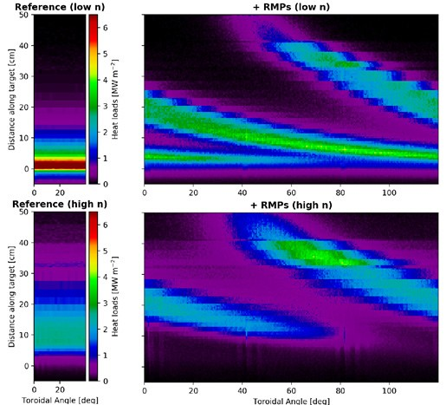
3-D field ELM suppressed H-mode as integrated scenario for ITER high Q
B.3.2 Effect of plasma response on divertor power fluxes with 3-D fields for ELM control and 3-D field optimization
Determine effect of plasma response to 3-D fields on the spatial structure and magnitude of toroidally asymmetric divertor power fluxes with 3-D fields for ELM control and optimization to maximize wetted area
Required to determine the spatial structure of divertor power fluxes in ITER and to identify the physics basis on which to extrapolate experimental results to ITER taking into account the plasma response expected to be required
High density divertor with 3-D fields in PFPO-1 H-modes: H. Frerichs, et al., PRL 2021

Slide 15
Conclusions
WP-TE is a major contributor to R&D to support IRP on multiple areas
Focus for 2022 on specific high priority topics with high impact on IRP (overall and specifically for PFPO-1)
Support of DMS baseline design (Shattered Pellet Injection, SPI)
He H-mode operation and/or H+10% He operation for Pre-Fusion Power Operation
3rd harmonic ECH heating validation for 1.8 T operation in PFPO
Low <n_{e}> ECH heated H-modes for operation in PFPO-1
Electron Cyclotron Wall Conditioning (ECWC) for use in PFPO-1
ECH-assisted and ohmic start-up for First Plasma (FP) and PFPO-1
Disruption loads characterization in PFPO
3-D field ELM suppressed H-mode as integrated scenario for ITER high Q scenarios

