Slide 1
2022 Programme goals & strategy
WP Tokamak Exploitation Task Force Leaders:
E. Joffrin, Marco Wischmeier, A. Hakola, B. Labit, E. Tsitrone, N. Vianello

Slide 2
Overarching priorities for work package Tokamak Exploitation in FP9 (reminder)
Prepare ITER exploitation (ITER Research Plan & ITPA CC)
Provide Physics Basis for guiding DEMO design
Exploit recent machine enhancements, i.e. related to PEX (Plasma EXhaust)
Address objectives of EUROfusion Roadmap:
Mission 1 (Plasma Regimes of Operation)
Mission 2 (Heat exhaust System)
https://wiki.euro-fusion.org/wiki/WPTE_wikipages:_Tokamak_Exploitation_Work_Package

Slide 3
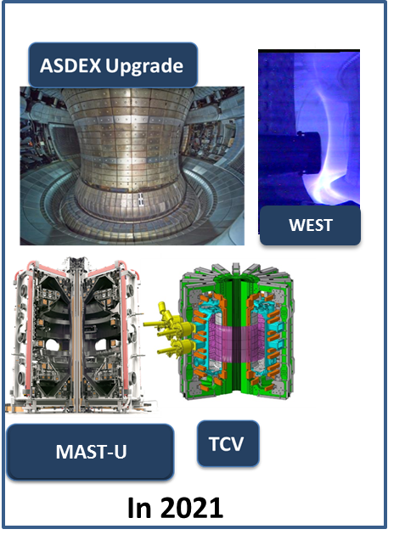
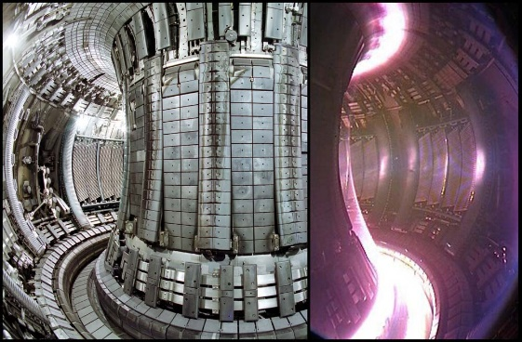
Tokamak Exploitation devices in 2022
WPTE devices in 2021
Participation of 4 devices in 2021: ASDEX Upgrade, MAST-U, TCV and WEST. JET integrated in 2022.
The operational budget allocated to WP TE to all devices is pre-defined by EUROfusion until 2025.
JET integrated end of 2021 with a pre-defined programme and participation for C40B (tritium) and C42 (pending final UK-EURATOM agreement)
In 2022 & 2023

Slide 4
All 5 devices will operate in 2022
In 2022, all five devices AUG, JET, MAST-U, TCV and WEST will operate
2021 | 2022
AUG
 |  | SPI / D He
MAST-U
 | Start /SuperX |  | ADC + cryo
TCV
WEST
 |  |  | PEX |  | PEX
JET
T |  | DT | T |  | D |  | He
Call for participation to 2022 (1st ½)
Pending UK-EURATOM agreement
Call for proposal to He (AUG; JET; …)
Call for proposal 2022 (2nd ½) & 2023
Call for participation 2022 (2nd ½) & 2023

Slide 5
Overall agenda for 2022
Programme meeting for 2022 on the 30th of September
Call for participation for the first half of 2022 (AUG/TCV/WEST + MAST-U modelling) sent mid-october and participation selected before Christmas
New WPTE DTFLs selected by October in prevision of the JET integration in WPTE
Unique call for proposal to the Helium campaigns in JET and ASDEX Upgrade by the end of 2021.
Call for proposal for the 2nd half of 2022 and 2023 covering experiments in all devices including JET at the beginning of 2022.
Call for participation to the 2022 (second half) and 2023 in April 2022. Selection expected in May. This will include the resources required for the analysis of the 2021+ first half of 2022 campaigns.
No calls for C40B and C42 JET campaigns.

Slide 6
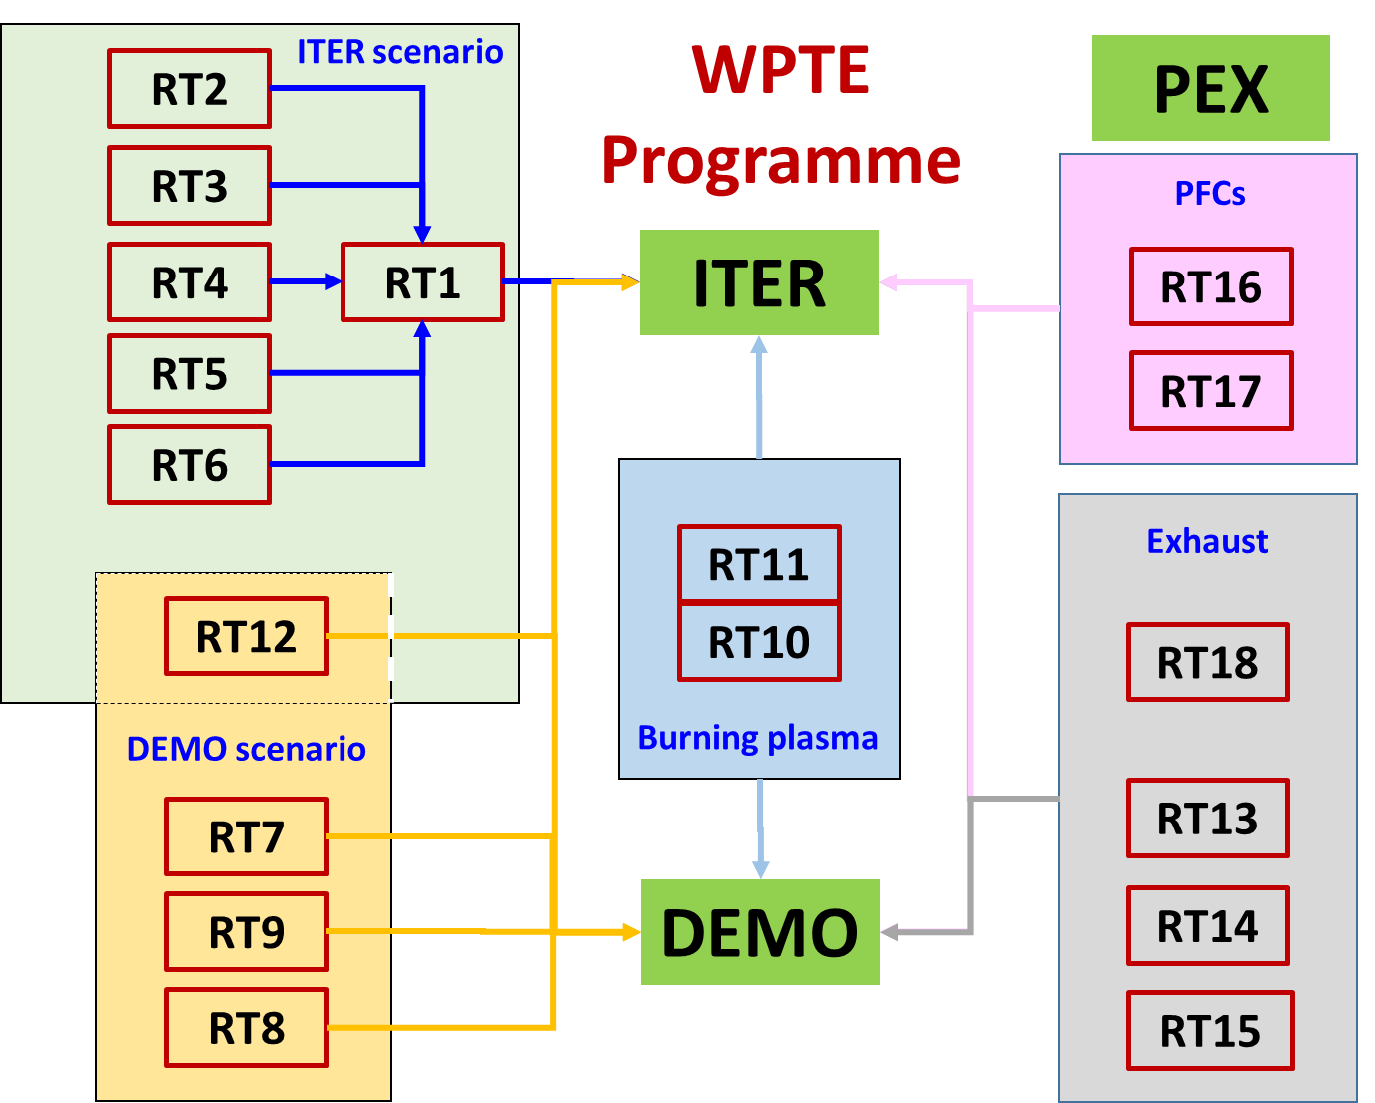
WPTE research topics structure will be kept as it is in the first half of 2022

Slide 7
Overview of RTs developments in 2022
The detailed plans for 2022 shall be discussed in the Programme meeting on the 30/09 – 01/10
➔ TFLs will work with the SCs by research Topics to elaborate the detailed plans for 2022
 | TFLs | Title | Indicative marker for 2022
RT1 | EJ/BL | IBL scenarios towards low collisinality and detachment | TCV: Expand BL scenario with more electron heating, TCV+AUG: dedicate pulses for ramp-down AUG: establish the link with EDA. WEST Er field measurements
RT2 | NV/BL | H-mode entry and pedestal dependence with impurities and isotopes | TCV+AUG: Focus on SOL coupling, GK modelling and continue exploration of low nu* . TCV: Zero torque and e- dominated plasmas + isotope
RT3 | EJ/BL | RF-assisted breakdown and current ramp-up optimization | AUG and WEST: scenario with IC assist to be retried if feasibility demonstrated. Complete dataset for burnthrough in AUG
RT4 | EJ/MW | Disruption avoidance and control for ITER and DEMO | AUG: Investigate shape dependence of HDL AUG+TCV: Introduce plasma state dependent soft stop
RT5 | EJ/AH | Run-away electron generation and mitigation | TCV: expand the flushing dataset to match JET/DIII-D shapes. WEST: experiment with new diagnostics AUG: add high Te data and flushing experiment Participate to IO SPI experimets (see next slides)
RT6 | NV/AH | ELM mitigation and suppression in ITER/DEMO relevant condition | AUG: RMP with impurity seeding Understand failure to stabilize ELMs in hydrogen MAST-U: tune H-mode scenario to apply RMP.

Slide 8
Overview of RTs developments in 2022
Important note: the detailed plans for 2022 shall be discussed in the Programme meeting on the 30/09 – 01/10
 | TFLs | Title | Marker
RT7 | NV/BL | Negative triangularity scenarios as an alternative for DEMO | Call for proposal: 9 proposals received to be discussed in Programme meeting. SOLPS modelling to be completed in TCV & AUG
RT8 | NV/BL | QH-mode and I-mode assessment in view of DEMO | AUG: Explore I-mode in fwd-Bt/Ip Understand the difference between C- and W-wall for the QH-mode by modelling WEST: first experiment
RT9 | MW/BL | Extension of EDA and QCE performance towards DEMO | Analysis: heat loads, turbulence, filamentary transport, pedestal stability. Explore EDA with ICRH, in Helium and in full detached scenario with RT control
RT10 | ET/AH | Fast-ion physics with dominant ICRF heating | WEST: starts studies of turbulence stabilization with fast ion AUG: repeat fast-ion chanelling with NBI AUG: Analysis of He fast ion measurements in the H phase.
RT11 | NV/BL | Impact of MHD activity on fast ion losses and transport | Continue experiments at high density (CTS team) Improve FI distribution reconstruction AUG: MEGA modelling and analyses of data MAST-U: Effect of RMP on FI losses
RT12 | EJ/NV | Development of the steady state scenario | Experiments planned in October. Priority in 2022.

Slide 9
Overview of RTs developments in 2022
Important note: the detailed plans for 2022 shall be discussed in the Programme meeting on the 30/09 – 01/10
 | TFLs | Title
RT13 | MW/AH | X-point radiation and control | TCV: Control of XPR to be tuned. MAST-U: experiment with active control in H-mode WEST : first attempt with open divertor
RT14 | MW/ET | Physics of plasma detachment / impurity mix/ heat load patterns | AUG+TCV: Analysis of data collected MAST-U: modelling of data
RT15 | NV/ET | Extrapolation of SOL transport to ITER and DEMO | Extend experiment to H-Mode Extend X-point investigation in particular in condition relevant for ITER/DEMO: High recycling & detachment Multi-machine comparison
RT16 | ET/AH | PFC damage evolution under tokamak conditions | AUG : 1 day divertor maniplulator experiment (detailed exp under definition) + MEMOS analysis WEST : Awaiting experiments (pre damaged PFU exposure, heat loads in castellated structures, preparation for high fluence exp)
RT17 | ET/AH | Material migration and fuel retention mechanisms in tokamaks | WEST: Awaiting experiment (W sources, changeover H/D, ammonia formation …) AUG: analysis of first wall data on W erosion sources, modelling of material miragtion
RT18 | MW/EJ | Alternative divertor configurations | TCV: Stronger focus on detachment studies in high-power, NBI and X3 heated ADC ELMy H-modes (X-divertor, X-point target, Super-X, SF- and SF+)

Slide 10
SPI experiment in ASDEX Upgrade in 2022
The SPI in ASDEX Upgrade is expected to operate in 2022 (IO-IPP collaboration)
IO must decide on the geometry of the shattering unit by 2023
Fragment sizes, but also injection plume characteristics can be expected to impact on the mitigation efficiency
Objectives from ITER Organization
Study of pre-TQ ablation of different fragment size distributions and properties for various target plasmas and SPI parameters;
Assessment of pre-TQ dual injection in an all-metal device for RE avoidance;
Ablation measurements of “single” fragment as reference for SPI and for model validation.
Topic 1 (Pre-TQ ablation studies): ~100-110 pulses
Topic 2 (Post-TQ ablation studies): ~10-20 pulses
Topic 3 (Dilution cooling studies): ~75-85 pulses
➔ 200 « Good » pulses

Slide 11
SPI experiment in ASDEX Upgrade in 2022
EUROfusion (TE) will act as a participant to the IO Programme in ASDEX
There are about 200 good pulses proposed by the ITER Programme, i.e. 240 including contingencies.
SPI experiments shall be done in single days of 25 pulses. This bring the total number of SPI days to 9 days.
IPP proposes that 45% of these pulses are part of the EUROfusion time (4 days) to match the share of EUROfusion in other Programmes.
TE will integrate this participation in RT05 and nominate a contact person for collaborating with the IO SCs.
There will be single shot requests: all pulses will go into a single ITER SPI pool and there will be no IPP or TE pulse flags as usual.
The TE call in mid-October will include the participation to the whole of SPI experiment with the IO plan of experiments.
For TE, 45% WP TE pulses are equivalent to 65 regular pulses bringing down down the total number of pulses to 430 out of 495

Slide 12
Future Helium campaigns in support of ITER
List of tentative items discussed by WPTE for Helium campaigns
Clarifying the LH power threshold in He
Chracterization of Elms and control with 3D fields in H-mode
Determine the efficiency of fuelling in He plasma
Intrinsic impurity transport in He plasma
Eigen Alfven mode stability in Helium plasma
Erosion and deposition balance in Helium plasmas compared to similar D operations
Sputtering of W in intra-ELM and inter-ELM phases by He2+ ions
Divertor power flux width in He plasmas in comparison to D plasmas and understanding detachment threshold
Exposure of W-PFCs to He plasmas and formation of fuzz.
Change over from He to H (or D)
On the basis of the past results from past Helium experiment in JET, AUG and WEST, TE has identified a list of potential items in particular for the ASDEX Upgrade campaign in 2022.
The proposal is to have 2 weeks of He (i.e. ~40 pulses) in ASDEX Upgrade prior to the long shutdown.
JET will also plan an Helium campaign at the end of 2022.
➔ A unique call for proposal shall be launched at the end of 2021 to prepare the programme on Helium.

Slide 13
Diagnostic enhancements for 2022
High priority diagnostics assessed by TE for 2022 (out of 16 proposals)
Device | Project | Motivations
AUG | Design and implementation of divTS system for the new upper divertor (PEX-DivIIo-ADC) | Expected to have a high impact on the PEX Programme to interpret the physics of the exhaust
WEST | Vertical endoscope for the fast IR camera | Aims at measuring the ELMs and disruptions on the target plate with of frequency of at least 10kHz and a good spatial resolution.
WEST | LIBS embarked on the remote arm | LIBS on the remote arm. ITER request even though no Beryllium.
TCV | Expansion of MANTIS systems: monitor RE-electrons and double-Null divertor concepts | Additional system: synchrotron radiation on a different location
TCV | MSE system | Will give additional constrains on equilibrium reconstruction uncertainties which might affect all cases, including alternative divertors, also important for the development of the AT scenario and the fast ion physics
JET high priority diagnostics will also be integrated in this list.

Slide 14
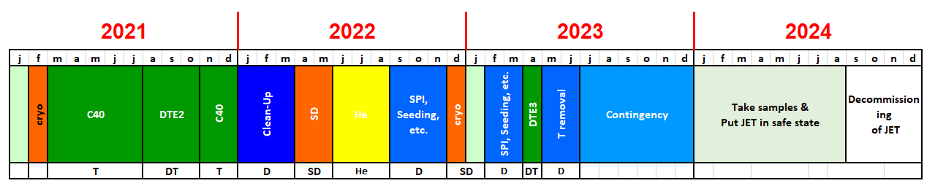
Handover of JET to WPTE
TE TFLs have now to manage C40B (Tritium) and C42 JET campaigns in 2022
JET will represent 50% of the total TE pulse budget overall
Pending agreement UK-EURATOM
Priorities for JET in 2022 and 2023:
Helium campaign
SPI experiment (with different barrels)
Seeding scenario
No ELM scenario (QH- and EDA modes)?
The JET 2022 -2023 schedule may need revision: ITER priority: SPI, Helium campaign versus DTE3 or even against elements of C40B and C42?
The JET diagnostics enhancement to be exploited: LIDS, HRTS, Bolometer

Slide 15
Organization with JET
All current JET TFLs will continue TFLs duties (TFM chairing, duty-TFL of experimental sessions, etc) until the end of 2021.
All current JET TFLs & dTFLs will continue the monitoring analysis of D-T experiments (C41) and endorsing conferences and papers until the end of 2022. The exact individual involvement (fractional time) is still under discussion.
TE TFL will take over TFL duties on the 1st of January 2022.
The experiment content, scientific coordinators and timeline should not be modified in principle. But this depends also on a possible revision of the JET Schedule.
The exact future of the tasks is under discussion since they may overlap with existing task in the existing research topics or in the TSVVs.
The management of the experiments of C40B and C42 will be redistributed among the TE TFLs including the analysis and publications.
TE task Force leaders will ensure a continuous presence on the Culham site

Slide 16

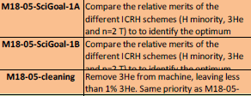



C40B campaign: « scientific goals »
Impact of neutrals and impurities on SOL and pedestal
Experiment that are presently part of C40B
Hybrid scenario for DT
ICRH scenario support in D and T plasmas
Power width scaling and ELM losses at high current
Determine the W source including ELM, RF and isotope effects
Isotope effects on confinement and transport
Isotope effects on confinement and transport
Dependence of pedestal structure on fuelling at constant beta

Slide 17

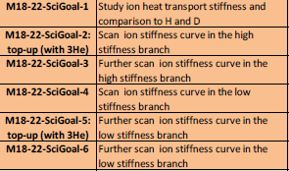


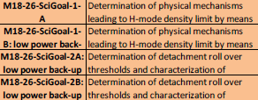
C40B campaign: « scientific goals »
Electron and ion threshold and stiffness in pure and mixed isotopes
Isotope effects on detachment in L-mode
Be erosion and migration to the divertor with isotopic effect
Particle transport in pure and mixed isotopes
Divertor geometry effect on detachment and SOL
NBI T power calibration
Isotope effect on H-mode detachment and density limit
Note: The vast majority of C40B experiments are related to isotope physics.

Slide 18
C42 campaign: present set of experiments
Green: experiment that have received machine time before C42.
Exp. | Tittle and link | JET TFLs | SCs
M21-03 | Baseline scenario for high fusion performance in DT | JM/EdeL | D. Frigione, L. Garzotti, F. Rimini, D. Van Eester
M21-06 | Integrated high performance seeded scenario | AH/JH | Sebastijan Brezinsek, Carine Giroud
M21-14 | Isotope dependence of L-H transition power threshold | JH/EdeL | Emilia Solano
M21-15 | Detachment and density limit in DT and 4He L-mode plasmas | DD/EdeL | Mathias Groth
M21-26 | T and DT comparison plasmas | CFM/JG
M21-18 | T-removal in JET-ILW | DD/AH | Dmitry Matveev, Tom Wauters
M21-19 | H-mode detachment and DL in mixed (H/D) and He plasmas | AH/EdeL | Gennady Sergienko, Mathias Groth
M21-20 | Be erosion and migration | DD/AH | Dmitriy Borodin, Timo Dittmar
M21-21 | Impact of neutrals, impurities, and opacity on pedestal and SOL | JH/AH | Carine Giroud, Mike Dunne
M21-22 | Ion Cyclotron assisted breakdown for ITER | DD/JM | Tom Wauters
M21-23 | Study of H-mode density limit in high radiation plasma scenarios | AH/EdeL | Gennady Sergienko, Hongjuan Sun
M21-24 | Plasma-Wall Interactions with Be/W Plasma-Facing Materials in He Plasmas | DD/AH | Sebastijan Brezinsek, Timo Dittmar
M21-25 | Validation of physics-based modelling predictions for peeling-limited pedestals | JH/EdeL | Lorenzo Frassinetti, Samuli Saarelma
C42 experiments does not include only tritium cleaning specific experiment but also Helium experiments as well as D comparison pulses

Slide 19
WPTE organization in 2022
In 2022, the TE task force will be joined by 3 more DTFL to cover the additional work coming from JET.
Organization of the WP TE Programme through Research Topics (RTs) lead by Scientific Coordinator(s). TFLs working as a team with scientific responsibilities shall continue as in 2021.
When JET will become part of the TE Programme (beyond mid 2022), the programme and SCs will be reshuffled.
Bi-weekly Coordination meeting (CoTEC) PMU/TFLs/Machine representatives (including the JET one) to review the machine status + timeline and programme requests 2 weeks ahead + participation to the operation of diagnostics.
PSO position for WPTE located in Garching is now filled.
Regular TF meeting every Monday @2pm. Second meeting in discussion to cover the additional material from JET.
TE TFLs will continue in providing support to the DEMO CT and develop the relation with WPPWIE and WPrIO as explained by the previous talk

Slide 20
Post mid-2022 Scientific Programme: outlook
After mid 2022:
ASDEX Upgrade will enter into a long shutdown until the end of 2023.
The JET schedule scientific priorities (Helium phase, SPI, DTE3, C40B, C42, etc) … should be rediscuss and links with the other device programme established
MAST-U will be equipped with new capabilities: cryo-pump diagnostics.
WEST may also increase some of its heating and diagnostics capabilities
To ensure a coherent scientific Programme for TE, programmatic discussion would need to take place within the whole FSD department. In particular:
What can be effectively and concretely delivered to ITER in this period
How best integrate DEMO request to support the machine « plasma system » design.
What additional elements do we need to include for ensuring that a divertor solution for DTT / DEMO can be designed
In advance of the 2023 facility review, the coming 1.5 year will strongly contribute to the basis available for the facilities assessment and give indication on whether we are able to achieve the objectives of FP9

Slide 21
Points for discussion in the near future
JET schedule in 2022-23 revision? 1) Timing and priority for Helium campaign, SPI, Radiative scenario, no-ELM scenario, DTE3. 2) Revision of the content of C40B and C42 in favour of essential ITER items?
Helium campaign priorities from ITER in AUG, JET and possibly in other devices
Inclusion of the DEMO CT requests into the WPTE Programme and attached resources.
Disruption/RE Programme Priorities after mid-2022 in TE with the JET and ASDEX SPI before the 2023 IO DMS FDR.
Synchronization of the PEX Programme with IO requirements (such as in WEST PFCs), and impact TCV and MAST-U (pumped super-X) on ADC/DEMO.
Enhancements in WPTE tokamaks? Is the diagnostic set proposed adequate and timely in devices for the scientific Programme?

Slide 22
Left over slides

Slide 23
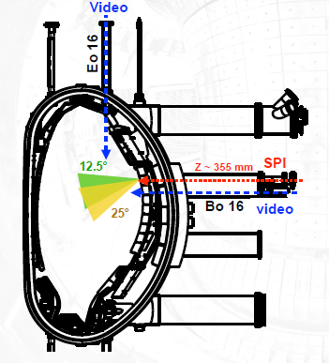
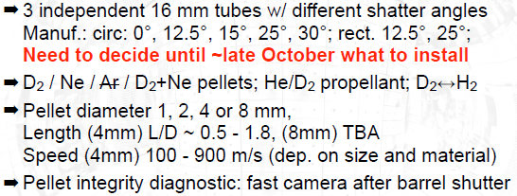
SPI experiment in ASDEX Upgrade in 2022

Slide 24
Preparative cycle for WP TE & timeline for 2021
Call for proposal (excluding AUG SPI) and for SCs – Deadline: 13 Nov. 2020
WP TE Programme meeting: 07-09 Dec. 2020
Call for participation (open throughout 2021)
WPTE WEST
Not before 2022
WPTE experiments started on March 4th 2021
C40 (TT)
DTE2 (DT)
C40B
(TT)
End of NJOC

Slide 25
Research Topics linked to Mission 1
Collaboration with WP rIO
RT1 | IBL scenarios towards low detachment and low collisionality (14)
RT2 | H-mode entry and pedestal dependence with impurities and isotopes (9)
RT3 | RF-assisted breakdown and current ramp-up optimization (8)
RT4 | Disruption avoidance development for ITER and DEMO (10)
RT5 | Run-away electron generation and mitigation (11)
RT6 | ELM mitigation and suppression in ITER/DEMO relevant condition (4)
RT7 | Negative triangularity scenarios as an alternative for DEMO(4)
RT8 | I-mode and QH-mode studies assessment in view of DEMO(7)
RT9 | Extension of EDA and QCE performance towards DEMO (7)
Mission 1-1: Demonstrate and qualify MHD stable high performance operation with metallic plasma facing components for ITER and DEMO
Mission 1-2: Improve physics description (experiments, theory / simulation) of energetics particles including their non-linear interplay with thermal plasmas in order to control burning plasmas in ITER and DEMO.
RT10 | Fast-ion physics with dominant ICRF heating (10)
RT11 | Impact of MHD activity on fast ion losses and transport (14)
Mission 1-3: Develop integrated scenarios with controllers for long pulse, ultimately steady state, operation for ITER and DEMO.
RT12 | Development of the steady state scenario (7)

Slide 26
Research Topics linked to Mission 2
RT13 | X-point radiation and control (8)
RT14 | Physics of plasma detachment / impurity mix/ heat load patterns (16)
RT15 | Extrapolation of SOL transport to ITER and DEMO (14)
Mission 2-1: Detachment control for ITER, DEMO baseline and HELIAS operation.
Mission 2-2: Prepare efficient Plasma Facing Components (PFC) operation for ITER, DEMO and HELIAS.
RT16 | PFC damage evolution under tokamak conditions (7)
RT17 | Material migration and fuel retention mechanisms in tokamaks (10)
Collaboration with WP WPIE
Mission 2-3: Investigate alternative innovative divertor geometries for DEMO.
RT18 | Alternative divertor configurations (12)

Slide 27
Overview of proposals and allocated pulses
Request for pulses was largely oversubscribed
 | AUG | TCV | MAST | WEST
Total | 1223 | 1741 | 978 | 1305
Budget | 387 | 806 | 360 | 270
TOTAL for M1 | 979 | 56,6% | 219 | 1163 | 34,0% | 339 | 624 | 34,4% | 165 | 663 | 17,4% | 50
TOTAL for M2 | 244 | 26,1% | 101 | 603 | 30,7% | 306 | 354 | 27,9% | 134 | 707 | 62,5% | 180
TOTAL |  |  | 320 |  |  | 645 |  |  | 299 |  |  | 230
Budget |  |  | 387 |  |  | 806 |  |  | 360 |  |  | 270
Contingency pulses left |  |  | 67 |  |  | 161 |  |  | 61 |  |  | 40
Contingency left in % |  |  | 17 |  |  | 20 |  |  | 17 |  |  | 15

Slide 28
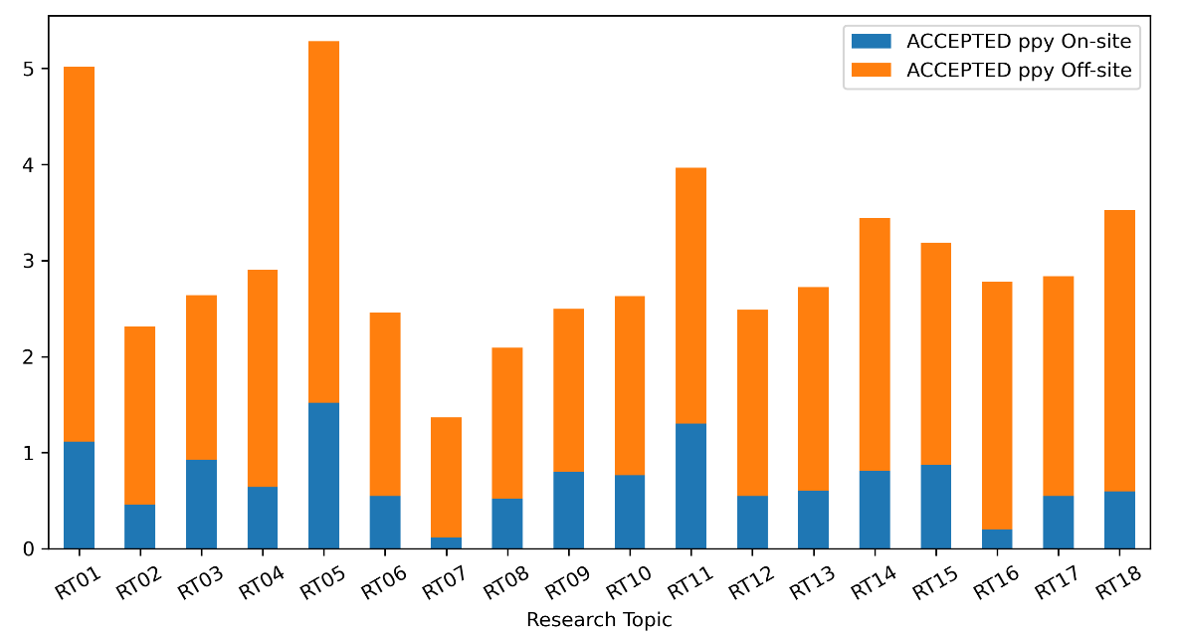
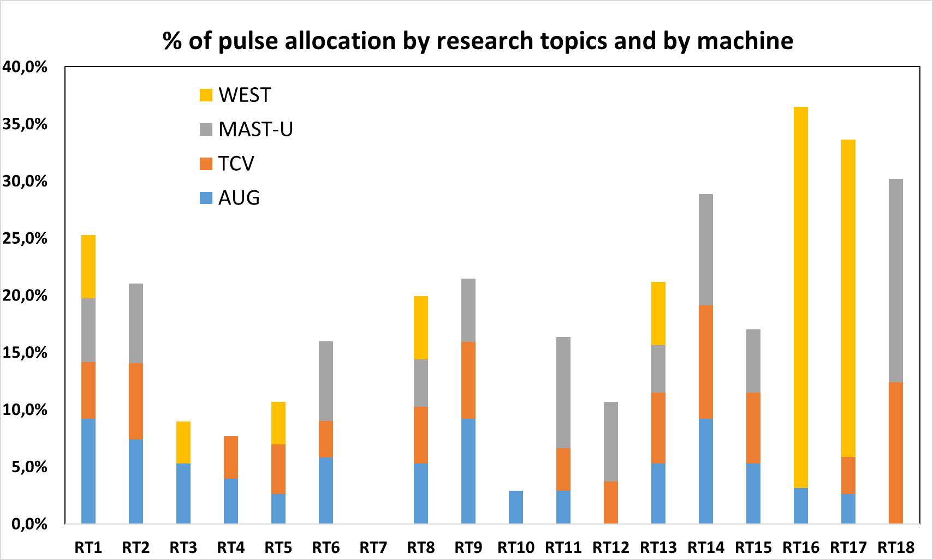
Statistics after the call for participation selection (I)
Allocations in line with high priority items:
RT01: ITER baseline scenario
RT18: PEX Upgrade:
RT14: Physics of detachment
RT05 and RT10, RT11 strong effort required on modelling and specific diagnostic operation (not covered by operation cost)
Other remarks:
RT07: no pulses this year
RT16 and RT17 (PFCs for next devices) focus on metallic machines + actively cooled components (AUG and WEST)
RT18 (alternative divertor) PEX enhancements in TCV & MAST-U
RT12: AT scenario part of IPP domestic Programme until end 2023.

Slide 29
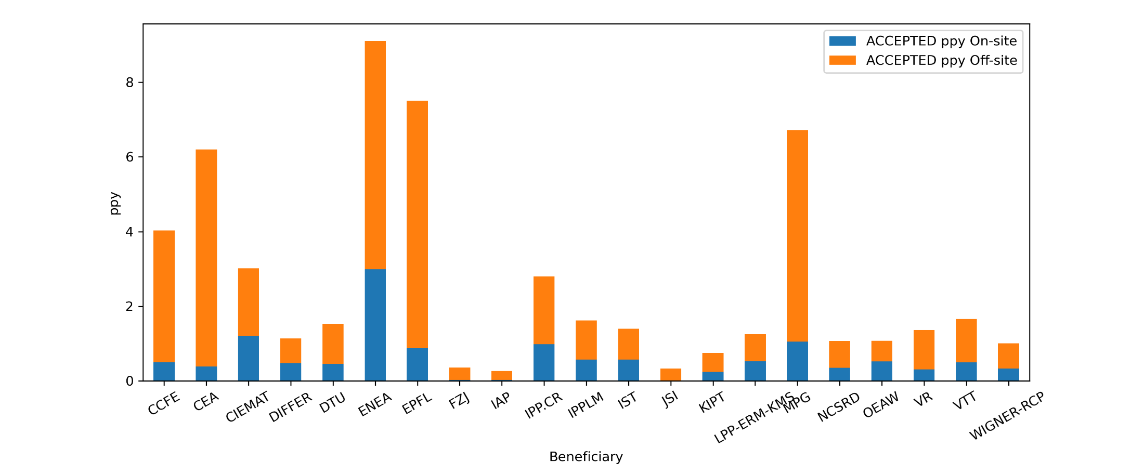
Statistics after the call for participation selection (II)
Beneficiary effort for the WPTE Programme in 2021
PPY
There are ~280keuros remaining in the participation after the account of people « covered by other means ». This will be dealt with in the next weeks.
The extended AUG campaign is already agreed. The detailed participation awaiting the timeline of the opening in 2021.

Slide 30
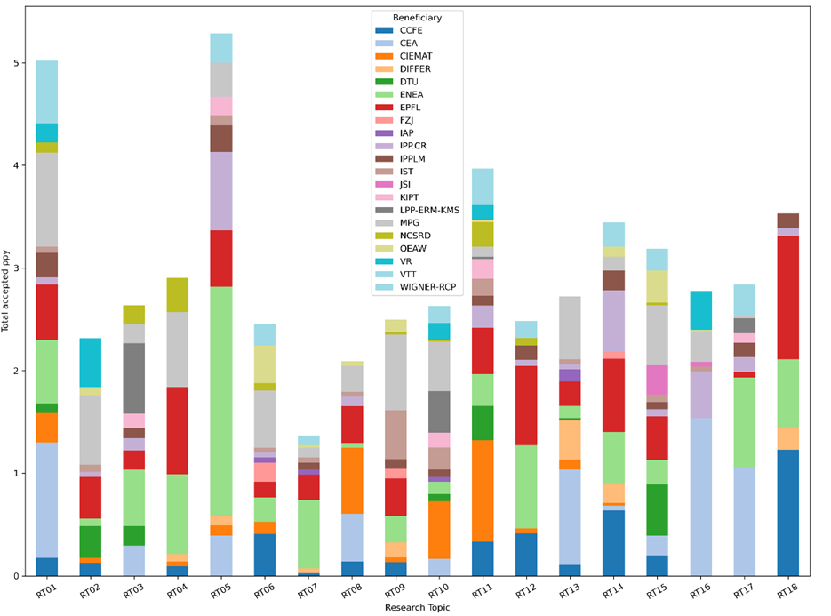
Participation by research topics and by beneficiaries

Slide 31
Risk identification
Risk description | Mitigation action
Non availability of any WP TE devices | Reprioritization of device usage
Delay in the PEX Upgrades on the various devices | Reprioritize PEX experiments and develop international collaboration
SPI experiments not conclusive in mitigating the disruption loads on tokamaks. | Find alternative mitigation solution to be developed on tokamaks
Transferability of no/reduced ELM scenario to ITER and DEMO not feasible. | Increase focus on JT-60SA and the importance of stellarator research
Monitoring of the retention in metallic devices not sufficiently quantifiable | Develop alternative monitoring methods
JET DT campaign not or partially achieved in 2021 | Review JET extension objectives for DTE3
Delay on real time diagnostics deployment for radiation control | Put more resources on real time control
Fast ion losses found too high in high beta scenarios for viable fusion performance | Expand the studies to JT-60SA

