Slide 1

Exhaust and Detachment
S. Wiesen
with support by M. Siccinio, M. Wischmeier, et al

Slide 2
Overview
DEMO Divertor Design studies
Core-edge coupling
Transients & divertor re-attachment
Open points (from FTD-DCT perspective)

Slide 3
DEMO divertor design studies

Slide 4
Early assessment for DEMO
SOLPS4.3, Kukushkin
Pacher
2007-2009
D/He/Be +
Ne-seeding
P_{SOL} = 300MW
Density control by
Core + Gas fuelling

Slide 5
Early assessment for DEMO
Full detachment of inner divertor restricts p_{PFR}
Criterion: max T_{e} at inner target falls below certain minimum, i.e. < 5eV
For DEMO: p_{PFR,max} = 18.6 Pa
SOLPS4.3, Kukushkin, Pacher 2007-2009

Slide 6
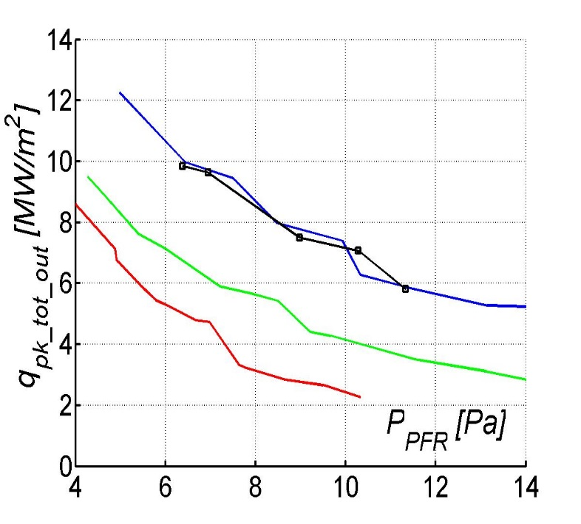
Lessons learned ITER divertor design
SOLPS4.3 has been the main workhorse for the ITER divertor design studies since 20+ years
Physics operating mode for the ITER divertor is to a large extent based on plasma boundary simulations conducted over ~15 years with the SOLPS-4.3 code (B2-Eirene) → mostly C targets!
▬ 1996 (ITER physics basis 1999)
▬ 2003 (neutral-viscosity added)
▬ 2004 (refined molecular collision kinetics added)
▬ 2005 (Lyman radiation trapping)
  A. S. Kukushkin et al. J. Nucl. Mat. 290-293 (2001) 887
  A. S. Kukushkin et al. Nucl. Fusion 42 (2002) 187
  A. S. Kukushkin and H. D. Pacher, PPCF 44 (2002) 931
  H. D. Pacher et al. J. Nucl. Mat. 313-316 (2003) 657
  A. S. Kukushkin et al. Nucl. Fusion 43 (2003) 716
  A. S. Kukushkin et al. Fus. Eng. Design 65 (2003) 355
  A. S. Kukushkin et al. Nucl. Fusion 45 (2005) 608
  A. S. Kukushkin et al. J. Nucl. Mat. 337-339 (2005) 17
  A. S. Kukushkin et al. Nucl. Fusion 47 (2007) 698
  A. S. Kukushkin et al. J. Nucl. Mat. 363-365 (2007) 308
  G. W. Pacher et al. Nucl. Fusion 48 (2008) 105003
  H. D. Pacher et al. J. Nucl. Mat. 390-391 (2009) 259
  A. S. Kukushkin et al. Nucl. Fusion 49 (2009) 075008
  A. S. Kukushkin et al., J. Nucl. Mat. 415 (2011) 2011
  H. D. Pacher et al. J. Nucl. Mat. 415 (2011) S492
  G. W. Pacher et al. Nucl. Fusion 51 (2011) 083004
  A. S. Kukushkin et al. Fus. Eng. Design 86 (2011) 2865
1996
2001
2009

Slide 7
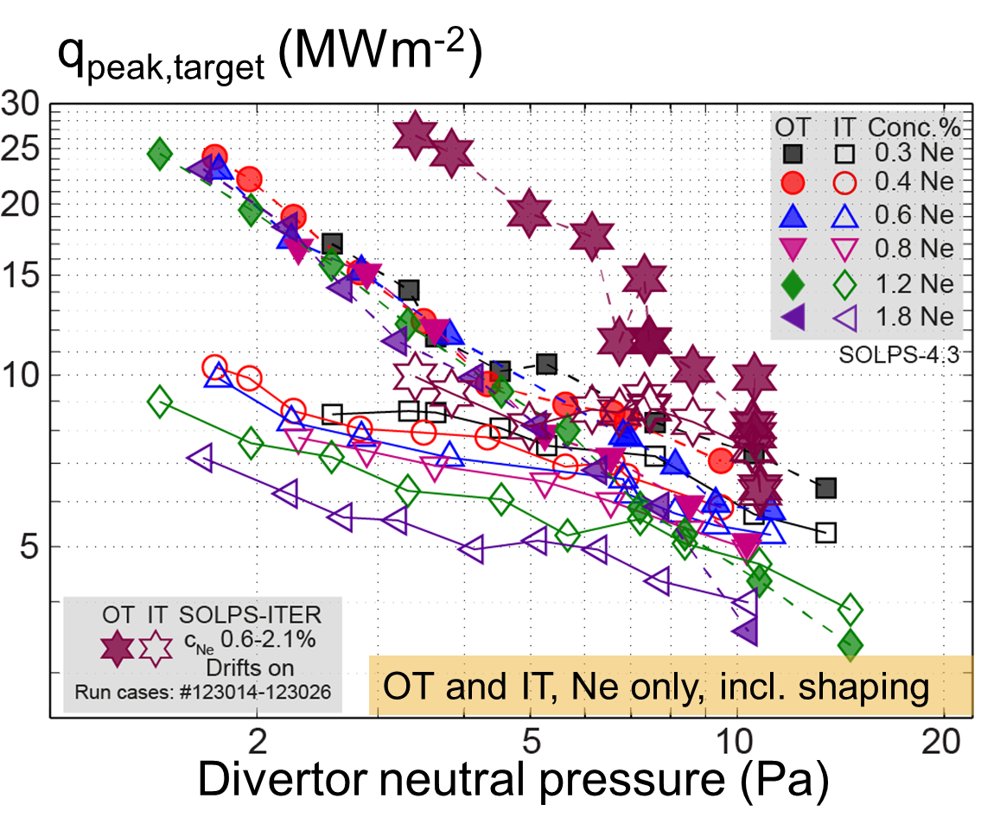
Revised ITER Divertor Design studies: metal wall & SOLPS-ITER
Assessment of several control parameters, together with satisfying a number of constraints (e.g. power loading and core He density or radiation)
→ establishment of DEMO operational windows and SOLPS-ITER based scalings
Extension towards EU-DEMO design:
assume validity of model first, e.g. through FSD experiments
Add physics: inclusion of drifts/currents, improved impurity models, neutral buffering/conductances, Lyman opacity effects, large f_{rad} (e.g. XPR) etc
Add constraints: divertor shape, field geometry, engineering limits, cost
→ towards an optimized DEMO divertor configuration (→ WPDIV, WPTFV)
P_{SOL}=100MW
R.A. Pitts, E. Kaveeva, V. Rozhanski, S. Wiesen, X. Bonnin et al, NME 2019

Slide 8
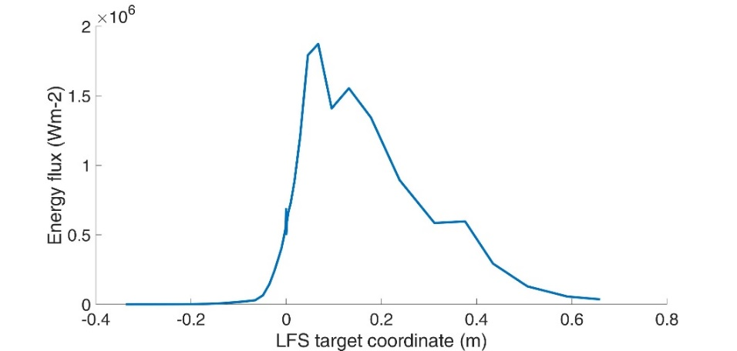
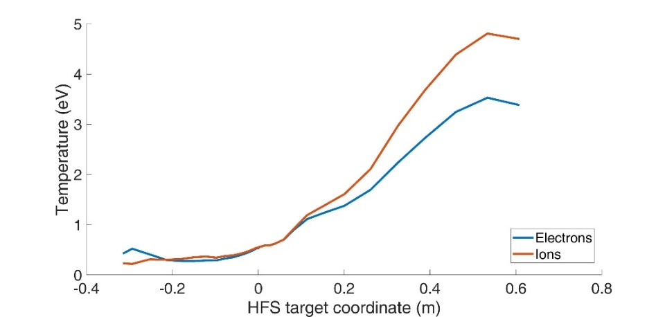
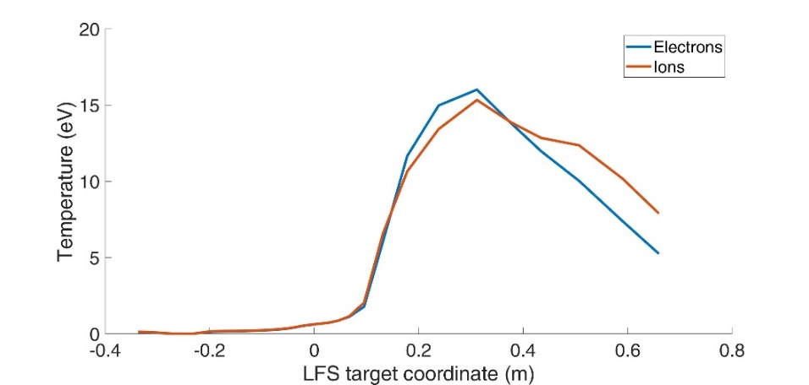
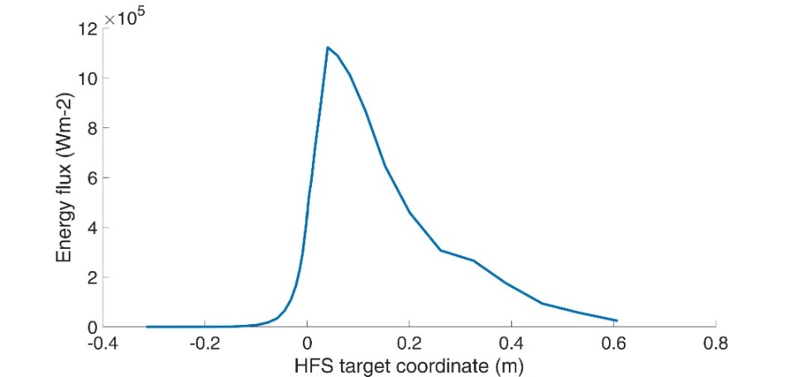
DEMO divertor assessment with new SOLPS-ITER
Work only started in FP8: F. Subba EU-DEMO → WPDES
SOLPS-ITER model parameters (no drifts/currents)
  Input power into edge: 150 MW
  D-puff: 1e23 atoms/s (~ 200 Pa m³ s⁻¹)
  Minor D pellet volumetric source: 7e21 (s⁻¹)
  D+He+Ar plasma
  Ar puff: 1.5e19 atoms/s
HFS deeply detached
Low temperatures; <1eV at max particle flux/density
Negligible heat flux ~ 1MW/m²
LFS partially detached
temperature low @ strike-line < 1.5eV
Heat-flux max 2MW/m²
Zeff ~1.9 in the core
HFS
LFS

Slide 9
Core-Edge coupling

Slide 10

Previous DEMO ASTRA/SOLPS4.3 coupling
Core & pedestal:
ASTRA/ICPS model
MMM/Weiland models, shear stabilised; JET/AUG
Edge:
SOLPS4.3 setup as in ITER – but no direct coupling
Provide ASTRA with n_{i}/T_{i,e} DT/He fluxes at spx
Derived scalings for point-of-detachment, i.e.:
$$n_{DT}^{sep}\sim μ^{0.43}$$
H.D. Pacher, G.W. Pacher, A.S. Kukushkin, G. Janeschitz
DEMO conceptual study EFDA TW6-TRP-002

Slide 11
Numerical assessment of integrated DEMO operational space
DEMO operating window, I=21 MA, Ne seeding feedback
Review of reduced integrated models: e.g. T. Luda et al: coupling of ASTRA/MISHKA w/ Kallenbach multi-point model of SOL
Review ASTRA/SOLPS-ITER coupling: functionality and code-implementation setup of revised EU-DEMO reference scenario
Also: Coupled JETTO-SANCO/SOLPS-ITER simulations: IMAS coupling to SOLPS-ITER foreseen (collaboration w/ IO)
Interface requirements for improved scenario integration:
Assess overlapping computational region between SOLPS-ITER (2D) and ASTRA (1D); identification of an improved scheme to couple: improved pedestal model (i.e. including core radiation), H&CD models etc
H.D. Pacher, G.W. Pacher, A.S. Kukushkin, G. Janeschitz
DEMO conceptual study EFDA TW6-TRP-002

Slide 12
Transients – Divertor re-attachment

Slide 13


What else can cause a loss of detachment?
Well, many things…
Fluctuations in the separatrix density.
Fluctuations in the separatrix power (e.g. pellet induced transient α-particle heating)
Combinations thereof.
Technical failure (e.g. impurity puff valve).
Control failure.
…others…
$$f_{rad}=40\%$$
$$f_{rad}=60\%$$
Impurity radiation
control required
JETTO-EDGE2D
ITER
[Wiesen, NF 2017]

Slide 14
Fuelling Pellet induced re-attachment
High density
Short bursts of
re-attachment
during pellet ablation
Such simulations
help to predict
and mitigate impact
of unavoidable
transients in HF
→ ITER & DEMO
divertor engineering
and operational design
JETTO-EDGE2D
ITER
[Wiesen, NF 2017]

Slide 15

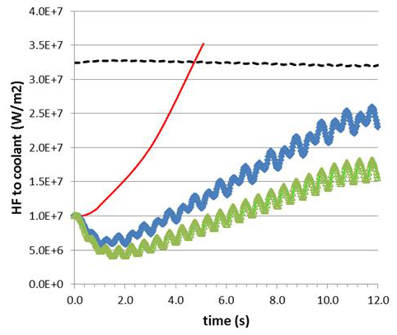
Re-attachment in DEMO
The maximum tolerable steady-state HF on the current DEMO SN divertor plate is 10-20 MW/m².
[J.H. You, G1 review mtg]
This value can be achieved only in detached plasma conditions (with seeded impurities).
In case of accidental divertor reattachment, the divertor reaches burn-out (leading to an in-vessel LOCA) in about 3 sec.
Divertor sweeping (to be activated only in emergency cases) to allow the divertor surviving while the current is ramped down [Maviglia, FED 2016].
Needs the presence of IVC.
RACLETTE:
10s HF ramp 10..70 MW/m²
Siccinio, NF 2019

Slide 16
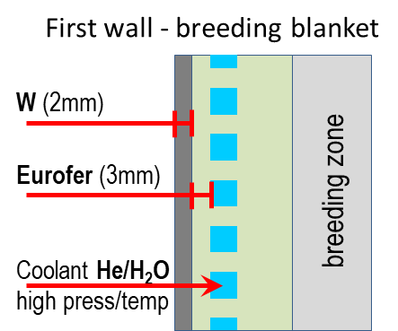
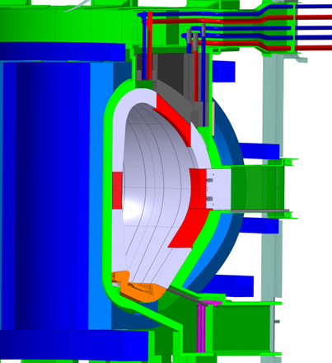
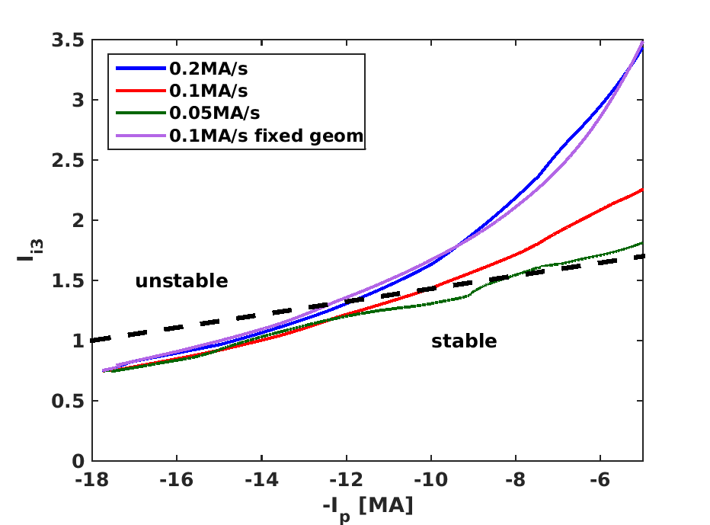
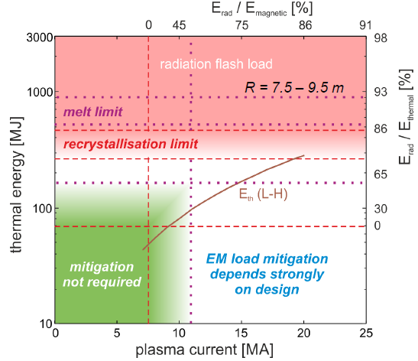
Re-attachment in DEMO
What about “fast termination”?
A fast plasma shutdown (like in ITER) at full current would pose unacceptable risks on the machine integrity [Maviglia, NME 2021],[Lehnen, IAEA 2016].
In parallel, the current cannot be ramped down faster than
~0.2 MA/s without losing vertical stability control.
(the increase of ramp down rate with the use of IVC is presently being investigated)
DEMO
ITER
[Lehnen, IAEA 2016]
[Siccinio, FED 2020]

Slide 17
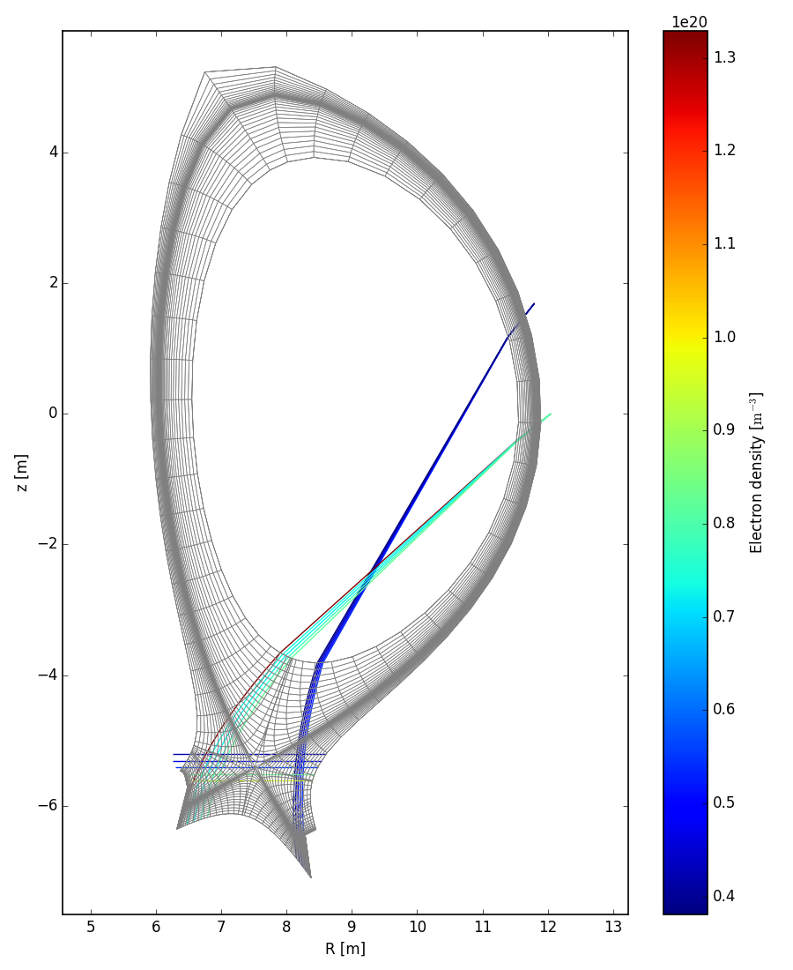
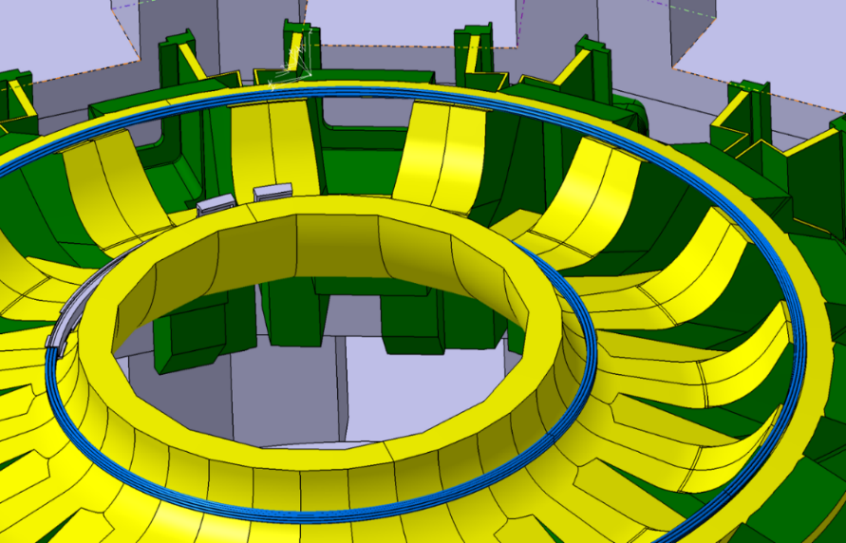
The (provisional) solution
Diagnostics able to detect reattachment before it happens (e.g. spectroscopy following the radiation front) [Biel, FED 2019].
Divertor sweeping (to be activated only in emergency cases) to allow the divertor surviving while the current is ramped down [Maviglia, FED 2016].
Needs the presence of IVC.
10s HF ramp 10..70 MW/m²
[Siccinio, NF 2019]
[Maviglia, NME 2021]

Slide 18
Open points (FTD-DCT)

Slide 19
Open points
What needs to be done in order to validate the current DEMO solution
(or to find a better one)?
Operational aspects
Basic physics
Reduced models
„Off-baseline“ investigations

Slide 20
Open points - Operational
Response from FSD
Feasibility of sweeping in (near) detached conditions:
JET: data available for horizontal target configuration, limited diagnostic in corner C/C configuration, more data available in V/H config. Also V/V
→ Action: Analysis requires data mining and contact SCs of baseline and hybrid scenarios → human resource allocation
Rampup-down (w/ or w/o sweeping): Requires numerical analysis and possibly testing on smaller device for model-experimental data comparison
→ Action: needs dedicated proposals for ramp down and modelling of ramp down possibly in RT12
Re-attachment: Investigate available experimental data from AUG and JET with seeding, power cut-offs, pellet fueling transients, pump cut-off (also: sawteeth or H-M-L trans)
→ Action: Analysis requires data mining and contact SCs of scenarios → human resource allocation
Feasibility of sweeping in detached/near-detached conditions, with/without seeding
Reliable detachment control scheme with “minimum”/controllable impact on core. Strong justification for IVC.
Feasibility of ramp-down in shape with/without sweeping (worse 0.2MA/s?)
Exploration of reattachment with loss of impurity seeding (e.g. determination of time-scales) in DEMO-similar divertor conditions
Exploration of reattachment with loss of power and/or due to increased PSOL (in DEMO e.g. from pellet ablation close to edge or increased Palpha)
These points should be prioritized w.r.t. physical understanding of the underlying phenomena (see next slides), since they could be addressed in a shorter time and allow for an early change of design.

Slide 21
Open points – Basic Physics
Response from FSD (1/2)
Re-attachment physics: Key question is trying to identify the relevant components determining the time scales on present day devices, and then extrapolate
→ Action: slow-transients expts, data mining, potential new expts
Transport in divertor: Composite effect of Cross-field drifts, perpendicular turbulent transport and diffusive transport via CX of momentum and power, complex
→ requires full model, input from RT09/13/14/15/18
Impurity concentration/compression ratio: fwd/rev field expts RT13/14, basic models exist, extrapolation: full model reqd?, size scaling expts AUG-JET
→ Action: require modelers and spectroscopists working on AUG/JET/ITER to sit down to decide what could be done; end of 2021 campaign; depends on DEMO scenario
Impurity mix: The optimization criteria/metric needs to be defined first, max frad seems independent on mix, but confinement depends on mix
Physics of re-attachment, as function of power, density and impurity (incl. fluctuations), pellets; time-scales
Transport in divertor region: e.g. prediction of broadening factor S, impact of drifts
Prediction of impurity concentration and compression ratio
Optimum impurity mix (species) for DEMO-like conditions (models?)
On size scaling (geometry) and impact on impurity transport /compression
LH transition threshold (and possible hysteresis) with radiating core (e.g. XPR) going beyond Martin's scaling; revised IPB98 scaling with impurity radiation loss (or rather include radiation in transport models?)
Predictability of time-dependent state-of-the-art models and tools to predict divertor transients and dynamics; flight-simulators (FSD/FTD together with ETASC)
SN/conventional

Slide 22
Open points – Basic Physics
Response from FSD (2/2)
Size scaling: Comparisons from experiment for N2 existing between AUG and JET; (reduced model existing Henderson, Hitzler, Huber 2020)
→ Action: requires human resource, could be done without additional pulses, RT13/14/18 & previous JET/AUG comparative expts
LH transition threshold:
→ Action: Information from JET and WPTE experiments on isotope effects and scalings; L-H threshold with radiation: data mining required to identify if and what type of experiments exist → potential new experiments
Flight simulators: TSVV11, sufficiently and timely? Enough resources for reduced-models on core/edge coupling? Transients? → top-down approach needed?
Physics of re-attachment, as function of power, density and impurity (incl. fluctuations), pellets; time-scales
Transport in divertor region: prediction of broadening factor S
Prediction of impurity concentration and compression ratio
Optimum impurity mix (species) for DEMO-like conditions (models?)
On size scaling (geometry) and impact on impurity transport /compression
LH transition threshold (and possible hysteresis) with radiating core (e.g. XPR) going beyond Martin's scaling; revised IPB98 scaling with impurity radiation loss (or rather include radiation in transport models?)
Predictability of time-dependent state-of-the-art models and tools to predict divertor transients and dynamics; flight-simulators (FSD/FTD together with ETASC)
SN/conventional

Slide 23
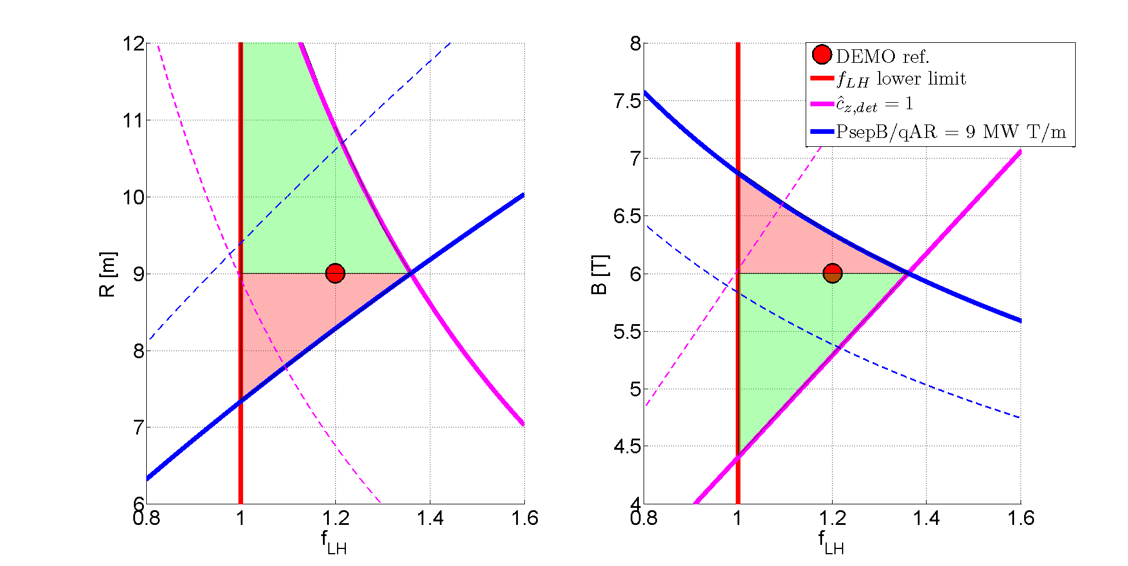
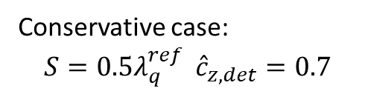
Open points – Reduced Models
Expanding on the extension/improvement of 0D model towards 1.5/2D model w.r.t confinement regime (reduced model) - scaling? Numerical model?
Towards improved figure-of-merits for HF (i.e. detachment) and c_{Z}
Response from FSD
c_{z}: ongoing, current approach double track for c_{z}
1) experiments on AUG and JET → extract scalings for c_{z}
2) Numerical modelling done for various devices, but combining modelling results from various publications not done
Higher B-field: no activity inside WPTE; numerical experiment attempted by Hitzler but not very successful numerically
→ Action: recommendation remains to reach out to C-MOD data, analysis exists, modelling and detailed comparison died out in 2017/2018; Compass-U?
Transport, i.e. λ_{q} & S: Input from RT13/14/18
Based on
Martin scaling for P_{LH}
Goldston & Reinke
Scalings for c_{Z} and λ_{q}
Conservative case:
$$S={0.5λ}_{q}^{ref} {\hat{c}}_{z,det}=0.7$$
[Siccinio, NF 2019]

Slide 24
Open points – „off baseline“
Response from FSD
ADC’s resilience against re-attachment: Needs to be proposed for WPTE RT18 – not included in current activities that focus on maximizing dissipation as primary objective to identify if the ADCs are real candidates…
→ Action: proposal submission but should be second priority after having established if ADC provide significant dissipative advantage
Re-attachment dynamics in ADC (e.g. DN):
Generally nearly no D/DN activity
→ Action: require explicit proposals and pulses and a clear question to be answered
(as we do not even know the dissipative properties of DDN from experiment)
Reattachment in ELM-free regimes:
Could be incorporated in RT09/08/13 if target scenario identified (closing gaps)
Resilience of ADC against re-attachment
Reattachment dynamics in ADC (e.g. double-null)
Does reattachment change its dynamics in ELM-free regimes (different “pedestal” conditions, fluctuations of different nature – e.g. bursts in I-mode)?

