Slide 1
UKAEA
Progress of DYON upgrade and plan in 2022 ~2024
Hyun-Tae Kim
Joint WPTE and WPPrIO Meeting on Plasma break-down/burn-through

Slide 2
Contents
Motivation of EM modelling development
Electromagnetic modelling development
ECH-assist burn-through modelling in KSTAR
Plans for 2022 (~2024)
Summary

Slide 3
Contents
Motivation of EM modelling development
Electromagnetic modelling development
ECH-assist burn-through modelling in KSTAR
Plans for 2022 (~2024)
Summary

Slide 4
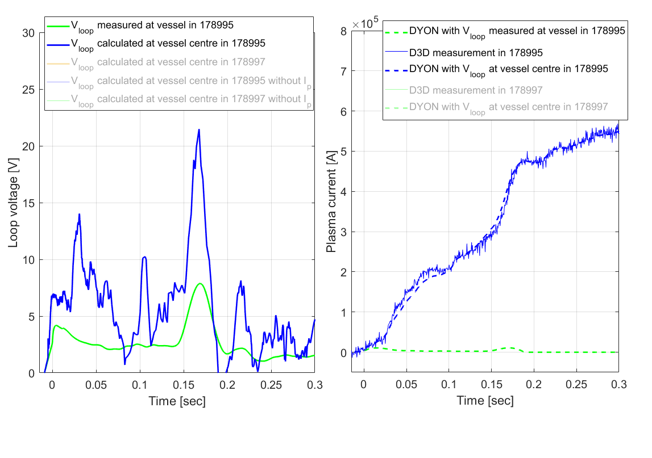
Motivation – V_{loop} needs to be calculated at a plasma position
D-IIID modelling with DYON
V_{loop} calculated in the plasma position
V_{loop} measured in the inboard mid-plane in D-IIID

Slide 5
Motivation – V_{loop} needs to be calculated at a plasma position
D-IIID modelling with DYON
Very good reproduction of I_{p}
In DYON
V_{loop} calculated in the plasma position
V_{loop} measured in the inboard mid-plane in D-IIID
Failed burn-through in DYON
Presented in D-IIID science meeting on 20 March 2020

Slide 6
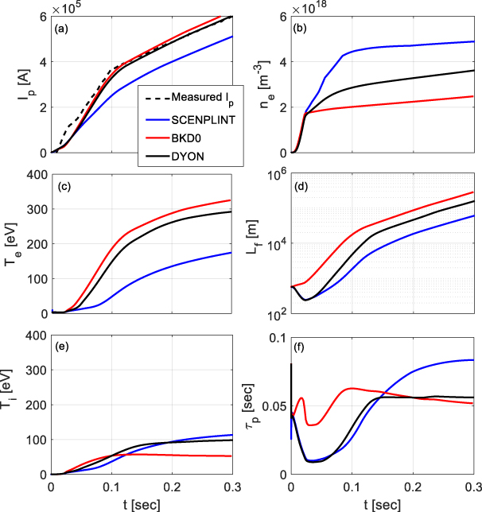
Motivation – Joint activity in ITPA-IOS found that evolution of V_{p} and L_{f} has a significant impact in burn-through modelling
Code benchmark (DYON, BKD0, and SCENPLINT) with JET #77210

Slide 7
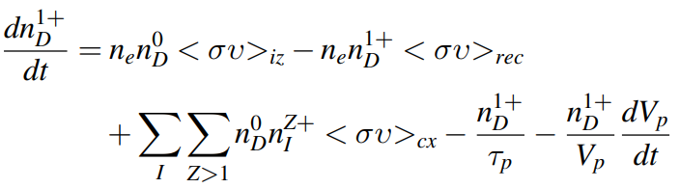
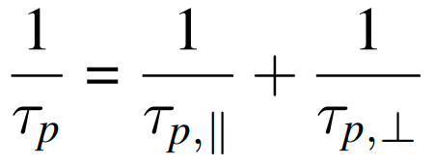




Motivation – Joint activity in ITPA-IOS found that evolution of V_{p} and L_{f} has a significant impact in burn-through modelling
Code benchmark (DYON, BKD0, and SCENPLINT) with JET #77210

Slide 8
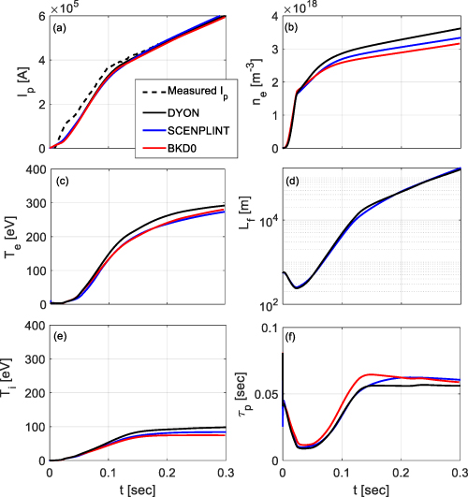
Motivation – Joint activity in ITPA-IOS found that evolution of V_{p} and L_{f} has a significant impact in burn-through modelling
Code benchmark (DYON, BKD0, and SCENPLINT) with JET #77210
Reconciliation work on the evolution of V_{p} and L_{f}
Hyun-Tae Kim et al 2020 Nucl. Fusion 60 126049

Slide 9
Contents
Motivation of EM modelling development
Electromagnetic modelling development
ECH-assist burn-through modelling in KSTAR
Plans for 2022 (~2024)
Summary

Slide 10
Contents
Motivation of EM modelling development
Electromagnetic modelling development
ECH-assist burn-through modelling in KSTAR
Plans for 2022 (~2024)
Summary

Slide 11
DYON - plasma burn-through modelling code (before upgrade)
Operation setting for tokamak start-up

Slide 12
DYON - plasma burn-through modelling code (before upgrade)
Input
DYON code

Slide 13
DYON - plasma burn-through modelling code (before upgrade)
Input
DYON code
Output

Slide 14
DYON - plasma burn-through modelling code (before upgrade)
Input
DYON code
Output
Impurity influx
from Plasma wall interaction
He, Be, C, O, N, and Ne available

Slide 15
DYON - plasma burn-through modelling code (before upgrade)
Input
DYON code
Output
References on plasma burn-through modelling and DYON code
Physics and computational simulations of plasma burn-through for tokamak start-up, PhD thesis, Imperial College London 2013
Enhancement of plasma burn-through simulation and validation in JET, NF (2012) 103016
PSI effects on plasma burn-through in JET, JNM 438 (2012) S1271
Physics of plasma burn-through and DYON simulations for the ITER-like wall, NF 53 (2013) 083024
Plasma burn-through simulations using the DYON code and predictions for ITER, PPCF 55 (2013) 124032
Benchmarking of codes for plasma burn-through in tokamaks, NF 60 (2020) 126049
Validation of plasma burn-through simulation with ECH power absorption model in KSTAR, NF (2021) submitted
Impurity influx
from Plasma wall interaction
He, Be, C, O, N, and Ne available
https://gitlab.com/dyonplasma/dyon

Slide 16


Electromagnetic model in DYON
Mutual Inductance of
coils and vessel currents
With plasma current
Resistance of coils and vessel elements
Mutual Inductance between
coils and vessel elements
Power supply voltage applied to coils
coils and vessel
currents
Position of plasma current
V_{loop}
Plasma resistance
Plasma inductance
The full circuit equations are integrated into the differential equation system of energy and particle balance equations of plasmas i.e. tight coupling

Slide 17
Validation of DYON electromagnetic modelling

Slide 18
Validation of DYON electromagnetic modelling (without I_{p})

Slide 19
Validation of DYON electromagnetic modelling with power supply voltage in KSTAR (without I_{p})
I_{coil} and I_{vessel} induced by power supply voltage V_{cv}
I_{vessel} induced by I_{p}
Not used

Slide 20
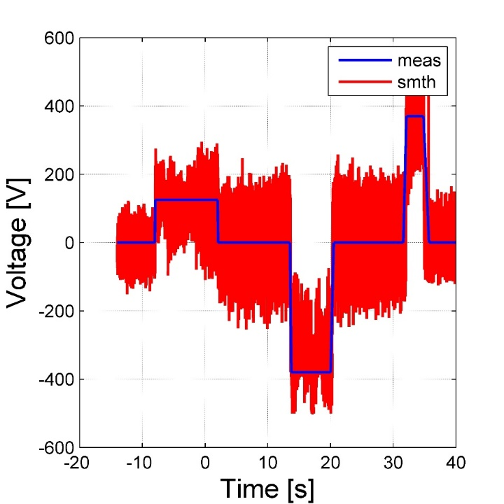
Validation of DYON electromagnetic modelling with power supply voltage in KSTAR (without I_{p})
I_{coil} and I_{vessel} induced by power supply voltage V_{cv}
I_{vessel} induced by I_{p}
V_{cv}(R’,Z’) measured in KSTAR
Not used
KSTAR
PF#1
PF#1 coil

Slide 21
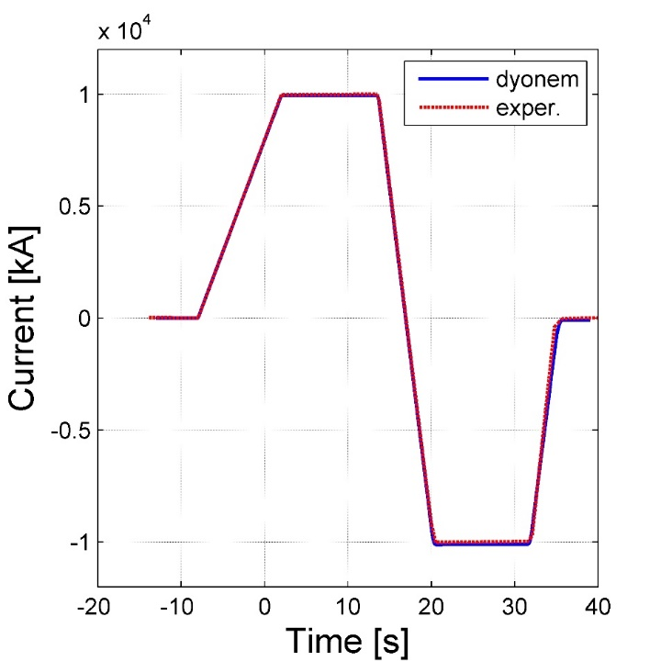
Validation of DYON electromagnetic modelling with power supply voltage in KSTAR (without I_{p})
I_{coil} and I_{vessel} induced by power supply voltage V_{cv}
I_{vessel} induced by I_{p}
V_{cv}(R’,Z’) measured in KSTAR
Not used
KSTAR
I_{coil}(R’,Z’) and I_{vessel}(R’, Z’)
PF#1
PF#1 coil
PF#1 coil
Coil current is well calculated with input power supply voltage.
Courtesy of Jeongwon Lee (KFE)

Slide 22
Validation of DYON electromagnetic modelling with coil currents input in VEST (without I_{p})
I_{vessel} induced by I_{coil}
I_{vessel} induced by I_{p}
Not used

Slide 23
Validation of DYON electromagnetic modelling with coil currents input in VEST (without I_{p})
I_{vessel} induced by I_{coil}
I_{vessel} induced by I_{p}
I_{coil}(R’,Z’) measured in VEST
Not used
I_{coil}(R’,Z’) and I_{vessel}(R’, Z’)
I_{coil} [kA]
Time [msec]

Slide 24
Validation of DYON electromagnetic modelling with coil currents input in VEST (without I_{p})
I_{vessel} induced by I_{coil}
I_{vessel} induced by I_{p}
I_{coil}(R’,Z’) measured in VEST
Not used
I_{coil}(R’,Z’) and I_{vessel}(R’, Z’)
I_{coil} [kA]
Time [msec]

Slide 25
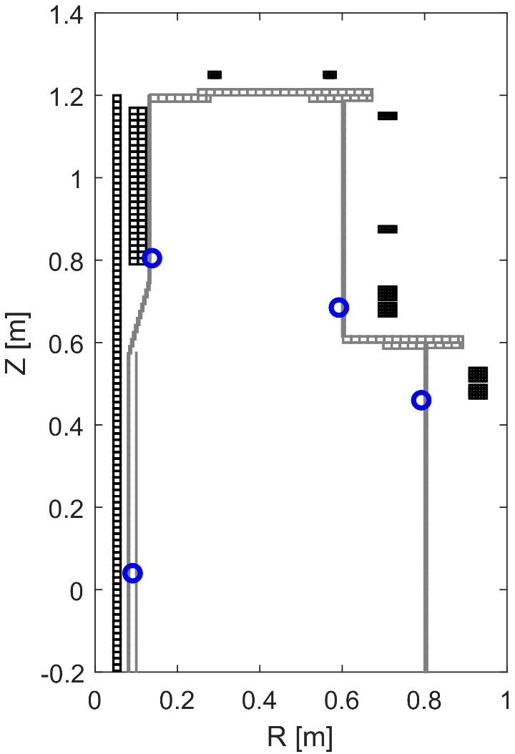
Validation of DYON electromagnetic modelling with coil currents input in VEST (without I_{p})
I_{vessel} induced by I_{coil}
I_{vessel} induced by I_{p}
I_{coil}(R’,Z’) measured in VEST
Not used
I_{coil}(R’,Z’) and I_{vessel}(R’, Z’)
Flux loops in VEST
V_{loop} [V]
I_{coil} [kA]
  DYON
  Measured
Synthetic flux loop data agrees very well with measurement.
Time [msec]
Courtesy of Seongchul Kim (SNU)
Time [msec]

Slide 26
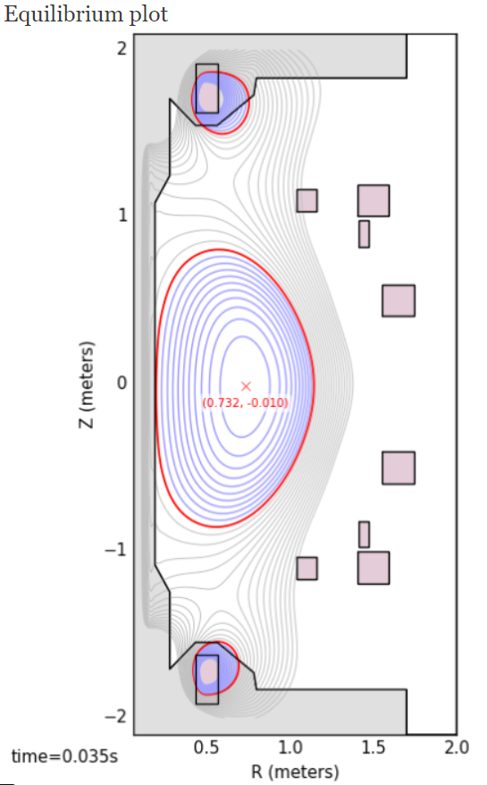
V_{loop} calculation in MAST (with I_{p})
27512
MAST
P2U
P3U
P5U
P6U
XMA RVCC
P4U
P1
P4L
P6L
P3L
P5L
P2L

Slide 27
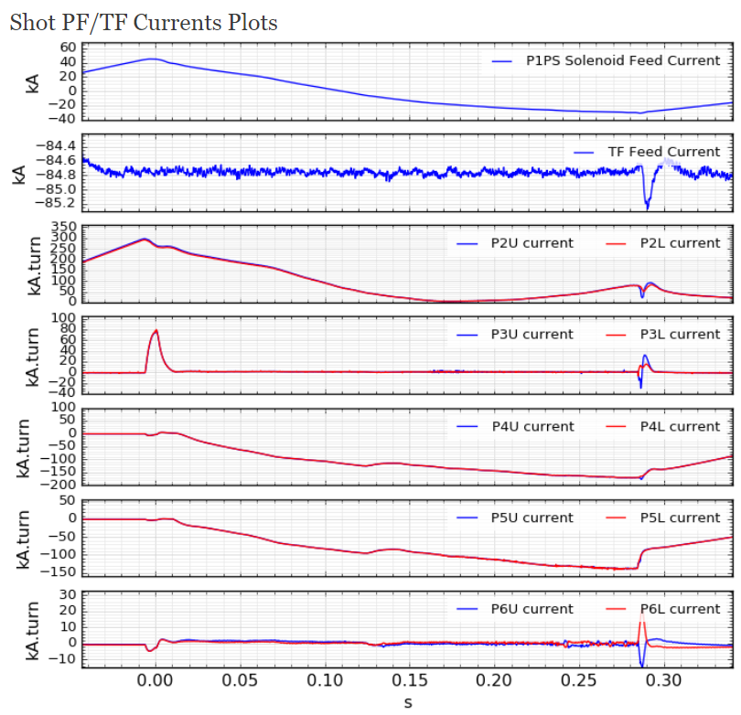
V_{loop} calculation in MAST (with I_{p})
27512
MAST
P2U
P3U
P5U
P6U
XMA RVCC
P4U
P1
P4L
P6L
P3L
P5L
P2L

Slide 28
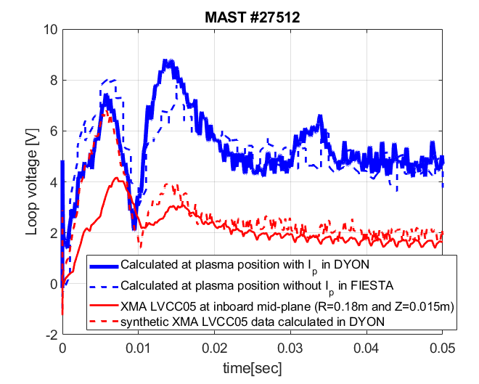
V_{loop} calculation in MAST (with I_{p})
27512
MAST
P2U
P3U
P5U
P6U
XMA RVCC
P4U
P1
P4L
P6L
P3L
P5L
P2L
Comparison of V_{loop} calculated in DYON with FIESTA (plasmaless) and XMA RVCC measurement.
Before 20ms, a small difference to FIESTA, while a large difference to XMA RVCC (possibly improved with plasma position and volume modelling?)
After 20ms, good agreement with both

Slide 29
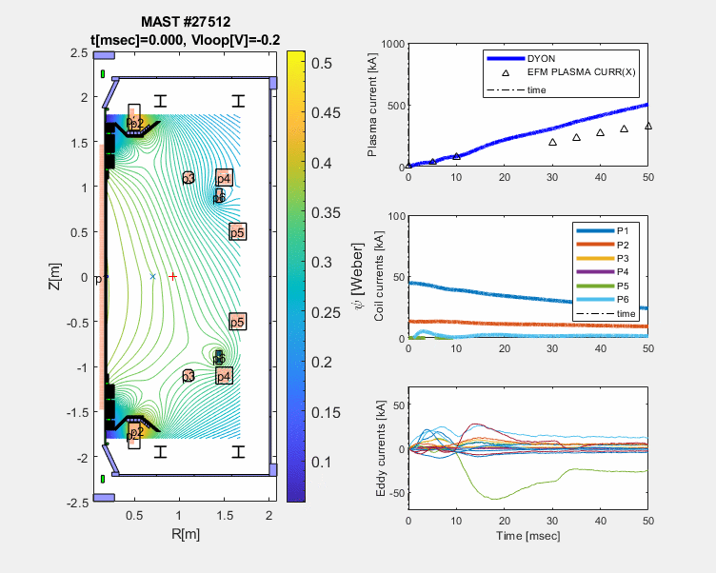
First electromagnetic plasma burn-through modelling with MAST data
Note, plasma position and plasma volume were prescribed in this simulation.
Next step is to add
global force balance and plasma volume model.

Slide 30
Contents
Motivation of EM modelling development
Electromagnetic modelling development
ECH-assist burn-through modelling in KSTAR
Plans for 2022 (~2024)
Summary

Slide 31
Contents
Motivation of EM modelling development
Electromagnetic modelling development
ECH-assist burn-through modelling in KSTAR
Plans for 2022 (~2024)
Summary

Slide 32
ECH-assisted burn-through modelling in DYON
KSTAR

Slide 33
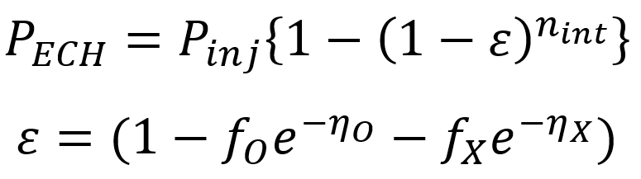
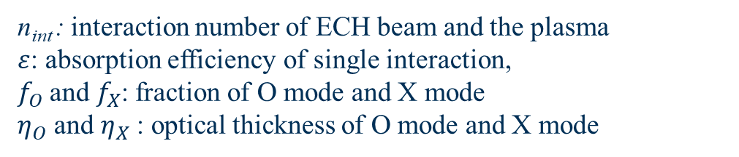
ECH-assisted burn-through modelling in DYON
KSTAR
n_{int} : interaction number of ECH beam and the plasma
$ε$: absorption efficiency of single interaction,
$f_{O}$and$f_{X}$: fraction of O mode and X mode
$η_{O}$ and $η_{X}$: optical thickness of O mode and X mode
Jeongwon Lee et al, Submitted to NF in 2021

Slide 34
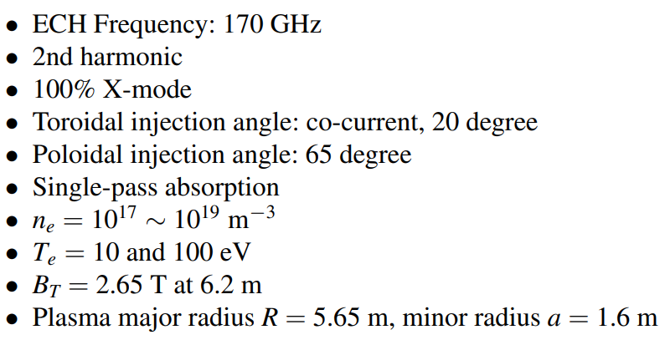
Comparison of ECH models in burn-through codes
Standalone calculation of ECH modules with ITER ECH configuration (PFPO1 or 2)

Slide 35
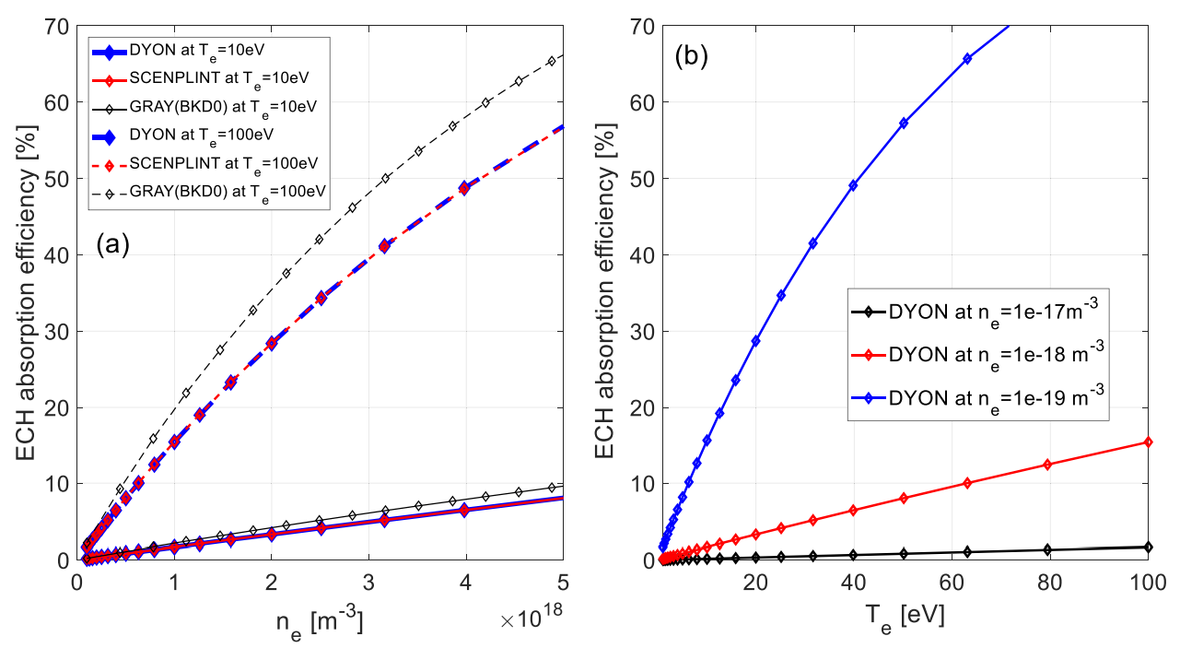
Comparison of ECH models in burn-through codes
Standalone calculation of ECH modules with ITER ECH configuration (PFPO1 or 2)

Slide 36
Comparison of ECH models in burn-through codes
Standalone calculation of ECH modules with ITER ECH configuration (PFPO1 or 2)
Typical range during the burn-through phase.
ECH absorption efficiency is less than 10%
Hyun-Tae Kim et al 2020 Nucl. Fusion 60 126049

Slide 37
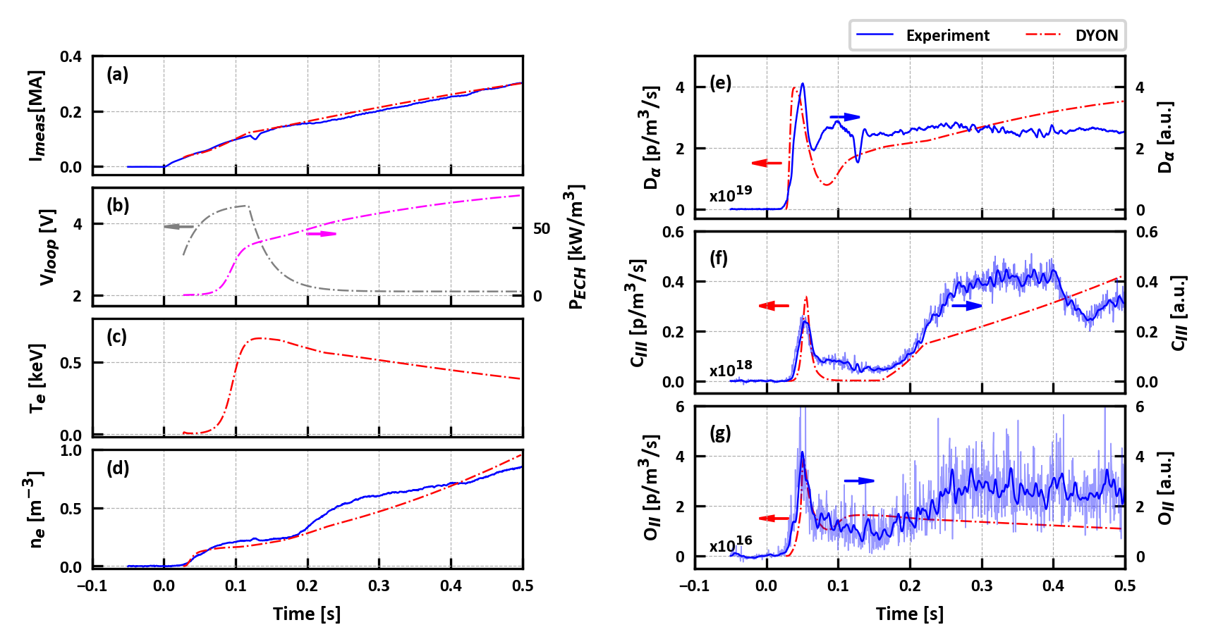
Comparison of ECH-assisted burn-through modelling with KSTAR data
(V_{p}=8.88m³)
KSTAR #14168
absorbed
600kW EC beam injected power
170GHz, 2nd harmonic, and 100% X-mode (same as ITER)
double path of EC beam
carbon sputtering yield, adjusted to reproduce ohmic discharges

Slide 38
Comparison of ECH-assisted burn-through modelling with KSTAR data
(V_{p}=8.88m³)
KSTAR #14168
absorbed
600kW EC beam injected power
170GHz, 2nd harmonic, and 100% X-mode (same as ITER)
double path of EC beam
carbon sputtering yield, adjusted to reproduce ohmic discharges
Well reproduced line emissions of impurities, and interferometry data
Jeongwon Lee et al, Submitted to NF in 2021

Slide 39
Contents
Motivation of EM modelling development
Electromagnetic modelling development
ECH-assist burn-through modelling in KSTAR
Plans for 2022 (~2024)
Summary

Slide 40
Contents
Motivation of EM modelling development
Electromagnetic modelling development
ECH-assist burn-through modelling in KSTAR
Plans for 2022 (~2024)
Summary

Slide 41
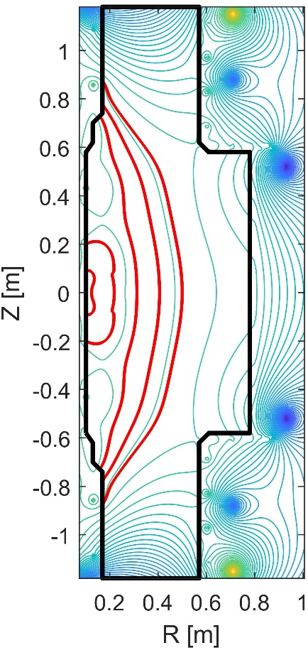
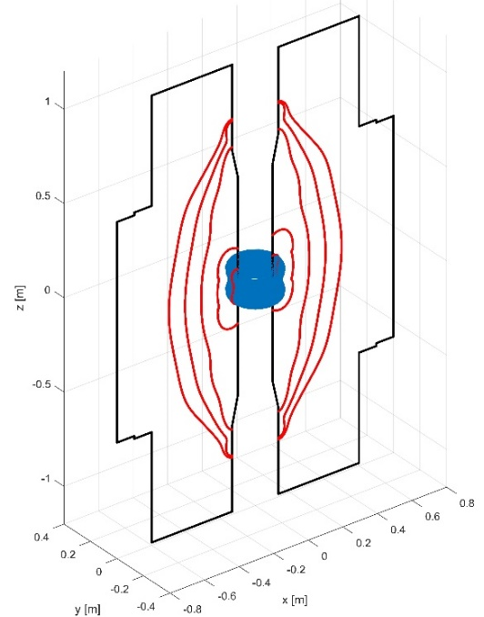
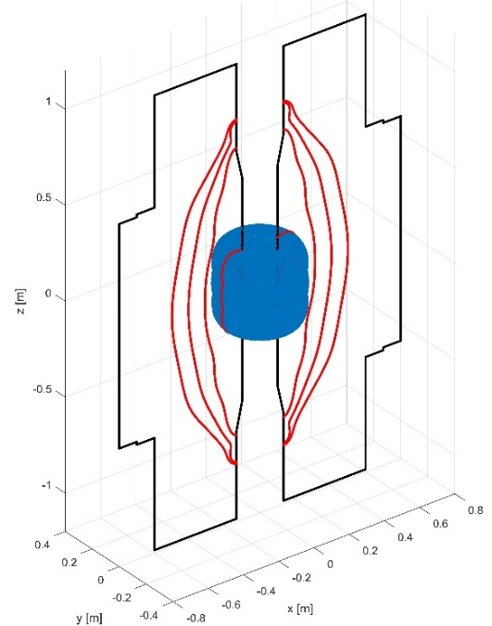
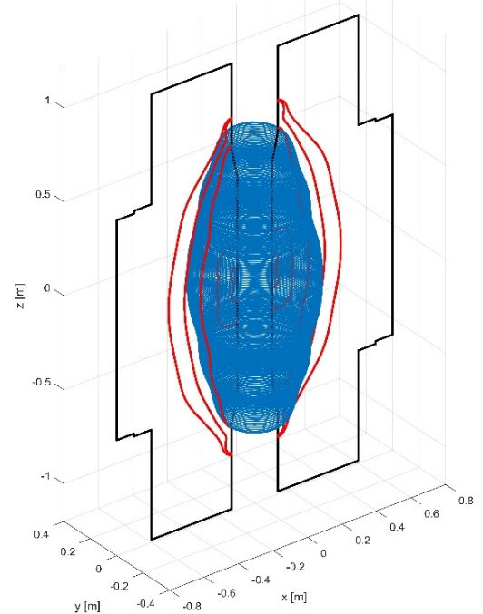
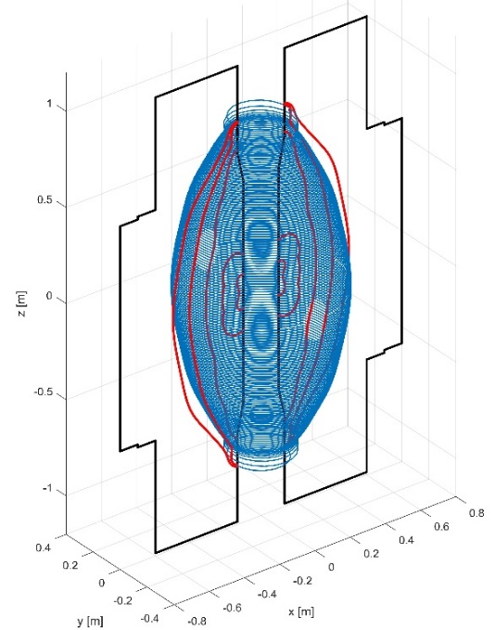
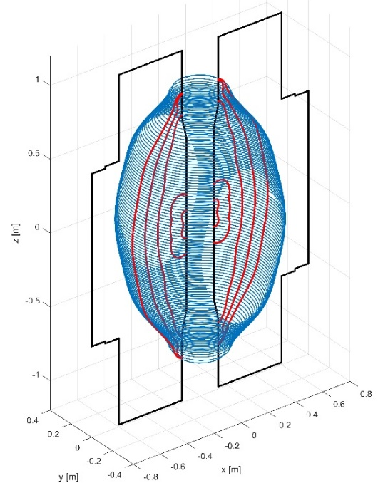
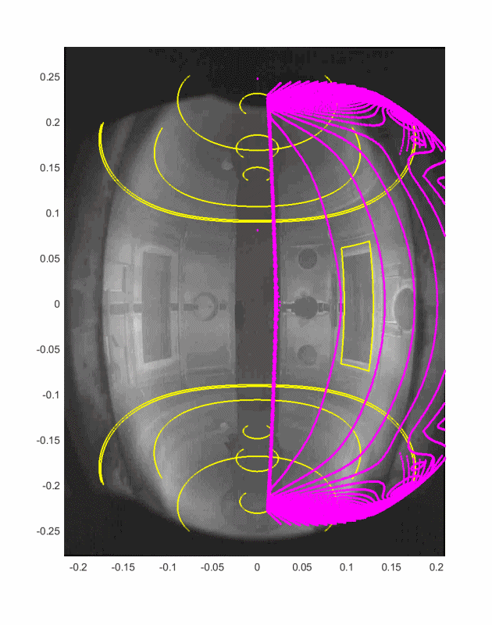


Planning to complete the development of plasma volume evolution model, and to validate against fast camera data
VEST
Before field lines are closed:
  Estimate the plasma volume with magnetic field lines which meet the Townsend criterion, where L_{f} is calculated in each field line.
Identify open field lines where electron avalanche is taking place
After field lines are closed:
  Estimate the plasma volume with the last closed flux surface touching the wall.

Slide 42
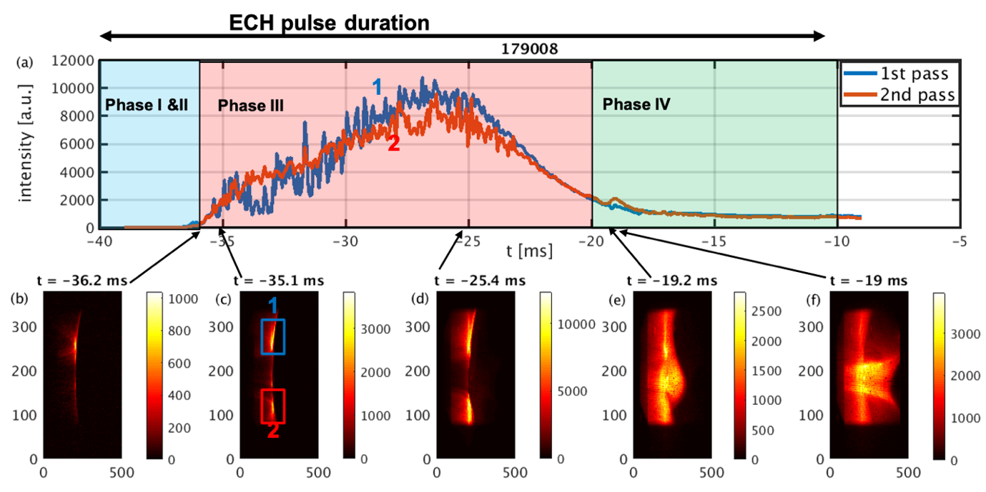
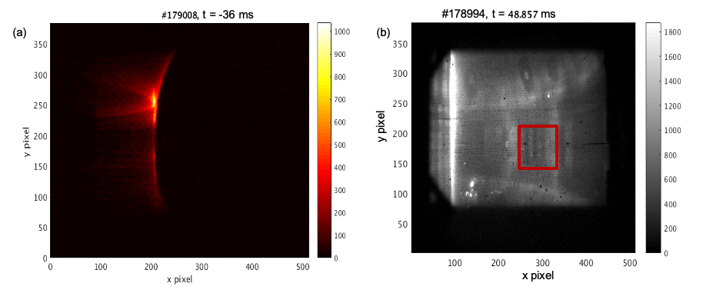
Planning to couple a PIC code - it might be required for ECH Pre-ionization modelling (subject to discussion)
Joyeeta Sinha, submitted for 2021 APS-DPP 63rd
For ECH pre-ionization modelling, localized electron avalanche should be modelled, possibly with a Particle-In-Cell code.

Slide 43
Planning ‘improved’ statistical validation
With simulation setting optimized for MAST (gas puffing coef=0.1, I_{ref}= 10kA and C sputtering yield = 0.015),

Slide 44
Planning ‘improved’ statistical validation
MAST
26338
26339
26527
26529
26530
26531
27251
27252
27253
27254
27255
27256
27257
27258
27511
27512
27514
27516
27517
27523
27524
27531
27532
27533
27534
27535
27536
27838
27859
27860
27866
28075
28076
28079
28334
28335
28336
28339
28340
28341
With simulation setting optimized for MAST (gas puffing coef=0.1, I_{ref}= 10kA and C sputtering yield = 0.015), DYON also well reproduced other 40 MAST discharges with direct induction start-up.

Slide 45
Planning ‘improved’ statistical validation
MAST
26338
26339
26527
26529
26530
26531
27251
27252
27253
27254
27255
27256
27257
27258
27511
27512
27514
27516
27517
27523
27524
27531
27532
27533
27534
27535
27536
27838
27859
27860
27866
28075
28076
28079
28334
28335
28336
28339
28340
28341
With simulation setting optimized for MAST (gas puffing coef=0.1, I_{ref}= 10kA and C sputtering yield = 0.015), DYON also well reproduced other 40 MAST discharges with direct induction start-up.
Caveats in the present statistical validation
V_{p}, R, and a were prescribed.
Only ohmic burn-through
No failed case
Need to be improved in 2022 statistical validation

Slide 46
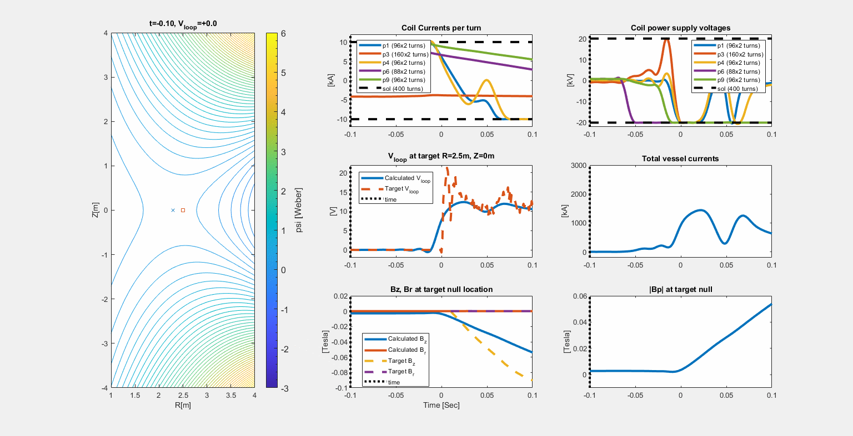
Planning to automatize the scenario optimization work flow, validate it against MAST-U, and apply it to ITER
Output:
Coil current or power supply voltage,
producing the V_{loop} and the field null quality, which are found to be required by DYON modelling assessment.
Courtesy of Federico Felici (EPFL)
Example: optimization of PF coil current scenario for STEP design with no solenoid and no passive stabilizer

Slide 47
Contents
Motivation of EM modelling development
Electromagnetic modelling development
ECH-assist burn-through modelling in KSTAR
Plans for 2022 (~2024)
Summary

Slide 48
Contents
Motivation of EM modelling development
Electromagnetic modelling development
ECH-assist burn-through modelling in KSTAR
Plans for 2022 (~2024)
Summary

Slide 49
Contents
Motivation of EM modelling development
Electromagnetic modelling development
ECH-assist burn-through modelling in KSTAR
Plans for 2022 (~2024)

Slide 50
Contents
Motivation of EM modelling development
Electromagnetic modelling development
ECH-assist burn-through modelling in KSTAR
Plans for 2022 (~2024)

Slide 51
Summary
Motivation of EM modelling development:
  D-IIID modelling – need for V_{loop} calculation at a plasma position
  Code benchmark - need to model the evolution of V_{p} and L_{f}
Electromagnetic modelling development:
    Full circuit equations have been integrated in DYON, and synthetic flux loop data agrees well with measurement.
ECH-assist burn-through modelling in KSTAR:
    DYON well reproduced a KSTAR discharge showing good agreements of synthetic line emission and interferometry data with measurements
Plans for 2022 (~2024):
  V_{p} evolution model development
  PIC code coupling for pre-ionization phase modelling
  Statistical validation with the electromagnetic model and ECH model, including failed discharges
  Automatize the scenario optimization work flow, validate it against MAST-U, and apply it to ITER

