Slide 1
PrIO-2.SIM.01-T001-D002
Coupling between kinetic models (BKD0), ECRH absorption (GRAY) and magnetic models (CREATE-BD), IMAS adaptation
D. Ricci, M. Mattei, L. Figini

Slide 2
General Overview of the 2021/22 Activities
Adaptation of the simulation codes to IMAS
  EC beam reflection models in GRAY for multi-pass EC and absorption evaluation at ITER plasma start-up (2021 Stand-alone code implementation in IMAS, 2022 coupling with BKD0/CREATE-BD)
  ITER BD breakdown and burnthrough magnetic simulation code (Matlab/Simulink) providing flux/field maps and other magnetic quantities (2021 Stand-alone code implementation in IMAS, 2022 coupling with BKD0)
Validation of coupled codes (CREATE-BD/BKD0/GRAY) on past TCV shots (2021)
Preliminary ITER predictive simulations with a light coupling (in IMAS) scheme between kinetic models (BKD0), ECRH absorption (GRAY) and CREATE-BD magnetic models via an Iterative procedure (2021 Identification of the reference Scenario and stand alone Magnetic Simulation, 2022 coupled simulations and sensitivity analyses)
Assessment of the ECRH absorption in the very initial phase of the ITER breakdown (2021) and proposed improved models (2022)
Reference Codes Modules
1. CREATE-BD Magnetic Simulation and Optimization of the BD Scenario (Matlab/Simulink code)
  a. Direct simulation: assign Voltage Waveforms → provides magnetic quantities
  b. Inverse Simulation: assign BD and early ramp up desired conditions → provides waveforms (not used for WPRiO activity)
2. BKD0: Plasma kinetic simulation (Fortran code)
3. GRAY: EC absorption (Fortran code)

Slide 3
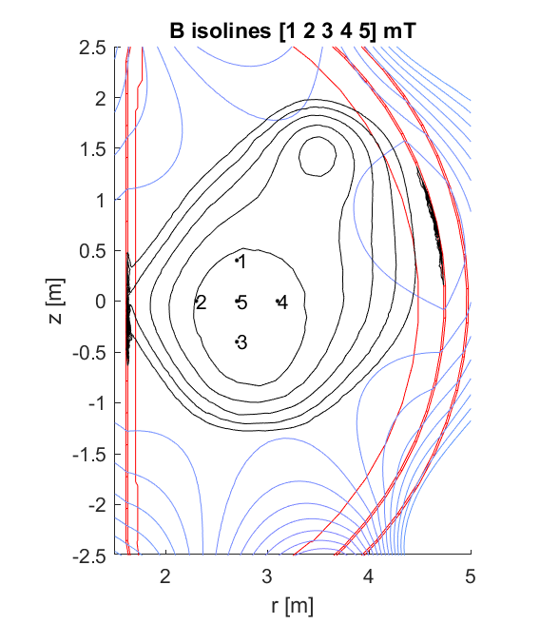
GRAY – BKD0 – CREATEBD general coupling scheme
EC beams config, P_{EC,in}
impurities
GRAY
EC Absorption Fortran
P_{abs}
CNR – BKD0
Start-up Simulation
Fortran
n_{e}, T_{e}
Iterative procedure
Ip
Vloop
CREATE-BD
Optimization/Simulation of the BD Magnetic Configuration
Matlab/Simulink
Flux/Field Map
Inputs for BD Scenario
(e.g Switching Networks configuration
BD time instant, BD region
Target Electric Field and Poloidal Field at BD
Initial values of the plasma resistance
Limits on Voltages, Forces, etc…)
Latest developments under WPSA for JT-60SA:
design and simulation

Slide 4
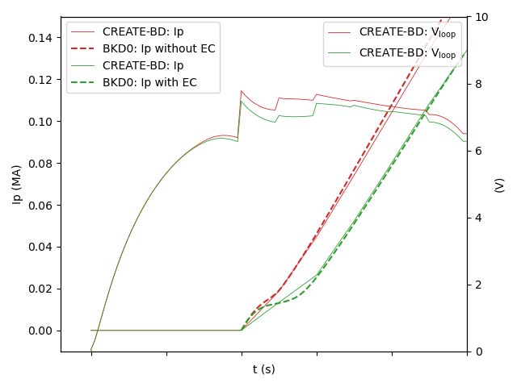
The JT-60SA example: design and simulation results
At the first iteration, given the specifications of the BD scenario and constraints, CREATE-BD performs an optimization of the magnetic configuration.
For next iterations, the plasma current calculated by BKD0 can be used for a further optimization or used just for a simulation of the dynamic evolution of the magnetic quantities, without changing the driving voltage/currents. In fact, if the Ip current provided by BKD0 is not sustainable by the PF coil system/power supplies the optimization solution drifts to a zero dIp/dt.
If driving voltages are fixed an important aspect to be evaluated is if the vertical and radial field well approximate the equilibrium fields during the ramp up.
GRAY EC absorption tables were computed only at the first iteration for the nominal scenario (no update with ne/Te)
ECH-assist improves Filed Null Configuration (FNC) breakdown (Expand breakdown regime to higher pressure)
[M.Yoshida EPS-2021]

Slide 5
The direct simulation scheme to be used for ITER-BD
EC beams config, P_{EC,in}
impurities
GRAY
EC Absorption Fortran
P_{abs}
CNR – BKD0
Start-up Simulation
Fortran
n_{e}, T_{e}
Iterative procedure
Ip
Vloop
CREATE-BD
Simulation of the BD Magnetic Configuration
MATLAB
Flux/Field Map
Switching Networks configuration
Voltage Waveforms
Initial currents
Driving waveforms can be assumed from past CREATE or DINA scenarios

Slide 6
Validation on TCV data (MST1 campaign)
CREATE made some validation activity of the magnetic model in view of an activity on the testing of fast tools for current corrections in collaboration with TCV (F.Felici)
Comparison of the measured fields with the simulated fields at the BD time (Shot 57433)
Simulated radial field in the 4 points of the BD region compared with TCV model simulation results

Slide 7
Validation on TCV data (MST1 campaign)
Discharges to be used for the validation of the coupling (MST1): #65149
#65150
#65151
Reconstruction
Open loop simulation
Example of simulation and reconstruction with CREATE Tools
#65149 time = -0.05s. Isofield lines step 0.5mT

Slide 8
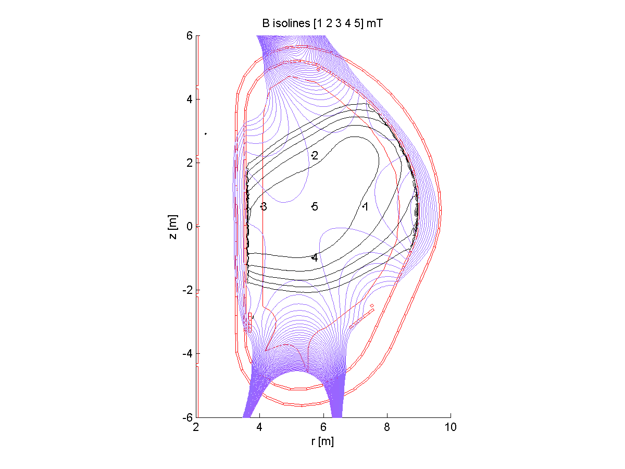
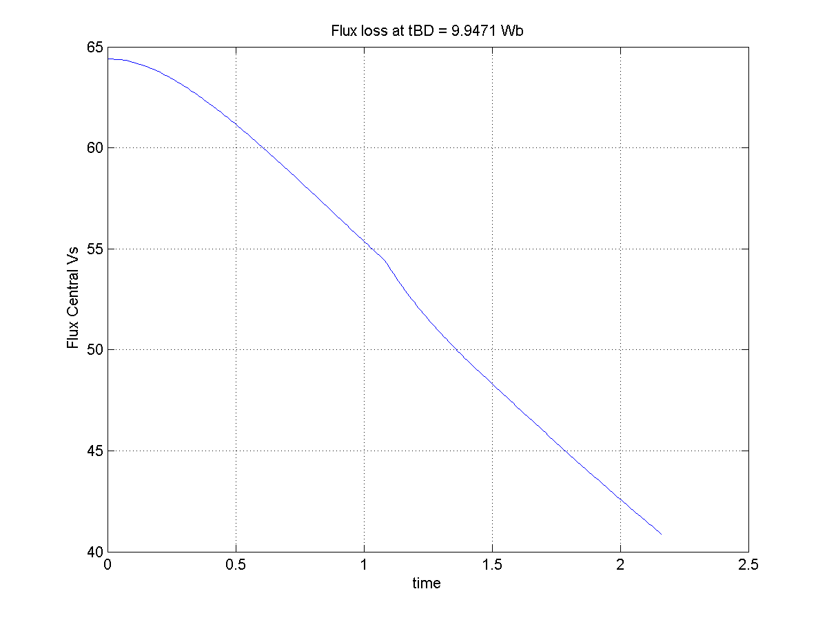
ITER magnetic model – Scenario Definition
ITER magnetic Model for the BD phase has been developed by CREATE and compared with DINA models output
Latest studies concentrated on FPO breakdown scenarios with half field and reduced current in the Central Solenoid
Flux loss = 10 Wb
Initial Flux = 64Wb
Half toroidal field – Reduced current in the CS – FPO
(DINA/TRANSMAK-like Scenario ITER_D_WDRNWZ Doc. 23/4/18)

Slide 9
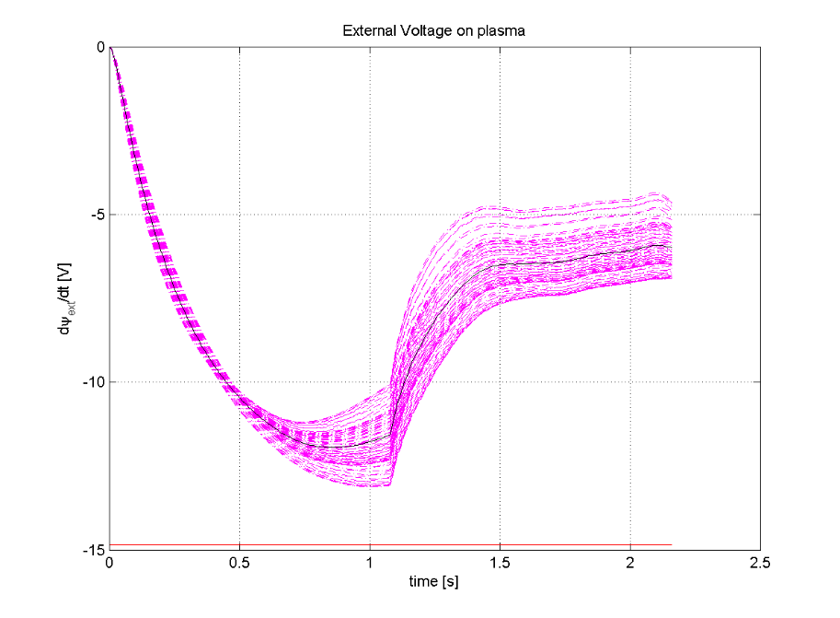
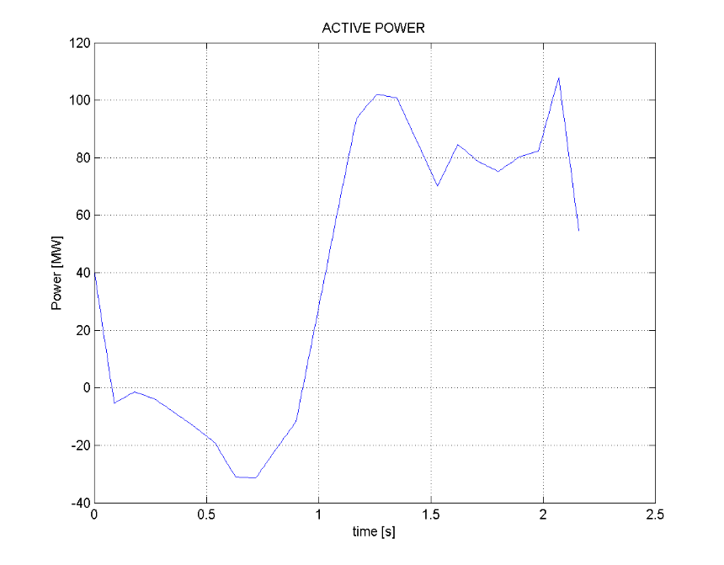
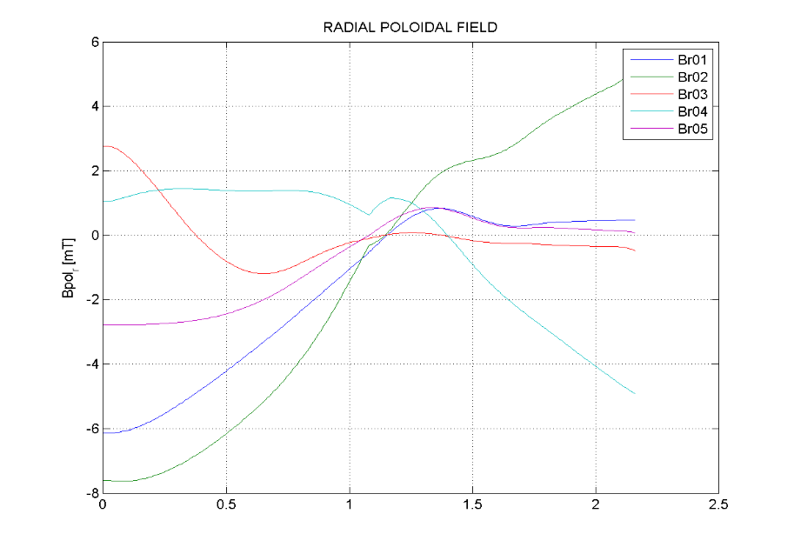
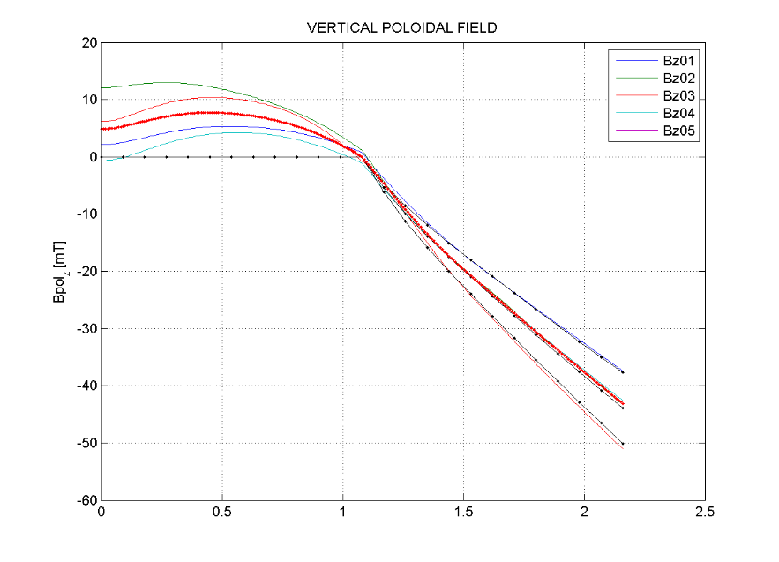
ITER magnetic model – Scenario Definition
External Voltage
Active Power
PS configuration for first plasma adopted (reduced number of modules)
Vertical Field
Radial Field

Slide 10
ITER magnetic model – IMAS implementation
Plasma/Tokamak model at BD – Matlab/Simulink
The PTM@BD code simulates the input-output axi-symmetric electromagnetic dynamics of the active/passive circuits, including the Switching Networks, in the pre-charge phase and in the breakdown phase.
It also simulates the plasma current rise in the burnthrough and the initial part of the ramp up where eddy currents are high with respect to the plasma current, using a simplified model of the plasma modelled as a circular massive conductor with fixed volume and position.
Provides as outputs the magnetic quantities to evaluate breakdown performance as radial and vertical poloidal fields, poloidal fluxes and loop voltage, as well as other quantities to be kept under control as currents, voltages, powers, vertical forces and maximum poloidal fields on coils

Slide 11
GRAY/BKD0 Input/output data in IMAS
ec_launchers/*
*/frequency
*/power_launched
*/mode
*/launching_position
*/steering_angle_tor
*/steering_angle_pol
*/beam
adaptation
to be completed by the end of 2021
wall/*
*/description_2d/limiter
GRAY
waves/*
*/electrons/power_thermal
*/profiles_1d
*/beam_tracing
equilibrium/*
*/profiles_1d/f
*/profiles_2d/psi
*/profiles_2d/b_field_r
*/profiles_2d/b_field_tor
*/profiles_2d/b_field_z
*/magnetic_axis
*/minor_radius
core_profiles/*
*(t)/electrons/temperature *(t)/electrons/density
*(t)/ion
*(t)/neutral
*/ip(t)
BKD0
core_profiles/*
*(0)/electrons
*(0)/ion
*(0)/neutral
*/v_loop(t)

Slide 12
Coupling GRAY/BKD0
Current status
Not in IMAS: data exchange via external files
Two-steps simulation
  GRAY → EC power absorption look-up table generated with
    fixed injection angles
    fixed simplified plasma geometry
    (good approx. for 0D quantities in regime of very localized absorption)
    n_{e}, T_{e} range covering all values encountered during the start-up phase
  BKD0 → Plasma evolution using pre-computed EC absorption values
Ongoing upgrade
Data exchange via IDSs
Direct coupling: GRAY called at each iteration of BKD0, using the istantaneous
    EC Injection angles & input power
    Magnetic geometry
    Electron density and temperature

Slide 13
EC Beam reflection model
Multi-pass absorption relevant for
EC-assisted start-up from ITER's Upper Launcher
Low EC absorption regime scenarios
Simplified model for EC beam reflection
Assumptions for the wall surface:
  Smooth, perfect conductor
  Axisymmetric shape
Reflection described with GO → each ray reflected as independent plane wave
Fraction P_{O,X} of reflected beam power coupled to
O-/X-mode determined at plasma boundary
P_{O,X} = |e_{O,X} . e_{refl}|²
OM/XM mutually orthogonal: P_{O} = 1 – P_{X}
Model under implementation in IMAS
ITER UL (LSM)
T_{e0} = 0.2 keV
n_{e0} = 5 10¹⁸ m⁻³
k_{refl} = k_{in} – 2 (k_{in} . n) n
e_{refl} = – e_{in} + 2 (e_{in} . n) n
k_{in}, k_{refl}: wave vector
e_{in}, e_{refl}: normalized electric field
n: normal to the wall surface at incidence point

Slide 14
EC beam reflection model (considerations)
A few considerations on the model
An arbitrary number of reflections can be handled, but the beam is soon scattered all around the vessel
→ only 1 reflection, i.e. 2 passes in the vessel, is usually considered (conservative P_{abs} estimate)
100% reflectivity assumed
  partly compensates conservative approach above
  easy to extend to arbitrary value
Under consideration a possible option to estimate absorption after the first 2 passes
→ "effective" reflectivity to account for
  gaps in the wall
  plasma volume to vessel volume ratio
  ... any other aspect affecting the absorption efficiency
JT-60SA Scen.4 @ T_{e}=0.2keV
XM launch, β=15 deg

Slide 15
Next steps in 2021-22
2021
Testing of the coupled codes on TCV (simulation activity out of IMAS)
Stand alone modules IMAS: GRAY, BKD0, CREATE-BD in direct mode (remote support desirable)
Assess ECRH absorption in the initial phase of the ITER bkd (for the identified scenario)
2022
Coupling codes in IMAS
Calculation of an operational window for ITER, i.e. a scan in (PEC, n_{neut}, impurities...)
Benchmark with Dyon (on the identified ITER scenario? details? to be agreed)
Foreseen PM 2022: 3 x 1.5PM (same as for 2021)

