Slide 1
TSVV thrust meeting
TSVV 12: stellarator optimisation
Per Helander on behalf of the TSVV 12 team
IPP Greifswald, Germany

Slide 2
Motivation: future stellarator programme
So far, W7-X has been highly successful. Theory-based design seems to pay off, e.g.,
Significantly better confinement than in other stellarators (Beidler, Nature 2021)
Smaller bootstrap current (Dinklage, Nature Phys. 2018)
What next? W7-X can probably be improved, e.g.
Better fast-ion confinement
Less turbulent transport?
Enable EUROfusion decision later this decade.

Slide 3
Lessons learned from W7-X
Island divertor works very well.
excellent detachment
better than W7-AS or any tokamak?
neutral compression perhaps a problem
requires careful control of bootstrap current to maintain island location
bootstrap current behaves as predicted
Confinement mostly limited by turbulence, not by neoclassical transport.
neoclassical optimisation nevertheless necessary for achieving best results
Fast ions not confined well enough for a reactor.
theoretically predicted heat loads on the wall seen with IR cameras.
W7-X was supposed to be MHD-stable up to , but
there are global m=n=1 instabilities (“sawteeth“) during ECCD

Slide 4
Quo vadis?
There are three known classes of orbit-confining stellarators, corresponding to the topology of level contours
Quasi-axisymmetric ones (QA)
Quasi-helically symmetric ones (QH)
Quasi-isodynamic ones (QI)
W7-X is QI (to a poor approximation) and this category is thus a generation ahead of the others.
QI is thus the lead contender, but it may be too early to write of QA and QH.
Is it possible to
improve fast-ion confinement?
reduce turbulence?
relax MHD stability requirements?
simplify coils?

Slide 5
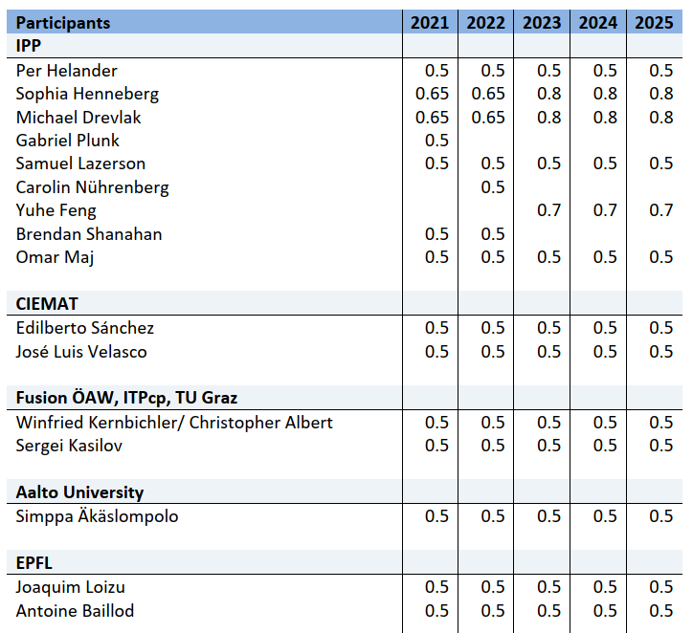
Team

Slide 6
Key deliverables
Turbulent and neoclassical transport
Integration of fast reduced modes of turbulent transport into stellarator optimisation codes (synergy with TSVV 13); Generalisation of tools for the evaluation of radial neoclassical transport, so that it can be minimised in collisionality regimes beyond the 1/ν regime.
Bootstrap Current and Energetic Particle Confinement
Accurate numerical tools for the evaluation of energetic particle confinement and for the calculation of the bootstrap current that are sufficiently fast to be integrated into stellarator optimization codes.
MHD equilibrium and stability
Efficient tools capable of assessing, for any stellarator equilibrium, ideal and resistive MHD stability (and the importance thereof), and robustness of the magnetic topology to current perturbations.
Improved optimization approaches
Improved algorithms to be employed in stellarator optimization for reduced sensitivity to local optima in parameter space, and development of approaches for coil simplification and robustness against errors
Stellarator Optimization codes
Advanced European stellarator optimization code including all the above developments. Application to produce a set of highly optimized stellarator configurations.

Slide 7
Major projects
Stellarator optimisation codes (ROSE, Stellopt, Simsopt)
Neoclassical code (KNOSOS)
MHD equilibrium and stabilitz codes (GVEC, SPEC, CAS3D)
Orbit integrators (GORILLA, SIMPLE, ANTS, ASCOT, BEAM3D)
Quick assessment of ITG threshold / turbulence
Edge (EMC3, Bsting)

Slide 8
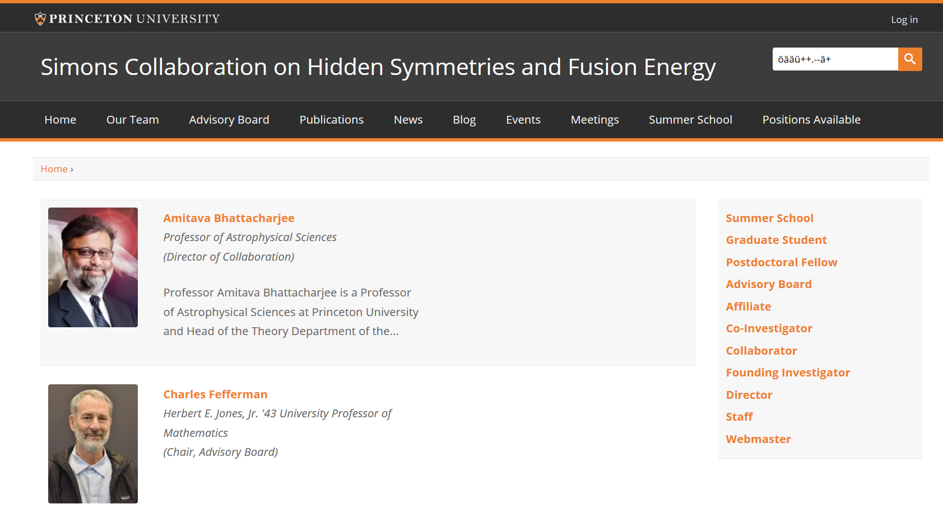
Parallel effort
Collaboration between
Princeton University
MPI for Plasma Physics
Courant Institute @ NYU
Cornell University
University of Maryland
Warwick University
Australian National University
Aim:
Clarify mathematical questions.
Find efficient methods for optimisation.
Design “optimal“ stellarators.
Construct stellarator optimisation code SIMSOPT
Initial funding period 2018-2022, renewal application submitted for 2022-2025.

Slide 9
Stellarator optimisation codes
There are three codes on the market
ROSE (IPP)
STELLOPT (US + IPP)
SIMSOPT (Simons)
We will not write a fourth one but instead improve existing ones.

Slide 10
2021 deliverables
SD1.2: The derivation of a first principles instability model will allow for running optimization codes without ad-hoc turbulence models or computationally expensive gyrokinetic codes.
In progress. A first model was published in JPP 2021, working on an extension.
SD3.1: Exploit the direct capability in SPEC to evaluate the ideal and resistive, internal and external, stability of stellarator equilibria.
In progress, see below.
SD4.3: Investigate if spectral condensation or a specific choice of the poloidal angle of the plasma boundary can improve stellarator optimization regarding the achieved penalty values and regarding iterations needed during the optimization.
Done and submitted for publication.
SD4.4: Investigate analytically the advantages and disadvantages of different ways of representing the magnetic field with respect to reducing the stellarator optimization space and the ease of combining coil and stellarator optimization.
Done and published
SD5.1: Implement an interface for the type of optimizer in the optimization code ROSE such that it can use optimizers of the MANGO library. These optimizers will be then tested against each other.
Done

Slide 11
Stability calculations with SPEC
The SPEC equilibrium code is based on MRxMHD and can also be used to calculate stability.
Second variation of MRxMHD energy functional, or Hessian matrix,
provides information about stability of each mode.
[Kumar et al, PPCF 2020, PPCF 2021]
verified tearing stability in slab
verified ideal & tearing stability in cylinder
verified ideal stability in tokamaks
ongoing: tearing stability in tokamaks
ongoing: stellarators

Slide 12
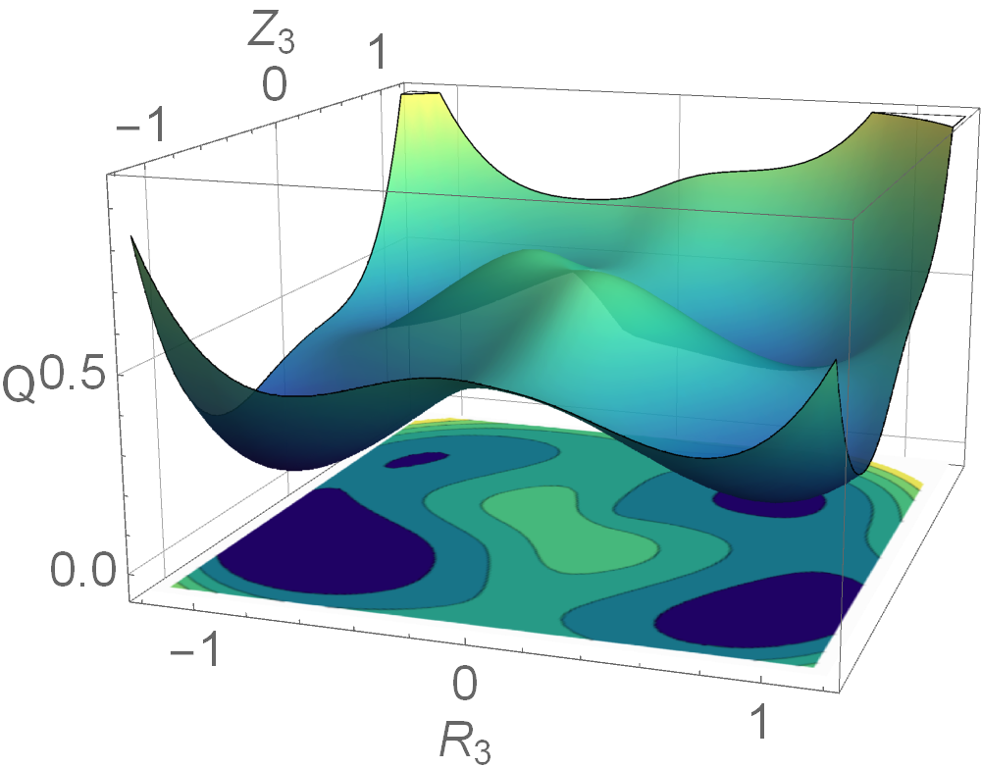
Representing the plasma boundary
Most stellarator optimisation relies on quick and robust fixed-boundary equibrium calculations.
The magnetic field is defined by the shape of the boundary, whose Fourier cofficients are varied until the dream stellarator is found.
This representation is not optimal.
If only few harmonics are included, not every shape can be represented.
If many harmonics are allowed, several very different choices correspond to almost the same shape.
Multiple minima in the optimisation landscape.
A unique, and apparently better, representation has been constructed (Henneberg, Helander and Drevlak, submitted to JPP)
Seems to improve and accelerate stellarator optimisation “in real life“.

Slide 13
Summary
Identifying the optimal next-step stellarator(s) for the EF programme is a huge task.
Cannot possibly be accomplished by this TSVV alone, but we can hopefully play an important role.
Parallel activities:
Other research in EU, not funded by EF
Simons collaboration on Hidden Symmetries and Fusion Energy
All 2021 deliverables are likely to be met.

