Slide 1
E-TASC Thrust 4 Meeting Update on TSVV#13 activities
J. M. García Regaña

Slide 2
TSVV#13 Project
Background
The understanding of turbulence in stellarators is limited in comparison with tokamaks, due to
the computational cost of handling 3D magnetic geometries;
the limitations of the flux tube approach for stellarators.
In particular, some aspects (electromagnetic turbulence, interplay between neoclassical (NC) physics and gyrokinetic (GK) turbulence) remain practically unexplored.
Project
9 milestones and 15 SMART deliverables to cover by 2025 the 5 key deliverables:
1) Stellarator GK codes verified against each other and 2) validated against stellarator and 3D tokamak experiments, 3) able to address the interaction between NC and GK turbulence and 4) to assess relative weight of NC and turb. transport. 5) Develop reduced models.
Team (CIEMAT, CCFE, MPG, DIFFER)
9 leading experts in GK theory and simulation, developers and users of the main European stellarator GK codes + a NC code: stella, GENE, EUTERPE, GENE-3D, KNOSOS.
Changes w.r.t. initial team: D. A. St.-Onge (U. Oxford) and A. Zocco (IPP-Greifswald) replacing F. I. Parra (U. Oxford) and J. A. Alcusón (UC3M).
Tasks for ACHs: stella optimized performance (CIEMAT), improved solvers for EUTERPE and GENE-3D (MPG), support for visualization (EPFL) and handling of EUTERPE data (VTT).

Slide 3
2021 Milestones
Milestone ID | Short name | Brief description | Participants | Due date
M1.1 | M-STELLA-COLL | Implementation of the full linearized collision operator in stella. | MB*, A. v. Boetticher | Jul. 21
M1.2 | M-BENCHMARK-ES-GLOB | Benchmark between GENE-3D and EUTERPE for electrostatic turbulence with adiabatic electrons. | ES*, ABN, JR, JGR | Jul. 21 Dec.21
M1.3 | M-STELLA-FFS | Development of a full-flux-surface (FFS) version of stella. | MB* | Dec. 21
M1.4 | M-GENE-3D-EM | Development of an electromagnetic version of GENE-3D and implementation of methods that allow to use larger time steps in GENE-3D simulations. | ABN*, F. Wilms | Dec. 21

Slide 4
2021 Milestones
Milestone ID | Short name | Brief description | Participants | Due date
M1.1 | M-STELLA-COLL | Implementation of the full linearized collision operator in stella. | MB*, A. v. Boetticher | Jul. 21
M1.2 | M-BENCHMARK-ES-GLOB | Benchmark between GENE-3D and EUTERPE for electrostatic turbulence with adiabatic electrons. | ES*, ABN, JR, JGR | Jul. 21 Dec.21
M1.3 | M-STELLA-FFS | Development of a full-flux-surface (FFS) version of stella. | MB* | Dec. 21
M1.4 | M-GENE-3D-EM | Development of an electromagnetic version of GENE-3D and implementation of methods that allow to use larger time steps in GENE-3D simulations. | ABN*, F. Wilms | Dec. 21

Slide 5
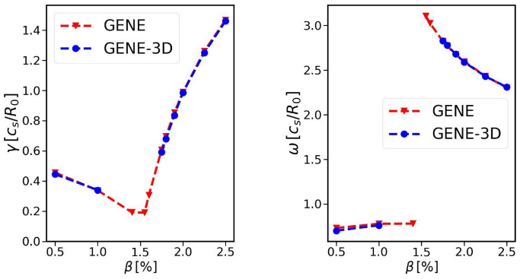
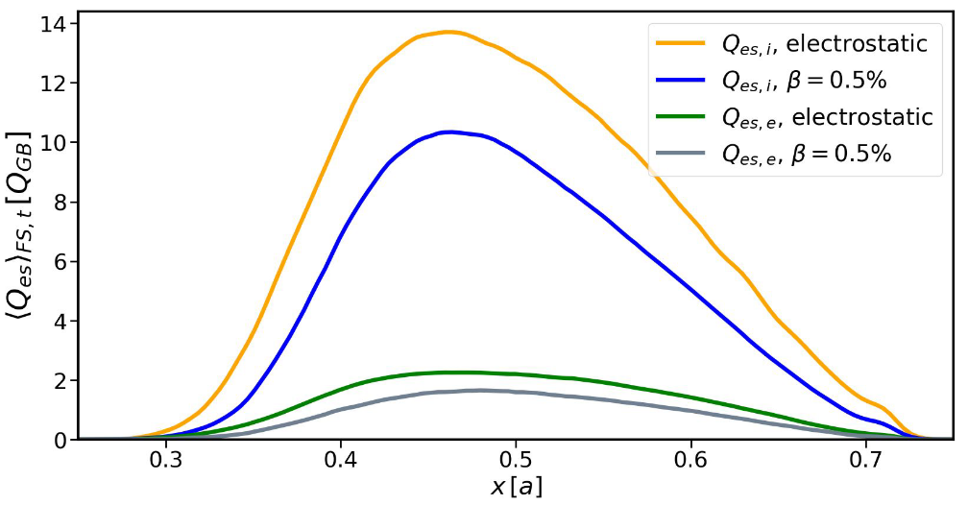
M-GENE-3D-EM
GENE-3D EM developed and benchmarked against the x-global version of GENE, linearly and nonlinearly.
Electromagnetic ITG turbulence in W7-X has been addressed.
Presented at TSVV#13 1st regular meeting, W7-X Phys. Meeting and paper submitted to JPP.

Slide 6
2021 Milestones
Milestone ID | Short name | Brief description | Participants | Due date
M1.1 | M-STELLA-COLL | Implementation of the full linearized collision operator in stella. | MB*, FP | Jul. 21
M1.2 | M-BENCHMARK-ES-GLOB | Benchmark between GENE-3D and EUTERPE for electrostatic turbulence with adiabatic electrons. | ES*, ABN, JR, JGR | Jul. 21 Dec.21
M1.3 | M-STELLA-FFS | Development of a full-flux-surface (FFS) version of stella. | MB*, FP | Dec. 21
M1.4 | M-GENE-3D-EM | Development of an electromagnetic version of GENE-3D and implementation of methods that allow to use larger time steps in GENE-3D simulations. | ABN* | Dec. 21

Slide 7
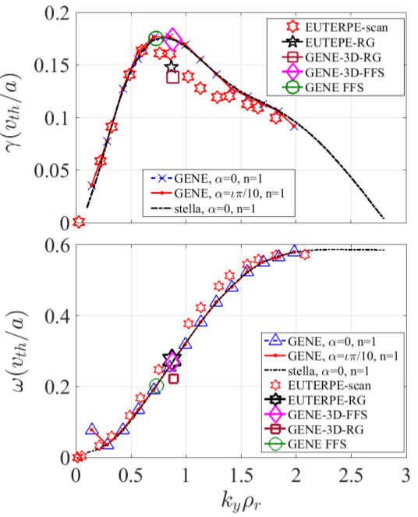
M-BENCHMARK-ES-GLOB
EUTERPE, GENE-3D, GENE and stella in LHD and W7-X using adiabatic electrons.
Addressed problems: stability of ITG and linear relaxation of ZF components.
Verification of codes beyond flux tube geometry and impact of the domain considered in linear simulations (related to D2.4 / D-TURB-DOMAIN)
IAEA contribution, NF paper submitted. To be presented at TSVV#13 2nd regular meeting. Nonlinear cases to be presented at EFTC´21.

Slide 8
M-STELLA-COLL and M-STELLA-FFS
Milestone ID | Short name | Brief description | Participants | Due date
M1.1 | M-STELLA-COLL | Implementation of the full linearized collision operator in stella. | MB*, A. v. Boetticher | Jul. 21
M1.2 | M-BENCHMARK-ES-GLOB | Benchmark between GENE-3D and EUTERPE for electrostatic turbulence with adiabatic electrons. | ES*, ABN, JR, JGR | Jul. 21 Dec.21
M1.3 | M-STELLA-FFS | Development of a full-flux-surface (FFS) version of stella. | MB* | Dec. 21
M1.4 | M-GENE-3D-EM | Development of an electromagnetic version of GENE-3D and implementation of methods that allow to use larger time steps in GENE-3D simulations. | ABN*, F. Wilms | Dec. 21
M-STELLA-COLL: implementation accomplished, first results and checks to be presented at TSVV#13 2nd regular meeting.
M-STELLA-FFS: development is ongoing.

Slide 9
Deliverables in 2021
Deliverable ID / Short name | Key deliverable(s) | Due date
D1.1 / D-REF-CASES | 1, 3, 4 | March 2021
Motivation: The stellarator gyrokinetic community lacks a reference case, similar to the Cyclone Base Case (CBC) in tokamaks (…) Tokamak equilibria with broken axisymmetry will also be considered.
SMART deliverable: agreed W7-X reference case and set of representative OP2 operation scenarios for comparisons, benchmark activities and OP2 predictive modelling tasks (…) a natural step will be that other codes with extended capabilities (e.g. spatial domain beyond flux-tube, collisions, etc.) expand the set of simulations for that reference case. Due date: March 2021
D1.2 / D-TURB-ZTRANSP | 3, 4 | Dec. 2021
Motivation: Due to the larger mass and charge of impurities (…) natural question about the effect of collisions on the turbulent transport of impurities.
SMART deliverable: Study of the effect of collisions on the background turbulence and impurity transport in multispecies electrostatic flux tube simulations. Due date: Dec. 2021.

Slide 10
Deliverables in 2021
Deliverable ID / Short name | Key deliverable(s) | Due date
D1.1 / D-REF-CASES | 1, 3, 4 | March 2021
Motivation: The stellarator gyrokinetic community lacks a reference case, similar to the Cyclone Base Case (CBC) in tokamaks (…) Tokamak equilibria with broken axisymmetry will also be considered.
SMART deliverable: agreed W7-X reference case and set of representative OP2 operation scenarios for comparisons, benchmark activities and OP2 predictive modelling tasks (…) a natural step will be that other codes with extended capabilities (e.g. spatial domain beyond flux-tube, collisions, etc.) expand the set of simulations for that reference case. Due date: March 2021
D1.2 / D-TURB-ZTRANSP | 3, 4 | Dec. 2021
Motivation: Due to the larger mass and charge of impurities (…) natural question about the effect of collisions on the turbulent transport of impurities.
SMART deliverable: Study of the effect of collisions on the background turbulence and impurity transport in multispecies electrostatic flux tube simulations. Due date: Dec. 2021.

Slide 11
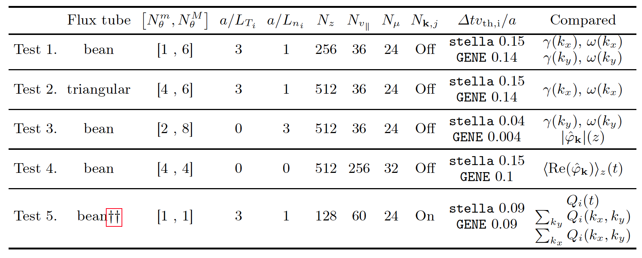
D-REF-CASES
A set of test cases has been considered for a comparison of the flux tube versions of GENE and stella.
Chosen configuration: W7-X high mirror (KJM) fixed boundary VMEC configuration with <β>=3%.
Manuscript submitted to JPP.
Presented at W7-X Turbulence Topical Group and coming EFTC´21. Data will be open and available.

Slide 12
Some progress along 2022 deliverables
Deliverable ID / Short name | Key deliverable(s) | Due date
D2.3 / D-TURB-WEIGHT | 1, 3 | Dec. 2022
Motivation: once the FFS of stella is developed (see M1.3), questions about the relative weight of turbulent to neoclassical transport or the minimal spatial domain required to accurately describe gyrokinetic turbulence in stellarators (see D-TURB-DOMAIN) can be addressed.
SMART deliverable: Assessment of the turbulent transport of the different species, with particular emphasis on impurities, with FFS electrostatic gyrokinetic simulations including collisions and comparisons with neoclassical calculations performed by the code KNOSOS and the neoclassical version of EUTERPE. This will allow to accurately assess the relative weight of turbulent to neoclassical transport.
D2.4 / D-TURB-DOMAIN | 1, 3 | Dec. 2022
Motivation: see motivation of TURB-WEIGHT.
SMART deliverable: Assessment of the effect of the spatial domain (global, FFS, FT) on the background turbulence and on the turbulent impurity transport in multispecies electrostatic gyrokinetic simulations, including collisions. This work will identify when it is actually necessary to go beyond FFS.

Slide 13
Some progress along 2022 deliverables
Deliverable ID / Short name | Key deliverable(s) | Due date
D2.3 / D-TURB-WEIGHT | 1, 3 | Dec. 2022
Motivation: once the FFS of stella is developed (see M1.3), questions about the relative weight of turbulent to neoclassical transport or the minimal spatial domain required to accurately describe gyrokinetic turbulence in stellarators (see D-TURB-DOMAIN) can be addressed.
SMAR deliverable;: Assessment of the turbulent transport of the different species, with particular emphasis on impurities, with FFS electrostatic gyrokinetic simulations including collisions and comparisons with neoclassical calculations performed by the code KNOSOS and the neoclassical version of EUTERPE. This will allow to accurately assess the relative weight of turbulent to neoclassical transport.
D2.4 / D-TURB-DOMAIN | 1, 3 | Dec. 2022
Motivation: see motivation of TURB-WEIGHT.
SMART deliverable: Assessment of the effect of the spatial domain (global, FFS, FT) on the background turbulence and on the turbulent impurity transport in multispecies electrostatic gyrokinetic simulations, including collisions. This work will identify when it is actually necessary to go beyond FFS.
D-TURB-DOMAIN: the extended cross-code comparison that includes M-BENCHMARK-ES-GLOB has already addressed aspects of this deliverable.

Slide 14
Some progress along 2022 deliverables
Deliverable ID / Short name | Key deliverable(s) | Due date
D2.3 / D-TURB-WEIGHT | 1, 3 | Dec. 2022
Motivation: once the FFS of stella is developed (see M1.3), questions about the relative weight of turbulent to neoclassical transport or the minimal spatial domain required to accurately describe gyrokinetic turbulence in stellarators (see D-TURB-DOMAIN) can be addressed.
SMART deliverable: Assessment of the turbulent transport of the different species, with particular emphasis on impurities, with FFS electrostatic gyrokinetic simulations including collisions and comparisons with neoclassical calculations performed by the code KNOSOS and the neoclassical version of EUTERPE. This will allow to accurately assess the relative weight of turbulent to neoclassical transport.
D2.4 / D-TURB-DOMAIN | 1, 3 | Dec. 2022
Motivation: see motivation of TURB-WEIGHT.
SMART deliverable: Assessment of the effect of the spatial domain (global, FFS, FT) on the background turbulence and on the turbulent impurity transport in multispecies electrostatic gyrokinetic simulations, including collisions. This work will identify when it is actually necessary to go beyond FFS.
D-TURB-DOMAIN: the extended cross-code comparison that includes M-BENCHMARK-ES-GLOB has already addressed aspects of this deliverable.

Slide 15
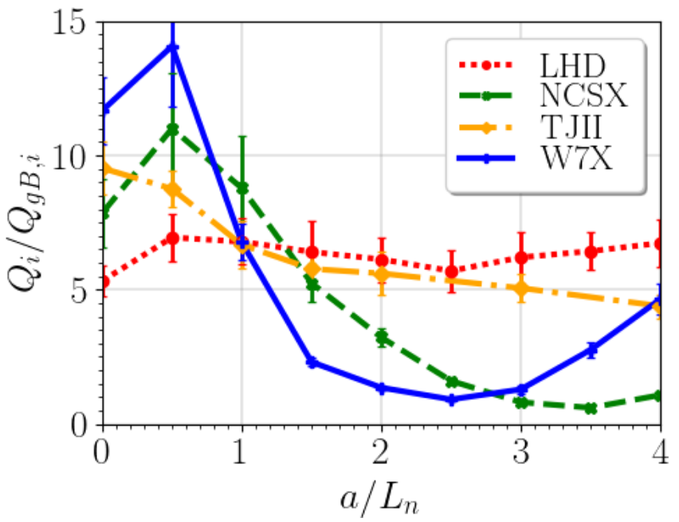
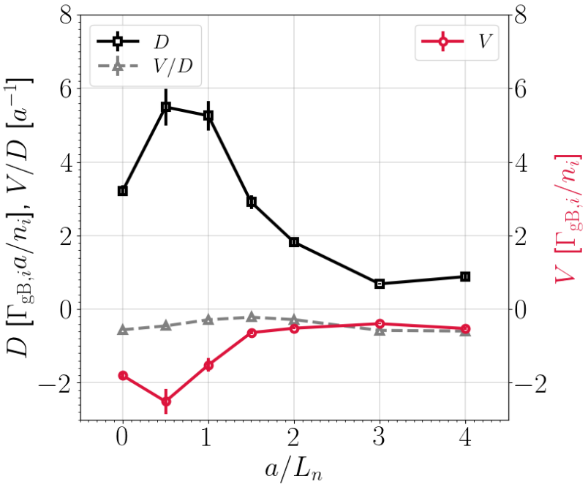
D-TURB-WEIGHT
The effect of the density gradient on the turbulent heat flux (Thiendpondt EFCT´21, Turbulence TG) and impurity particle transport (García-Regaña NF´21) has been investigated with stella FT simulations in W7-X and other stellarators.
Strong reduction of turbulent fluxes found (of both ion heat and impurity particle fluxes) has been found → Room for neoclassical levels to compete with turbulence?

Slide 16
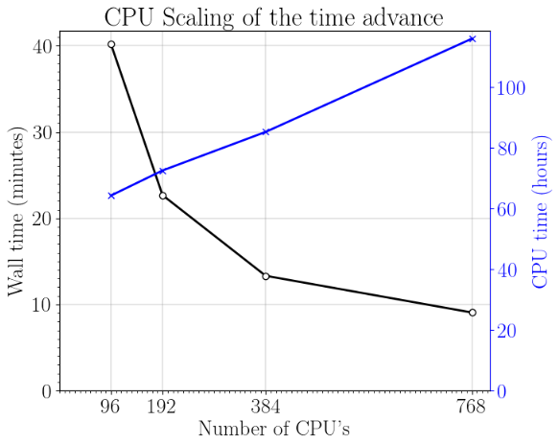
ACH-CIEMAT work on TSVV#13 needs
BSC (ACH-CIEMAT), CIEMAT and U. Oxford (CCFE) KoM meeting on July 19.
Three tasks proposed to ACH/CIEMAT
Dedicated study that looks into the overall performance and optimization of stella
Focusing on the performance of the inizialisation part and also optimising it.
Add target in the makefile that allows to loop through test cases in compilation.
CIEMAT and U. Oxford have handed over our initial assesments of 1) and 2).

Slide 17
ACH-CIEMAT work on TSVV#13 needs
BSC (ACH-CIEMAT), CIEMAT and U. Oxford (CCFE) KoM meeting on July 19.
Three tasks proposed to ACH/CIEMAT
Dedicated study that looks into the overall performance and optimization of stella
Focusing on the performance of the inizialisation part and also optimising it.
Add target in the makefile that allows to loop through test cases in compilation.
CIEMAT and U. Oxford have handed over our initial assesments of 1) and 2).
Summary
All 2021 milestones and deliverables progress adequately.
Aspects addressed by 2022 deliverables have been partly covered during 2021.
ACH-CIEMAT support activities just begun.

