Slide 1
Analysis of Material behavior e.g. (Wf/W) under Plasma and heat loading regarding mechanical properties e.g. cracking, embrittlement, and microstructure. (FZJ)
Advanced Engineering Materials
Fusion Materials Development at Forschungszentrum Juelich
DOI:10.1002/adem.201901376
Jan W. Coenen , A. Litnovsky and Contributors
1: Forschungszentrum Jülich GmbH, Institut für Energie- und Klimaforschung 52425 Jülich, Germany,; 2: Department of Engineering Physics, University of Wisconsin Madison, WI 53706 Madison, USA

Slide 2
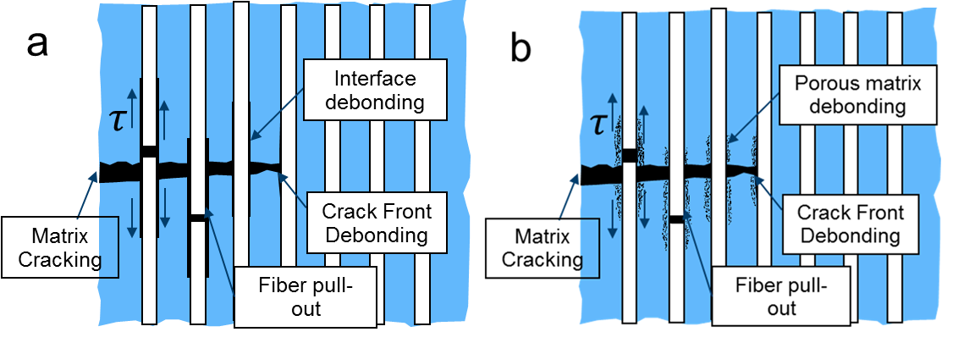
Porous matrix Wf/W by SPS
A controlled amount of fine scale matrix porosity, obviating the need for a fiber coating.
This approach can be viewed as an extension of the porous coating concept wherein crack deflection occurs because of the low fracture toughness of the porous interphase
Wf/W
Compare to conventional W_{f}/W
No interface needed
  easy to produce
Lower process temperature
  less fiber recrystallization
More homogeneous material
  no weak interface area
Thermal conductivity reduced
Retention?

Slide 3
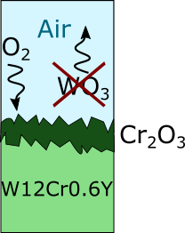
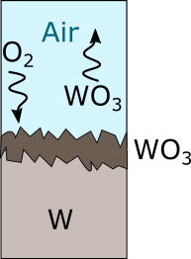
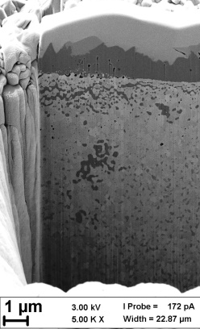
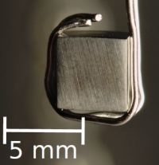
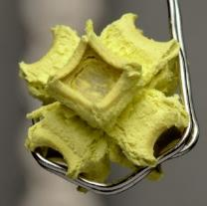


Tungsten based Smart ALLOYs
Utilize chromium and yttrium to achieve stable oxidation suppression
Fusion accidents & Oxidizing environments
Challenge:
Suppress oxidation when utilizing refractories during ‘Loss of coolant’ and air ingress
W-Cr-Y alloys form protective chromium oxide layer
Formation of tungsten-oxides is suppressed
Addition of yttrium (~ 0.6 wt%) is crucial
Nucleation sites, grain-boundary segregation, oxide pegs, impurity binding…
1000°C, 1 bar,
80 vol.% Ar+20 vol.% O₂, 10 hours
Litnovsky, A.; Klein, F.; Schmitz, J.; Wegener, T.; Linsmeier, C.; Gilbert, M.; Rasinski, M.; Kreter, A.; Tan, X.; Mao, Y.; Coenen, J.W; Bram, M. & Gonzalez-Julian, J. Smart first wall materials for intrinsic safety of a fusion power plant
Fusion Engineering and Design, Elsevier BV, 2018

Slide 4
Wf/W in PSI-2
Y.Mao

Slide 5
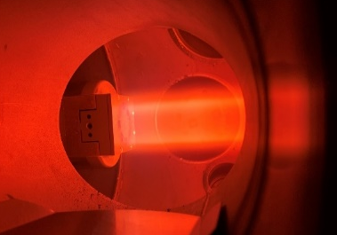
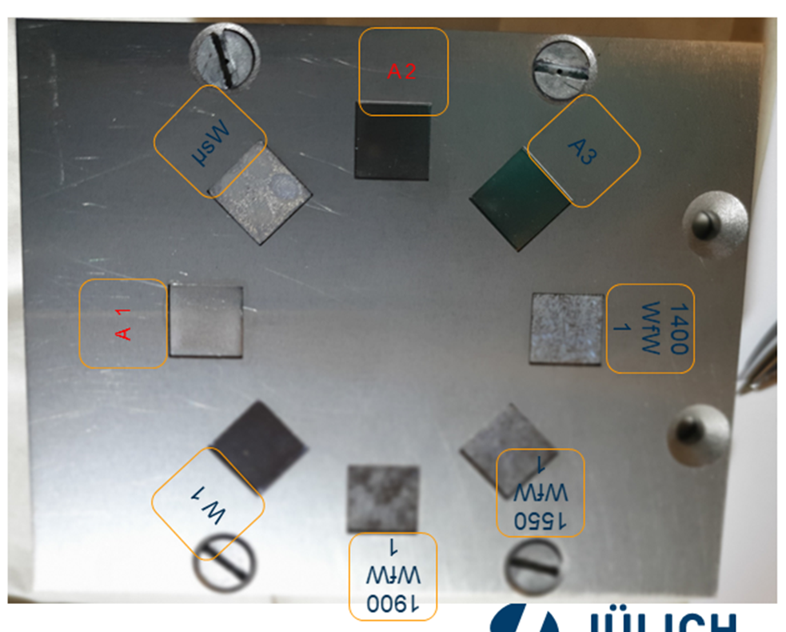
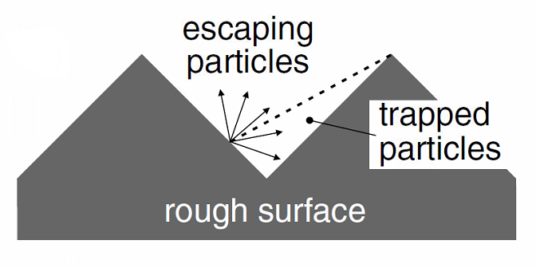
Plasma wall interaction on porous matrix W_{f}/W
-A. Kreter, 2008
Neon plasma, 98-117 eV, total fluence of 5.4×10²⁵ Ne⁺ m⁻², 100 min, ~200⁰C
Theoretical weight loss due to sputtering is 4.0 mg
With the increasing porosity, the weight loss decreases
The sputtered W were re-caught by the pores/surface roughness
Before Ne erosion
After Ne erosion

Slide 6
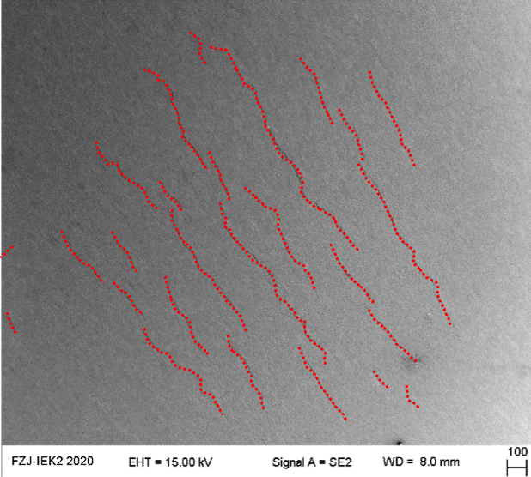
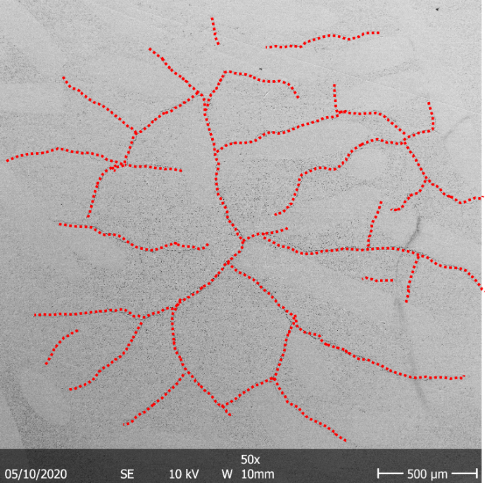
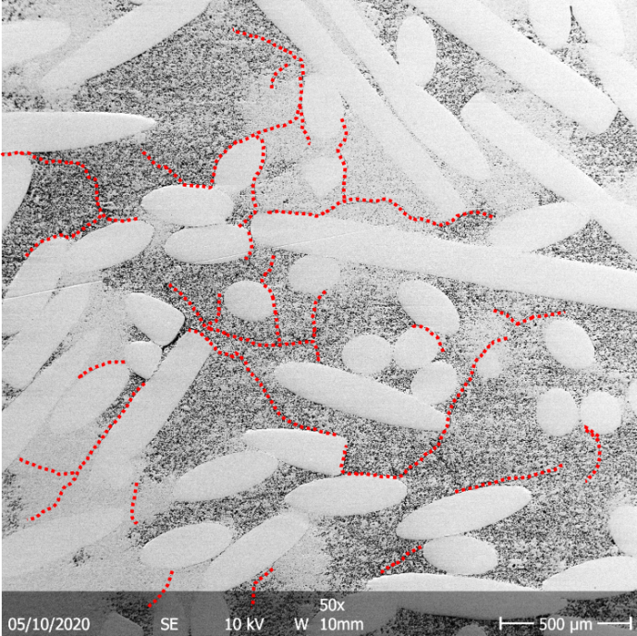
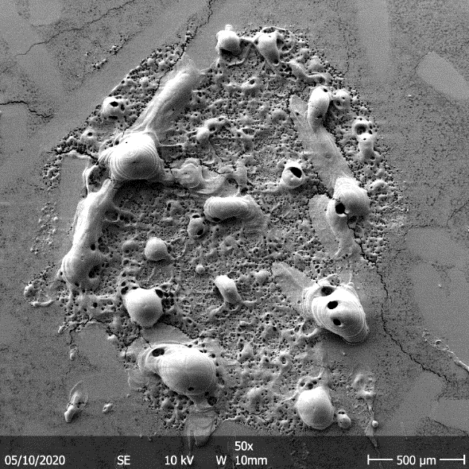
Thermal shock
Labs = 0.38 GW/m², Tbase = RT, n = 1000 pulses
W
92%
85%
1.6GW/M² 2ms
Laser thermal shock has been performed to simulate the transient heat load
The cracking threshold of porous matrix is between 0.19 GWm⁻² and 0.38 GWm⁻², which is similar to ITER-grade W
Due to low thermal conductivity, severe melting are observed under loading condition of 1.6 GWm⁻² for 2ms.

Slide 7
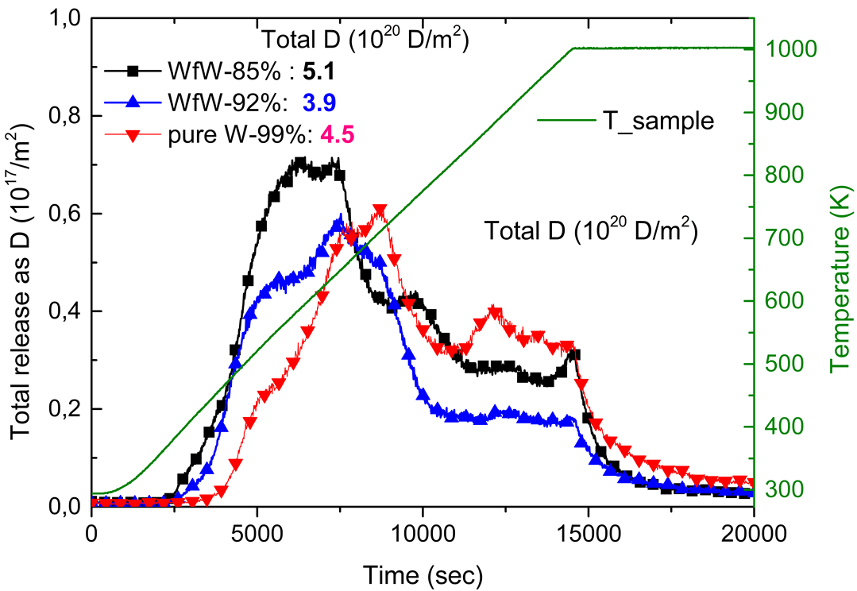
PM W_{f}/W
Porous Matrix Properties
D Plasma Exposure
Bias voltage 78 eV;
Total fluence was 4.99x10²⁵D⁺ m⁻². Temperature was ~202 °C.
D retention was measured by TDS
Porous matrix W_{f}/W shows similar behavior compared to pure W

Slide 8
Smart-W

Slide 9
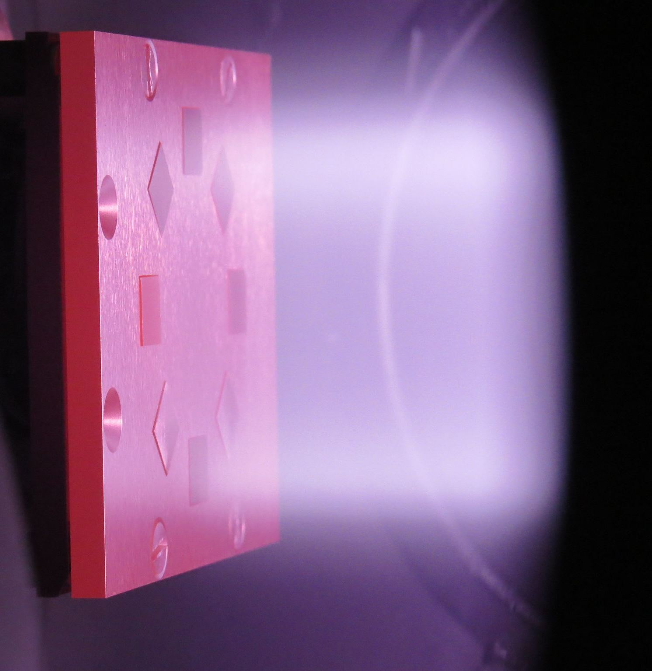
HHF and plasma tests on SMART alloys
Status and plans
Alloy | Plasma tests | HHF tests | Comments
SMART W-Cr-Y | Finished by now PSI 2 and Magnum PSI | Planned for 2022 | We will see depending on modeling whether new tests are required
SMART W-Cr-Zr | 2021-2022* PSI 2 | not yet in plan | New: oxidation resistance confirmed Tests depend on availability of samples supplied by HFUT (CN)
Nanostructured alloys | 2021-2022* PSI 2 | not yet in plan | Tests depend on availability of samples supplied by SBU (USA)

Slide 10

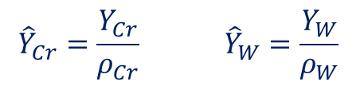
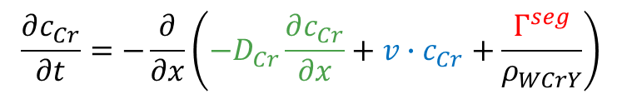

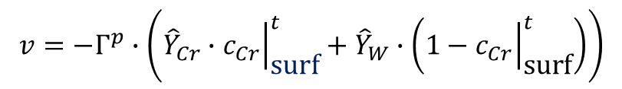






Understanding material response to plasma exposure
P. Bittner
Combined model : erosion, diffusion and segregation
Modification of the work of P.S. Ho [5] by adding segregation flux $Γ^{seg}$
diffusion with surface recession and segregation
Surface recession velocity
$$\frac{∂c_{Cr}}{∂t}=−\frac{∂}{∂x}\left(−D_{Cr}\frac{∂c_{Cr}}{∂x}+v∙c_{Cr}+\frac{Γ^{seg}}{ρ_{WCrY}}\right)$$
$$v=−Γ^{p}∙\left({\hat{Y}}_{Cr}∙{\left.c_{Cr}\right|}_{\text{surf}}^{t}+{\hat{Y}}_{W}∙\left(1−{\left.c_{Cr}\right|}_{\text{surf}}^{t}\right)\right)$$
$$c$$
$$Γ^{p}$$
$$Γ^{diff}+Γ^{recession}+Γ^{seg}$$
(atomic-) density normalized sputter yields
$${\hat{Y}}_{Cr}=\frac{Y_{Cr}}{ρ_{Cr}} {\hat{Y}}_{W}=\frac{Y_{W}}{ρ_{W}}$$
$$c_{bulk}$$
$$t→∞$$
Note: ${\hat{Y}}_{Cr}>{\hat{Y}}_{W}⟺$ preferential sputtering of $Cr$
$$x→∞$$
$$0$$
Coming next: application of the model to experiments
[5] P.S. Ho, Surface Science 72 (1978) 253-263

Slide 11
Add Ons

Slide 12
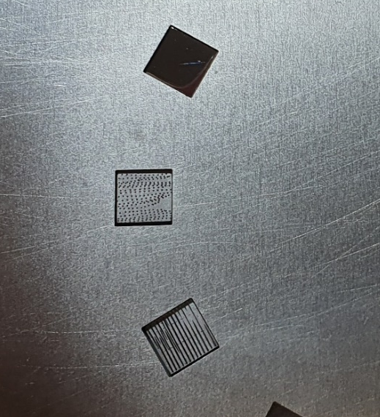
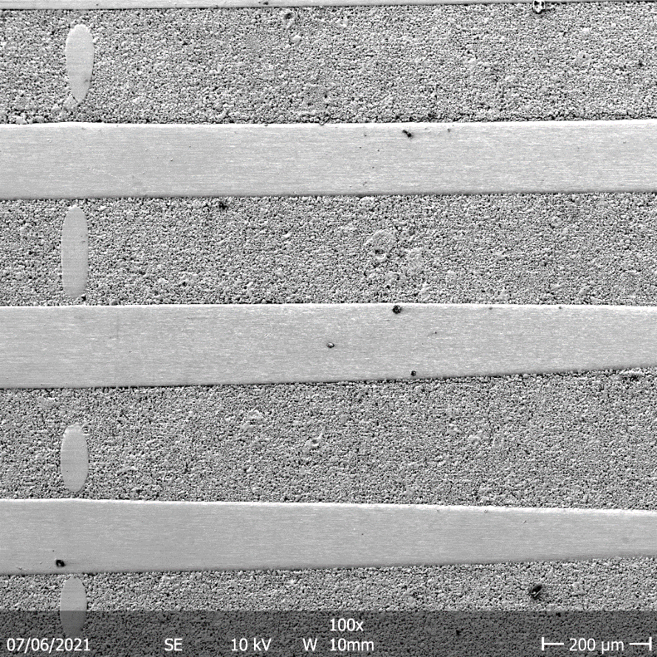
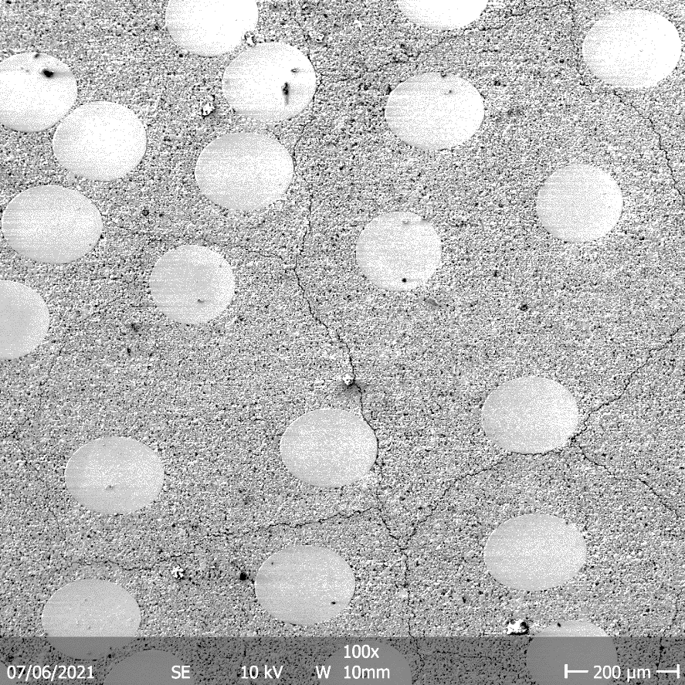
Laser shock by PSI-2
Fiber vertical to the loading surface
Fiber parallel to the loading surface
Loading condition
Labs = 0.38 GW/m², Tbase = RT, n = 100 pulses
After the loading: crack bridging by the fibers

Slide 13
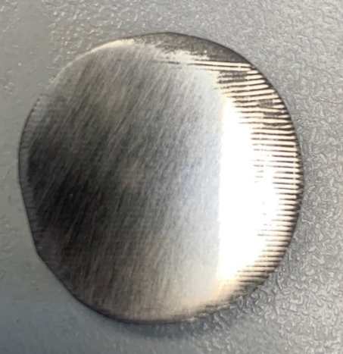
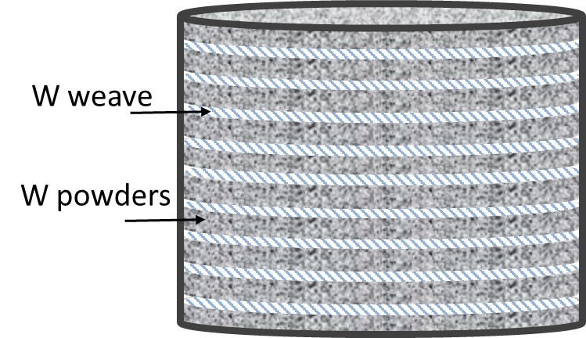
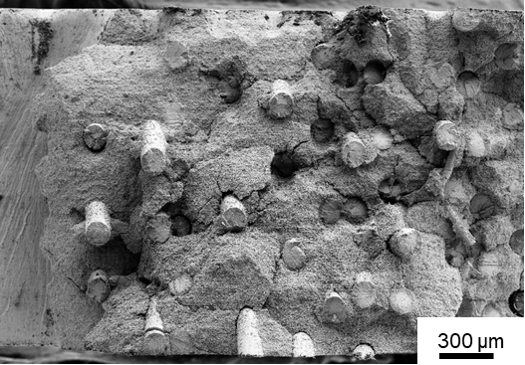
Long fiber W_{f}/W by PM
Pre-notched 3-point bending tests
4-point bending test: flexural strength: ~466 Mpa
Random fiber porous matrix Wf/W with 40% fiber content: ~250 Mpa
Random fiber conventional Wf/W with yttria interface and 30% fiber content: ~230 MPa

