Slide 1
PWIE-SP A.3.T - T001- D002 Performance of advanced materials under high heat loads and their microstructural characterization
J. Riesch^{*,a}, Y. Mao^{b,c}, D. Schwalenberg^{b,e}, B. Böswirthª, S. Elgetiª, H. Greunerª, L. Raumann^{b}, J.W. Coenen^{b,d}, and R. Neu^{a,e}
ªMax-Planck-Institut für Plasmaphysik, 85748 Garching, Germany
^{b}Forschungszentrum Jülich GmbH, Institut für Energie- und Klimaforschung – Plasmaphysik, 52425 Jülich, Germany
^{c}School of Mechanical Engineering, Hefei University of Technology, Hefei 230009, China
^{d}Department of Engineering Physics, University of Wisconsin - Madison, Madison, WI53706, USA
^{e}Technische Universität München, 85748 Garching, Germany
Notes:
20 min + 3 min Diskussion

Slide 2
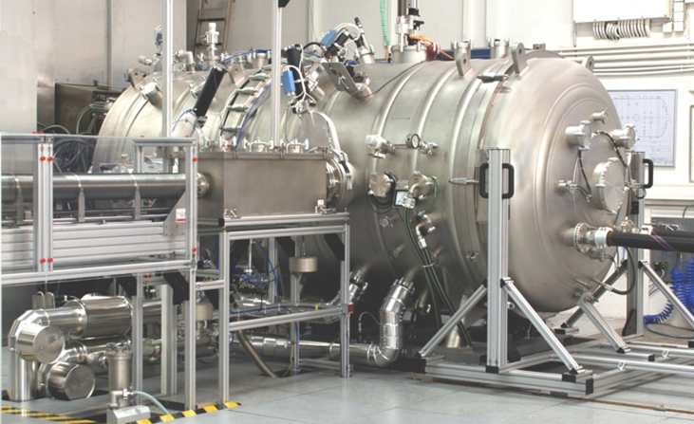
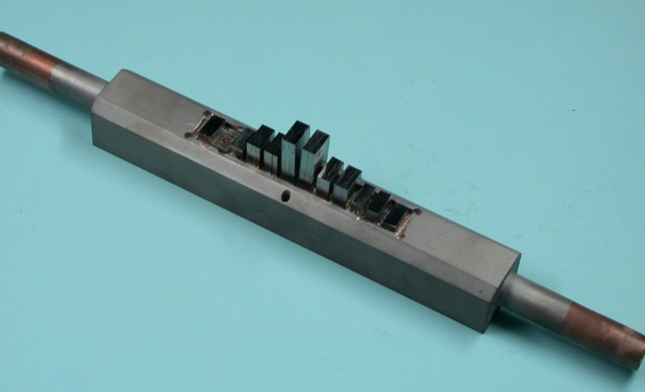
HHF tests of block-based mock-ups in GLADIS
Aim: Test material until its limit
GLADIS: Homogeneous heating by H neutral beams
Heat flux: 10/15/20 MW/m²
Pulse length: 30s (equilibrium after 13s)
Actively cooled: water inlet 20 °C, 12 m/s
Procedure
First step: screening up to maximum heat flux
Second step: 100 cycles at maximum heat flux
Block based mock-up
CVD- and PM-W_{f}/W
Different sample heights to vary the surface temperature
5mm x 10mm x 5/10/15/20mm (EU DEMO divertor targets R&D; W armour thickness 5-8 mm) [J.H. You et al. Journal of Nuclear Materials 544 (2021) 152670]
Garching LArge DIvertor Sample test facility [Greuner et al. J NUCL MATER 367-370,(2007) 1444-1448]
soldered W_{f}/W blocks
W coated CuCrZr
Notes:
Lieber Hans,
die H atom fluence ist beim cycling 100 Pulse a 15 s für:
15 MW/m² = 7 e24 H/m²
10 MW/m² = 5,5 e24 H/m²
Beachte aber die abgeschnittenen Blöcke woh Du narürlich die fluence nicht zusammen addieren kannst.
Grüße, henri
Divertor targets R&D
Armour thickness 5-8mm
witdth 23 x 4/12mm
J.H. You, E. Visca, T. Barrett et al.
Journal of Nuclear Materials 544 (2021) 152670

Slide 3
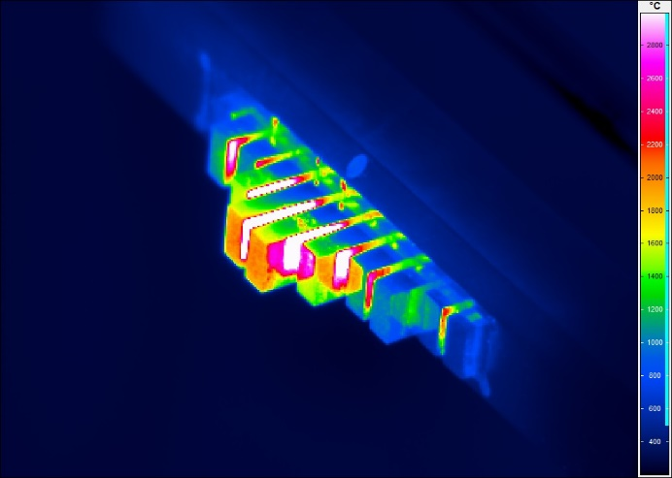
Status & Results
T_{surf}=3293
Status
CVD- and conventional PM-W_{f}/W: HHF tests completed; microstructural analysis almost done
Porous PM-W_{f}/W in Gladis: 10 MW/m² done, microstructural analysis started
GLADIS days in 2021: 3 spent + 2-3 planned
Results
CVD-W_{f}/W
Depending on architecture survival up to 20 MW/m² & crucial role of fibre orientation and manufacturing
PM-W_{f}/W
very good performance up to 15 MW/m² & some degradation at 20 MW/m2 (under evaluation)
200 µm
Conventional PM W_{f}/W after 100 pulses at 15 MW/m²
2800
1600
100th pulse
400
Porous PM W_{f}/W after 100 pulses at 10 MW/m²

