Slide 1
SPA Contribution of SCK•CEN
Dmitry Terentyev - 15/09/2021

Slide 2
Wire strength is linked to toughness (K_{Q})
Conditional fracture toughness goes down with T_{test}
Consistently with the reduction of the wire strength
K_{Q}_RT/K_{Q}_500C = 1.33; UTS_RT/UTS_500C = 1.35
Wire diameter 145 µm

Slide 3
Annealing of W fibers: effect of K-doping
Tests done at 300°C and 500°C demonstrate that:
Annealing of un-doped W wire above 1600°C makes complete brittle
K-doped wires exhibit limited strength (> 500MPa) upon annealing up to 1900°C
250C
550C
700C

Slide 4
Fracture toughness tests of non-irradiated samples
All samples with new wires exhibit similar behavior
Wire’s strength decreases with raising test temperature
Below DBTT
Above DBTT
Fiber rupture
Fiber rupture

Slide 5
Fracture toughness tests on n-irradiated samples
Irradiation conditions: 1 dpa, Tirr=600 and 1000°C
long-fiber samples: matrix ductility is reduced by irradiation, wire strength remains the same
short-fiber samples: wire strength remains the same (matrix is brittle as fore irradiation)

Slide 6
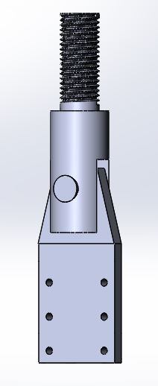
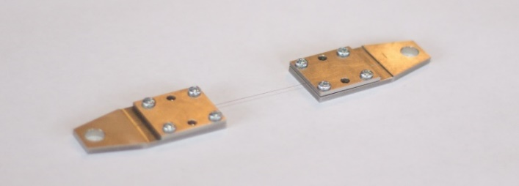
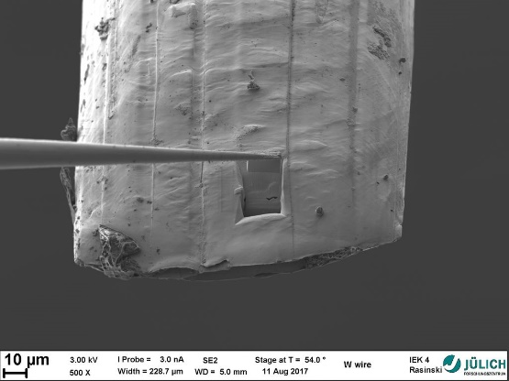
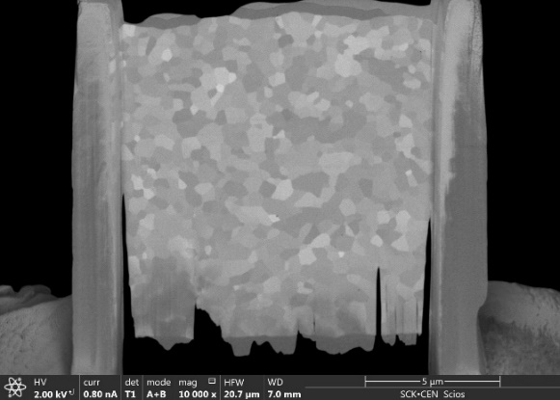
Work plan for 2021-2025
Investigate effect of high- and low- temperature neutron irradiation in W fibers and W yarns/braids. K-doped fibers should be considered.
Tensile strength
Microstructure
Strategy:
Develop tensile testing procedure in hot cells
For 145 µm wire
For relevant braids/yarns
Irradiation
Temperature= low (50-70), 300-400, 600, 800, 1200°C
Damage level = 0.15-0.2; 0.5, 1 dpa
Post Irradiation examination
Tests in the temperature range RT-600°C
SEM
FIB + TEM/APT (up to interest of other collaborators)

Slide 7
Copyright © SCK CEN
PLEASE NOTE!
This presentation contains data, information and formats for dedicated use only and may not be communicated, copied, reproduced, distributed or cited without the explicit written permission of SCK CEN. If this explicit written permission has been obtained, please reference the author, followed by ‘by courtesy of SCK CEN’.
Any infringement to this rule is illegal and entitles to claim damages from the infringer, without prejudice to any other right in case of granting a patent or registration in the field of intellectual property.
SCK CEN
Studiecentrum voor Kernenergie
Centre d'Etude de l'Energie Nucléaire
Belgian Nuclear Research Centre
Stichting van Openbaar Nut
Fondation d'Utilité Publique
Foundation of Public Utility
Registered Office: Avenue Herrmann-Debrouxlaan 40 – BE-1160 BRUSSELS
Operational Office: Boeretang 200 – BE-2400 MOL

