Slide 1




Assessment of hydrogen impact on material properties linked to ITER relevant PFUs
M. Richou, G. Kermouche¹, M. Lemetais, L. Gallais² and the WEST team
1
2
SPA - Midterm -15th of September 2021

Slide 2
OUTLINE
1. Studied tungsten
2. Use of WEST to assess hydrogen impact on recrystallization and softening
3. What are the properties we plan to investigate ?
  Loss of mechanical properties -> Hardness measurements
  Modification of the microstructure -> EBSD measurements
4. For what modelization ?
  Impact on recrystallization and softening kinetics.

Slide 3
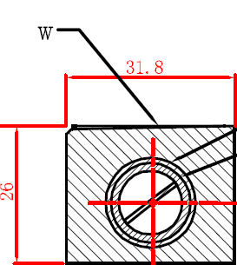
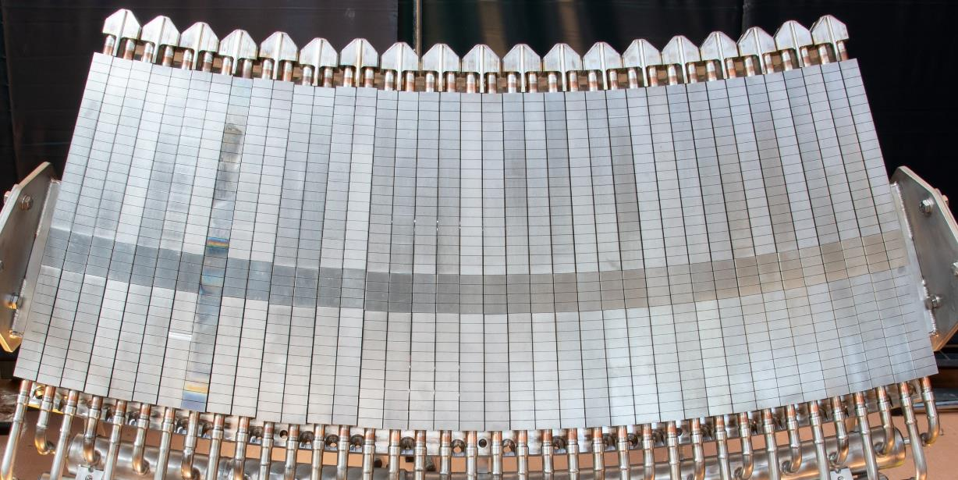
1. Studied tungsten – implementation in WEST
Incident flux
Tungsten and component manufactured by AT&M/ASIPP
ITER-like Geometry:
  6mm W thickness
  Block width from 26.3 mm to 31.8 mm
  AT&M rolled W (ITER W grade material)
A-A
CuOFHC
CuCrZr
500 mm

Slide 4
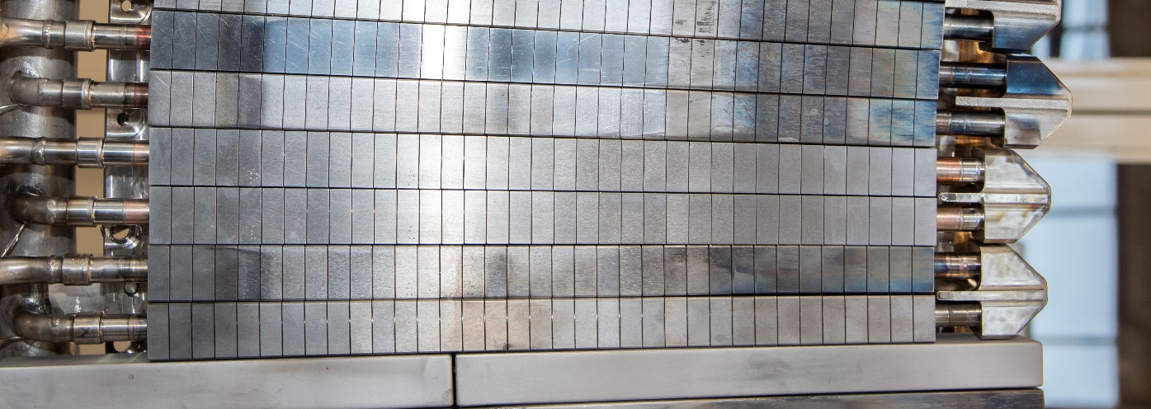
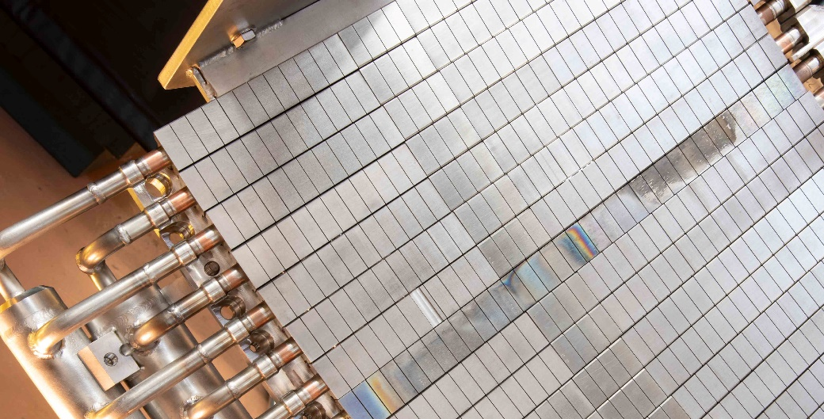
2. Use of WEST to assess hydrogen impact on recrystallization and softening (1/2)
C5
WEN003 (Position 17)
WEN004 (Position 18)
WEN004 (Position8)
C4
2 components chosen and available for this study (2021)
Future activities:
Estimates of campaign integrated fluence to be performed, uncertainties to be assessed
 | Duration max (s) | Cumul (s) | LH max (MW) | W LH total (MJ) | Max heat flux (MW/m²)
C4 – D2 | 55 (USN) | 9678 | 5.4 | 7823 | 6 [J.Gaspar, Nuclear Fusion, 2021]
July-Nov19
C4 - He | 30 | 2991 | 4.5 | 4300
Oct-Nov19
C5 | 23 | 4630 | 5.4 | 2625 | Under investigation
Nov20-Jan21

Slide 5
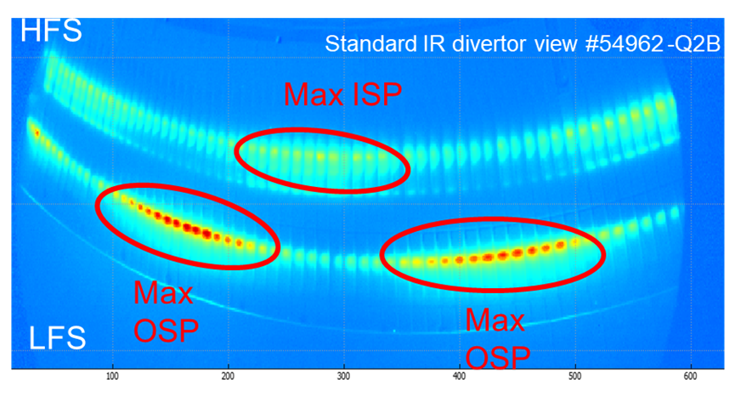
2. Use of WEST to assess hydrogen impact on recristallisation and softening (2/2)
Maximum of heat flux on PFU surface*
(Normalized to max OSP)
* : depends on plasma scenario (magnetic configuration, in/out asymmetry …)
100 %
OSP
50 %
ISP
N° PFU
C5
C4
Future activity:
temperature range reached during plasma operation under assessment (geometry, misalignement..)
5
Notes:
ces composants n’ont pas dépassé 700°C à tout casser sur la top surface (à confirmer par Yann),
Seul endroit où ça a pu chauffer plus localement : bord d’attaque de composants désalignés (je ne sais pas si c’est le cas des 2 que tu as choisi). Ou sinon, pendant les chocs thermiques liés aux disruptions etc, mais sur des temps très courts, dc recrystalisation peu vraisemblable
De yann:
Pour C4 on trouve 110 pulses avec une température FBG > 400°C, et environ 30 chocs avec un TFBG > 600°C, quelques pulses autour de 800°, mesure située à 4mm de la surface donc suffisamment proche pour donner une bonne estimation (en tout cas une borne inférieure) – bien entendu la température vraie de surface est légèrement supérieure, par exemple pour 800°C mesuré on estime avec les calculs de Jonathan une température de surface de 1000°C environ. Donc je dirai que nous avons une petite dizaine de chocs ou Tsurface approche les 1000°C à la fin du choc.

Slide 6
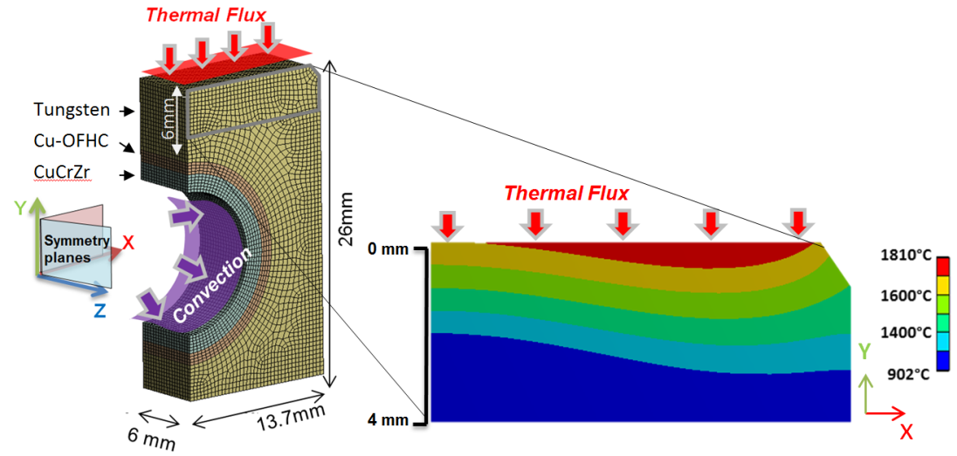
3. What are the properties we plan to investigate ? (1/3)
A. Durif, 2019, Fus. Eng and design
Thermal gradient within the component is present during plasma loading
What is the effect of combined loading on tungsten microstructure and softening ?
Objective : Characterize the modification of the microstructure (time and temperature dependent), the softening to propose predictive recrystallization and softening kinetics models

Slide 7
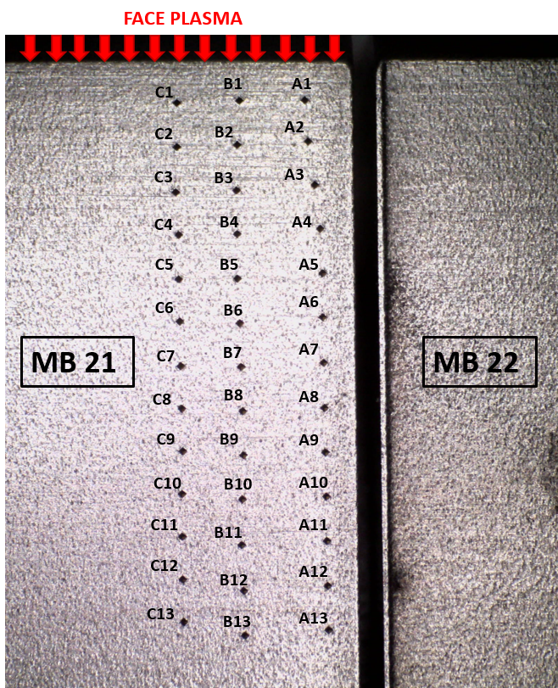
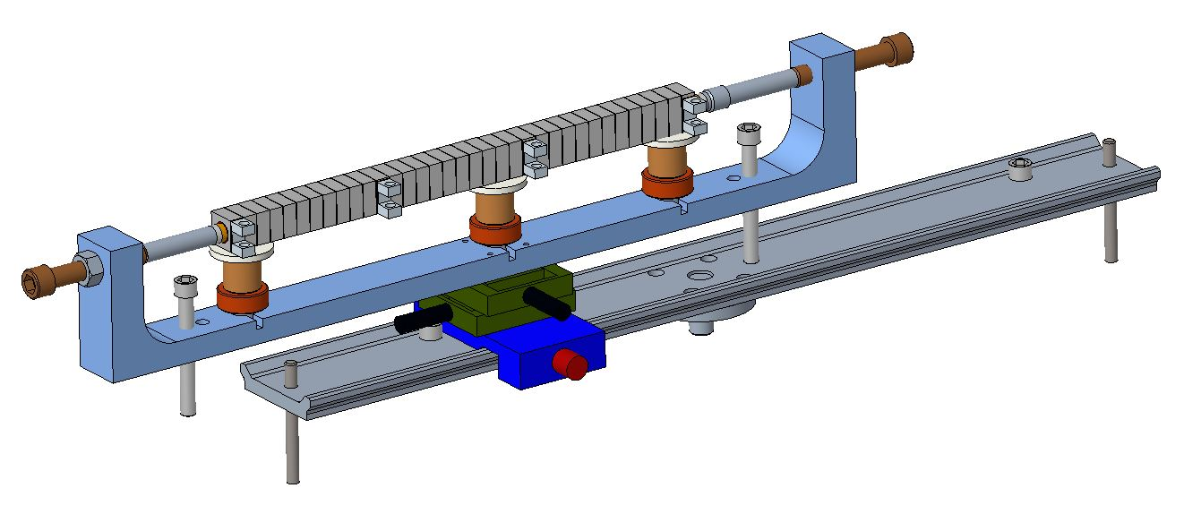
3. What are the properties we plan to investigate ? (2/3)
First trials on non-loaded components (2021) ✓
y
Set up Sketch
y
1 mm
Future objective:
Perform the measurements on the WEST components (formal procedure for PFU return to public domain ongoing)

Slide 8
3. What are the properties we plan to investigate ? (3/3)
Nanoindentation
L. Karanja, 2021, Crystals
Nanoindentation : Statistical nanoindentation analysis can help to separate contributions of recovery / recrystallization mechanisms to macroscopic softening
EBSD : Estimation of grain size distribution, quantification of recrystallized-non recrystallized grains
Future objective:
Need to cut the components (authorization pending and cutting scheme under construction)

Slide 9
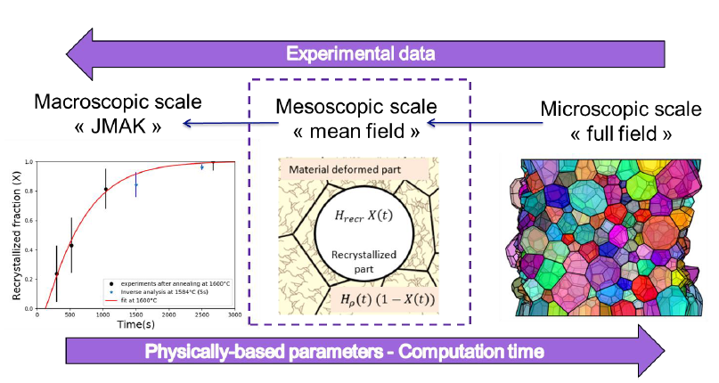
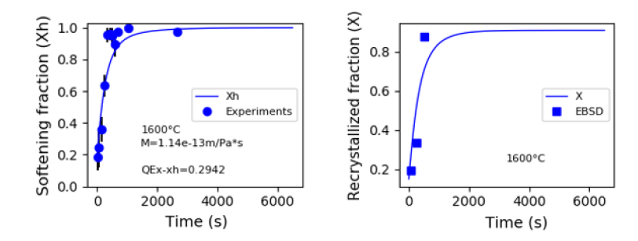
4. For what modelization ?
A. Durif, 2021, Submitted
Mean field model can help to evidence/discriminate recrystallisation-induced softening from recovery-induced softening
Future objective:
According to measurements, propose parameters to be implemented in models

Slide 11
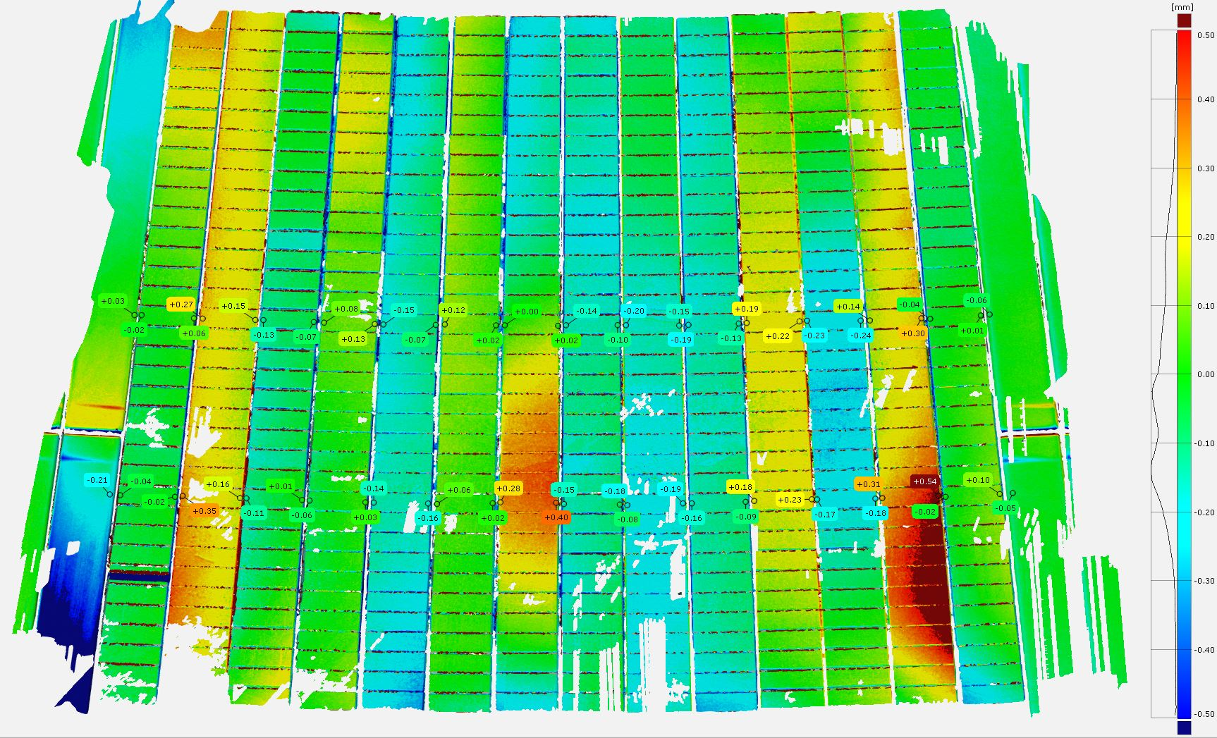
Metrology C4
5
12
20
30
17 18

