Slide 1


Analysis for PSI-2 exposed materials, focusing on recrystallization
M. Rasinski
Forschungszentrum Jülich GmbH, Institut Für Energie- und Klimaforschung – Plasmaphysik

Slide 2
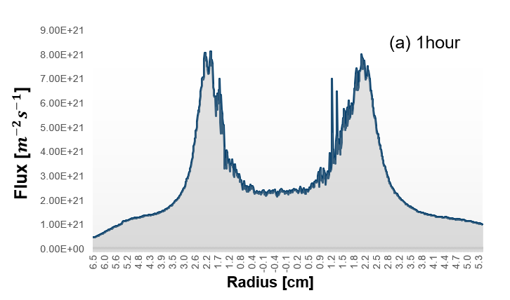
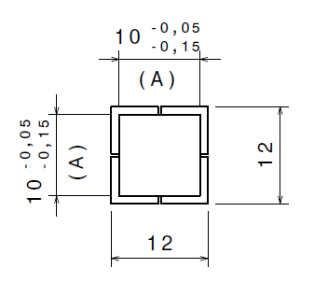
Experimental - I
Pure tungsten from Plansee.
Grain elongation transversal to the surface.
Samples were exposed in PSI-2
Composition | Bias | E_{i} [eV] | Flux [10²¹ i/m²s] | Fluence [10²⁶ i/m²] | T [°C]
100He | 100 V | 75-90 | 9.1 | 1 | 240
80D+20He | 100 V | 70-90 | 4.2 | 1 | 250
75D+20He+5N | 100 V | 70-85 | 4.7 | 1 | 255
PSI-2 plasma profile
as an ion flux fraction
1
2
After the plasma exposure, samples were annealed in vacuum (~ 3 × 10⁻⁵ mbar) at 1100°C, 1200°C, 1300°C, 1400°C, 1500°C and 1600°C for 1h.
12 mm
3
4
10 mm
Scheme of sample used for PSI-2 exposure

Slide 3
Hardness HV0.1
deterioration of hardness after annealing at 1400 ºC
large error bar due to complex microstructure
small change in hardness when compared plasma exposed and non-exposed samples (especially at temperature above 1400 ºC)
He
DHe
DHeN

Slide 4
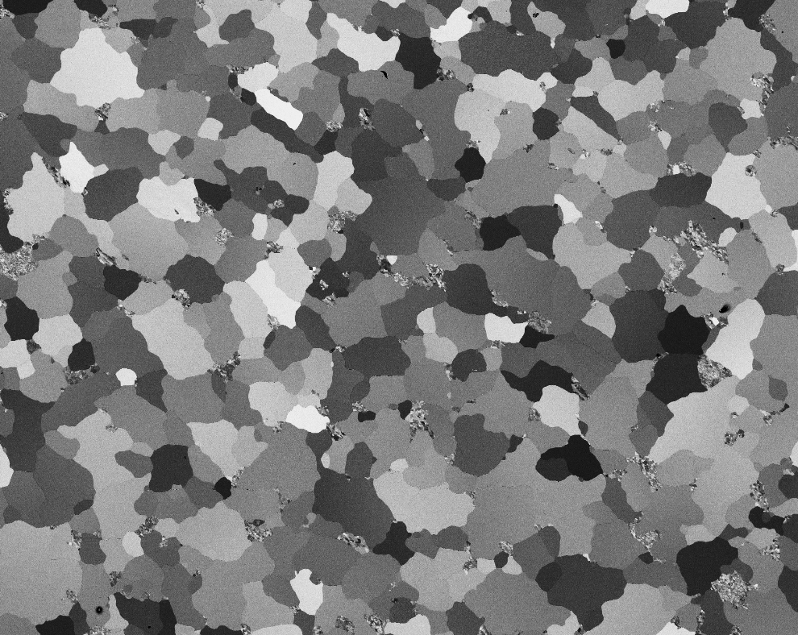
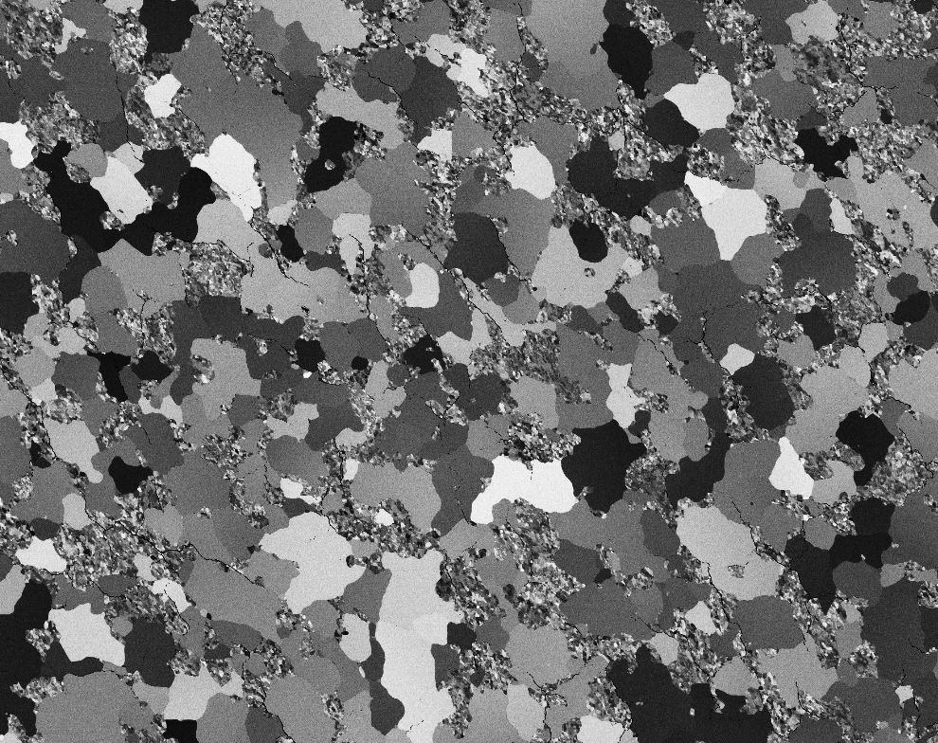
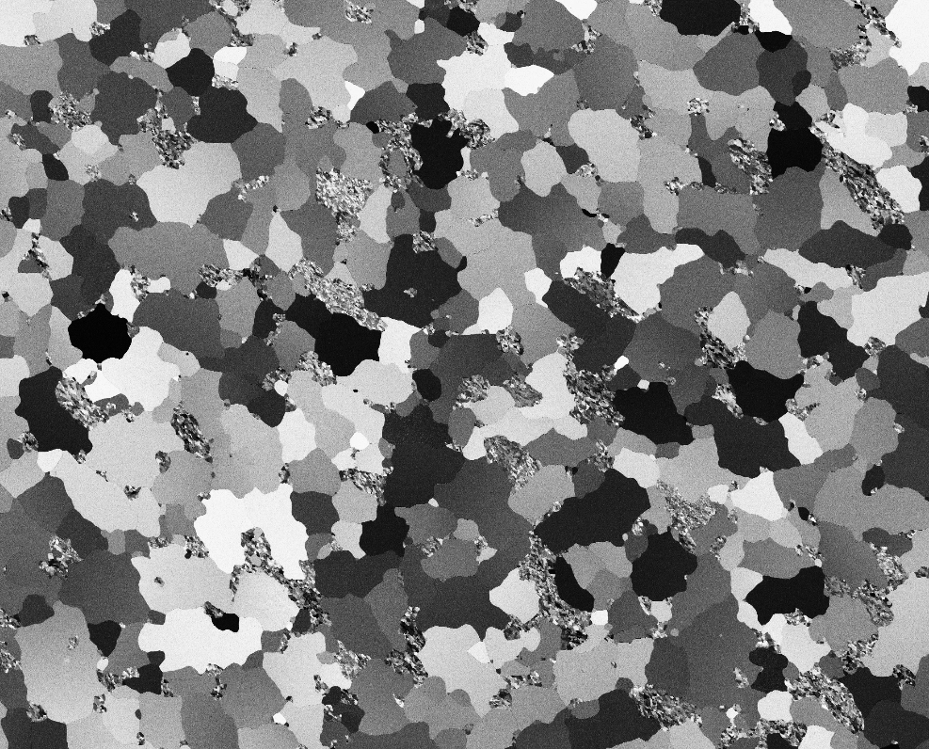
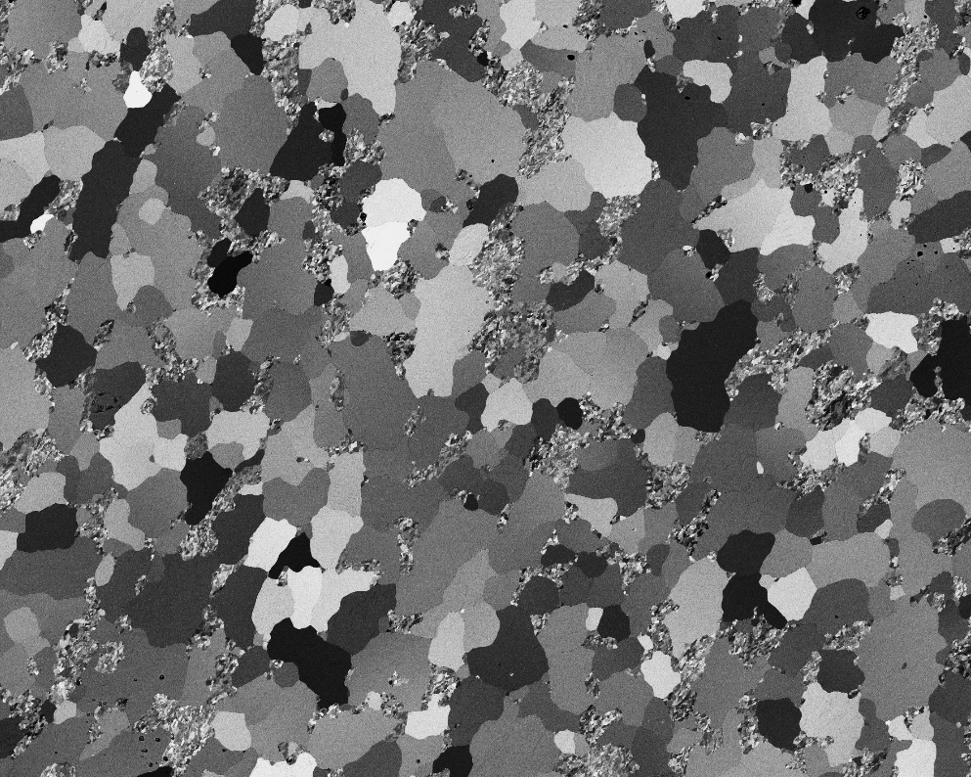
Scanning electron microscopy
un-exp
He
SEM images taken form the surface of samples after PSI-2 plasma exposure and subsequent annealing at 1500°C.
Samples subjected to plasma before annealing show the presence of small grains
Non-exposed sample – pure large grain structure
200 μm
DHe
DHeN

Slide 5
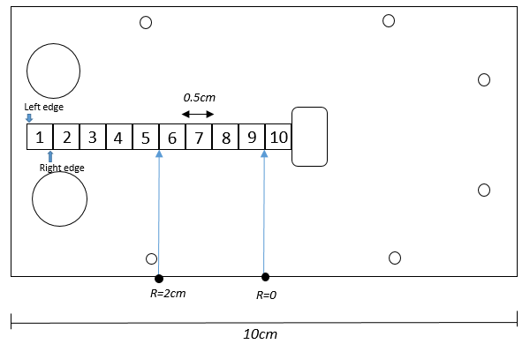
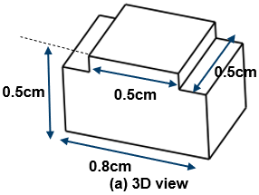
Experimental - II
Pure tungsten from Plansee.
Grain elongation transversal to the surface.
Samples were exposed in PSI-2
Composition | Bias | Flux max [10²¹ i/m²s] | Time [h] | T [°C]
100D | 240 V | 8 | 1 | 1340 – 1390
100D | 240 V | 7 | 2 | 1310 – 1370
100D | 240 V | 7.1 | 5 | 1310 – 1370
PSI-2 plasma profile
as an ion flux fraction
Samples were heated by the plasma only. No active cooling on the back side of the samples.
Temperature was measured individually for each sample by a double color pyrometer.
Scheme of sample used for PSI-2 exposure

Slide 6
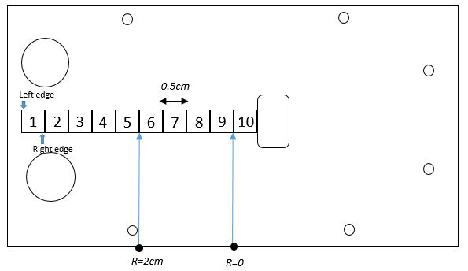
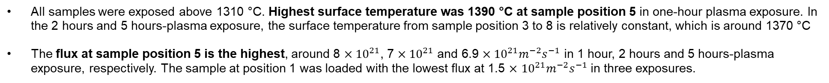
PSI-2 plasma exposure
Surface temperature on each tungsten sample Plasma flux in the middle of each sample
All samples were exposed above 1310 °C. Highest surface temperature was 1390 °C at sample position 5 in one-hour plasma exposure. In the 2 hours and 5 hours-plasma exposure, the surface temperature from sample position 3 to 8 is relatively constant, which is around 1370 °C
The flux at sample position 5 is the highest, around 8 $×{10}^{21}$, 7 $×{10}^{21}$ and 6.9 $×{10}^{21}m^{−2}s^{−1}$ in 1 hour, 2 hours and 5 hours-plasma exposure, respectively. The sample at position 1 was loaded with the lowest flux at 1.5 $×$ ${10}^{21}m^{−2}s^{−1}$in three exposures.

Slide 7
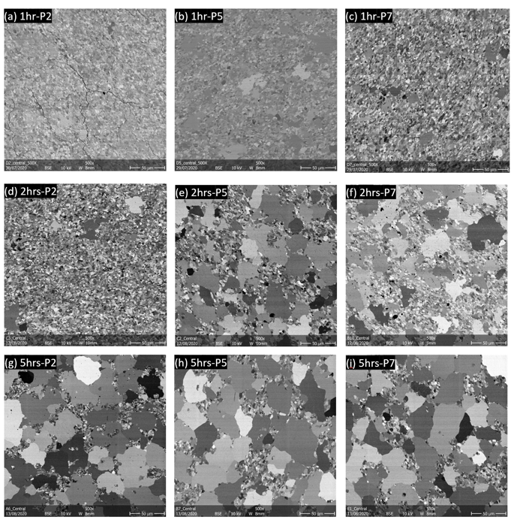
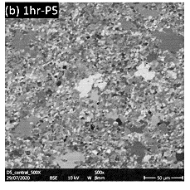
Surface morphology
No hydrogen-induced bubbles or blisters were found
Large grains start to appear at a surface temperature peak position.
The longer the sample is exposed to deuterium, the more abundant large particles on the surface can be observed.
After 5h exposure large grains observer on the surface of all samples
SEM BSE images of tungsten surface after deuterium plasma exposure.

Slide 8
Hardness HV0.1
deterioration of hardness after annealing at 1400 ºC
large error bar due to complex microstructure
Hardness of 1h D plasma exposed sample fits with the hardness of un-exposed tungsten.
HV0.1 Vickers hardness of samples after low temperature plasma exposure and subsequent annealing

Slide 9
Activation energy
The calculated activation energy is 𝐸Δ𝐻𝑉/2 = 480 KJ/mol.
Literature comparison
Activation energy of volume self-diffusion E_{SD.vol} = 568 kJ/mol for polycrystalline tungsten in the temperature range 1287 °C to 1453 °C [1]
Activation energy of grain boundary diffusion in tungsten 377–460 kJ/mol [1]
For the tungsten plate warm-rolled to a large plastic strain:
by 90% thickness reduction, the activation energy 352 kJ/mol [2]
by 67% thickness reduction, the activation energy 579 kJ/mol [3]
Arrhenius plot of the times to half of the total hardness loss of pure tungsten in dependence on temperature during deuterium plasma exposure.
For the double forged Plansee tungsten exposed to high flux D plasma at Magnum_PSI: 425 to 440 kJ/mol [4]
[1] E. Lassner, W.-D. Schubert, Tungsten (1999)
[2] A.Alfonso JNM 455 (2014)
[3] A.Alfonso Fusion Eng. Des. 98-99 (2015)
[4] V.Shah JNM 545 (2021)

Slide 10
Conclusions
Samples with transversal grain oriented exposed to various plasma composition and annealed in vacuum at temperature 1100 to 1600 ºC.
Small difference in recrystallized grains fraction after annealing between exposed and non-exposed samples was reported.
Small difference in hardness was observed. Higher hardness values were recorded for plasma exposed samples.
Effect of plasma exposure on tungsten recrystallization, at every plasma composition, noticeable.
No visible effect of D or N addition visible – major influence is coming form He presence.
Samples with transversal grain oriented exposed to D plasma at elevated temperature
1310 – 1390 ºC for 1, 2 and 5h.
Major factor responsible for recovery and recrystallization is temperature.
Influence of D loading at elevated temperature on W recrystallization is negligible
Calculated activation energy is with good agreement with literature studies and confirms grain boundary diffusion mechanism.
Further experiments will be focused on different plasma compositions – influence of He and other seeded impurities will be studied.

