Slide 1
WPPWIE-SP.A.T-T001: High Particle Fluence Exposures of Plasma-Facing Components for ITER
Martin Balden, IPP

Slide 2
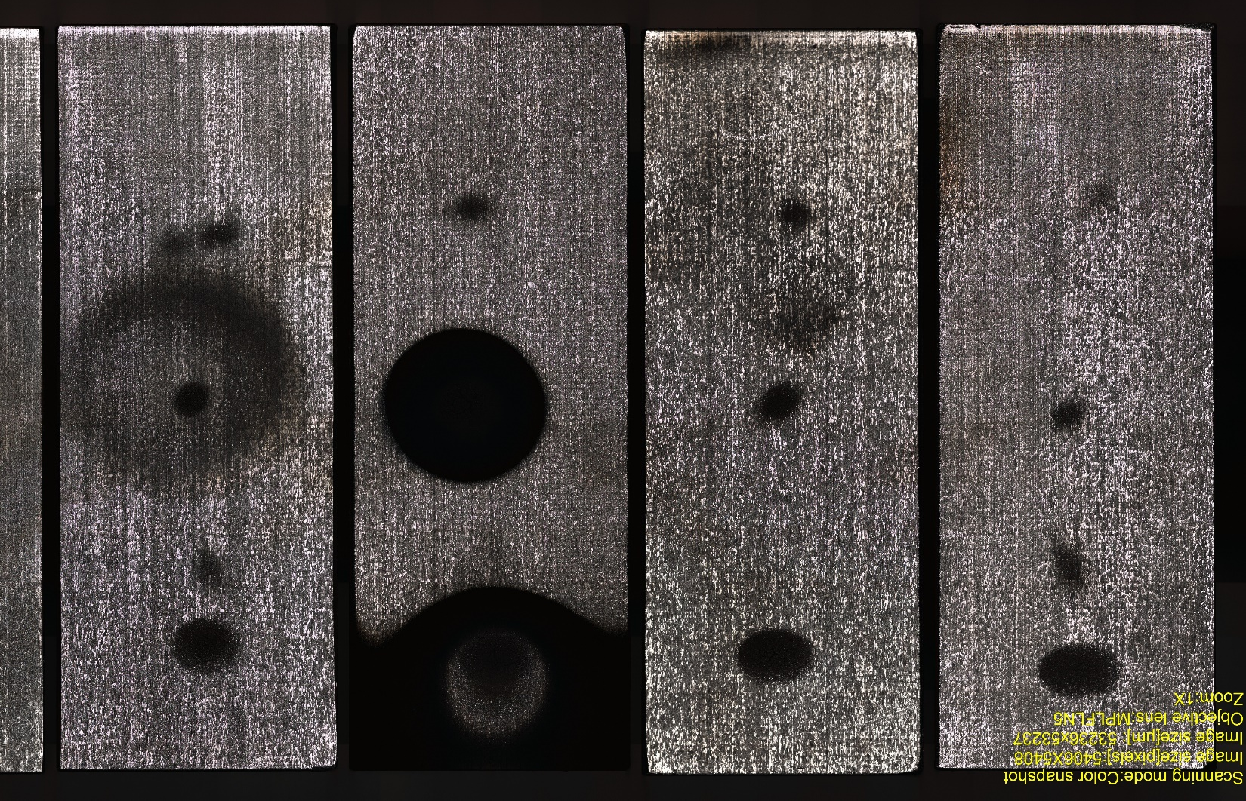
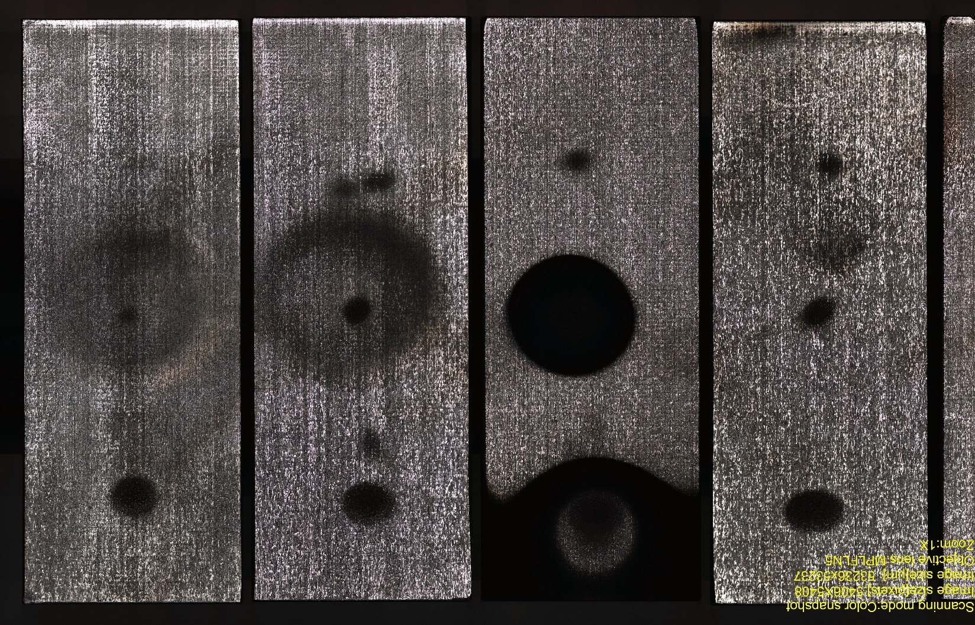
SP-A.2: High Particle Fluence Exposures of Plasma-Facing Components for ITER
Task description: “This Task is envisioned to utilize existing high fluence devices such as MAGNUM-PSI … to allow extrapolation of data from existing materials studies towards the effect of high flux and fluence on materials and components. Particular this includes W PFUs for ITER and their use in WEST, but also studies related to pre-damage (e.g. self-damage, cracking etc.) materials for exposure. The task includes pre- and post-analysis in collaboration with SP B. …”
Task to be performed: D002: Pre- and post-analysis of materials and components (MPG, M. Balden, 2 PM)
Work done until September 2021:
Evaluating data gained under WPPFC-SP5 (Pre- and post-analysis of W monoblock chain after high-flux high-fluence high cycle number transient loading)
Provide data for implementation and assist in/for publications*
Waiting for samples for pre-analysis
Round 4: impurities, 1500°C Dec. 2020
m08
m16
m24
T5-MB74 T4-MB68 T3-MB61 T2-MB53 T1-MB50
* T.W. Morgan, Y. Li, M. Balden, S. Brezinsek, G. De Temmerman, Combined high fluence and high cycle number transient loading of ITER-like monoblocks in Magnum-PSI, Nuclear Fusion accepted (2021)
T.W. Morgan, Y. Li, M. Balden, S. Brezinsek, G. De Temmerman, Combined high fluence and high cycle number transient loading of ITER-like monoblocks in Magnum-PSI, presented at 24th International Conference on Plasma Surface Interactions in Controlled Fusion Devices (PSI 2021) (WO16-I)
T.W. Morgan, M. Balden, T. Schwarz-Selinger, Y. Li, T. Loewenhoff, M. Wirtz, S. Brezinsek, G. De Temmerman, Accelerated Lifetime Tests of ITER-Like Tungsten Monoblocks in Magnum-PSI, presented at 28th IAEA Fusion energy Conference (FEC2020) (Tech/3-1)

