Slide 1
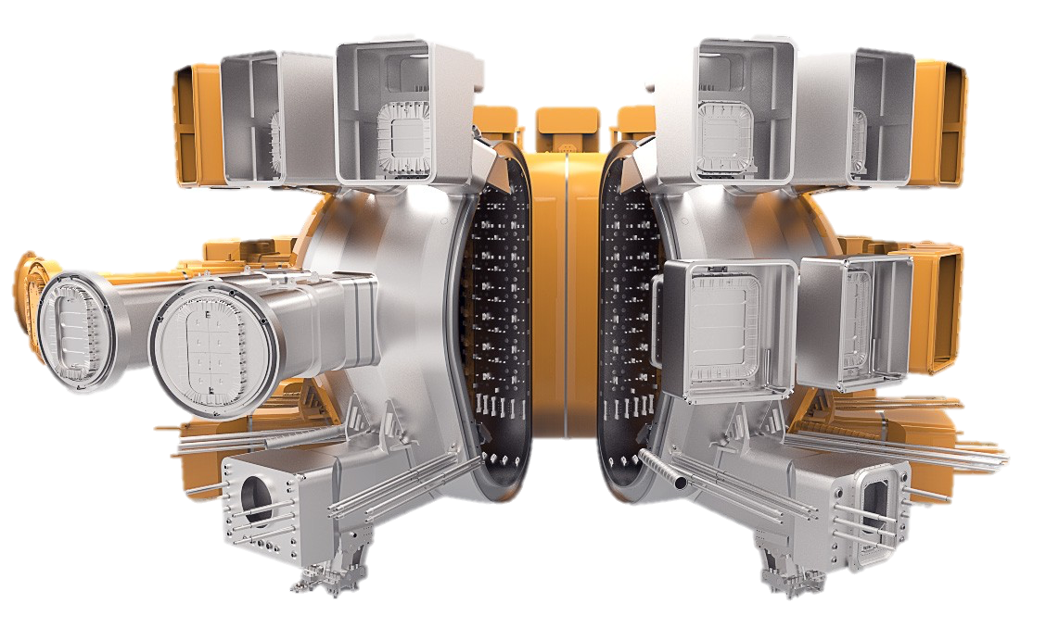
SPA – PEP
2021 Jan.W.coenen & Contributors

Slide 2
Newest version
https://idm.euro-fusion.org/?uid=2PJH6H
Updates will take place also in planning for 2022

Slide 3
SPA – Comments for 2022

Slide 4
SP A1
Continuation of activities
Evaluation of OLMAT / CIEMAT and adaption for 2022
SP A2
Continuation of activities
Choose new Materials / Mockups
PRD/MAT/DIV
SP A3
Continuation of activities
New Material Types / Samples
Synergistic Loads on SMART-W
SP A4
Continuation of Activities
Likely removal to TOKES activities due to EEG
Further extension of Rcrystallisation activities DTU.CEA.FZJ

Slide 5
For 2022
Titles
SP A1
Synergistic Load Studies of Plasma-Facing Materials for ITER & DEMO
SP A2
High Particle Fluence Exposures of Plasma-Facing Components for ITER
SP A3
Advanced Materials under thermo-mechanical and plasma loads
SP A4
High Temperature performance of Armour Materials: Recrystallization and Melting

Slide 6
For 2022
Deliverables
D-SPA1 Provide the data, and experimental validation needed for utilisation of current baseline materials in ITER,W7-X and JT60-SA by means of Synergistic exposures in HHF and Linear Plasma Devices. Power load capabilities and damage thresholds.
D-SPA2 Provide the necessary experiments to allow extrapolation of data from existing materials studies towards the effect of high flux and fluence on materials and components.
D-SPA3 Develop qualification methods for advanced materials for ITER & beyond by different thermomechanical test procedures, heat load treatment techniques, and laboratory experiments as well as linear plasma devices.
D-SPA3 Develop tools to assess damage of components under conditions close or above melting temperature as provide understanding of recrystallisation processes of components at high temperature

