Slide 1
TSVV3 – Regular advancement meeting 22/09/2021 – Task 1 Project news
P. Tamain

Slide 2
Format of regular meetings
Meeting held every other week on Wednesdays @ 2pm, but exceptions possible
Meeting info (agenda, link…) can be found on official agenda of project on indico: https://indico.euro-fusion.org/category/276/manage/ (link also available on Wikipage of project)
3 parts:
Project news (P. Tamain)
Round-table review of on-going work, progress and difficulties (all): trial today, if too long, might move to format with flash report from each task RO
Task topical presentations
Please upload presentations there or send them to me

Slide 3
Code progress monitoring
Strong push from Scientific Board towards professionalization of codes development / management
Aims at EUROfusion Standard Software (?)
System of traffic lights to monitor code status / progress on chosen criteria
Please fill for your code by Friday and send back to me
Comment’s on relevance of criteria are also welcome to fuel discussion

Slide 4
Gitlab available on Gateway!
Apparently (very fresh news!), Gitlab available on Gateway
= one of points monitored by traffic lights system
First step: ask for account on Gateway => https://wiki.eufus.eu/doku.php
Will enquire more detailed procedure and circulate it

Slide 5
Reporting for HPC and SB
Received request for reporting of HPC time usage on Marconi in cycle 4 (projects FUA34_EBC and FUAC4_EBC) – e-mail sent today
Please provide me with feedback by Wednesday 29th
Next SB board meeting is scheduled for next Wednesday
Late to ask for systematic reporting, but please provide me with key highlights of your recent activity in the form of a single slide / figure
+ Update on status of path to deliverables: all good, difficulties, foreseeable delays…
before Monday 27th

Slide 6
Latest publications
M Scotto d’Abusco et al : 4th August 2021 | DocumentID : 30357
: Core-edge 2D ﬂuid modeling of full tokamak discharge with varying magnetic equilibrium: from WEST start-up to ramp-down
Journal : Nuclear Fusion, .
Co-authors : G. Giorgiani, J.F. Artaud, H. Buﬀerand , G. Ciraolo , P. Ghendrih, E. Serre, P. Tamain
H Bufferand et al : 28th July 2021 | DocumentID : 30320
: Implementation of multi-component Zhdanov closure in SOLEDGE3X
Journal : Plasma Physics and Controlled Fusion, .
Co-authors : J. Balbin, S. Baschetti, J. Bucalossi, G. Ciraolo, Ph. Ghendrih, R. Mao, N. Rivals, P. Tamain, H. Yang, G. Giorgiani, F. Schwander, M. Scotto d'Abusco, E. Serre, J. Denis, Y. Marandet, M. Raghunathan, P. Innocente, D. Galassi
A. J. Coelho et al : 22nd July 2021 | DocumentID : 30280
: First global simulations of plasma turbulence in a stellarator with an island divertor
Conference : 19th European Fusion Theory Conference, Virtual, 11th October 2021.
Co-authors : J. Loizu, P. Ricci
A Coroado et al : 18th June 2021 | DocumentID : 30041
: A self-consistent multi-component model of plasma turbulence and kinetic neutral dynamics for the simulation of the tokamak boundary
Journal : Nuclear Fusion, .
Co-authors : P.Ricci
M. Giacomin et al : 1st June 2021 | DocumentID : 29830
: The GBS code for the self-consistent simulation of plasma turbulence and kinetic neutral dynamics in the tokamak boundary
Journal : Computer Physics Communications, .
Co-authors : P.Ricci, A.Coroado, G.Fourestey, D.Galassi, E.Lanti, D.Mancini, N.Richard, N.Varini
W Dekeyser et al : 29th April 2021 | DocumentID : 29620
: A self-consistent mean-field model for anomalous transport due to electrostatic ExB drift turbulence in the scrape-off layer and implementation in SOLPS-ITER
Conference : The 18th International Workshop on Plasma Edge Theory in Fusion Devices (PET21), Lausanne, Switzerland, 13th September 2021.
Co-authors : R. Coosemans, S. Carli, M. Baelmans
R. Coosemans et al : 27th April 2021 | DocumentID : 29611
: A self-consistent mean-field model for turbulent particle and heat transport in 2D interchange-dominated ExB turbulence in the scrape-off layer
Conference : The 18th International Workshop on Plasma Edge Theory in Fusion Devices (PET21), Lausanne, Switzerland, 13th September 2021.
Co-authors : W. Dekeyser, M. Baelmans

Slide 7
Reminder on publication rules
Pinboard validation:
TSVV/ACH-internal papers can be endorsed by the respective PI alone
Papers with WP involvement should have the respective PL as secondary endorser
TSVV papers are to be brought to the attention of the respective Thrust Facilitator
Acknowledgements:
Use standard EUROfusion acknowledgment sentence: “This work has been carried out within the framework of the EUROfusion Consortium and has received funding from the Euratom research and training programme 2014-2018 and 2019-2020 under grant agreement No 633053. The views and opinions expressed herein do not necessarily reflect those of the European Commission.”
HPC acknowledgment if related anyhow: “This work was granted access to the HPC resources of the EUROfusion High Performance Computer (Marconi-Fusion) under the project TSVV3.”

Slide 8
Upcoming deliverables
Reference | Title | What exactly? | Who? | Due date
D3.1 | Implementation and generalization of RANS transport models and related BCs in edge codes | a) One-equation k model in EBC/SOLEDGE3X | KUL, CEA | déc-21
 |  | b) Basic two-equation k-ε/ζ models in SOLEDGE3X/SOLPS-ITER |  | déc-21
D4.1 | Report on performance evaluation and gain in each supported code | Flash report on performance evaluation and gains | Codes’ ROs with ACH | déc-21
D5.1 | Implement fluid neutrals models derived in TSVV5 in existing turbulence codes (SOLEDGE3X, EBC, FELTOR) | Turbulence codes with fluid neutrals model embedded | CEA, KUL, DTU | déc-21
D9.1 | Create publicly accessible git repositories for all contributing codes and setup continuous integration environment | Git repositories wit CI environment for each partner code | All partners | déc-21

Slide 9
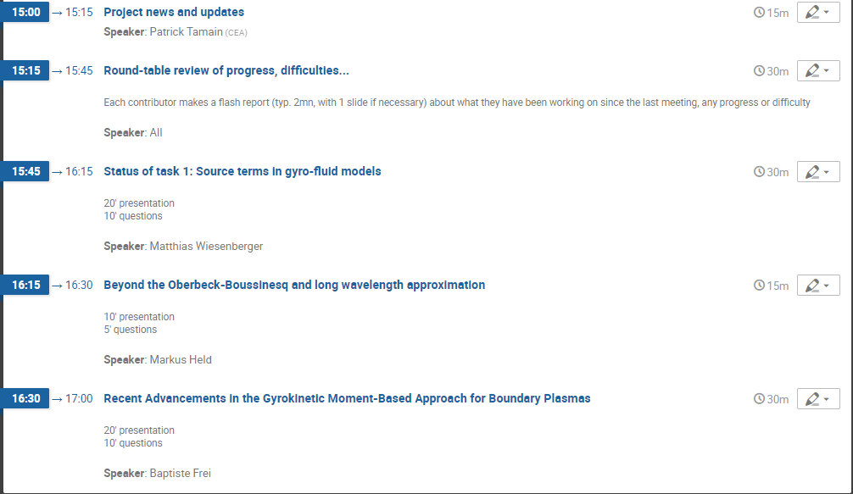
Today’s meeting agenda
Swap?

