Slide 1
Source terms in gyro-fluid models
TSVV3 status meeting, M. Wiesenberger, 22.9.21

Slide 2
Overview
Density sources generate vorticity/angular momentum and ExB energy
drift-fluid models need to be corrected: source must be included in drift-reduction
Physical explanation of gyro-fluid source term: part of momentum goes into gyration and external magnetic field, not into gyro-centre motion

Slide 3
The kinetic source function
s(x,v,t) stands for ionization, recombination, charge-exchange, collisions, ...
the kinetic moments for plasma-neutral interactions have already been worked out [1,2]
PLAN: derive the gyro-kinetic/ -fluid model in terms of these moments ☺
[1] Meier E.T. and Shumlak U., Phys. Plasmas 19, 072508 (2012); https://doi.org/10.1063/1.4736975 [2] A. S. Thrysøe, et al. Phys. Plasmas 25, 032307 (2018); https://doi.org/10.1063/1.5019662

Slide 4
Gyro-kinetics = coordinate transformation
„ A coodinate transformation along the streamlines of a vector field in phase space“
All objects on phase space are transformed including sources e.g. in LWL:
Gyro-centre density
Gyro-centre source
gyro-centres and particles are generated at different posisitons

Slide 5
Derive quasineutrality in time in long wavelength:
Assume: the sources are quasineutral too, no net charge is generated
Polarization source

Slide 6
Density and pressure sources generate vorticity…
R. Gerru, M. Wiesenberger, A. H. Nielsen, V. Naulin, J. Juul Rasmussen and M. Held, To be published Nucl. Fusion (2021)
Gyro-fluid vorticity equation
( Density, pressure and parallel momentum equations look like expected)

Slide 7
… or angular momentum
Under flux surface average
… or kinetic energy !
Wiesenberger M. and Held M. Nucl. Fusion 60 (2020) 096018 (26pp)
https://doi.org/10.1088/1741-4326/ab9fa8

Slide 8
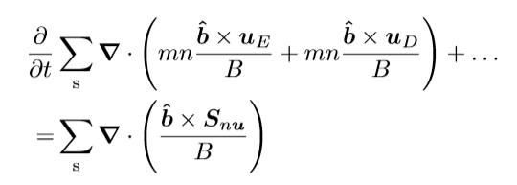
Which one is correct?
Gyro-fluid
Drift-fluid
Simakov A. N. and Catto P.J., Physics of Plasmas 10, 4744 (2003); https://doi.org/10.1063/1.1623492
Drift-kinetic?
Hypothesis: Drift-expansion must also expand source terms

Slide 9
Without E-field no net momentum is transfered into the plasma by ionization!
IONIZATION
BEFORE: neutrals
AFTER: ions
B
B
mNV_n
mN<V> = 0
Drift-fluid predicts wrong momentum gain by plasma

Slide 10
With E-Field the net momentum gain via ionization is always V_ExB irrespective of the momentum of the neutral fluid
IONIZATION
BEFORE: neutrals
AFTER: ions
E
E
B
B
mNV = 0
mNV = mNV_ExB
(external) Magnetic field is the only provider of momentum

Slide 11
Summary
Density sources generate vorticity/angular momentum and ExB energy
drift-fluid models need to be corrected: source must be included in drift-reduction
Physical explanation of gyro-fluid source term: part of momentum goes into gyration and external magnetic field, not into gyro-centre motion

