Slide 1


+
2021 Monitoring Meeting EUROfusion ENR Project (ENR-TEC.01.KIT)
“New Generation of Megawatt-Class Fusion Gyrotron Systems Based on Highly Efficient Operation at the Second Harmonic of the Cyclotron Frequency”
Stefan Illy on behalf of the ENR Project Team

Slide 2
Outline
Introduction
Main Objective and Approach
T1.1.1: Initial Studies on MW-class 2nd Harmonic Operation
T1.1.2: Research on Coupling System for Injection Locking
T1.2.1: Mode Converting Outer Corrugations
Conclusion and Outlook

Slide 3
Introduction

Slide 4
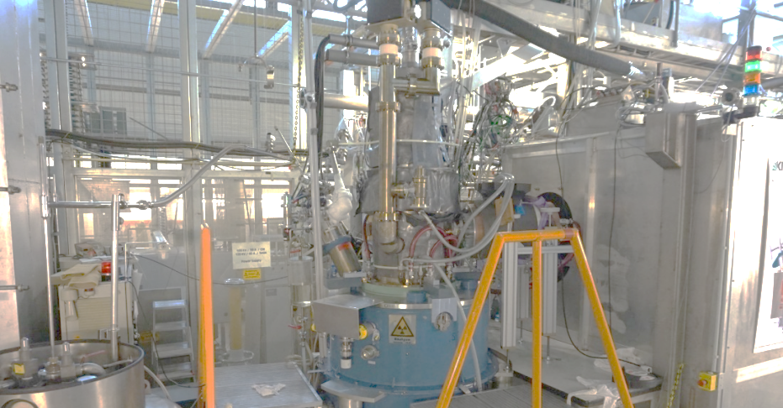
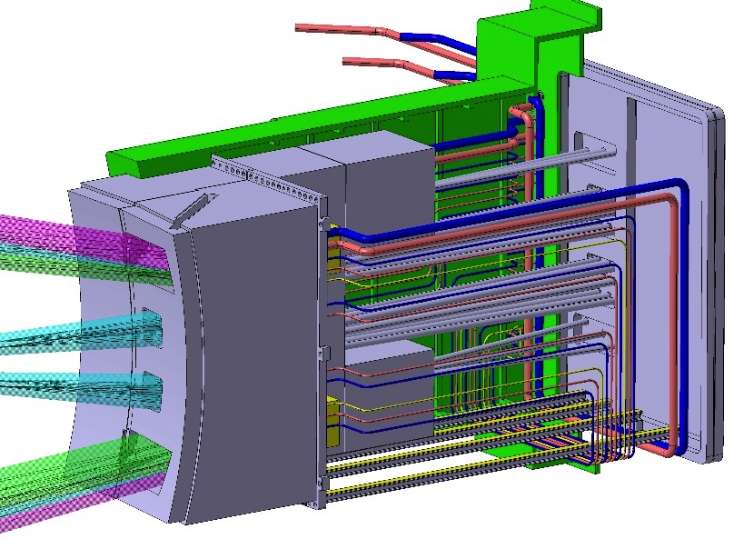
Key Components of the DEMO EC System
Gyrotron
EC equatorial launcher
4
Quasi-optical transmission line
Plasma

Slide 5
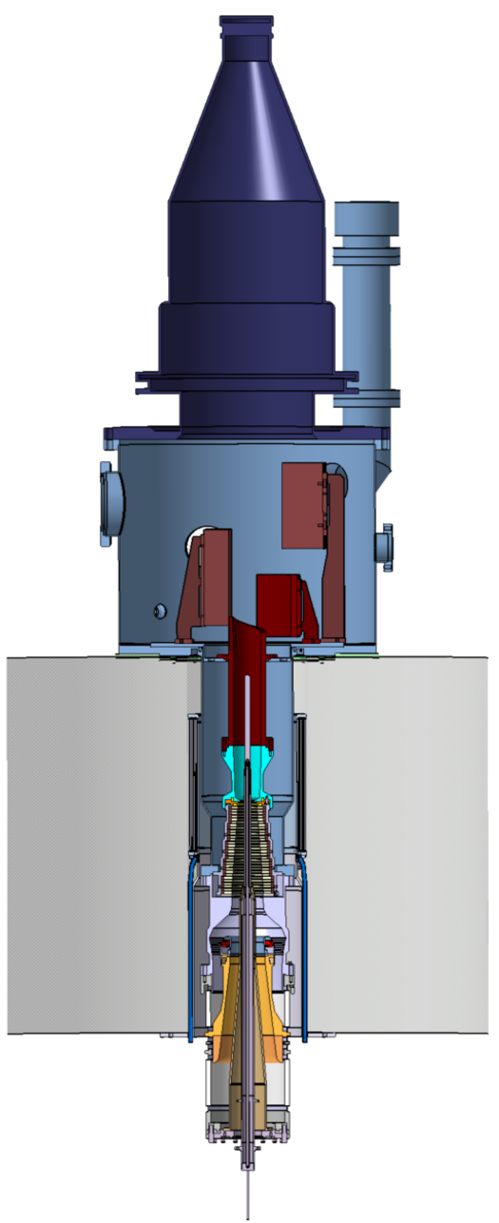
Key Components of the DEMO EC System
Gyrotron
Collector
Gaussian beam output at CVD diamond window
Height ~3 m, weight ~1 ton
EC equatorial launcher
Super Conducting Magnet
~6 T @140 GHz
~7 T @170 GHz
~8 T @200 GHz
~10 T @240 GHz
f [GHz] ~ s·28/γ·B [T]
Coaxial cavity
5
Cathode/Emitter (MIG)
Quasi-optical transmission line
Plasma

Slide 6
Key Components of the DEMO EC System
Gyrotron
Collector
Gaussian beam output at CVD diamond window
Height ~3 m, weight ~1 ton
EC equatorial launcher
Super Conducting Magnet
~6 T @140 GHz
~7 T @170 GHz
~8 T @200 GHz
~10 T @240 GHz
f [GHz] ~ s·28/γ·B [T]
Coaxial cavity
6
Cathode/Emitter (MIG)
Quasi-optical transmission line
Plasma
The required magnetic field becomes an issue for operation at > 200 GHz
→ Gyrotrons operating at 2nd Harmonic (s=2) might be the solution!

Slide 7
Main Objective and Approach
We aim for a completely new generation of highly efficient, megawatt-class fusion gyrotrons that will operate at the 2nd harmonic (s = 2) of the electron cyclotron frequency.
Three enabling technologies will be addressed:
  The coaxial-type cavity technology that is specifically adapted to the operation at
  2nd harmonics in combination with advanced inner and outer corrugations.
  The Multi-stage Depressed Collector (MDC) technology based on E×B drift concept.
  Injection locking using an external driving source.

Slide 8
T1.1.1: Initial Studies on Megawatt-class 2nd Harmonic
Operation

Slide 9
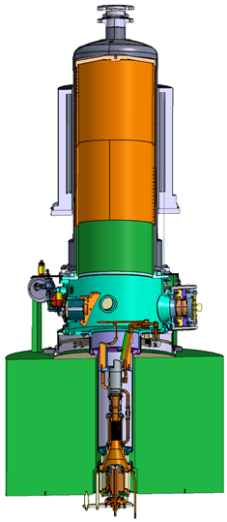
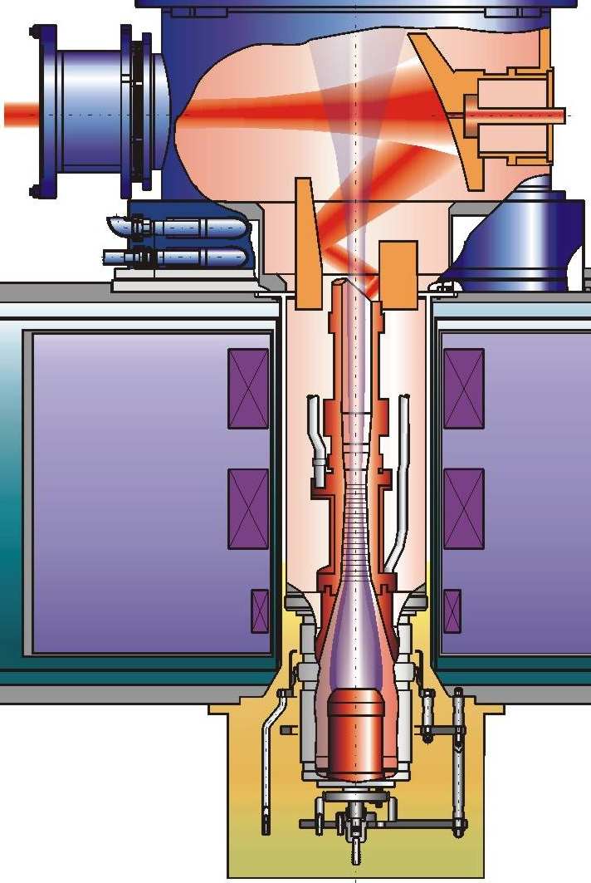
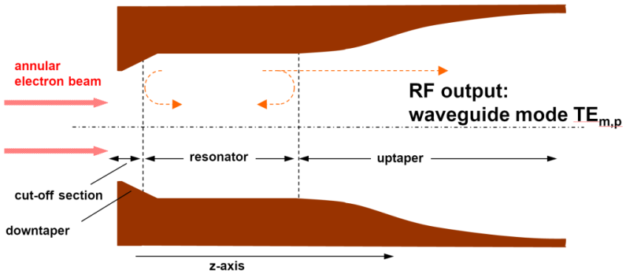
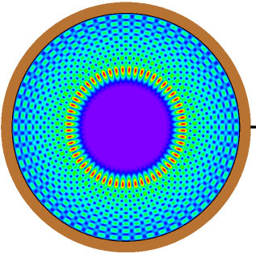
Basics: The Classic Hollow-Type Gyrotron
140 GHz
1 MW CW
for
W7-X
helical
electron beam
TE_{28,8}-mode
Hollow-type cavity

Slide 10
Fundamental Challenge
Typical mode spectrum at 140 GHz
Very dense mode spectrum even for 140 GHz TE_{28,8}-mode gyrotron
Advance to coaxial-cavity design
Introduce inner-/outer corrugations
Move to injection locking

Slide 11
Towards Coaxial Cavity Gyrotron
W7-X /
ITER
DEMO
→ Improved mode selectivity
→ Larger output power at even
higher frequencies
TE_{28,8}–mode hollow cavity
TE_{34,19}–mode coaxial cavity

Slide 12
Towards Coaxial Cavity Gyrotron
DEMO
W7-X /
ITER
→ Improved mode selectivity
→ Larger output power at even
higher frequencies
TE_{28,8}–mode hollow cavity

Slide 13

Kick-Start the Simulation of 2nd Harmonic Operation
Take the cavity design and operating point of the 170/204 GHz dual-frequency 2 MW coaxial gyrotron under preparation at KIT.
Increase of the midsection length of the cavity by 5.6 mm, allow for
2nd harmonic operation with the very-high order TE_{40,23} mode (χ = 126).
Single-mode simulation result (EURIDICE),
E_{b} = 89.5 keV
I_{b} = 81.2 A 1.3 MW @ 204.1 GHz
B₀ = 4.19 T ρ = 2.2 kW/cm²
R_{b} = 9.53 mm η_{elec} = 19 %
α = 1.26

Slide 14
Considering Mode Competition
No chance for 2nd harmonic
TE_{40,23} excitation without
additional means!
Possible solution:
Injection Locking
e-beam current

Slide 15
Kick-Start the Simulation on Injection Locking
Start from known coaxial-cavity designs and advance to 2nd harmonic operation:
  TE_{34,19}-mode 170 GHz 2 MW DEMO pre-prototype
  TE_{40,23}-mode 170/204 GHz dual frequency design
Simulate the injection locking by assuming an injected signal at the same frequency as the one in free-running operation.

Slide 16
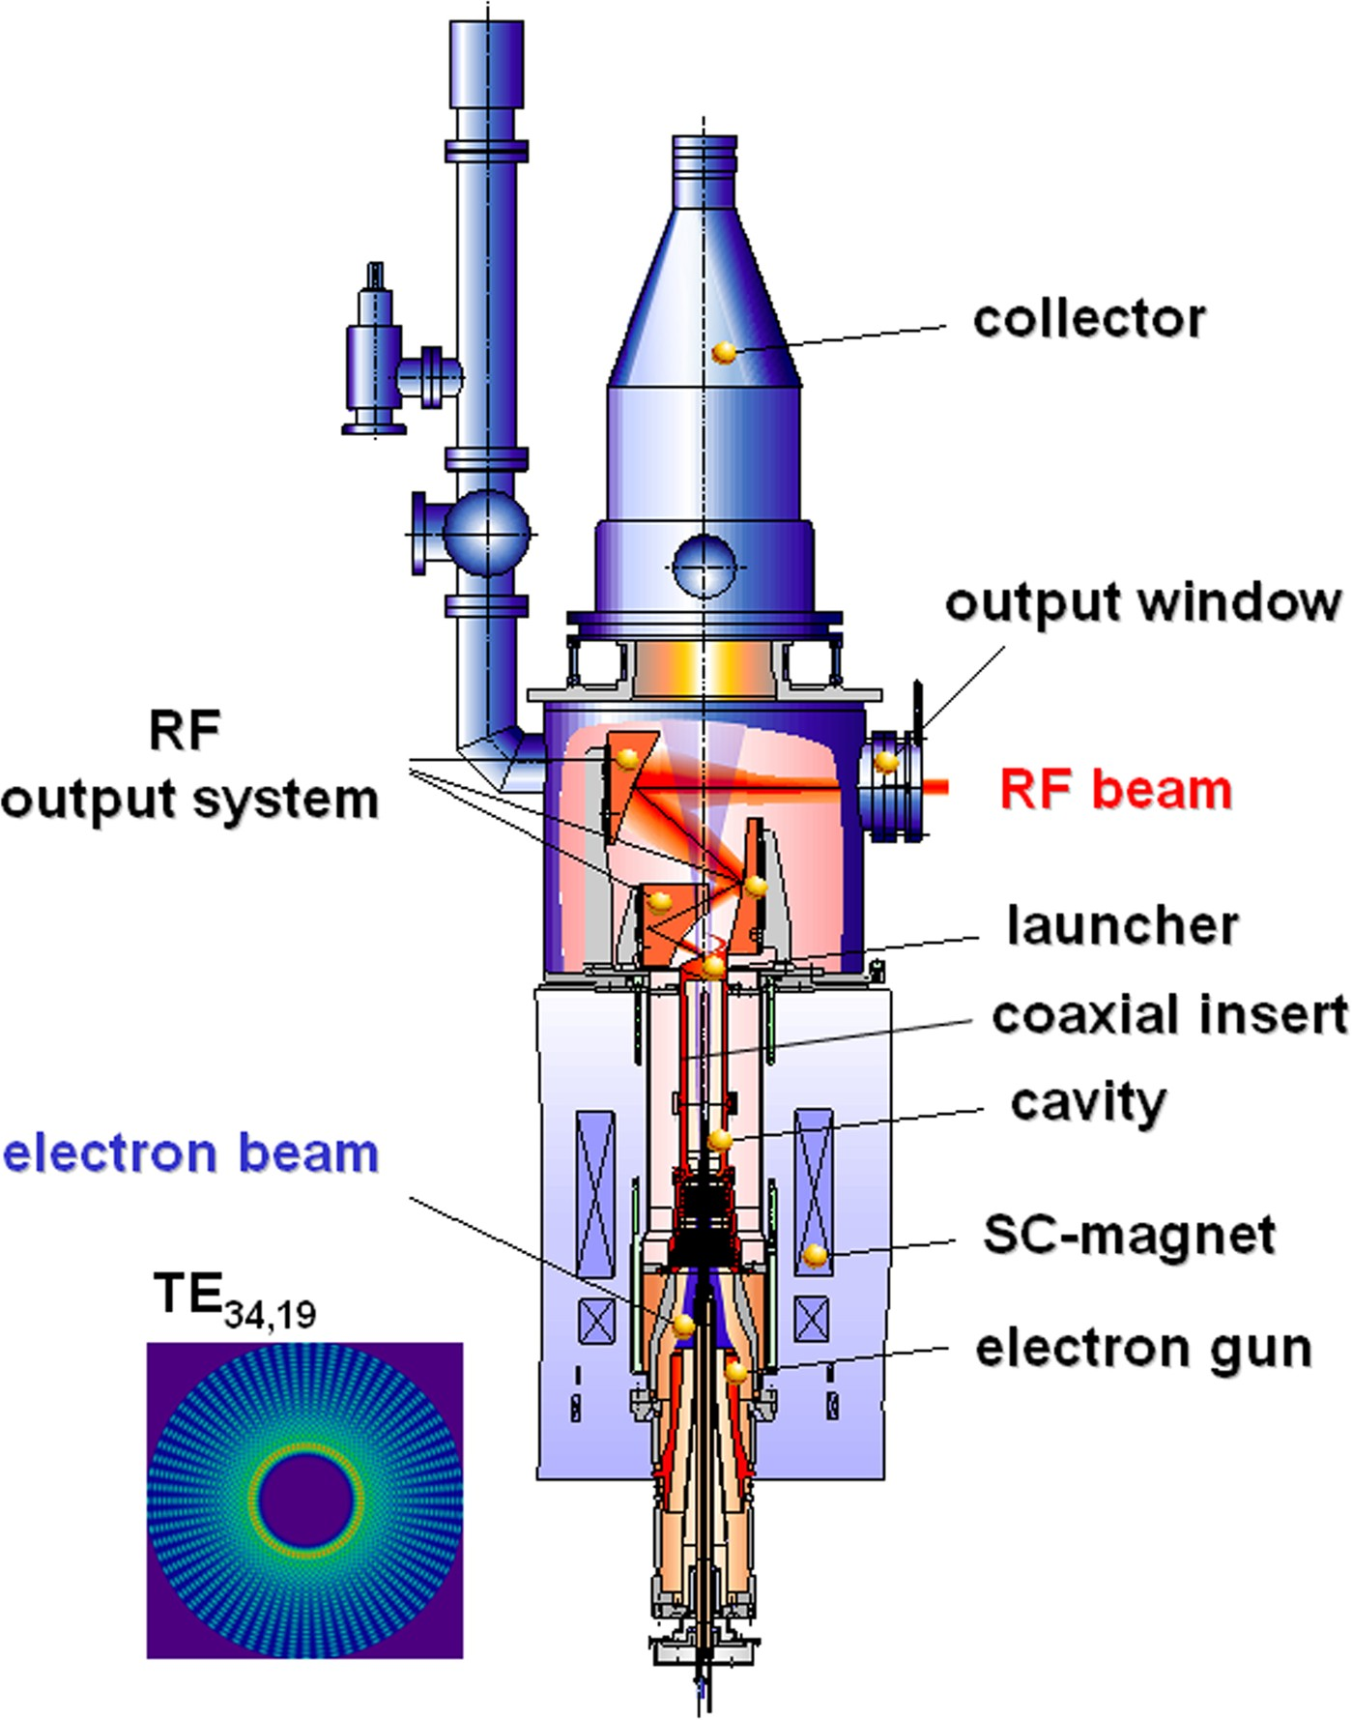
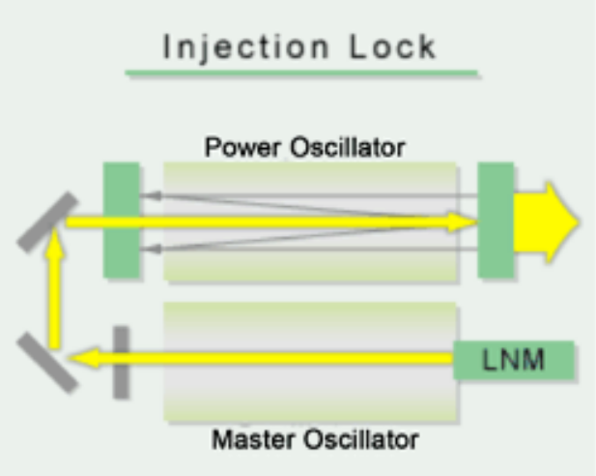
Fundamentals
Injection locked operation of low power gyrotrons studied in 1970’s
Technical issue for MW-class gyrotrons is the injection of the signal
Injection locking is well known for a variety of oscillation systems (e.g. lasers)

Slide 17
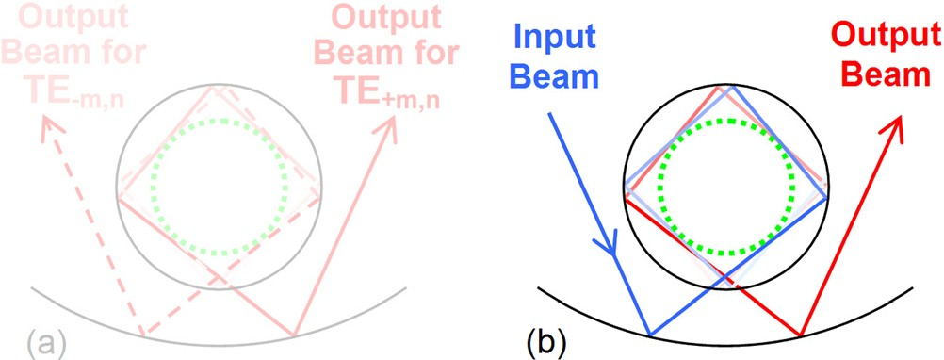
Fundamentals
Injection locked operation of low power gyrotrons studied in 1970’s
Technical issue for MW-class gyrotrons is the injection of the signal
Solved recently by synthesized launcher geometry
Input beam
[3] A. V. Chirkov et al., Perspective gyrotron with mode converter for co- and counter-rotation operating modes, Applied Physics Letters, 2015

Slide 18
Single- and Multi-Mode Simulations for TE_{40,23}-Mode with 18 kW Injected Power (using EURIDICE)
Single-mode simulation
Multi-mode simulation
Solution proposals considered:
Only TE_{+40,23}-mode
Alternative frequency and/or power injection
Outer corrugations (T1.2)
Triode start-up
Injection to directly suppress dangerous competitors

Slide 19
First Findings with Regards to Injection Locking
(for TE_{34,19}-Mode at 170 GHz)
  The stability range can be increased with injection locking and increasing injected power!
    With moderate injected power P_{i}=150 kW:
    +300 kW net output power, 3 kV more stability range
    and 4% higher electronic efficiency (26% → 30%).
    For driving power P_{i} > 150 kW the benefit decreases.
  BUT: The Ohmic loading increases very rapidly with increasing injected power
  (2.2 kW/cm² → 4.1 kW/cm² for P_{i}=150 kW).

Slide 20

To the New Finding of Increased Ohmic Loading by Applying an Injected Power
Reason:
  An injected signal without interaction causes a standing wave (due to superposition of incoming and back-reflected outgoing wave).
The injected signal induces a maximum field that is two times the maximum field at free-running operation (for identical power).
The maximum possible power that can be injected is limited.
$$P_{loss_injected} \text{≃} 4∙P_{loss_free_running}$$

Slide 21
T1.1.2: Research on a Coupling System for Injection Locking

Slide 22
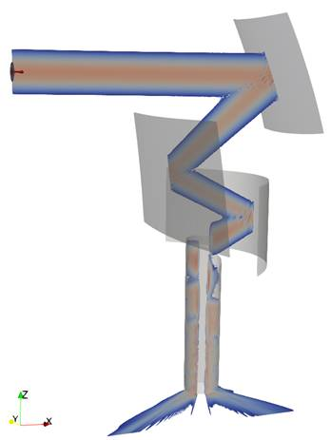
T1.1.2: Research on coupling system
Sub-task: “Improvement of KarLESSS code for the simulation of the quasi-optical (Q.O.) system with ideal Gaussian mode injection from the launcher, forward and backward propagation of the wave beam in the Q.O. system.”
Mirror 3
TEM_{0,0}
Prove-of-principle simulation:
  Coaxial 2 MW gyrotron
  170 GHz
  TE_{34,19}
  Input: TEM_{0,0} (Gaussian beam)
Mirror 2
Mirror 1
Launcher
Field radiated into the cavity

Slide 23
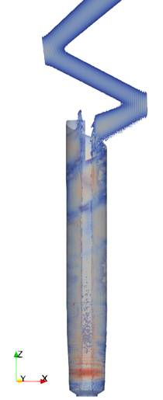
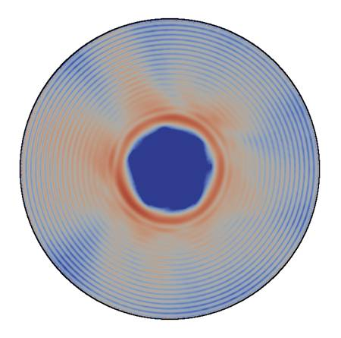
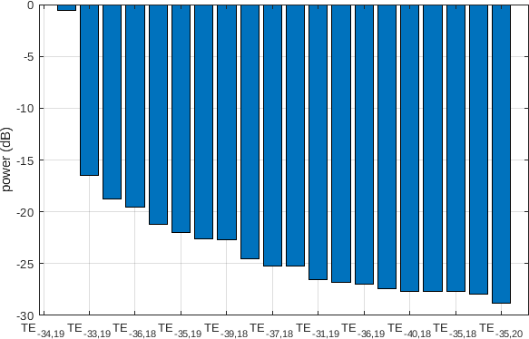
T1.1.2: Research on coupling system
TEM_{0,0}
Mode pattern at the
launcher entrance
Mode content
Launcher
Cavity

Slide 24


T1.1.2: Research on Coupling System
Design of launcher for co-and counter-rotating mode
Based on hybrid-type launcher
sidelobe
Next steps: improve the hybrid-type launcher to depress the sidelobes
Field distribution operating in TE+32,9 mode
On aperture
Field distribution operating in TE-32,9 mode
On aperture

Slide 25
T1.2.1: Mode Converting Outer Corrugations

Slide 26
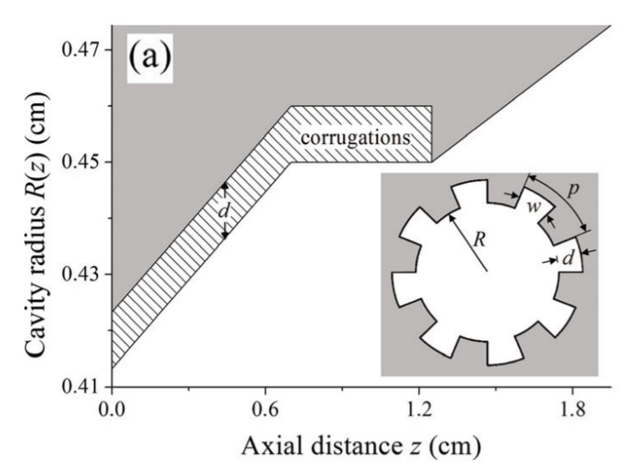
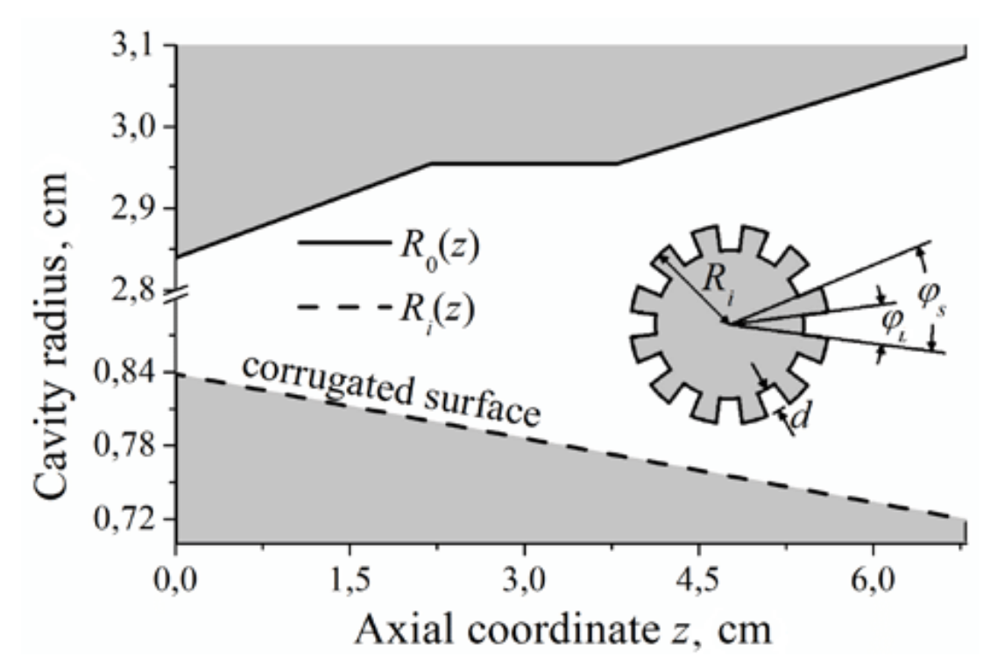
Inner and Outer Corrugations
Inner corrugations (insert)
Outer (wall) corrugations
standard
non-standard
Effect due to impedance corrugation
→ Attenuates unwanted modes
Effect due to mode conversion
→ Converts energy to other modes

Slide 27
Fundamental Design Strategy
By introducing azimuthal corrugations on the outer wall, the modes are coupled with lower order ones and degenerate. The degenerated modes present low quality factor Q and cannot be excited.
The number of the azimuthal corrugations should be properly chosen in order that only the first harmonic, low-order modes, to be coupled and consequently suppressed.
The geometrical properties of the coaxial insert should be appropriately modified taking the technological constraints for the maximum acceptable Ohmic loading of the insert into account.

Slide 28
Basic Assumptions for Kick-Start
Start from the 2 MW 170 GHz coaxial cavity (TE_{34,19} –mode, eigenvalue χ ≈ 105) and assume a magnetostatic field of B ≈ 3.43 T.
Target for suppression of only the first harmonic competitors (χ ≈ 52) leaving the second harmonic ones (including the operating mode) unaffected.

Slide 29
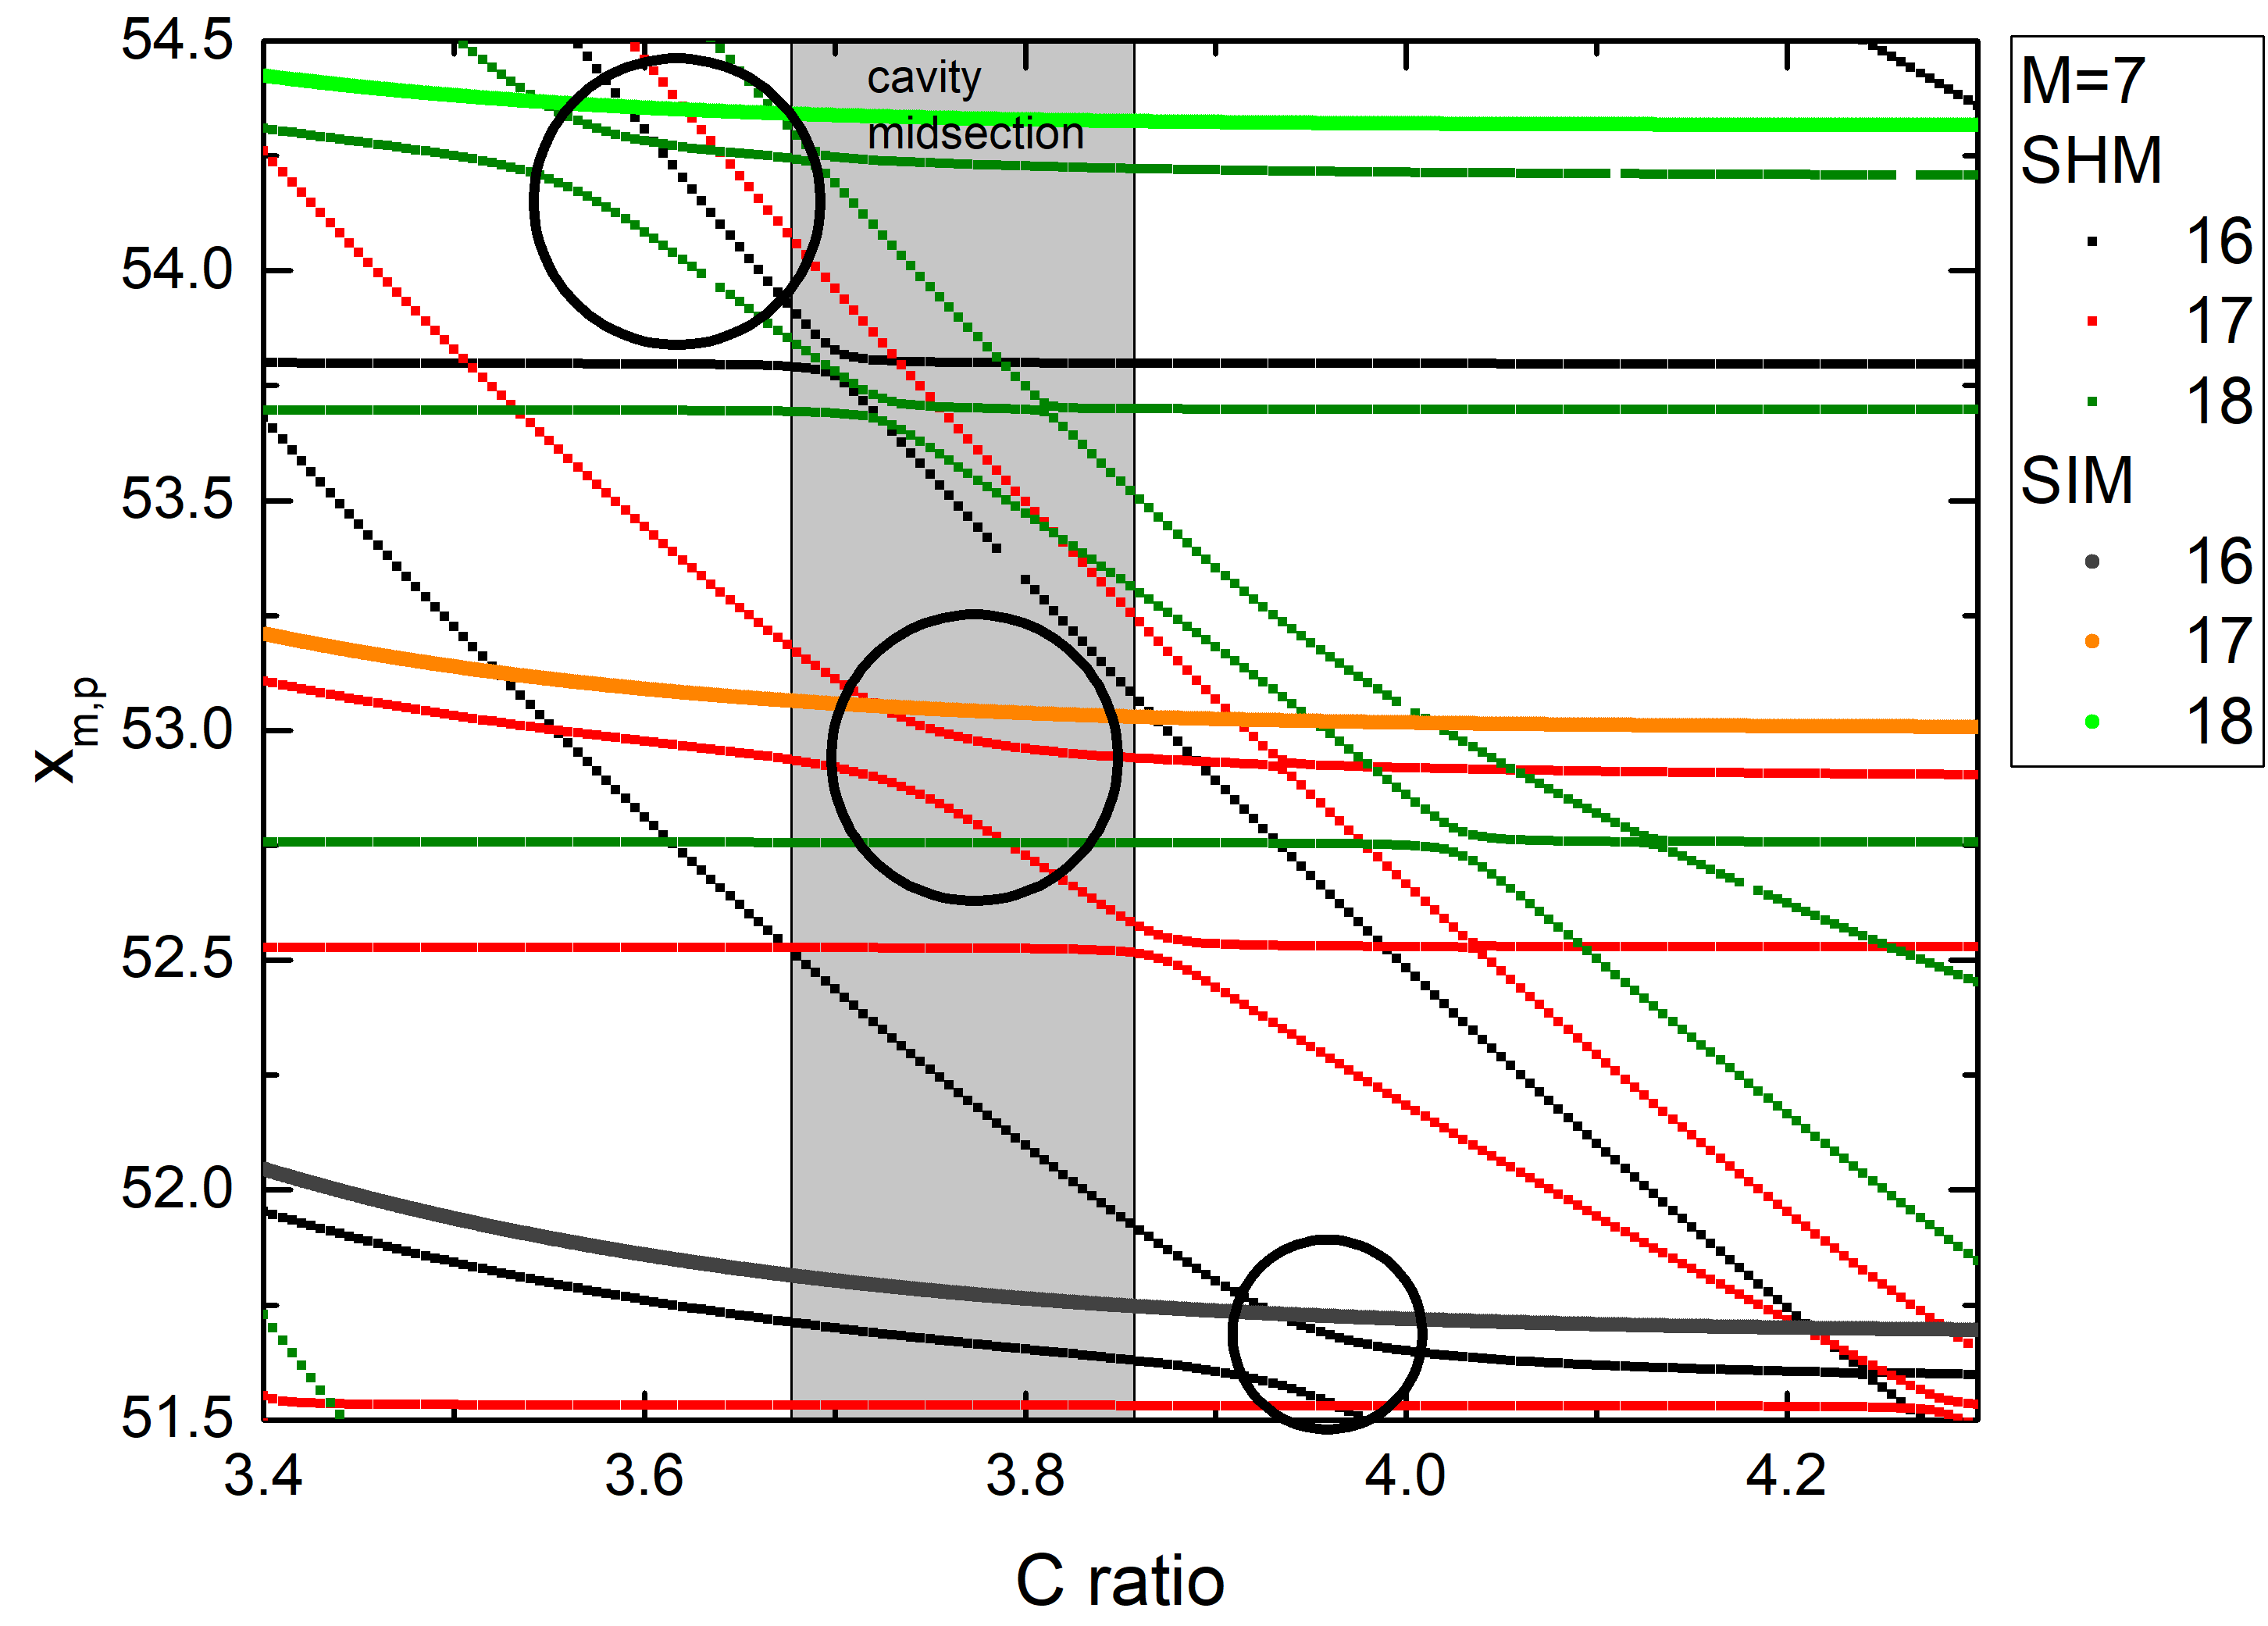
T1.2.1: Mode converting azimuthal corrugations
Eigenvalues versus C ratio of the case with inner corrugations only (SIM) and when M=7 outer corrugations are introduced. The coupling regions are also visible (encircled areas).
Work already performed
Identification of the competing modes of the first and second harmonic.
Investigation of various coupling schemes.
It was found that only the first harmonic competitors should be coupled and the coaxial insert geometrical properties should be appropriately changed.

Slide 30

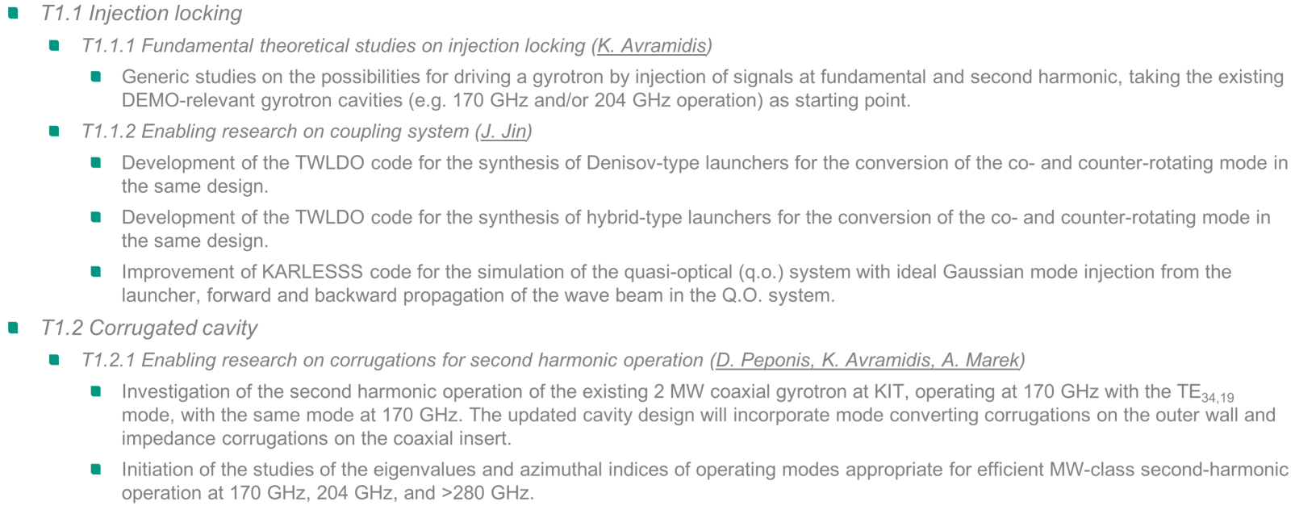
Conclusion and Outlook
Goals and objectives for Q3/Q4 2021 reached (also with new, unexpected findings).
For 2022: Continuation based on the current findings according to task specifications.

Slide 31
Thank you for your attention!

Slide 32
BACKUP SLIDES …

Slide 33
Project Roadmap
The three elements (injection locking, advanced corrugated cavity, MDC)
will be comprehensively studied aiming at the development of the
theoretical background and the required tools.
A high-frequency, high-power and high-efficiency gyrotron operating at second-harmonic will be designed based on the theory and tools developed in the first part.
The possibility to design a gyrotron operating at very high frequency (above 280 GHz) for future Electron Cyclotron Heating (ECH) systems and Collective Thomson Scattering (CTS) diagnostics will be investigated.
Preparation of the first worldwide experiments of a high-power gyrotron operating in second harmonic with the support of injection locking technique. The presence of two operational high-power gyrotron test stands at KIT is an important advantage for that purpose.

Slide 34
ENR-TEC.01.KIT-T001 2021-06-01 – 2021-12-31
Task 1 - Fundamental theoretical research on individual methods
T1.1 Injection locking
  T1.1.1 Fundamental theoretical studies on injection locking (K. Avramidis)
    Generic studies on the possibilities for driving a gyrotron by injection of signals at fundamental and second harmonic, taking the existing DEMO-relevant gyrotron cavities (e.g. 170 GHz and/or 204 GHz operation) as starting point.
  T1.1.2 Enabling research on coupling system (J. Jin)
    Development of the TWLDO code for the synthesis of Denisov-type launchers for the conversion of the co- and counter-rotating mode in the same design.
    Development of the TWLDO code for the synthesis of hybrid-type launchers for the conversion of the co- and counter-rotating mode in the same design.
    Improvement of KARLESSS code for the simulation of the quasi-optical (q.o.) system with ideal Gaussian mode injection from the launcher, forward and backward propagation of the wave beam in the Q.O. system.
T1.2 Corrugated cavity
  T1.2.1 Enabling research on corrugations for second harmonic operation (D. Peponis, K. Avramidis, A. Marek)
    Investigation of the second harmonic operation of the existing 2 MW coaxial gyrotron at KIT, operating at 170 GHz with the TE_{34,19} mode, with the same mode at 170 GHz. The updated cavity design will incorporate mode converting corrugations on the outer wall and impedance corrugations on the coaxial insert.
    Initiation of the studies of the eigenvalues and azimuthal indices of operating modes appropriate for efficient MW-class second-harmonic operation at 170 GHz, 204 GHz, and >280 GHz.

Slide 35
ENR-TEC.01.KIT-T001 2021-06-01 – 2021-12-31
Deliverables
The first-year deliverable will include the results of the tasks performed in 2021, such as the fundamental theoretical studies on injection locking and on advanced corrugated cavities for second harmonic operation.

Slide 36
ENR-TEC.01.KIT-T002 2022
Task 1 - Fundamental theoretical research on individual methods
T1.1 Injection locking
  T1.1.1 Fundamental theoretical studies on injection locking (K. Avramidis)
    Systematic research on the influence of major design parameters, concerning the cavity geometry and the electron beam properties, on the performance of an injection-locked gyrotron at fundamental and second harmonic operation.
    Studies on the influence of mode purity of the external signal on gyrotron operation.
  T1.1.2 Enabling research on coupling system (J. Jin)
    Design a Denisov-type launcher for the co- and counter-rotating mode, investigate the change of the field distribution due to the influence of the perturbation corresponding to the anti-rotating mode.
    Design a hybrid-type launcher for the co- and counter-rotating mode to achieve a higher conversion efficiency in comparison to the Denisov-type launcher as much as possible.
    Investigation of the possibility for mirror-line launchers to be used for the conversion of the co- and counter-rotating mode, the possibility for a mirror-line launcher to provide a higher conversion efficiency in comparison to the Denisov-type and hybrid-type launchers.
    Design of mirror systems, and analysis of the q.o. system.

Slide 37
ENR-TEC.01.KIT-T002 2022
Task 1 - Fundamental theoretical research on individual methods
T1.2 Corrugated cavity
  T1.2.1 Enabling research on corrugations for second harmonic operation
  (D. Peponis, K. Avramidis, A. Marek)
    Investigation of the second harmonic operation of the existing coaxial gyrotron design by KIT, which allows for
    2 MW operation at 204 GHz with the TE_{40,23} mode, with the same mode at 204 GHz. The updated cavity design will incorporate mode converting corrugations on the outer wall and impedance corrugations on the coaxial insert.
    Continuation of the studies of the eigenvalues and azimuthal indices of operating modes appropriate for efficient MW-class second-harmonic operation at 170 GHz, 204 GHz, and >280 GHz.
  T1.2.2 Enabling research on multi-frequency operation (I. Chelis, A. Marek)
    Search for suitable mode pairs/triplets for multi-frequency operation, based on the sets of suitable modes found in T1.2.1.
    Investigation of possible compromises on the design strategies to achieve the best possible performance of the same design in two/three frequencies.

Slide 38
ENR-TEC.01.KIT-T002 2022
Task 1 - Fundamental theoretical research on individual methods
T1.3 Multistage depressed collector (B. Ell, G. Latsas)
  Fundamental research on different MDC design approaches based on E×B concept for gyrotron operation at higher harmonics. Such design approaches are the coaxial and cylindrical helical MDCs, MDC approaches based on the transformation of the annular beam to sheet beam, MDC approach based on helicoid magnetic field, and novel/alternative design approaches.
  The most appropriate design approach will be chosen considering the manufacturing complexity and the operational efficiency. A MDC will be optimized for a typical spent beam of the second-harmonic gyrotron operation.
  Fundamental research on the influence of secondary electrons on MDC operation and comparison with the fundamental harmonic results will be performed.
  The influence of stray magnetic field and misalignments on the MDC operation and comparison with the corresponding results obtained in older WP for the fundamental harmonic will take place.

Slide 39
ENR-TEC.01.KIT-T002 2022
Deliverables
The annual deliverable will include the results of the tasks performed in 2022: the continuation of the fundamental theoretical studies on injection locking and advanced corrugated cavities, as well as the theoretical investigation on the multistage depressed collector for second harmonic operation.

