Slide 1
Reconstruction of 4D and 5D fast-ion phase space distribution functions in tokamaks and stellarators
D. Moseev on behalf of the project team
Monitoring of 2021 activities

Slide 2
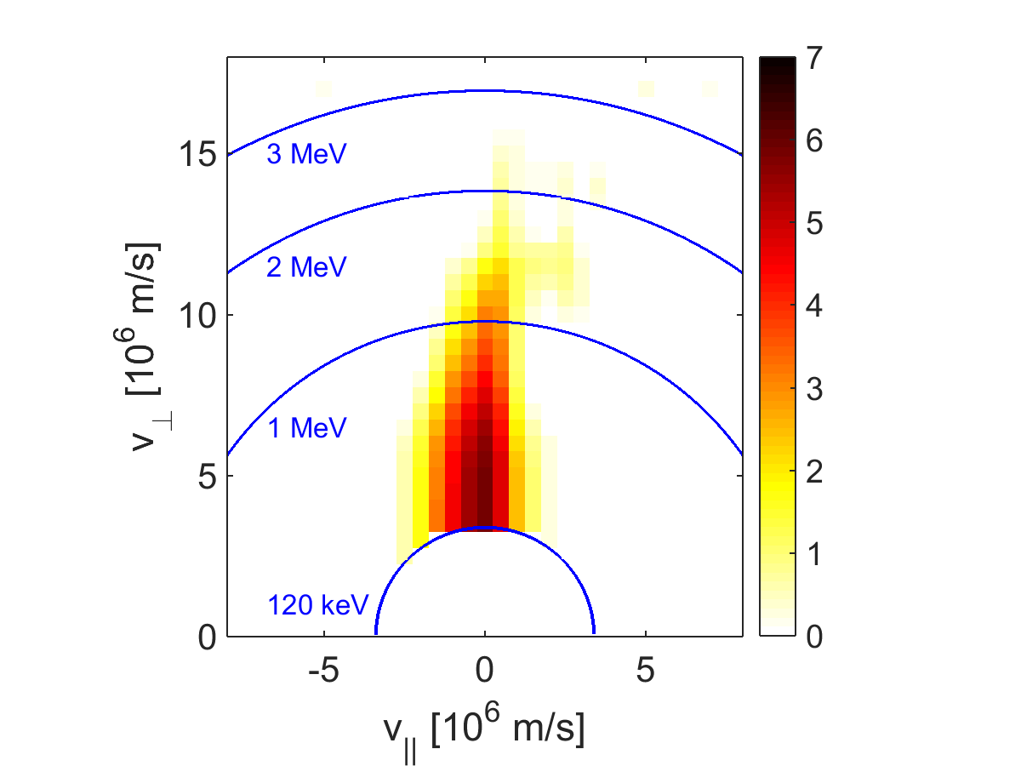
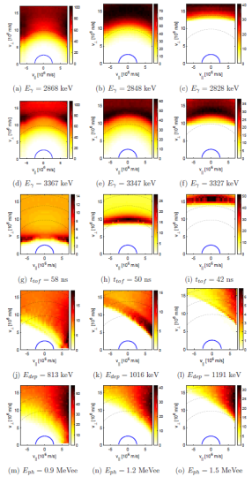
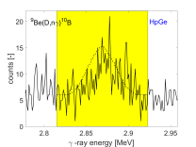
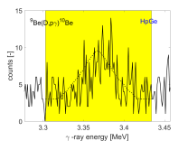
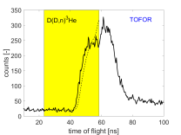
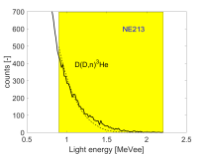
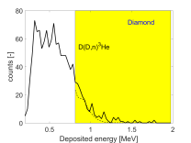
Inferring the distribution function from the measurements
Forward problem
$$WF=S$$
Distribution function F
Weight functions W
Measurements S
Inverse problem

Slide 3
Inferring the distribution function from the measurements
Usually such problems are solved by velocity-space tomography (Salewski) or orbit tomography (Stagner).
Salewski et al 2016 NF

Slide 4
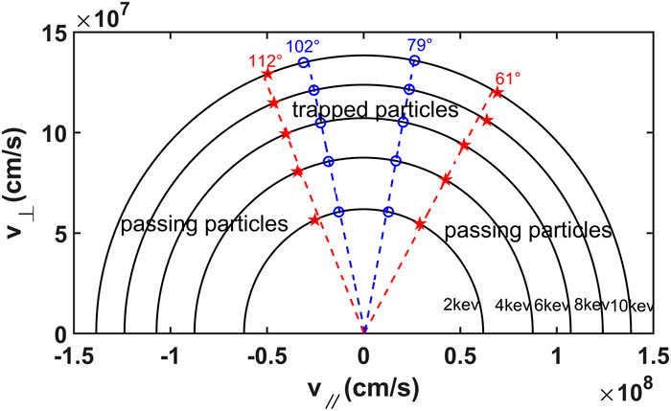
Inferring the distribution function from the measurements
However, for stellarators it is not very applicable: toroidal symmetry is broken.
C. Y. Su; S. Y. Chen; H. F. Liu; M. L. Mou; W. P. Guo; C. J. Tang; AIP Advances 10, 015004 (2020)

Slide 5
Inferring the distribution function from the measurements
5D space is difficult to probe – no reasonable number of diagnostics can be enough, one needs a strong prior.
We have a magnetic configuration and plasma profiles, the FI distribution function is deterministic.

Slide 6
Inferring the distribution function from the measurements
Possible soluition: Monte-Carlo simulations contain such information on connectivity of different regions of the phase space. We try to represent the measured distribution function of FI as a linear combination of pre-computed slowing down distribution functions. First tests at EAST and TCV were successfull.

Slide 7
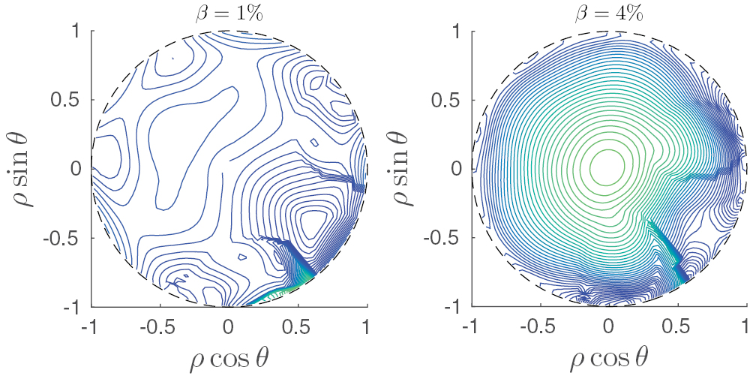
Why do we need a FI tomography in stellarators?
Physics: knowledge of the distribution function where we cannot measure it
Machine development: strategic planning of new diagnostic, maximizing information from the diagnostic
Specific for W7-X: show the optimization of the machine
J. Faustin, NF 2016

Slide 8
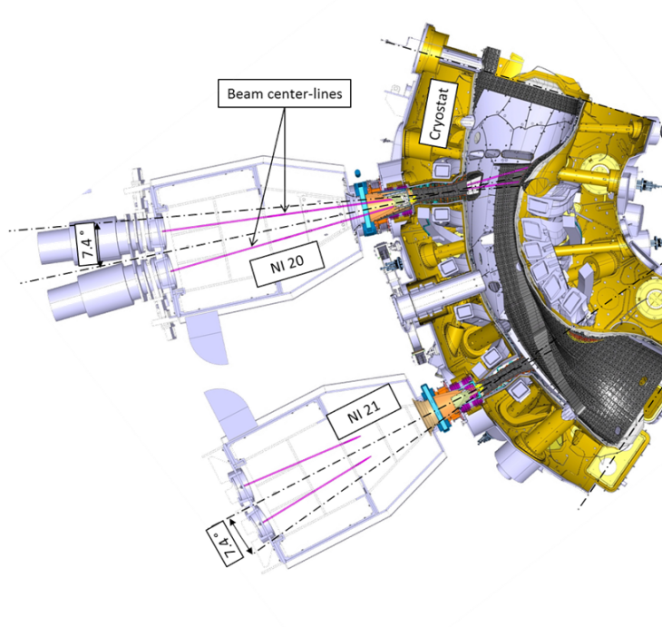
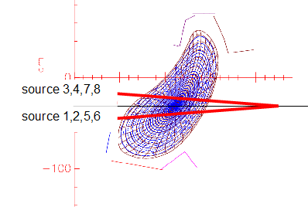
First try in W7-X simulations
NBI Energy mix: E:E/2:E/3
65:25:10
8x3=24
5D phase-space distributions
NI20 sources
2
1
3
4
NI21 sources
8
7
5
6
(More) radial sources
(More) tangential sources

Slide 9
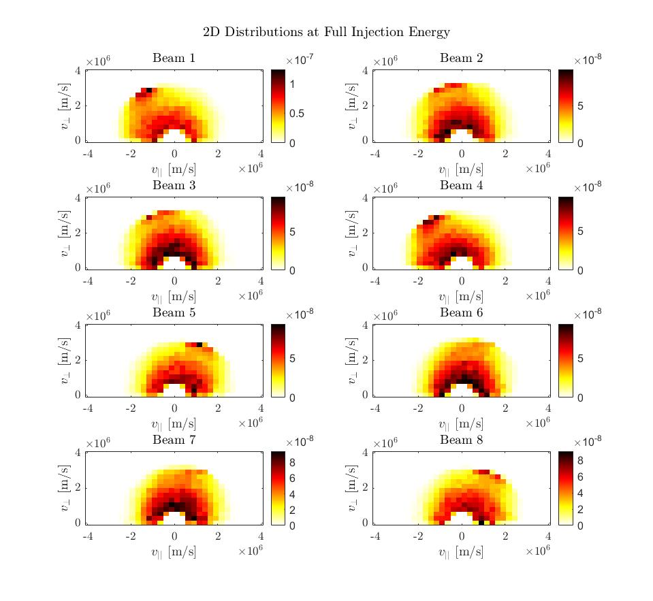
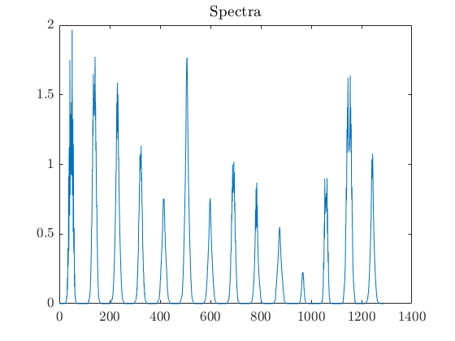
First try in W7-X simulations
True solution
Synthetic signal / Forward problem
$$F=∑a_{i}f_{SDi}=F_{SD}A$$
$$S=WF=WF_{SD}A=W_{SD}A$$
+10% noise
24 5D BEAMS3D simulations
14 Doppler-shift spectra
A1
A7
A13
A19
A4
A10
A16
A22
Credit: B. Schmidt

Slide 10
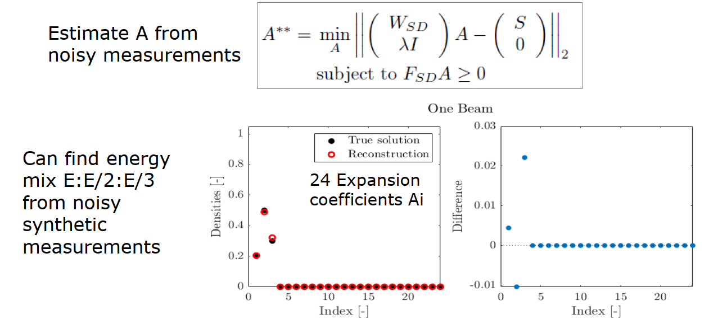
First try in W7-X simulations

Slide 11
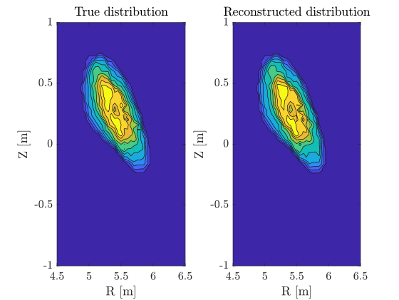
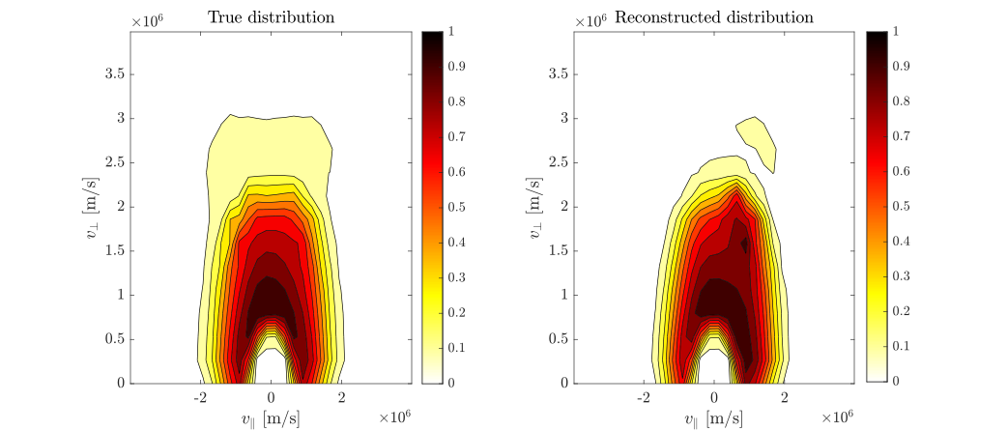
First try on W7-X simulations
$$F=∑a_{i}f_{SDi}=F_{SD}A$$
Infer the expansion coefficients
Calculate 5D distribution
Credit: Bo Schmidt

Slide 12
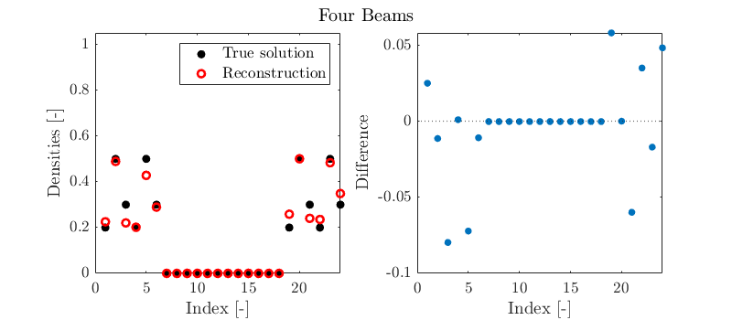
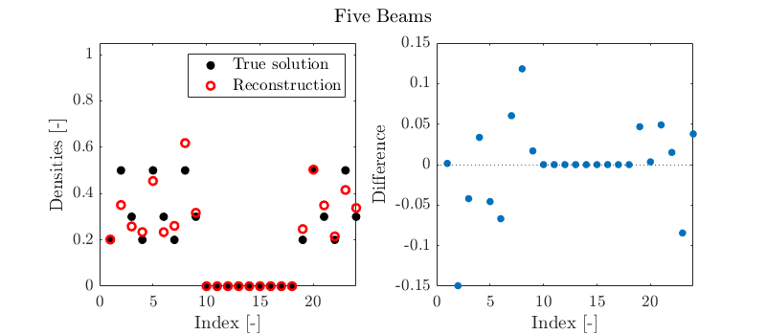
First try on W7-X simulations
Now 14 simultaneosly measured FIDA spectra at Wendelstein 7-X
Could go up to 237 simultaneously measured FIDA spectra

Slide 13
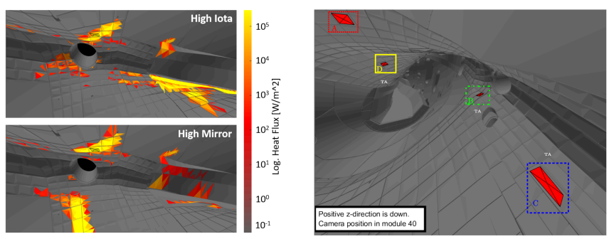
Diagnostic optimization software
Architecture of the software is still to be defined
Forward models for W7-X diagnostics are being developed
Faraday cups modelling is just finished
ICE is under development
Credit: S. Lazerson

Slide 14
Organizational
Project started in July 2021
2 PhD students planned to join the project
PhD student 1 joined DTU in August 2021
PhD student 2 will join IPP in January 2022
BEAMS3D: normalization works properly, basis functions for W7-X beams are computed
LHD simulations are set up, discussion of the basis functions
Overall, the discussion over computation of a new basis is ongoing: so far the plan is to use point-like sources in the phase space
Smart way to do that is still to be found: on grid 10x10x10x10x10 in (R, phi, Z, E, p) we end up with 10⁵ basis functions
Experiment: First stellarator experiments will be done on LHD on December 03 and 08
Benchmarking with the experiment: Successful test on TCV with 2-view FIDA; JET data is being prepared for the analysis.

Slide 15
In conclusion
Found additional partner in LHD to test our method
Our plans were just shifted by 7 months,
Most importantly, we wanted to finish testing and validating our reconstruction algorithm. This work is still in progress, there is a good progress (shown in slides above), to be completed by summer 2022.
Diagnostic models (FILD, ICE) are being developed for the case of W7-X for the optimization software.

