Slide 1



TSVV-14 Update
J. Morris, M. Coleman, J. Cook, F. Franza, K. Maijeh, I. Maione, D. Short
TSVV-14 – 3rd E-TASC Scientific Board 29th September 2021
This work was part funded by the RCUK Energy Programme [grant number EP/T012250/1]. This work has been carried out within the framework of the EUROfusion Consortium and has received funding from the Euratom research and training programme 2014-2018 and 2019-2020 under grant agreement No 633053. The views and opinions expressed herein do not necessarily reflect those of the European Commission.

Slide 2
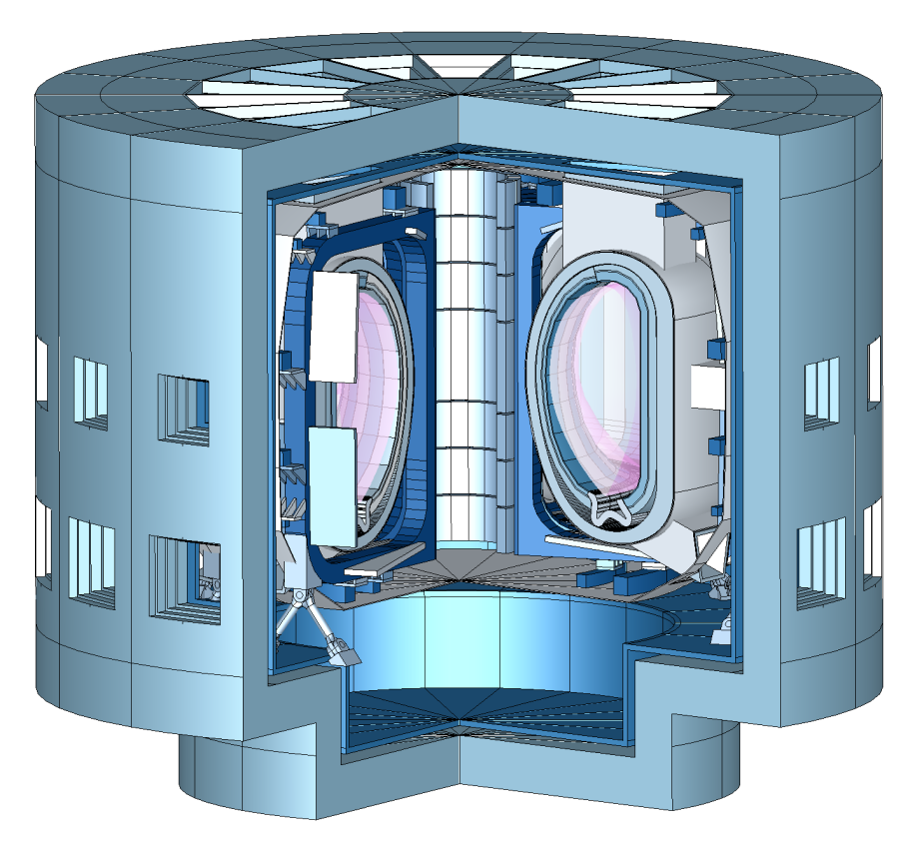
Objectives
Multi-fidelity System Codes for EU-DEMO
Create open-source reactor design tool and framework
Merge BLUEPRINT (UKAEA) and MIRA (KIT) codes as foundation of project
Project runs 2021-2025
3 PPY/year

Slide 3
Progress
Current Status
Merge of BLUEPRINT and MIRA is essentially complete (T1, T2, M1, M2)
  Some issues have slowed down progress (T3 only in initial stages)
  Balance between long-term solutions vs. maintaining functionality in short-term
  Migrating userbase over to new codebase successful
Underspend in 2021 due to a number of factors
  Beginning work in May
  Resource availability at KIT and UKAEA (partially due to late start)
ACH meetings to discuss work with hub took place in Sept 2021. Ongoing discussions about what ACH contribution will look like and if it is suitable for project.
On course for open-source release in December (M3)
Milestone | Status
M1 – project start-up | Completed
M2 – Code integration plan | Completed
M3 – Open-source release | On-track for Dec 2021
Task | Status
T1 – Software review | Completed
T2 – Integration of two codes | Completed
T3 – Data exchange and interfaces | Small delay

Slide 4
Outlook
2022
Tasks/Milestones for 2022 still appropriate
  Some neutronics tasks might need to be reshuffled given reason below
Project risk due to author of MIRA code leaving KIT at end of 2021 (F. Franza)
  KIT to organise replacement, but still will have fairly large impact on delivery
  Have begun to plan contingencies if KIT staff resource not in place for some tasks (e.g. 2-D neutronics)
Aim to begin building community around BLUEMIRA after open-source release in December 2021
ACH status dependent on 2021 discussions

Slide 5
Questions?

