Slide 1
Docker Environment for EIRENE CI cases
15th October 2021 | TSVV-5 Meeting I D. Harting

Slide 2
Overview
Docker in a nut-shell
EIRENE CI structure
Docker-image creation for EIRENE CI
How to run and create new EIRENE test cases in Docker
Some useful Docker commands

Slide 3
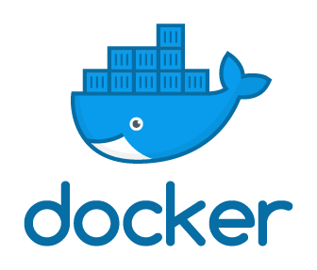
What is Docker?
Docker allows to run applications in a pre-defined environment
You can install Docker on your local computer (Windows/Linux/Mac)
  Via an Docker-image you create a Docker-container in which your application can run
Docker is a command line tool (although some GUI exits)
  :> docker [OPTIONS] COMMAND
  :> docker --help
  :> docker COMMAND --help
Work-flow and terminology:
A Docker-container is a running instance of a Docker-image
Docker-file
Docker-image
Docker-registry
Docker-container

Slide 4
EIRENE CI structure
Three repositories are used for the EIRENE CI under GitLab in the group eirene
  eirene/eirene – Main source code repository of EIRENE with small Wiki
  eirene/eirene-ci-image – Repository for the Docker-file and location of the registry for the Docker-image used by the EIRENE CI
  eirene/eirene-sample-cases – Repository with test cases used by the
  EIRENE CI (not ideal)
    This sample-case repository should be replaced later by the catalogue system !

Slide 5
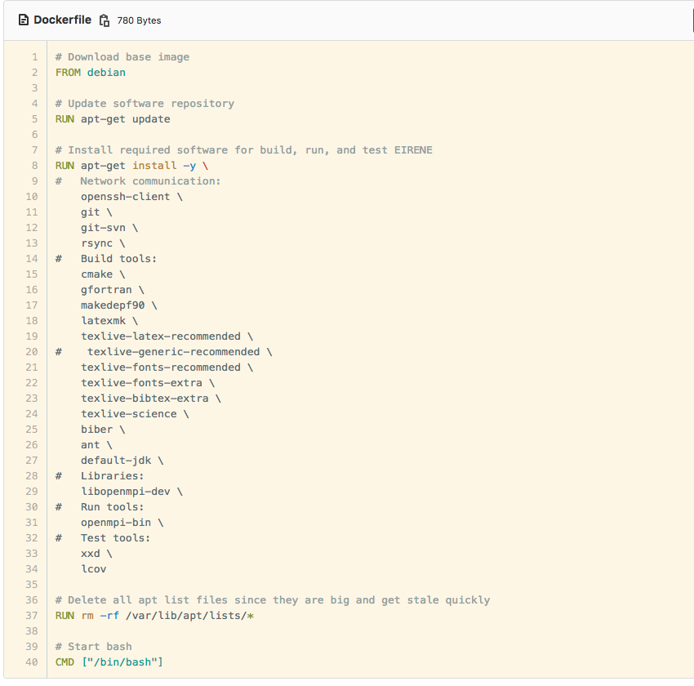
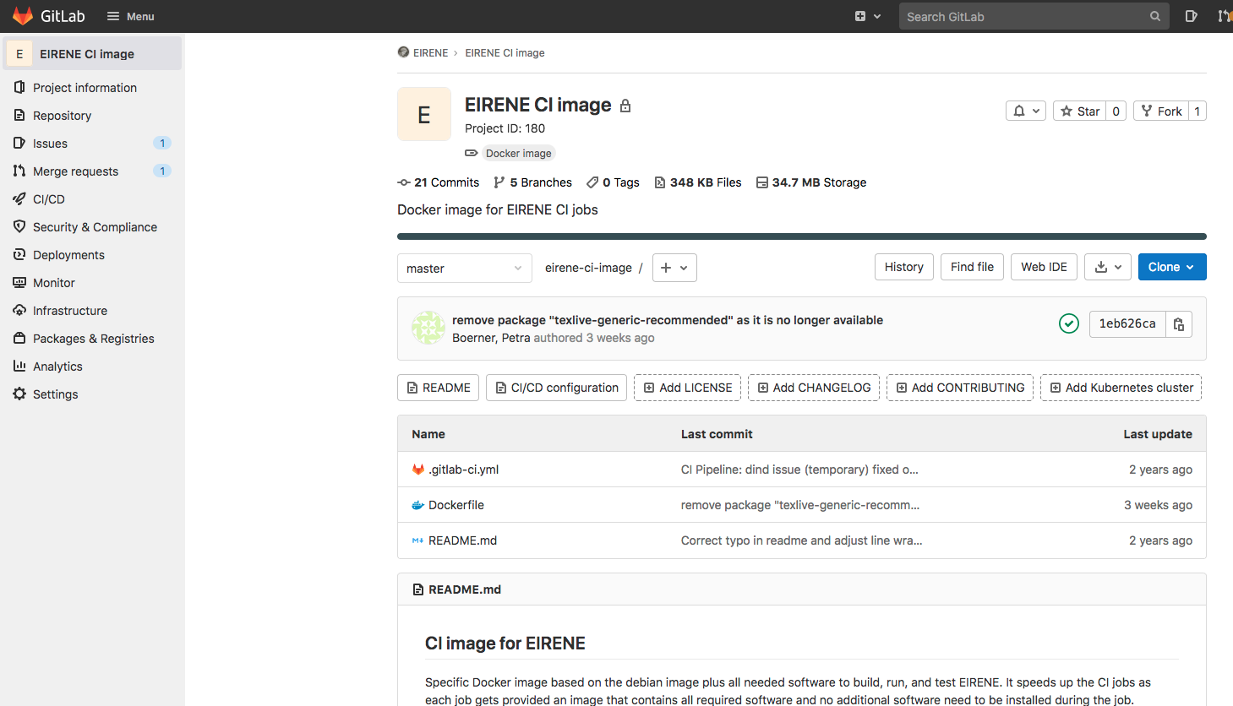
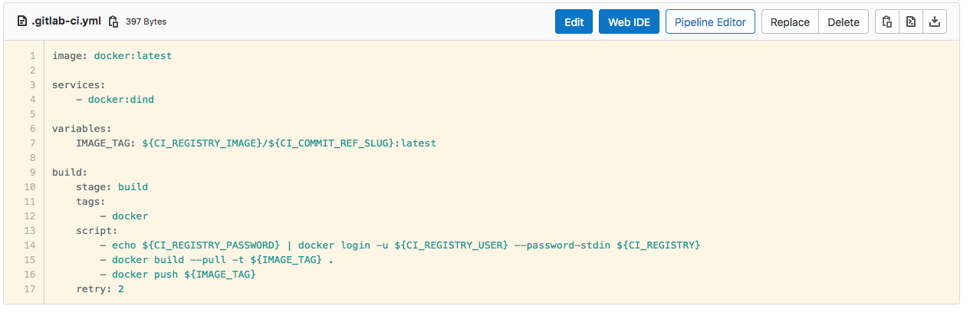
Creation and storage of EIRENE CI Docker image
GitLab provides for each repository a registry to store Docker-images
EIRENE CI uses the Docker-images stored in the registry of repository
  https://jugit.fz-juelich.de/eirene/eirene-ci-image
  It contains the Docker-file to configure the Docker-image
The Docker-image is created by the CI script (.gitlab-ci.yml) of the
eirene/eirene-ci-image repository
  The image is finally pushed to the registry and available for EIRENE CI

Slide 6
Docker on IEK-4 computers
Currently Docker is only installed on one machine – ipp411
You must be part of the local Docker-group to use Docker
Mapping directories to the Docker-container is on ipp411 only possible for directories under /private and /private2
  Mapping directories from your $HOME directory is currently not possible!
How to run the EIRENE test cases is described in the EIRENE wiki
  https://jugit.fz-juelich.de/eirene/eirene/-/wikis/EIRENE-Continuous-Integration

Slide 7
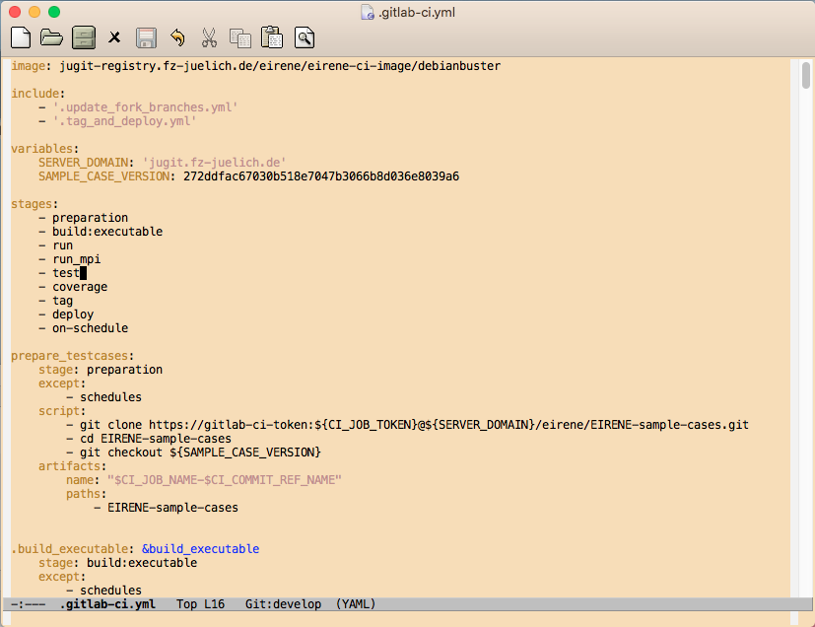



Setup working directory on ipp411
Create working directory on ipp411
Do not accidentally commit the test cases to the EIRENE repository !!!
Clone EIRENE and checkout desired branch
Clone EIRENE test cases into EIRENE directory

Slide 8

Setup working directory on ipp411
… continued
Clone the EMC3 source repository into the EMC3 subdirectory of the
EIRENE-sample-cases directory
Do not accidentally commit the EMC3 repository to the EIRENE repository or the sample-cases repository!!!

Slide 9
Start the Docker-image
Access token for the registry with the Docker-image are currently setup only in a private fork: https://jugit.fz-juelich.de/eirene_dmh/eirene-ci-image
ACCESS TOKEN:
Username: dmh
Password: w3xw2Fc4gBs--PkfHx7x
First login to the Docker-registry
ipp411:~> docker login jugit-registry.fz-juelich.de/
eirene_dmh/eirene-ci-image/debianstretch
Username: dmh
Password: w3xw2Fc4gBs--PkfHx7x

Slide 10
Start the Docker-image
… continued
Run the Docker-image
ipp411:~> cd /private2/$USER/eirene-testcase-build
ipp411:eirene-testcase-build> docker run -it -v `pwd`:`pwd` -w `pwd`
jugit-registry.fz-juelich.de/eirene_dmh/
eirene-ci-image/debianstretch
root@30e2042d324f:/private2/d.harting/eirene-testcase-build#
docker run
  will first pull the image from the registry, create a Docker-container, start the container and run the command specified in the Docker-file (here /bin/bash)
Options:
  -it for interactive shell with tty
  -v `pwd`: `pwd` map current directory to the same location in the container
  -w `pwd` set the working directory in the container

Slide 11
Compiling
Compile EIRENE library
root@30e2042d324f:eirene-testcase-build> cd eirene
root@30e2042d324f:eirene> mkdir buildRelease
root@30e2042d324f:eirene> cd buildRelease
root@30e2042d324f:buildRelease> FC=gfortran cmake ../src root@30e2042d324f:buildRelease> make EIRENE
Compile EMC3
root@30e2042d324f:eirene/buildRelease> cd ../EIRENE-sample-cases/EMC3/emc3
root@30e2042d324f:EMC3/emc3> mkdir -p buildRelease
root@30e2042d324f:EMC3/emc3> cd buildRelease root@30e2042d324f:emc3/buildRelease> FC=gfortran cmake ../src
-DCMAKE_BUILD_TYPE=Release
-DEIRENE_MODULES=../../../../buildRelease
-DEIRENE_LIBRARY=../../../../libRelease/libEIRENE.a
-DEIRENE_DATABASE=../../../../Database
root@30e2042d324f:emc3/buildRelease> make emc3_eirene

Slide 12
Run the test cases
root@30e2042d324f:emc3/buildRelease> cd /private2/$USER/eirene-testcase-build
root@30e2042d324f:eirene-testcase-build> cd eirene/EIRENE-sample-cases
root@30e2042d324f:EIRENE-sample-cases> export MPIRUN_FLAGS='--allow-run-as-root’
root@30e2042d324f:EIRENE-sample-cases> make test
This will run the EIRENE test cases in the Docker-container
When you are finished type ‘exit’ to leave the shell of the docker container
The newly created test-cases can be used to replace the existing test-cases for the EIRENE CI

Slide 13
Some Useful Docker commands
docker ps – List all running Docker-container
docker ps -a – List all Docker-container, also stopped and paused ones
docker rm CONTAINER – Remove Docker-container.
docker images or docker image ls – Lists local available images which were pulled from a registry
docker image rm IMAGE or docker rmi IMAGE – Remove Docker-image locally.
docker pull NAME – Pull an Docker-image from a registry
docker login URL – Login to a Docker-registry
docker logout URL – Logout from a Docker-registry
docker create IMAGE – Create a new Docker-container from a Docker-image
docker start CONTAINER – Start a Docker-container
docker stop CONTAINR – Stop a Docker-container
docker pause CONTAINER – Pause all processes in a Docker-container
docker restart CONTAINER – Restart a Docker-container
docker run IMAGE [COMMAND] – Run a command in a new Docker-Container

Slide 14

Thank you!

