Slide 1
Anisothermal mean-field model for 2D ExB drift turbulence in the SOL
Reinart Coosemans, Wouter Dekeyser, Martine Baelmans
Notes:
First of I would like to appreciate the efforts of the organising commitee for simulating the effects of a jetlag as closely as possible in an online conference.
First of I would like to appreciate the efforts of the organising commitee for simulating a live conference as good as possible, including a schedule replicating the jetlag effect very closely.
First of I would like to thank the organising commitee for simulating a live conference as good as possible. I must say I am especially appreciative for their efforts of a schedule the presentation to replicate the jetlag effect very closely.

Slide 2
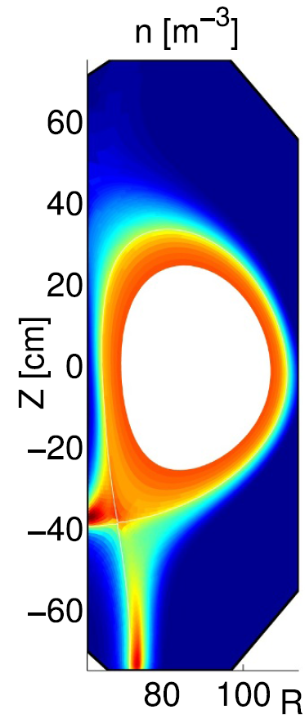
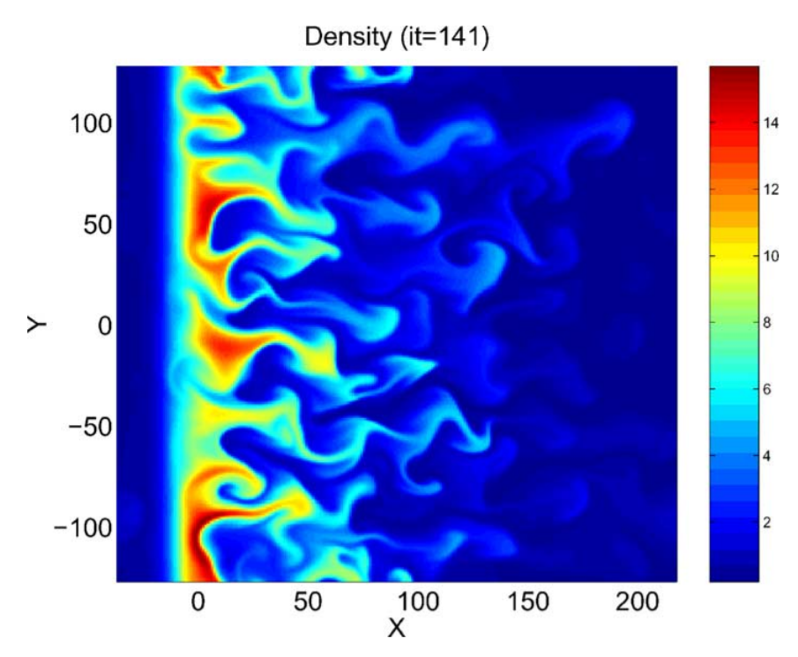
Research approach
[2]
[1]
[3]
[1] S. Cowley, Physics World (2010).
[2] Y. Sarazin et al., J. Nucl. Mater. (2003).
[3] S. Baschetti et al., Nuclear Materials and Energy (2019).
Notes:
So, in our present study, we try to look at reduced, 2D models of the turbulence and try to develop averaged models for those. The hypothesis is that the turbulence in the real machines, complex geometries, will have similar characteristics, to some extent, such that the models derived for the simplified case give a good indication of what happens in the more complex case.
In addition, the complex case will be investigated in more detail, using 3D turbulence simulations in later work packages.

Slide 3
Research objective
Develop closure models to include the average effect of turbulence in mean-field codes.
Mean-field codes
Hydrodynamic turbulence models
Turbulent mean-field transport model
Generalization
+ implementation in SOLPS-ITER
Reference data
This talk
cfr. W. Dekeyser
Next talk
Notes:
“So we have these mean field models in which we want to incorporate the turbulence in a better way, but how will we do that? Well, in first instance we will look at what has been done in the related field of hydrodynamic turbulence modelling. However, how can we know then that these models we developed make any sense for plasma turbulence? Well, therefore we will use detailed reference data for this ExB turbulence specifically. Thus this should yield a turbulent mean field model. In a next step, this model can than be integrated in a mean-field code such as SOLPS, as has been done by Stefano.”

Slide 4
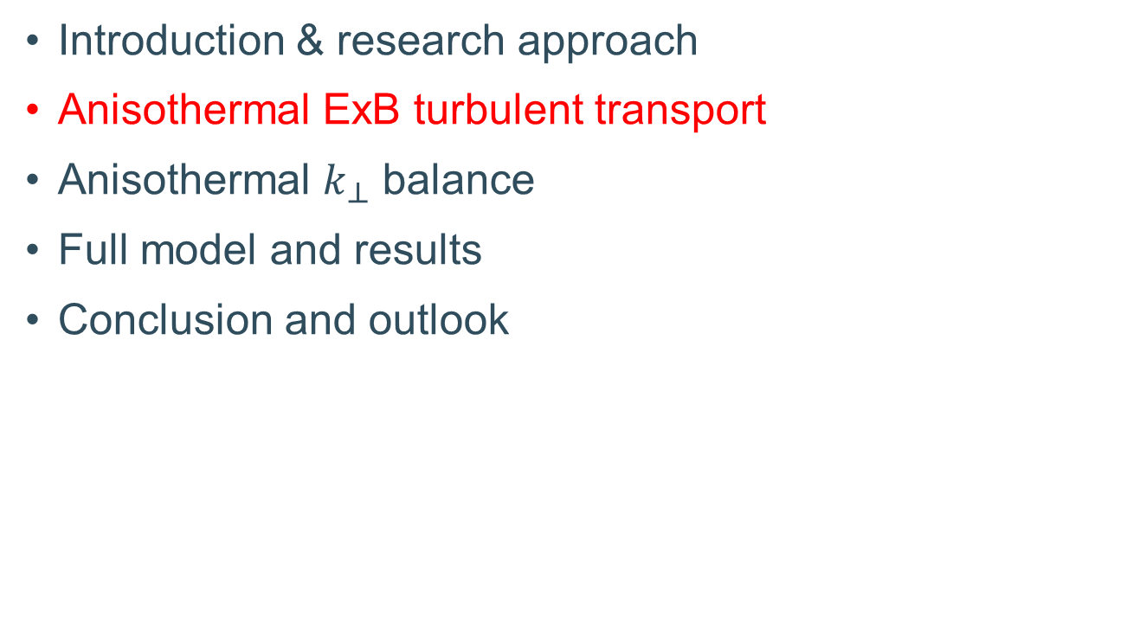
Overview
Introduction & research approach
Anisothermal ExB turbulent transport
Anisothermal $k_{⊥}$ balance
Full model and results
Conclusion and outlook

Slide 5
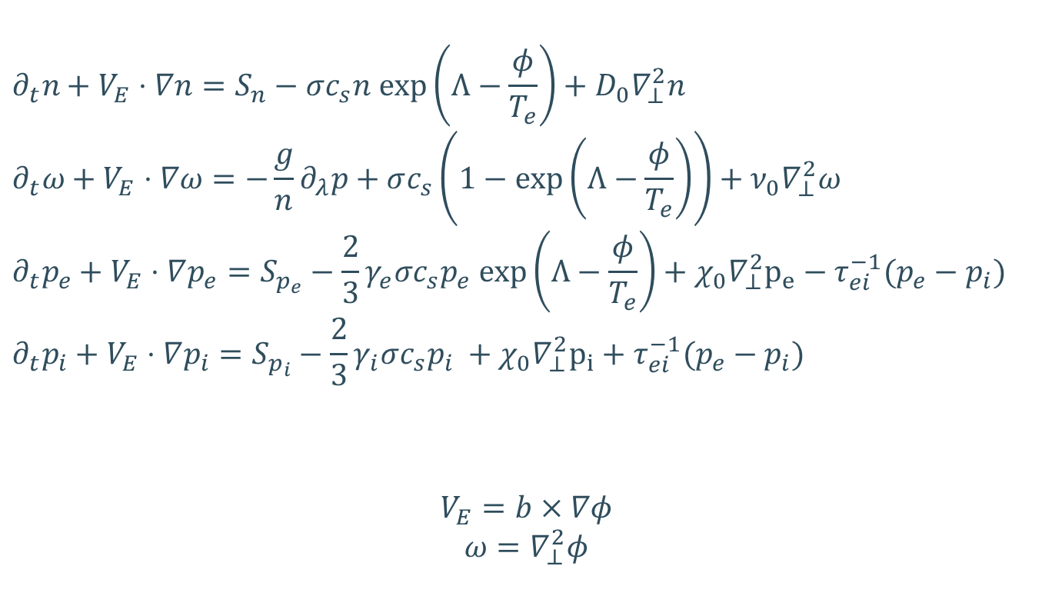
Anisothermal TOKAM2D
$$∂_{t}n+V_{E}⋅∇n=S_{n}−σc_{s}n exp\left(Λ−\frac{φ}{T_{e}}\right)+D_{0}∇_{⊥}^{2}n$$
$$∂_{t}ω+V_{E}⋅∇ω=−\frac{g}{n}∂_{λ}p+σc_{s}\left(1−exp\left(Λ−\frac{φ}{T_{e}}\right)\right)+ν_{0}∇_{⊥}^{2}ω$$
$$∂_{t}p_{e}+V_{E}⋅∇p_{e}=S_{p_{e}}−\frac{2}{3}γ_{e}σc_{s}p_{e} exp\left(Λ−\frac{φ}{T_{e}}\right)+χ_{0}∇_{⊥}^{2}p_{e}−τ_{ei}^{−1}(p_{e}−p_{i})$$
$$∂_{t}p_{i}+V_{E}⋅∇p_{i}=S_{p_{i}}−\frac{2}{3}γ_{i}σc_{s}p_{i} +χ_{0}∇_{⊥}^{2}p_{i}+τ_{ei}^{−1}(p_{e}−p_{i})$$
$$V_{E}=b×∇φ$$
$$ω=∇_{⊥}^{2}φ$$
[4] Y. Sarazin et al., Phys. Plasmas (1998).
[5] Y. Marandet et al., Plasma Phys. Control. Fusion (2016).
[6] N. Nace, PhD thesis (2018).
Notes:
-Transport terms with ExB convection only
-Diamagnetic and polarisation currents + model for sheath currents
Interchange mechanism = result of magnetic curvature = result of centrifugal force = diamagnetic current building up charge on top and bottom of density bubble => electric field => convected outward due to ExB drift

Slide 6

Anisothermal TOKAM2D averaging
$$∂_{t}\overline{n}+∇⋅\overline{nV_{E}}={\overline{S}}_{n}−σc_{s}\overline{n exp\left(Λ−\frac{φ}{T_{e}}\right)}+D_{0}∇_{⊥}^{2}\overline{n}$$
$$∂_{t}{\overline{p}}_{e}+∇⋅\overline{p_{e}V_{E}}={\overline{S}}_{p_{e}}−\frac{2}{3}\overline{γ_{i}σc_{s}p_{e} exp\left(Λ−\frac{φ}{T_{e}}\right)}+χ_{0}∇_{⊥}^{2}{\overline{p}}_{e}−τ_{ei}^{−1}({\overline{p}}_{e}−{\overline{p}}_{i})$$
$$∂_{t}{\overline{p}}_{i}+∇⋅\overline{p_{i}V_{E}}={\overline{S}}_{p_{i}}−\frac{2}{3}\overline{γ_{i}σc_{s}p_{i}} +χ_{0}∇_{⊥}^{2}{\overline{p}}_{i}+τ_{ei}^{−1}({\overline{p}}_{e}−{\overline{p}}_{i})$$
Notes:
-Transport terms with ExB convection only
-Diamagnetic and polarisation currents + model for sheath currents
Interchange mechanism = result of magnetic curvature = result of centrifugal force = diamagnetic current building up charge on top and bottom of density bubble => electric field => convected outward due to ExB drift

Slide 7
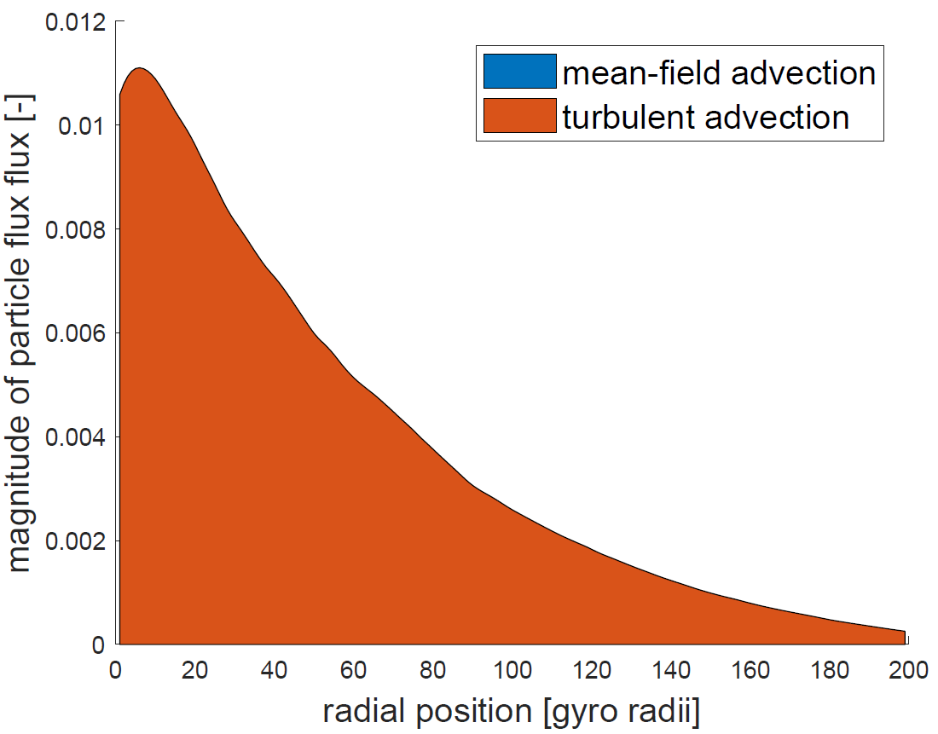
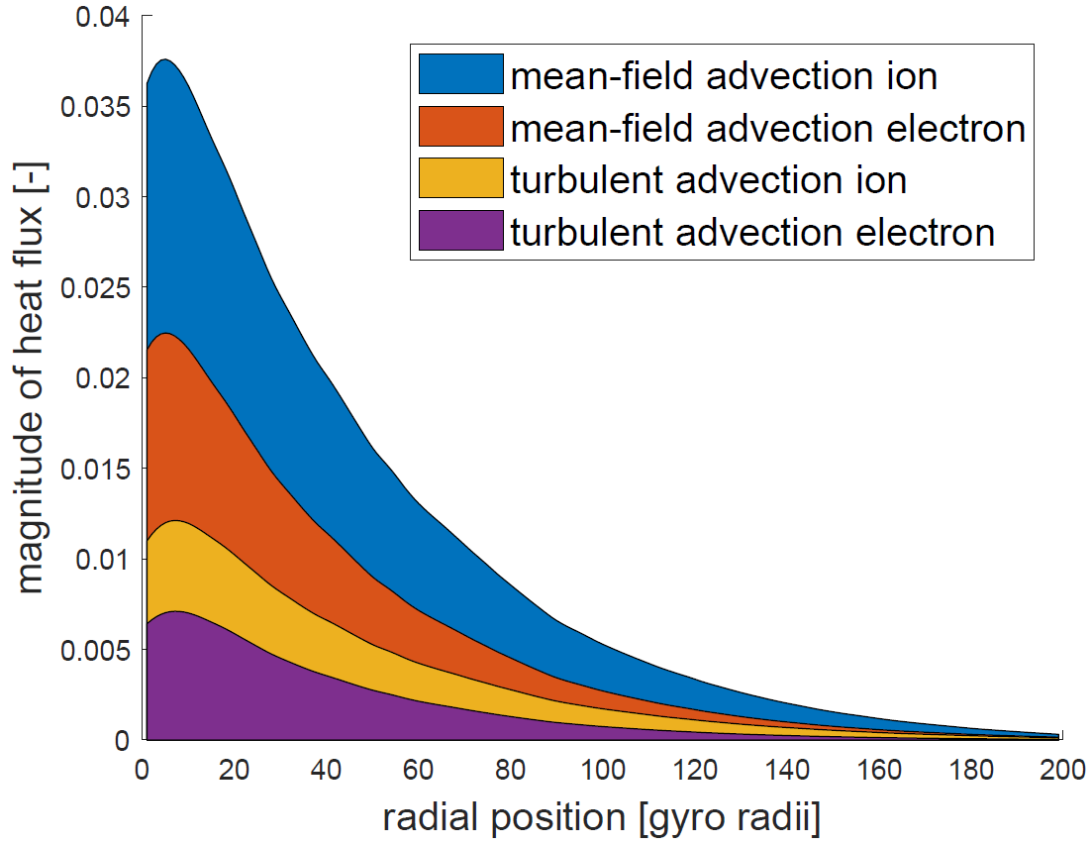


Mean-field and turbulent advection for particle and heat fluxes
$$Γ_{n}=\overline{nV}=\overline{n}\overline{V}+\overline{n^{′}V^{′}}$$
$$Γ_{p}=\overline{nTV}=\overline{n}\tilde{T}\tilde{V}+\overline{nT^{′′}V^{′′}}$$
[7] V.M. Canuto, Astrophys. J. (1997).

Slide 8
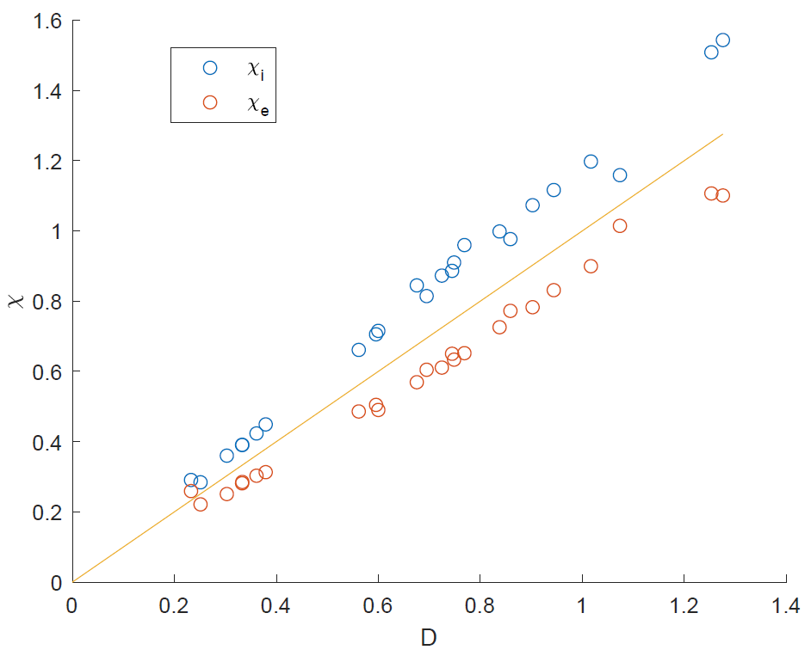


Diffusive model for turbulent fluxes
Particle transport
  $Γ_{n}=\overline{n}{\overline{V}}_{E}+\overline{n^{′}V_{E}^{′}}$
  $\overline{n^{′}V_{E}′}≈−D∇\overline{n}$
Thermal energy transport
  $Γ_{p}=\tilde{T}Γ_{n}+\overline{nT^{′′}V_{E}′′}$
  $\overline{nT^{′′}V_{E}^{′′}}≈−\overline{n}χ∇\tilde{T}$
$D_{n}\sim χ_{i}\sim χ_{e}$
database of T2D simulations over broad parameter range
$g=3..12 {×10}^{−4}$
$σ=0.2..2×{10}^{−4}$
$T_{inj}=2..8$
$ν=2.5..10×{10}^{−3}$
[8] R. Coosemans et al., J. Phys.: Conf. Ser. (2021).
Notes:
Diffusion coeffients for particles and electron and ion heat flux seem to be very similar. => physics-wise, we can probably focus on the particle flux for now.

Slide 9
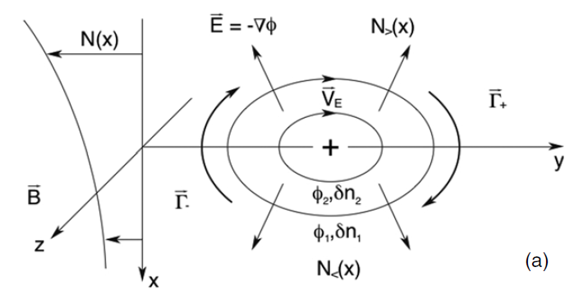


Turbulent kinetic energy $k_{⊥}$
$$\overline{n}k_{⊥}=\frac{\overline{nV_{E}^{′′2}}}{2}$$
$V_{E}=$ $b×∇φ$
[9]
[9] Y. G.R. Tynan et al., Plasma Phys. Control. Fusion (2009).
Notes:
Discuss ExB drift as orbits of particles in “random” electrostatic field that changes in time. This change in time is in term driven by the flow of particles in it (through charge balance equation)
K has a double interest here: on the one hand, it is a measure of the intensity of the turbulence, and developing an equation for it will yield some insight into the physics of the turbulence, i.e. its creation and destruction mechanisms. Secondly, it will be shown to be related to the particle transport. Indeed, the density wheighed velocity is a measure for the ExB orbit velocity the particles follow in their orbits in the fluctuating potential field that is exactly the motion responsible for the particle transport => k-epsilon RANS model like approach

Slide 10
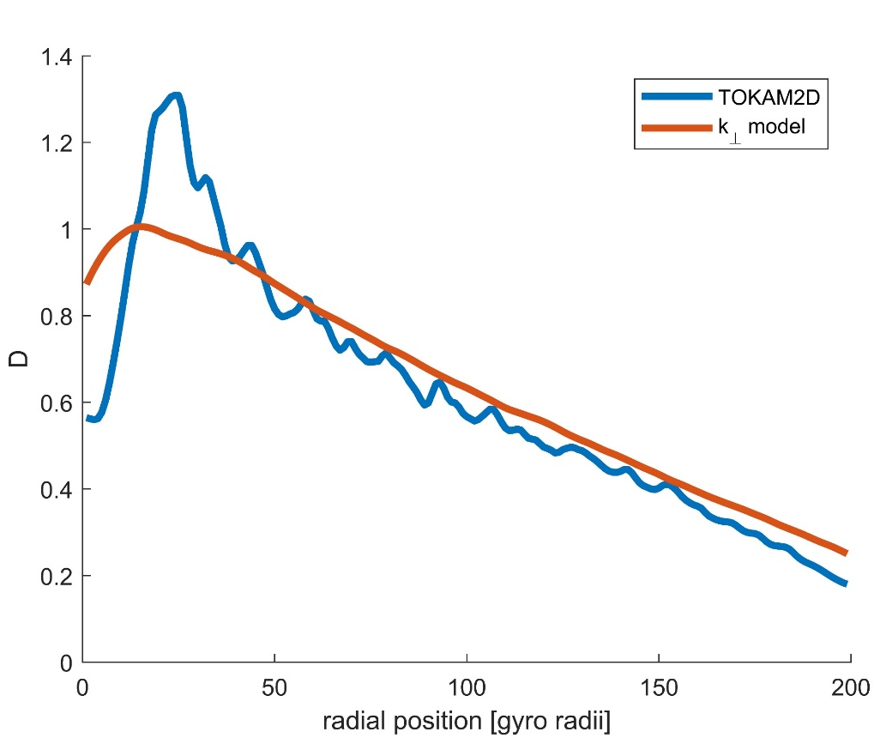
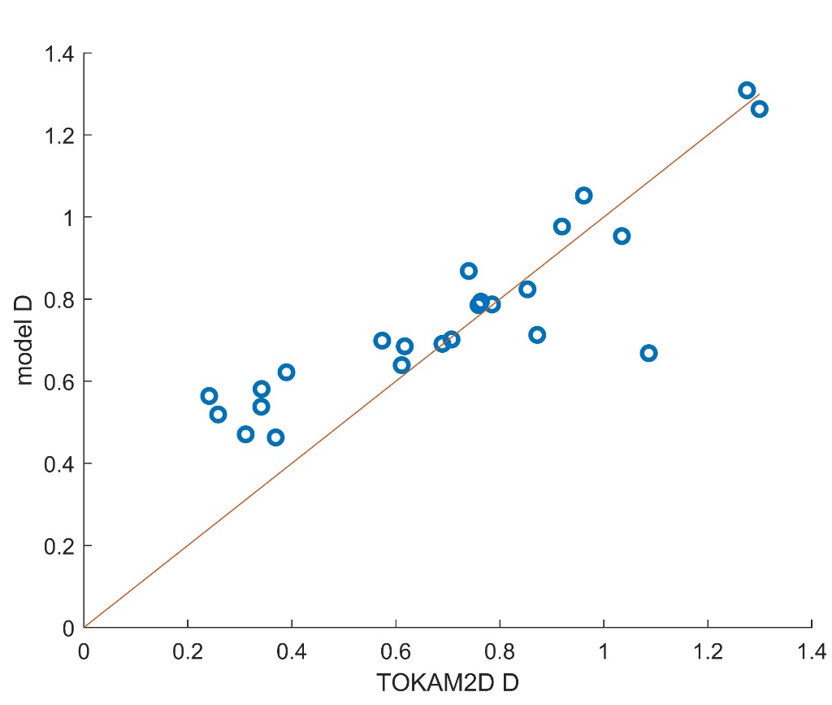
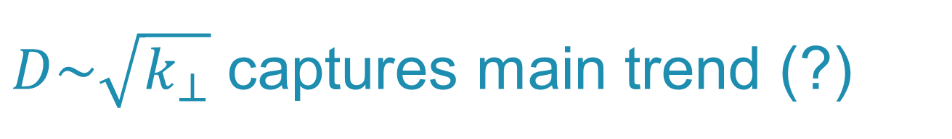
$D\sim \sqrt{k_{⊥}}$ captures main trend (?)
[10] R. Coosemans et al., Phys. Plasmas (2021).
[11] R. De Wolf et al., Nucl. Fusion (2021).
Notes:
Alternative: $D\sim \frac{k}{\sqrt{k}+f(S_{λ})}$

Slide 11
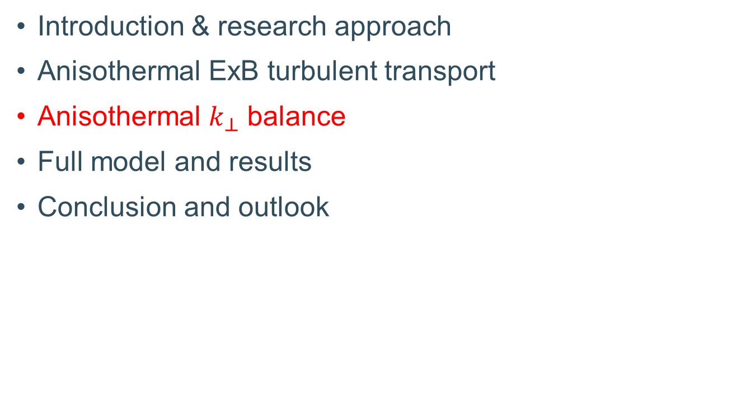
Overview
Introduction & research approach
Anisothermal ExB turbulent transport
Anisothermal $k_{⊥}$ balance
Full model and results
Conclusion and outlook

Slide 12


Analytically derived $k_{⊥}$ equation
$$\frac{∂}{∂t}\overline{n}k_{⊥}+∇⋅Γ_{k_{⊥}}=S_{k_{⊥}}$$
$$Γ_{k_{⊥}}≈Γ_{k_{⊥},⊥}+Γ_{k_{⊥},|| }≈Γ_{n}k_{⊥}+\frac{\overline{nV_{E}^{′′}{V_{E}^{′′}}^{2}}}{2}+Γ_{k_{⊥},|| }$$
[10] R. Coosemans et al., Phys. Plasmas (2021).

Slide 13
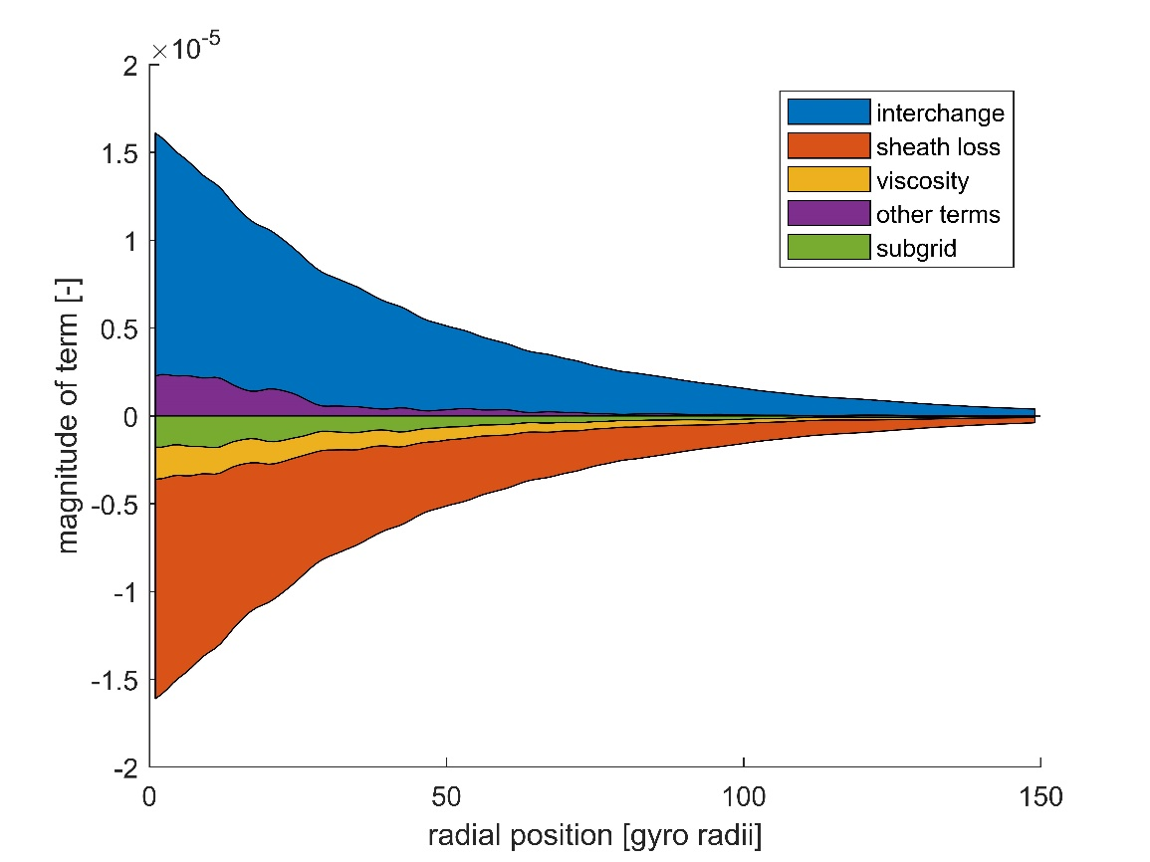
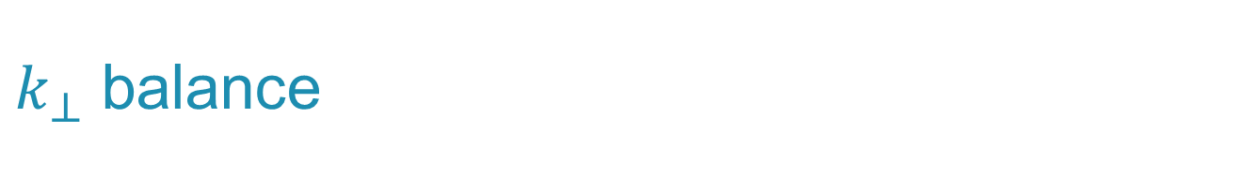
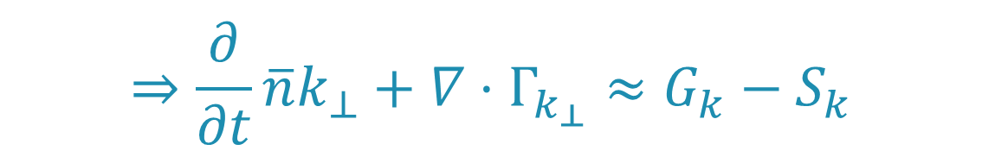
$k_{⊥}$ balance
$$⇒\frac{∂}{∂t}\overline{n}k_{⊥}+∇⋅Γ_{k_{⊥}}≈G_{k}−S_{k}$$
Interchange source
Sheath loss sink
Notes:
Approximately the same relative importance of the different terms.
Anisothermal balance is steeper, because the temperature profile influences the profiles of k and density as well.
K equation itself didn’t change too much either
Maybe leave away the isothermal balance?

Slide 14
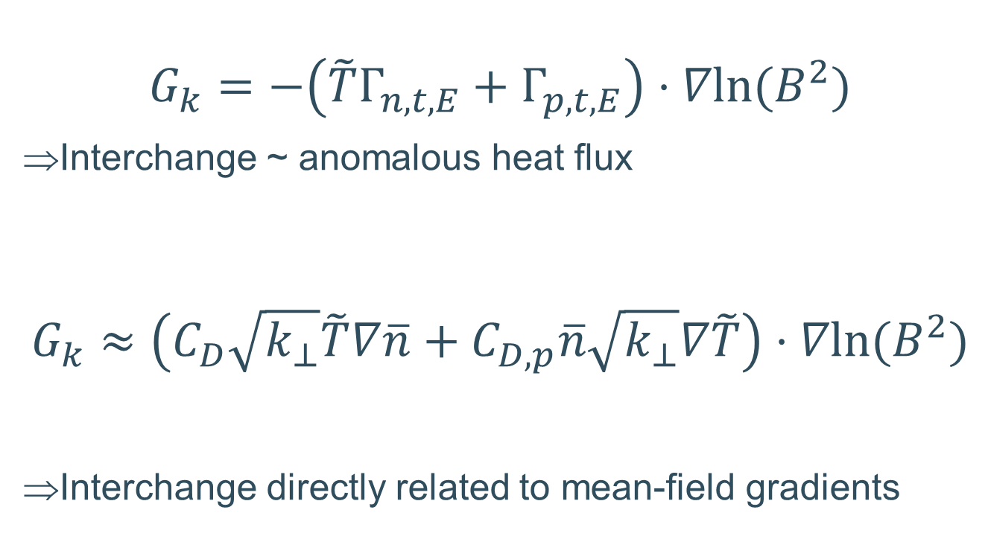
Analytical interchange model
$$G_{k}=−\left(\tilde{T}Γ_{n,t,E}+Γ_{p,t,E}\right)⋅∇ln⁡(B^{2})$$
Interchange ~ anomalous heat flux
$$G_{k}≈\left(C_{D}\sqrt{k_{⊥}}\tilde{T}∇\overline{n}+C_{D,p}\overline{n}\sqrt{k_{⊥}}∇\tilde{T}\right)⋅∇ln⁡(B^{2})$$
Interchange directly related to mean-field gradients
[10] R. Coosemans et al., Phys. Plasmas (2021).
Notes:
$$p^{′}=nT−\overline{nT}=\left(\overline{n}+n^{′}\right)\left(\tilde{T}+T^{′′}\right)−\overline{n}\tilde{T}=\overline{n}T^{′′}+n^{′}\tilde{T}+n^{′}T^{′′}$$
$$\overline{nT^{′′}V_{E}^{′′}}=\overline{nT^{′′}({\overline{V}}_{E}+V_{E}^{′}−{\tilde{V}}_{E})}=\overline{nT^{′′}V_{E}^{′}}$$

Slide 15
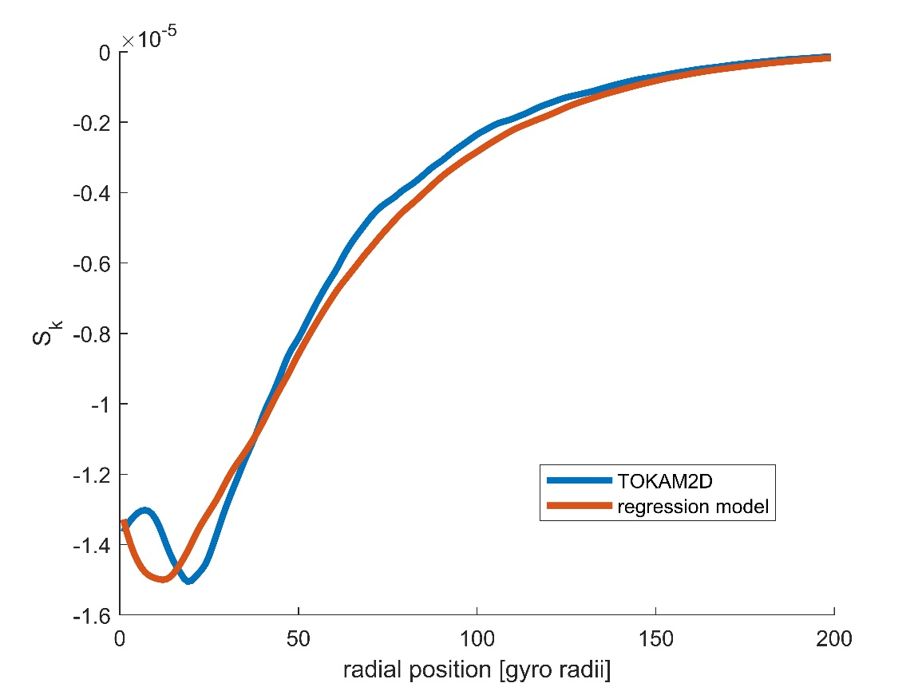
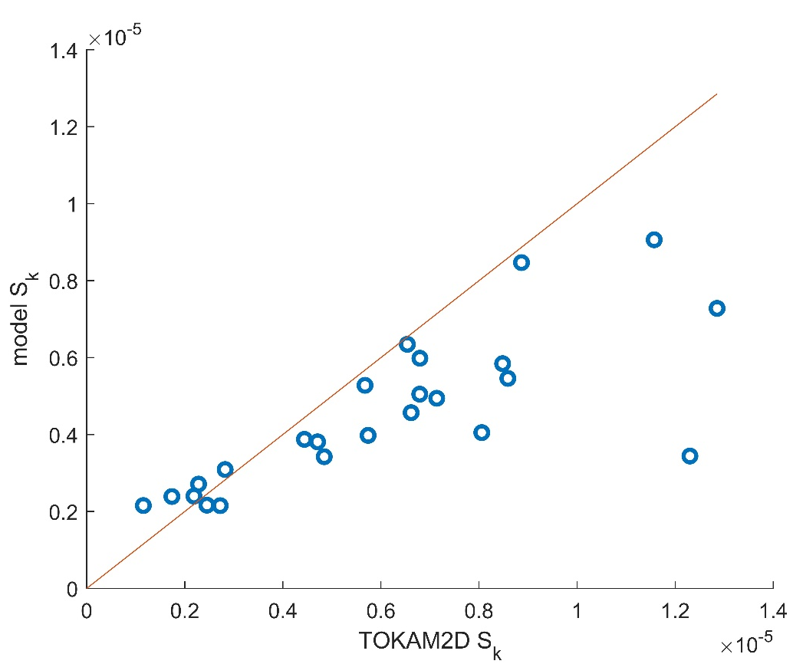
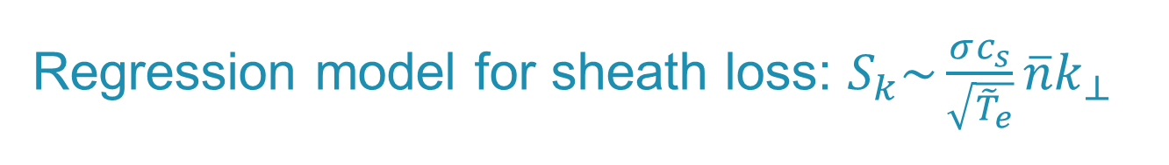
Regression model for sheath loss: $S_{k}\sim \frac{σc_{s}}{\sqrt{{\tilde{T}}_{e}}}\overline{n}k_{⊥}$
[11] R. De Wolf et al., Nucl. Fusion (2021).
Notes:
Still room for improvement, but results are much improved by it already. Also, formula not yet dimensionally consistent, and not in line with the series expansion performed earlier.
Modelling both contributions seperately will likely require quite some effort, which may not be worth it for the simplified treatment of het parallel direction in the TOKAM2D data. Rather model it well only in 3D and continue with ad hoc fitting model for now?

Slide 16
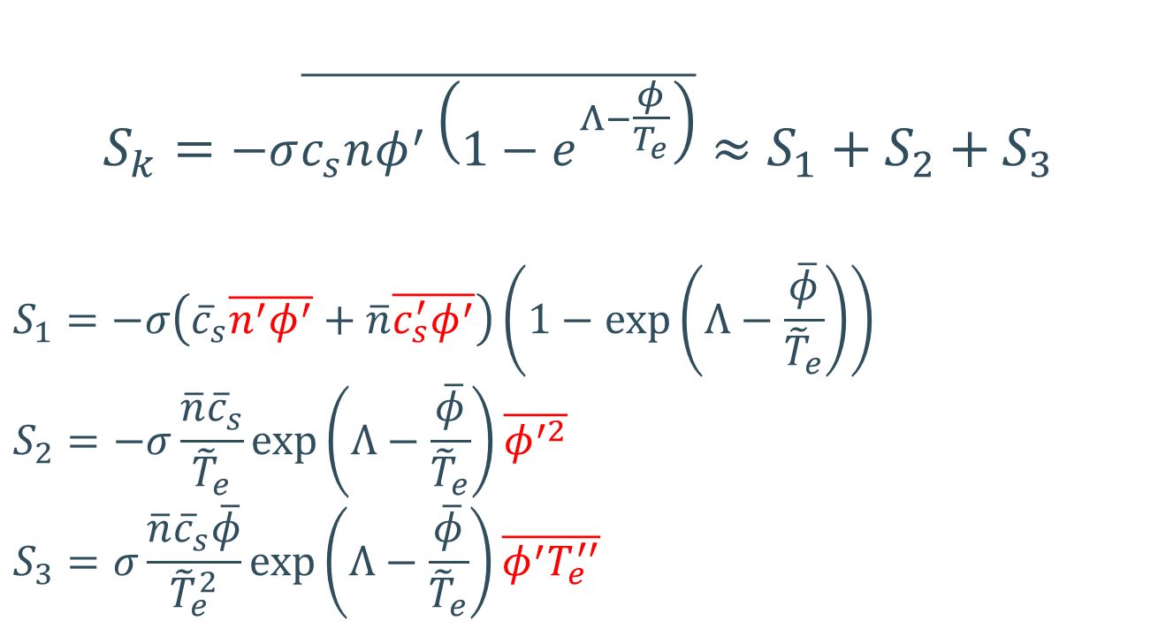
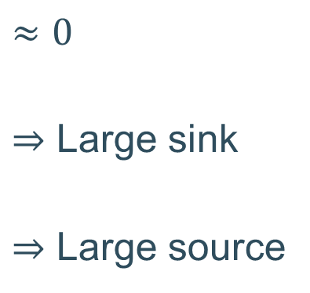
Series expansion for sheath loss term
$$S_{k}=−σ\overline{c_{s}nφ^{′}\left(1−e^{Λ−\frac{φ}{T_{e}}}\right)}≈S_{1}+S_{2}+S_{3}$$
$$S_{1}=−σ\left({\overline{c}}_{s}\overline{n^{′}φ^{′}}+\overline{n}\overline{c_{s}^{′}φ^{′}}\right)\left(1−\exp\left(Λ−\frac{\overline{φ}}{{\tilde{T}}_{e}}\right)\right)$$
$$S_{2}=−σ\frac{\overline{n}{\overline{c}}_{s}}{{\tilde{T}}_{e}}\exp\left(Λ−\frac{\overline{φ}}{{\tilde{T}}_{e}}\right)\overline{φ^{′2}}$$
$$S_{3}=σ\frac{\overline{n}{\overline{c}}_{s}\overline{φ}}{{\tilde{T}}_{e}^{2}}\exp\left(Λ−\frac{\overline{φ}}{{\tilde{T}}_{e}}\right)\overline{φ^{′}T_{e}^{′′}}$$
$$≈0$$
$⇒$ Large sink
$⇒$ Large source
[12] C. Baudoin et al., Contrib. Plasma Phys. (2016).
[13] C. Baudoin, PhD thesis (2018).
Notes:
Regarding the averages of the sound speed, I used following expansion to fill these out: ${\overline{c}}_{s}=\sqrt{\tilde{T}}$ and $c_{s}^{′}=\frac{T^{′′}}{2\sqrt{\tilde{T}}}$

Slide 17
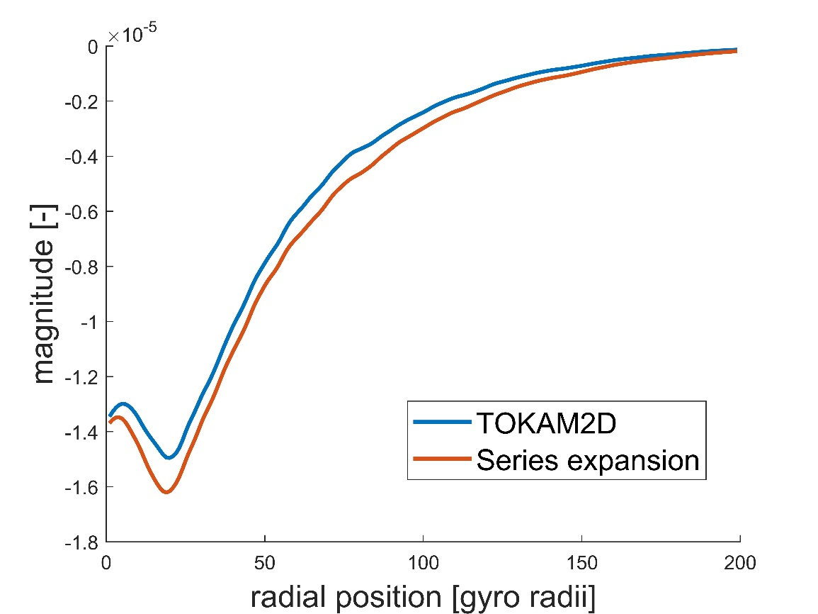
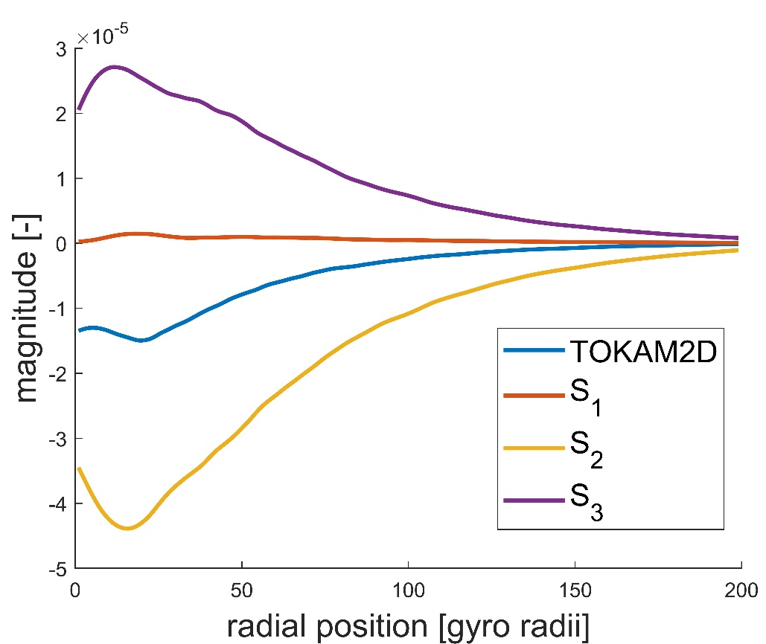
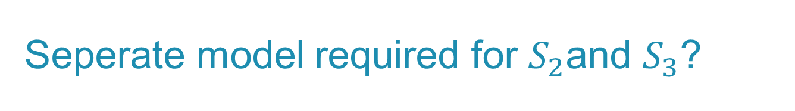
Seperate model required for $S_{2}$and $S_{3}$?
[12] C. Baudoin et al., Contrib. Plasma Phys. (2016).
[13] C. Baudoin, PhD thesis (2018).
Notes:
Regarding the averages of the sound speed, I used following expansion to fill these out: ${\overline{c}}_{s}=\sqrt{\tilde{T}}$ and $c_{s}^{′}=\frac{T^{′′}}{2\sqrt{\tilde{T}}}$
Similar picture obtained for the enstrophy sheath sink.
I only considered this expansion for a single simulation yet, might reprocess my database to get more data from all the simulations.
Modelling both contributions seperately will likely require quite some effort, which may not be worth it for the simplified treatment of het parallel direction in the TOKAM2D data. Rather model it well only in 3D and continue with ad hoc fitting model for now?

Slide 18
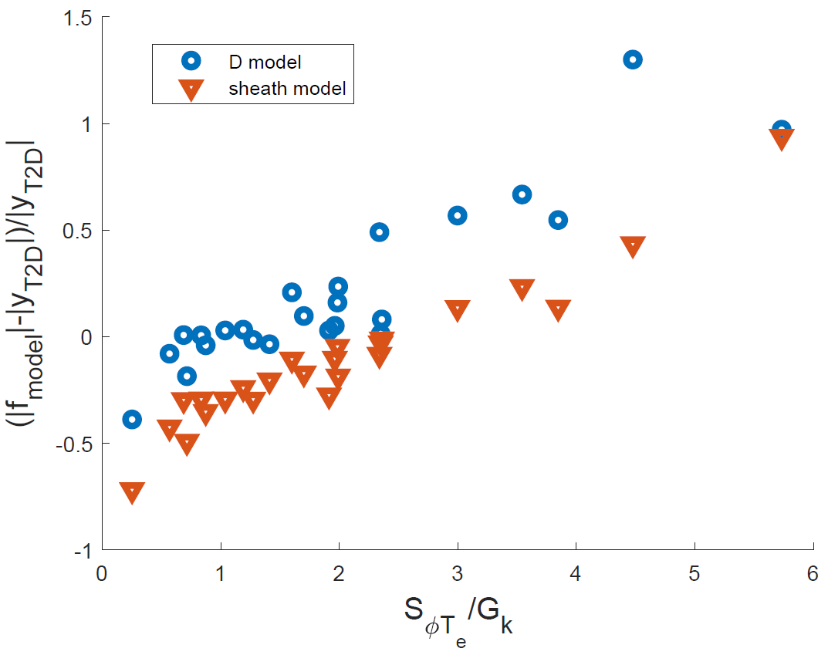

Model error $\sim S_{φT_{e}}$
Notes:
Regarding the averages of the sound speed, I used following expansion to fill these out: ${\overline{c}}_{s}=\sqrt{\tilde{T}}$ and $c_{s}^{′}=\frac{T^{′′}}{2\sqrt{\tilde{T}}}$
Similar picture obtained for the enstrophy sheath sink.
I only considered this expansion for a single simulation yet, might reprocess my database to get more data from all the simulations.
Modelling both contributions seperately will likely require quite some effort, which may not be worth it for the simplified treatment of het parallel direction in the TOKAM2D data. Rather model it well only in 3D and continue with ad hoc fitting model for now?

Slide 19
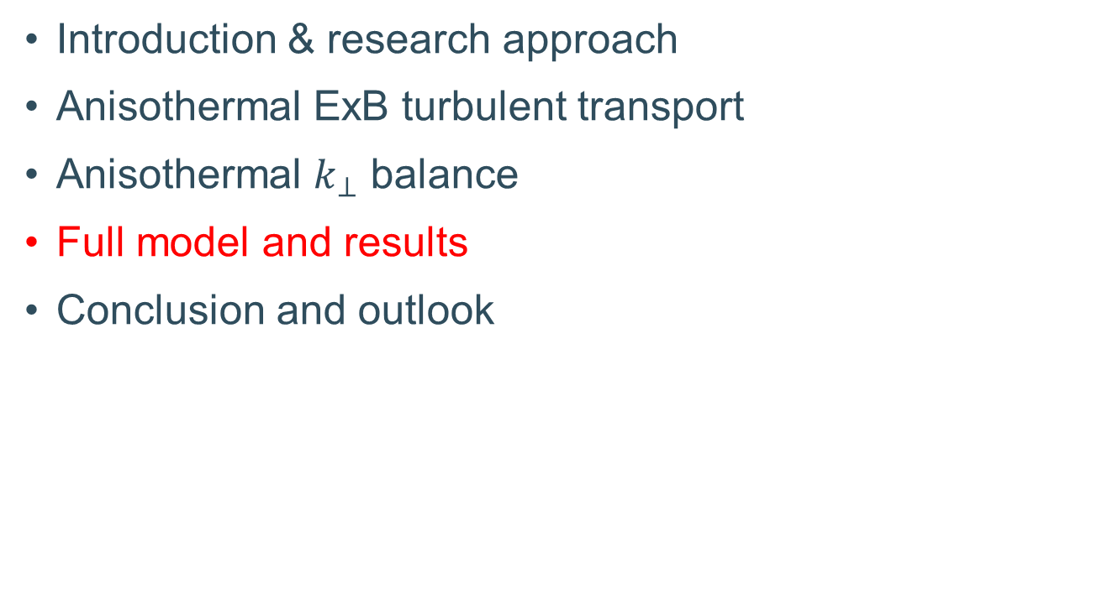
Overview
Introduction & research approach
Anisothermal ExB turbulent transport
Anisothermal $k_{⊥}$ balance
Full model and results
Conclusion and outlook

Slide 20
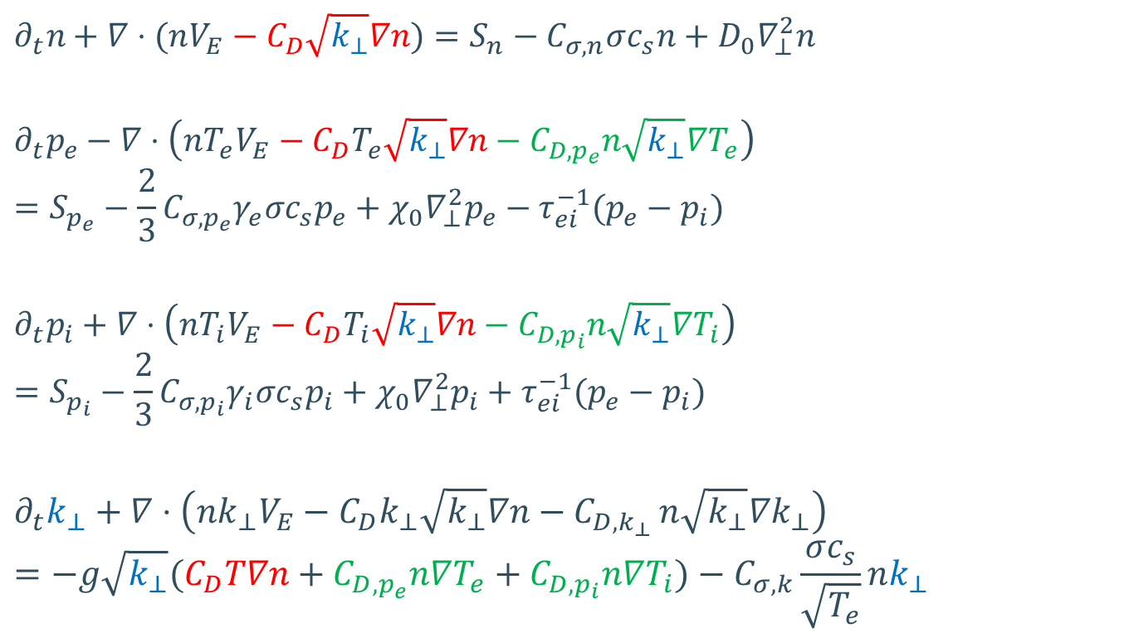

Full anisothermal $k_{⊥}$ model
$$∂_{t}n+∇⋅(nV_{E}−C_{D}\sqrt{k_{⊥}}∇n)=S_{n}−C_{σ,n}σc_{s}n+D_{0}∇_{⊥}^{2}n$$
$$∂_{t}p_{e}−∇⋅\left(nT_{e}V_{E}−C_{D}T_{e}\sqrt{k_{⊥}}∇n−C_{D,p_{e}}n\sqrt{k_{⊥}}∇T_{e}\right)=S_{p_{e}}−\frac{2}{3}C_{σ,p_{e}}γ_{e}σc_{s}p_{e}+χ_{0}∇_{⊥}^{2}p_{e}−τ_{ei}^{−1}(p_{e}−p_{i})$$
$$∂_{t}p_{i}+∇⋅\left(nT_{i}V_{E}−C_{D}T_{i}\sqrt{k_{⊥}}∇n−C_{D,p_{i}}n\sqrt{k_{⊥}}∇T_{i}\right)=S_{p_{i}}−\frac{2}{3}C_{σ,p_{i}}γ_{i}σc_{s}p_{i}+χ_{0}∇_{⊥}^{2}p_{i}+τ_{ei}^{−1}(p_{e}−p_{i})$$
$$∂_{t}k_{⊥}+∇⋅\left(nk_{⊥}V_{E}−C_{D}k_{⊥}\sqrt{k_{⊥}}∇n−C_{D,k_{⊥} }n\sqrt{k_{⊥}}∇k_{⊥}\right)=−g\sqrt{k_{⊥}}(C_{D}T∇n+C_{D,p_{e}}n∇T_{e}+C_{D,p_{i}}n∇T_{i})−C_{σ,k}\frac{σc_{s}}{\sqrt{T_{e}}}nk_{⊥}$$
Notes:
Recall that avg(p)=avg(n) tilde(T)
Note that if or $D≈D_{T}$, $Γ_{p}≈−D∇p$
Note that also the turbulent transport of k is modelled very poorly. Very weird behaviour though, uphill transport in quite some simulations. Magnitude remains small though.

Slide 21
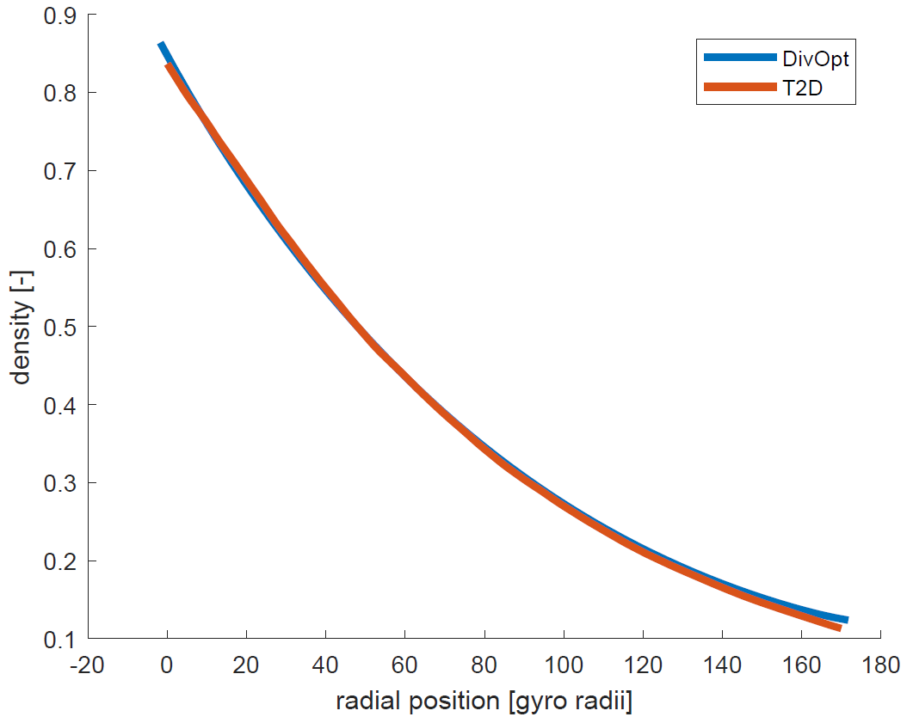
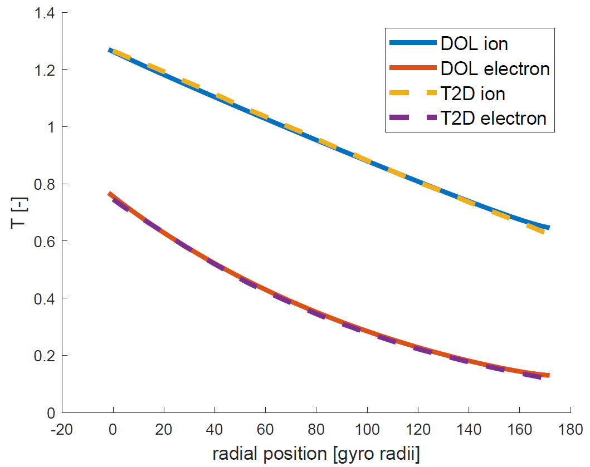
Excellent match for default case
Density
Temperatures
Notes:
Note that in this simulation, the sheath loss sink parameter has been fit to match the interchange source of this particular simulation, it is not the general parameter.

Slide 22
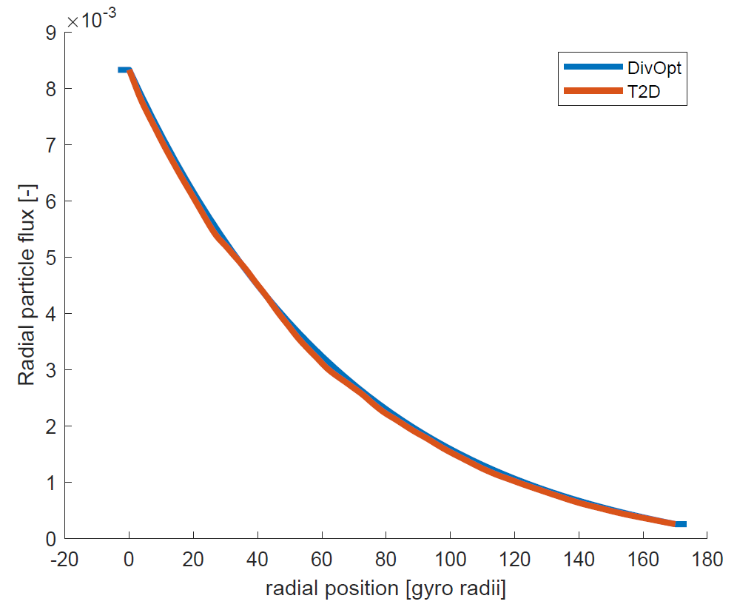
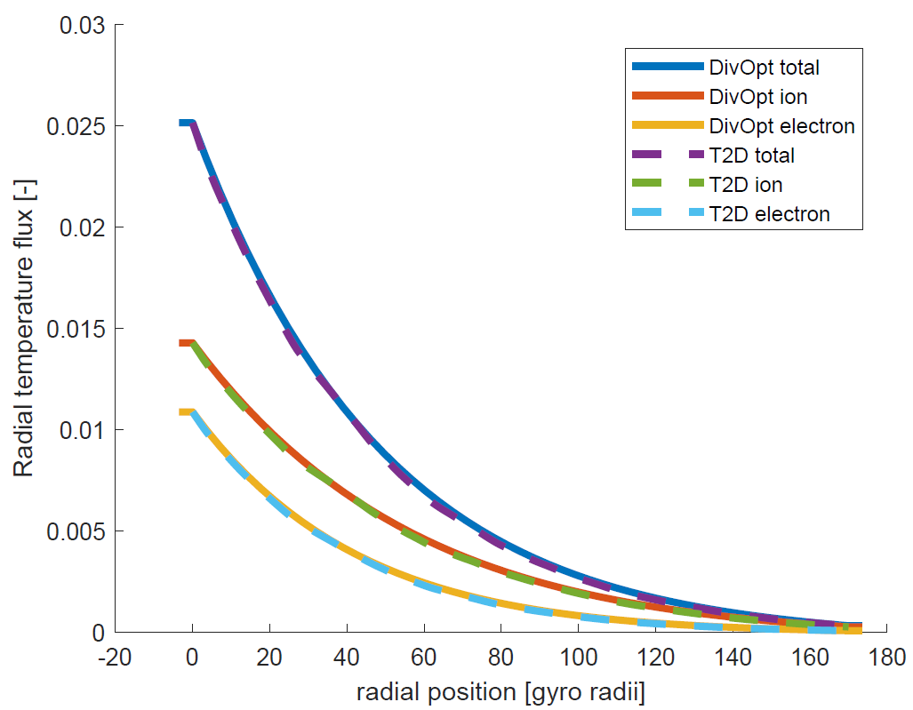
Excellent match for default case
Particle flux
Heat fluxes
Notes:
Note that in this simulation, the sheath loss sink parameter has been fit to match the interchange source of this particular simulation, it is not the general parameter.
Images still to be updated if I want to include them…

Slide 23
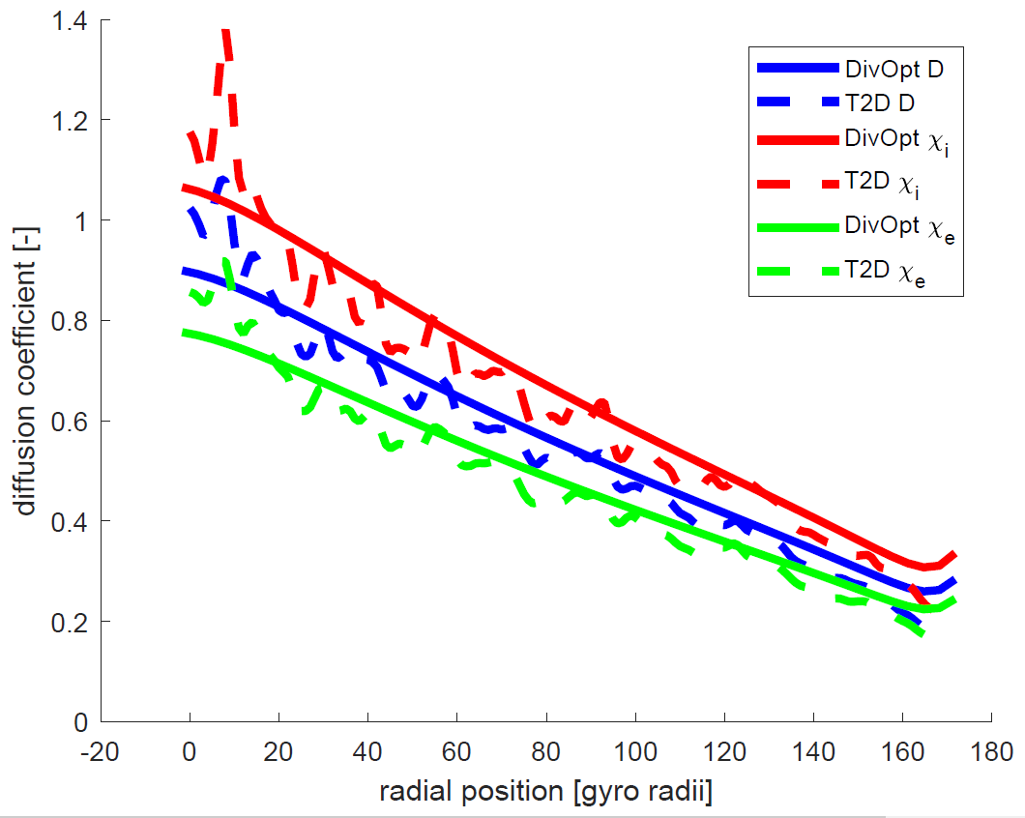
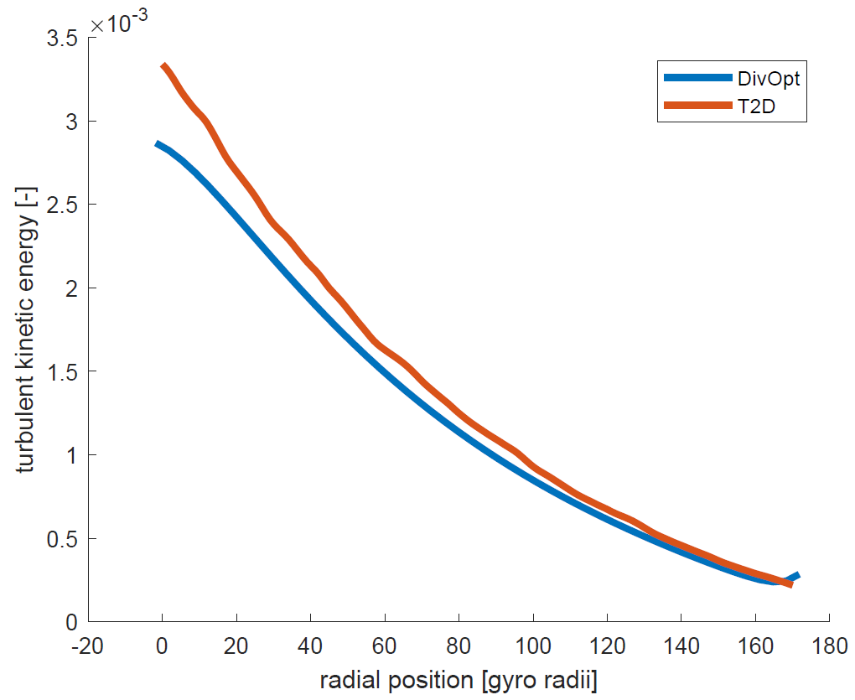
Excellent match for default case
Transport coefficients
Turbulent kinetic energy
Notes:
Note that in this simulation, the sheath loss sink parameter has been fit to match the interchange source of this particular simulation, it is not the general parameter.

Slide 24
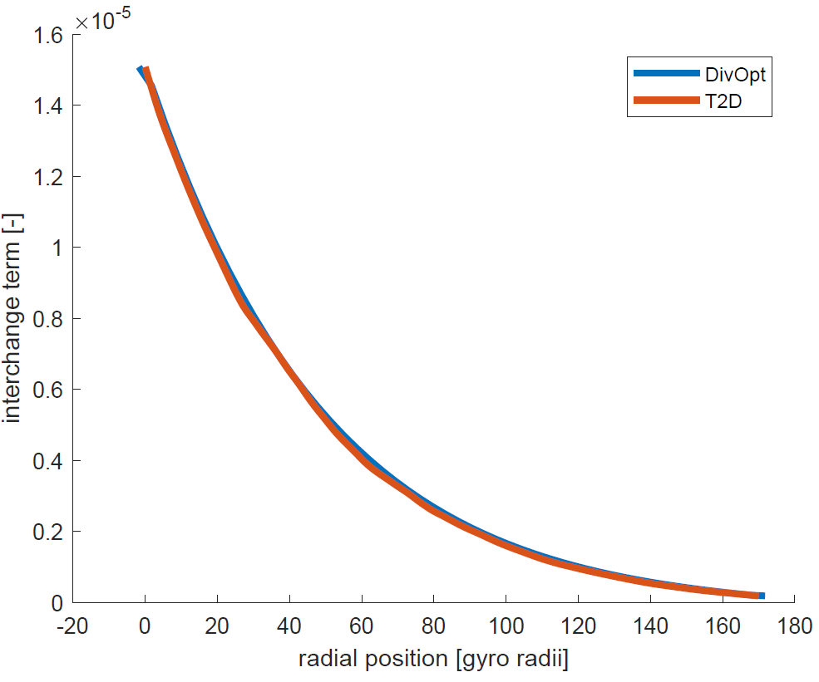
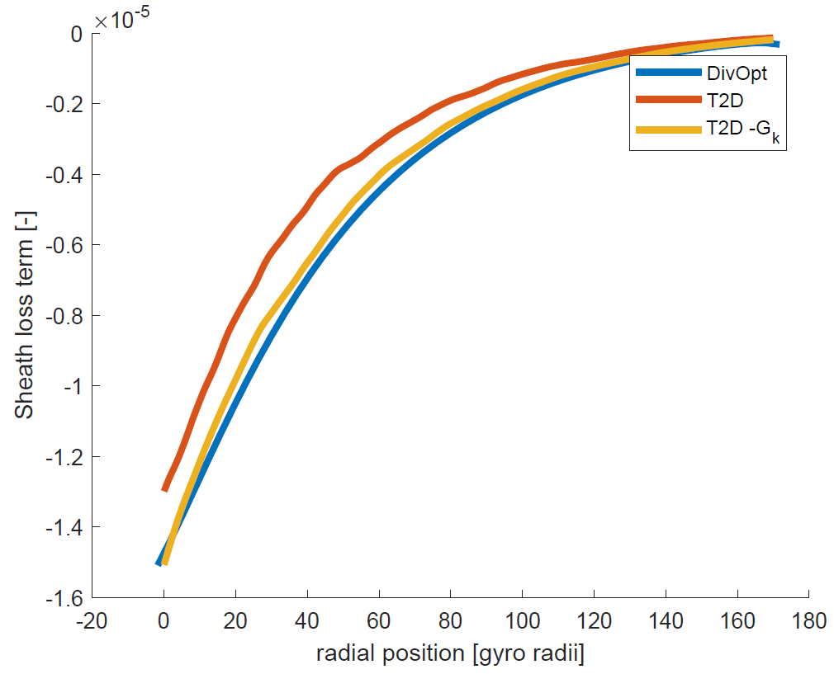
Excellent match for default case
Interchange source
Sheath term
Notes:
Note that in this simulation, the sheath loss sink parameter has been fit to match the interchange source of this particular simulation, it is not the general parameter.

Slide 25
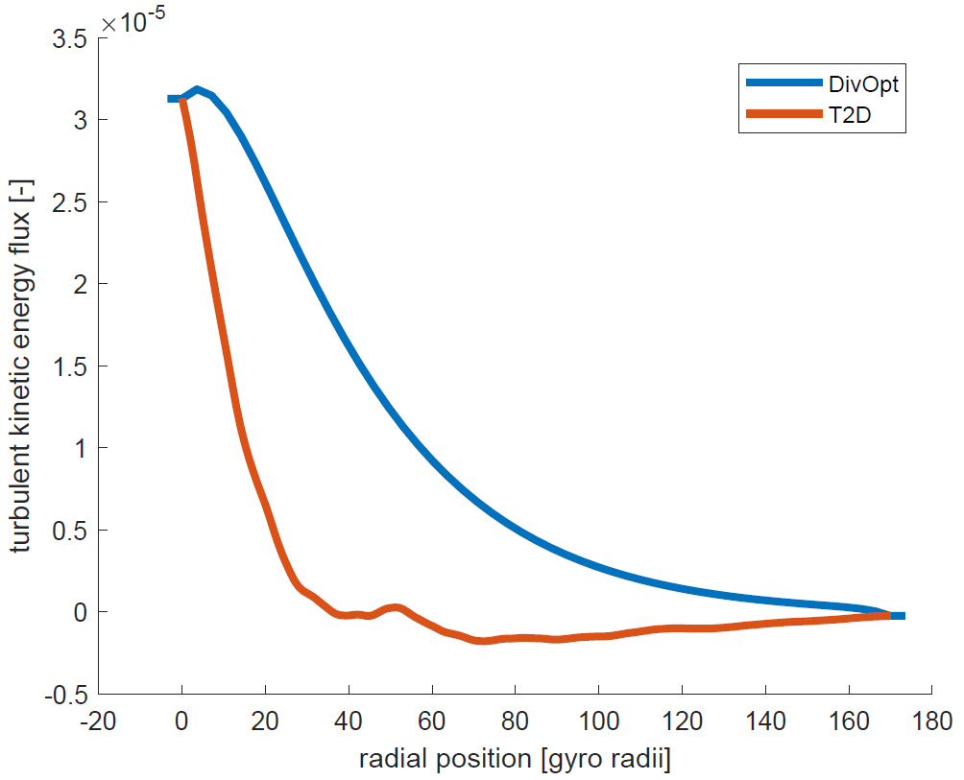


Very poor fit of $Γ_{k}$ though…
Flux of turbulent kinetic energy
$Γ_{k,t}$ inward at times
But $∇⋅Γ_{k}≪G_{k}$
Notes:
Note that in this simulation, the sheath loss sink parameter has been fit to match the interchange source of this particular simulation, it is not the general parameter.

Slide 26
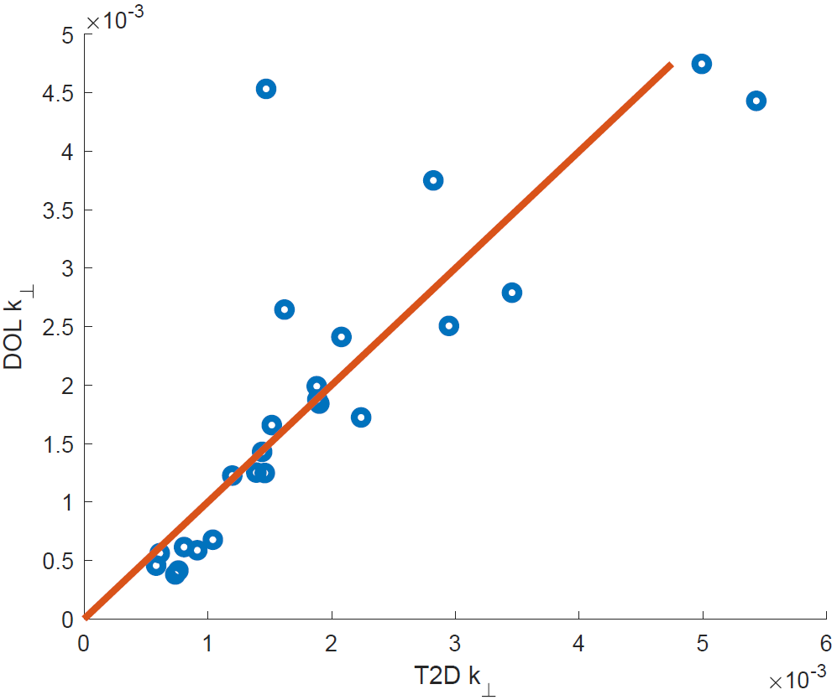
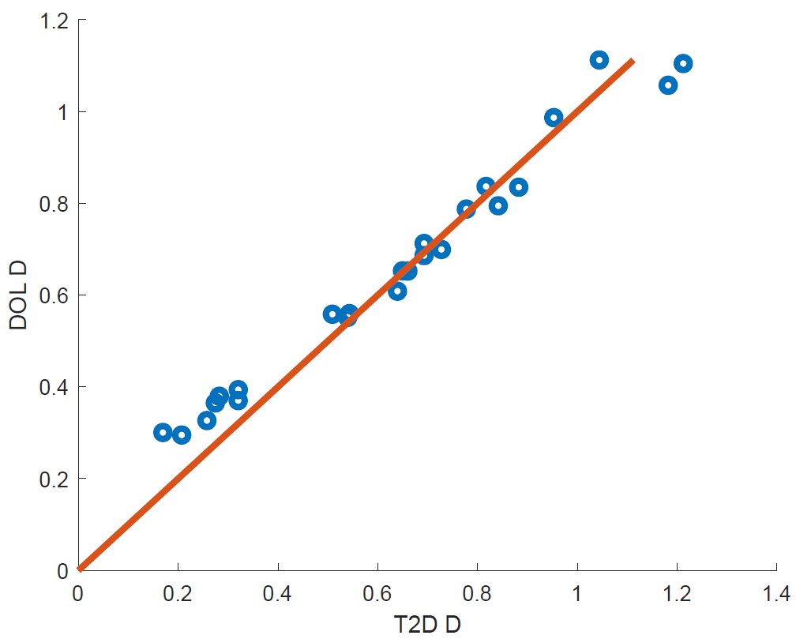

Mediocre match of accross simulation behaviour
$$k_{⊥}$$
Diffusion coefficient
Notes:
Note that in this simulation, the sheath loss sink parameter has been fit to match the interchange source of this particular simulation, it is not the general parameter.
Largest deviations in k sig02, sig05 and g12 simulations => simulations where S_phi/Gk is lowest, where drive due to SCW term is thus lowest => since the influence of SCW is spread out over the simulations (because it is not modelled), these simulations with little SCW profit from this increased model k, while it is not there in reality. In the D model, these simulations are roughly on the perfect fit line.
Cluster at low k that is slightly underestimated in DOL seem to correspond to simulations where S_phi/Gk is highest. Here, the story is somewhat the opposite. Hight SCW drive in T2D, which is not moddelled per simulation in DOL and thus underestimated in DOL for these simulations. These simulations then somehow correspond to an overestimated D still. So the low transport for SCW transport descrepancy seems to be stronger than the underestimation of SCW drive of k. Simulations in this cluster are g3, sig15, sig2, Ti2Te2, Ti2Te3sig14, Ti3Te2sig14, g4nu8.
Simulations at highest k are Ti6Te6 and Ti2Te8. Those with highest D are the same and g12.

Slide 27
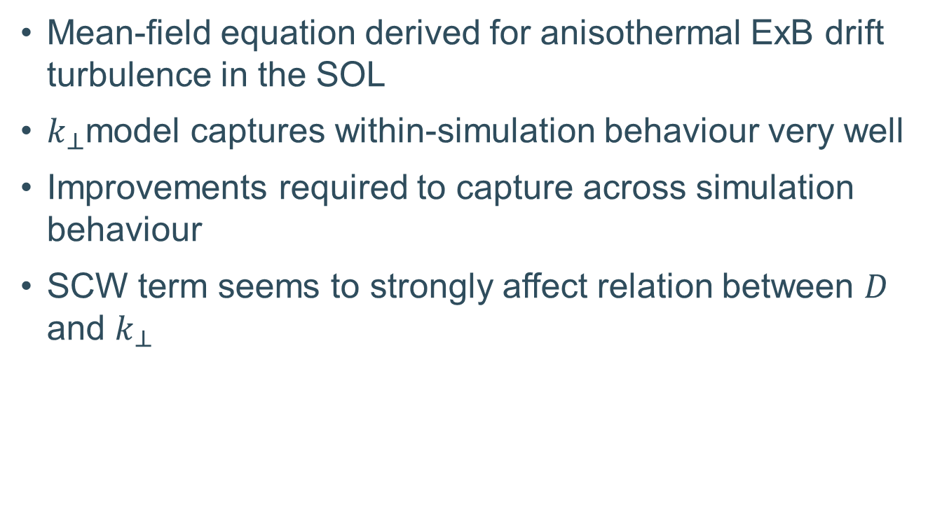
Conclusion
Mean-field equation derived for anisothermal ExB drift turbulence in the SOL
$k_{⊥}$model captures within-simulation behaviour very well
Improvements required to capture across simulation behaviour
SCW term seems to strongly affect relation between $D$ and $k_{⊥}$

Slide 28
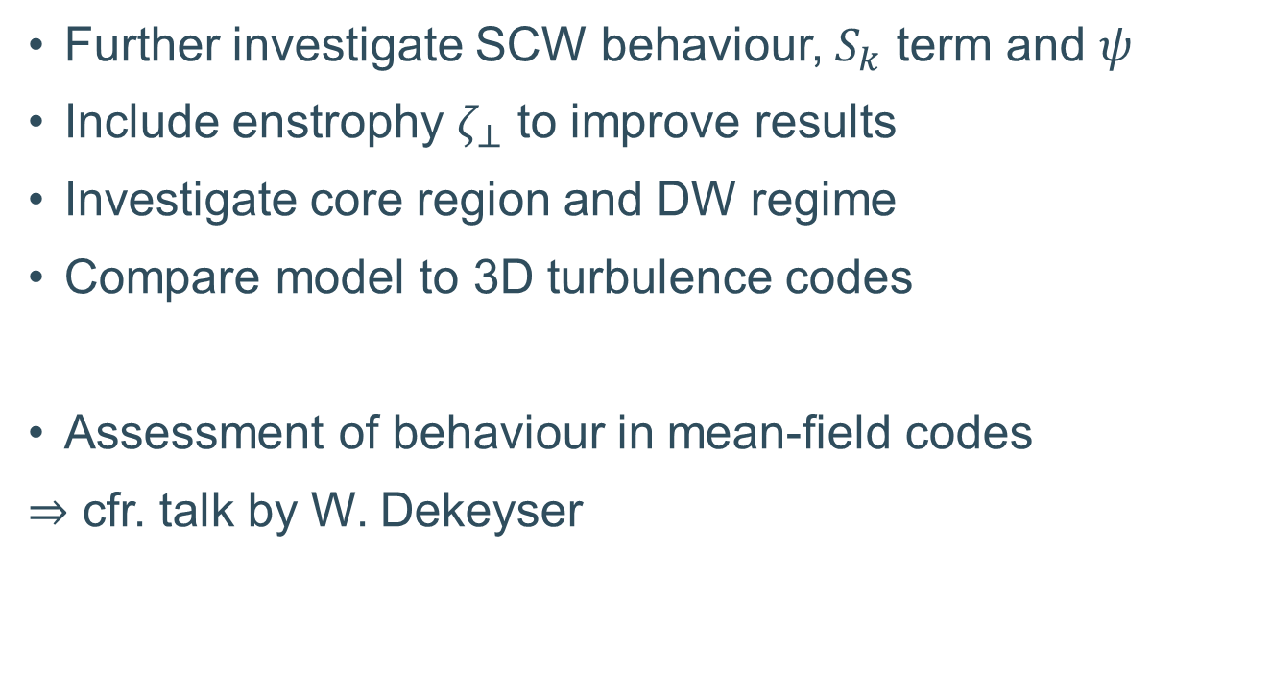
Outlook and future work
Further investigate SCW behaviour, $S_{k}$ term and $ψ$
Include enstrophy $ζ_{⊥}$ to improve results
Investigate core region and DW regime
Compare model to 3D turbulence codes
Assessment of behaviour in mean-field codes
$⇒$ cfr. talk by W. Dekeyser
[8] R. Coosemans et al., J. Phys.: Conf. Ser. (2021).
[14] R. Coosemans et al., Contrib. Plasma Phys. (2020).
[15] S. Carli et al., Contrib. Plasma Phys. (2020).
Notes:
Include $ζ_{⊥}$ to improve results?
Benefit might be limited
Increased uncertainty due to new terms to be modelled
Include the effect of shear?
Effect of best models is not enormous (see JPCS paper)
Briefly tried $D\sim \frac{k_{⊥}}{\sqrt{k_{⊥}}+S_{λ}}$ to circumvent $ζ_{⊥}$
Improve model for $S_{k}$?
Highest impact expected
However, may not be worthwile to investigate in TOKAM2D
Extend this work to the 3D case
Proper parallel physics
Assess validity in different tokamak regions
Extend this work to core region
Drift waves (3D treatment required)
Flow shear $⇒$ influence on $D$ and $k_{⊥}$
Influence of turbulence regime?

Slide 29
Questions?
Notes:
“Thank you for listening to my presentation. I would like to invite you to ask any question that you still have about my proposal.”
Of
“Thank you for listening to my presentation. I would glad to answer any questions you still have about my PhD proposal.”

Slide 30
References
[1] S. Cowley, Physics World (2010).
[2] Y. Sarazin et al., J. Nucl. Mater. (2003).
[3] S. Baschetti et al., Nuclear Materials and Energy (2019).
[4] Y. Sarazin et al., Phys. Plasmas (1998).
[5] Y. Marandet et al., Plasma Phys. Control. Fusion (2016).
[6] N. Nace, PhD thesis (2018).
[7] V.M. Canuto, Astrophys. J. (1997).
[8] R. Coosemans et al., J. Phys.: Conf. Ser. (2021).
[9] Y. G.R. Tynan et al., Plasma Phys. Control. Fusion (2009).
[10] R. Coosemans et al., Phys. Plasmas (2021).
[11] R. De Wolf et al., Nucl. Fusion (2021).
[12] C. Baudoin et al., Contrib. Plasma Phys. (2016).
[13] C. Baudoin, PhD thesis (2018).
[14] R. Coosemans et al., Contrib. Plasma Phys. (2020).
[15] S. Carli et al., Contrib. Plasma Phys. (2020).

Slide 31
Back up slides

Slide 32
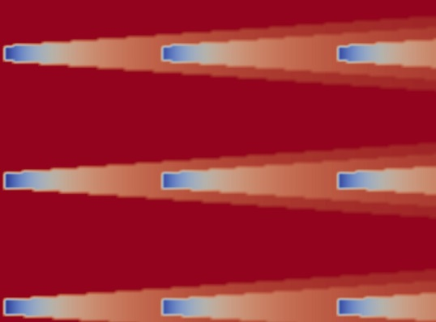



Hydrodynamic turbulence modeling strategies
Cheap
Gross approximations
Expensive
Detailed modeling
Analytical
models
Reynolds-Averaged
Navier-Stokes
(RANS)
Large-Eddy Simulation
(LES)
Direct Numerical Simulation
(DNS)
Schmidt (2014)
Calaf et al. (2010)
Sandberg and Jones (2011)
Notes:
In hydrodynamic turbulence modelling a whole framework of models exist that model turbulence in more or less detail. The DNS simulations resolve all time scales and are equivalent to the turbulence codes used in ExB turbulence. These can however not be used for design purposes due to their excessive computaional cost.
Then there are intermediate scale LES models and finally RANS models. These RANS models feature an averaged description of the flow field only, and are thus mean-field like. Averaging the governing equation introduces a number of closure terms into the equation though, which are typically modelled using the turbulent kinetic energy and the dissipation of it. This category of models is only in its infancy to the best of my knowledge, with some models already published for example by Bufferyand. The goal of our work is to bridge this gap and derive similar RANS like models for the radial transport in ExB turbulence by means of a rigorous analytical treatment.
Analytical models perhaps equivalent to Bohm scaling models, Eich scaling model from serafina,…
Beter uitleggen, korter => in HD turbulence modelling, an range of models exists that range from DNS models resolving all time and length scales of the turbulence, to very simple models which only resolve the averaged properties of the flow. We would like to develop an analogue for these last ones for ExB turublence. Research into these models has only been started relatively recently. The basic idea of these

Slide 33




RANS methodology
Reynolds averaging
Favre averaging
Example
[7] V.M. Canuto, Astrophys. J. (1997).
Notes:
Bottom example shows that in a nonlinear term, you get a mean flow, and a fluctuation based component. As in this case the densisty is involved, both can be grouped in one term using the favre average

Slide 34


Isothermal $k_{⊥}$ transport model
Average continuity equation
$$\frac{∂\overline{n}}{∂t}+∇⋅\left(\overline{n}{\overline{V}}_{E}+\overline{n^{′}V_{E}^{′}}\right)={\overline{S}}_{n}−σc_{s}\overline{n}+D_{0}∇_{⊥}^{2}\overline{n}$$
Turbulent particle flux
$$Γ_{n,t}=\overline{n^{′}V_{E}^{′}}=−D∇_{⊥}\overline{n}=C_{D}\sqrt{k_{⊥}}∇_{⊥}\overline{n}$$
Turbulent kinetic energy equation
$$\frac{∂}{∂t}\overline{n}k_{⊥}+∇⋅{\overline{Γ}}_{k_{⊥}}=gTΓ_{n,t}−C_{sink}\sqrt{σ}c_{s}\overline{n}k_{⊥}$$
[10] R. Coosemans et al., Phys. Plasmas (2021).
Notes:
Physical picture painted here is the following:
-as a certain turbulent particle flux in the direction of decreasing magnetic field originates, this causes k to increase
-this in turn leads to an increase of the turbulent particle flux => … => turbulent builds up
-reaches a balance with the linear sink of k at some point
Good fit of the data, seems to be rather robust + inherently captures ballooning as well + might be related to the gradient removal hypothesis for saturation: high turbulence levels tend to remove the source for their instability, turbulence is then just removed by transport to the sheath => intermittent vs steady state interpretation
however, Bufferand model might also compPretty different from the picture painted by Bufferend…
ly with gradient removal hypothesis: source depends on density gradient, which becomes smaller as the turbulence level increases, decreasing the drive term. This could also be saturated by a linear sink, or by parallel transport to the sheath
Very promising results
Seems to capture the dominant physics
However, poor scaling with viscosity
Not too happy with $ρ_{ref}$ in diffusive relation
because k only so far => only a velocity scale => might still require another scale, enstrophy, to have a length and a time scale

Slide 35



Isothermal $k_{⊥}$ model: profile results
[10] R. Coosemans et al., Phys. Plasmas (2021).
[11] R. De Wolf et al., Nucl. Fusion (2021).

Slide 36


Isothermal $k_{⊥}$ model: parameter space results
[14] R. Coosemans et al., Contrib. Plasma Phys. (2020).
Notes:
Again, for postprocessing of TOKAM2D data to predict D vs actuatl T2D D data. Note that for the k-enstrophy model, I removed the error of both the k and the enstrophy equation (by bringing them to the RHS), did that to improve results.

Slide 37




Isothermal $k_{⊥}$ model extensions
$k_{⊥}−ζ_{⊥}$ model
core region
Separatrix
[8] R. Coosemans et al., J. Phys.: Conf. Ser. (2021).
[14] R. Coosemans et al., Contrib. Plasma Phys. (2020).
Notes:
Left extension: k enstr model improves results, but basic physics is not changed too much
Right extension: include core region with DW dynamics. Strong shear appears, model changes required, diffusion coefficient now also needs to include shear time scale

Slide 38




Thermal energy balance
$p_{i}$ balance
$p_{e}$ balance
Notes:
Probably these surface area plots would be nice here as well

Slide 39



$ζ_{⊥}$ balance
Isothermal balance
Anisothermal balance
Interchange source
Subgrid
Viscous sink
Sheath loss sink
[14] R. Coosemans et al., Contrib. Plasma Phys. (2020).
Notes:
Approximately the same relative importance of the different terms, arguably a smallr role played by the sheath loss term
Anisothermal balance is steeper, because the temperature profile influences the profiles of k and density as well.
Enstrophy equation itself didn’t change too much either

Slide 40

Analytical anisothermal interchange model
$$G_{k}=−\overline{p^{′}V_{E}^{′}}⋅∇\ln\left(B^{2}\right)−∇\left(\overline{p^{′}φ^{′}}\right)⋅\left(∇\frac{1}{B^{2}}×B\right)$$
$$\overline{p^{′}V_{E}^{′}}=\overline{\tilde{T}{n^{′}V}_{E}^{′}}+\overline{\overline{n}T^{′′}V_{E}′}+\overline{n′T^{′′}V_{E}′}=\tilde{T}\overline{{n^{′}V}_{E}^{′}}+\overline{nT^{′′}V_{E}^{′′}}$$
$$G_{k}=−(\tilde{T}Γ_{n,t,E}+Γ_{p,t,E})⋅∇\ln\left(B^{2}\right)−∇\left(\overline{p^{′}φ^{′}}\right)⋅\left(∇\frac{1}{B^{2}}×B\right)$$
$$G_{k,T2D}=−g(\tilde{T}Γ_{n,t,E}+Γ_{p,t,E})$$
Notes:
$$p^{′}=nT−\overline{nT}=\left(\overline{n}+n^{′}\right)\left(\tilde{T}+T^{′′}\right)−\overline{n}\tilde{T}=\overline{n}T^{′′}+n^{′}\tilde{T}+n^{′}T^{′′}$$
$$\overline{nT^{′′}V_{E}^{′′}}=\overline{nT^{′′}({\overline{V}}_{E}+V_{E}^{′}−{\tilde{V}}_{E})}=\overline{nT^{′′}V_{E}^{′}}$$

Slide 41

Full anisothermal $k_{⊥}$ model
$$∂_{t}\overline{n}+∇⋅(\overline{n}{\overline{V}}_{E}−C_{D}\sqrt{k_{⊥}}∇\overline{n})={\overline{S}}_{n}−C_{σ,n}σ\sqrt{\tilde{T}}\overline{n}+D_{0}∇_{⊥}^{2}\overline{n}$$
$$∂_{t}{\overline{p}}_{e}−∇⋅\left(\overline{n}{\tilde{T}}_{e}{\overline{V}}_{E}−C_{D}{\tilde{T}}_{e}\sqrt{k_{⊥}}∇\overline{n}−C_{D,p_{e}}\overline{n}\sqrt{k_{⊥}}∇{\tilde{T}}_{e}\right)={\overline{S}}_{p_{e}}−\frac{2}{3}C_{σ,p_{e}}γ_{e}σ\sqrt{\tilde{T}}{\overline{p}}_{e}+χ_{0}∇_{⊥}^{2}{\overline{p}}_{e}−τ_{ei}^{−1}({\overline{p}}_{e}−{\overline{p}}_{i})$$
$$∂_{t}{\overline{p}}_{i}+∇⋅\left(\overline{n}{\tilde{T}}_{i}{\overline{V}}_{E}−C_{D}{\tilde{T}}_{i}\sqrt{k_{⊥}}∇\overline{n}−C_{D,p_{i}}\overline{n}\sqrt{k_{⊥}}∇{\tilde{T}}_{i}\right)={\overline{S}}_{p_{i}}−\frac{2}{3}C_{σ,p_{i}}γ_{i}σ\sqrt{\tilde{T}}{\overline{p}}_{i}+χ_{0}∇_{⊥}^{2}{\overline{p}}_{i}+τ_{ei}^{−1}({\overline{p}}_{e}−{\overline{p}}_{i})$$
$$∂_{t}k_{⊥}+∇⋅\left(\overline{n}k_{⊥}{\overline{V}}_{E}−C_{D}k_{⊥}\sqrt{k_{⊥}}∇\overline{n}−C_{D,k_{⊥} }\overline{n}\sqrt{k_{⊥}}∇k_{⊥}\right)=−g\sqrt{k_{⊥}}(C_{D}\tilde{T}∇\overline{n}+C_{D,p_{e}}\overline{n}∇{\tilde{T}}_{e}+C_{D,p_{i}}\overline{n}∇{\tilde{T}}_{i})−C_{σ,k}\frac{σ\sqrt{\tilde{T}}}{\sqrt{{\tilde{T}}_{e}}}\overline{n}k_{⊥}$$
Notes:
Recall that avg(p)=avg(n) tilde(T)
Note that if or $D≈D_{T}$, $Γ_{p}≈−D∇p$
Note that also the turbulent transport of k is modelled very poorly. Very weird behaviour though, uphill transport in quite some simulations. Magnitude remains small though.

Slide 42

Full anisothermal $k_{⊥}$ model
$$∂_{t}\overline{n}+∇⋅(\overline{n}{\overline{V}}_{E}+Γ_{n,t})={\overline{S}}_{n}−C_{σ,n}σ\sqrt{\tilde{T}}\overline{n}+D_{0}∇_{⊥}^{2}\overline{n}$$
$$∂_{t}{\overline{p}}_{e}+∇⋅\left({\tilde{T}}_{e}Γ_{n}+Γ_{p_{e},t}\right)={\overline{S}}_{p_{e}}−\frac{2}{3}C_{σ,p_{e}}γ_{e}σ\sqrt{\tilde{T}}{\overline{p}}_{e}+χ_{0}∇_{⊥}^{2}{\overline{p}}_{e}−τ_{ei}^{−1}({\overline{p}}_{e}−{\overline{p}}_{i})$$
$$∂_{t}{\overline{p}}_{i}+∇⋅\left({\tilde{T}}_{i}Γ_{n}+Γ_{p_{i},t}\right)={\overline{S}}_{p_{i}}C_{σ,p_{i}}−\frac{2}{3}γ_{i}σ\sqrt{\tilde{T}}{\overline{p}}_{i}+χ_{0}∇_{⊥}^{2}{\overline{p}}_{i}+τ_{ei}^{−1}({\overline{p}}_{e}−{\overline{p}}_{i})$$
$$∂_{t}k_{⊥}+∇⋅(k_{⊥}Γ_{n}+Γ_{k_{⊥},t})=g(\tilde{T}Γ_{n,t}+Γ_{p_{e},t}+Γ_{p_{i},t})−C_{σ,k}\frac{σ\sqrt{\tilde{T}}}{\sqrt{{\tilde{T}}_{e}}}\overline{n}k_{⊥}$$
$$Γ_{n}=−C_{D}\sqrt{k_{⊥}}∇\overline{n}$$
$$Γ_{p,t}=−C_{D,p}\overline{n}\sqrt{k_{⊥}}∇\tilde{T}$$
$$Γ_{k_{⊥},t}=−C_{D,k}\overline{n}\sqrt{k_{⊥}}∇k_{⊥}$$
Notes:
Recall that avg(p)=avg(n) tilde(T)
Note that if or $D≈D_{T}$, $Γ_{p}≈−D∇p$
Note that also the turbulent transport of k is modelled very poorly. Very weird behaviour though, uphill transport in quite some simulations. Magnitude remains small though.

Slide 43

Sheath conductive wall instability (SCW)
diamagnetic direction
C. Baudoin, PhD text (2018).
Radial direction
[12] C. Baudoin et al., Contrib. Plasma Phys. (2016).
[13] C. Baudoin, PhD thesis (2018).
Notes:
An initial diamagnetic perturbation of the temperature leads to the potential following it because of the sheath term.
The electric field in the diamagnetic direction then leads to a radial ExB drift convecting the temperature.
In the presence of a temperature gradient, this leads to a diamagnetic shift of the temperature profile (upwards in the drawing) but also to a deepening of the initial temperature perturbation, hence leading to an instability which propagates in the diamagentic direction.
This does indeed seem to be somewhat similar to a drift wave.

Slide 44




SCW suppressed in TOKAM2D
SCW1: $exp\left(Λ−\frac{φ}{T_{e}}\right)$
SCW0: $exp\left(Λ−\frac{φ}{{\left\langle T_{e}\right\rangle }_{y}}\right)$
Notes:
Note that in this simulation, the sheath loss sink parameter has been fit to match the interchange source of this particular simulation, it is not the general parameter.
Largest deviations in k sig02, sig05 and g12 simulations => simulations where S_phi/Gk is lowest, where drive due to SCW term is thus lowest => since the influence of SCW is spread out over the simulations (because it is not modelled), these simulations with little SCW profit from this increased model k, while it is not there in reality. In the D model, these simulations are roughly on the perfect fit line.
Cluster at low k that is slightly underestimated in DOL seem to correspond to simulations where S_phi/Gk is highest. Here, the story is somewhat the opposite. Hight SCW drive in T2D, which is not moddelled per simulation in DOL and thus underestimated in DOL for these simulations. These simulations then somehow correspond to an overestimated D still. So the low transport for SCW transport descrepancy seems to be stronger than the underestimation of SCW drive of k. Simulations in this cluster are g3, sig15, sig2, Ti2Te2, Ti2Te3sig14, Ti3Te2sig14, g4nu8.
Simulations at highest k are Ti6Te6 and Ti2Te8. Those with highest D are the same and g12.

Slide 45



SCW instability infuences $k_{⊥}$ and $D$

Slide 46

interchange vs SCW phase shift
Interchange instability
  $ψ=ψ_{N}−ψ_{PHI}\sim π/2$ expected
  Maximum transport for given $\hat{N},\hat{PHI}∼k_{⊥}$
SCW instability
  $ψ=ψ_{N}−ψ_{PHI}\sim 0..π/4$ expected
  Lower transport for given $\hat{N},\hat{PHI}∼k_{⊥}$
${\left\langle FFT_{y}\left(x\left(r,λ,t\right)\right) \right\rangle }_{t}$ used for spectral analysis

Slide 47




SCW instability affects phase structure
SCW0
SCW1
iso
SCW1g0

Slide 48


$D≈C_{D}\sqrt{k_{⊥}}sin⁡(ψ_{n}−ψ_{φ})$?

Slide 49


Better match of DOL for SCW0 data
$$k_{⊥}$$
Diffusion coefficient
Notes:
Note that in this simulation, the sheath loss sink parameter has been fit to match the interchange source of this particular simulation, it is not the general parameter.

