Slide 1
Application of k-epsilon model to WEST modelling and perspectives of development
S. Baschetti, H. Bufferand, G. Ciraolo, Ph. Ghendrih, E. Serre, P. Tamain and the WEST Team

Slide 2
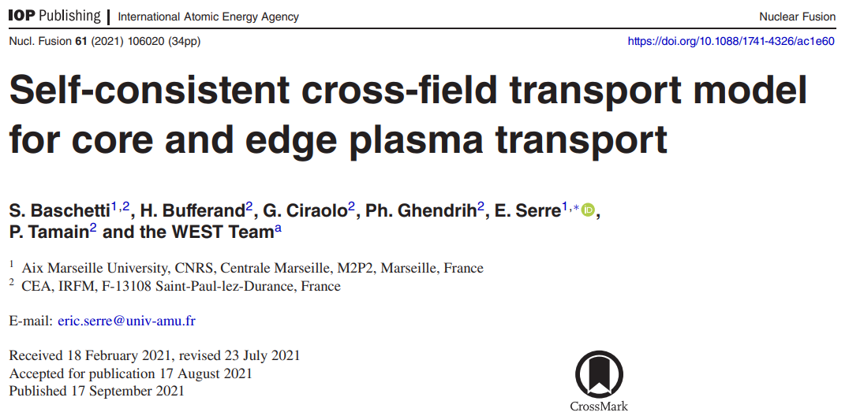
Overview
This presentation = rough summary of paper published in NF

Slide 3
What are reduced turbulence models?
Coarse-graining $\left\langle …\right\rangle$
$$∂_{t}n_{e}+\vec{∇}⋅\left(n_{e}\vec{u}\right)=S_{n}$$
$$∂_{t}{\overline{n}}_{e}+\vec{∇}⋅\left({\overline{n}}_{e}\overline{\vec{u}}\right)+\vec{∇}⋅\left\langle {\tilde{n}}_{e}\tilde{\vec{u}}\right\rangle =S_{n}$$
Mean-field
+ gradient-diffusion ansatz
$$\left\langle {\tilde{n}}_{e}{\tilde{\vec{u}}}_{⊥}\right\rangle ≡−D\vec{∇}n_{e}$$
N_{grid} free parameters
Machine /case dependent
Cpu-time: ~10kh.cpu
Mean-field reduced turbulence model
$\left\langle {\tilde{n}}_{e}\tilde{\vec{u}}\right\rangle$=?
Few free parameters
Universal
Cpu-time: $≳$10kh.cpu
Direct numerical simulation
$$∂_{t}n_{e}+\vec{∇}⋅\left(n_{e}\vec{u}\right)=S_{n}$$
No free parameter
Cpu-time: ~10Mh.cpu
Fidelity / computing time
☹ Not predictive
☺☺?
☹ Costly and slow

Slide 4
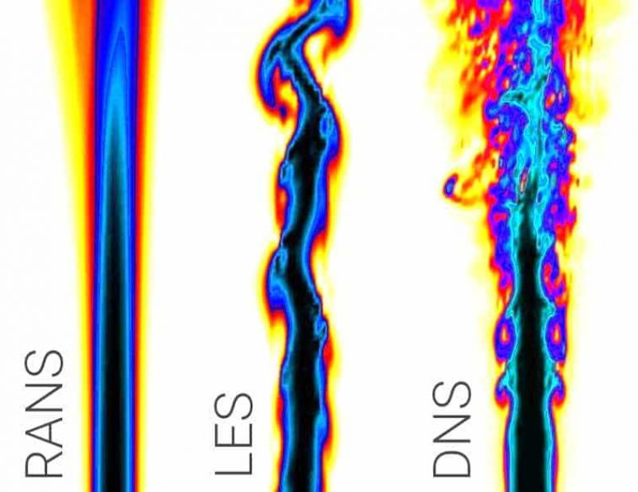
The precedent of RANS modelling in CFD
Issue (fidelity/cost compromise) already faced in CFD in the 70’s
Proposed solution: Reynolds-Averaged Navier-Stokes (RANS) models
fluctuation-averaged transport equations + equations on turbulence statistical properties
E.g.: 𝜿−𝜺 model with 𝜿 fluctuations kinetic energy, 𝜺 its dissipation rate
[Launder & Spalding (1974), Computer Methods in Applied Mechanics and Engineering. 3 (2): 269–289]
Work-horse of scoping design studies in automotive and aeronautic industries

Slide 5
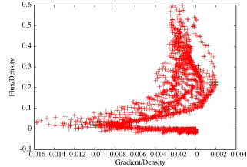
“But SOL turbulence cannot be represented by diffusion!”
“We know that SOL turbulence transport is quasi-ballistic so cannot be represented by diffusion”
True if one cares about micro-scale and high-frequency events. But if only coarse-grained solutions are sought (i.e., 95% of cases), no drop of generality to assume $\left\langle {\tilde{n}}_{e}{\tilde{\vec{u}}}_{⊥}\right\rangle ≡−D\vec{∇}n_{e}$ if relevant physics put in determining D
“But turbulent transport is non-local and does not necessarily depend on local gradients”
Who said that D should depend only on local plasma parameters? All depends on the physics included in the determination of D
“But there are other non-linearities due to fluctuations”
True, but provided enough info on turbulence properties, one can derive correction terms
A gradient-diffusion approach is not doomed to fail provided:
1- one is interested only in coarse-grained (fluctuation averaged) aspects of the edge plasma
2- relevant turbulence physics is included in the determination of transport coefficients
[Naulin et al, JNM 2007]
[Havlickova et al, JNM 2011]
[Marandet et al, NF 2011]

Slide 6
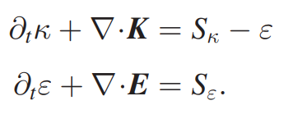
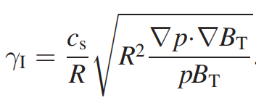
A $κ−ε$ model for edge plasma turbulence (1)
Closure needed
Heuristic approach
Generic model:
Diffusive perp. transport + second order expansion of sources:
Dimensional analysis
Interchange instability:
Kolmogorov theory

Slide 7
A $κ−ε$ model for edge plasma turbulence (2)
Closure needed
Weak turbulence regime:
L-mode SOL width scaling with only RHS [Scarabosio, JNM 2013]
Link to plasma transport:
$$D_{ω}={κ_{max}}/{γ_{κ}}→+∞$$
$$\frac{λ_{SOL}}{a}=α_{s}qρ_{⋆} ⇒ V=c_{s}ρ_{⋆}\frac{α_{s}/\sqrt{C_{ν}}}{A}\sqrt{\frac{τ_{∥}γ_{ε}^{2}}{γ_{κ}}}$$

Slide 8
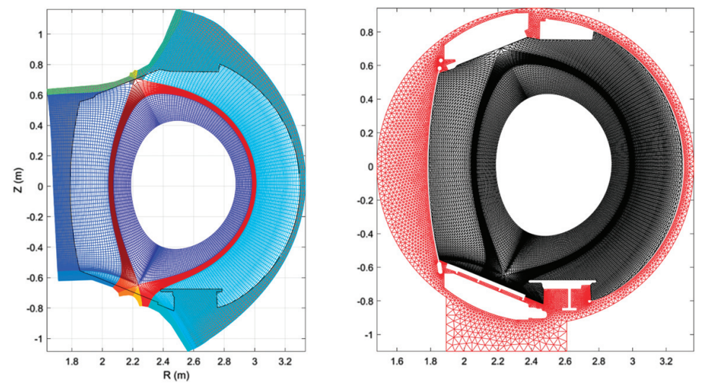
Application to WEST discharge
𝜿−𝜺 model implemented in SOLEDGE2D – EIRENE applied to WEST discharge #55049
Remaining free parameter $C_{ν}$ tuned from previous studies in TCV [Baschetti et al, 2018 & 2019] and kept the same

Slide 9
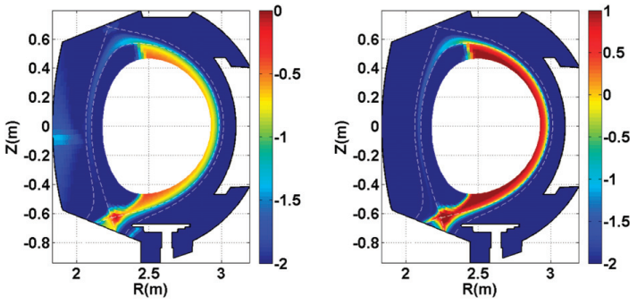
2D poloidal distribution of transport
Ballooning of turbulence and associated transport recovered self-consistently
Far SOL transport found very low => tuning of model might be necessary
$$\log_{10}{(κ[au])}$$
$$\log_{10}{(D_{n} [m^{2}.s^{−1}])}$$

Slide 10
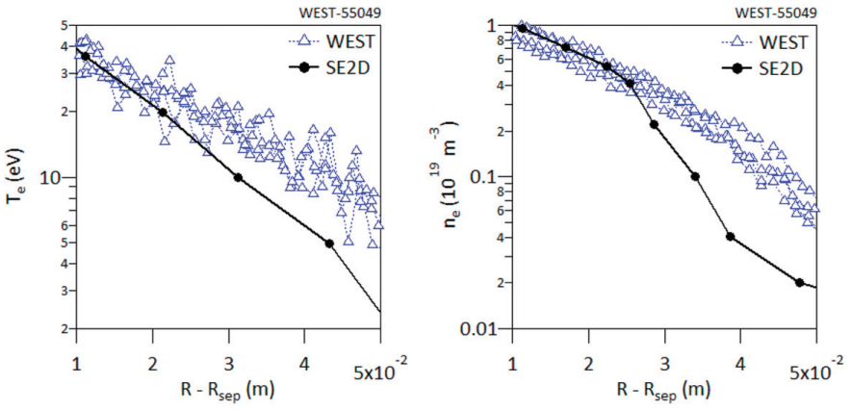
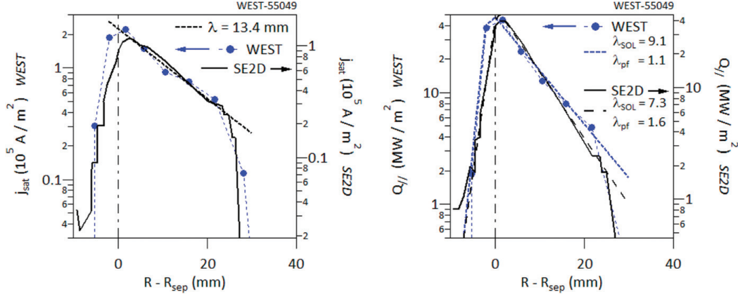
Good agreement without any parameter tuning
Mid-plane
Outer target

Slide 11
Next steps
2 main lines of development of this work:
Improvement on RANS model itself (for example to understand and solve low level of far SOL transport)
Add new instabilities in expression of growth rates
Include more physics in turbulence damping mechanisms (e.g., shear flows, 1D example given in NF paper)
Investigate models based on different unknowns (e.g., Reynolds Stress model)
Move away from heuristic approach by starting from turbulence equations
Improve closure of system by analysing database
Build up database of edge turbulence simulations in range of geometries and regimes
Regression analysis (e.g., iPoPe method [Cartier-Michaud et al, PoP 2020])

Slide 12
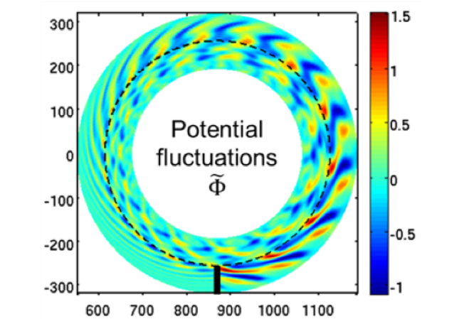
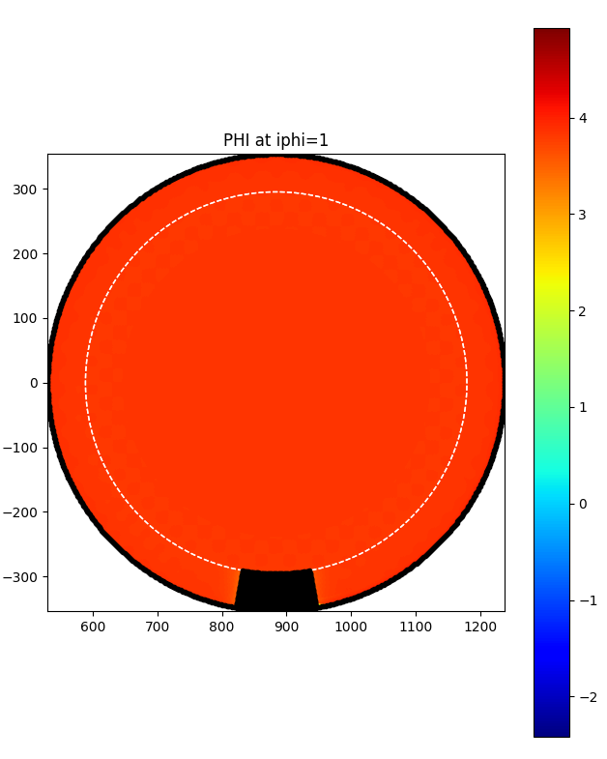
Simulations database under construction
Started running simulations for simulation database
3D slab cases (already some with TOKAM3X, currently trying to re-run with SOLEDGE3X)
Circular limited cases (already some with TOKAM3X, currently trying to re-run with SOLEDGE3X)
Diverted cases without and with neutrals
Difficulties with tangential boundary conditions
TOKAM3X
Contributions of other codes welcome (tbd) in order to rationalize computing time

