Slide 1
Conclusions: Variable Grouping and general refactoring
Eirene Streamlining Code Camp
J. Gonzalez; 10-11-2021

Slide 2
Topics discussed for variable grouping

Slide 3
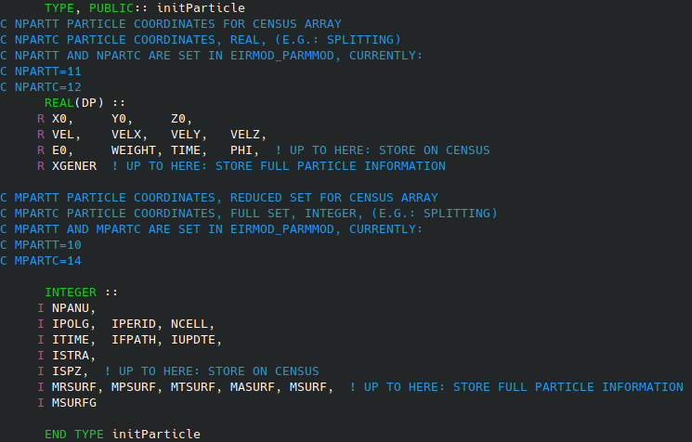
Initial particle properties
To improve clarity in EIRENE_LOCAT1, the output should be clear.
This can be easily achieved by creating a TYPE to store initial properties for the particle.
This will be an OUT argument for EIRENE_LOCAT1
No need for SAVE statement.
It clarifies the function of EIRENE_LOCAT1
Restructure USE so they are called when needed, not at the beginning of the module.
A variable of TYPE(initParticle) will be passed to LOCAT1 for writing values in.
J. Gonzalez; PMI 2021-10-21
3
21-06-2021

Slide 4
Geometry
If a generic cell is used in the main loop for streamlining, a TYPE could be a good way to approach this.
This should account for the number of cells, the neighbor information, and specific variables to deal with toroidal surfaces.
This, plus the generic unstructured grid, should eliminate almost all branching related with geometry.
J. Gonzalez; PMI 2021-10-21
4
21-06-2021

Slide 5
MPI
Variables broadcast in MPI could be grouped to reduce number of messages.
TYPEs need to be defined.
HOWEVER: these TYPEs should keep a physical meaning, not just generic variable grouping.
J. Gonzalez; PMI 2021-10-21
5
21-06-2021

Slide 6
Tally TYPE
Using existing development for HDF5.
Maybe ABSTRACT TYPE is not allowed do to AD tool. It could be achievable with it, but more code repetition is required.
J. Gonzalez; PMI 2021-10-21
6
21-06-2021

Slide 7
Trajectory TYPE
Already some work in EIRMOD_CUPD, but incomplete.
This should be highly related with tallies scoring, specially accounting for parallel wotk.
Wait for conclusions of the Toy Model.
J. Gonzalez; PMI 2021-10-21
7
21-06-2021

Slide 8
A&M processes types
A&M processes have common operations (e.g. update cross-section for MFP calculation) but very process dependent.
This could be done easily with procedures contained in each type.
It would help reduce branching (caused by collision type) and encapsulate the code.
Still, a task for the next Code Camp.
Abstract reaction type.
Wait for results about standalone work in CRM (interaction with YACORA team).
J. Gonzalez; PMI 2021-10-21
8
21-06-2021

Slide 9
MODCOL
Very used array, with very little explanation.
It could be restructured as a type in which the different indexes of the array are substituted by named variables.
J. Gonzalez; PMI 2021-10-21
9
21-06-2021

Slide 10
General variable renaiming for clarity

Slide 11
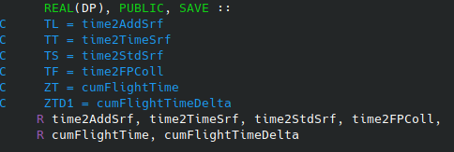
How a variable (or procedure) name should be decided
It should be a clear definition of the variable purpose.
No more 6 character variables.
Camel Case notation??
It would be useful to switch to free format.
Abbreviations should be agreed upon and consistent throughout the code. Stated in Coding Guidelines.
Mandatory for new developments, although it would be worth to provide clarity for often used variables.
Aim to have variables clear enough that no comments are required.
J. Gonzalez; PMI 2021-10-21
11
21-06-2021

Slide 12
Conclusions
J. Gonzalez; IFPAE 2021
11
05-05-2021

Slide 13
Conclusions
Eirene could greatly benefit from having more clear variables, both in naming connection and structure.
Abbreviations should be agreed upon and be consistent throughout the code.
Procedures should have a clear intent and mostly only modify variables passed as OUT/INOUT.
Statements as SAVE should be removed: it hinders parallelization and makes the code impossible to follow.
Procedures should have a clear single action (calculating position, or velocity, or cross-section…), although performance should be taken into account. Internal procedures might be a solution.
We should aim to PURE procedures within the code to improve optimization.
J. Gonzalez; PMI 2021-10-21
13
21-06-2021

Slide 14
Thank you for your attention
J. Gonzalez | Eirene Code Camp 2021

Slide 15
Title
Text
J. Gonzalez; PMI 2021-10-21
15
21-06-2021

