Slide 1

LID hydrogen desorption dynamics
Spectroscopic Observations
30.3.2020 I Miroslaw Zlobinski, et al.

Slide 2
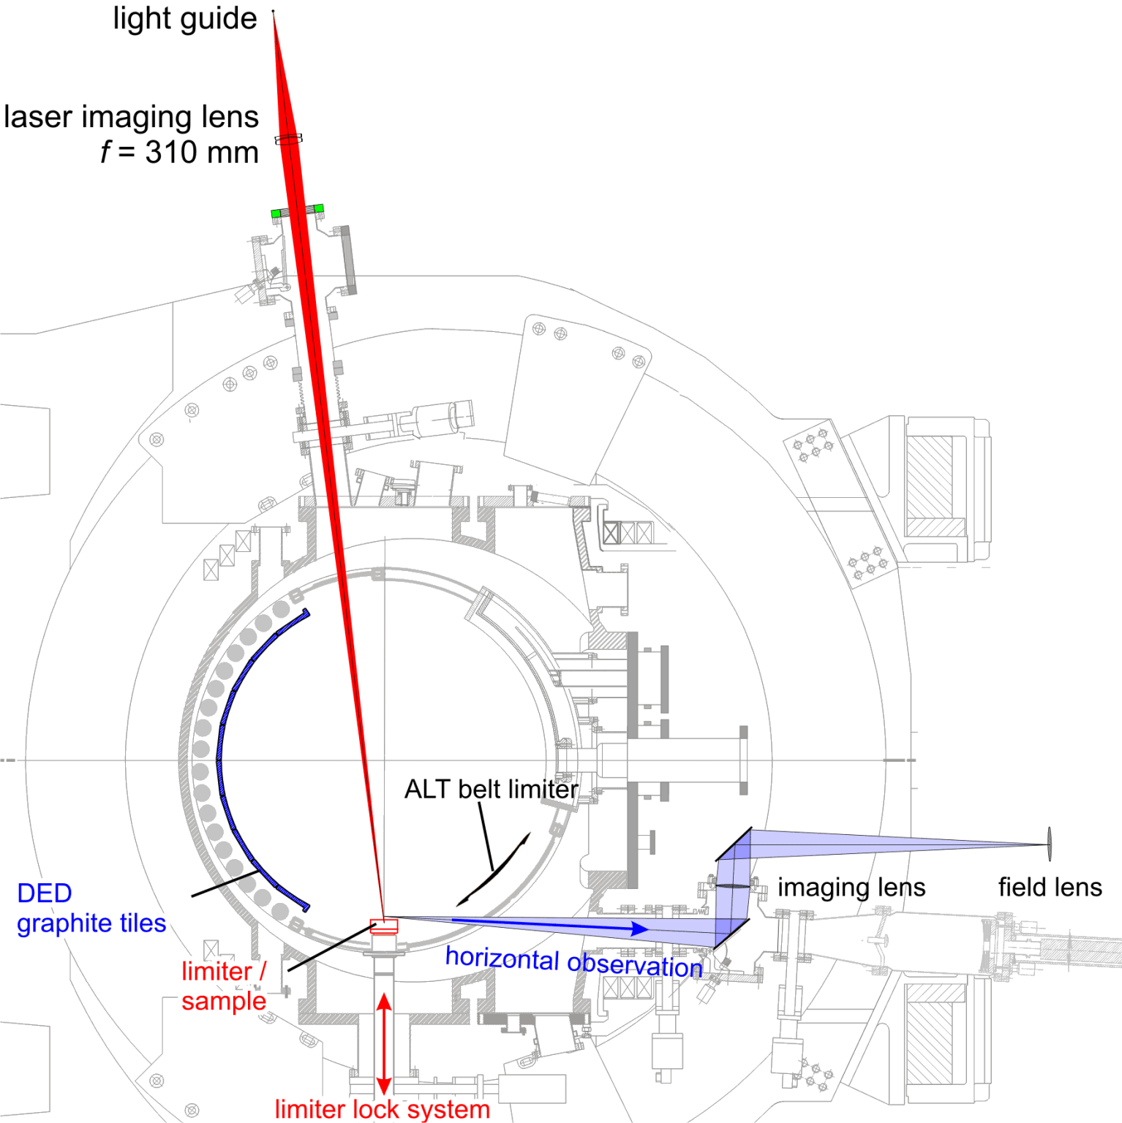
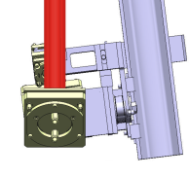
Spectroscopic setup at TEXTOR
coaxial observation (CO)
fibre to hi-resolution spectrometer
(5-15 pm), 2 Hz, range: 363-715 nm
synchronized with laser
monitoring diode
laser fibre optics, 400 µm core diameter, 30 m
vertical observation (VO)
IR camera (3 types):
10 – 3500 Hz
300 – 7000 K
8 bit VIS camera
50 Hz, 0.2 Mpixel
with image intensifier
coaxial laser injection
LASAG
and observation sytem
(CLIO)
Nd:YAG Laser
1064 nm
E_{max} = 50 J / pulse
f=250
11
920
CaF₂
lenses
neutral density and spectral filters
1140
PK16
f=360
100
PK27
horizontal observation (HO)
integrating spectrometers
polychromator
400
several fast diodes with spectral filters to observe selected wavelength emission
path in vacuum:
2200 mm
liner (r=550)
LCFS (r=460)
7°
7°
SOL (r>460)
9
HFS
spatially resolving spectrometer
LFS
toroidal
field coil
(r=470)
920
150
10b
f=630
200
f=560
14 bit digital VIS camera
100 Hz, 0.3 Mpixel,
synchronized with laser,
with gateable image intensifier (10 ns – 60 s)
(r=477)
1050
PK21
2
PK14
R = 0
R = 1750

Slide 3
Spectroscopic observation
Typically hydrogen desorption shorter than laser pulse.
With increasing layer thickness the desorption duration increases.
Only for very thick layers a fraction of desorption continues after laser pulse.
(during spot temperature decay)
W surface
without layer
=> for camera observation: integration time of 5 ms was selected
3

Slide 4
Spectroscopic observation with fast camera
fast camera observation through H_{α} filter
with 2500 Hz, 0.4 ms/frame
5 ms laser pulse duration
desorption from 200 nm a-C:D layer on graphite
4
[Irrek 2008, hdl.handle.net/2128/3621]

