Slide 1

LID rastering mode
Examples and requirements
30.3.2020 I Miroslaw Zlobinski, et al.

Slide 2
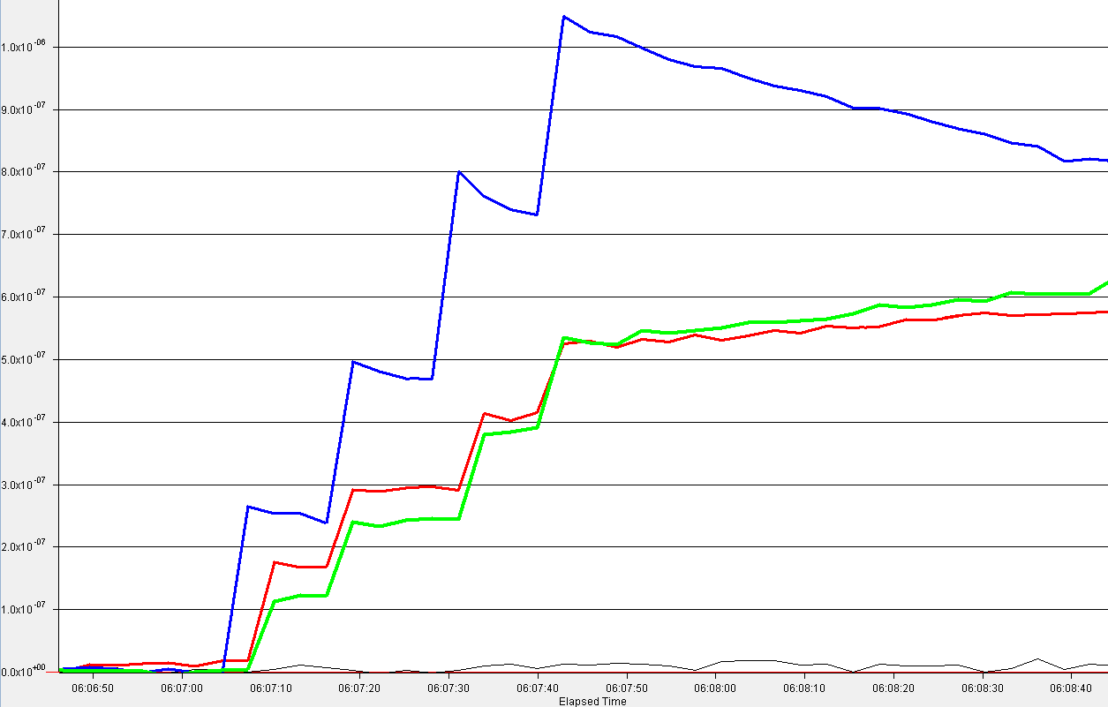
LID spot position scan (rastering mode)
10 µm Be/D layer
with 1.5 at% D
on bulk W substrate (ITER grade)
layer produced in laboratory by
magnetron sputtering
Laser pulses every 5 mm
=> spots not overlapping
(3 mm spot diameter)
Pumping:
all pumps off
all ionisation gauges off
remaining pumping effect
probably due to
ionisation in QMS itself
wall effects
QMS signal (MKS)
mass 4
mass 3
mass 2
2
[shot1077-1180] FZJ087

Slide 3
LID spot position scan (rastering mode)
2 speeds possible:
Slow rastering with intermediate RGA data points
=> evaluation of each step/pulse individually
(extrapolation of pumping effects necessary if pumping time constant ≥ duration between laser pulses)
Fast rastering within one cycle of RGA acquisition
=> accumulated evaluation
(pumping effects can be neglected as they are slower than desorption duration for all laser pulses)
requirement: fast movable mirrors
3

