Slide 1

LID spot temperature measurements and simulations
Examples and requirements
30.3.2020 I Miroslaw Zlobinski, et al.

Slide 2
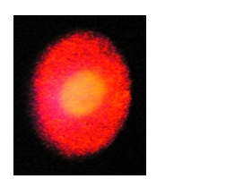
LID spot temperature on bulk W
For short pulses: agreement of analytic,
numeric calculation and measurement
within ~100 K (acceptable)
point pyrometer spot
Laser spot (Ø 3 mm)
W surface
without layer
ANSYS simulation
2

Slide 3
Effect of surface reflectivity on LID spot temperature (W surfaces)
all with W on top surface but still difference in reflectivity up to factor 2
(due to different porosity in CFC and coating coverage)
for comparison:
34 at% C, 25 at% D, 25 at% H, 10 at% W, 5 at% O, 1 at% B
3

Slide 4
Effect of surface reflectivity on LID spot temperature (layer effect)
a-C:H layer = amorphous hydrocarbon layer
Layer growth can lead to
reflectivity change of factor 2
4

Slide 5
Effect of layers on LID spot temperature (heat curvature effect)
Density * Heat capacity (ρc) increase in the layer
leads to different time evolution, but same max. temperature
This effect can be used to deduce information about the layer
5

Slide 6
Effect of layers on LID spot temperature (heat offset effect)
heat conductivity increases => lower max. temperature in already heated spot
Effect appears esp. if layer material different than substrate
Layer growth => increase in surface temperature (if no adverse reflectivity change)
Temperatures could be measured without layer => with layer a lower boundary for the temperature is known
=> only overheating should appear with layer (neglecting possible reflectivity effects + assuming laser reproducibility)
6

