Slide 1
In-vessel IR fibres
Anna Widdowson, Mikhail Maslov

Slide 2
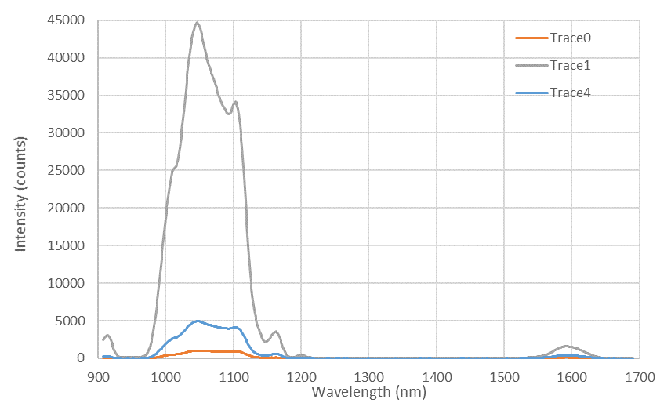
Fibre response 910-1690 nm
Spectrometer NIR 910-1690 nm
1st strong transmission region: 1000-1100 nm
2nd transmission region: >1550 nm (to ? nm)
Decrease is response of spectrometer after 1600 nm therefore transmission after this not known.
NO transmission ~1175-1550 nm.
Transmission is possible at two IR wavelengths for emissivity measurement.

