Slide 1
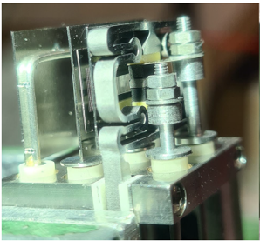
Diagnostic Pressure Gauges
55.G3
Work done by
F4E
&
IPP Garching
Philip Andrew

Slide 2
Content
ITER neutral pressure measurement
Diagnostic Pressure Gauges (DPG)
  Location
  Description
  R&D
Development in Gauge emission source
  Filament
  Indirect heating
  Emitter clamp
Summary

Slide 3
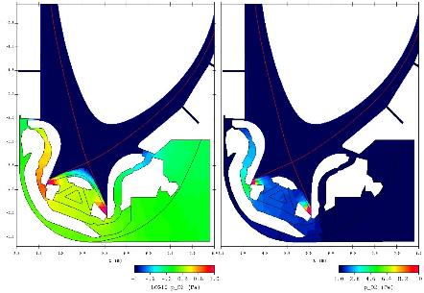


Neutral gas pressure in ITER
Pressure of neutral gas between plasma and vacuum vessel
  Main source of gas: neutralization of plasma where it contacts divertor
  Gas pressure and flow affects impurity and He ash exhaust
  Numerical simulation of neutral pressure:
< 0.01 Pa
Log₁₀ p_{n} (Pa)
P_{n} (Pa)
5 Pa
1 Pa

Slide 4
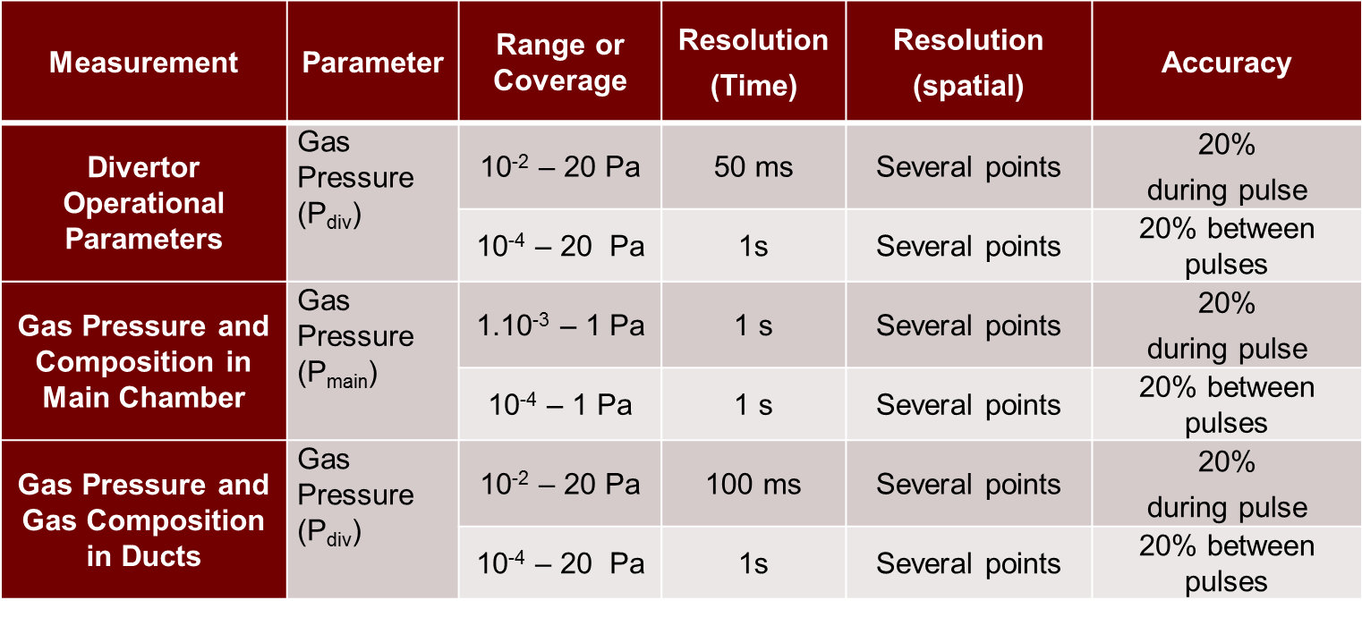
Neutral Pressure Measurement
ITER measurement requirements
  Locations, pressure range, response time

Slide 5
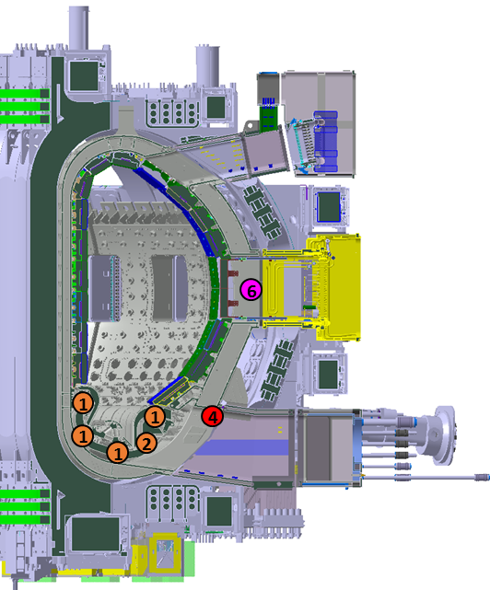
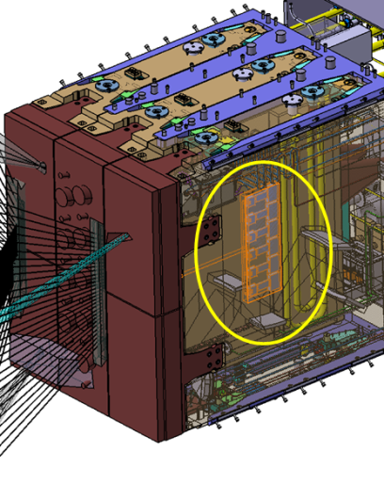
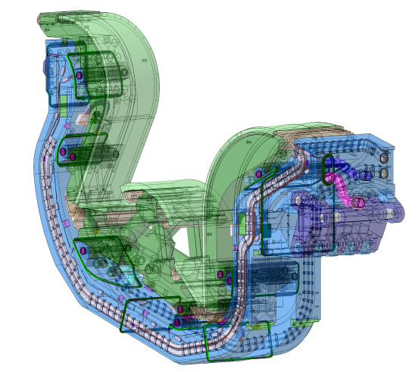
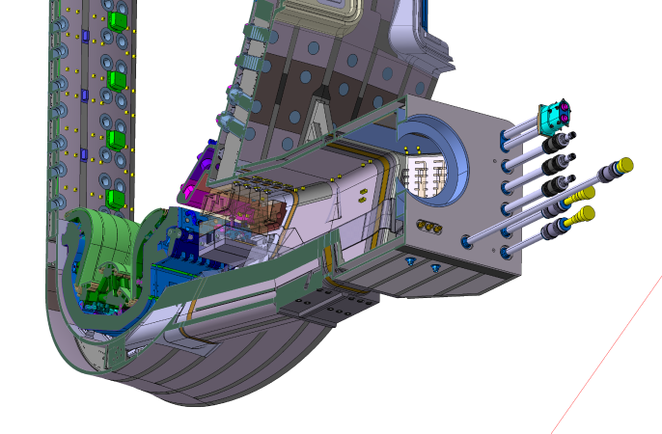
DPG Distribution in ITER
6 DPG heads (5 spares) in each of 2 Equatorial Port Plugs (#1&1))
Poloidal cross section of ITER
6 DPG heads (1 spare) in each of 4 Divertor Cassettes (# 8, 23, 26 44)
4 DPG heads (3 spares) in each of 4 Lower Ports (#4, 6, 12, 18)

Slide 6
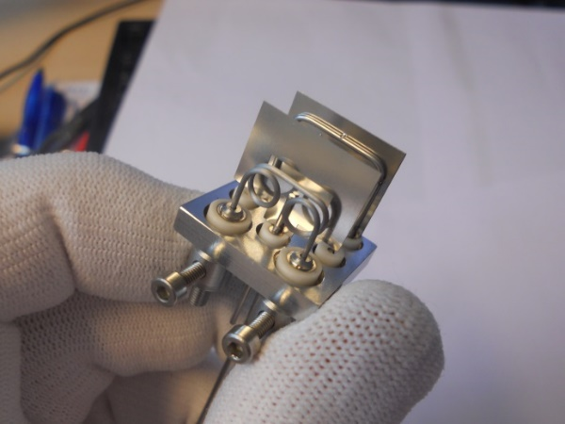
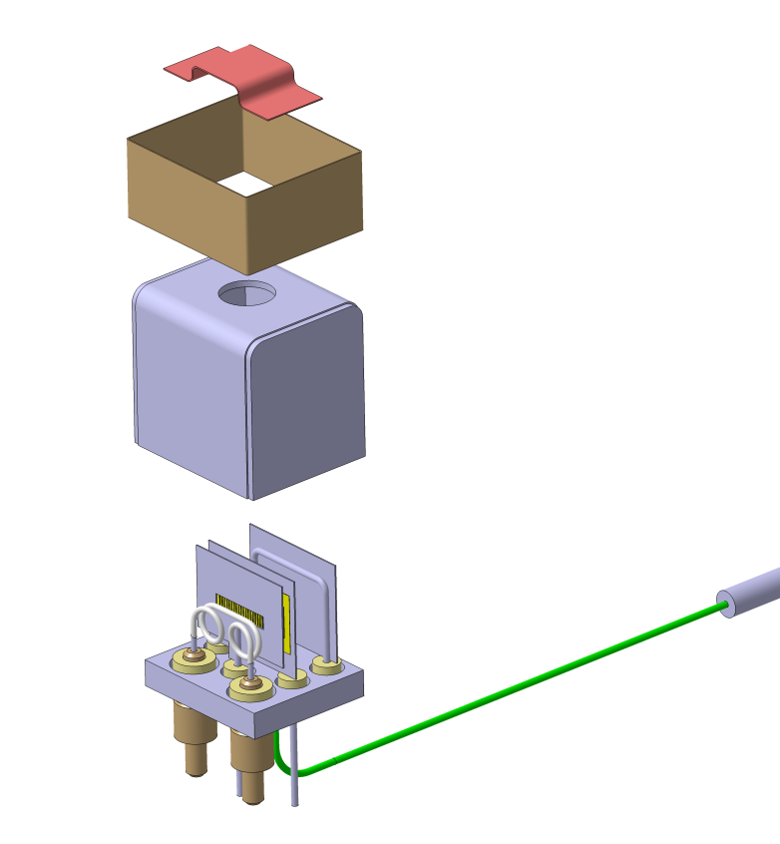
Diagnostic Pressure Gauge: ionization gauge
Prototype produced by IPT-Albrecht
Ion collector
Baffle bridge
Baffle ring
Acceleration grid
with different transparencies
Housing
Ceramic insulators
Brazing CB 10
Ag 64,8 Cu 25,2 Ti 10
Filament Ø 0,8
different materials, different coatings
Brazing Au82 Ni18
Control electrode
Base plate
Filament supports
Material Molybdenum
Thermocouple

Slide 7
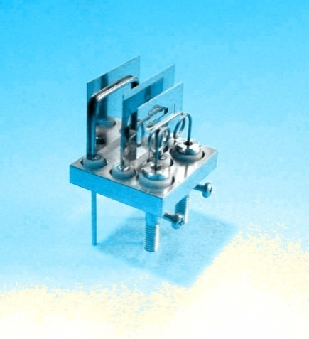
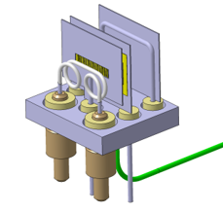

problem with hot filament:
ASDEX Pressure Gauge
with filament emitter
1900 K
25A

Slide 8
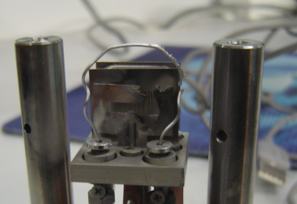
Extreme example of problem with hot filament:
ASDEX Pressure Gauge
with standard filament
ASDEX Pressure Gauge with std filament
Removed from EAST tokamak
Filament over powered & yielded (cause not fully understood)
Acknowledgement: Houyin WANG & EAST team in Hefei, China

Slide 9
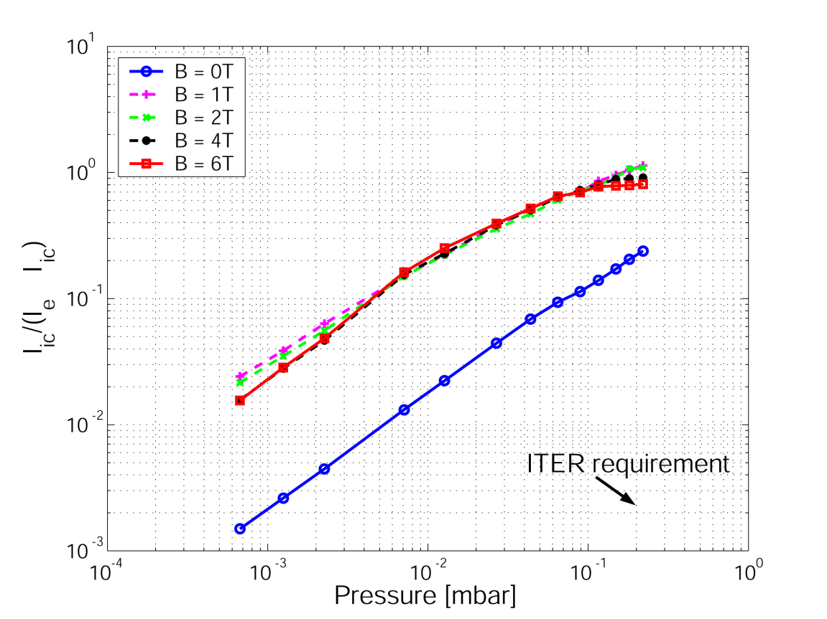
Main Technical Issues for implementation on ITER
Filament life
  Higher i ₓ B force
  Longer total “filament on” time
Extended pressure range
  Saturation effect at high pressures
Sensing ion current at 200m distance
  Pre-amplifiers typically used would be in excessive radiation environment
  Risk of cross talk over various junctions along the cable length
Ion Current vs Pressure
II

Slide 10
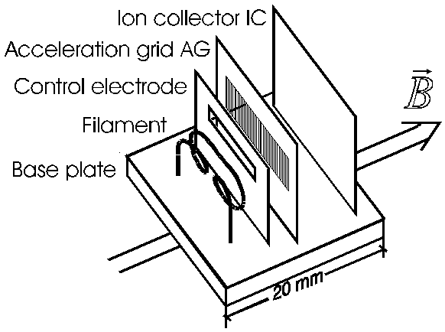
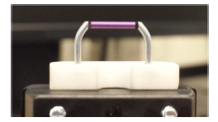
Variant of ASDEX gauge developed by W7X team
Pressure Gauge with LaB₆ source
Pressure Gauge with W filament
Molybdenum posts
Graphite heaters
LaB₆ crystal
Tungsten Filament

Slide 11

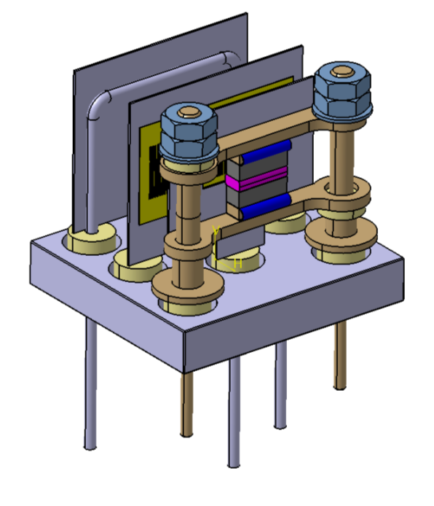
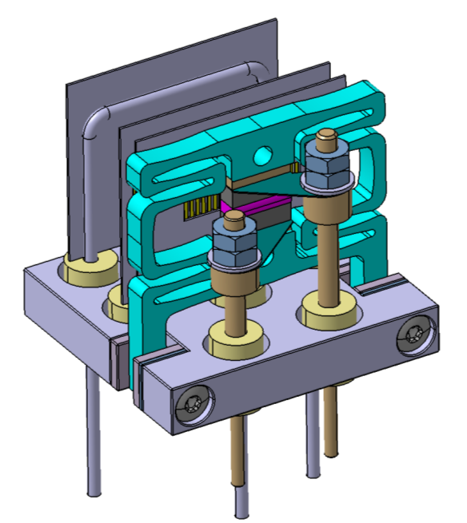
Emitter change for ITER Gauge
ZrC
Electron emitter
Graphite heaters
Material choices: ZrC expected to be more radiation resistant
Geometric choices: ZrC could run hotter than LaB6, need compliant emitter support

Slide 12
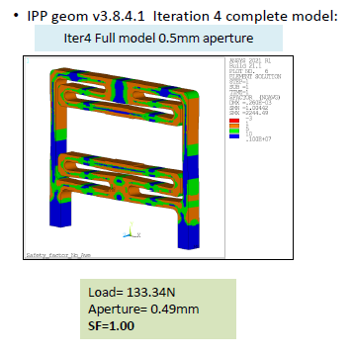
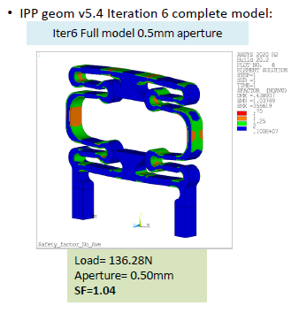
Emitter stack and frame geometry optimization
Frame geometry → provide compression and remain elastic during stack expansion
Emitter geometry → reduce heating current and power providing stable performance
Stress distributions

Slide 13
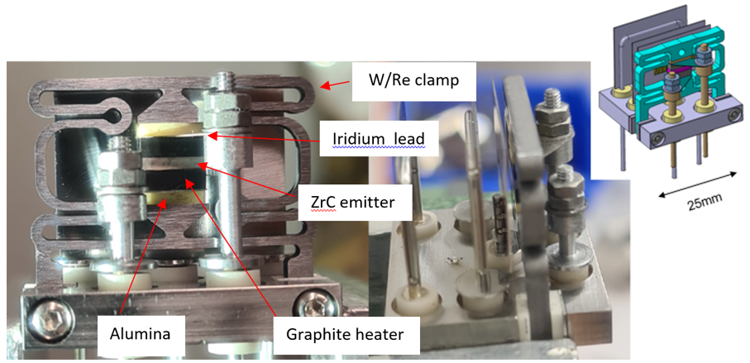
ZrC emitter with frame
frame
Prototype produced by IPT-Albrecht
Emitter assembled at IPP Garching

Slide 14
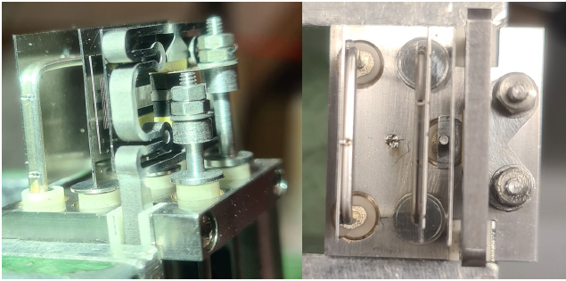
ZrC emitter with frame
Prototype produced by IPT-Albrecht
Emitter assembled at IPP Garching

Slide 15

Summary
Pressure gauges design modification after Preliminary Design Review
  W filament replaced by polycrystalline ZrC
  No more issue with Lorentz force on filament
  Electrical resistance heating of electrical feedthrough reduced greatly ( 25A -> ~ 8 A )
  Operation more stable and reproducible
Final Design Review is scheduled for May 2022
Experimental validation of final design is ongoing

