Slide 1
ITER R&D priorities for pure He plasmas on JET/AUG
R. A. Pitts and A. Loarte
On behalf of the Science Division Science, Controls and Operation Department
ITER Organization, Route de Vinon-sur-Verdon, CS 90 046, 13067 St. Paul Lez Durance Cedex, France
The views and opinions expressed herein do not necessarily reflect those of the ITER Organization.

Slide 2
Supporting R&D for the ITER Research Plan
R&D Workbook covers required research areas in support of the IRP development
3 priority categories identified:
Outcome of R&D can have major impact on system design or on the IRP (e.g. modifying overall experimental strategy in each phase or the objectives of the phases themselves)
Outcome of R&D expected to have medium impact on system design or on the IRP (e.g. modifying significant details of experimental strategy to achieve objectives in each phase)
Outcome of R&D expected to optimize details of IRP experimental strategy to achieve objectives in each phase by providing relevant experience
R&D to support ITER Research Plan
ITER Research Plan

Slide 3
Most relevant He plasma R&D Workbook items
B.2. Stationary H-mode plasmas, ELMs, ELM control and impact on H-mode and power fluxes
B.2.1: He H-mode operation with W PFCs and ELM control
B.2.2: Mixed H+~10% He H-mode operation and ELM control
B.2.7: Fueling of He H-mode plasmas
B.3: Characterization and control of stationary power fluxes
B.3.1: Divertor power flux deposition width in ITER H-mode plasmas
B.3.6: Wall power/particle fluxes in ITER H-mode plasmas
B.3.7: Radiative divertor operation in He H-modes
B.4: Plasma-material/component interactions and consequences for ITER operation
B.4.1: Be wall erosion in He plasmas
B.4.2: He plasma modification of W mechanical properties at high fluences
B.4.3: Formation of fuzz by He/W interaction and critical fuzz thickness

Slide 4
Key IRP needs relevant to pure He operation
ITER should demonstrate H-mode operation in the PFPO (non-nuclear) phases to develop scenario and control schemes for FPO
Margin in power to access H-mode in PFPO is small (or non-existent) in hydrogen plasmas, but much higher in helium
H-mode threshold in H and He will be assessed in PFPO and, if expectations confirmed and scenarios viable, H-mode operation will be performed in He
5 MA/1.8 T (PFPO-1)
7.5 MA/2.65 T (PFPO-2)
Plasma species | P_{L-H} (MW) n_{e} = 0.5 n_{GW} | P_{max} (MW)
H | 22 | 20 (+10*)
He | 16 | 20 (+10*)
Plasma species | P_{L-H} (MW) n_{e} = 0.5 n_{GW} | P_{max} (MW)**
H | 58 | 53 (+10*)
He | 38 | 73 (+10*)
*Possible P_{ECH} upgrade from start of PFPO-1
**Includes NBI → only hydrogen beams in PFPO. But very low beam fueling in ITER.

Slide 5
A note on margin to P_{L-H}
Upgrade to full set of 27 ELM control coil power supplies proposed at ITER STAC-27 (May 2021) supported:
Aim to have complete ELM control capability available from PFPO-1
But margin to P_{L-H} even in He plasmas at 1.8T/5 MA (PFPO-1) is small:
Clear evidence from JET/AUG that He H-mode scenarios viable in metallic environment gives strong support to request ECH power upgrade for PFPO-1
No good ICRF heating scheme for hydrogen at 2.65 T → best scheme is 2nd harmonic He⁴ heating (He⁴ conc. ~20%, but low SPA absorption)
Good ICRF scheme in He plasma → fundamental minority H heating with ~100% SPA

Slide 6
Key IRP questions for pure He (1)
Are He H-mode scenarios viable from the point of view of scenario development for FPO? → from JET answer is YES, if good He pumping (Ar frosting on NBI sources & divertor cryo-pumps)
e.g. D. McDonald et al., PPCF 46 (2004) 519, D. McDonald et al., IAEA FEC 2010, paper EXC/2-4Rb
BUT: all discharges in CFC → critical to demonstrate that this also applies in the Be/W (or all-metal) environment
NB: JET pure He campaigns in 2001, 2009 with two different divertor configurations (septum (2001), no septum (2009))
NB: no He cryo-pumping issue on ITER

Slide 7
Key IRP questions for pure He (2)
Are there specific PWI issues with Be/W which change the scenario performance from the earlier experiments in JET-C?
How is the operational space affected by enhanced W sputtering?
How much is main chamber Be sputtering enhanced and are the Be migration pathways different in He cf. D/H (different SOL/divertor plasmas)
Does operation actually get easier with time during a pure He campaign (steadily increased divertor target coverage of Be)?
Is there any potential degradation of W PFC lifetime due to specific He effects?
W fuzz formation (and any role for transient annealing)?
Any effect of He-induced embrittlement (reduced cracking threshold)?
How is fuel retention in Be/W modified by He operation?

Slide 8
Some more detailed comments on IRP He H-mode issues

Slide 9
He H-mode L-H threshold
The key assumption for ITER is that P_{L-H,He} < P_{LH,H} and this is now well established → no more work required on this
Minimum P_{L-H} density also important but 2nd order priority and is now well characterized
On JET-ILW, P_{L-H,He} ~ P_{L-H,D} at sufficiently high density
E. R. Solano et al, NF 61 (2021) 124001

Slide 10
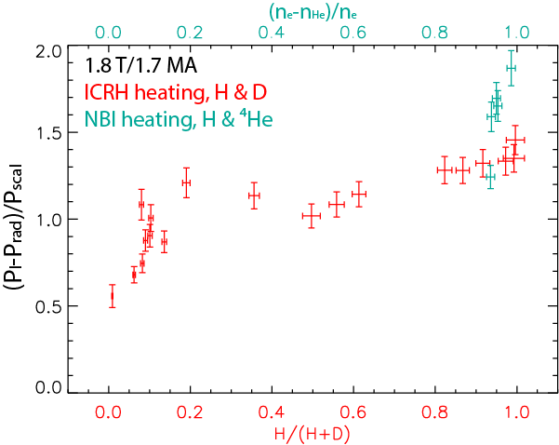
H+10%He H-modes: L-H threshold
Potentially attractive alternative to He H-modes for PFPO-1
BUT, impact of He on P_{LH} is not the same across devices → needs to be resolved
DIII-D
H + ⁴He
AUG
JET
J. C. Hillesheim et al, 2018 IAEA EX/4-1
U. Plank et al, NF 60 (2020) 074001
L. Schmitz et al, 2020 IAEA P1-1007

Slide 11
He H-mode pedestal issues for ITER (1)
W production and penetration through the pedestal may be more unfavourable than in D plasmas
Favourable effects of neo-classical transport producing outward radial W convection velocity reduced in He plasma (higher collisionality of He ions with W ions in the pedestal) → is W transport in the pedestal worse (more inward) in He plasma?
7.5 MA/ 2.65 T D
7.5 MA/ 2.65 T He
accumulation
accumulation
R. Dux et al, PPCF 56 (2014) 124003

Slide 12
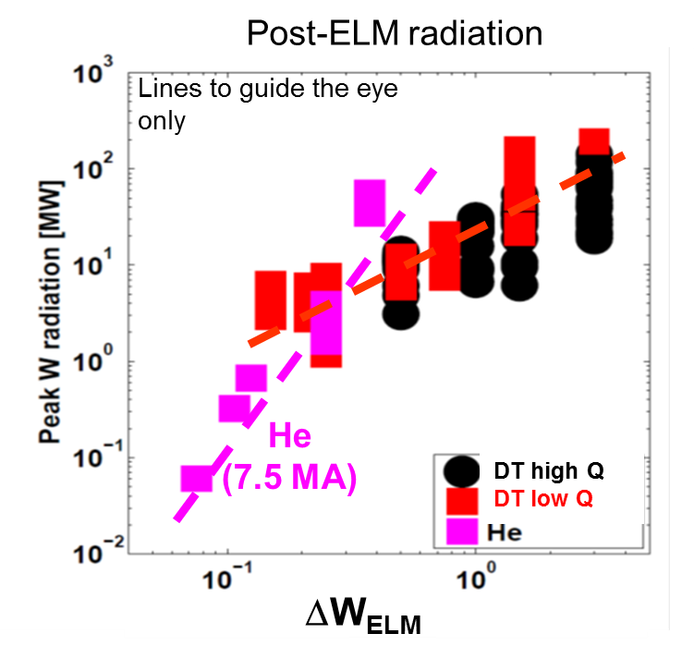
He H-mode pedestal issues for ITER (2)
W control may be more challenging due to larger W sputtering (including ELMs)
Is there a pathway to an H-mode scenario in He (balance between gain in P_{L-H} and loss in P_{sep} due to increase in core radiation)?
Ok on AUG (J. Schweinzer et al., EPS 2013, paper P2.134) → high f_{ELM} (~100 Hz), without Ar frost (low ΔW_{ELM})
R. Dux, et al, NME 12 (2017) 28

Slide 13
He H-mode control issues for ITER (1)
ELM control with 3-D fields and pellet pacing (H) in He H-modes not well understood
DIII-D demonstrated ELM control with 3-D fields in zero-torque He H-modes (ECH and balanced NBI), but at high density/collisionality (low j_{bootstrap})
T. Evans et al, NF 57 (2017) 086016

Slide 14
He H-mode control issues for ITER (2)
Hydrogen pellet pacing introduces 0.8-1.6 x 10²¹ H atoms/Hz for f_{ELM,paced} ~10 Hz → comparable to He fueling (≤ 2 x 10²² s⁻¹ at 2.65 T/7.5 MA)
Dilution of He in the edge/pedestal region may trigger H-L back transition, limiting use of pellet pacing in PFPO → is this controlled more by edge than core transport?
F. Ryter et al, NF 53 (2013) 113003

Slide 15
He H-mode operation: practical issues (1)
In the context of ITER operation, high purity He H-modes required to ensure that minority species do not impact pedestal behaviour (n_{He}/n_{e} ~5% for ICRF heating in PFPO-2)
Use of He NBI strongly recommended since goal is low collisionality He H-modes
Low <n_{e}>/collisionality He H-modes require Ar frost on cryo-pumps → if H/D NBI is then used, He is pumped well and this leads to H/D-rich plasmas (DIII-D experience)
If H/D NBI is used, then to keep high He purity, Ar frosting should be avoided → leads to high <n_{e}>/collisionality and typically with high f_{ELM} → not very ITER relevant

Slide 16
He H-mode operation: practical issues (2)
For improved ITER relevance, preference for new He experiments on JET/AUG would be for H (and not D) background species
For as long as He purity remains relatively high (>80%?), all main PWI issues related to He operation should be investigable even with some H/D contamination
For studies of ELM control with RMPs (not possible on JET), RF only heating on AUG (if sufficient power) would be very relevant to PFPO-1 operation on ITER (ECH only)

Slide 17
SPI in pure He
Disruption mitigation (SPI) would have to be deployed in any ITER He plasma campaign (hydrogen/impurity pellets)
Would request some limited number of pulses (~1 session) in a JET pure He campaign to verify that there are no fundamental differences in mitigating a He plasma cf. H or D plasmas and to quantify the recovery from SPI-induced wall loading in subsequent He plasmas
Would require that appropriate D plasma reference SPI pulses also be executed later in the JET programme
Almost certainly use D pellets, since JET SPI not optimized for H-pellets (higher velocity, issues with shattering → more gas than shards)
Depends on status of commissioning of new JET SPI1 by the time of the He campaign

Slide 18
Wall preparation for pure He campaign
Best option for ITER is residual H only in He plasma → what is best strategy following clean-up campaign prior to pure He experiments?
Isotope exchange from D → H with GDC, plasma, ICWC?
Then ICWC species exchange from H → He?
AUG used He ICWC very effectively in preparation for last He campaign
Opportunity for more ICWC studies on JET, particularly given that He ICWC plasmas are more dense → better experimental data for modelling.
New low T_{e} TS spectrometers being installed for SPI1 → improved diagnosis of ICWC plasma
A. Hakola et al, NF 57 (2017) 066015

Slide 19
Summary
The two highest ITER priorities for extended JET operation are SPI experiments and pure He plasma operation
Two key questions to be answered by pure He campaigns
Are He H-mode scenarios viable from the point of view of scenario development for FPO in the ITER non-active phases? → JET, AUG
Are there specific PWI issues with Be/W which change the scenario performance found in earlier pure He experiments in JET-C? → JET only
IO interest in a D/H NBI, no Ar frost He campaign on JET is very low unless it is demonstrated, in advance of any decision on the nature of the pure He 2022 campaign, that this is a viable option from the scenario/He concentration/low collisionality/Type I ELM frequency point of view

