Slide 1
Plasma-wall interaction with He plasmas and metallic walls
Sebastijan Brezinsek
PL WP PWIE

Slide 2
PWI Processes: He on Be/W vs. D on Be/W
for D on Be most relevant
V

Slide 3
PWI Processes: He on Be/W vs. D on Be/W
for He on Be most relevant
+ fuzz formation might be possible, but erosion is too high to build Be „foam“

Slide 4
PWI Processes: He on Be/W vs. D on Be/W
for D on W most relevant

Slide 5
PWI Processes: He on Be/W vs. D on Be/W
for He on W most relevant
+ fuzz formation possible, competition between growth and formation

Slide 6
JET-ILW input to ITER PWI issues:
He operation
Why can‘t we do this in other tokamaks?
Other tokamaks can help to some extent with W, but Be is unique for JET! Be&W interplay is unique! Pure W related PWI studies with He are possible in AUG.
Why can‘t we do this in linear plasmas?
Linear plasma can help to disentangle some of the physics, but the integrated view is only in a tokamak with high magnetic field, high fluxes, impurities, flows, surface temperature variation possible … and there is no plasma which can handle Be in the moment!
Is a pure He plasma required?
Pure He plasma is preferred to have clean experiments to model and understand!
Several percent of He in is already dominating the sputtering of W against Be
~10% D in He would be OK for W fuzz studies.

Slide 7
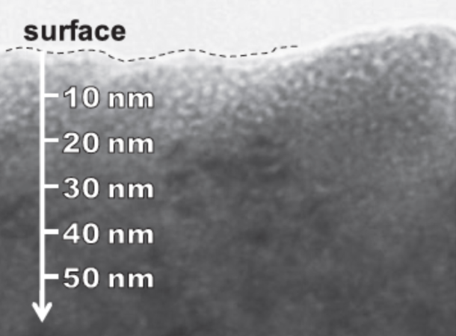
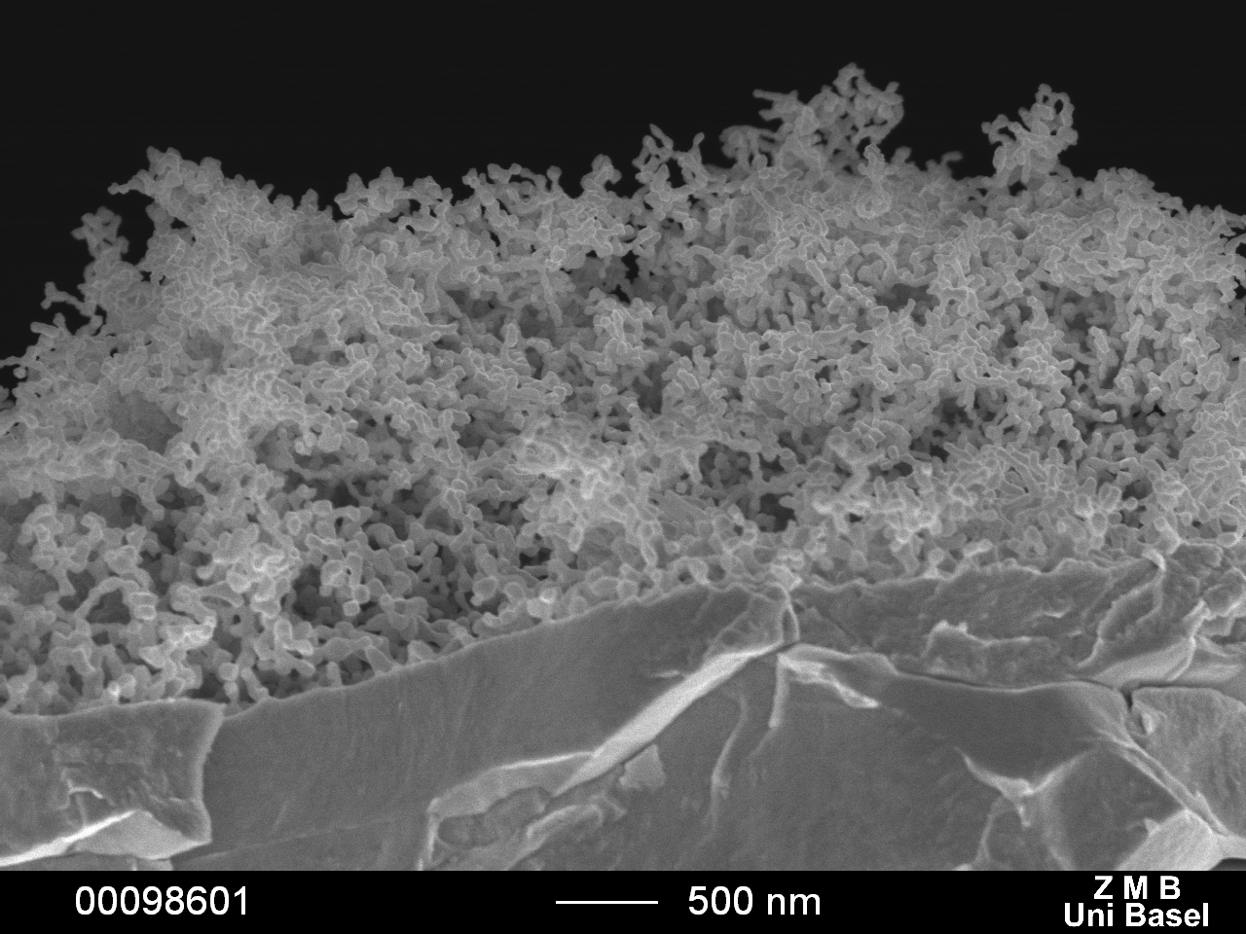
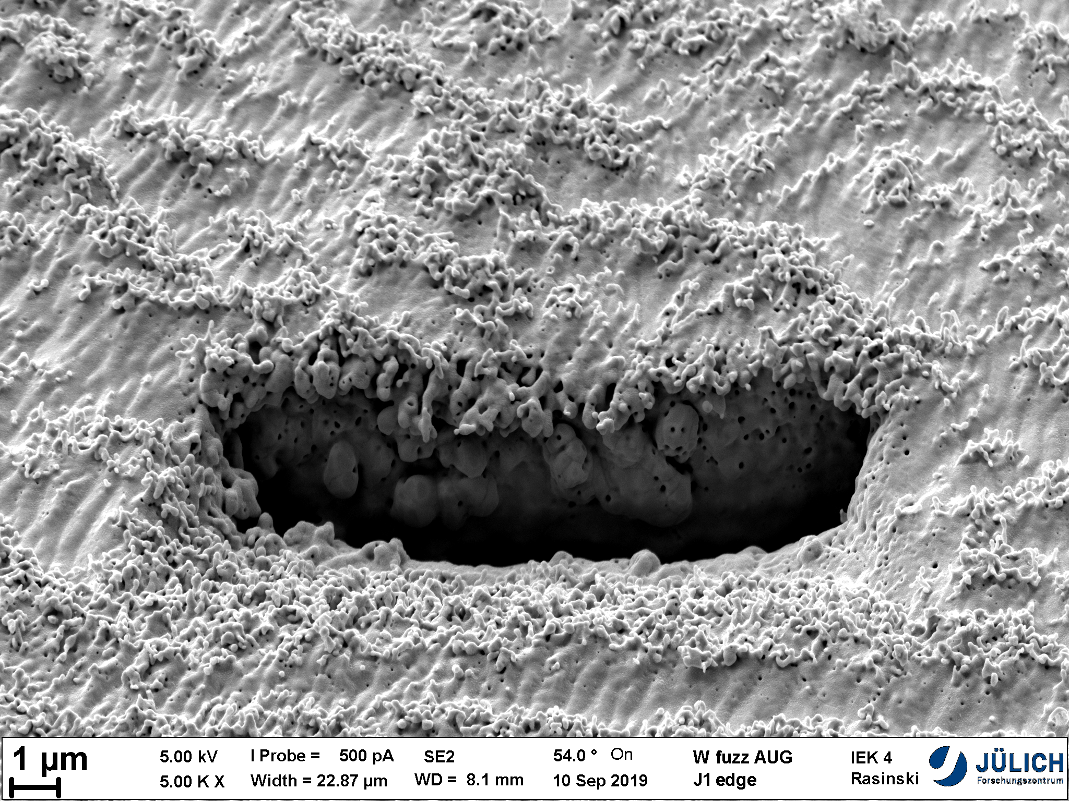
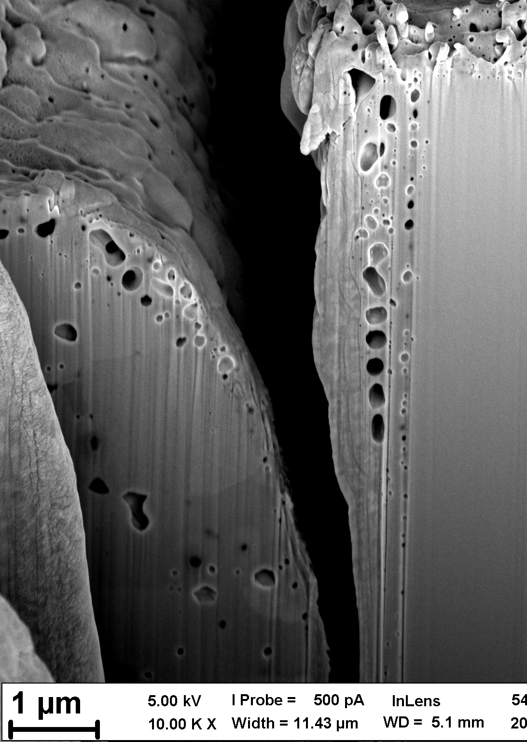

JET-ILW input to ITER PWI issues (B):
He plasma operation
Operation in Helium (and comparison with H and D)
  Operation in ITER during PFPO in He or He/H mixtures (for H-mode access)
  L-H threshold and pedestal in H-mode (He and He/H mixtures)
  Accumulating effects of He impact on W and impact on power handling (He-W PSI)
  Be source and Be migration might be increased due to higher yields (Be-W PSI)
  Enhancement of W erosion by He physical sputtering (min. factor 4) (He-W PSI)
ASDEX Upgrade
M. Miyamoto, JNM 2011
G. De Temmerman, JVSTA 2012
He bubbles in W
W fuzz
Benchmark experiment in JET to validate de Temmerman model about the interplay:
E_{fuzz} for physical sputtering of W fuzz
ITPA DSOL 33
S. Brezinsek
PSI 2021
But Be co-deposition not included and seems crucial with low-Z main chamber wall! See B in AUG and C in TEXTOR results!

Slide 8
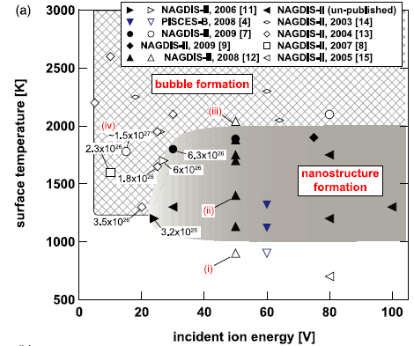
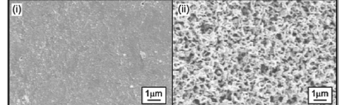
Existence window for W nanostructure
W nanostructure formation requires set of conditions which need to be met simultaneously
  W surface temperature T_{surf} > 850-1000 K, but < 2000 K before annealing/re-crystallization dominates
  Incident energy of He ion E_{in} > 20 eV, but keV produce also W nanostructures
  He ion fluence φ> 1-2×10²⁴ m⁻² , but also valid for mixed He/H plasmas (acc. He fluence counts!)
pristine W
AUG,
WEST,
JET
W nanostructure
[S. Kajita et al. NF 2009]
W nanostructure formation conditions can be met in tokamaks, but variations in temperature,
impact energy distribution, fluence distribution + interplay with impurities (erosion / co-deposition)
ERO2.0 modul for surface roughness and nanostructures has been developed recently for lin. plasma studies (G. Alberti et al.). Combine this for tokamak conditions is the next step here ...

Slide 9
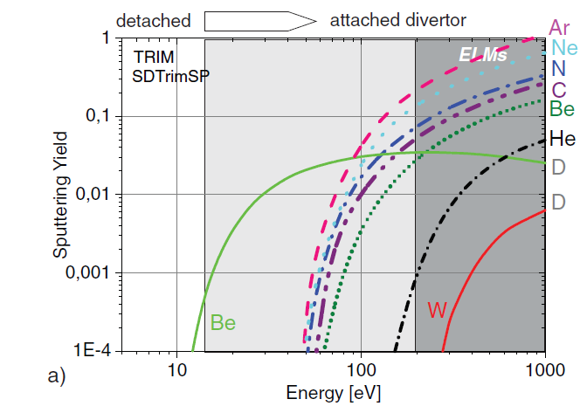
JET-ILW input to ITER PWI issues (B):
He plasma operation
Operation in Helium (and comparison with H and D)
  Operation in ITER during PFPO in He or He/H mixtures (for H-mode access)
  L-H threshold and pedestal in H-mode (He and He/H mixtures)
  Accumulating effects of He impact on W and impact on power handling (He-W PSI)
  Be source and Be migration might be increased due to higher yields (Be-W PSI)
  Enhancement of W erosion by He physical sputtering (min. factor 4) (He-W PSI)
JET:
Sputtering of W in intra-ELM and
inter-ELM phases by He²⁺ ions if above E_{thres}
High prompt W re-deposition at typical
magnetic fields and ionising conditions
[S. Brezinsek et al. NF 2019]

Slide 10
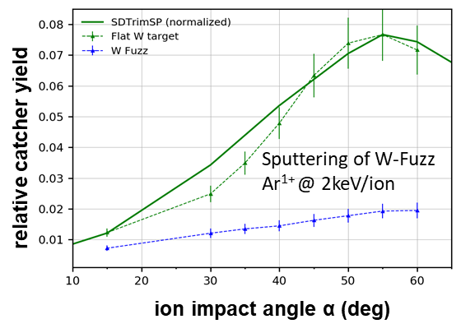
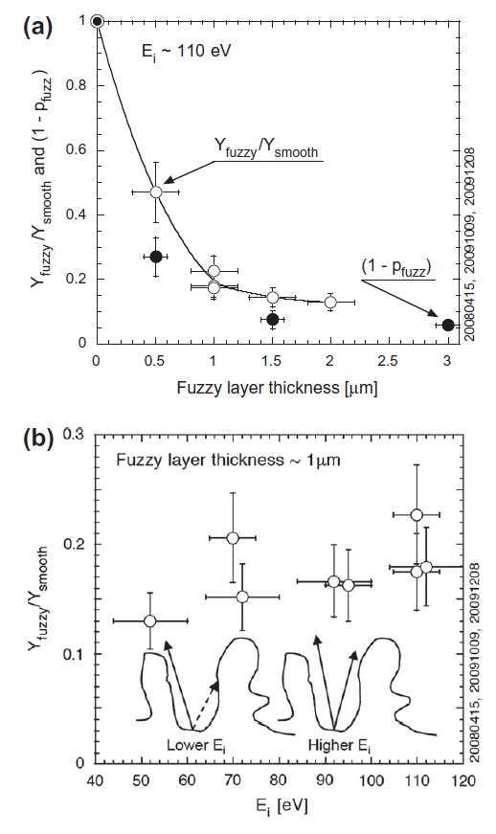
W sputtering
Effective sputtering of W nanostructures is 3-5 x lower than of smooth W
Sputtering varies during W fuzz growth until steady-state conditions reached
Re-deposition due to geometry effects and change in angular distribution
[R. Stadlmayr et al.]
[D. Nishijimal et al.]
Change of reflection properties of W material => pure fuzz is dark
Changes of IR footprint => A. Möller e al. PS 2017 (in situ observation possible)

Slide 11
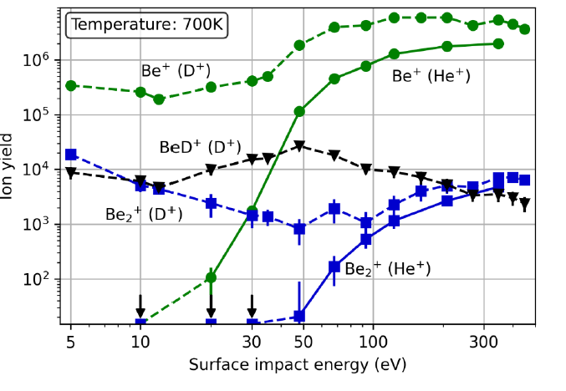
JET-ILW input to ITER PWI issues (B):
He plasma operation
Operation in Helium (and comparison with H and D)
  Operation in ITER during PFPO in He or He/H mixtures (for H-mode access)
  L-H threshold and pedestal in H-mode (He and He/H mixtures)
  Accumulating effects of He impact on W and impact on power handling (He-W PSI)
  Be source and Be migration might be increased due to higher yields (Be-W PSI)
  Enhancement of W erosion by He physical sputtering (min. factor 4) (He-W PSI)
Complex situation
Erosion at lower impact energies in D due to
chemical assisted physical sputtering CAPS
Higher physical sputtering of Be due to
higher mass and double ionisiation
In case of W => clear change of first wall
erosion due impact threshold energy for W
(AUG)
[S. Brezinsek et al. ]
[Duensing et al. ]

Slide 12
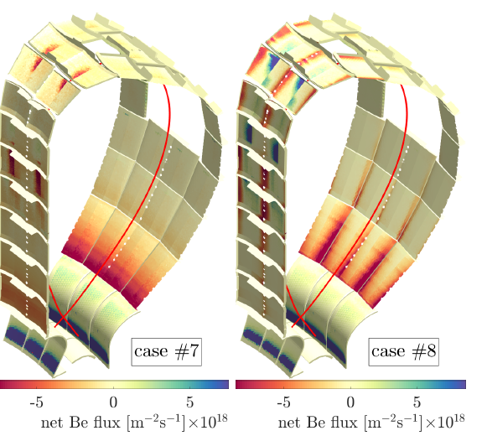
ERO2.0 in He vs. H for ITER
Hydrogen
L-mode
Helium
L-mode
Goal:
Pair of plasmas for the JET-ILW with
SOLPS-ITER or EMC3-EIRENE
background for pure He and pure H as
reference benchmark case
Prediction of Be codeposition on the W divertor of ITER during PFPO => critical limit of fluence or time not to start with Be-coated divertor into FPO
Can only be done in JET with Be/W!
[J. Romazanov et al.
NF 2019 ]

Slide 13
JET-ILW input to ITER PWI issues:
He operation program proposal I
Operation in Helium (He-PSI)
  Impurity production by He: Be (limiter) and W (divertor) sputtering
  Accumulating effects of He in W and Be and operational consequences
  Operate He campaign before shut-down and tile removal for analysis
  In-situ W surface modifications (fuzz growth) on a single bulk W row (5B)
  Study W thermal conductivity variation by repetition of H-mode plasmas
  Study Be-He and W-He surface modifications (surface roughness / mix materials / reflection)
  Gas balance/ He removal studies to determine retention of He (He/W) in Be/W in vertical target and limiter operation (use of LID-QMS)
  Divertor detachment studies in He (w/o hydrogen molecular physics)
  Benchmark of plasma (SOLPS) and PWI codes (ERO2.0 and WallDYN3D)
Dedicated campaign in (pure) He to mimic ITER PFPO conditions:
He campaign including multiple series of identical plasmas
[=> PFC tile removal would give added values]

Slide 14
M21-24: Study the effect of He plasma-interactions with Be and W PFCs
Proponent(s): S. Brezinsek, T. Dittmar, S. Wiesen, G. Sergienko, M. Groth, D. Douai
Rationale: This proposal aims in a period of He plasmas in support of ITER PFPO
  operation with He dominated plasmas in ITER in L- and H-mode (radiation, clean-up, and dilution)
  W divertor and Be first wall lifetime estimates (erosion, power handling, and He retention (nanobubbles)
  divertor plasma characterisation in He (absence of molecular physics)
  reference plasmas for plasma-edge modelling (e.g. SOLPS-ITER) and PWI-modelling (e.g. ERO)
  unique chance of a (last) He campaign in the Be/W mix to minimize risks for ITER PFCs in PFPO phase
Summary of Proposal(s):
  Exchange to He by plasma discharges (or ICWC) and collect residual T and quantify D (2 sessions)
  Establish plasma scenario in He in ELMy H-mode with RF and NBI heating. Goal would be a V5 configuration on stack 2 of tile 5 which mimic the C30C plasma in D in divertor conditions. Attempt 2.0MA, 2.0T for min. 6s static strike line at 12-14MW input power. Moderate He fuelling - no seeding. (1 session)
  Divertor characterisation in He (gas, power, strike-line variation) (1 session)
  Try to build-up W fuzz matching surface temperature / impact energy / He fluence and diagnose in-situ by reflectivity changes of tile 5 and thermal response (ELMs). 40 discharges needed to get fluence (4 sessions)
  Exchange to He by plasma discharges (or ICWC) and collect residual D and quantify He (2 sessions)
  Interpretative plasma modelling (e.g. SOLPS-ITER) and PWI modelling (e.g. ERO2.0) to validate ITER predictions. Benchmark of W fuzz formation/destruction model (e.g. de Temmerman model)
  Post-mortem analysis of tile 5 stack 2 once available under WP PWIE (bulk-W lamellae)
Scientific Deliverables:
  Provision of reference plasmas to validate edge-modelling and PWI in He plasmas for ITER PFPO
  Quantification of He in Be and W PFCs in quasi-steady state conditions in Be/W mix / clean-up capabities
  Validation of the W nanostructure formation/destruction model in view of ITER and DEMO

Slide 15
JET-ILW input to ITER PWI issues:
He operation program proposal II
Operation in Helium (He-PSI)
  Overlap in temperature window between W nanostructure formation and W recrystallization. Combine both with OSP on tile 5A or B and T_{surf}~
  around T~1600°C for enough time/fluence. λq footprint could be used
  to get W-fuzz on tile 5A (with) and 5B without W re-crystallisation
  Study He content in Be-co-deposits on tile 5 in-situ via LID-QMS => demonstrate He content control (budget)
  Analysis by high resolution imaging to document change in
  surface reflection as measure of W nanostructure formation (turns black)
  This could potentially be done after DT in a clean-up phase
    W re-crystallization is “frozen” and will not change
    W fuzz-structure will not change if location in PFR and no tile re-heated
    Tile removal could be postponed to next opening (LIBS on RH?)
He exploration experiments
clean He operation
~4 weeks for PWI studies
C30C-like
~2 weeks
LIBS / tile removal
Include mix H or D + He
Note: low REPETITION RATE
5 pulses per session

Slide 17
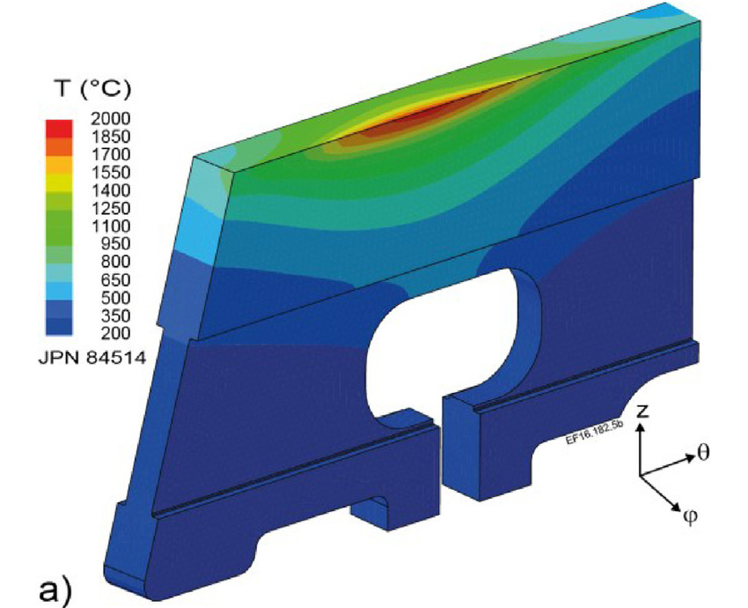
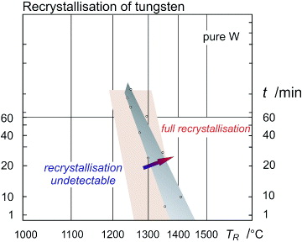
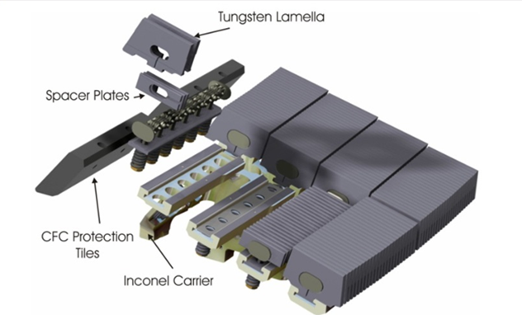
Proposed new JET-ILW input to ITER PWI issues (2020+)
Operation above the re-crystallisation limit of W PFCs
  Re-crystallisation of W (>1400-1600°C) impacts properties of W PFCs
  Potential enhancement of crack formation under high power loads
  Study temperature rise per “comparable” ELM impact
Ph. Mertens et al.

Slide 18
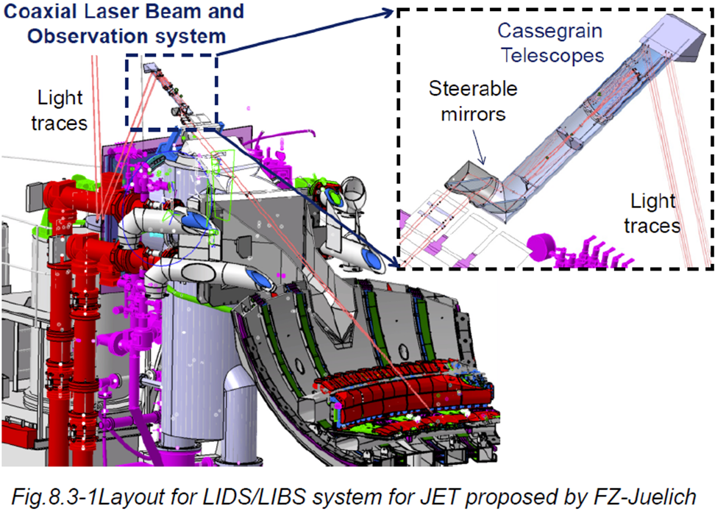
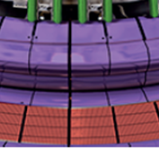
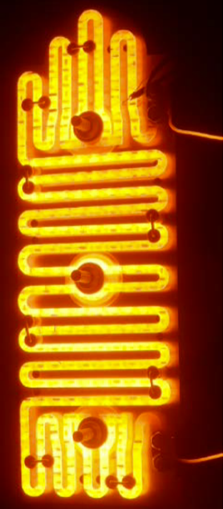
JET-ILW input to ITER PWI issues (A/B):
Cold First Wall operation program proposal I
Full campaign at low temperature (~110°C) and comparison with (~200°C)
Determination of global Be migration pattern (code validation / predictions)
  Determination of Be source strength at low T_{surf} (supersaturation of Be)
  Change in deposition strength inner divertor / outer divertor in deposition zone
  Benchmark of material migration codes (ERO/WallDYN) and validation of ITER predictions
  (impact on ITER Be PFC lifetime)
  (Potentially) in-situ analysis of deposition pattern by LIBS on JET remote handling arm
Determination of long-term fuel retention in Be layers (code validation/predictions)
  Gas balances / post-mortem analysis (impact on ITER safety)
  In-situ analysis of fuel content by LID-QMS

