Slide 1
ENR-MOD.MPG01 ATEP – October 19th, 2021
WP1: theoretical framework
WP1 – Update (…and some WP2.1)
Matteo V. Falessi1, Yueyan Li2,1, Alessandro Zocco3 and Fulvio Zonca1,4
1Center for Nonlinear Plasma Science and ENEA C.R. Frascati, 00044 Frascati, Italy
2CREATE Consortium, Via Claudio 21, 80125 Napoli, Italy
3Max-Planck-Institut für Plasmaphysik, Greifswald, Germany
4IFTS and Dept. Physics, Zhejiang University, Hangzhou, 310027 P.R. China
Frascati, October 19th 2021

Slide 2
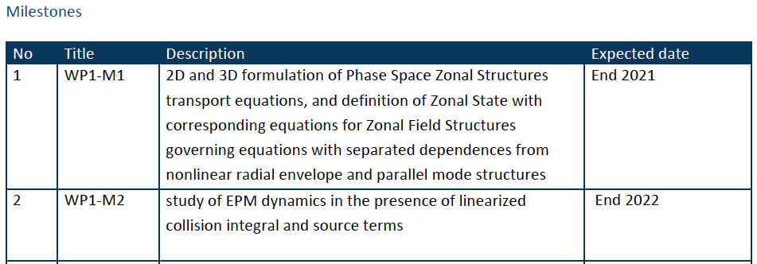
Milestones and Deliverables
Frascati, October 19th 2021

Slide 3
Milestones and Deliverables
Frascati, October 19th 2021

Slide 4
Status of manpower
Y. Li has been hired: PostDoc contract by CREATE
3pm foreseen in 2021 are secured and work on WP1&2 is in progress as expected.
minor possible delay on deliverable WP2.1-D1 depending on bureaucracy (to be reabsorbed in early 2022)
Frascati, October 19th 2021

Slide 5
Ongoing activities - I
Publications:
2 manuscripts on Chorus: simple paradigmatic application of general PSZS theoretical framework ➔ WP1-D1
- A theoretical framework of chorus wave excitation (FZ,
XT, LC); RMPP to be published
- Nonlinear dynamics of phase space transport by chorus
emission (FZ, XT, LC); JGR submitted
2 manuscripts in preparation:
- Nonlinear equilibria and transport processes in burning
plasmas (MF, LC, ZQ, FZ); NJP to be submitted
- Section for NF Chapter 5 update (MF, LC, ZQ, FZ);
NF to be submitted
Draft in preparation (A. Zocco et al.): 3D generalization of PSZS theoretical framework ➔ WP1-D1/WP2.3
Frascati, October 19th 2021

Slide 6
Ongoing activities - II
Presentations:
2 invited presentations: general PSZS theoretical framework ➔ WP1-D1
- Numerical study of kinetic low frequency electromagnetic
continuous spectrum with DAEPS code (YL, LC, RM, FZ);
AAPPS invited (explaining recent DIIID results; consistent
with LIGKA ➔ see Philipp’s presentation) ➔ WP2.1
- Nonlinear gyrokinetic theory of Alfvénic fluctuations and
energetic particle transport (FZ, LC, MF, ZQ); ISEP invited
Joint CNPS-DTT seminar:
- Canonical particle motion in quasisymmetric toroidal
magnetic fusion devices: applications to turbulent
transport. A. Zocco (connection with draft in preparation
on 3D extension of PSZS transport theory) ➔ WP2.3
Frascati, October 19th 2021

Slide 7
Results highlights - I
Frascati, October 19th 2021

Slide 8
Results highlights - II
Frascati, October 19th 2021

Slide 9
Thanks
Thank you for your attention!
謝謝
Your questions are welcome
荣福欧 - Frascati, October 19th 2021

