Slide 1
A proposed metric for quantifying progress in fusion science: Fusion Science Level (FSL)
M. Wischmeier
08 Dec 2020

Slide 2
Why and how to quantify progress?
EUROfusion grant agreement: extremely ambitious goals and defines missions, milestones and deliverables
Money is distributed for achieved deliverables (in order to have meaningful reports we need to overcome the fear of not receiving funding if a serious and comprehensible attempt was made)
Deliverables are completed to a large extent by reports, which describe activities, problems and accomplishments
Do the reports inform us as a scientific community if we are closer to the realization Nuclear Fusion?
Reports usually describe what has been done and which scientific findings have been obtained
But how can we measure our success in view of our goal?
Where do we stand?
How “far” are specific goals? How much time will we need? How many resources could it cost us to get there? Is it more costly to go one path than another?
On which basis do we adjust our priorities and identify our weaknesses to overcome critical aspects in which progress may be slow and which define the critical path?

Slide 3
The concept of technological readiness level for engineering
Technology Readiness Levels – widely used as a risk mitigation tool – immature technology is a cause of cost growth and schedule delay; asked for by Horizon2020
Allows common understanding of technology status
Key driver is risk management
Used to make decisions for technology funding
Inside EUROfusion: widely adopted in PPP&T for defining system, technology and manufacturing readiness, invented by NASA in 1974,

Slide 4
DEMO Technology R&D - Concept Design Phase
Prioritize R&D within a multi-year Technology Maturation Plan (TMP)
Critical technology elements (CTEs) have been identified for all systems
TRAs (Technological Readiness Assessment) by Independent Expert Panels, including IO, F4E experts and industry
Likely not applicable
G1
G2
G3
G4
G5
G6
G7
9
2020
2024
2027-30
8
7
6
5
4
Key:
Technology Readiness Level (TRL)
Integration Readiness Level (IRL)
Manufacturing Readiness Level (MRL)
3
2
1
Courtesy Gianfranco Federici

Slide 5
Technological Readiness in Physics?
UKAEA nuclear waste management concluded that TRL are intractable for the purposes of calibrating the scientific maturity of underpinning science, identifying the requisite level of scientific maturity and plotting a route to attaining that robustness in understanding, TRLs have proven intractable.
Need to measure scientific risk in achieving the physics basis for fusion electricity and act accordingly to focus or spread our effort in experiments, modelling and theory development
In an ideal world: Need to quantify in a comprehensible way which experimental time is best used by EUROfusion on which device accessible at which time – what is the best use of the portfolio of our resources ources?
In reality the availability of machine time largely defines which experiments are possible and likely as the total amount of machine time is not a function of the requirements neither based purely on scientific priorities
E.g. are similar experiments required on different devices? Yes? No? How does this contribute to our understanding? Or is it just for the sake to check something?

Slide 6
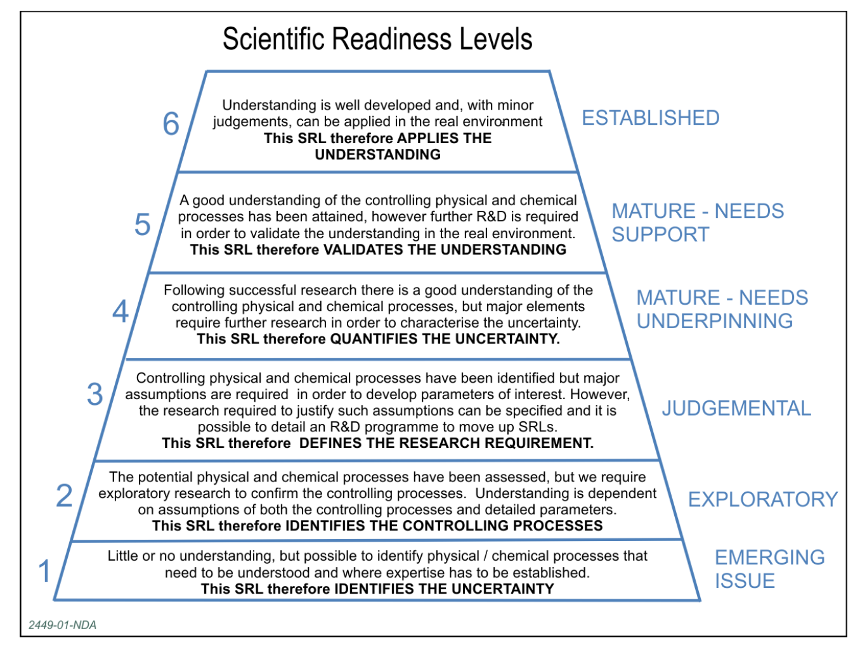
UKAEA Nuclear Waste Management and ESA developed Scientific Readiness Level, SRLTM
Slightly adopted from UKAEA WMO:
Scientific Readiness Level —> Fusion Science Level (?)
FSL can support research planning and prioritisation.
Help to challenge the adequacy of current plans.
FSL provide focus on real needs by examining our level of understanding.
Could assist our Regulators (in our case the European Commission and the fusion community) in understanding critical knowledge gaps.
Defend physics research from the “search for all knowledge” (at unnecessary cost and taking forever).
Geological Disposal Science and Technology Plan May 2016
NDA Report no. NDA/RWM/121 → however, the RWM trademarked the name!
Similar item by ESA for EO: European Space Agency 2015: EOP-SM/2776/MDru-mdru

Slide 7
The importance for a goal oriented approach for fusion physics by FSL
The concept of FSL :
A useful tool for assessing:
current understanding;
What understanding is required / sensible at the generic stage. Identification of success…but a tool, not an end in itself! ➔ therefore not to be mixed up with the deliverables that are part of the reporting for the grant agreement and the transfer of money from EC (even though not making progress may impact FP10 funding…) [doing the latter would be premature, if we have not tested the concept for a while and see if it really does help prioritizing]
Defining FSL :
Exercise for WP or TF or sub groups to identify the levels (first applying it to the easisest examples or the largest funded activities)
Would allow to compare the needs originating from engineering and their TRL, that may depend on the our Fusion Science Level (e.g. impact of exhaust scenarios on the conceptual design of DEMO) – coupling of certain TRL and FSL
might identify numerical modelling and/or theory/experiment based scaling needs, to where and how to increase efforts for preparing reliable physics basis

Slide 8
Research Topic Status Evaluation Criteria
Level | Criteria
Emerging | Little or no understanding yet on WP TE devices
Exploratory | Physical process is assessed on WP TE devices, transposing to ITER or DEMO is uncertain
Judgemental | Controlling physical processes has been assessed on WP TE devices, but extrapolation to ITER/DEMO requires scalable parameters and further investigation
Mature - needs underpinning | Good understanding of controlling physical processes on WP TE devices, but major uncertainty in view of transposing ITER/DEMO
Mature - needs support | A good understanding has been achieved on WP TE devices, further research exploring ITER or DEMO relevant parameters
Established | Understanding is well developed and can be applied to ITER or DEMO
Further refinement of Ansatz may be needed; e.g. some distinction between ITER & DEMO
WP TE deliverables given here = multi year programme
N.B.: Ds marked as scientific objective for 2021 for which significant progress in 2021 targeted

Slide 9
RT04: Disruption avoidance development for ITER and DEMO
 |  | 21 | Status | Achievements
D1 | Advance control frameworks on WPTE devices for integrated disruption avoidance: state observers, actuator sharing, RT event detectors | X | Mature – needs underpinning | Similar method developed on AUG and TCV
D2 | Improve predictive understanding of specific disruption paths and their avoidance. Focus on H-mode density limit (HDL) disruptions and NTMs |  | Judgemental | Avoidance scheme in development but not yet ready
D3 | Implement and study automated methods for discharge recovery or soft-stop |  | Exploratory

Slide 10
RT08: QH-mode and I-mode assessment in view of DEMO
 |  | 21 | Status | Achievements
D1 | Develop I-mode and QH-mode and determine existence space | X | Emerging | AUG: looking for I-mode in fwd-Bt: promising results with improved confinement wrt L-mode TCV: 1 session done so far focusing on QH-mode: scenario development – no clear sign of QH/EHO phase
D2 | Extend cross-machine scaling of PL-I threshold |  | Emerging | Exploration of I-mode in fwd-Bt/Ip
D3 | Compatibility of QH-mode and I-mode with DEMO constraints (including dominant electron heating, low torque, high ne_{sep}, dissipative divertor) |  | Emerging | Not addressed; Rev-Bt/Ip campaign needed on AUG
D4 | Access and sustainment of QH-mode with a metallic wall |  | Exploratory | QH-mode phase extended up to 500 ms
D5 | Quantify heat loads for I-mode and QH-mode and compare with existing scaling(s) |  | Exploratory | Data collected (most likely), but missing competencies for analysis

Slide 11
RT14: Physics of plasma detachment / impurity mix/ heat load patterns
 |  | 21 | Status | Achievements
D1 | Characterize detachment access and core plasma performance in scenarios using different gas valve locations, enrichment and compression, impurity mixtures, and field direction |  | Mature – needs underpinning | Impurity seeding scan performed in AUG (Ar/N2) and TCV
D2 | Explore the effect of divertor pressure on detachment and plasma core performance through changes in pumping speed and divertor closure | X | Judgemental | Impact of divertor closure investigated in TCV (old vs new baffles) and MAST-U (first experiments)
D3 | Assess whether the parameter dependences related to detachment scale the same between (reduced) SOL models and experiment and determine the impact of divertor geometries (e.g. baffled vs. non-baffled and compact vs. conventional) on these trends |  | Judgemental | AUG and TCV simulations started
D4 | Quantify the degree of ELM buffering achievable by impurity seeding, investigating the dependences on relevant machine parameters (e.g. Ip and divertor geometry) and the different measurements that may scale with the energy deposited by the ELM (e.g. floating potential or H-alpha) |  | Exploratory | ELM buffering assessed in AUG and TCV seeding experiments.
D5 | Measure divertor heat loads and assess power/energy balance in attached & detached divertor operation | X | Emerging | Not adressed yet

Slide 12
RT16: PFC ageing under tokamak conditions
 |  | 21 | Status | Achievements
D1 | Quantify using experimental data and predictive modelling local power load distributions at castellated and shaped PFCs for ITER and DEMO | X | Mature – underpinning | AUG : data from previous experiments on gap penetration conclusive, corresponding paper = work in progress WEST : data analysis from previous campaigns ongoing, complex interpretation of IR data evidenced (emissivity, reflections, cavity effects in gaps); good basis for 2022 experiments Modelling effort just started
D2 | Determine the role of plasma parameters and thermionic emission in melt dynamics on metallic plasma-facing components in view of ITER operation | X | Mature -support | AUG : data from previous melting experiments + Ir vs Nb experiment conclusive, modelling ongoing WEST : update of the MEMOS code for actively cooled PFC performed, modelling of previous WEST sustained melting experiments ongoing
D3 | Assessment of thermo-mechanical degradation of ITER like actively cooled W PFCs (including pre-damaged PFC) in tokamak conditions by sustained high power / high particle fluence plasma exposure |  | Emerging | Preparation of pre damaged PFU (pronounced crack network) performed, pre damaged PFU installed, ready for exposure in WEST for C6 campaign Plans to produce a more severe pre-damage (self castellation) for C7

Slide 13
Discussion on Terminologies
Explorative
Judgemental ➔Subjective? Characterized? Assessed?
Mature ➔ better distinction between “needs underpinning” and ”needs support”

Slide 14
Risk involved for ITER or DEMO as a function of FSL
FSL only provide a snapshot of a status at any given time
FSL does not imply by itself a prioritization
FSL can over the years document progress
Will the Fusion Science Level and thus our physics basis ever be good enough to extrapolate to ITER/DEMO without uncertainties? ➔ unlikely: for most physics areas as for complex system there will always be the need to identify and quantify the uncertainties of the extrapolation

Slide 15
Categories (currently being discussed inside the DCT – taken from FSD-FTD meetings)
Cat 1 to fulfil the following 3 weighted criteria
C1 A scenario for which a model exists has been demonstrated to be repeatable in various devices (various sizes, currents and fields)
C2 A scenario has been demonstrated to be compatible with a W-wall with DEMO unavoidable boundary conditions (e.g. detached divertor, pellet fuelling, high confinement)
C3 A scenario is robust and controllable; the sensors/actuators have to be DEMO compatible
Key milestone: G2 (@Milestone2) which is scheduled for 2024 ➔
Have at least one scenario that fulfils the 3 Cs sufficiently
Prioritization should address likelihood for a scenario to be brought to state by 2024
➔ Guide definition of milestones and review of these defined milestones inside the FSD-FTD

Slide 16
Beyond the FSL ➔ Prioritizations
Question: as extrapolations come with uncertainties (something we rarely quantify…) what is the risk we can or want to take when extrapolating to ITER/DEMO if we do it based on a specific FSL for that scientific item/objective?
Can we afford that risk? Yes? No?
How expensive is the risk that is to be taken?
Involves risk assessment and scalable parameters (role of TSVVs)…
Certain FSL may be more tolerable than others in terms of control or physics…
Only the combination of FSL and risk assessment in view of ITER/DEMO can lead to a prioritization tool

Slide 17
Discussion
FSL provide can assist in quantifying the status and the progress
FSL are the basis to undertake prioritizations
Prioritizations cannot be done without assessing the risks for extrapolations to ITER/DEMO ➔ one needs both!

