Slide 1

Some topics for advanced MHD modelling and applications (all involving n=m=1 modes here)
Jonathan P. Graves

Slide 2

INTRODUCTION
Topics covered in this presentation
Strong equilibrium toroidal flows in MHD – analytical and numerical comparisons
Delta B-parallel corrections for MHD, importance for MHD and gyrokinetic codes
Modelling of non-resonant internal kink modes
Some applications of non-resonant internal kink modes (motivating TSVV group to adopt non-resonant internal kinks)
Kinetic-MHD, challenges with collisionless thermal ions
Plan for kinetic-MHD code with strong flows.
2
J. P. Graves Kinetic MHD topics, TSVV 10 18th October 2021

Slide 3
Stabilising centrifugal effects on MHD instabilities
Example where analysis has been ahead of some codes
MISHKA numerical results [Chapman, NF 2006] showing weak stabilisation of the internal kink mode by plasma rotation did not agree with analytical predictions.
It was proposed that MISHKA doesn’t have centrifugal effects embedded in its equilibrium. Comparisons with CASTOR-FLOW (consistent equilibria) showed expected result:
[Chapman, Graves, Wahlberg, NF 2010]
3
J. P. Graves Kinetic MHD topics, TSVV 10 18th October 2021
3

Slide 4
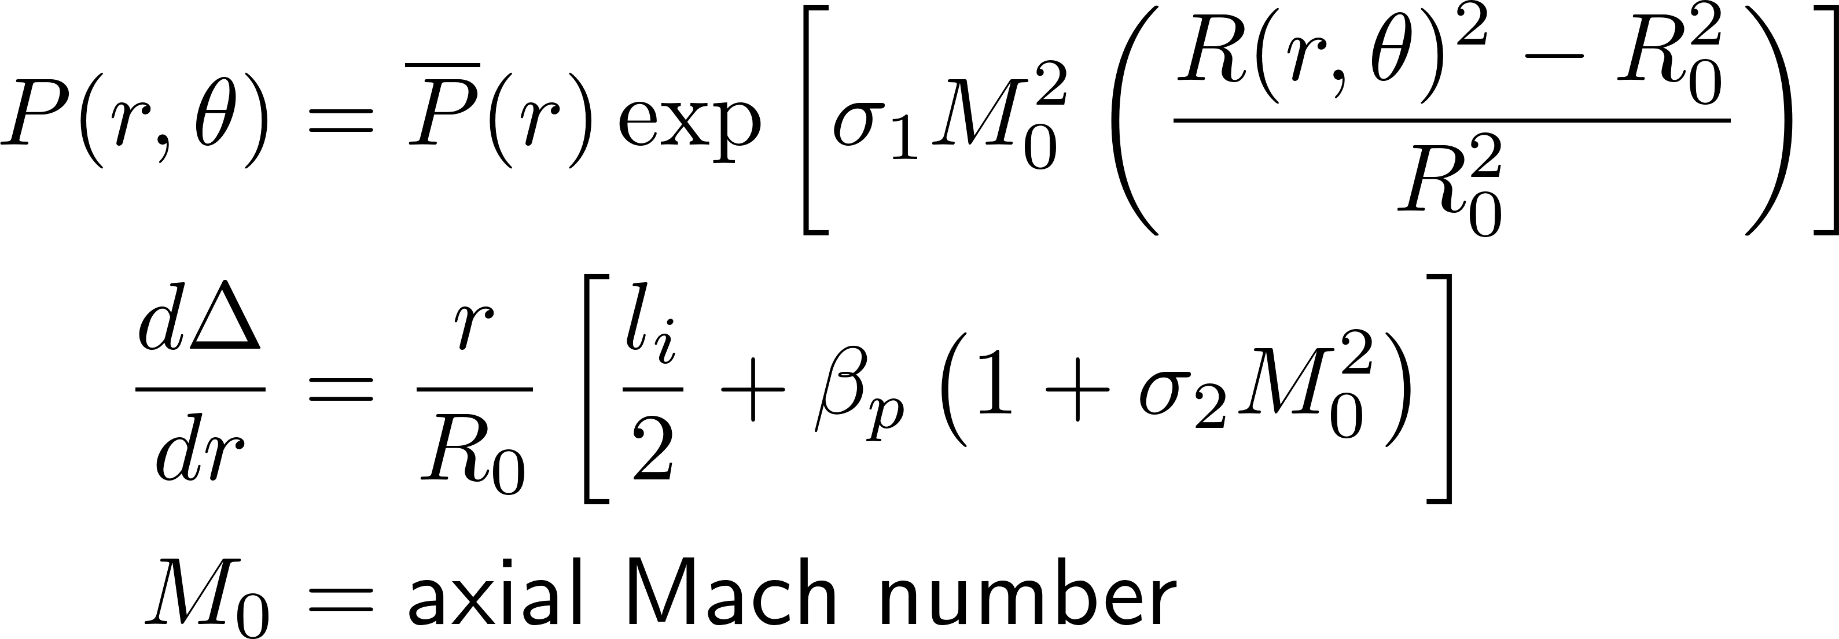

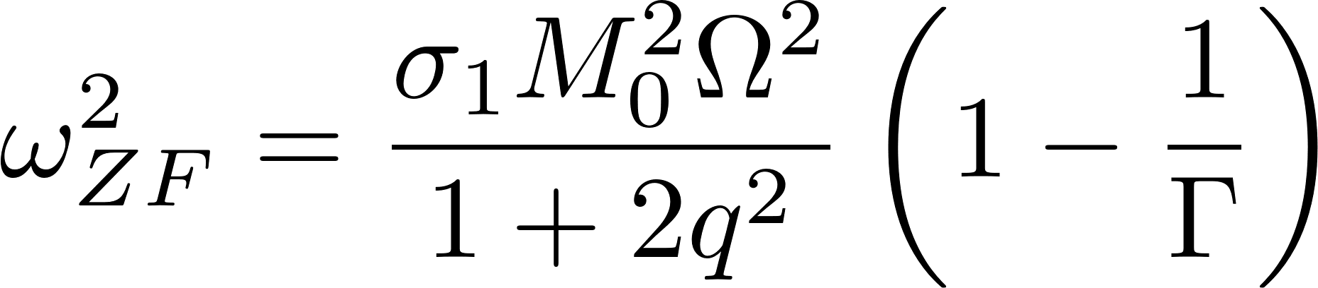
Stabilising centrifugal effects on MHD instabilities
MISHKA included strong flow corrections in the linearized stability equations. But the magnetic equilibrium did not include the centrifugal shift effects
We established an approach to model MISHKA or CASTOR-FLOW analytically, with binary switches enabling or disabling the centrifugal effect in the starting equilibrium equations, which we carried through to the final analytic dispersion relations [Wahlberg, Chapman, Graves, PoP 2009].
Two switches apply to the problem
is connected with n=0 Zonal flow, a low frequency GAM [Graves, Wahlberg, PPCF 2017] potentially measurable in MAST or NSTX:
J. P. Graves Kinetic MHD topics, TSVV 10 18th October 2021
4
4
4

Slide 5
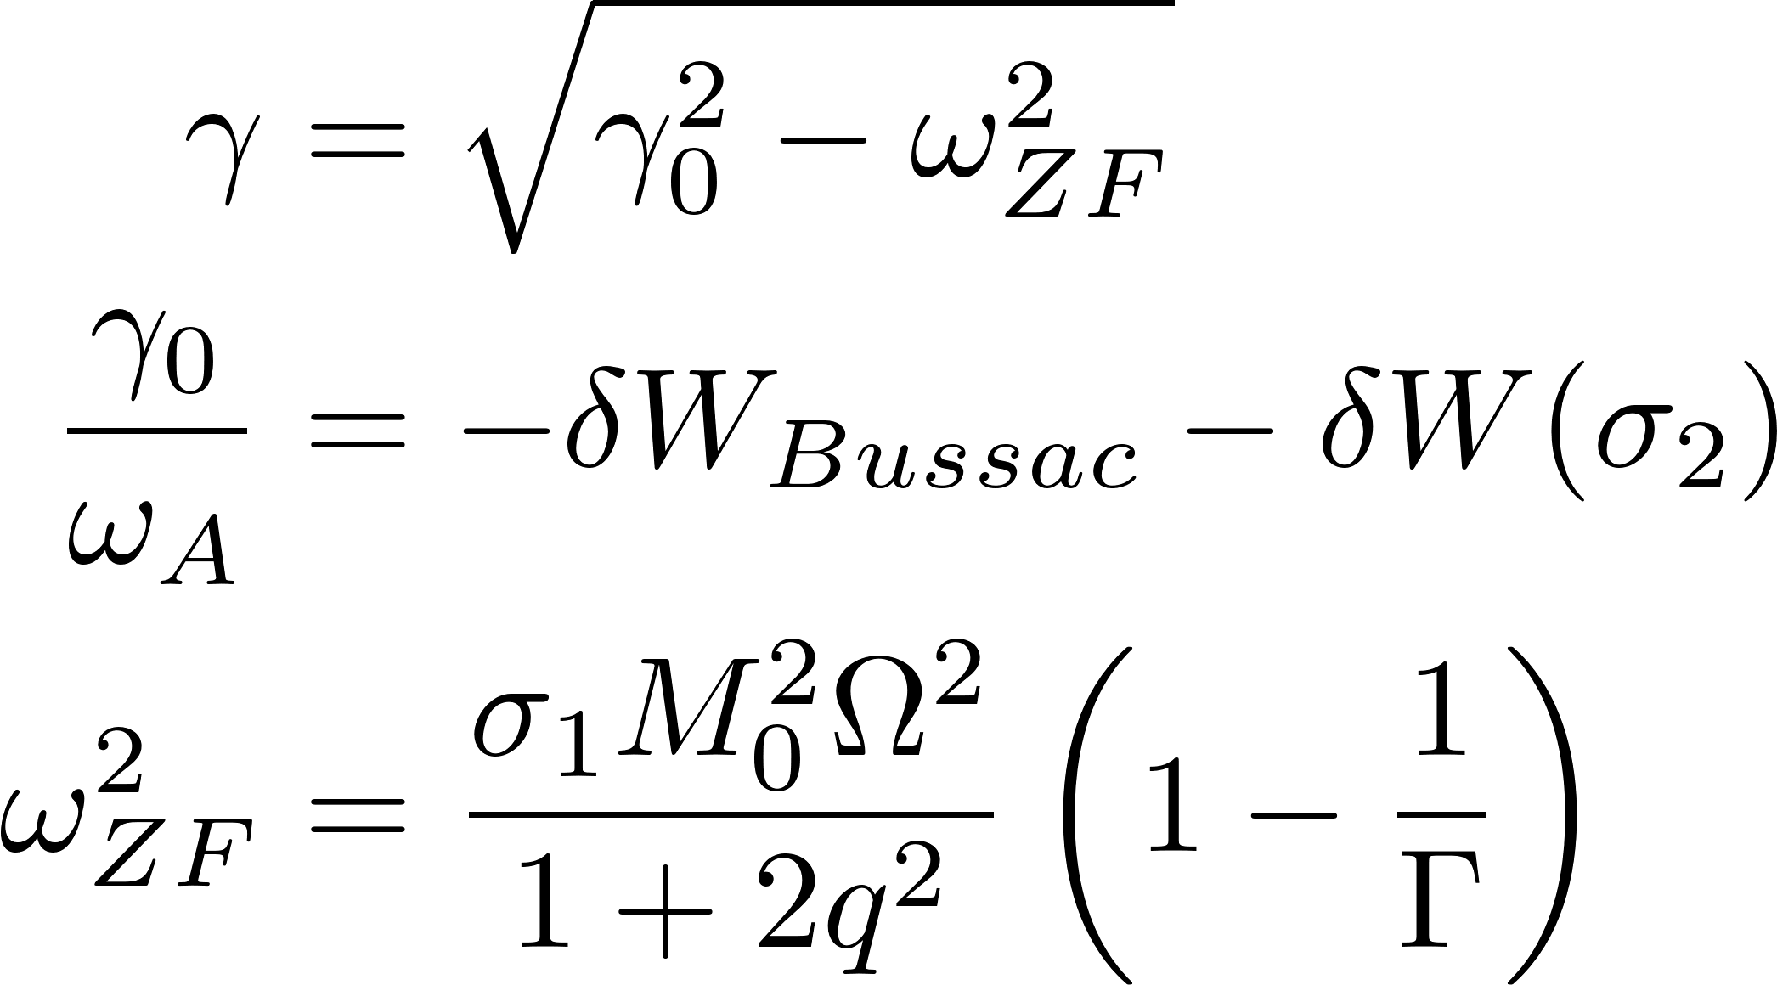
Stabilising centrifugal effects on MHD instabilities
[Wahlberg, Chapman, Graves, PoP 2009].
J. P. Graves Kinetic MHD topics, TSVV 10 18th October 2021
5
5
5
5

Slide 6
Destabilising Flow effects on MHD instabilities
Semi-analytic results:
Numerical comparison:
Strong flow gradients can overcome the ZF stabilizing effect. New classes of instabilities such as Kelvin-Holmholz can be born. These can be described using low shear infernal mode approach (e.g. 1,1) [Wahlberg, Graves, Chapman PoP 2013; Chapman, Walkden, Graves, Wahlberg NF 2011], and might be observable in upgraded MAST (strong flows).
J. P. Graves Kinetic MHD topics, TSVV 10 18th October 2021
6
6
6
6

Slide 7
Parallel Magnetic Fluctuations
Following the MISHKA, CASTOR-FLOW work, analytical calculations were made to investigate the effect of neglecting parallel magnetic fluctuations in MHD model. Condition for stability (sigma=1 is full model, sigma=0 is reduced model)
[Graves et al, PPCF 2019]:
Again, used binary switches. Motivation: main version of JOREK neglects parallel magnetic fluctuations. So do some Gyro-kinetic codes. This explains why some gyro-kinetic codes cannot recover internal kink, and why JOREK cannot.
Also investigated interchange modes. Similar binary switches for Mercier criterion. JOREK always stable to Mercier.
We also investigated the approximation used in some gyro-kinetic codes which approximate delta B_parallel effects by replacing grad-B drifts with curvature drifts. Only small errors with this approach were found. These were calculated.
Also investigated the approximation adopted in JOREK for the toroidal field:
Concluded that JOREK and basic gyro-kinetic codes that neglect delta B_parallel and approximate the field will be OK for instabilities (including peeling- ballooning) resonant with q>>1. So a problem for tokamak core, and all RFP.
[Chapman, Graves, Wahlberg, NF 2010]
7
J. P. Graves Kinetic MHD topics, TSVV 10 18th October 2021
7

Slide 8
Modelling non-resonant internal kink
Why non-resonant internal kink modes?
They are tokamak relevant. Hybrid scenarios. See next.
We can legitimately avoid resistive reconnection. So clean fishbone simulations! E.g. XTOR could separate reconnection and linear/non-linear kinetic-MHD physics.
We have shown analytically that fishbones are highly unstable to non-resonant internal kinks, and they will appear before standard MHD low frequency branch: [Chapman, HAM, Pinches, Akers, Field, Graves, Hastie, NF 2010]
We have an ideal MHD analytic description of linear growth rate and non-linear amplitude, verified (recall ideal MHD is OK without rational surface)
We can describe the non-linear ideal MHD mode with a 3D equilibrium code, saturated initial value (XTOR) and analytic - permitting 3 way comparisons
Advanced studies can easily be undertaken with an equilibrium description, e.g. fast particle transport and impurity transport
8
J. P. Graves Kinetic MHD topics, TSVV 10 18th October 2021
8

Slide 9



Continuous n=1 modes during hybrid sawtooth free scenarios
MAST LLM
Long
Chapman, HAM, Pinches, Akers, Field, Graves, Hastie, NF 2010
Good core performance achieved by avoiding sawteeth
Poloidal magnetic field isn’t stationary in a real plasma (resistive diffusion)
-> magnetic field line pitch reduces
Fishbones appear first, then continuous modes
fishbones
time
n=1 LLM
plasma performance degrading
9
J. P. Graves Kinetic MHD topics, TSVV 10 18th October 2021
9

Slide 10
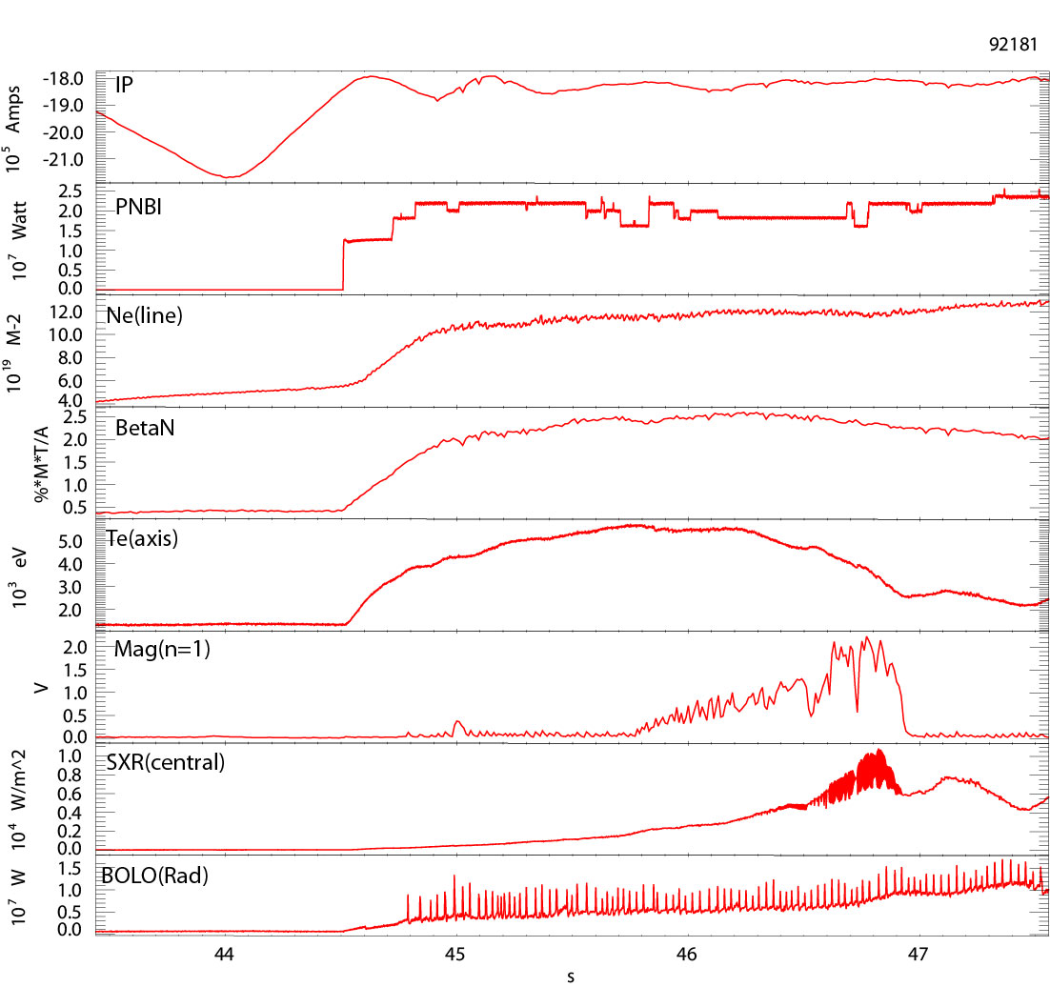
Continuous n=1 modes during hybrid sawtooth free scenarios
JET n=1 modes
Long
DT fusion record preparation with sawtooth free hybrid scenario
30MW auxiliary heating power
High beta, large neutron yield until n=1 modes
Particular feature of JET: tungsten divertor.
Pulse degradation due to impurity accumulation and radiation associated with MHD (see e.g. Te (axis) drop
Graves, Challis, Mantsinen, Frigione
10
J. P. Graves Kinetic MHD topics, TSVV 10 18th October 2021
10

Slide 11
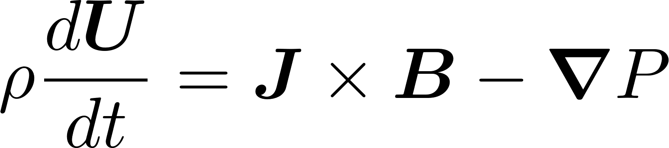
Modelling n=m=1 non-resonant mode
Graves, Challis, Mantsinen, Frigione
Analytical approach
Expand ideal MHD equations, e.g. linear expansion of momentum equation:
For non resonant modes, ideal MHD is a good model. Instability condition determined by proximity of reversal in q being close to rational surface m/n=1, and pressure being large:
The linear treatment can be extended non-linearly. We may obtain the saturated amplitude from analytic treatment:
11
J. P. Graves Kinetic MHD topics, TSVV 10 18th October 2021
11

Slide 12
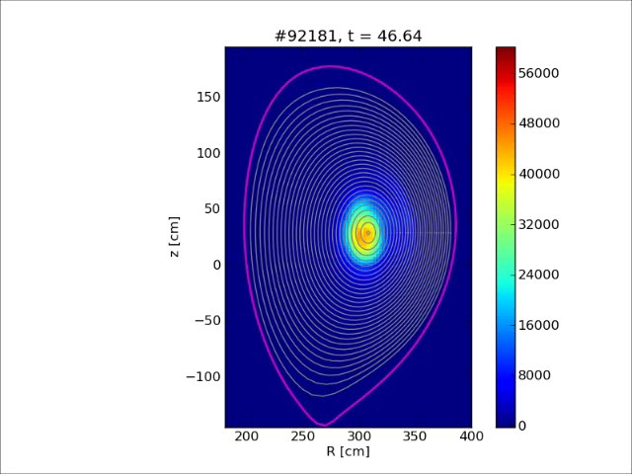
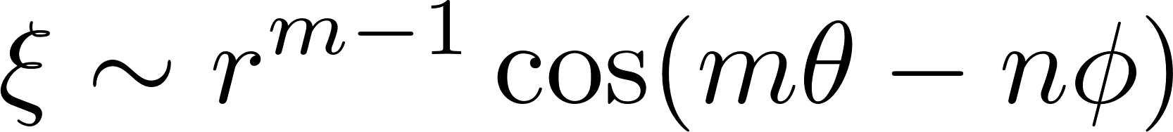
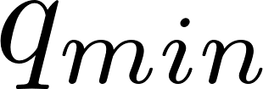
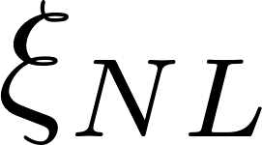
Modelling n=m=1 non-resonant mode
Compare with experiment
MHD fluctuations near the magnetic axis has spatial dependence:
So for m=1, the magnetic axis (r=0) exhibits a shift
The non-linear amplitude of the m=n=1 mode is the same at r=0 as it is up to
Hence, use SXR tomography with centrally peaked impurities to measure kink mode amplitude and compare against
12
J. P. Graves Kinetic MHD topics, TSVV 10 18th October 2021
12

Slide 13
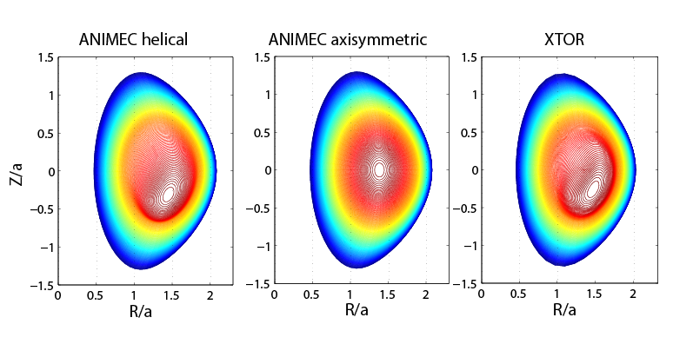
Modelling n=m=1 non-resonant mode
Analytical, 3D equilibrium and initial value (XTOR)
If we require only the saturated ideal MHD state we can use a 3D equilibrium code (use stellarator tools, e.g. VMEC or ANIMEC)
Without equilibrium
flows, this is a
magnetostatic mode
Same analysis models
m=1 SHAX in RFPs
0
Brunetti, Graves, Cooper, Lutjens, NF 2014
13
J. P. Graves Kinetic MHD topics, TSVV 10 18th October 2021
13

Slide 14
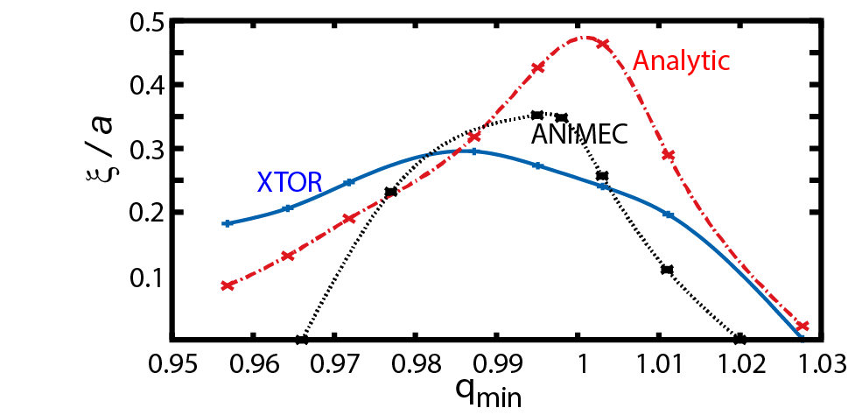
Modelling n=m=1 non-resonant mode
Analytical, 3D equilibrium and initial value (XTOR)
Three way comparison works quite well for non resonant case
For q_min< 1, there is at least one rational surface
For such resonant modes the equilibrium approach is more challenged (current sheets develop, very fine resolution required)
Clean advanced studies possible, e.g. fishbones in XTOR, and fast ion or impuritiy transport studies in VENUS-MHD
resonant m=1
non resonant m=1
[Graves, PPCF 2013]
VMEC wrong here
14
J. P. Graves Kinetic MHD topics, TSVV 10 18th October 2021
14

Slide 15
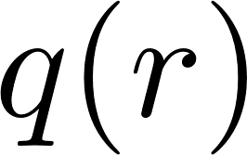
Advanced Modelling with VMEC approach
MAST fast ion confinement modelling
[Mast, 26887, Cecconello, NF 2012]
Model MAST impaired NBI heating and current drive using VENUS-LEVIS guiding centre code. q-profile drops towards unity, making kink amplitude bigger, NBI ions are pushed away from axis [Pfefferle, Graves, NF 2014]
15
J. P. Graves Kinetic MHD topics, TSVV 10 18th October 2021
15

Slide 16
Advanced Modelling with VMEC approach
MAST fast ion confinement modelling
Modelling of fast ion transport with kink mode agreed well with experiment (virtual diagnostic of Neutron emissivity]
Full-F calculations quantified impaired NB-current drive:
[Mast, 26887, Cecconello, NF 2012]
16
J. P. Graves Kinetic MHD topics, TSVV 10 18th October 2021
16

Slide 17
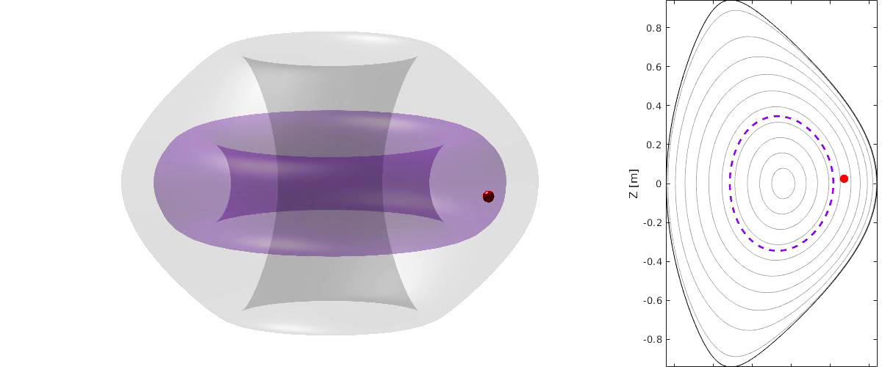
Advanced Modelling with VMEC approach
MAST fast ion confinement modelling
[Pfefferle, Graves, NF 2014]
17
J. P. Graves Kinetic MHD topics, TSVV 10 18th October 2021
17

Slide 18
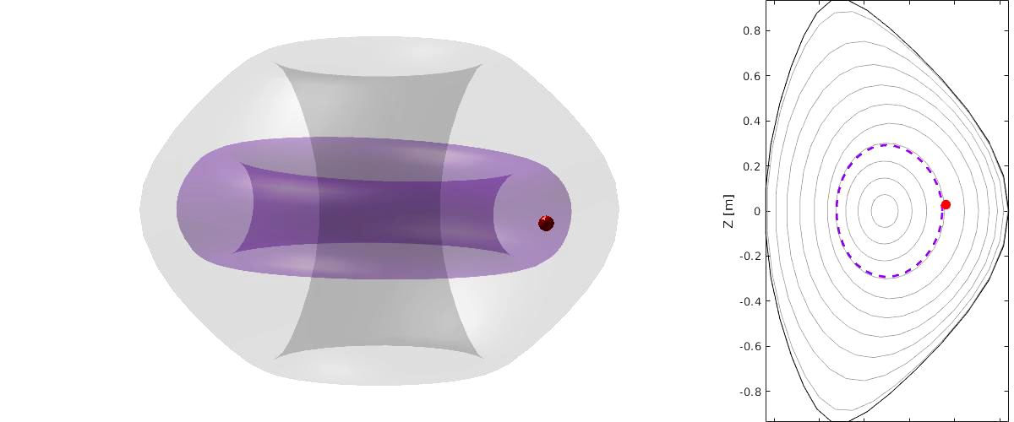
Advanced Modelling with VMEC approach
MAST fast ion confinement modelling
[Pfefferle, Graves, NF 2014]
18
J. P. Graves Kinetic MHD topics, TSVV 10 18th October 2021
18

Slide 19
Advanced Modelling with VMEC approach
Numerical challenges for transport modelling
Boozer coordinates are highly non-orthogonal!
ANIMEC/VMEC coordinates are better, but Jacobian can vanish for exact resonant kink:
[Pfefferle, Graves, CPC 2016]
19
J. P. Graves Kinetic MHD topics, TSVV 10 18th October 2021
19

Slide 20
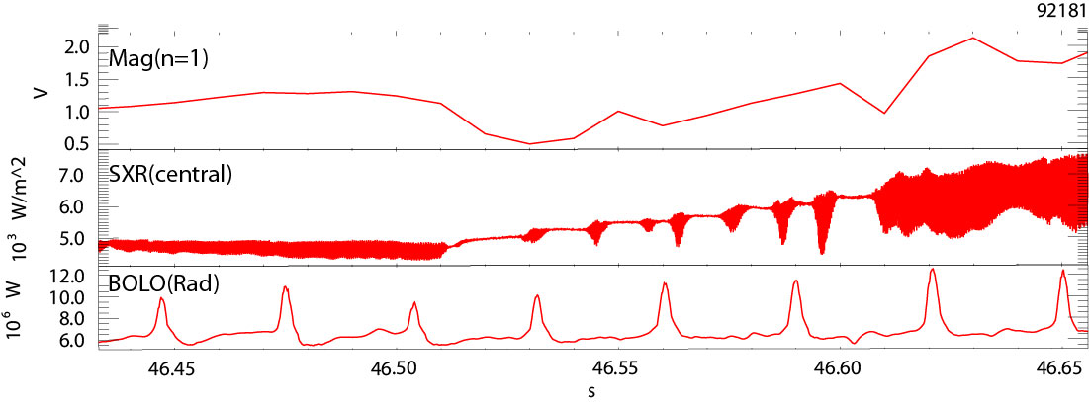
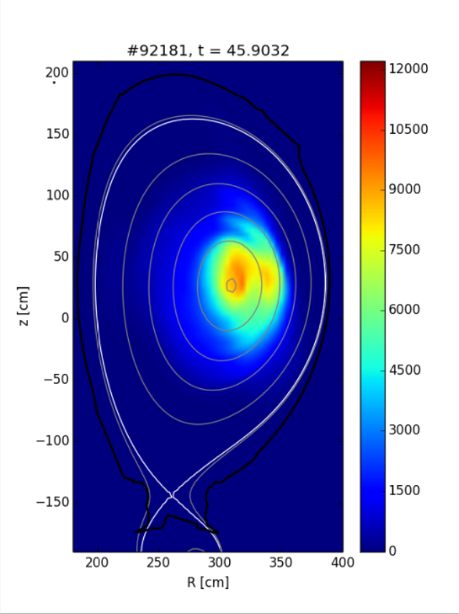
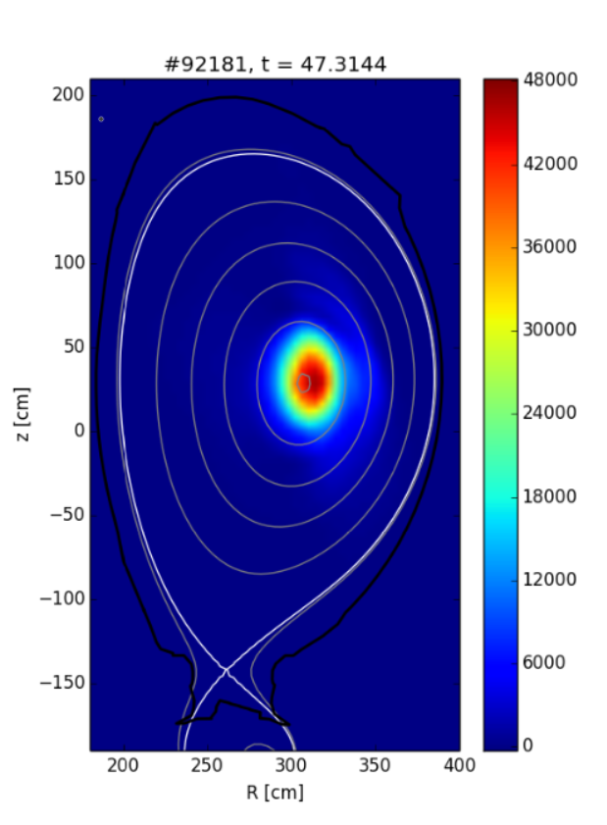
Advanced Modelling with VMEC approach
Heavy impurity Transport in JET
Weak 1/1 cont. mode
Growing fishbone
Strong 1/1 cont. mode
20
J. P. Graves Kinetic MHD topics, TSVV 10 18th October 2021
20

Slide 21

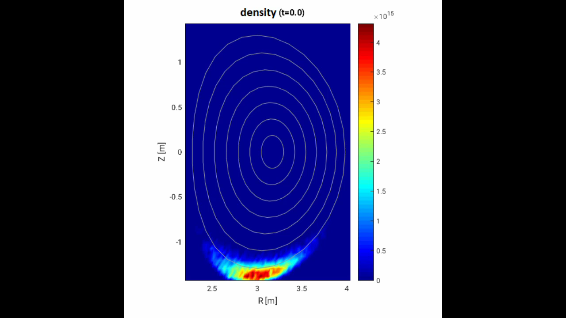
Advanced Modelling with VMEC approach
Impurity Transport Modeling JET
[Neto, Graves, PPCF 2021]
Fast JET tomography showing kink amplitude
VENUS-LEVIS (in plasma frame)
21
J. P. Graves Kinetic MHD topics, TSVV 10 18th October 2021
21

Slide 22
Advanced Kinetic MHD
The idea is to investigate instability conditions of pressure driven instabilities with collisionless thermal ions.
Motivation for new code with full kinetic thermal ion physics
Fast particles have low mass density. Hence they don’t create significant corrections to inertia, nor do they impact Q-N (no corrections to parallel electric field)
Fast ions typically have associated drifts much larger than MHD oscillation frequency of pressure driven instabilities, so they can often be considered weakly interacting (weak resonance effects, though they have an effect)
Shear flow effects more important for thermal ions (same reasons)
Some kinetic MHD codes do not include kinetic corrections for parallel electric field (e.g. use resistive Ohm’s law only, which may not be appropriate for weakly collisional regimes).
Fine scale kinetic corrections in ideal inertial layer could be a challenge for initial value approach. Linear eigenvalue code would be advantageous.
Kinetic MHD approach recently shown to have strong advantages over gyro-kinetic approach (not necessary to calculate numerically to same order in rho).
22
J. P. Graves Kinetic MHD topics, TSVV 10 18th October 2021

Slide 23
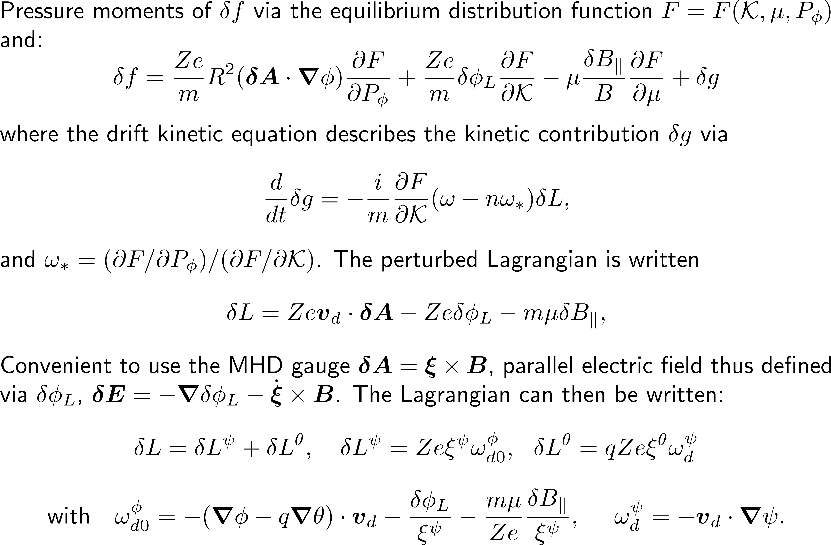
Advanced Kinetic MHD
23
J. P. Graves Kinetic MHD topics, TSVV 10 18th October 2021

Slide 24
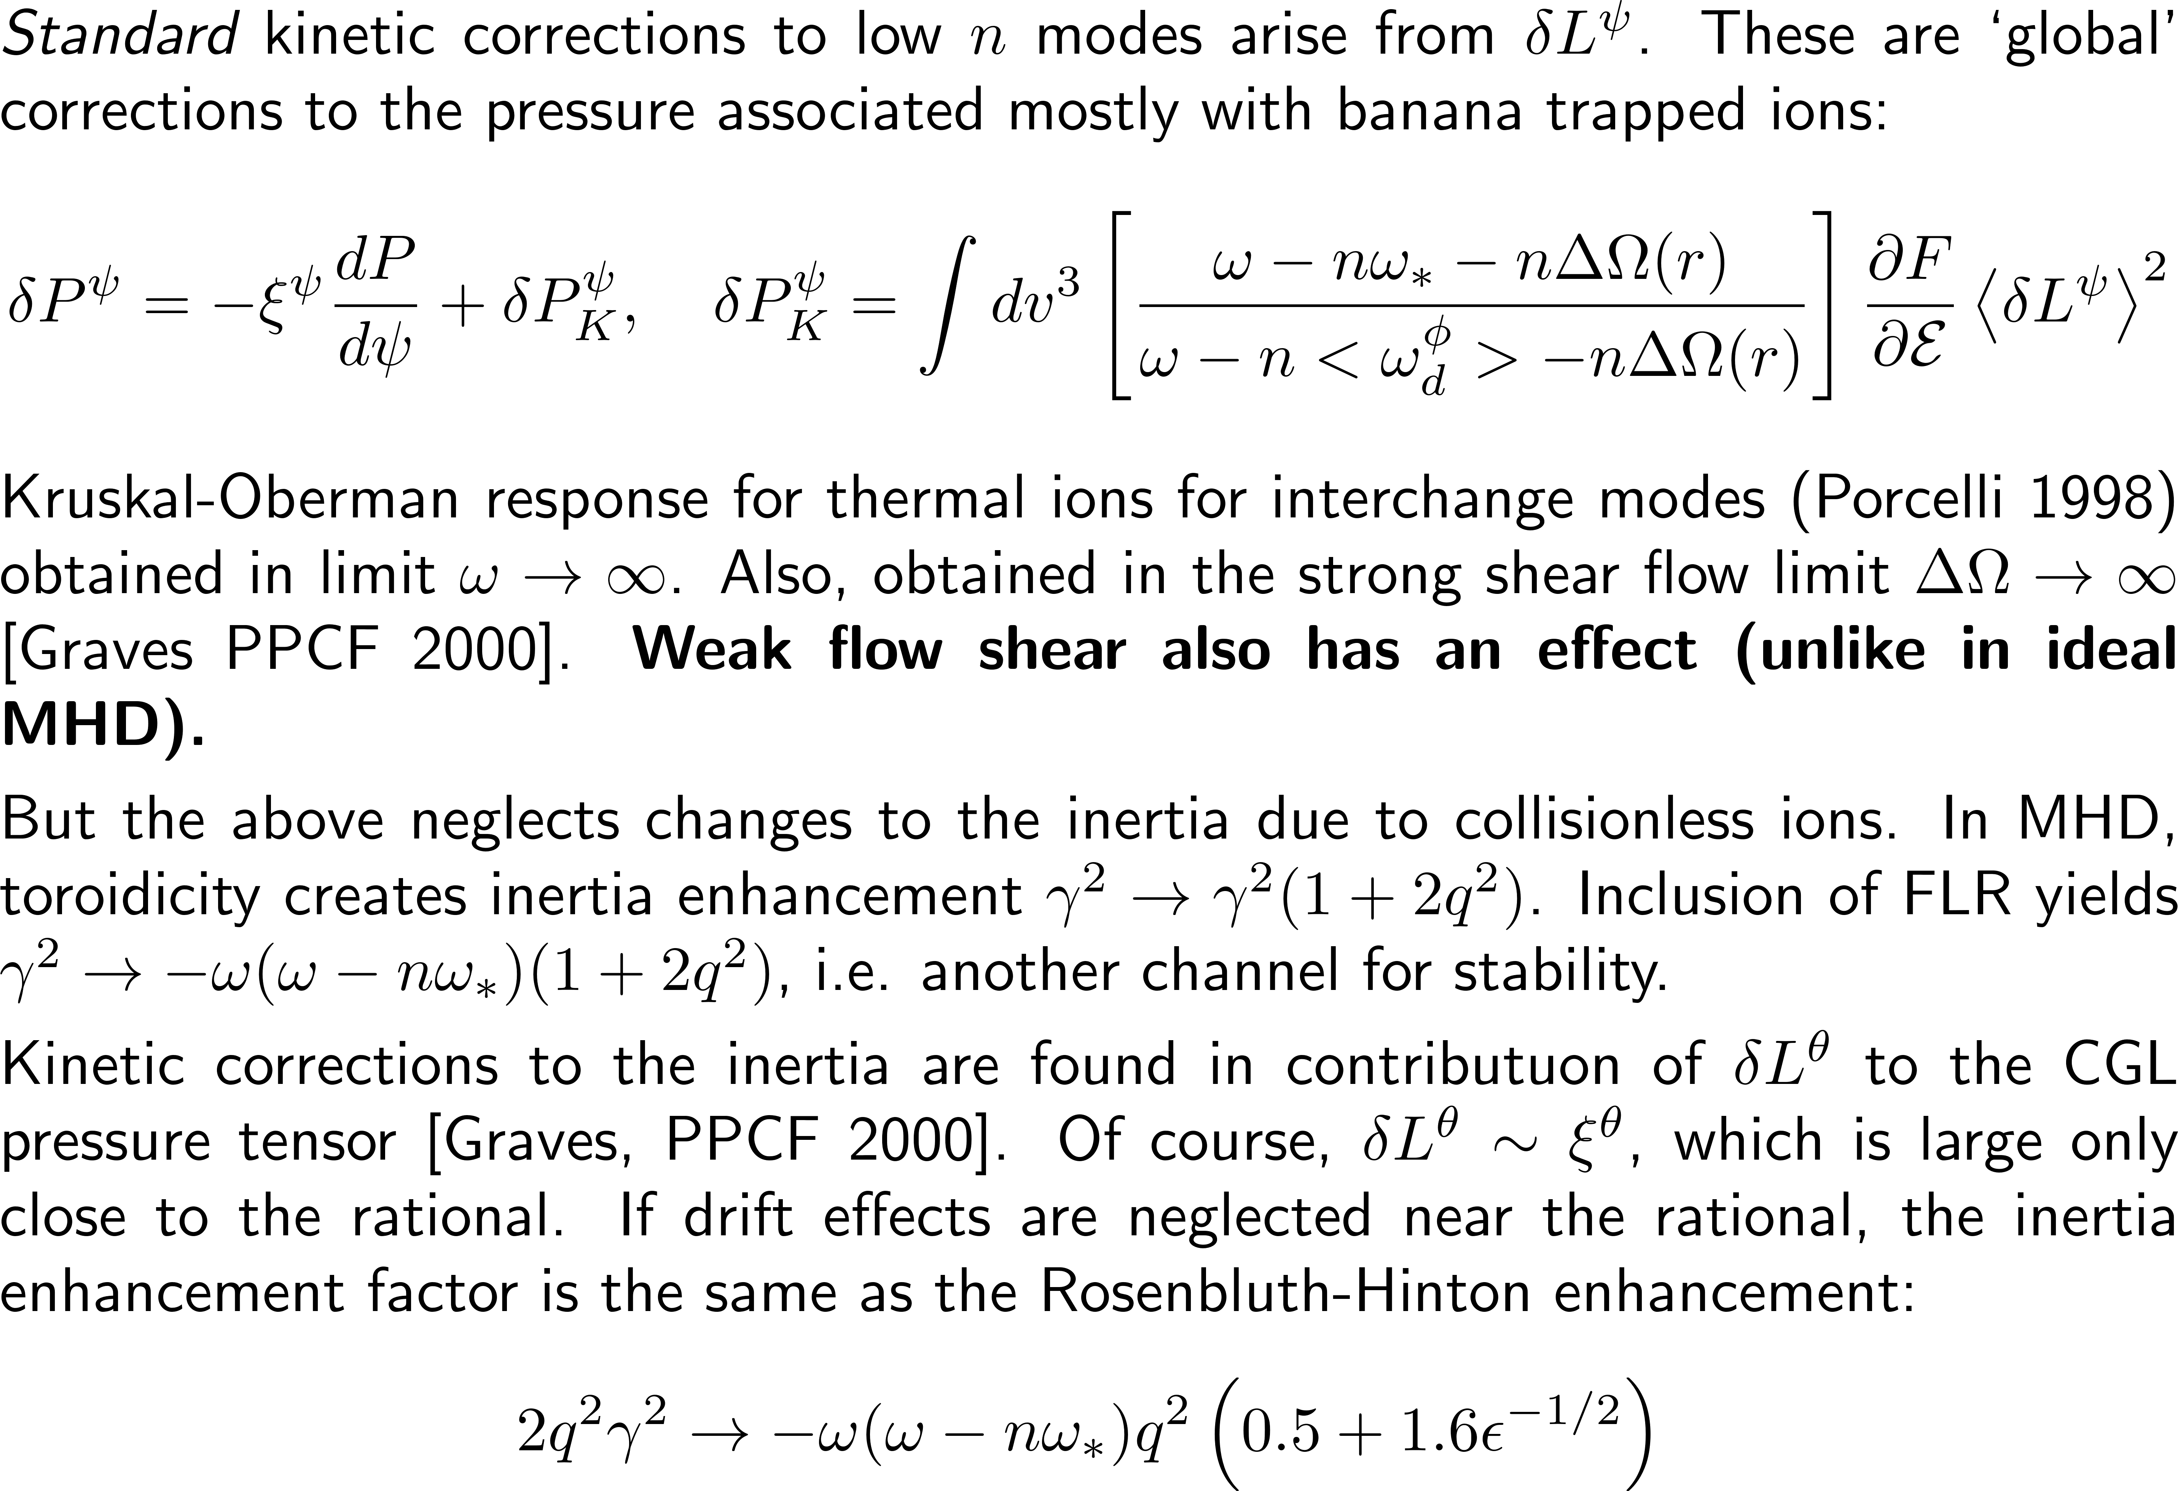
Advanced Kinetic MHD – analytic considerations
24
J. P. Graves Kinetic MHD topics, TSVV 10 18th October 2021

Slide 25
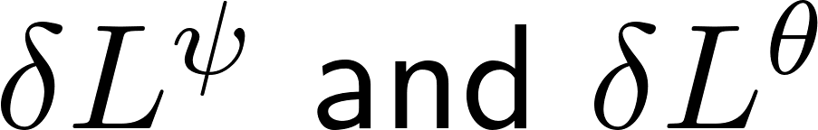
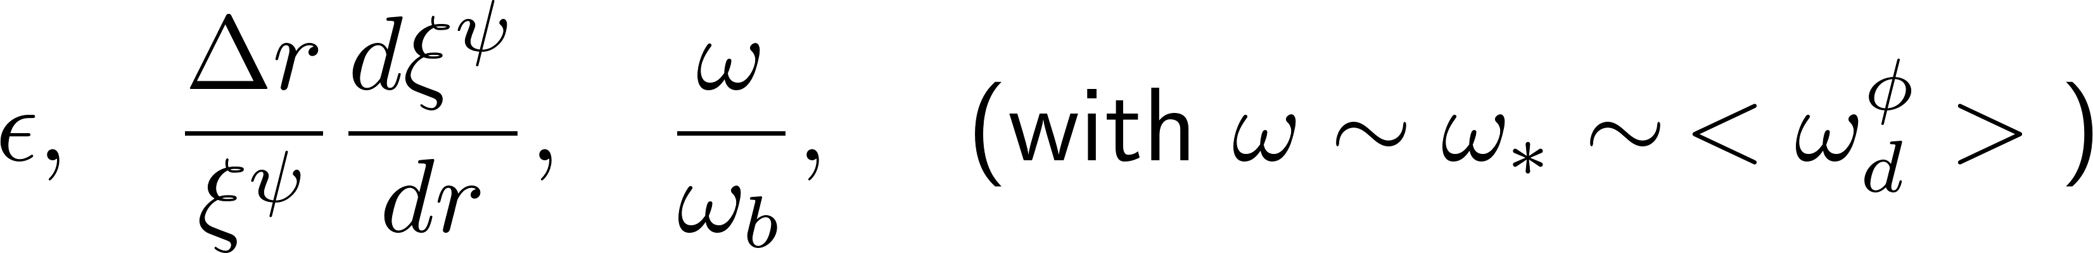
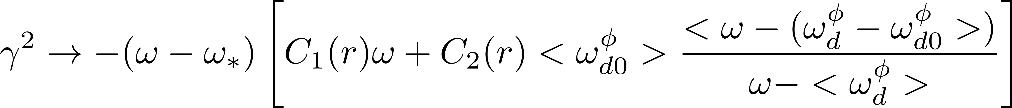
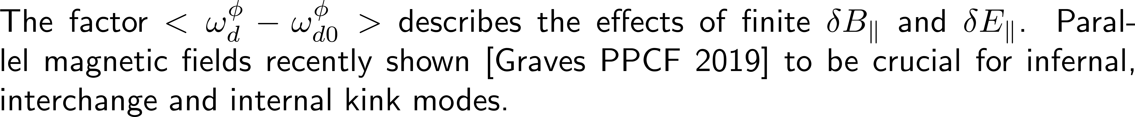
Advanced Kinetic MHD – analytic considerations
Until now the effects from have been undertaken separately, the usual idea being that one uses a matching procedure
Matching procedures aren’t always straightforward, e.g. for low-n interchange. For infernal modes the problem can’t be treated with a matching procedure because the inertia is significant over a large radial extent
Time has been spent to try to treat the whole problem in a global and continuous way. Using infernal equation approach
Both passing and trapped ions physics is needed. Kinetic passing ions are crucial for recovery of the 1.6 q^2/epsilon^1/2 factor.
Problem treated via expansion with respect to three parameters:
Inclusion of full drift effects in the inertia produce new instability channels, which will be investigated for pressure driven instabilities:
25
J. P. Graves Kinetic MHD topics, TSVV 10 18th October 2021

Slide 26
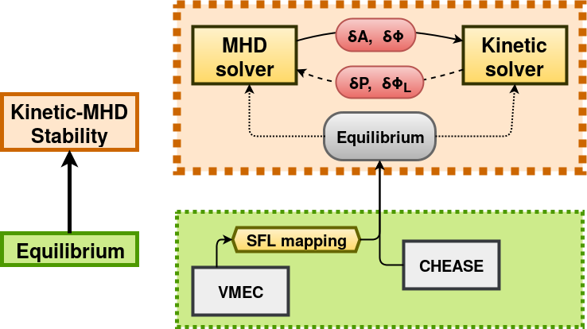
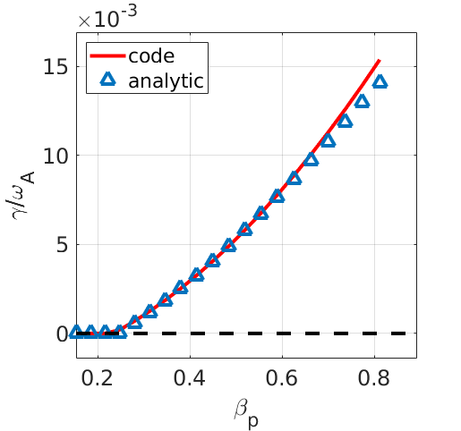
VENUS-MHD and K-MHD code
The VENUS-MHD code had been benchmarked for ideal MHD (n=m=1) without flow
Initial comparisons have been undertaken for cases where centrifugal effects are important
The routines for matrix inversion will remain when kinetic corrections are added
EnR project will develop a solver for the drift kinetic equation, taking fields from VENUS-MHD, returning updated moments. Initially QN equation and parallel electric field will be included.
The numerical methods for closing the new code VENUS-KMHD have not yet been decided. But we hope to learn from the Eulerian approach used in the fully EM gyrokinetic code GENE.
Plan to benchmark against analytic kinetic MHD results, including weak rotation shear effects described, inertia enhancement etc. Then develop a code that can handle strong flows.
26
J. P. Graves Kinetic MHD topics, TSVV 10 18th October 2021

Slide 27
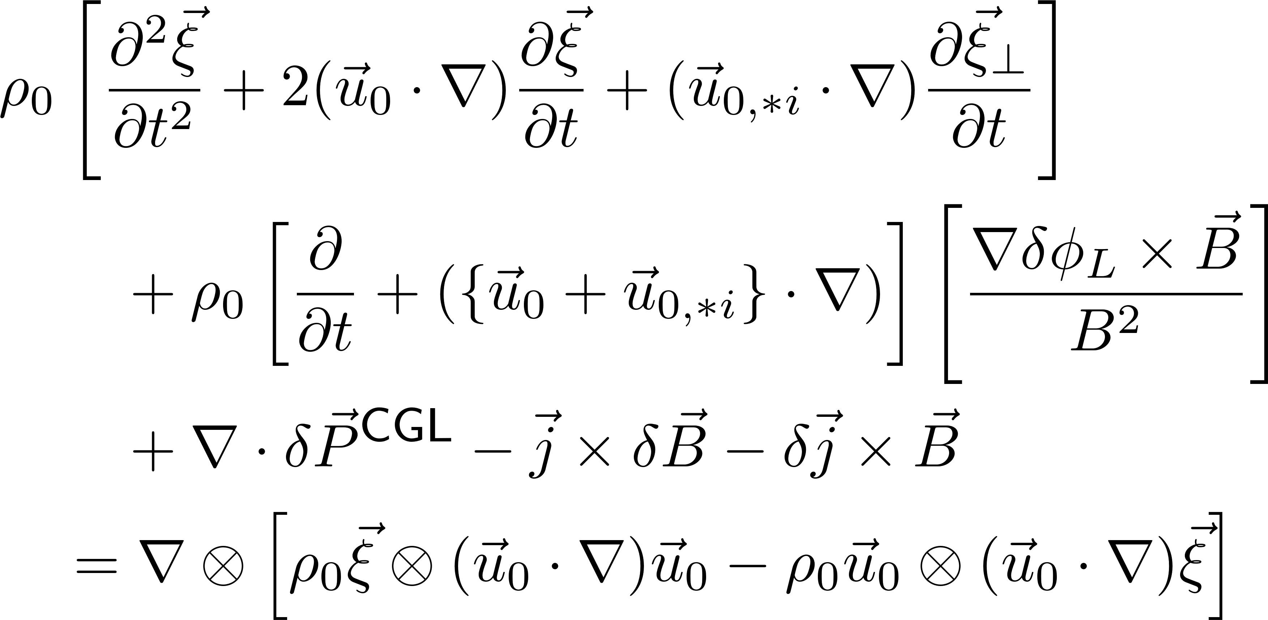
VENUS-MHD and K-MHD code
Kinetic-MHD equations have been derived consistently in the collisionless limit. Fluid FLR diamagnetic effects (very hard!), centrifugal corrections with wave-particle resonance physics:
From Lanthaler, Graves PPCF 2019. Parallel pressure, perpendicular pressure and density moments of kinetic equation required. QN equation resolves Lagrangian potential which defines parallel electric field.
For pressure driven instabilities we require full EM effects.
The kinetic MHD approach was shown in this paper to be more efficient than standard gyro-kinetic codes. Same physics in gyrokinetic code approach requires solving to one order higher in Larmor radius.
Non-linear model has been developed too. But parallel electric field corrections neglected.
27
J. P. Graves Kinetic MHD topics, TSVV 10 18th October 2021

