Slide 1
Plans for the stellarator db in 2022
A. Dinklage

Slide 2
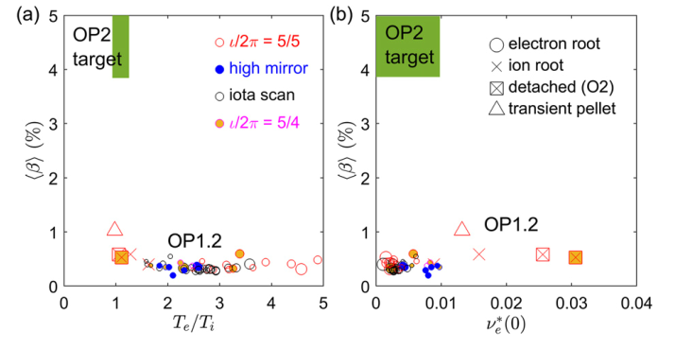
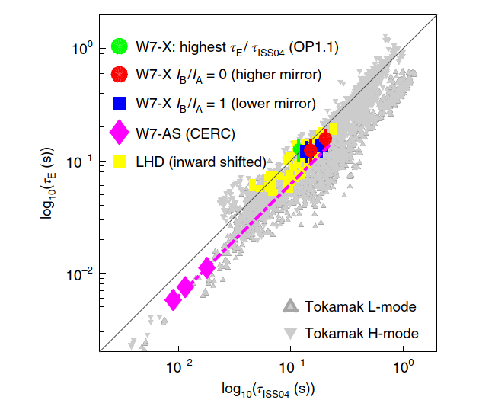
Scientific plan 2022: towards concept comparison
W7-X Data from OP1 & modelling
Scenario/concept comparison
2022
Dinklage et al., Nucl. Fusion (2021) accepted
Dinklage et al., Nature Phys. 14 (2018) 855
Specific targets:
IEA TCP S-H: update of the 0-D database, transfer of data into agreed format (IMAS), ensure accessibility and interoperability
IEA steady-state working group : input for Kikuchi-diagram
Prepare and provide selected data-sets from W7-X OP1
lowest collisionality attained with < 7MW, (T_{e} ~ T_{i}), ECH/NBI: confinement data
and recent campaigns on LHD
Documentation of performance progress, identification of crucial parameters, assess FAIRness

Slide 3
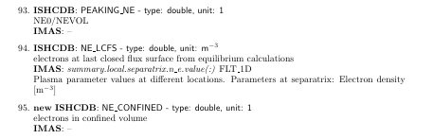
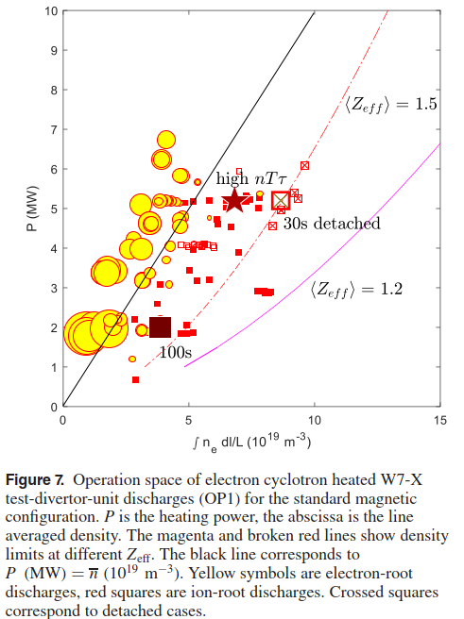
Technical Plan
ISCDB documentation and IMAS data dictionary
Representation of dataset for transfer:
Experimental input, modelling results
(e.g. ~180 profiles of phys. quantities per time-lsice)
Pursue mapping of 0D stellarator confinement database into IMAS: resolve missing entries
Provide additional cases for W7-X and LHD (t.b.c.) from INCO
Start with mapping of 1D stellarator profile database into IMAS

Slide 4
Some of my own “EUROfusion IMAS experiences”
The transfer of the stellarator db into IMAS was part of the milestones of the db in FP8 (though not critical for WPS1)
The transfer was not conducted due to a lack of resources in FP8
Specification of the underlying issue (resources) was not straight-forward in FP9 and required some research
When trying to pursue the transfer of ISCDB into IMAS, some recommended EUROfusion contacts were not responsive at all
Some were, but were not available in needed time-slots
The official IMAS contact had no resources
Contact w/ IO (Schneider, Hoehnen, Pinches) was constructive and immediate support was provided
Draft translation of data dictionaries conducted
First impression: the IMASification appears to need detailed expert knowledge both in datascience and plasma physics
To be continued: unclear – overarching strategy (who keeps the data, what is the data management plan), IPR, FAIRness, …

