Slide 1
Status of HPC, Gateway & JDC
FSD-Project-Board-Theory Meeting
March 10, 2022
R. Kamendje

Slide 2
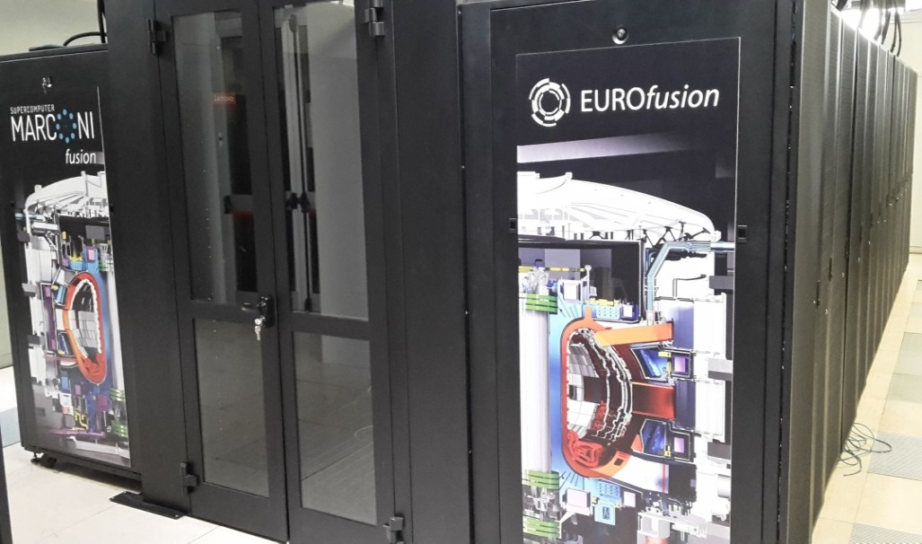
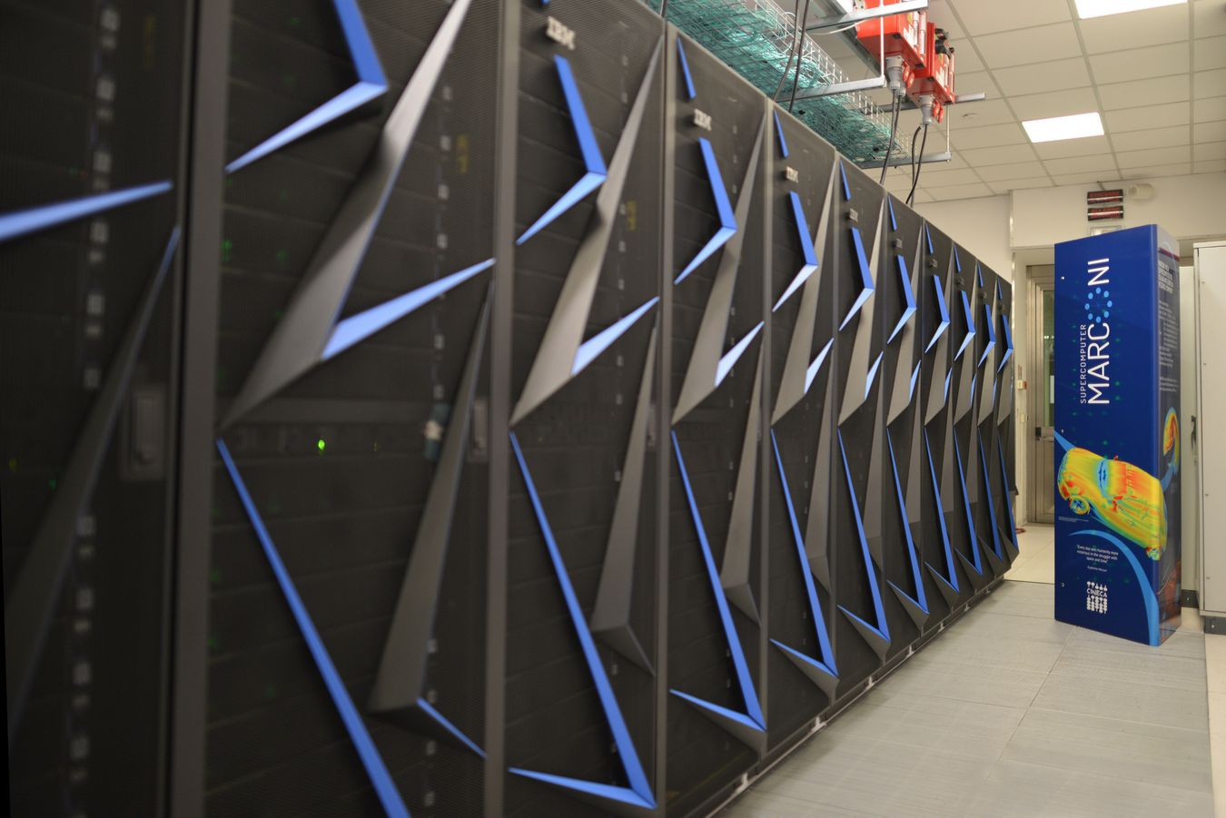

Marconi Fusion & Gateway
Marconi - SKL partition (A3) - 2848 nodes
6.0 Pflops (HPL) - 9.2 Pflops (peak)
Marconi100 - GPU partition (C1) - 99 nodes
2.2 Pflops (HPL) - 3,0 Pflops (peak)

Slide 3
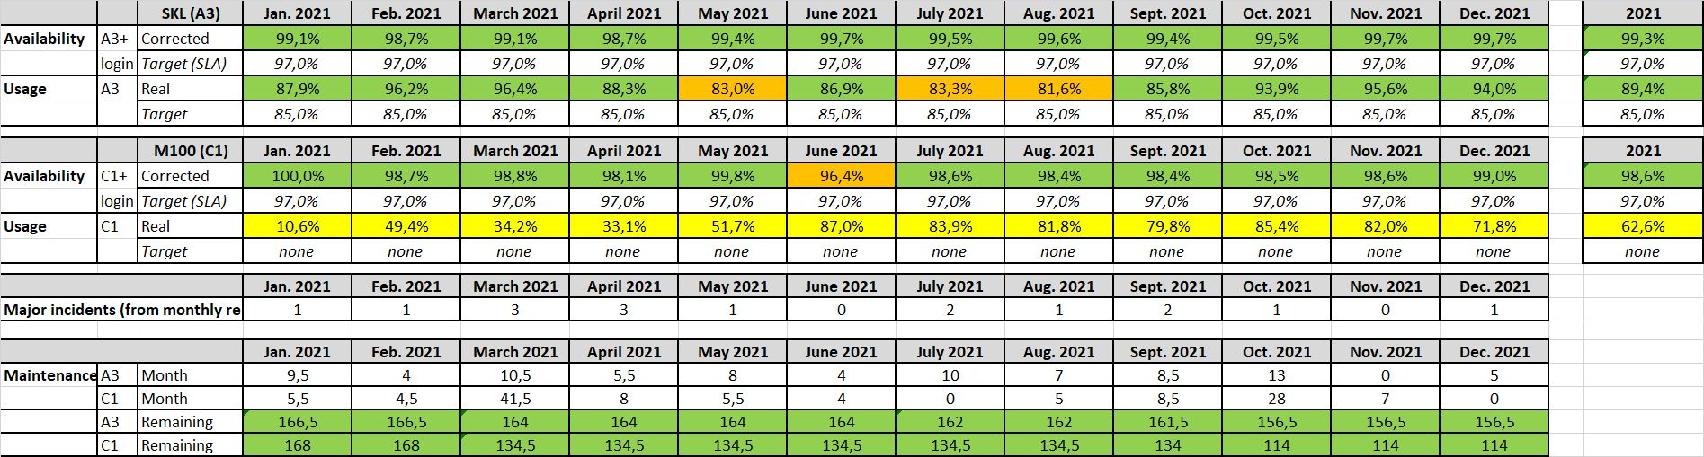
Marconi-Fusion: Availability/Usage in 2021

Slide 4
Marconi-Fusion: Usage 2021

Slide 5
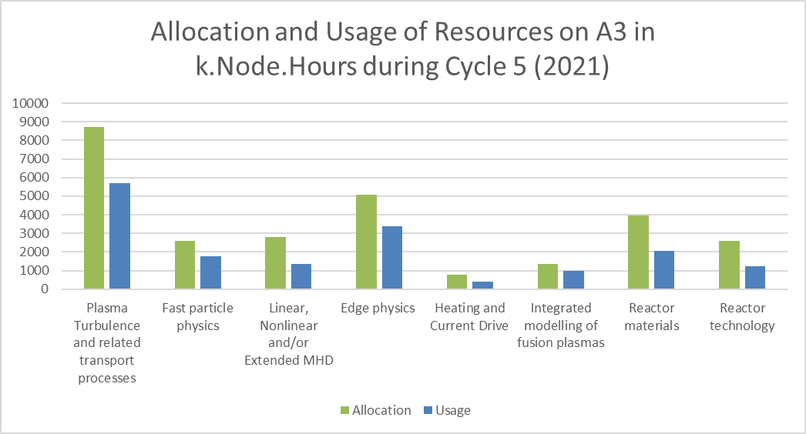
Marconi-Fusion: Usage 2021 – A3

Slide 6
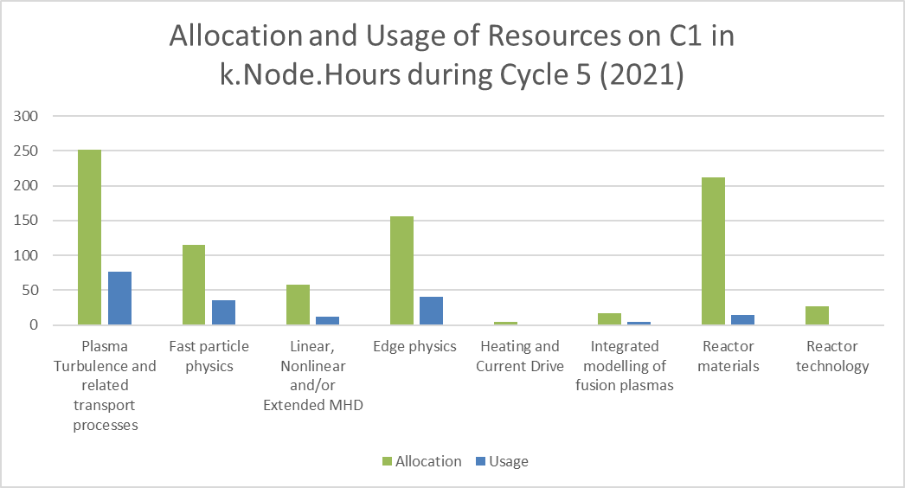
Marconi-Fusion: Usage 2021 – C1

Slide 7
JET Data Centre
JDC available for use by the fusion community as of 21st February 2022
Data available at JDC composed of
  JET Experimental Data - Raw and processed scientific and technical data from experiments, video and audio files
  Machine configuration data - configuration data and meta-data for the JET vessel, systems and diagnostics
  JET operational information - scientific, technical and administrative logs and summaries
  Documentation and configuration information - computing infrastructure information for users and maintainers; technical logs & monitoring data
  Documents and records - shared document folders for JET projects and activities; paper archive of technical and administrative documentation
Details on request for account giving access to the services available at: https://users.jetdata.eu.

