Slide 1

WPTE Programme
WP Tokamak Exploitation Task Force Leaders:
E. Joffrin, Marco Wischmeier, M. Baruzzo, A. Kappatou, D. Keeling, A. Hakola, B. Labit, E. Tsitrone, N. Vianello

Slide 2
Overarching priorities for work package Tokamak Exploitation in FP9
Prepare ITER exploitation (ITER Research Plan & ITPA CC)
Provide Physics Basis for guiding DEMO design
Exploit recent machine enhancements, i.e. related to PEX (Plasma EXhaust)
Address objectives of EUROfusion Roadmap:
Mission 1 (Plasma Regimes of Operation)
Mission 2 (Heat exhaust System)
https://wiki.euro-fusion.org/wiki/WPTE_wikipages:_Tokamak_Exploitation_Work_Package

Slide 3
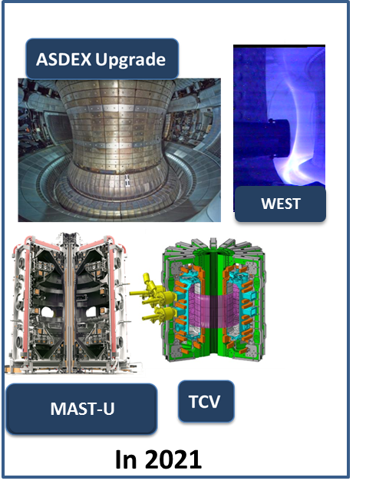
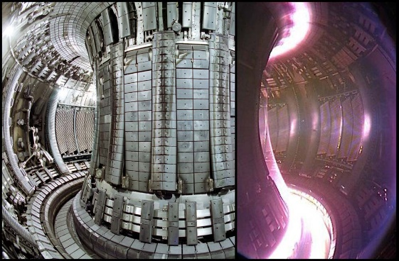
Exploitation of EUROfusion Tokamak devices
Participation of 4 devices in 2021: ASDEX Upgrade, MAST-U, TCV and WEST using at best devices capabilities
The operational budget allocated to WP TE to all 4 devices is pre-defined by EUROfusion until 2025.
JET integrated end of 2021 (after DT) with a pre-defined programme C40B and C42 and participation.
*PEP to be updated & confirmation from GA awaited

Slide 4
Schedule evolution in 2021
Start of WPTE experiments in 2021 folllowing the call for proposal (October 2020 and the call for participation (December 2020)
WEST campaign moved to 2022 following the He tank incident
MAST-U: extended by one month
Machine | 2021
 | Jan | Feb |  | Mar |  | Apr |  | May |  | Jun |  | Jul |  | Aug |  | Sep | Oct | Nov | Dec
AUG
 | AUG programme 2021
MAST-U
 |  |  |  |  |  |  |  | 1st physics campaign
TCV
 | w/o baffles |  |  |  |  | w/ baffles 1.0 |  |  |  |  |  |  |  |  | w/ baffles 2.0 |  |  | w/o baffles
WEST
 | C5 camp. |  |  |  |  |  |  |  |  |  |  |  | C6 campaign
JET (reference)
 | C40, T campaign |  |  |  |  |  |  |  |  | C41, DTE2 |  |  |  |  | C42 campaign
JET campaign delayed: C42 until the end of 2021 and C40B and C42 in 2022

Slide 5
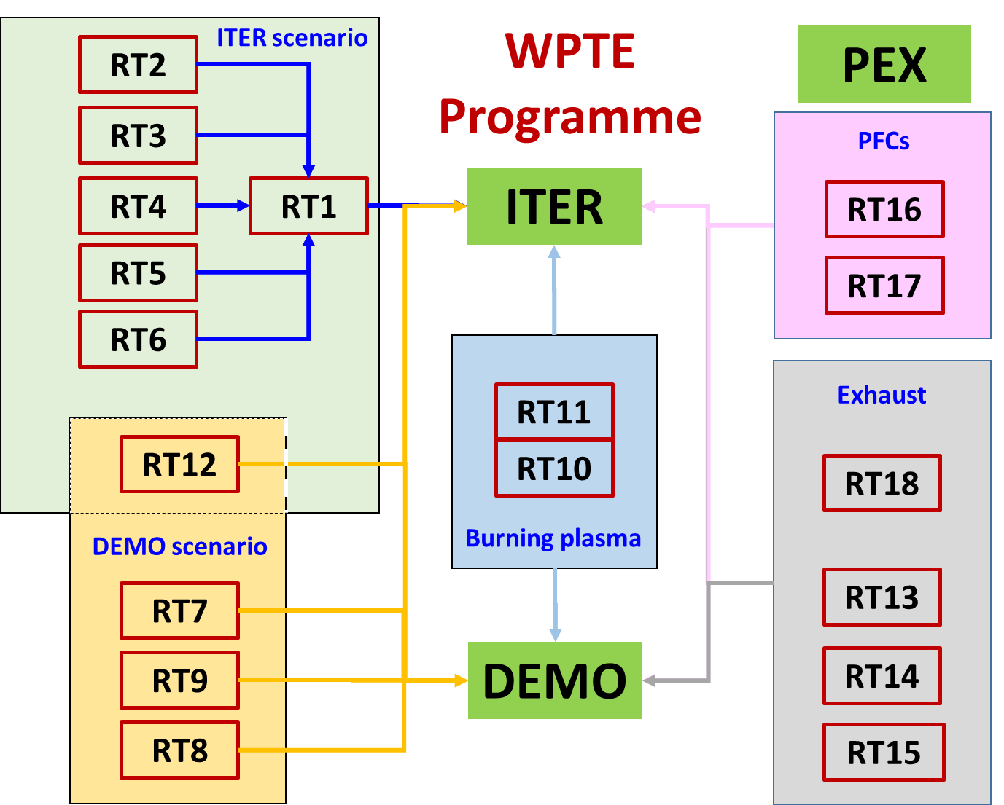
WPTE Programme organization until the 1st of July 2022
WP PrIO
WP PWIE
DCT

Slide 6
Tokamak exploitation: 2021-22 research topics
 | Research Topics
RT1 | ITER Baseline scenarios towards low collisinality and detachment
RT2 | H-mode entry and pedestal dependence with impurities and isotopes
RT3 | RF-assisted breakdown and current ramp-up optimization
RT4 | Disruption avoidance and control for ITER and DEMO
RT5 | Run-away electron generation and mitigation
RT6 | ELM mitigation and suppression in ITER/DEMO relevant condition
RT7 | Negative triangularity scenarios as an alternative for DEMO
RT8 | QH-mode and I-mode assessment in view of DEMO
RT9 | Extension of EDA and QCE performance towards DEMO
RT12 | Development of the steady state scenario
RT10 | Fast-ion physics with dominant ICRF heating
RT11 | Impact of MHD activity on fast ion losses and transport
RT13 | X-point radiation and control
RT14 | Physics of plasma detachment / impurity mix/ heat load patterns
RT15 | Extrapolation of SOL transport to ITER and DEMO
RT18 | Alternative divertor configurations
RT16 | PFC damage evolution under tokamak conditions
RT17 | Material migration and fuel retention mechanisms in tokamaks
ITER Scenario
DEMO
Scenario
Burning plasma
Exhaust
PEX
PFC

Slide 7
Overview of research topics 2021 experiments (M1)
 | Titles | Scientific coordinators | TFLs | AUG | TCV | MAST-U | WEST
RT01 | IBL scenarios towards low collisinality and detachment | Lidia Piron, Thomas Pütterich, Olivier Sauter | EJ/BL | 46/39 | 49/40 | 22/20 | 0/15
RT02 | H-mode entry and pedestal dependence with impurities and isotopes | Mike Dunne, Lorenzo Frassinetti | NV/BL | 29/28 | 54/54 | 30/25 | 0/0
RT03 | RF-assisted breakdown and current ramp-up optimization | Daria Ricci, Tom Wauters | EJ/BL | 21/20 | 0/0 | 0/0 | 0/10
RT04 | Disruption avoidance and control for ITER and DEMO | Marc Maraschek, Federico Felici, Ondrej Kudlacek | EJ/MW | 17/15 | 38/30 | 0/0 | 0/0
RT05 | Run-away electron generation and mitigation | Umar Sheikh, Ondrej Ficker, Cédric Reux | EJ/AH | 13/10 | 36/35 | 0/0 | 0/10
RT06 | ELM mitigation and suppression in ITER/DEMO relevant condition | Wolfgang Suttrop, David Ryan | NV/AH | 30/26 | 0/26 | 20/25 | 0/0
RT07 | Negative triangularity scenarios as an alternative for DEMO | Tommaso Bolzonella | NV/BL | 0/0 | 0/0 | 0/0 | 0/0
RT08 | QH-mode and I-mode assessment in view of DEMO | Eleonora Viezzer, Antoine Merle | NV/BL | 24/20 | 22/40 | 11/15 | 0/15
RT09 | Extension of EDA and QCE performance towards DEMO | Luís Gil, Michael Faitsch | MW/BL | 43/35 | 25/54 | 21/20 | 0/0
RT10 | Fast-ion physics with dominant ICRF heating | Yevgen Kazakov, Roberto Bilato | ET/AH | 17/11 | 0/0 | 0/0 | 0/0
RT11 | Impact of MHD activity on fast ion losses and transport | Manuel Garcia-Munoz, Matteo Vallar | NV/BL | 18/15 | 19/30 | 38/35 | 0/0
RT12 | Development of the steady state scenario | Chiara Piron, Stefano Coda | EJ/NV | 0/0 | 0/30 | 31/25 | 0/0

Slide 8
Overview of research topics 2021 experiments (M2)
 | Titles | Scientific coordinators | TFLs | AUG | TCV | MAST-U | WEST
RT13 | X-point radiation and control | Sven Wiesen, Matthias Bernert | MW/AH | 21/20 | 61/50 | 13/15 | 0/15
RT14 | Physics of plasma detachment / impurity mix/ heat load patterns | Stuart Henderson, Olivier Février, Aaro Järvinen | MW/ET | 37/35 | 65/80 | 36/35 | 0/0
RT15 | Extrapolation of SOL transport to ITER and DEMO | Georg Harrer, Dominik Brida | NV/ET | 26/20 | 40/50 | 10/20 | 0/0
RT16 | PFC damage evolution under tokamak conditions | Yann Corre, Karl Krieger | ET/AH | 8/12 | 0/0 | 0/0 | 0/90
RT17 | Material migration and fuel retention mechanisms in tokamaks | Thierry Loarer, Jari Likonen | ET/AH | 24/14 | 0/26 | 0/0 | 0/75
RT18 | Alternative divertor configurations | Christian Theiler, Andrew Thornton | MW/EJ | 0/0 | 115/100 | 73/64 | 0/0
TOTALs | 374/387 | 524/806 | 312/360 | 0/270
Note:
TCV campaign to be completed in December 2021.
ASDEX Upgrade is extended by 2 or 3 days in Dec. 2021.
MAST started well !

Slide 9
ASDEX Upgrade 2021 december campaign
AUG has planned 3 additional days of operation in December 2021 (still considered as part of 2021 campaign)
Shot allocated to complete work already started with maximized impact on 2022 conferences
RT | Shot allocation Dec 2021
RT01 | 12
RT03 | 9
RT04 | 11
RT13 | 6
Total | 38 (+6 Contingency)

Slide 10
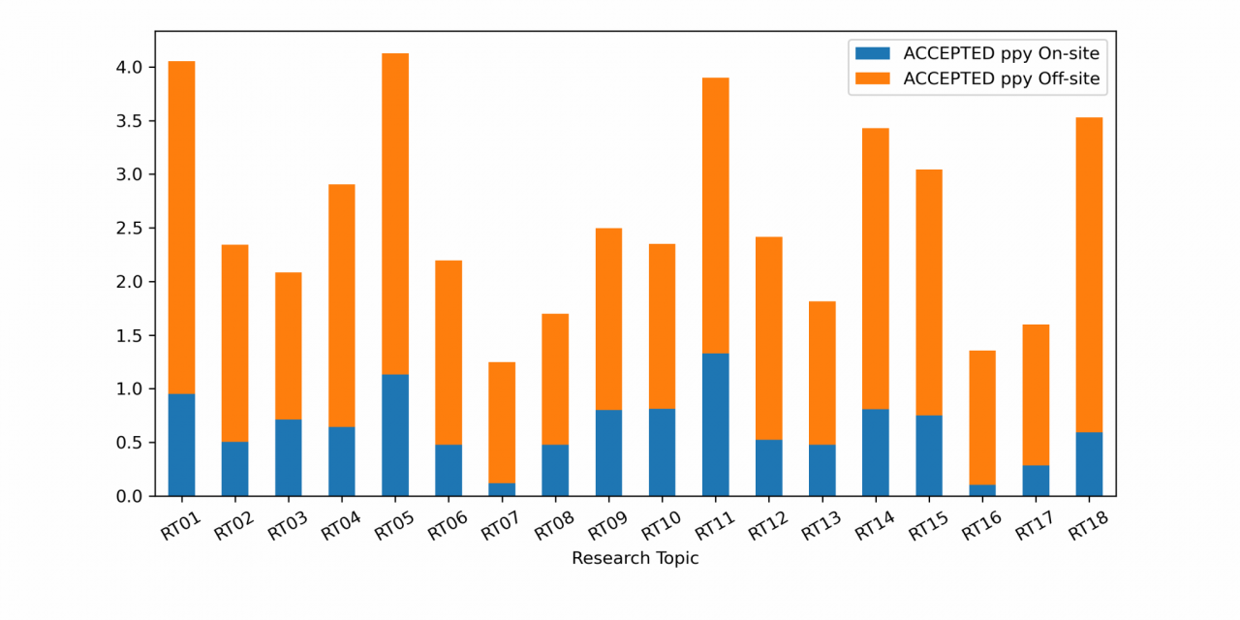
2021 participation by RT
Allocations in line with high priority items:
RT01: ITER baseline scenario
RT18: PEX Upgrade:
RT14: Physics of detachment
RT05 and RT10, RT11 strong effort required on modelling and specific diagnostic operation (not covered by operation cost)
WEST budget moved to 2022
Other remarks:
RT07: no pulses this year
RT16 and RT17 (PFCs for next devices) focus on metallic machines
RT18 (alternative divertor) PEX enhancements in TCV & MAST-U
RT12: AT scenario part of IPP domestic Programme until end 2023.
Not included here: the budget remainder (of ~5ppy) will be used for the ASDEX Upgrade december campaign. The exact allocation is presently discussed with the relevant Scientific Coordinators

Slide 11
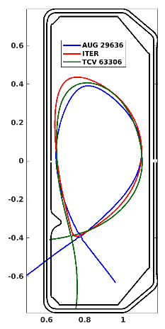
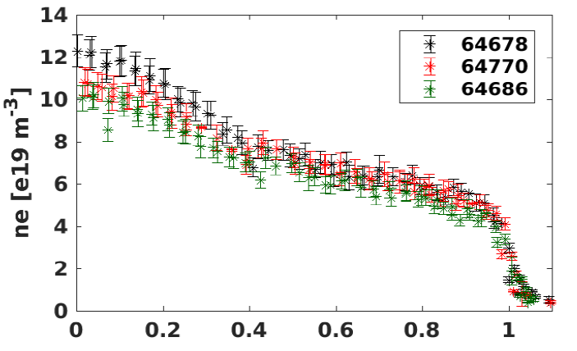
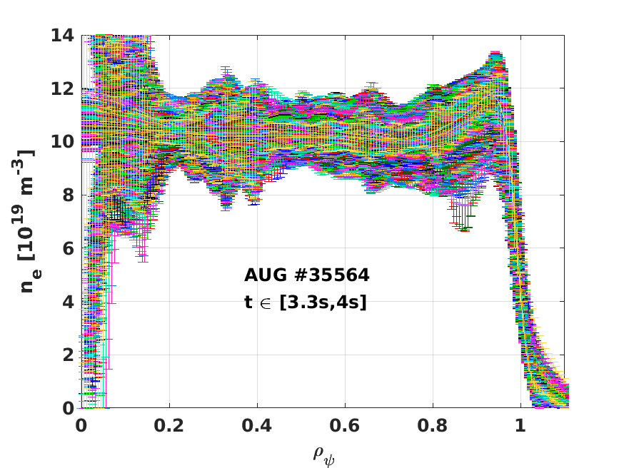
Grant deliverables in 2021
TE.D.01 | Successful establishment of Type I ELMy H-mode scenario with dominant electron heating for the first safe operation of ITER. | Dec. 2021 | Partial; experiments planned still in TCV and AUG in 2021 with optimal e- heating
TCV
ASDEX Upgrade
RT01
➔ Variation of ν* important to understand this difference
TCV is expected to produce more data in December 2021 with more additional electron heating power
H-mode exit/landing and pellet impact on ELM and confinement also studied in this research topic.

Slide 12
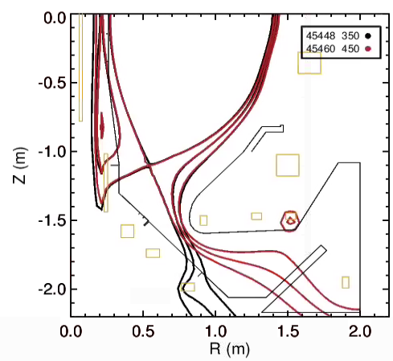
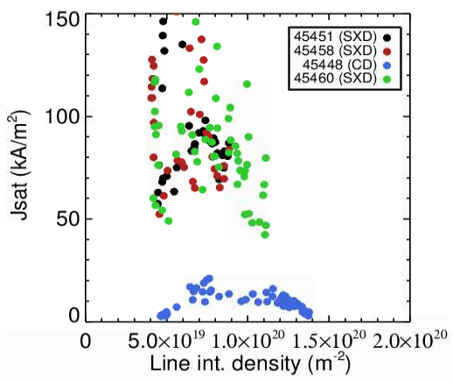
Grant deliverables in 2021
TE.D.02 | The effect of total flux expansion and snowflake configurations in environments with intrinsic impurities on power dissipation quantified. | Dec. 2021 | Experiments nearly completed – only L-mode. H-mode started; modeling ongoing (RT18)
CIII front position
RT18
Expect -38%
Obtain -22%
D₂
Predicted reduction of detachment threshold in Super-X partly recovered
Target n_{e} and j_{sat} do not increase as expected in Super-X. Interpretative SOLEDGE2D simulation on-going
Super-X: Rollover at
Line avg. n_{e} = ~0.7x10²⁰ m⁻²
Conventional: Rollover
Line avg. n_{e} = ~1.2x10²⁰ m⁻²

Slide 13
Overview of research topics advances (M1)
Level | Emerging | Exploratory | Judgemental | Mature-needs underpinning | Mature-needs support | Established
RT | Title | D1 | D2 | D3 | D4 | D5 | D6
RT01 | IBL scenarios towards low collisinality and detachment
RT02 | H-mode entry and pedestal dependence with impurities and isotopes
RT03 | RF-assisted breakdown and current ramp-up optimization
RT04 | Disruption avoidance and control for ITER and DEMO
RT05 | Run-away electron generation and mitigation
RT06 | ELM mitigation and suppression in ITER/DEMO relevant condition
RT07 | Negative triangularity scenarios as an alternative for DEMO
RT08 | QH-mode and I-mode assessment in view of DEMO
RT09 | Extension of EDA and QCE performance towards DEMO
RT10 | Fast-ion physics with dominant ICRF heating
RT11 | Impact of MHD activity on fast ion losses and transport
RT12 | Development of the steady state scenario

Slide 14
Overview of research topics advances (M2)
Level | Emerging | Exploratory | Judgemental | Mature-needs underpinning | Mature-needs support | Established
 | Title | D1 | D2 | D3 | D4 | D5
RT13 | X-point radiation and control
RT14 | Physics of plasma detachment / impurity mix/ heat load patterns
RT15 | Extrapolation of SOL transport to ITER and DEMO
RT16 | PFC damage evolution under tokamak conditions
RT17 | Material migration and fuel retention mechanisms in tokamaks
RT18 | Alternative divertor configurations
The rating of each objectives are regularly updated with the recent advances.

Slide 15


Tokamak Exploitation in its scientific environment
Theory, Simulation
Verification, Validation
Advanced Computing Hub
WP PWIE
Plasma Wall Interaction and Exhaust
Preparation of ITER Operation
EU Tokamak Exploitation
(PEX)
WP PrIO
WPSA
DEMO central team
(Plasma division)
Exploitation of JT-60SA
2024
DCT
AUG, MAST-U, TCV, WEST, JET

Slide 16
Linking WP TE activitieswith WP PWIE
Link with WP PWIE and PEX exploitation (WPTE DTFL also TA coord)
Activity
PWI modelling | RT16: melting experiments modelling in AUG / WEST performed in 2021 commonly under TE and PWIE. RT17: material migration in AUG/WEST modelling using plasma background provided by TE material migration codes (ERO2.0, WallDYN) run under PWIE
Post Mortem analysis | RT16 & RT17: Analysis of components after exposure in WEST and AUG carried out in PWIE to characterize material migration, fuel retention etc and material damage: 2021 : WEST erosion markers exposed in the C3 campaign ; 2022 : WEST erosion markers exposed in the C4 (incl He exposure) campaign + first ITER like PFU exposed in phase 1 of WEST. Preparation and pre-characterization of marker samples/probes under PWIE for experiments to be executed within TE
ADC and extrapolation to DEMO | RT18: first experiments carried out in MAST-U and continuation of experiments in TCV. Link between experimental / interpretative modelling carried out under TE and extrapolation modelling carried out in PWIE to be clarified. Note: ADC funding in PWIE ends in 2022: risk for RT18.

Slide 17
Linking WPTE with WP rIO and WP SA
PrIO | EUROfusion database: Databases on disruption, pedestal, confinement Status of the database reviewed and action drawn for their development. WPTE has TFLs ROs for each database to facilitate the collection of data ITPA management Involvement of the ITPA EU members agreed. WPTE will review the advances of each groups in its Task force Meeting. Breakdown and ramp-up for ITER: Meeting with TSVV11 and IO: coordination of the work discussed and agreed in particular with RT03 and WPSA.
SA | No meeting has been held with WPSA yet (Delay of JT-60SA). However: First plasma (September 2022): RT03 (breakdown + ramp-up) + RT04 (control of disruptions) Preparation of the first campaigns (2025): RT12 (advanced scenario) + RT10 & RT11 (fast particles) + RT02 (pedestal) + RT05 (run-aways)

Slide 18
Interaction with the DEMO Central Team (DCT)
Regular meetings held in the framework of the bi-weekly FSD-FTD meetings
Identification of gaps and resulting actions for overcoming these scientific gaps
Ultimately update the document on “Key DEMO Physics Uncertainties and Related Investigation Needs” to include a prioritization of the actions by WPTE
Three topics addressed in 2021 and actions identified towards WPTE
Divertor physics (RT13/RT14)
Transient phases in scenario (ramp-up/down; H-L/L-H transition) (RT01/RT03)
No ELM scenarios → impact on the priorities for RT08
3D effects: error field; resonant magnetic perturbation; ripple (RT01/RT06)
In 2022, these actions will be included in the present Research Topics and the future Programme starting on the 1st of July 2022.

Slide 19
Coordination with the thrusts
Communication with TSVVs has occurred in three different ways:
TFLs are participating to 4 of the thrust meeting: thrust 1, 2, 3, & 5. WPTE acts as facilitator for thrust 1
Separate working meeting have been oragnised with TSVV PIs, to identify the most urgent actions of validation or requests from the TFs.
Task force meeting have been requested to TSVVs PIs for them to present their plans for 2022: TSVV11, TSVV8, etc …
In the future, working level meeting between thrusts and scientific coordinators are encouraged and faciliated by the TFLs

Slide 20
Actions in view of the 2022-23 Programme
Call for proposal for 2022-23
WP TE Programme meeting for 2022-23
Call for participation for 2022-23
Machine | 2022
 | Jan | Feb | Mar |  | Apr | May |  | Jun |  | Jul |  | Aug |  | Sep | Oct | Nov | Dec
AUG
 | AUG 2022 campaign (D) |  |  |  |  |  |  |  |  |  | He
MAST-U
 |  |  |  |  |  |  |  |  |  | MU02 campaign
TCV
 | No baffles |  |  |  |  |  |  | LILO |  |  |  | SISO
WEST
 |  |  | C6 campaign |  |  |  |  |  |  |  |  |  |  | C7 campaign
JET
 | C40B |  | C42 |  |  |  | C42 (contd) |  |  | He plasmas |  |  |  |  | D plasmas
Call for proposal for Helium
Start of the 2022-23 WPTE Prog
Programme meeting for Helium
Call for participation for Helium

Slide 21
Pulse budget in 2022
 | AUG | TCV | MAST | WEST | JET
2022 (1st half) | 390 | 720 | 0 | 270 | C40B C42
2022 (2nd half) | 0 | 400 to 560 (tbc) | 320 (tbc) | 130 | He / D campaigns
In addition: the deuterium ASDEX Upgrade campaign also includes 9 days of SPI experiments (225 pulses) with the same share of machine time (45%) for EUROfusion.
The ASDEX Upgrade deuterium campaign will end on the 15th of July and is entirely included in the call for participation launched last October.
ASDEX Upgrade last two weeks of July is dedicqted to Helium plasmas (=40 pulses for EUROfusion). The Helium campaigns in AUG and JET are managed separately and the object of a separate call.

Slide 22
Conclusions from the September Programme meeting
Following the review meeting held in the second week of September, WP TE has organized a Programme meeting on the 30th of September to revise the priorities for the first half of 2022:
The priorities for all Research topics have all been discussed in view of achieving the 2022 milestones and deliverables.
It was decided that reversed BT/Ip operation on ASDEX Upgrade will not happen in 2022. The request was expressed mainly by RT08 (I-mode & QH-mode)
The programmatic optimum sequence of baffles (no; short; long) was agreed for TCV.
The proposals for negative triangularity (RT07) where also discussed and prioritized. It was announced that and additional SC will be requested in the call for participation
The participation of WP TE scientists to the IO SPI experiments on ASDEX Upgrade experiment was announced. In 2022, this will concern 9 days of Programme outside of the EUROfusion allocation on this device.
The call for proposals for the Helium campaign on ASDEX Upgrade and JET was announced before the end of 2021
The management of JET campaign C40B and C42 by WPTE has also been announced.

Slide 23
Pulse allocation in the first half of 2022 (M1)
RT# | Title | AUG | TCV | WEST | Total
RT01 | IBL scenario towards detachment and low collisionality | 40 | 45 | 15 | 100
RT02 | H-mode entry and pedestal dependence with impurities and isotopes | 18 | 30 | 0 | 48
RT03 | RF-assisted breakdown and current ramp-up optimization | 15 | 20 | 10 | 45
RT04 | Disruption avoidance development for ITER and DEMO | 20 | 30 | 0 | 50
RT05 | Run-way generation and mitigation | 30 | 55 | 10 | 95
RT06 | ELM mitigation and suppression in ITER/DEMO relevant condition | 30 | 20 | 0 | 50
RT07 | Negative triangularity | 16 | 60 | 0 | 76
RT08 | I-Mode and QH-mode studies | 8 (7) | 50 | 15 | 90
RT09 | Extension of EDA and QCE performance towards DEMO | 25 | 50 | 0 | 75
RT10 | Fast-ion losses with dominant IRCH | 8 | 0 | 0 | 8
RT11 | Impact of MHD pertubations on fast ion losses | 15 | 30 | 0 | 45
RT12 | Development of the steady state scenario | 0 | 65 | 0 | 65
A third NT day may be foreseen if first 2 days successful. This will bring the budget to RT07 to 24.

Slide 24
Pulse allocation in the first half of 2022 (M2)
RT# | Title | AUG | TCV | WEST | Total
RT13 | X-point radiation and control | 15 | 30 | 15 | 60
RT14 | Physics of plasma detachment / impurity mix/ heat load patterns | 22 | 30 | 0 | 52
RT15 | SOL transport | 20 | 40 | 0 | 60
RT16 | PFC ageing under tokamak conditions | 10 | 0 | 90 | 100
RT17 | Material migration, fuel retention, dust formation and conditioning | 10 | 0 | 75 | 85
RT18 | Alternative divertor configuration | 0 | 70 | 0 | 70
Summary
 | AUG | TCV | WEST | Total
Total M1 | 225* | 455 | 50 | 730
Total M2 | 77 | 170 | 180 | 427
TOTAL | 302 | 625 | 230 | 1157
Contingency | 88 | 95 | 40 | 223
Contingency % | 22 | 13 | 15
*do not include the 3rd day for RT07 nor the potential 7 days for RT08

Slide 25
Changes to the organization of WPTE in 2022
 | TFLs | Title | SC | SC | SC
RT1 | EJ/BL/DK | IBL scenarios towards low collisinality and detachment | O. Sauter, | T. Puetterich | L. Piron
RT2 | NV/BL | H-mode entry and pedestal dependence with impurities and isotopes | M. Dunne, | L. Frassinetti
RT3 | EJ/BL | RF-assisted breakdown and current ramp-up optimization | D. Ricci, | E. Lerche
RT4 | EJ/MW/MB | Disruption avoidance and control for ITER and DEMO | F. Felici, | M. Maraschek | O. Kudlacek
RT5 | EJ/AH/MB | Run-away electron generation and mitigation | U. Sheikh, | C. Reux, | O. Ficker
RT6 | NV/AH | ELM mitigation and suppression in ITER/DEMO relevant condition | W. Suttrop | D. Ryan
RT7 | NV/BL | Negative triangularity scenarios as an alternative for DEMO | T. Bolzonella | New SC
RT8 | NV/BL | QH-mode and I-mode assessment in view of DEMO | E. Viezzer | A.Merle
RT9 | MW/BL/DK | Extension of EDA and QCE performance towards DEMO | M. Faitsch | L. Gil
RT10 | ET/AH/AK | Fast-ion physics with dominant ICRF heating | Y. Kazakov | R.Bilato
RT11 | NV/BL/AK | Impact of MHD activity on fast ion losses and transport | M. Vallar | M. Garcia-Munoz
RT12 | EJ/NV/DK | Development of the steady state scenario | S. Coda, | C. Piron
RT13 | MW/AH/MB | X-point radiation and control | M. Bernert, | S. Wiesen
RT14 | MW/ET/AK | Physics of plasma detachment / impurity mix/ heat load patterns | O. Février, | S. Henderson | A. Jarvinen
RT15 | NV/ET | Extrapolation of SOL transport to ITER and DEMO | D. Brida, | G. Harrer
RT16 | ET/AH | PFC damage evolution under tokamak conditions | Y. Corre, | K. Krieger
RT17 | ET/AH | Material migration and fuel retention mechanisms in tokamaks | T. Loarer, | J. Likonen
RT18 | MW/EJ | Alternative divertor configurations | A. Thornton | C. Theiler

Slide 26
Integration of JET
The integration of JET into the WPTE Programme has started.
WPTE TFL will be in charge of JET from the 1st of January 2022.
JET TFLs will stay in charge of the analysis of the DT campaign
3 new TFLs are now part of the team and fully operational (2 of them are already on the Culham site)
WPTE TFLs will participate to the DT phase as « Duty » TFLs until the end of 2021, and will be in charge of C40B (tritium) and C42 (cleaning-up) campaigns
.
SPI, Seeding
JET priorities in 2022: 1) Helium campaign; 2) SPI experiments; 3) Seeding scenarios

Slide 27
Integration of JET: experiments
Campaign | Exp no | Title
C40B (TT) | M18-02 | Hybrid scenario for DT
 | M18-05 | ICRH scenario in support of D and T plasmas
 | M18-14 | Isotope dependence of L-H transition PL-H
 | M18-15 | Access to type I ELMs with reduced torque
 | M18-17 | Power width scaling and ELM losses at high I_{p}
 | M18-18 | Isotope effects on W source
 | M18-19 | Isotope effects on confinement and transport
 | M18-20 | Dependence of pedestal structure on fuelling at constant beta
 | M18-22 | Electron and ion heat threshold and stiffness
 | M18-24 | Particle transport in pure and mixed isotopes
 | M18-26 | H-mode detachment and DL
 | M18-29 | Isotope effect of Be erosion and migration to divertor
C42 (D) | M21-03 | Baseline scenario at high I_{p}
 | M21-06 | Integrated high performance seeded scenario (Ne)
 | M21-14 | Isotope dependence of L-H transition power threshold
 | M21-15 | L-mode detachment and DL in He plasmas
 | M21-18 | T-removal in JET-ILW
 | M21-19 | H-mode DL in He plasmas
 | M21-20 | Be erosion and migration
 | M21-21 | Impact of neutrals, impurities and opacity on pedestal and SOL
 | M21-22 | Ion cyclotron assisted breakdown for ITER
 | M21-23 | H-mode DL in high radiation plasma scenarios
 | M21-24 | PWI with Be/W PFMs in ⁴He plasmas
 | M21-25 | Validation of physics-based modelling predictions for peeling-limited pedestals
 | M21-26 | T and D-T comparison plasmas
Mostly about isotope physics
DTE2 experiments follow up

Slide 28
Deliverables after the 1st of july 2022
GA Deliverable No. | GA Deliverable Title | Due Date | Comments
TE.D.03 | High fluence operation on actively cooled divertor at WEST assessed, and documented. | Dec. 2022 | RT16 + following campaigns
TE.D.04 | Achievement of ELM control during the transient phases (I_{p} ramp-up and down, entering and exiting H-mode etc.) integrating ITER operational constraints. | Dec. 2022 | RT06 and RT01 + following campaigns
TE.D.05 | The role of turbulent and MHD driven transport in the vicinity of the separatrix for the stability of the pedestal quantified and the implications for predictions for ITER and DEMO reported. | Dec. 2022 | RT15 & RT02 & RT09 + following campaigns
The research topics after the 1st of July 2022 are not yet known. However the TFLs will ensure that continuity exists with the existing research topics when designing the new Programme

Slide 29
2022 Grant and WP Milestones
GA Milestone No. | GA Milestone Title | Due Date | Comments
TE.M.01 | Completion of the disruption and run-away mitigation experimental programme with the SPIs. | Dec. 2022 | RT05 (with IO) + SPI on JET
Sequential WP-M ID | Related RT | WP Milestone Title | Due Date | Related GA D/M No. | Criticality of Relation to the GA D/M (high/low)
WP-M01 | RT01-RT18 | Complete He campaign on AUG and JET | 12/2022 | TE.M.05 | Low
WP-M02 | RT15 | Achieve and complete TE.D.05 | 12/2022 | TE.D.05 | High
WP-M03 | RT01 RT06 RT08 RT09 | Achieve and complete TE.D.04 (Mission 1.1) | 12/2022 | TE.D.04 | High
WP-M04 | RT10 RT11 | Complete execution and analysis of experiments on JET aimed at elucidating alpha particle dynamics and transport and interaction with MHD modes. (Mission 1.2) | 12/2022 | TE.M.03 | High
WP-M05 | RT12 | Execute experiments on WPTE devices aimed at developing high β steady-state scenarios (Mission 1.3) | 12/2022 | TE.M.02 | High
WP-M06 | RT13 | Multisensor detachment control on WPTE devices (XPR, MANTIS) (Mission 2.1) | 12/2022 | TE.D.09 | High
WP-M07 | RT17 | Complete comparison between erosion and deposition processes in D and He (Mission 2.2) | 12/2022 | TE.D.08 | High
WP-M08 | RT18 | Complete first modelling efforts on MAST-U and TCV to quantify the effect of total flux expansion on detachment onset, radiative stability and SOL dissipative capability (Mission 2.3) | 12/2022 | TE.D.02 | High

Slide 30
Enhancements proposals in 2022
TFLs have selected high priority diagnostic enhancements for 2022
AUG
  Design and implementation of divTS system for the new upper divertor: Expected to have a high impact on the PEX Programme to interpret the physics of the exhaust
WEST
  Vertical endoscope for the fast IR camera: Aims at measuring transients heat flux (ELMs and disruptions) on the target plate with of frequency of at least 10kHz and a good spatial resolution.
➔ A call will be launched before the end of the year
There are also enhancement planned in JET in 2022: SPI modification; HRTS; Tile 6 gap spectroscopy; LIDS
The LIBS feasibility to be discussed with PWIE

Slide 31
2022 budget
Without UKAEA/EPFL
WBS ID | Topic | Effort [PM]* | E&GS [k€]** | Missions [k€] | Total resources [k€] | Consortium Contribution [k€]
TE |  | 0.00 | 0 | 729 | 1,031 | 758
TE-1 | Project Management (TFLs) | 96.15 | 0 | 0 | 751 | 526
TE-2 | Experimental Campaign | 1,380.34 | 0 | 369 | 11,197 | 5,705
TE-3 | Machine operation | 1,327.58 | 8,201 | 0 | 22,530 | 12,873
TE-4 | Enhancements (PEX; diag; etc …) | 133.22 | 2,521 | 0 | 4,308 | 1,401
Grand Total |  | 2,937.29 | 10,722 | 1,098 | 39,817 | 21,263
WBS ID | Topic | Total resources [k€] | Involved Beneficiary(ies) / Affiliated Entities
TE-3 | Machine operation | 3,727 | EPFL
TE-4 | Enhancements | 70 | EPFL
TE |  | 1,929 | UKAEA
TE-2 | Experimental Campaign | 7,458 | UKAEA
TE-3 | Machine operation | 76,313 | UKAEA
TE-4 | Enhancements (SPI; HRTS; etc …) | 8,371 | UKAEA
Grand Total |  | 97,867

Slide 32
Change requests
WEST 2021 campaign has been shifted to 2022 (this was already known last June) ➔ TE.D.03: High fluence operation on actively cooled divertor at WEST assessed, and documented (Dec 2022) should be revised.
The 2021 Scientific Programme present structure continues until the 1st of July 2022 and is covered by a call for participation (launched on the 22nd of October). Changes are:
  Pulses allocated for the negative triangularity topic (RT07) on TCV and AUG + new SC
  WPTE (RT05) will participate to SPI AUG experiments with IO programmatic headlines.
  New allocation of pulses proposed on AUG and TCV.
  TE TFLs will manage JET C40B and C42 campaigns with 3 new DTFLs
  Diagnostic enhancements have also been selected.
The call for Helium campaign (ASDEX Upgrade and JET) is treated in a separate call to determine its detailed Programme in 2022 ➔ WP-MO1
The Scientific Programme elaboration beyond the 1st of July 2021 and until the end of 2023 is covered by a call for proposal next January that will include all five devices (AUG, JET, MAST-U, TCV, WEST).

Slide 33
Conclusions
The Research Topics have made good progress in 2021 and more is expected in ASDEX and TCV before Christmas in addition to the on-going analysis.
2022 will be a challenging year for WP TE with the integration of the JET campaigns and a new gouvernance.
The JET campaign schedule, headlines and rationale (Helium; SPI ; DTE3, …) shall be discussed in the next weeks with the other work packages of the FSD department.

Slide 34
Back-up slides

Slide 35
Risk identification
Risk description | Mitigation action | Risk Probability | Risk Impact
Non availability of any WP TE devices | Reprioritization of device usage
Delay in the PEX Upgrades on the various devices | Reprioritize PEX experiments and develop international collaboration
SPI experiments not conclusive in mitigating the disruption loads on tokamaks. | Find alternative mitigation solution to be developed on tokamaks
Transferability of no/reduced ELM scenario to ITER and DEMO not feasible. | Increase focus on JT-60SA and the importance of stellarator research
Monitoring of the retention in metallic devices not sufficiently quantifiable | Develop alternative monitoring methods
JET DT campaign not or partially achieved in 2021 | Review JET extension objectives for DTE3
Delay on real time diagnostics deployment for radiation control | Put more resources on real time control
Fast ion losses found too high in high beta scenarios for viable fusion performance | Expand the studies to JT-60SA
Permanent unavailability of part of JET additional heating systems (e.g. one NIB or RF antenna array) | Re-scope remainder of JET scientific program

Slide 36
WPTE exploitation of devices organized as campaign
Organization of the WP TE Programme through Research Topics (RTs) lead by Scientific Coordinator(s). TFLs working as a team with scientific responsibilities
RTs defined on the basis of scientific proposals ➔ RTs integrate the proposals into a single unit with defined scientific objectives for 2021 and beyond
Research topic teams have been assembled from the call for participation to address a set of targeted objectives discussed beforehand with the SCs.
Links of WPTE RTs with internal programmes agreed with machine heads.
Diagnostic enhancement inherited from FP8 is under review by the TFLs. There is no enhancements budget for WPTE in 2021.
Bi-weekly Coordination meeting (CoTEC) PMU/TFLs/Machine representatives to review the machine status + timeline and programme requests 2 weeks ahead + participation to the operation of diagnostics.
PSO position for WPTE located in Garching to be filled in the next weeks
Regular TF meeting every Monday @2pm. WPTE TFLs following JET TF meeting
TFLs also following the advances of the JET TT, DT campaign and cleaning (C42)

Slide 37
Linking WP TE RTs with TSVVs and Thrusts
TSVV / Research topic No | 1 | 2 | 3 | 4 | 5 | 6 | 7 | 8 | 9 | 10 | 11 | 12 | 13 | 14 | 15 | 16 | 17 | 18
TSVV 01 Physics of the L-H Transition and Pedestals
TSVV 03 Plasma Particle/Heat Exhaust: Fluid/Gyrofluid Edge Codes
TSVV 04 Plasma Particle/Heat Exhaust: Gyrokinetic/Kinetic Edge Codes
TSVV 05 Neutral Gas Dynamics in the Edge
TSVV 06 Impurity Sources, Transport, and Screening
TSVV 07 Plasma-Wall Interaction in DEMO
TSVV 08 Integrated Modelling of Transient MHD Events
TSVV 09 Dynamics of Runaway Electrons in Tokamak Disruptions
TSVV 10 Physics of Burning Plasmas
TSVV 02 Physics Properties of Strongly Shaped Configurations
TSVV 11 Validated Frameworks for the Reliable Prediction of Plasma Performance and Operational Limits in Tokamaks
TSVV 14 Multi-Fidelity Systems Code for DEMO
Thrust 1
Thrust 2
Thrust 3
Thrust 5
➔ Interaction between WPs, E-tasc SB and TSVVs is organised in thrusts and WPTE acts as facilitator for Thrust 1

Slide 38
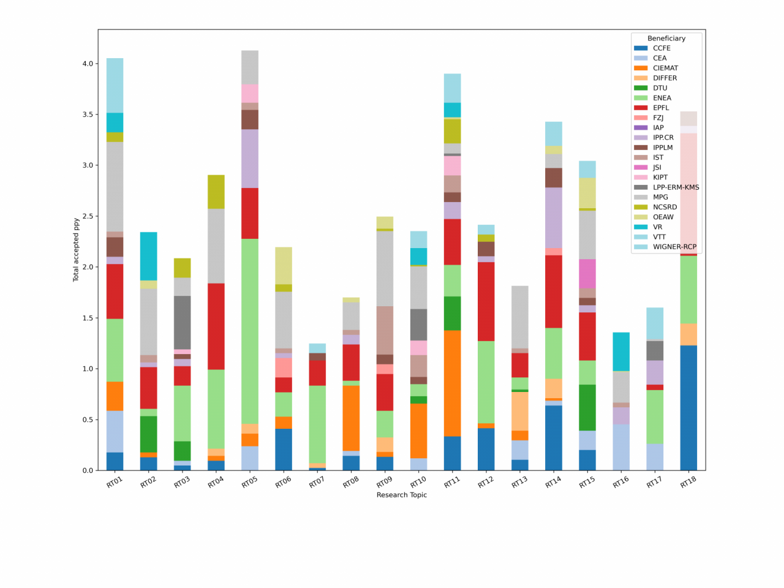
Participation by research topics and by beneficiaries

Slide 39
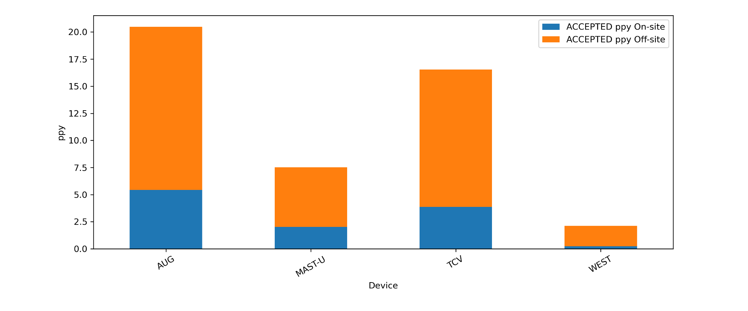
Participation by device

