Slide 1
TSVV3 – Regular advancement meeting 03/11/2021 – Task 4: codes performance optimization Project news
P. Tamain

Slide 2
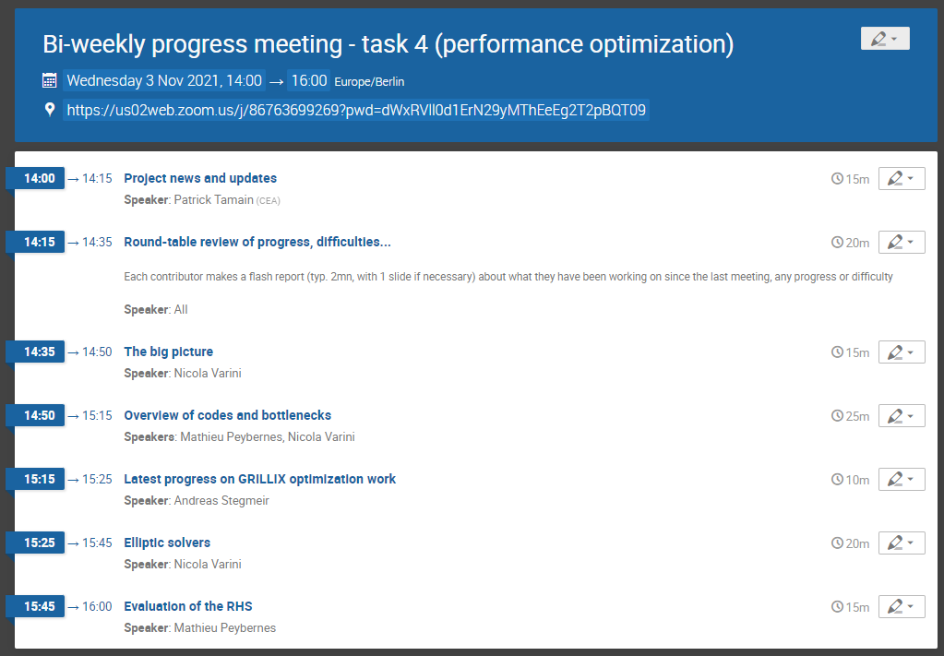
Today’s meeting agenda

Slide 3
Gentle reminder: Marconi call
Expecting feedback from each code’s contact person by Friday this week
A few guide lines:
Please ventilate planned computing time by task and highlight link to project proposal (deliverables, …))
As a guide line for how much we can expect: in cycle 5, we had 40 Mh.cpus ~10Mh.cpu per code involved

Slide 4
Latest publications
3D magnetic geometry
A. J. Coelho et al : 28th October 2021 | DocumentID : 30774
: Global simulations of plasma turbulence in diverted stellarators
Conference : 30th International Toki Conference on Plasma and Fusion Research (ITC), Gifu, Japan Virtual, 16th November 2021.
Co-authors : J. Loizu, P. Ricci
WorkPackage : 3.TSVV/CEA-03 -
Neutrals-turbulence interaction, synthetic diagnostic
A Coroado et al : 26th October 2021 | DocumentID : 30771
: Numerical simulations of Gas Puff Imaging using a multi-component model of the neutral-plasma interaction in the tokamak boundary
Journal : Physics of Plasmas, .
Co-authors : P. Ricci
WorkPackage : 3.TSVV/CEA-03 -

Slide 5
End of year report
End of year report to be handed over to EUROfusion by 31/12/2021
Some tolerance on achievement of first deliverables due to late start of project & ACHs, but report has to be summited on time
Proposed organization:
Do not believe a dedicated project meeting is necessary as deliverable concerned topics have been or will have been treated recently
Asking each team to provide a short summary report (5 to 10 lines for each task they contributed to) illustrated by key figures => due date = December 6th
I will contact shortly contact people concerned by deliverables to assess their status (last chance given by PMU to amend workplan)

Slide 6
Upcoming deliverables
Reference | Title | What exactly? | Who? | Due date
D3.1 | Implementation and generalization of RANS transport models and related BCs in edge codes | a) One-equation k model in EBC/SOLEDGE3X | KUL, CEA | déc-21
 |  | b) Basic two-equation k-ε/ζ models in SOLEDGE3X/SOLPS-ITER |  | déc-21
D4.1 | Report on performance evaluation and gain in each supported code | Flash report on performance evaluation and gains | Codes’ ROs with ACH | déc-21
D5.1 | Implement fluid neutrals models derived in TSVV5 in existing turbulence codes (SOLEDGE3X, EBC, FELTOR) | Turbulence codes with fluid neutrals model embedded | CEA, KUL, DTU | déc-21
D9.1 | Create publicly accessible git repositories for all contributing codes and setup continuous integration environment | Git repositories wit CI environment for each partner code | All partners | déc-21
Remarks:
D4.1: scope of report reduced following compression of ACH support => profiling report
D9.1: full deployment of CI/CD delayed by compression of ACH support => report on advancement

Slide 7
Today’s meeting agenda

