Slide 1
Global gyrokinetic studies of Negative Triangularity turbulence
P. Donnel, G. Di Giannatale, L. Villard
P. Donnel, TSVV2 progress meeting, 02/12/2021

Slide 2
Preparation of ORB5 for the study
ORB5 [Lanti 2019]
Recent upgrades
Arbitrary geometry
Hybrid electron model (trap.=kin., pas.=adia.)
Global
Flux driven
Collisions
Robust boundary conditions (edge study)
ECRH/ECCD source [Donnel 2021]
Non linear and multi-species collisions
[Donnel 2021]
Introduction of a buffer zone

Slide 3
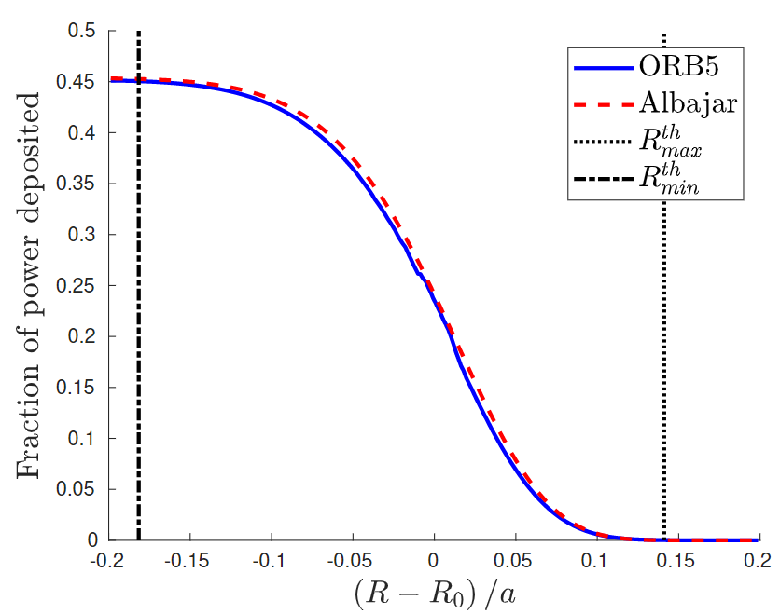
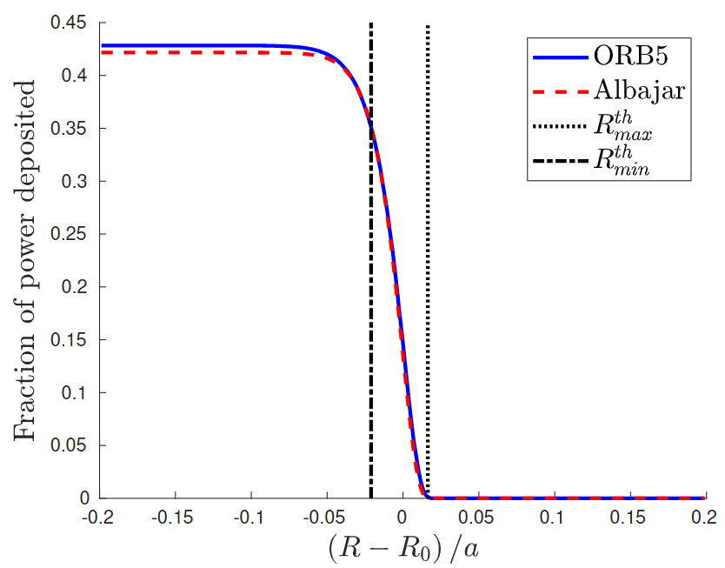
Realistic ECRH/ECCD source
Analytical developpment of a quasilinear operator to model ECRH [Donnel 2021] and ECCD [to be submitted] in the case of an equatorial propagation of the beam.
ECRH
ECCD
Comparisons with LUKE/C3P0 are ongoing

Slide 4
Three options for the buffer zone
Naive Krook
$\frac{∂}{∂t}(δF)=−ν(s)δF$
Krook conserving particles:
$\frac{∂}{∂t}(δF)=−ν(s)δF$ + C $(s)$
with C $(s)$ is a scalar chosen to conserve $\int{δFd^{3}v}$ over spatial bins
Collisionnal buffer
$\frac{∂}{∂t}(F)=ν(s)\hat{C} (F,F_{init})$ (Handled via Langevin kicks)
In all cases,
$ν(s) =ν_{0}{\left(\frac{s−s_{buf}}{s_{max}−s_{buf}}\right)}^{2}$ if $s>s_{buf}$
where $s=\sqrt{ψ}$
See Giovanni’s presentation for more details and upgrades

Slide 5
Generation of the MHD equilibrium with CHEASE
CHEASE is a MHD equilibrium solver. It needs as an input
The shape of the plasma boundary
Profiles of pressure and plasma current
The following steps have been performed to construct the equilibria for the study
Identify a pair of well diagnosed TCV shots with positive and negative triangularity
Take the experimental profiles and extend them in prevision of the buffer (flat pressure, no current, change the shape of the plasma boundary)
Make sure the equilibria are in agreement with experimental datas (profiles in the «core», plasma shape at the «LCFS»)

Slide 6
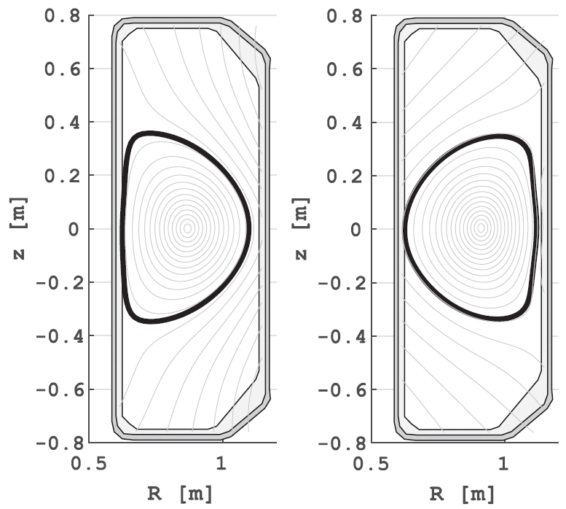
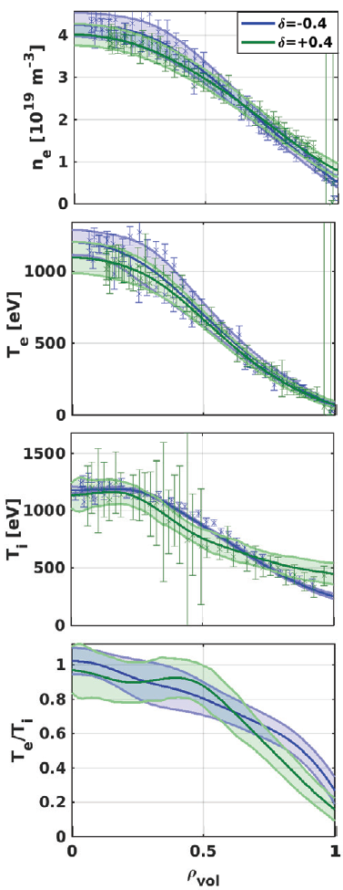
Choice of the initial profiles for the study
Two well diagnosed TCV shots with matched profiles (60797 for δ>0, 58499 for δ<0) have been chosen.
For this parameters, a mixed ITG/TEM turbulence is predicted (TEM dominant [Merlo 2019] )
[Fontana 2020]

Slide 7
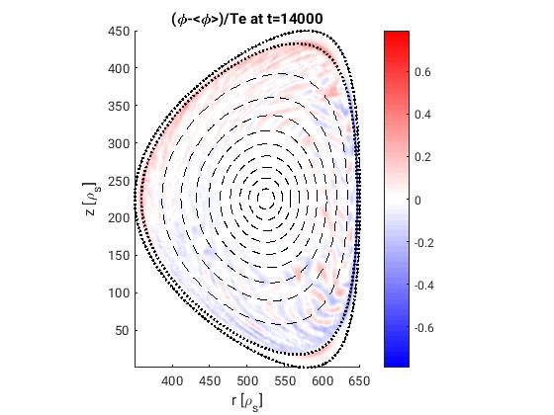
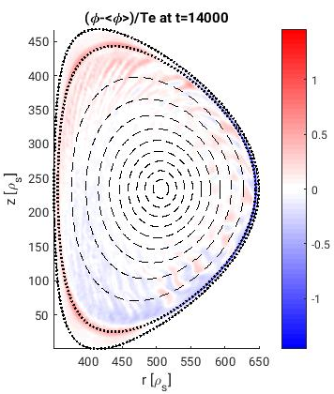
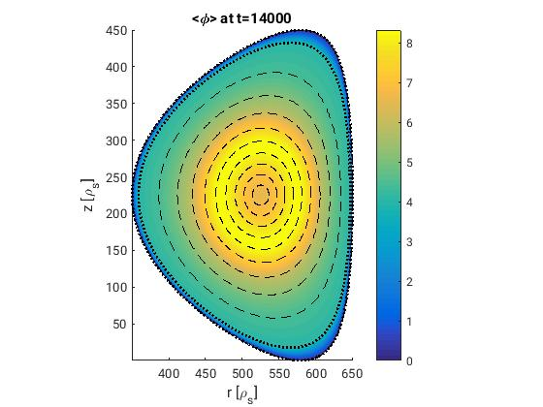
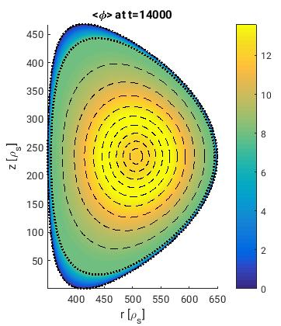
Hybrid e- + collision + ECRH + shaping
Smaller fluctuations in the case of negative triangularity
Buffer zone
Large impact of shaping on the electric potential development
P. Donnel, TSVV2 progress meeting, 02/12/2021

Slide 8
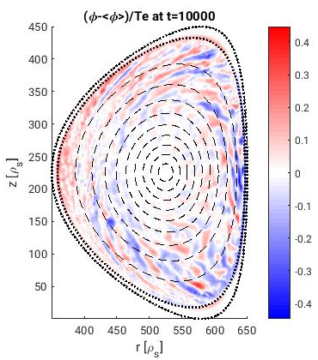
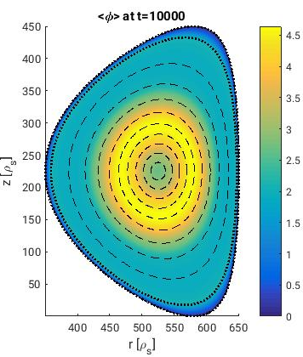
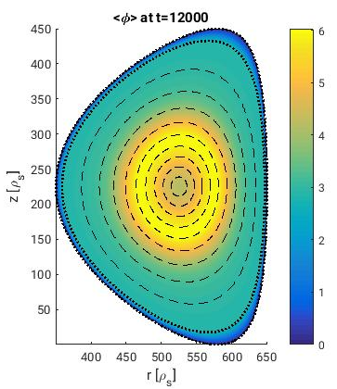
Important effect of time on the buffer potential
time
P. Donnel, TSVV2 progress meeting, 02/12/2021

Slide 9
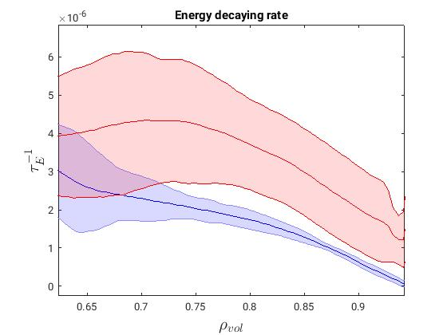
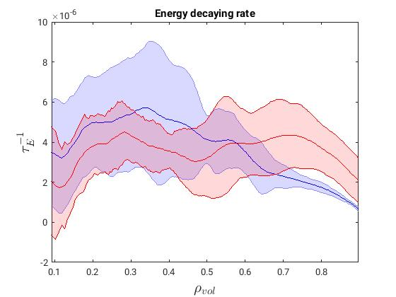
Energy decaying rate
$$τ_{E}^{−1}\left(r,t\right)=\frac{Energyflux\left(r,t\right)}{\int_{0}^{r}{Energy\left(r^{′},t\right)dr′}}$$
δ<0
δ>0
δ<0
δ>0
δ<0
δ>0
Significant improvement of confinement in negative triangularity in the edge. Marginally the opposite in the core
P. Donnel, TSVV2 progress meeting, 02/12/2021

Slide 10
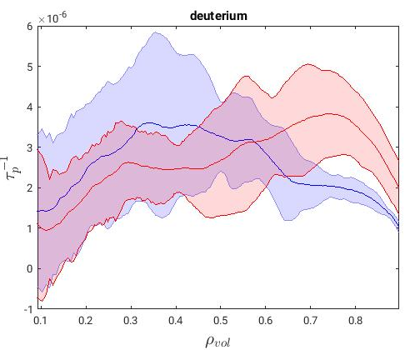
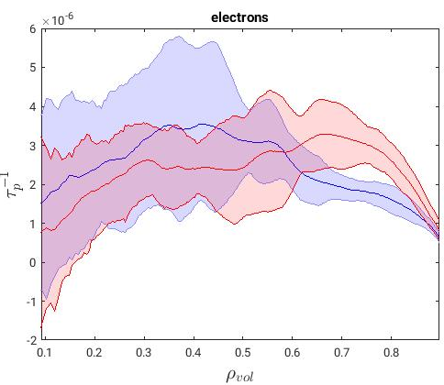
Particle confinement time
δ<0
δ>0
δ<0
δ>0
Significant improvement of confinement in negative triangularity in the edge. Marginally the opposite in the core
P. Donnel, TSVV2 progress meeting, 02/12/2021

Slide 11
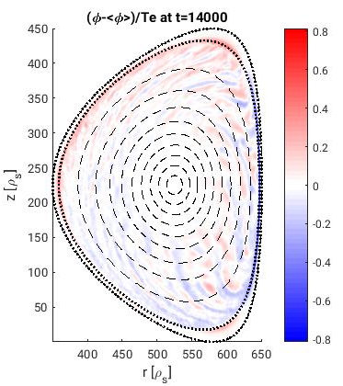
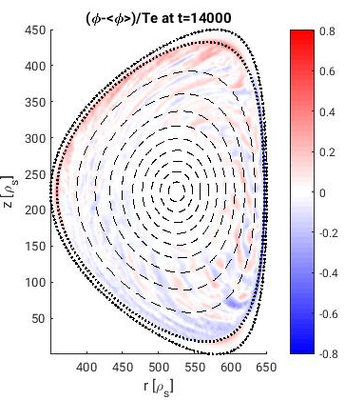
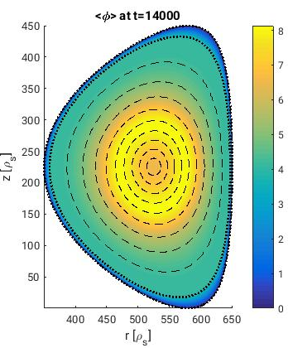
Limited impact of the source level
100 kW
200 kW
300 kW
P. Donnel, TSVV2 progress meeting, 02/12/2021

Slide 12
Conclusion
Flux-driven, global GK simulations of shaped plasmas in presence of collisions have been performed for the first time with ORB5
Improved confinement of negative triangularity retrieved (only when including trapped kinetic electrons and collisions)
Difficulty to reach a quasi-steady state
Necessity to improve the boundary condition

Slide 13
Next steps
Study the impact of buffer (type, $ν_{0}$, $s_{buf}$) in adiabatic electrons, then with hybrid electrons
Try to reach a quasi-steady state
Upgrade of GYSELA to be able to simulate the same physics
Comparison between GK codes (ORB5, GENE, GYSELA)
Comparison between GK simulations and experiments
Giovanni’s presentation

Slide 14
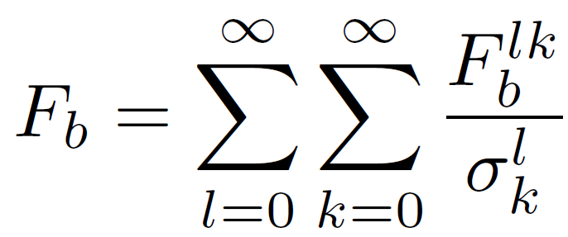
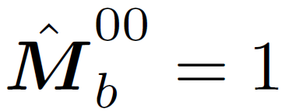
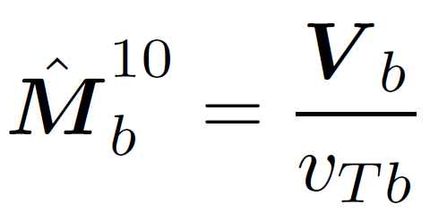
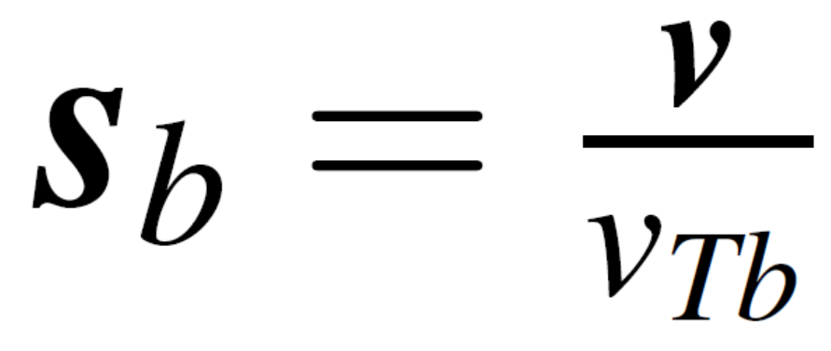
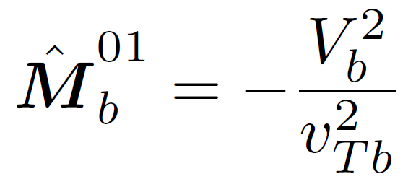
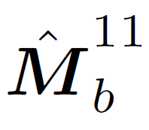
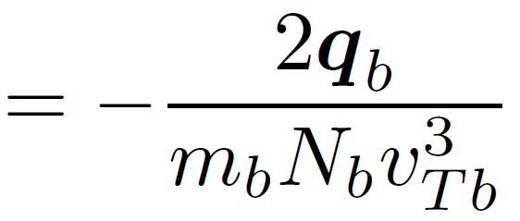
Non linear collision operator
Collision of a distribution function of species a ($F_{a}$) on a distribution function of species b ($F_{b}$):
t
t
t
t
t
t
t
1
1
t
[Hirshman 1981, Ji 2006]
Unshifted Maxwellian distribution
Normalized velocity:
Generalised Laguerre
Irreducible
Harmonic
Moment of the distribution
Truncation of the distribution function consistent with neoclassical physics

