Slide 1
Global gyrokinetic studies of Negative Triangularity turbulence Next steps with ORB5
G. Di Giannatale, P. Donnel, L. Villard et al..

Slide 2
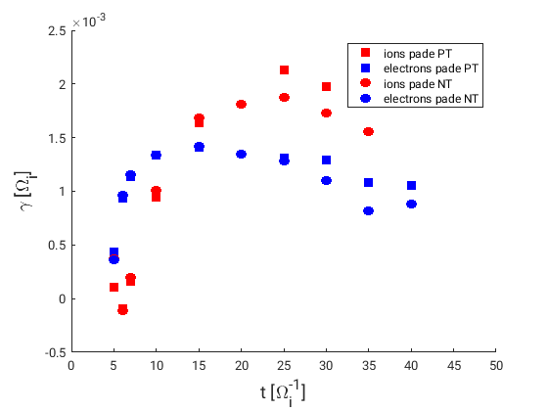
Linear simulations
A set of linear simulations have been performed in PT and NT.
No big differences appear in the linear phase of the simulations
Ingredients: Pade’ approximations, hybrid electrons, collisions (linear operator, see P. Donnel presentation)
n

Slide 3
Current status for NL simulations
First numerical simulations with ECRH source have been performed (see P. Donnel presentation).
The next step is to do the same NL simulations adding:
Pade’ approximation
Naive approximation of a limiter. Buffer region with a further poloidal and radial dependence
Try to reach the steady state condition

Slide 4
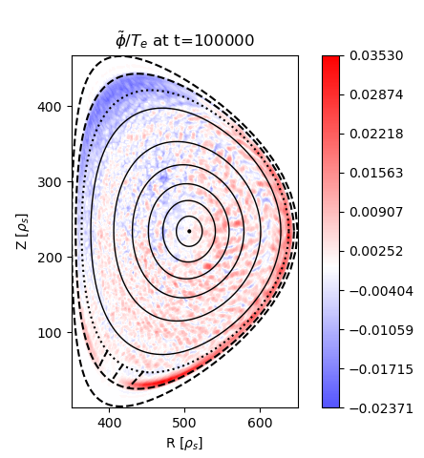
Buffer region
$\frac{∂}{∂t}\left(δF\right)=−ν\left(s,θ\right)δF$
$\frac{∂}{∂t}(δF)=−ν(s)δF$ + C $(s)$
Naive limiter
With conserving Krook buffer accumulates fluctuations
No fluctuations in the buffer with naive Krook

Slide 5
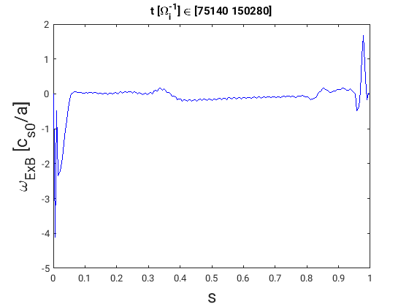
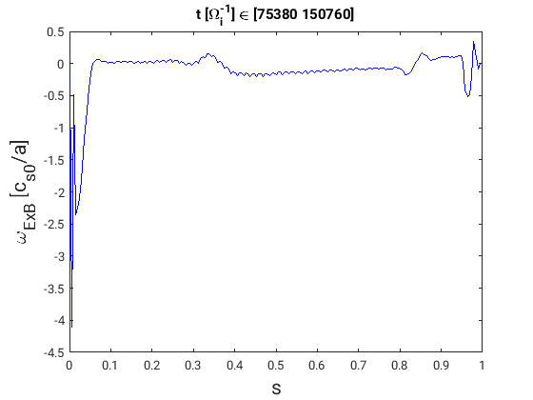
Buffer region – E x B shear
Limiter
No limiter
$$ω_{ExB}=\frac{s}{q}\frac{dψ}{ds} \frac{d^{2}}{d^{2}ψ^{ }} Φ_{0}$$
$ω_{ExB}$ spike at the edge is systematic for every “limiter” simulation
L. Villard et al PoP 9, 2684 (2002)
$$Φ_{0} Zonal Component$$

Slide 6
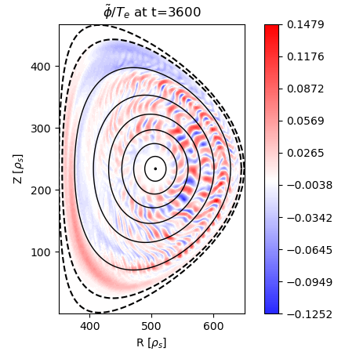
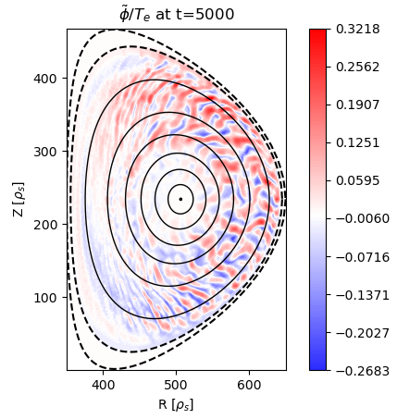
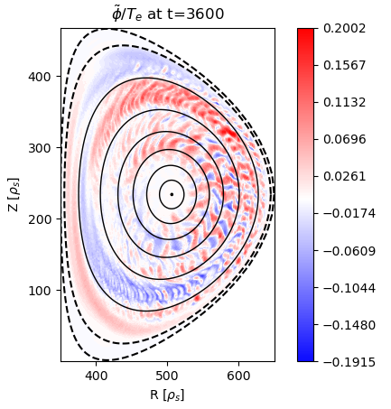
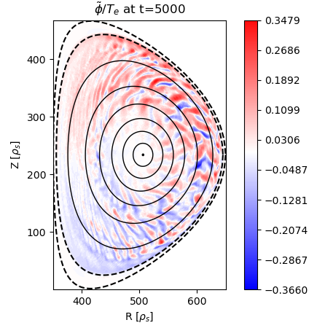
Pade solver for NL runs
LWA
(See details in P. Donnel slides)
Good agreement in the first turbulent phase of the
simulation
Pade’

Slide 7
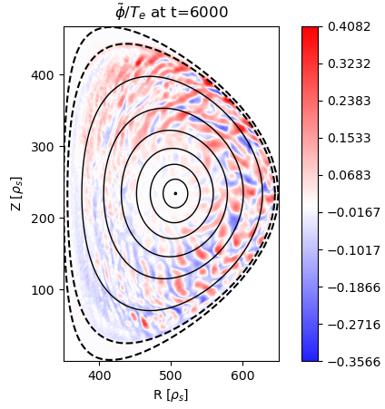
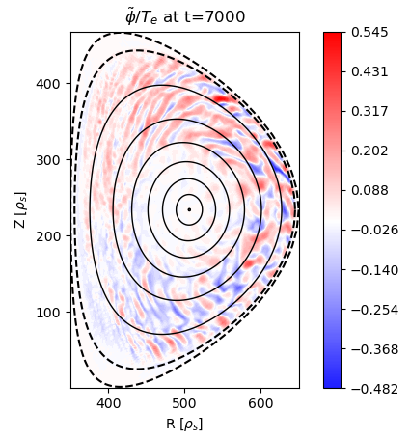
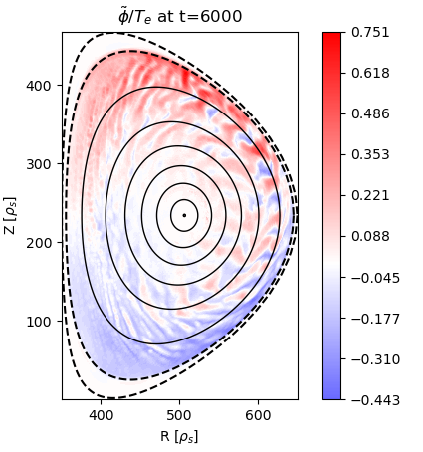
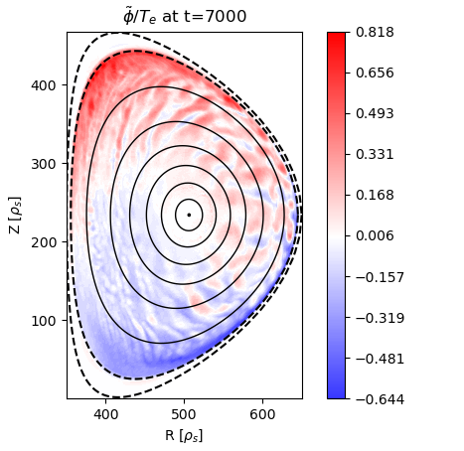
Pade solver for NL runs
LWA
Naive krook:
No buffer fluctuations
accumulations
M=1 structure emerging
with Pade’
problem
Pade’

Slide 8
Next steps
Modify the Poisson equation for open field lines
Systematic studies for PT/NT of limiter effects
Fix the LWA and Pade simulations problems for hybrid electrons
Pade shows emergence of m=1 structure (and then it crashes)
LWA works good but then it crashes suddenly
Perform NT-PT study with:
Hybrid electrons
Pade approximation
Limiter
ECRH
Comparison with experimental data

