Slide 1
Linear KBM simulations in W7-X equilibria and plans for nonlinear simulations
TSVV#13 Progress Update – November 8th 2021
Paul Mulholland , Josefine Proll and MJ Pueschel
in collaboration with Ksenia Aleynikova

Slide 2
Outline
Reproducing previous linear KBM results (Aleynikova 2018) – how they were carried out?
New exploratory linear simulations (different gradients, $β$ values, W7-X configurations)
Looking for suitable regime for nonlinear KBM runs (not yet done in W7-X)
Plans going forward

Slide 3
Current Deliverable - D2.6 / D-KBM-BASIC
Map out KBM saturation and flux scalings (linear and nonlinear electromagnetic ITG stabilization) at high vs. low magnetic shear, and apply the acquired knowledge to the W7-X configuration space. This will expand the physics basis on electromagnetic turbulence in 3D geometry.
Due dates:
Linear part of the work will be performed during 2021.
Nonlinear analyses to be accomplished by Dec. 2022.

Slide 4
Current Deliverable - D2.6 / D-KBM-BASIC
Map out KBM saturation and flux scalings (linear and nonlinear electromagnetic ITG stabilization) at high vs. low magnetic shear, and apply the acquired knowledge to the W7-X configuration space. This will expand the physics basis on electromagnetic turbulence in 3D geometry.
Due dates:
Linear part of the work will be performed during 2021. (On track )
Nonlinear analyses to be accomplished by Dec. 2022. (Start later this year)

Slide 5
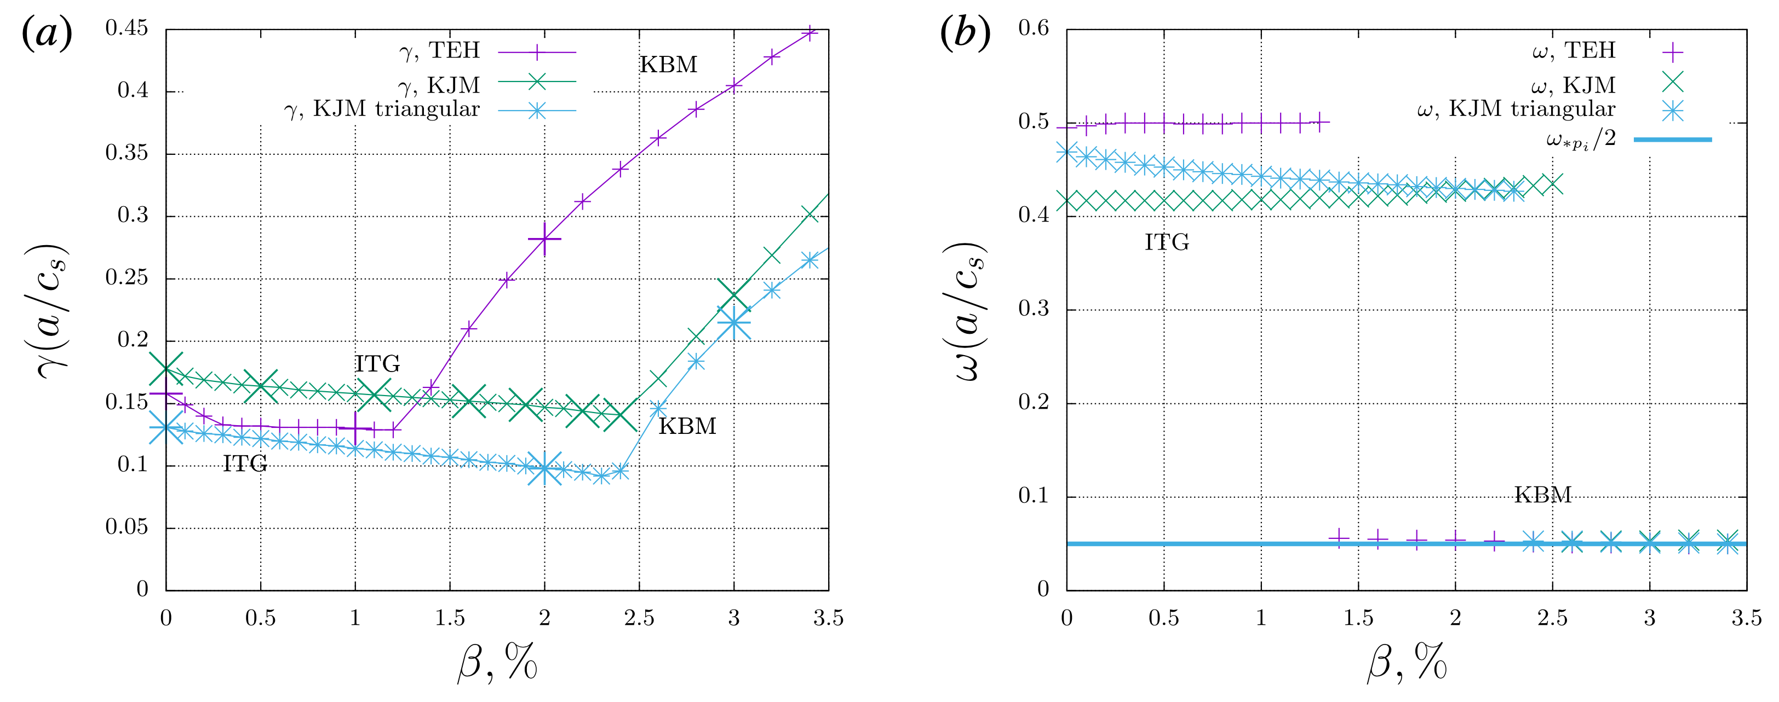
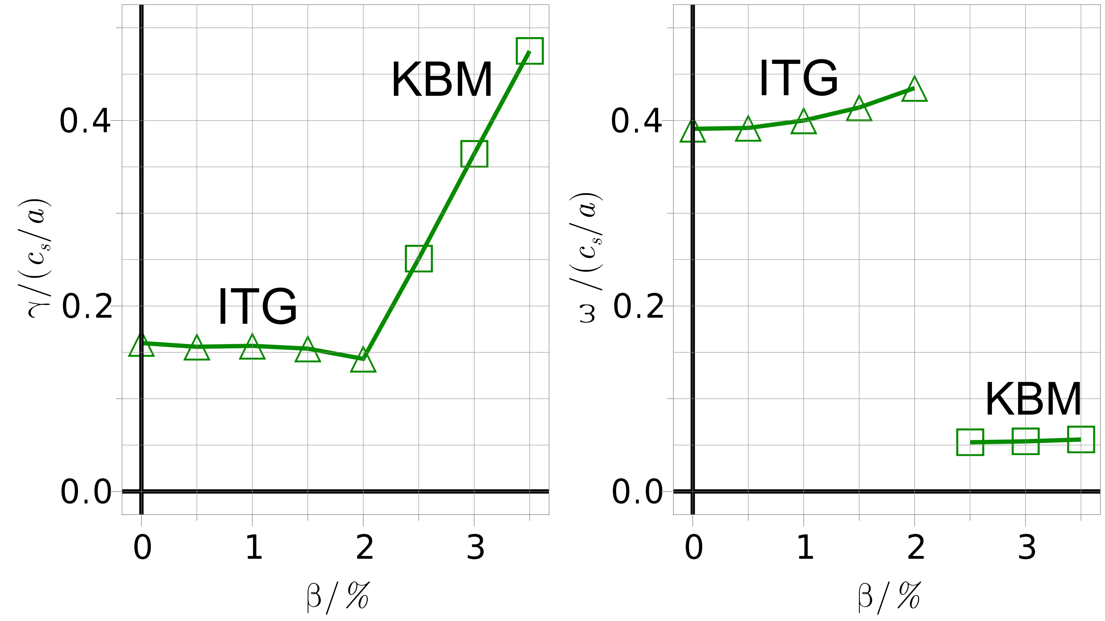
Reproducing linear results
in W7-X
Aleynikova 2018

Slide 6
Reproducing linear results
in W7-X
Aleynikova 2018
$$\left\langle β\right\rangle =5\%$$
KJM
$$\left\langle β\right\rangle =4\%$$
Discrepancies due to using equilibria with different “volume-averaged $β$ for both species” = $\left\langle β\right\rangle$
Local dynamic $β$
for one species

Slide 7
Reproducing linear results
in W7-X
Aleynikova 2018
KBMs – driven by pressure gradient $∇p$
$$\frac{dp}{dx}=−\frac{∇p}{p_{mag}}$$
GENE:
Simulation approach
$$\left\langle β\right\rangle =5\%$$
One VMEC equilibrium file: $\left\langle β\right\rangle$held constant
$\frac{dp}{dx}$ evaluated by GENE as $β$ is increased $\left(\frac{dp}{dx}∝β\right)$
Inconsistent approach – equilibrium should change with $β$
KJM
$$\left\langle β\right\rangle =4\%$$
Discrepancies due to using equilibria with different “volume-averaged $β$ for both species” = $\left\langle β\right\rangle$
Local dynamic $β$
for one species

Slide 8
$\frac{dp}{dx}$ approach - levels of consistency
Totally inconsistent – keep equilibrium constant and $\frac{dp}{dx}$ constant as local $β$ is increased in GENE
Partially consistent – keep equilibrium constant, evaluate $\frac{dp}{dx}$ self-consistently as $β$ is increased
Consistent (as much as possible) – vary equilibrium files throughout simulation (corresponding to increased $β$), and evaluate $\frac{dp}{dx}$ self-consistently as $β$ is increased

Slide 9
$\frac{dp}{dx}$ approach - levels of consistency
Totally inconsistent – keep equilibrium constant and $\frac{dp}{dx}$ constant as local $β$ is increased in GENE
Partially consistent – keep equilibrium constant, evaluate $\frac{dp}{dx}$ self-consistently as $β$ is increased
Consistent (as much as possible) – vary equilibrium files throughout simulation (corresponding to increased $β$), and evaluate $\frac{dp}{dx}$ self-consistently as $β$ is increased
Fast computation of large linear runs
For studying behaviour of instabilities
Insufficient accuracy

Slide 10
$\frac{dp}{dx}$ approach - levels of consistency
Totally inconsistent – keep equilibrium constant and $\frac{dp}{dx}$ constant as local $β$ is increased in GENE
Partially consistent – keep equilibrium constant, evaluate $\frac{dp}{dx}$ self-consistently as $β$ is increased
Consistent (as much as possible) – vary equilibrium files throughout simulation (corresponding to increased $β$), and evaluate $\frac{dp}{dx}$ self-consistently as $β$ is increased
For higher accuracy studies
Finding linear instability thresholds
Finding suitable regimes for nonlinear studies
Nonlinear simulations
Fast computation of large linear runs
For studying behaviour of instabilities
Insufficient accuracy

Slide 11
Small crosses – totally inconsistent:
Fixed equilibrium
Fixed $\frac{dp}{dx}$
Large crosses – partially consistent:
Fixed equilibrium
Consistently calculated $\frac{dp}{dx}$
Aleynikova 2018
We applied second approach

Slide 12
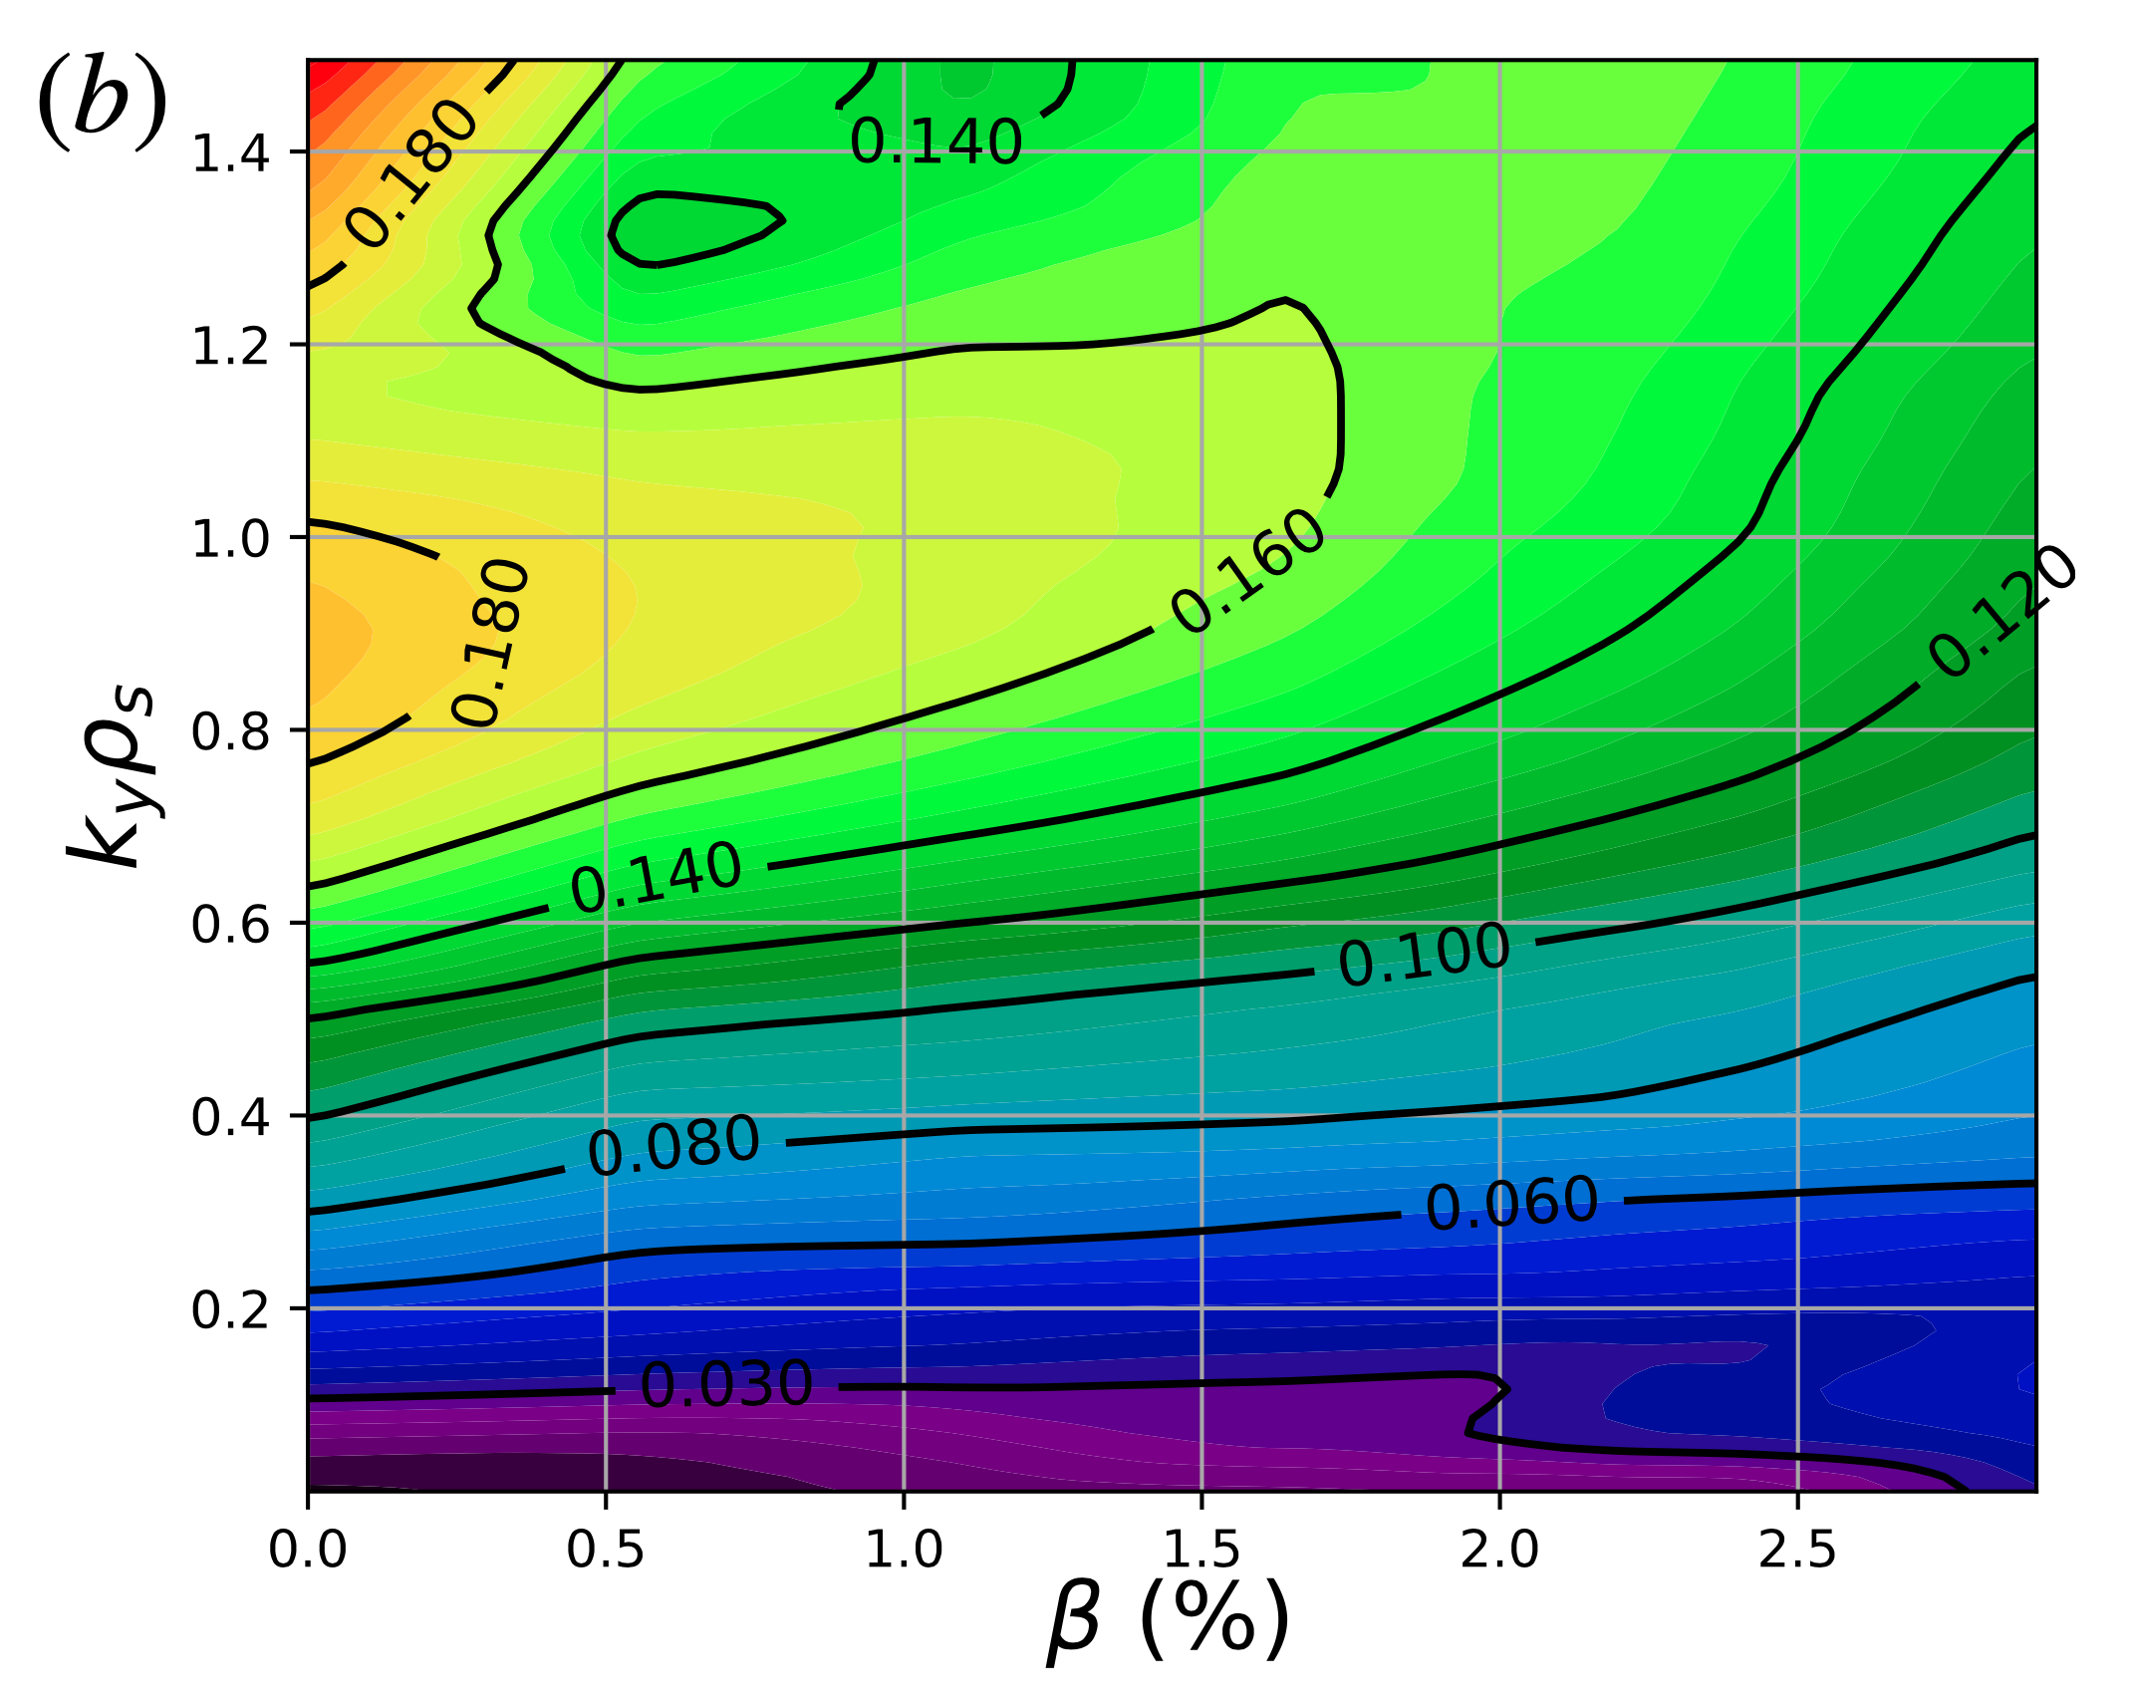
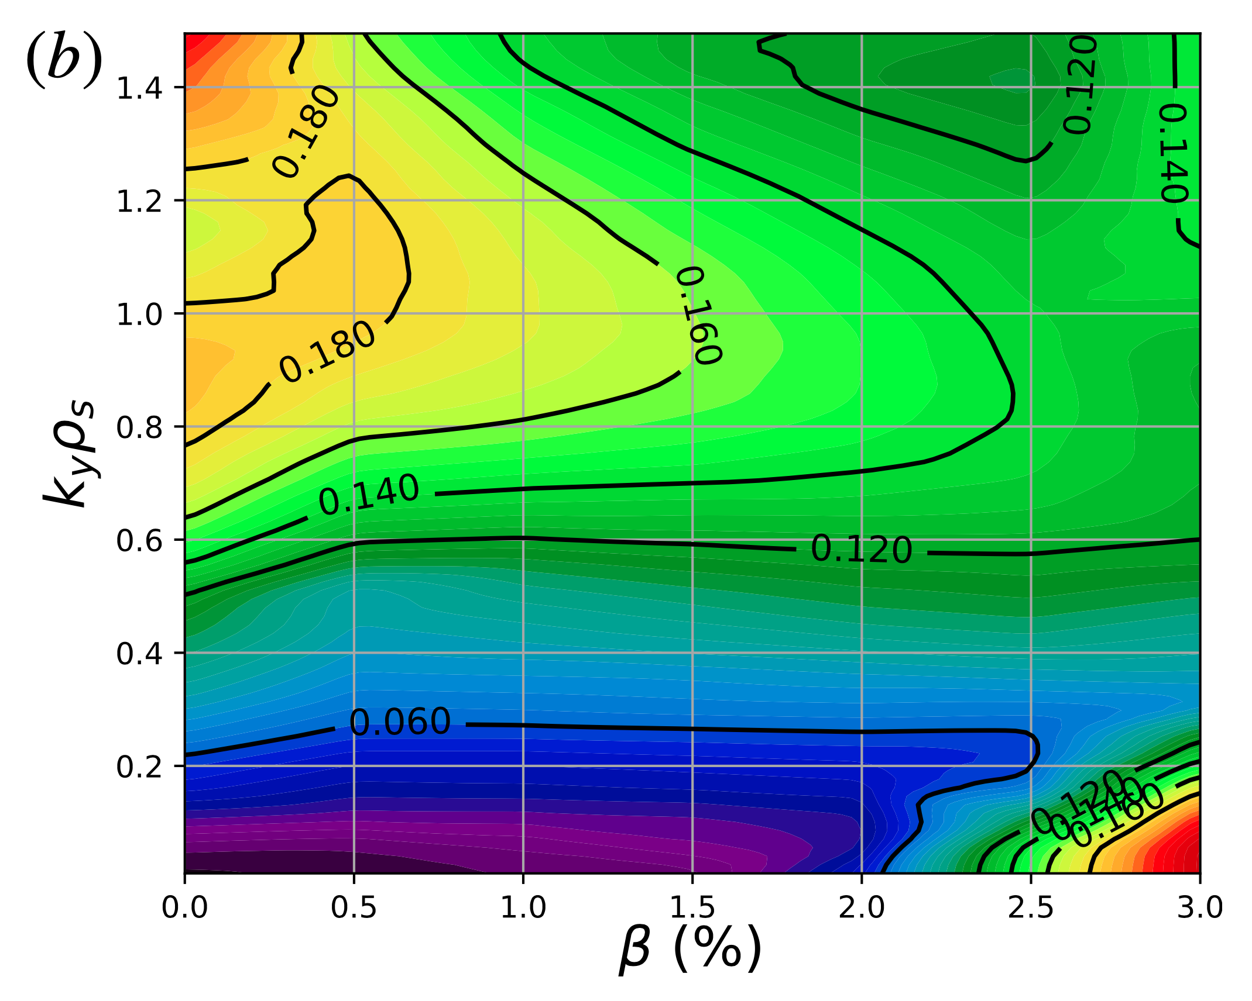
$\frac{dp}{dx}$ approach – impact of inconsistency in W7-X
Aleynikova 2018
Varying equilibrium consistently:
$\left\langle β\right\rangle$increases with dynamic $β$
Inconsistent – equilibrium held fixed:
$\left\langle β\right\rangle$= 0 as dynamic $β$ increases

Slide 13
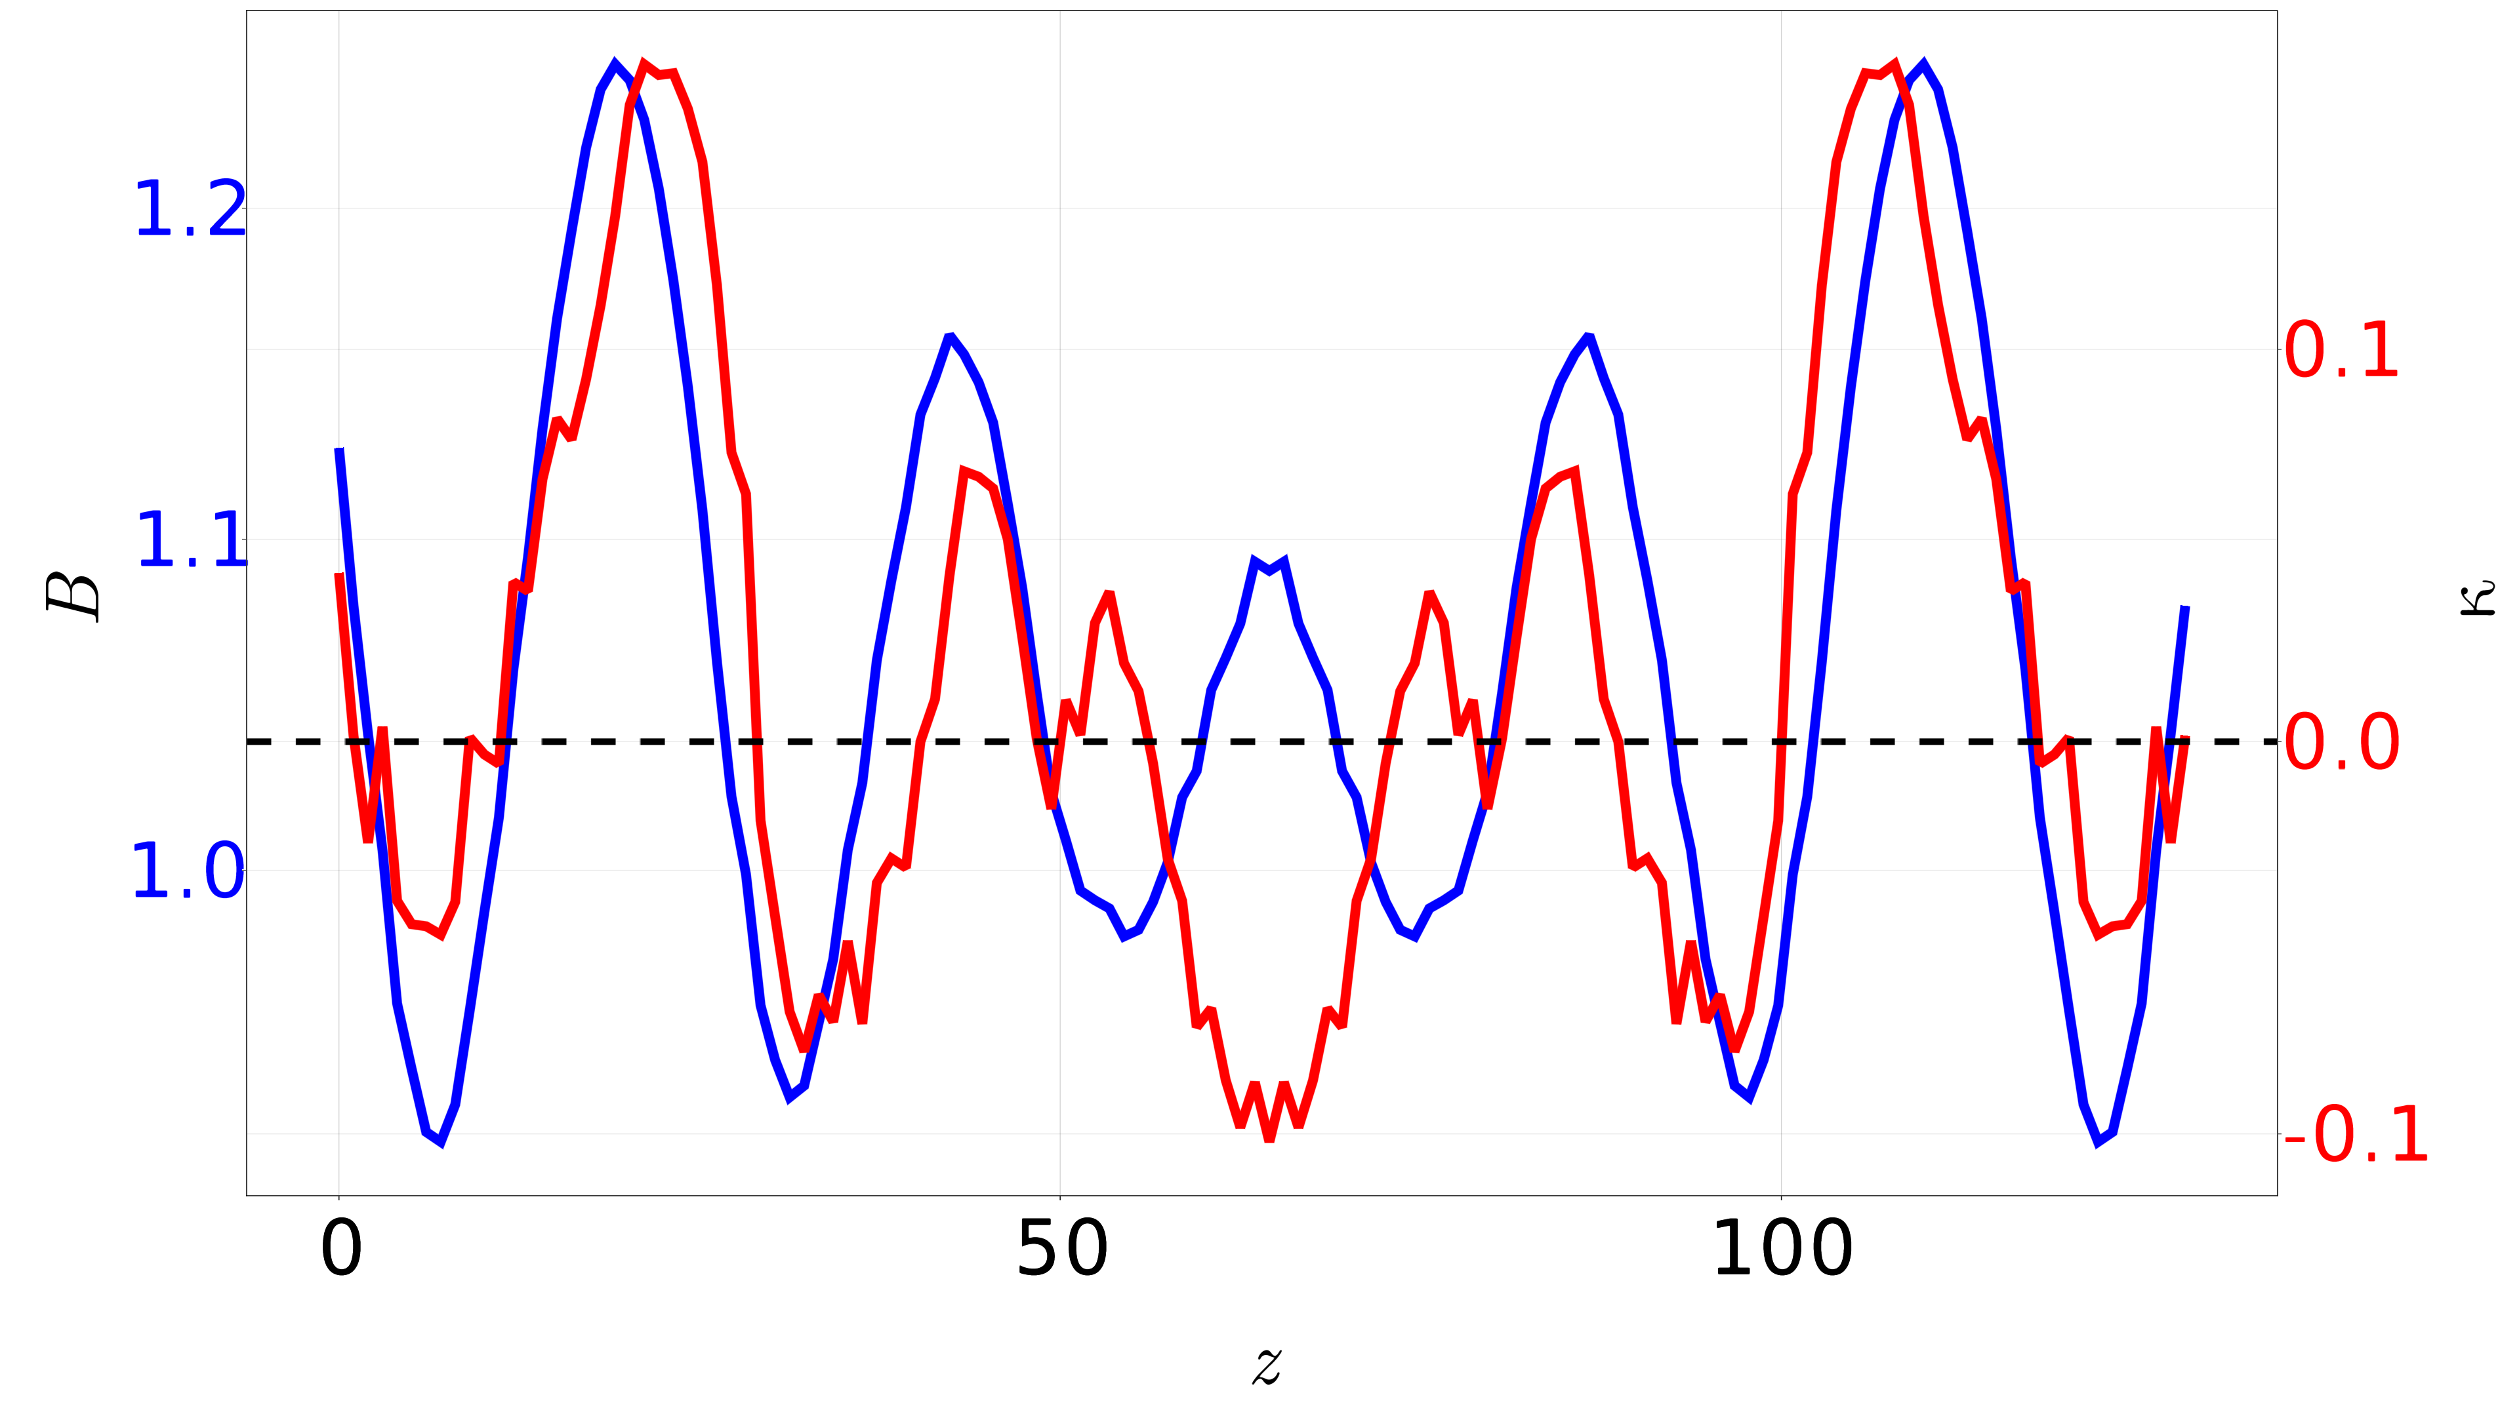
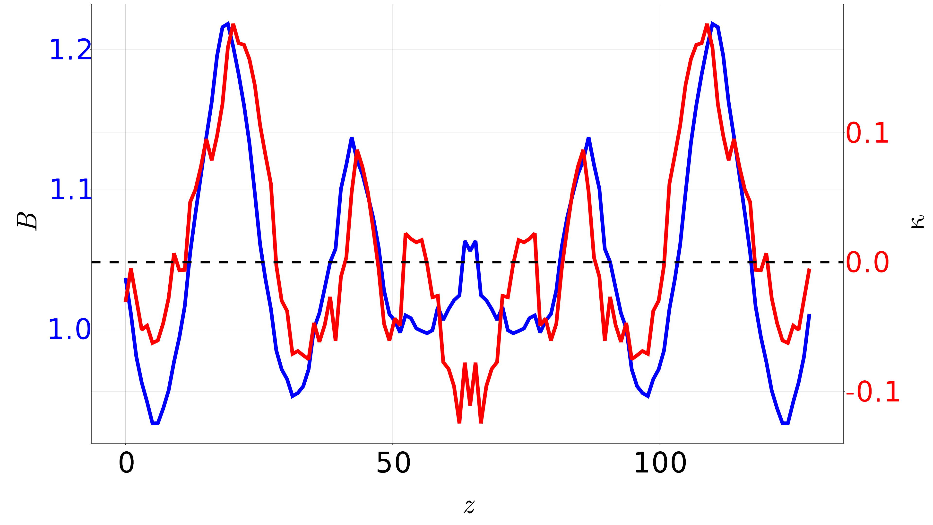
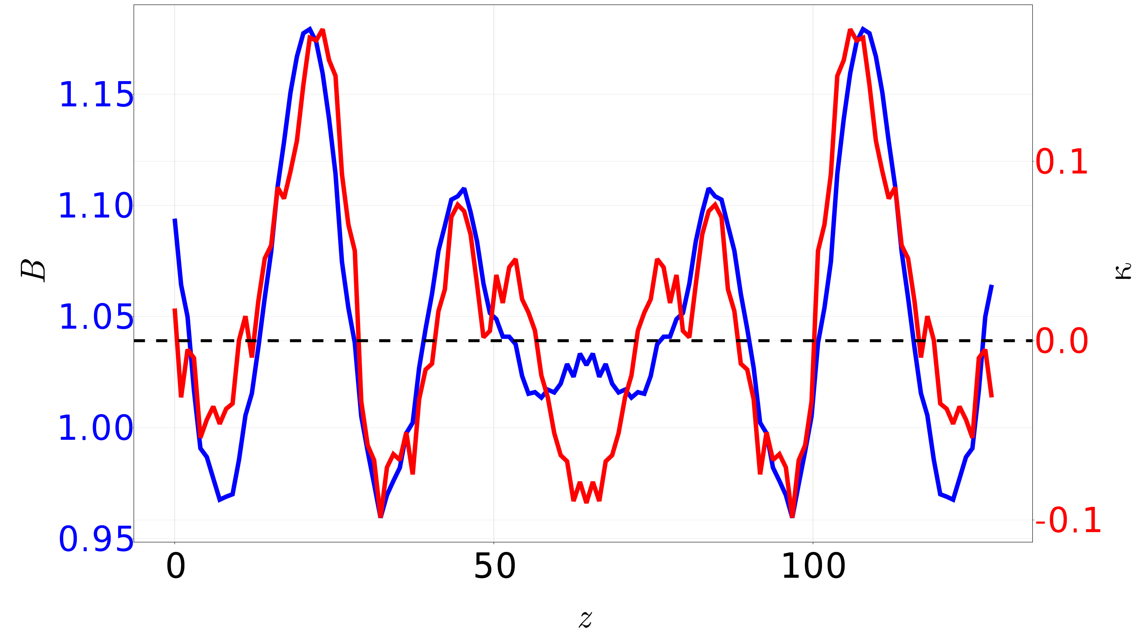
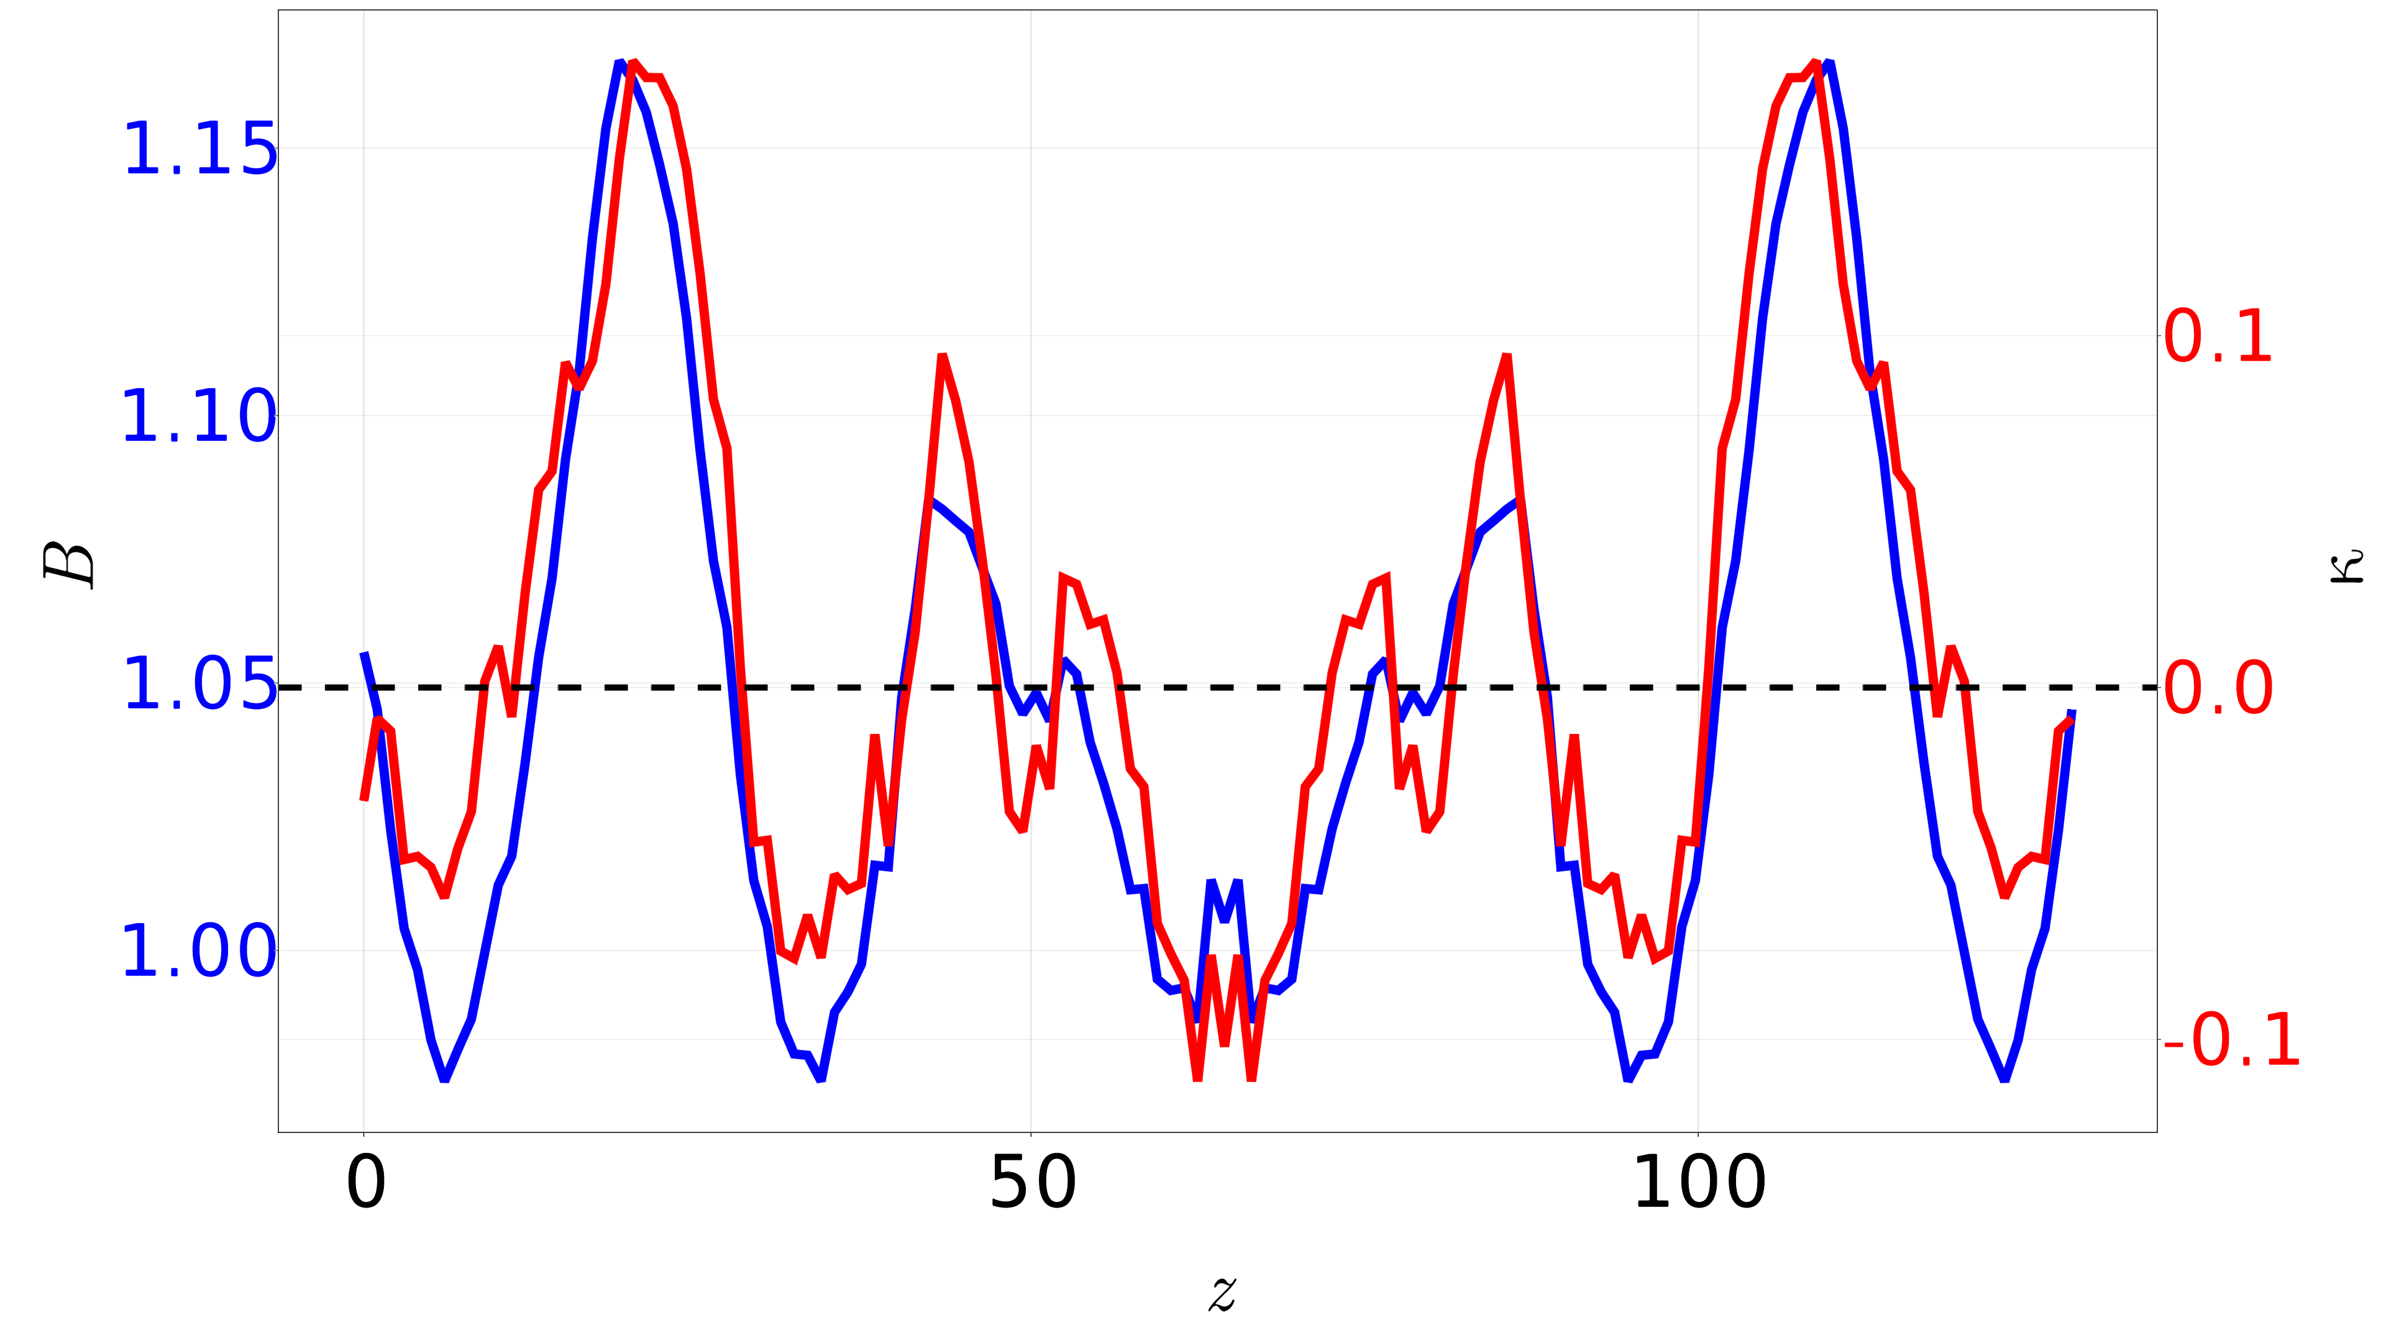
Choosing W7-X Configurations
KJM
ILD
FIS
DKH
Want a variety of shear values, safety factors, etc.

Slide 14
Choosing W7-X Configurations
KJM
ILD
FIS
DKH
Will compare these two configurations to start
Want a variety of shear values, safety factors, etc.

Slide 15
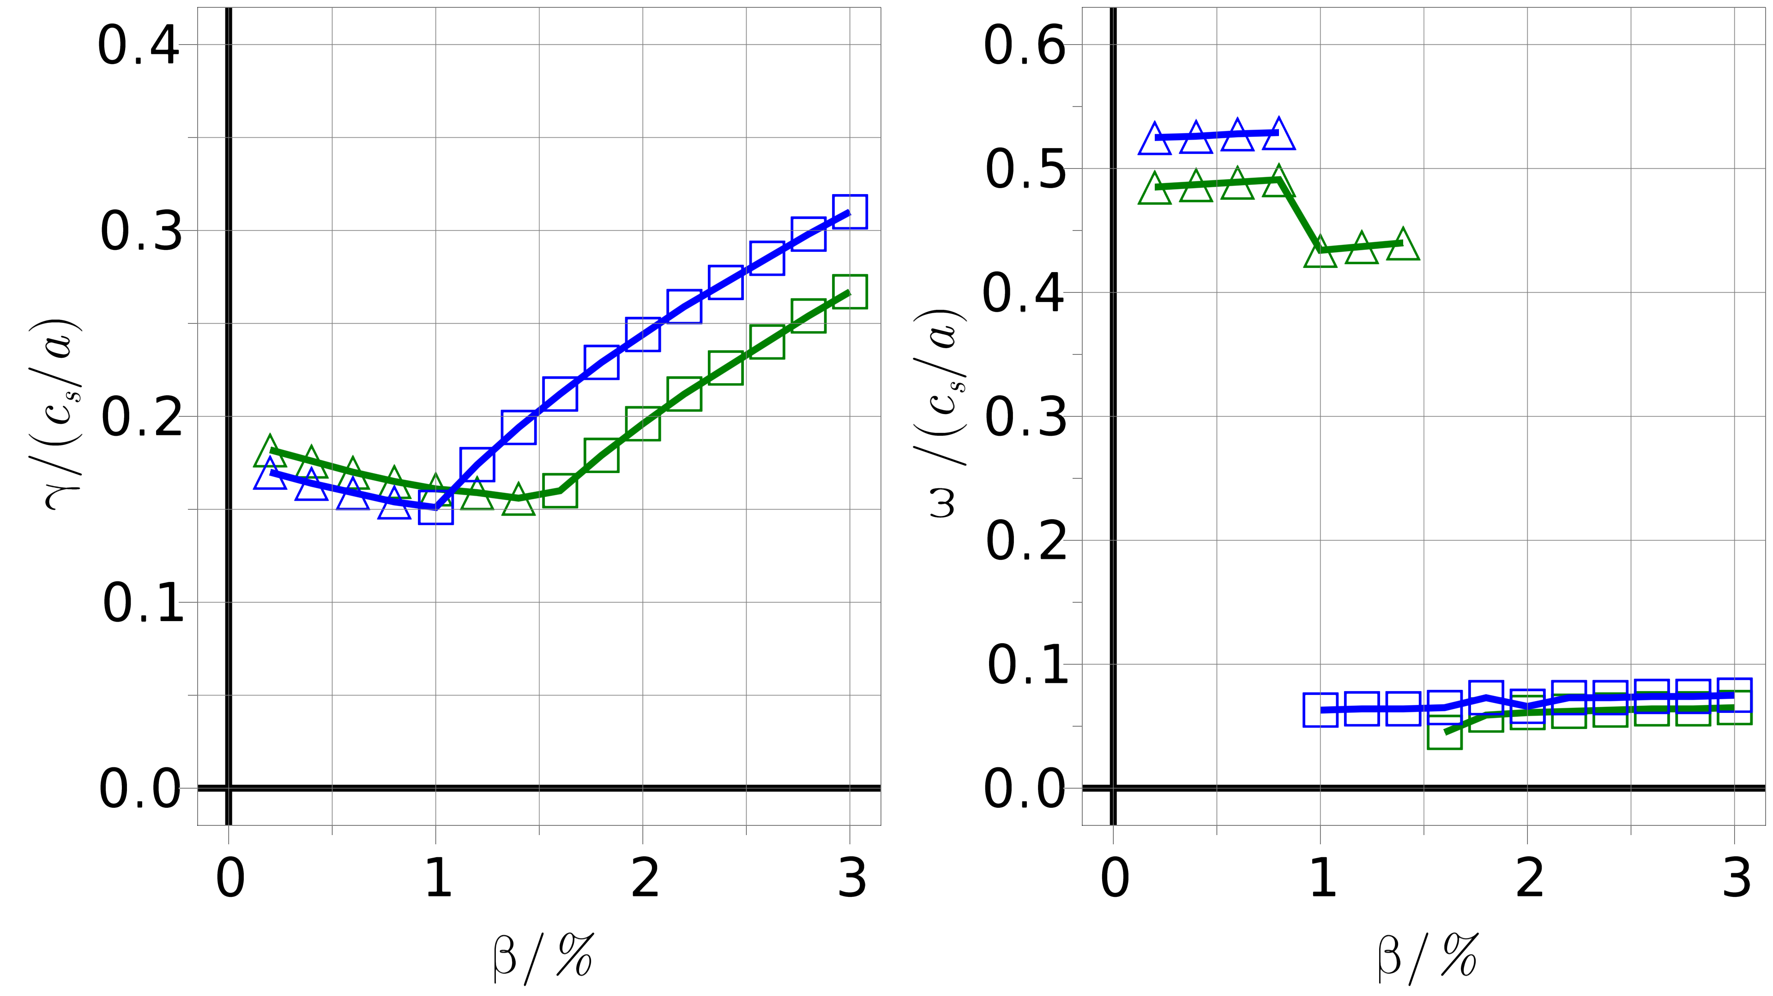
Effect of geometry on KBM threshold
KJM
$$\hat{s}=−0.1062 \\ q_{0}=1.1096$$
ILD
$\hat{s}=−0.0959$
$$q_{0}=1.0915$$
$a/{L_{T_{i}}}$= 3
△ - ITG
□ - KBM
ITG
KBM
ITG
KBM

Slide 16
Effect of geometry on KBM threshold
ITG-KBM $β$-threshold decreases for lower $\left|\hat{s}\right|$?
KJM
$$\hat{s}=−0.1062 \\ q_{0}=1.1096$$
ILD
$\hat{s}=−0.0959$
$$q_{0}=1.0915$$
$a/{L_{T_{i}}}$= 3
△ - ITG
□ - KBM
ITG
KBM
ITG
KBM

Slide 17
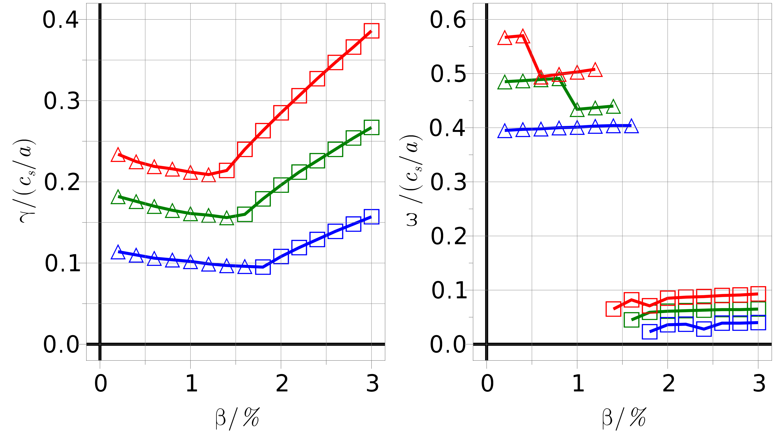
Effect of gradients on KBM threshold
$a/{L_{T_{i}}}$= 2
$a/{L_{T_{i}}}$= 3
$a/{L_{T_{i}}}$= 4
△ - ITG
□ - KBM
ITG
KBM
ITG
KBM
Geometry: KJM

Slide 18
ITG-KBM $β$-threshold decreases for increasing $a/{L_{T_{i}}}?$
Effect of gradients on KBM threshold
$a/{L_{T_{i}}}$= 2
$a/{L_{T_{i}}}$= 3
$a/{L_{T_{i}}}$= 4
△ - ITG
□ - KBM
ITG
KBM
ITG
KBM
Geometry: KJM

Slide 19
Recap of linear simulation progress
Reproduced previous linear KBM results in W7-X
Selected variety of W7-X configurations with different levels of shear and safety factor
Begun simulating KBMs linearly (partially consistently up to now)
Noted effect of varying temperature gradients and shear on linear KBM behaviour

Slide 20
Recap of linear simulation progress
Reproduced previous linear KBM results in W7-X
Selected variety of W7-X configurations with different levels of shear and safety factor
Begun simulating KBMs linearly (partially consistently up to now)
Noted effect of varying temperature gradients and shear on linear KBM behaviour
Next:
Will need to run same simulations fully consistently with more configurations before drawing conclusions
Find suitable parameter regimes for nonlinear runs

Slide 21
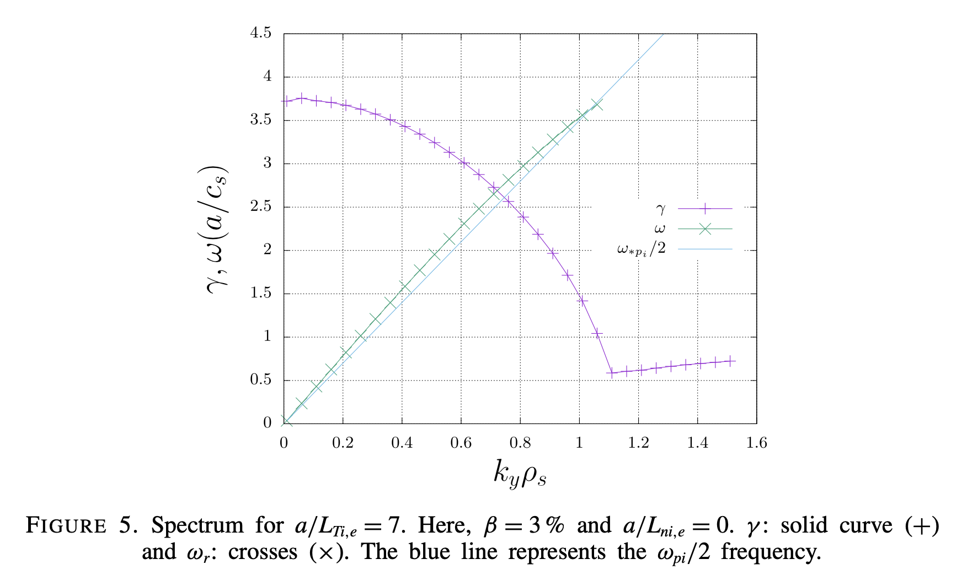
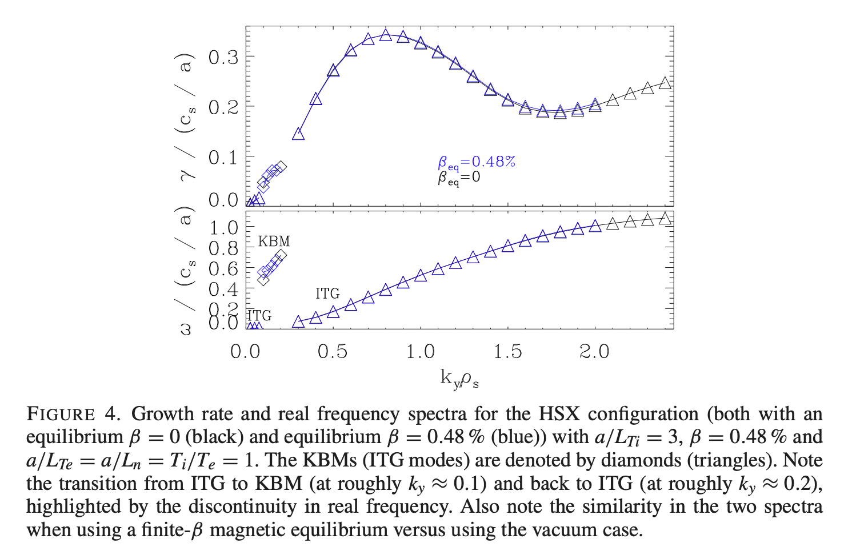
Search for nonlinear KBM regime
Aleynikova 2018
McKinney 2021
NL regime difficult to find due to $γ\left(k_{y}ρ\right)$ peaking at $k_{y}ρ=0$ in W-7X (for high temperature gradients)
Need finite $k_{y}ρ$ (where KBMs stable) in order for NL runs to saturate
Ideally, will find a regime analogous to HSX
Want to isolate a KBM $k_{y}ρ$-range which has a finite lower bound ($k_{y}ρ$> 0)

Slide 22
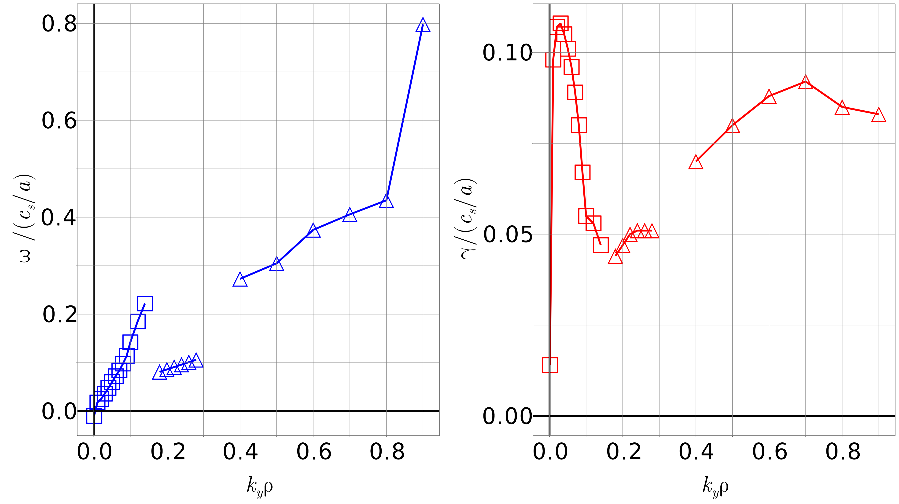
Exploratory linear simulations
$a/{L_{T_{i}}}$= 2
$β$ = 2%
□ - KBM
△ - ITG
Geometry: KJM

Slide 23
Exploratory linear simulations
$a/{L_{T_{i}}}$= 2
$β$ = 2%
□ - KBM
△ - ITG
Distinct peak in $γ\left(k_{y}ρ\right)$ for KBMs: purely numerical?
Geometry: KJM

Slide 24
Exploratory linear simulations
Further investigation required, e.g. n_pol >1
$a/{L_{T_{i}}}$= 2
$β$ = 2%
□ - KBM
△ - ITG
Distinct peak in $γ\left(k_{y}ρ\right)$ for KBMs: purely numerical?
Geometry: KJM

Slide 25
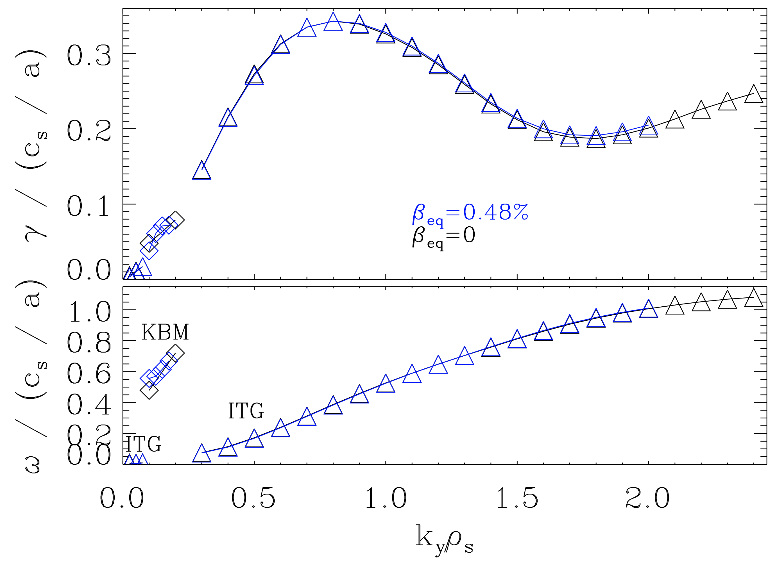
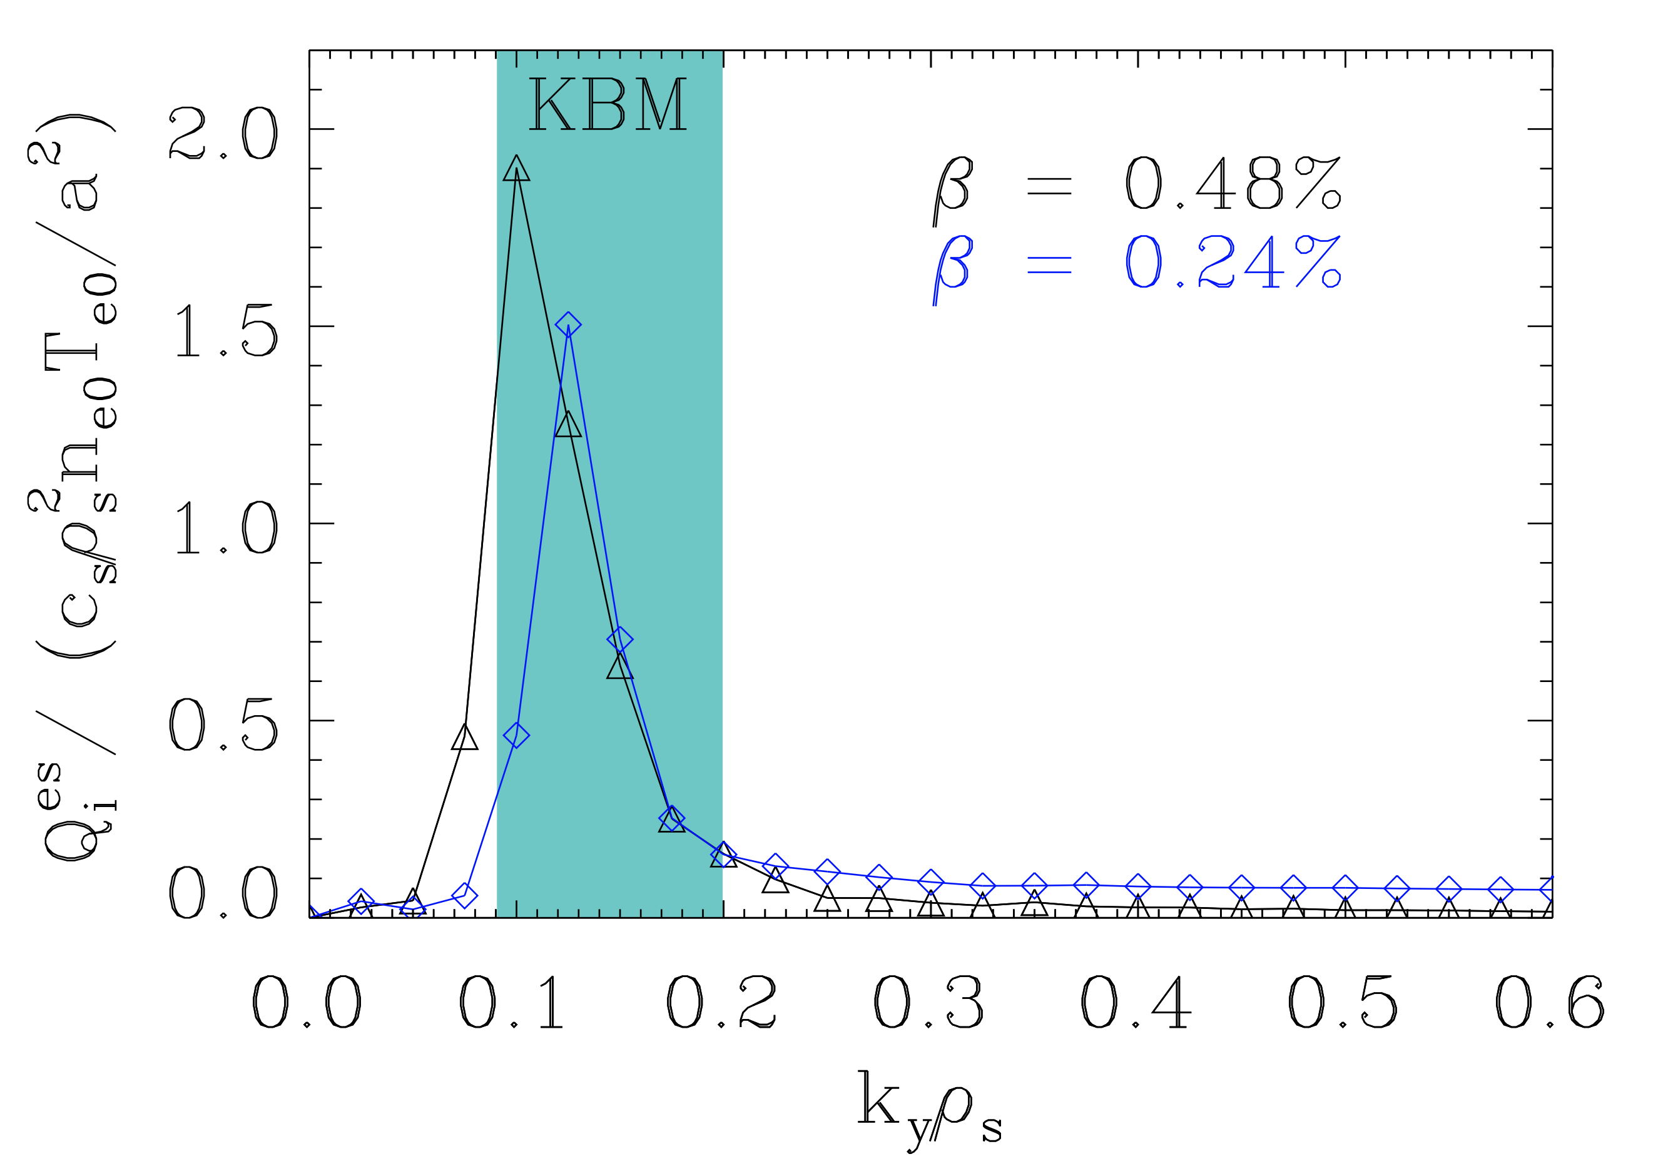
Linear and nonlinear KBMs in HSX
Quasilinear estimate of heat flux
$$Q ∝ \frac{γ}{k_{y}^{2}}$$
KBMs: Low linear growth rate, yet cause of large nonlinear heat flux
McKinney 2021

Slide 26
Linear and nonlinear KBMs in HSX
Quasilinear estimate of heat flux
$$Q ∝ \frac{γ}{k_{y}^{2}}$$
KBMs very important nonlinearly - dominant cause of transport
KBMs: Low linear growth rate, yet cause of large nonlinear heat flux
McKinney 2021

Slide 27
Nonlinear plan going forward
Motivation – enhance physical understanding of KBMs (very important nonlinearly)
Compare linear and nonlinear features – how do KBM thresholds change?
How much can linear tell us – e.g., do high growth rates imply large nonlinear heat flux? Do KBMs dominate nonlinearly?
Limitations of GENE flux tube simulations: can saturated nonlinear KBM simulations be achieved in ANY configuration?

Slide 28
Final remarks
Linear simulations well underway – will dive deeper and investigate effects of shear in W7-X
Almost ready to explore nonlinear regimes (before end of this year)
Nonlinear simulations - difficult in some configurations (for reaching saturation in realistic regimes)
Find suitable parameter regimes that reach saturation to better understand nonlinear electromagnetic instability behaviour

Slide 29
Extras

Slide 30
Deliverables
By 2022: map out KBM saturation and flux scalings (linear and nonlinear electromagnetic ITG stabilization) at high vs. low magnetic shear, and apply the acquired knowledge to the W7-X configuration space.
By 2023: perform linear and nonlinear simulations using high- and low-beta W7-X equilibria and profiles for direct link to experiment.
By 2024: construct and test quasilinear models first for electrostatic kinetic-electron turbulence, then for high-beta high-grad-T_i plasmas, in order to determine to what extent fast quasilinear transport models can be applied to finite-beta stellarator plasmas.

Slide 31
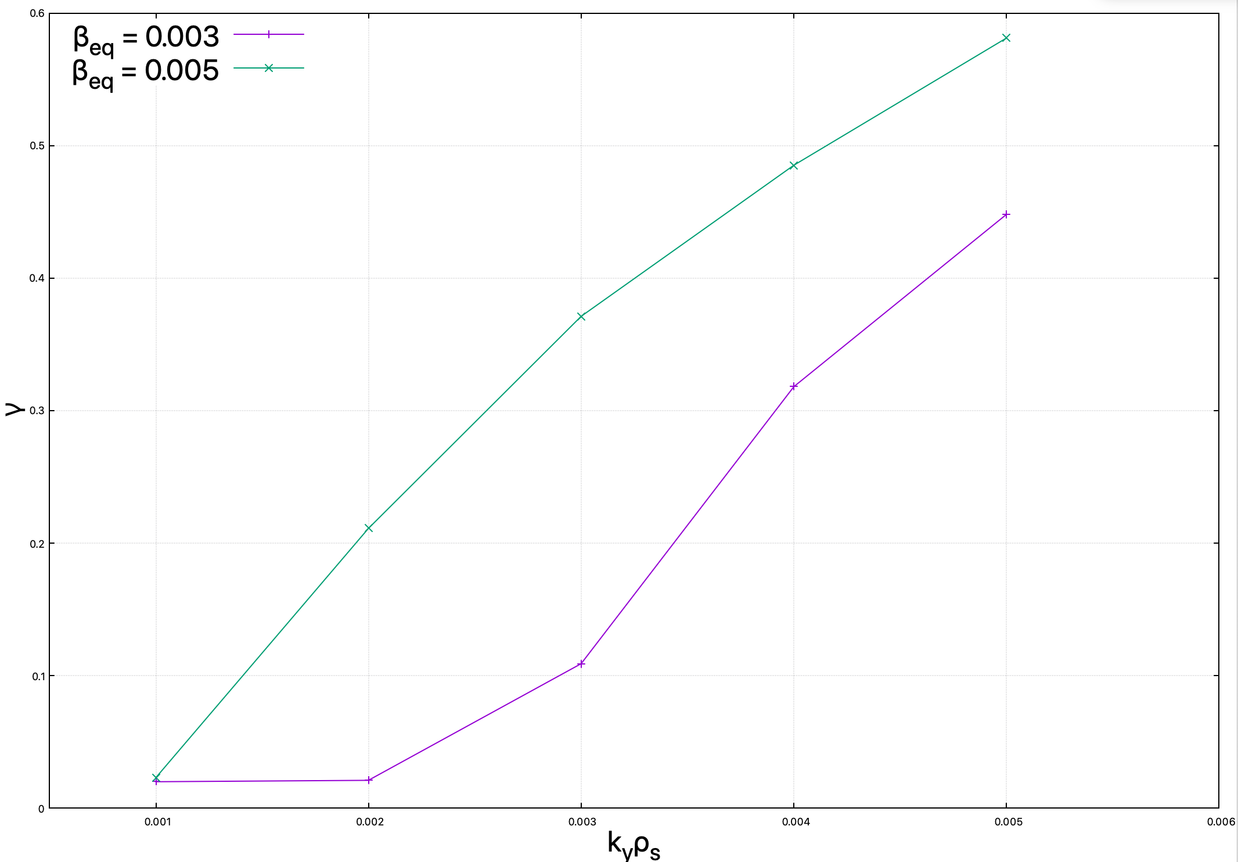
Importance of using correct $\left\langle β\right\rangle$
Need to be fully consistent!

