Slide 1






TSVV Task 5: “Neutral Gas Dynamics in the Edge”
Progress and news
D. Borodin et al.

Slide 2
Deliverables 2021 (IMS, approved)
The leaning of the code should begin aimed at segregating the compact numeric core free from branching (for more details see the proposal). The concept and the 1st code version following it at least for a selected application case should be provided by the end of the year.
The main application ("portfolio") and related CI cases should be defined including predictive modelling for ITER and DEMO utilizing the new capabilities to be provided be provided: improved CRMs, FKH and improved paralellization.
The FEM FW model as well as a simulation case for MAGNUM-PSI coupled with it and EIRENE-EUNOMIA code-code validation in a view of possible unification and capabilities transfer should be provided by the end of the year.
CRM and FKH progress report: definition of the related verification/validation cases (including JET and MAGNUM-PSI), test beds and figures of merit for performance and accuracy assessment should be defined etc. Detailed strategy for code/data modifications should be elaborated.
Report on fundamental A&M data (and postprocessing tools) in AMJUEL and other EIRENE-related databases.
Execute standalone EIRENE simulations with vibrationally excited hydrogen molecules and assess functionality of the code for slabs, JET and MAGNUM-PSI.
All deliverables, but 6 are good progressing except to 3/6 months delay of the task/ACH start, we are gaining on the initial plan for this year (I would wish for tolerance for 2021 delay by 1-2 months).
EIRENE simulations with improved CRMs suffer from unoccupied vacancy in FZJ till mid. Oct. 2021.

Slide 3
TSVV-5 events in focus groups
Nov 2021 Code Camp for 5 days focused work on streamlining the code
  More on the next slide…
Meeting on A&M data and CRMs with Yacora team (8th DEC 2021).
  We have already had a joint meeting with Yacora team (U.Fanz, D.Wunderlich)
  https://indico.euro-fusion.org/event/1107/
  To invite next time: M.O’Mullane (ADAS); D.Tshakhaya (BIT2); J.Tennysson (RMPS for molecules), D.Fursa (CCC for molecules)?.. Handshake with validation at JET ILW and MAGNUM-PSI
Reduced model data for outgassing, FEM with applications to Magmum-PSI (Dec 2021?..)
  Some cooperation already started within SOLPS-ITER communication (G.Nallo, Turin)
Meeting on selection of DEMO application case(s) (mid 2022?..)
  External participation from DEMO-relevant WPs?..
  Invite TSVV-6,7 PIs?..
In person meeting meeting to follow-up the Code Camp

Slide 4
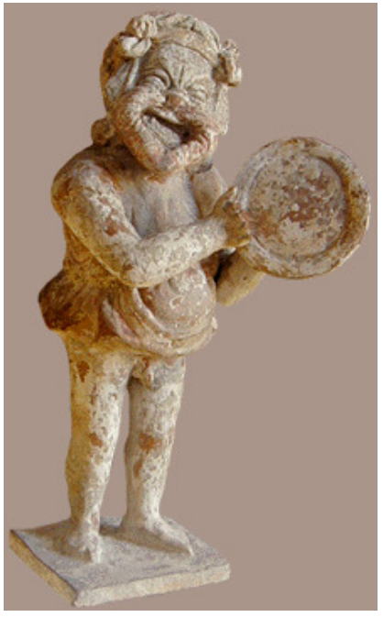
EIRENE Streamlining, Code Camp FZJ (4-10 November 2021) · Indico (euro-fusion.org)
Code Camp
EIRENE streamlining
  Version merging scope agreed including synchronisation with SOLPS-ITER
  Grouping of variables into TYPEs (some key structures drafted)
  Unloading the main loop from branching agreed
    Abstractisation of the cell type (removing “geometry” branching)
    Abstractisation of A&M reactions + tracking of internal states
IMASification (ITER + ACH)
  Large presentation and active participation from ITER
  Agreed on using SOLPS-ITER IDS structures as a basis
  List of tasks well suitable for ACH identified
EIRENE “toy model” – EIRON (ACH-VTT)
  Perfect for testing of various parallelisation strategies
  Corellates with EIRENE internal structure and profiling results
Eiron (Eιρων)

Slide 5
Basic items well suitable for ACH
a) Utility routines to build GGD objects (Thomas Johnson - not EIRENE specific!)
➔ just tetraeders for instance
➔ should be done for all EIRENE geometry types.
b) Interpolation and extraction routines.
B2.5 grid IMASification (SOLPS-ITER) can be used as example

Slide 6
Continue with IMASifcation via SOLPS-ITER
Short-mid term activity . . .
Basically B2.5-EIRENE is IMASIfied from the fluid side for output. Still, there are variables in EIRENE worth IMASification, not seeable from the B2.5 IDSs
statistical variances
all, what is outside the B2.5 grid (extended grid and more).
CRM internal data
Particular processes, surfaces etc. defined inside EIRENE
Emission data with EIRENE resolution (particular processes, lines, species, cells, surfaces, etc)
metadata specific for EIRENE (code library node)
With support from ACH?..
make IMAS from base files describing geometry
provide conversion tools for grid types (e.g. quadragular to thriangular)

Slide 7
Thanks for the attention!

Slide 8
Generalized Grid Description (GGD)
For most IDSs, the geometry on which the data is stored must be provided as part of the IDS.
For 1-D data, on can use the profiles_1d structure.
For more complex data, we rely on the GGD.
  IDS data fields are then found within the ggd(itime) structure.
The GGD has a time index, i.e. a different grid can be defined for each time-step.
The GGD works on the principle of separability of spaces.
A full geometry is a “product” of spaces.
The number and dimensionality of the spaces are arbitrary.

Slide 9
GGD Spaces
A GGD space is structured as a hierarchy of objects of increasing dimensionality, as needed.
  0-D objects: “nodes” → grid vertices
  1-D objects: “edges” → line segments connecting nodes
  2-D objects: “faces” → planar shapes delimited by edges
  3-D objects: “volumes” → voxels delimited by faces
Coordinate type and topology are provided in the space description.
For each type of object, we create an ordered list.
Each object has the properties:
  nodes(:): the list of nodes making up the object
  measure: the size of object (0-D: N/A, 1-D: length, 2-D: area, 3-D: volume)
  geometry(:): additional useful geometrical information (physical coordinates, size when “multiplied” by the other spaces, connection length, etc…)
  boundary(:), boundary(:)%index and boundary(:)%neighbours(:) provide the connectivity

Slide 10
Adjusted PPM table for 2021

Slide 11
Summary: TSVV-5 progress and plans
Physics
  Fluid-kinetic hybridisation (FKH) development successfully continues
  A&M CRM improvement (mostly preparatory work so far…)
  Kinetic ions on the EIRENE side (F.Schluck, discussion with TSVV-6)
  Establishing simulation cases (validation, ITER, DEMO) – in progress
Code development
  Parallelisation: OpenMP-MPI hybrid (related code refactoring done; optimisation and restructuring e.g. domain decomposition are necessary)
  Code streamlining (Segregation of the numeric core, etc.) – code camp
  Improved I/O (JSON/HDF5), visualisation, IMASification, etc. – in progress.
Organisational items
  Repository for simulations (EUDAT?.., using JAC catalogue experience) – concept under development, depends on selection of base system.
  New EIRENE license, “infectious open source” (draft discussed with FZJ layers and ITER still in circulation)
  Regular meetings (1 general / 2-3 topical every 2nd week) + focus group events by necessity. Some VCs are open outside TSVV-5.
  ➔ Example: 17 Sep. topical meeting on SOLPS (with ITER participation)
Requires communication with other TSVVs
Requires ACH support

Slide 12
IMASication of EIRENE as NGM
Long term activity . . .
EIRENE as an NGM should be IMASified independent on B2.5
a) keep B2.5 IDSs as a basis for other fluid codes (starting with SOLEDGE3X). Flag where generalisation is needed. Leas with the other related TSVVs to have the IDS structure conform.
b) Start trasforming common variables between B2.5 and EIRENE into IMAS (very long term!!)
➔Best to do after the streamlining and total version merge!
➔Data structure developed by streamlining should keep in mind future IMASification.
c) Start with IMAS input for EIRENE
➔ adding Cartesian velocity components
➔ incorporate ways to use the machine description DB

