Slide 1
ITER’s activities and priorities in the field of plasma disruptions for 2022-2023
Michael Lehnen
Science Division

Slide 2
Outline
ITER DMS design & timeline
DMS Task Force Programme – Experiments and Modelling
R&D in support of the ITER Research Plan

Slide 3
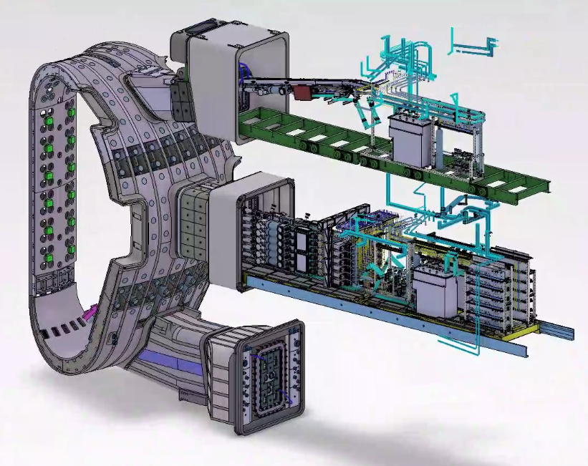
ITER DMS
UP 2,8,14: 3 injectors
2-3 Jun 2021 System Design Review meeting
Jun 2021 Freezing of interfaces with Diagnostic First Wall
Sep 2021 System functional and specific requirements defined
22-24 Feb 2022 Preliminary Design Review
May 2022 Report to ITER STAC
Q2 2023 Final Design Review
Note: after FDR starts the Manufacturing Readiness Review (MMR) allowing for some design adjustments as identified during FDR
EP 2,8,17: 24 injectors

Slide 4
DMS Task Force – Experiments/Modelling
Scope
DMS Design Specification
Objectives
Definition and validation of mitigation scenarios
Requirements on the following to achieve mitigation targets:
  Pellet material and delivered mass
  Injection locations and directions
  Fragment sizes
  Fragment velocities and velocity dispersion
  Fragment plume geometry
  Pellet arrival accuracy
Provision of requirements to the technology programme of the DMS TF
Implementation
Facilitating SPI experiments at various devices through provision of SPI systems or upgrades of these (AUG, JET, KSTAR) and diagnostics (AUG, DIII-D, KSTAR)
Experiment preparation and coordination through the TF in collaboration with ITPA MHD (MDC-24) and EUROfusion (AUG, JET)
ITER DMS modelling work through dedicated agreements with IO
Coordination and information exchange for modelling/theory activities through domestic programmes in the ITER member states (regular TF meetings)

Slide 5
DMS Task Force - Experiments
KSTAR
2 triple injectors toroidally 180° separated
Switch to rectangular shattering unit with shallow angle in 2022
Dispersion interferometer operational
Aiming for full bolometer coverage in 2022
(Wide-angle view in 4 toroidal locations, double fans in 2 toroidal locations for tomographic reconstruction)
Main objectives:
Adequacy of the injection locations
Efficiency of multiple simultaneous injections
Quantification of radiation peaking
Required quantities, pellet compositions, injection sequences
Single 4.5 mm D SPI
Density rise at injection point at 180° away

Slide 6
DMS Task Force - Experiments
DIII-D
2 triple injectors toroidally 120° separated
Discussion of experiment proposals for 2022/23 ongoing
IO proposed large set of pulses to extent the database for pure D injection (dual injection, pellet size, etc.)
Low Te capability of the TS diagnostic enables profile measurements during pre-TQ and post-TQ phases
Main objectives:
Adequacy of the injection locations (complementary to KSTAR)
Efficiency of multiple simultaneous injections
Efficacy of the staggered H/D injection scheme for runaway electron avoidance
Required quantities, pellet compositions, injection sequences

Slide 7
DMS Task Force - Experiments
JET
Single triple injector
Upgrades in collaboration with UKAEA, USIPO/ORNL, EUROfusion:
  Injector upgrade to enable low velocities without punch and to change barrel diameters (2 x 10 mm, 1 x 8.1mm)
  HRTS low Te/high ne capability
Main objectives:
Exploration of the pure D SPI ITER scheme in an all-metal environment
Assessment of the efficiency of pre-thermal quench dual injection of identical pellets from a single injection location with dual D and Ne/D SPI and staggered D + Ne/D SPI
Extension of the SPI database to target plasmas with high thermal energy (at least 8 MJ) and high plasma current (at least 3.0 MA); provision of the energy dependence of the above injection schemes
Exploration of RE impact mitigation with multiple deuterium injections

Slide 8
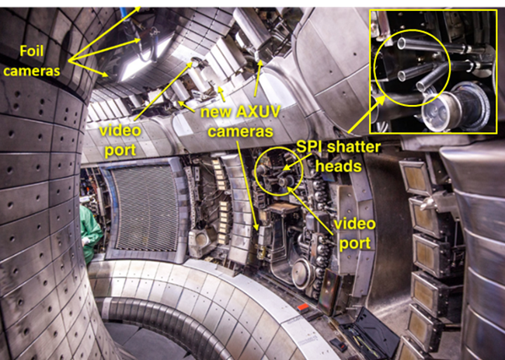
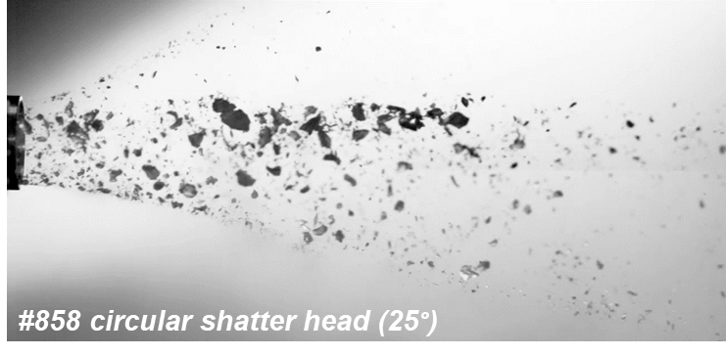
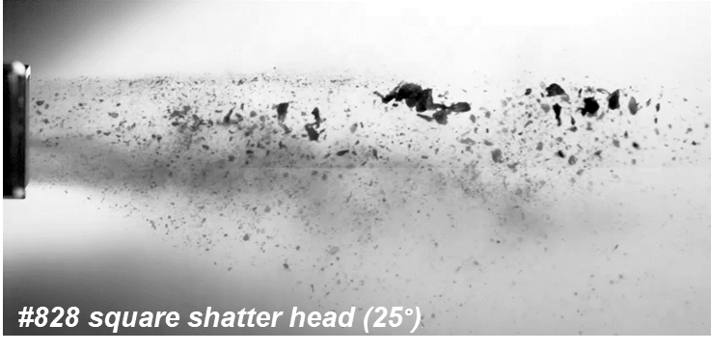
DMS Task Force - Experiments
ASDEX Upgrade
Single triple injector with different shatter tubes
Shattering characterization very successful, >1300 videos
Injector installed at AUG and operational (first SPI into plasma Dec 2021)
Diagnostic upgrades: bolometers operational, fast cameras (tangential, vertical and radial views) in preparation, expected available in March
Main objectives:
Study of pre-thermal-quench ablation of different fragment size distributions for various target plasmas and SPI parameters;
Study of particle assimilation for SPI into pre-thermal-quench and current quench plasmas;
Assessment of the potential of pre-thermal-quench dual injection in an all-metal device to raise the density for runaway avoidance
Size scaling together with upcoming JET data!

Slide 9
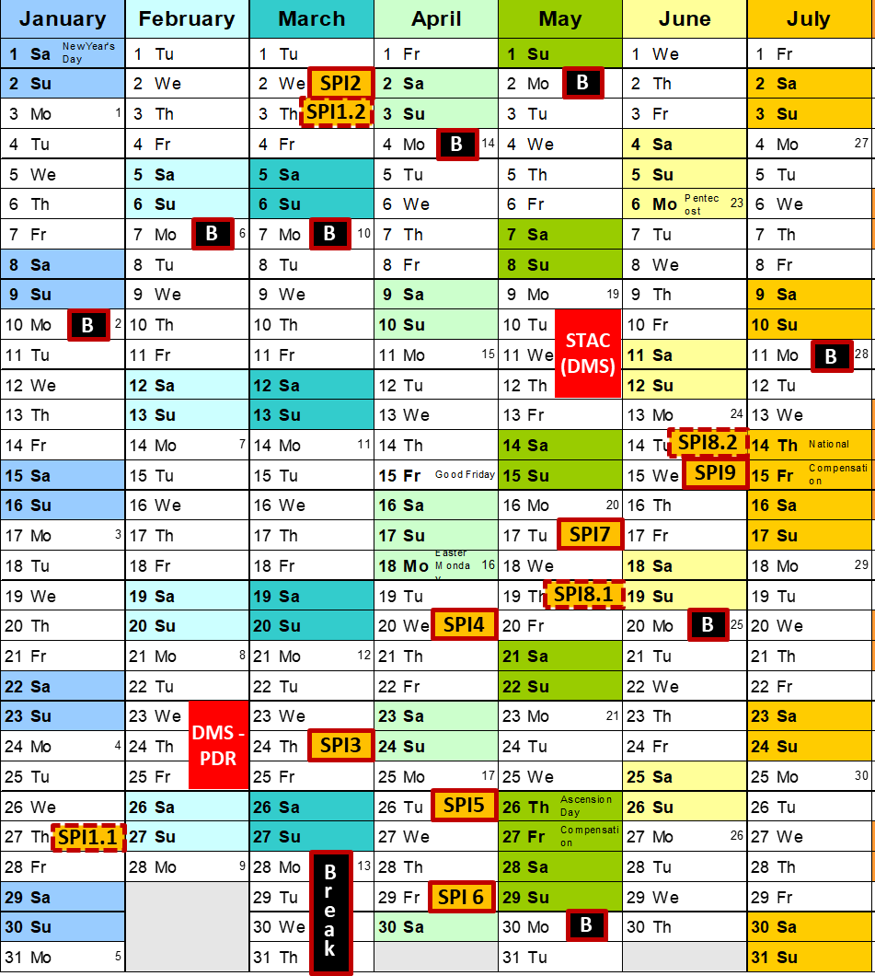
DMS Task Force - Experiments
ASDEX Upgrade
Single triple injector with different shatter tubes
Schedule:
21/01/2022 ITER DMS TF preparation meeting for January session (with EUROfusion participation)

Slide 10
DMS Task Force - Experiments
J-TEXT
Contributes to MDC-22 with studies on RE mitigation and radiation distribution
EAST
New SPI system in 2022; IO is in contact with EAST SPI team to explore possible experiments to support the ITER DMS design work
JT-60SA
Evaluation of the feasibility/relevance for ITER of an SPI programme in JT-60SA
joint IO-QST-F4E(EUROfusion) exercise (to be finalised in 2022)

Slide 11
DMS Task Force - Modelling
Objectives
  Model optimisation and validation
  Complement experiments
  Extrapolation to ITER
Activities within direct IO collaborations:
  3D MHD SPI simulations → Complete description of the mitigation process
  1D SPI simulations → Extensive parameter scans
  RE simulations → 1D with focus on RE physics
  Shattering simulations → Understanding of pellet fragmentation (technology)

Slide 12
DMS Task Force – 3D MHD modelling
JOREK SPI simulations (Beihang University)
Code optimisations including implementation of a particle impurity model (to replace coronal equilibrium)
ITER SPI simulations studying impact of injection configuration, injection timing, fragment sizes and compositions, plasma energy, including multiple SPI and pure H staggered SPI
NIMROD/M3D-C1 simulations (GA)
Code benchmark and experimental validation (KSTAR, DIII-D SPI + single pellet)
ITER SPI simulations studying impact of injection configuration, injection timing, fragment sizes and compositions, plasma energy, including multiple SPI and pure H staggered SPI
JOREK simulations (IPP)
RE fluid simulations in 2D and 3D, code benchmark with DINA/GO,
Assessment of MHD role during plateau and loss phase with Ne and H SPI in ITER
SPI simulations supporting AUG experiments
JOREK KSTAR SPI simulations (SNU)
Integration of SPI system and synthetic diagnostics
SPI simulations supporting KSTAR experiments

Slide 13
DMS Task Force – 1D / RE modelling
INDEX SPI simulations (QST)
Code optimisation including model for SPI ablation and plasmoid drift effects
Model validation with experimental data (so far with DIII-D TS data)
ITER SPI simulations assessing density rise and energy balance as function of various DMS engineering parameters (e.g. fragment size, velocity and velocity dispersion, arrival jitter, pellet size, etc.)
DREAM RE simulations (Chalmers University)
Code optimisations including implementation of a workflow to allow integrating transport coefficients from 3D MHD modelling (JOREK)
Code benchmark with JOREK 2D, 3D, DINA, INDEX
ITER SPI simulations to assess possible RE formation under a large variety of injection parameters
INDEX simulations for different fragment sizes
Fragment sizes

Slide 14
Required R&D in Support the ITER Research Plan
ITR-20-008 in https://www.iter.org/technical-reports
A. R&D for design completion
A.1-4 Optimisation of SPI to achieve RE avoidance with TQ and CQ mitigation
largely addressed by the ITER DMS TF programme
A.5 DMS – alternative injections techniques
material injection other than SPI, e.g. shell pellets, electro-magnetic injectors, …
A.6 DMS – alternative disruption mitigation strategies
mitigation schemes other than material injection, e.g. RE-wave interaction
ITPA MDC-23 | Formation, suppression and mitigation of REs | R. Sweeney
ITPA MDC-24 | Shattered Pellet Injection (SPI Physics Validation) | N. Eidietis
ITPA MDC-26 | RE - Wave / MHD Interactions | C. Paz-Soldan

Slide 15
Required R&D in Support the ITER Research Plan
B. Implementation of the ITER Research Plan
B.1.1 Disruption/VDE thermal load characterization
B.1.2 Disruption/VDE mechanical load (current flow) characterization including toroidal rotation
aVDE inertial load definition exercise is ongoing in IO (deadline 12/2022), validation is required!
Full 3D simulations of unmitigated ITER disruptions, J. Artola, IO-F4E-QST (EUROfusion)
Implementation of DINA Disruption Simulator in IMAS (IO contract)
Measurements of halo parameters needed, IO proposal for WEST C2-W2.7-P6
Simulations of disruption induced beryllium melt splashing (IO contract)
ITPA MDC-25 | Sources and Scalings of Nonaxisymmetric "Sideways" Disruption Forces for ITER | V. Yanovskiy
ITPA MDC-JA-3 | Disruption forces – theory and modeling | V. D. Pustovitov
ITPA MDC-JA-4 | UFO disruptions and divertor hot spot monitoring | R. Granetz

Slide 16
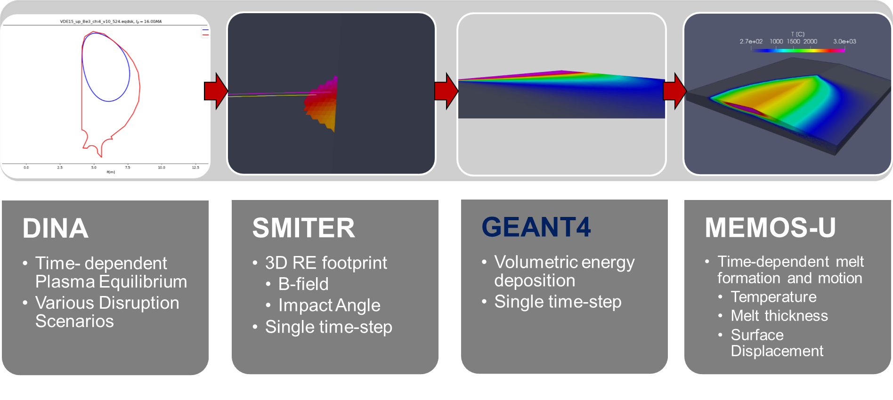
Required R&D in Support the ITER Research Plan
B. Implementation of the ITER Research Plan
B.1.3 Runaway electron load characterisation
JET RE impact benchmark (L. Chen, Monaco post-doc until Sep 2022)
ITER RE impact on first wall and divertor (L. Chen)
Post-mortem analysis of JET IWGL tile after RE impact (EUROfusion labs, IO contact R. Pitts)
Workflow for RE impact studies
New in 2022!
ITPA MDC-DSOL-1 | Characterization of power deposition to PFCs by runaway electrons | E. Nardon E. Hollmann
Provision of IR data for model validation with focus on impacts after mitigation attempts
Impact of RMP on energy deposition

Slide 17
Required R&D in Support the ITER Research Plan
B. Implementation of the ITER Research Plan
B.1.4 Disruption detection
B.1.5 Disruption prediction
B.1.6 Disruption avoidance
Design work of the ITER Plasma Control System for PFPO-1 kicked-off this week,
3.5 year activity including the development of the DMS trigger function
DMS trigger function
MDC-IOS-1 | Control for disruption-free operation | D. Humphreys
MDC-17 | Active disruption avoidance | M. Maraschek
MDC-22 | Disruption Prediction | G. Pautasso
MDC-22 group meeting 3 Feb, 15-17 CET

Slide 18
Summary
The timeline for the DMS design requires intense R&D until mid 2023, but specific aspects to be continued also after during MRR phase
DMS design related R&D largely covered by the ITER DMS Task Force Programme
Continuation of disruption mitigation research is needed beyond DMS design finalisation to prepare DMS operation on ITER and to provide back-up solutions in case mitigation targets cannot be achieved as expected
R&D in support of the ITER research plan is partly addressed through ITPA JEX/JAs, specific activities either coordinated by IO or within domestic programmes. Good quality measurements remain very scarce and efforts are needed to increase the database to allow more detailed assessment of loads for ITER.

