Slide 1

Runaway Electrons in Tokamak Disruptions
Where do we stand? What should we do?
EUROfusion FSD Science Coordination Meeting, 18/01/22
E. Nardon
Acknowledgments: TSVV 9 team

Slide 2
Outline
Present knowledge and open questions
Prospects for ITER
Tools and plans

Slide 3
Outline
Present knowledge and open questions
Prospects for ITER
Tools and plans

Slide 4
Theory
Review papers: [Breizman NF 2019] [Boozer PoP 2015]
RE generation mechanisms have been identified and explored theoretically:
  Primary:
    Non-nuclear: Dreicer, hot tail
    Nuclear: Tritium β decay, Compton scattering
  Secondary: avalanche
Seminal theory works from several decades ago (e.g. [Rosenbluth NF 1997]) but important recent developments:
  Effect of partial screening of the nuclear charge of partially ionized impurities [Hesslow JPP 2018]
    Bound electrons may boost the avalanche [Hesslow NF 2019]
  Phase space dynamics
    Theory of 2 threshold E|| fields [Aleynikov PRL 2015]
    RE vortex [Guo PPCF 2017]
  Self-consistent model for hot tail generation during a thermal quench [Aleynikov NF 2017]
  …

Slide 5
RE generation models
Validation of RE generation models in quiescent plasmas is well advanced
  Threshold E|| field larger than Connor-Hastie value in several machines [Granetz PoP 2014]
  Kinetic whistler wave instabilities may play a key role in this [Liu PRL 2018]
Models for RE generation during disruptions are not mature yet
  More difficult than quiescent situations because of 3D MHD
    Electron transport due to magnetic stochasticity
    Electron acceleration by large MHD-driven E|| [Sommariva NF 2018]
    Impurity mixing
  3D MHD codes…
    …are just beginning to produce ~ plausible disruption simulations [Nardon PPCF 2021]
    …have not yet produced disruption simulations with a self-consistent treatment of REs
      but test particle studies have been done with JOREK [Sommariva NF 2018] [Särkimäki, in prep.]
  <3D codes (e.g. ASTRA-STRAHL [Linder NF 2020] or DREAM [Brandström MSc 2021])…
    …are more advanced in terms of self-consistent RE modelling
    …but how to take 3D MHD into account?
      3D-MHD-related factors are often used as knobs in order to match experimental data → Validation or ‘fancy fit’?

Slide 6
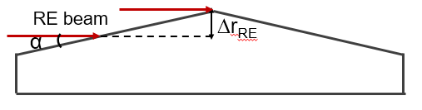
RE beam impact
Physics of the RE beam impact is only partly understood
‘Standard’ RE beam impacts seem to be highly localized
  ∆r_{RE} ~ 1-2 mm allows reproducing post-mortem observed melt pattern on JET [Chen AAPPS 2021]
  Order of magnitude of ∆r_{RE} seems consistent with a Larmor radius
Toroidal peaking is observed, e.g. at JET ‘beyond misalignment tolerances’ [Reux NF 2015]
  Suggests role of MHD
Termination is typically bursty (HXR, magnetics) at DIII-D and JET
  Due to MHD? Or perhaps to RE filaments [Eriksson PRL 2004]?
A large fraction of the magnetic energy can be converted into RE kinetic energy during the termination
  Crucial in ITER because typically E_{mag} >> E_{kin}
  The converted fraction grows with τ_{loss}/τ_{res} [Martin-Solis NF 2014]
  → A fast termination (small τ_{loss}) with clean a background plasma (long τ_{res}) is beneficial
A proposed ITPA DivSOL/MDC collaboration on the “Characterization of power deposition to PFCs by REs” is under discussion (coordinators: E. Hollmann, E. Nardon)

Slide 7
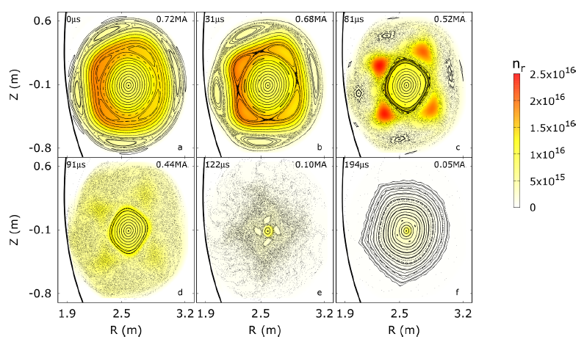
RE beam mitigation
Benign RE beam termination observed in JET and DIII-D after a D₂ SPI into the beam [Reux PRL 2021]
  JOREK simulations suggest a strong heat flux spreading due to large MHD [Bandaru PPCF 2021]
    Probably much larger MHD than in ‘standard’ terminations
  Absence of E_{mag} → E_{kin} conversion thanks to fast termination and clean background plasma probably also plays a role

Slide 8
Outline
Present knowledge and open questions
Prospects for ITER
Tools and plans

Slide 9
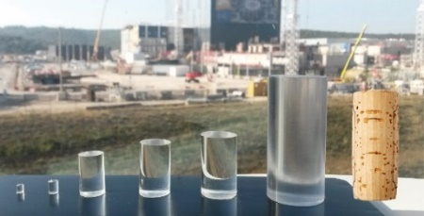
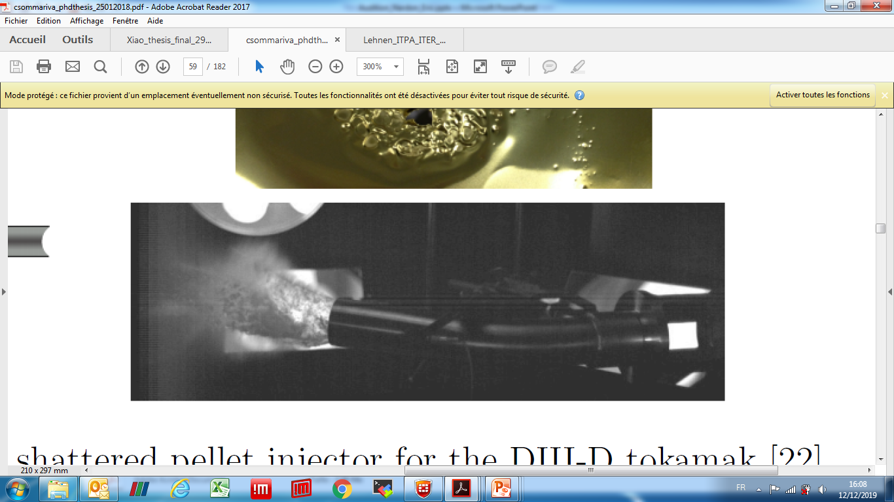
The ITER Shattered Pellet Injection (SPI) system
  Objectives:
    Thermal load mitigation
    Electromagnetic load mitigation
    RE avoidance
    RE mitigation
  Up to 24 pellets from midplane (3 different ports)
  Pellet size ~ wine bottle cork (1 pellet contains ~2 x 10²⁴ atoms)
  Material: Ne+H₂
    Ne needed to radiate the energy and make the current quench short enough
    H₂ may be useful for RE avoidance or mitigation
  Velocity: a few 100 m/s
  Shattering by bend at end of flight tube
    Number & size of shards depend on bend angle and pellet velocity

Slide 10
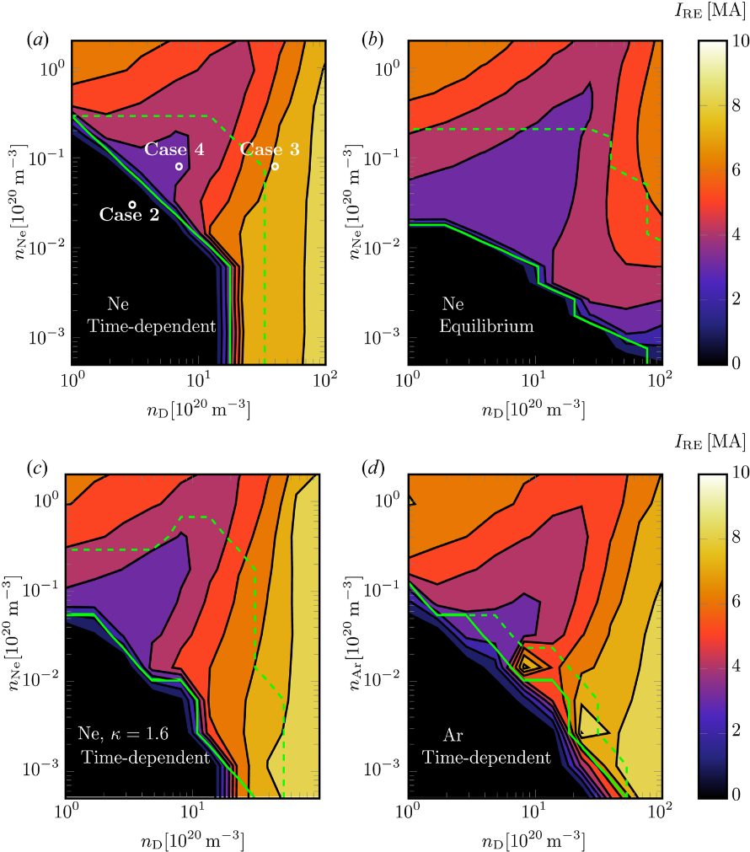
Prospects for RE avoidance in ITER (1/3)
General considerations:
  Avalanche gain scales exponentially with I_{p} → Will be >> than in present machines
  Dreicer seed expected to be negligible (T_{e} sufficiently ‘high’ during CQ)
  Hot tail seed hard to predict but could be very large
  Nuclear seeds small but non-negligible due to huge avalanche gain
Increasing n_{e} by injecting H₂ reduces all seeds except Compton
  Would need to reach n_{e} ~ 2-4 x 10²¹/m³ to avoid large beam from Compton-initiated avalanche, according to [Martin-Solis NF 2017]
  …but recent simulations with GO predict that this will not work because of recombination, such that a multi-MA RE beam will form, whatever the assimilated Ne+H₂ mixture [Vallhagen JPP 2020]
  Open question: may MHD instabilities deconfine REs before the beam becomes dangerous?
Too slow CQ

Slide 11
Prospects for RE avoidance in ITER (2/3)
Non-nuclear phase may be easier (no Compton source) but hot tail generation remains a risk
However, hot tail generation might be suppressed by a 2 step scheme: 1) H₂ SPI, 2) Ne SPI [Nardon NF 2020] [Vallhagen, in prep.]
    H₂ SPI → dilution cooling without immediate TQ, leaving time for electron distribution to cool down to a few 100 eV as a Maxwellian
Open question: effect of the drift of ablation plasmoids towards the LFS?
  Large radial transport of the injected material observed at DIII-D [Shiraki APS 2021]

Slide 12
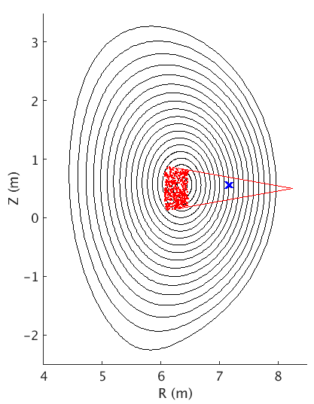
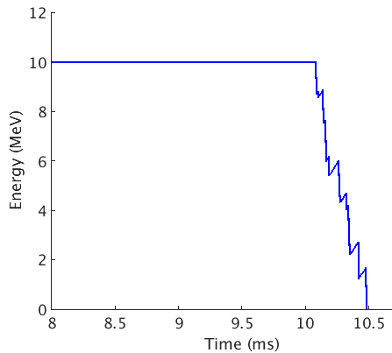
Prospects for RE avoidance in ITER (3/3)
Other ideas:
For the active phase (assuming negligible hot tail seed): post-TQ injection of solid fragments to stop nuclear seeds before they avalanche [Nardon NF 2021]
RE
Shard cloud
Waves / kinetic instabilities
  Role of ~MHz modes in RE generation during DIII-D disruptions suggested by observations [Lvovskiy PPCF 2018]
  Modelling interprets the modes as Compressional Alfvén Eigenmodes [Liu NF 2021]
  Exploitable in ITER?
    Need to avoid collisional damping, i.e. need low enough n_{e}, high enough T_{e}

Slide 13
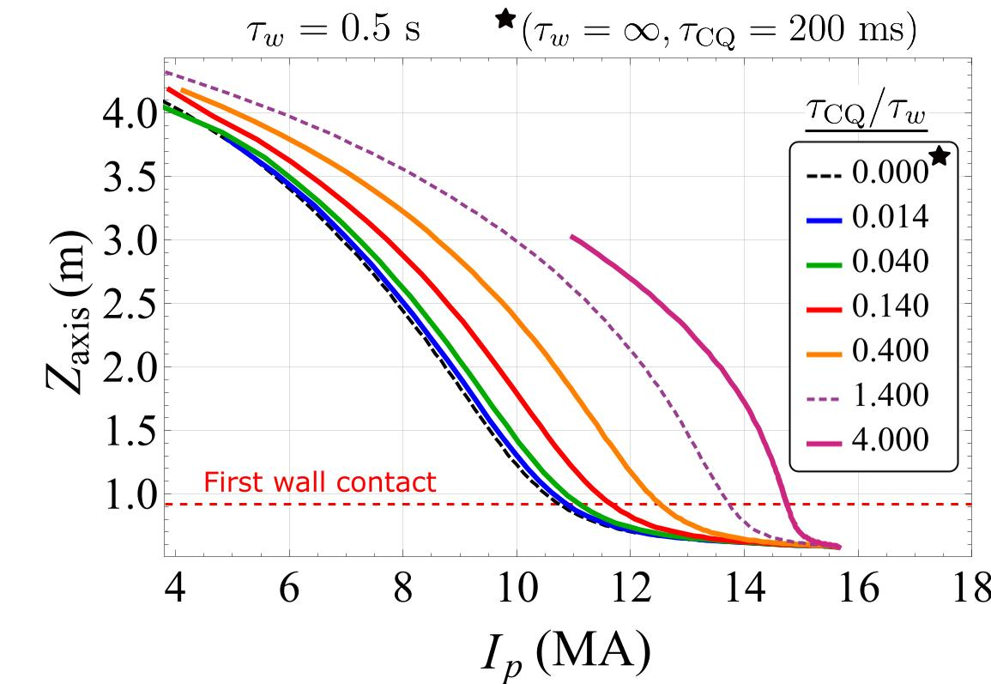
Prospects for RE mitigation in ITER (1/2)
How much mitigation is needed, i.e. what is the tolerable I_{RE} at impact?
Estimates based on a ‘scraping-off’ model (∆r_{RE} ~ a few mm) and assuming no E_{mag} → E_{kin} conversion give a tolerable I_{RE} (for cooling channel integrity) between ~100 kA and ~3.6 MA depending on hypotheses, e.g. concerning toroidal uniformity [Chen AAPPS 2021]
2D JOREK simulations
Injection of high Z material into the RE beam used to be considered as a possible mitigation scheme, but…
In ITER, high vessel conductivity implies Z_{p} = f(I_{p}) for fast CQ
→ Strongly limits the possibility to reduce I_{p} before impact
E_{mag} → E_{kin} conversion during the termination could be large
→ Pessimistic outlook for strategies based on high Z material injection according to DINA modelling [Konovalov IAEA 2016]
Courtesy J. Artola

Slide 14
Prospects for RE mitigation in ITER (2/2)
H₂ SPI into RE beam is now considered the best hope for RE mitigation in ITER after promising results at DIII-D and JET.
Prospects and open questions for ITER [Paz-Soldan APS 2021]:
  Shards will probably be sublimated at the edge of the RE beam
  Subsequent expansion of ablation clouds to be clarified: do clouds stay neutral enough that they can expand across the whole plasma? [Kiramov NF 2020][Samulyak et al., ongoing]
  If they do not expand much, will the material mix sufficiently fast? [Hollmann APS 2021]
  Assuming good mixing, recombination can be obtained with the right amount of H₂
    Possibly key to get
      fast and large MHD instability
      clean background plasma
  Amplitude of MHD modes? Need 3D non-linear MHD modelling, e.g. with JOREK [Bandaru PPCF 2021] or M3D-C1 [Liu APS 2021]
Another idea (not assessed yet): spread the impact by applying Resonant Magnetic Perturbations

Slide 15
Outline
Present knowledge and open questions
Prospects for ITER
Tools and plans

Slide 16
Tools (TSVV 9)
2 main ‘workhorses’:
DREAM kinetic code [Hoppe CPC 2021]
  Solves 1D flux surface averaged transport equations
    Disruption-oriented (e.g. includes impurities)
  Self-consistently evolves the electron distribution function using a bounce-averaged kinetic equation
JOREK 3D MHD code [Hoelzl NF 2021]
  Can include REs as a fluid [Bandaru PRE 2019] or as test particles [Sommariva NF 2018] [Särkimäki, in prep.]
Other tools: LUKE, ASTRA, ETS, …

Slide 17
Plans (1/2)
Mainly covered by TSVV 9 but hope for support from WPTE for validation, + support from IO
Simulate RE generation and avoidance in ITER with DREAM and JOREK (revisit GO study)
  DREAM will provide more precise kinetic effects
    First investigations on hot tail + stochastic transport published in [Sveningsson PRL 2021]
    More simulations planned under Chalmers Univ.-IO collaboration agreement
  JOREK will allow assessing the possible effect of MHD instabilities
    Planned under IPP-IO collaboration agreement
Improve RE generation models in <3D codes:
  In particular concerning 3D MHD effects:
    Transport due to magnetic stochasticity
    Acceleration by MHD-driven E||
    Impurity mixing
  Strategy:
    Assess effect based on JOREK simulations, e.g. using test particles [Särkimäki, in prep.] [Sommariva NF 2018]
    Increase our confidence that JOREK captures these effects well
    Provide reduced models to DREAM and others

Slide 18
Plans (2/2)
Validate DREAM for RE generation
  Database of pulses
  Uncertainty quantification
Validate JOREK for RE generation
  For a few pulses, detailed comparison with experimental data using several synthetic diagnostics
Assess effect of drift of ablation plasmoids towards the LFS and consequences for 2 step SPI scheme
Model RE mitigation by D₂/H₂ SPI
  Develop DREAM and JOREK to model self-consistently the RE beam and its background plasma …and D₂/H₂ SPI into this system
  Model the beam termination with JOREK, starting from an MHD stable situation and self-consistently including the background plasma
  Model the beam termination with DREAM, with ad hoc 3D MHD effects (e.g. from JOREK)
  Validate against e.g. JET or DIII-D data
  Make ITER predictions and find optimal strategy
Study possible use of (RE-driven or externally injected) waves / kinetic instabilities for RE avoidance or mitigation

Slide 19
Backup slides

Slide 20
K. Särkimäki

