Slide 1
iota dependencies at W7-AS (1)
M. Hirsch
contact: matthias.hirsch@ipp.mpg.de
for reading:
overview: W7-AS review Hirsch 2008 et al PPCF 50 053001, p65 ff
more detailed: Brakel_1997_PPCF 39 B237, Brakel_2002_Nucl. fusion

Slide 2
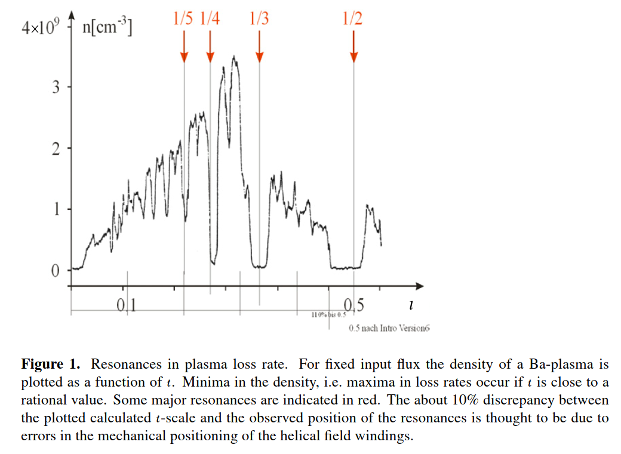
basic feature of low-shear stellarators
Grieger_PPCF_1986
W2-A: Ba-plasma with electrons heated by contact ionization with a hot CO₂-laser heated Ta ball at the magnetic axis. Steady-state heating allows to scan iota continuously.
-> confinement is practically lost with rational iota (and respective islands induced by field perturbtions) in the confinement region
Jaenicle et al 1993

Slide 3
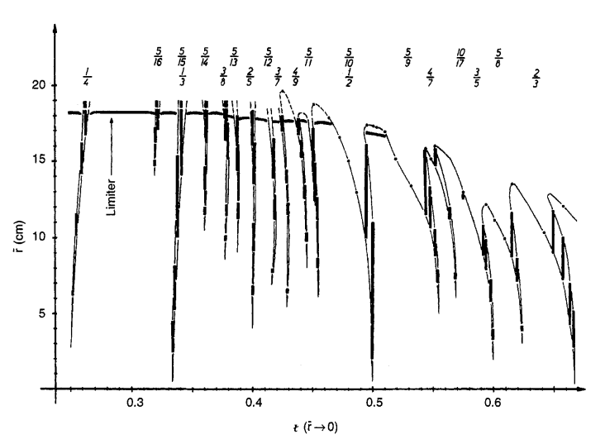
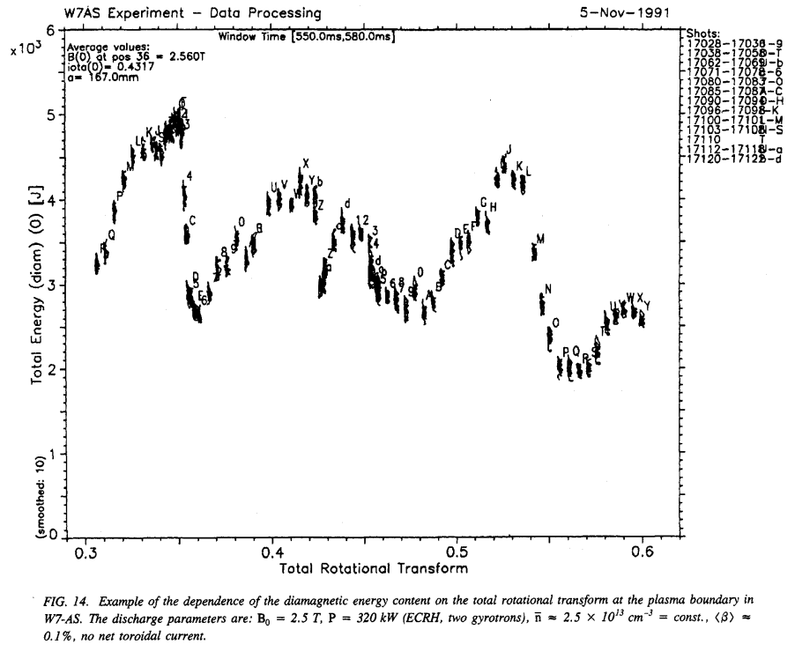
effect of low magnetic shear (beta<<1%)
Jaenicke et al 1993 Nucl. Fusion
flux surface mapping. r(LCFS) and radial island extent
limiter config.
separatrix config.
low-beta iota scan, (iota a = current ratio in coils)
Ip=0 achived by Ohmic transformer, net current fee -> edge iota kept constant
P_{ECRH}=350kW, 2.3 10¹⁹m⁻³, island boundary due to fully retracted top/bottom rail limiters,
Ti<<Te, but Ti measurements rare (no CXRS)
-> confinement degradation not explained by islands at major resonances acting as confinement shortcuts

Slide 4
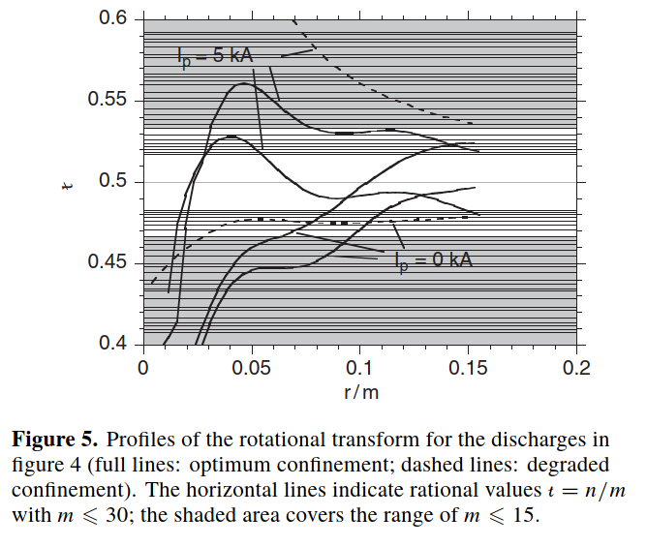
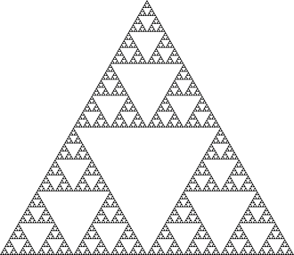
a heuristic model -> “the effect of higher order rationals”
Brakel_1998_EPS,
empirical model for chi_e (ions are cold):
local electron heat conductivity is increased from its optimum value by the density of low-order rationals (for calculations taken up to m=20) and reduced by the local magnetic shear (i.e. depends on “the radial size of the related small islands”)
-> self similarity ...
-> proposal to do this as an exercise for W7-X
-> optimum confinement if the boundary is in a “resonance free” close to the low order rationals, avoiding low order rationals
-> confinement degrades if densely spaced rational surfaces are a mayor part of the plasma
Brakel et al 1997 PPCF
Brakel and W7AS team 2002 Nucl. Fusion

Slide 5
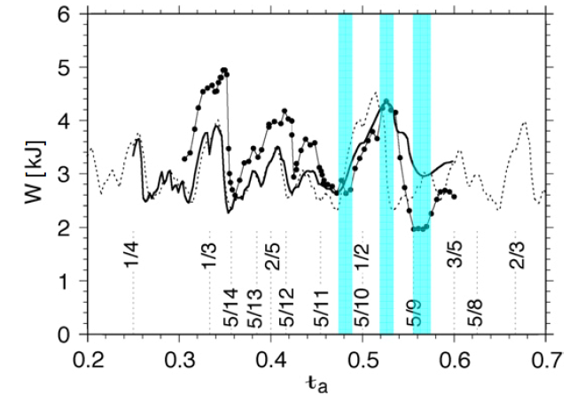
effect of low magnetic shear (beta<<1%) by current control
limiter config.
separatrix config.
Brakel et al 1997 PPCF
Brakel and W7AS team 2002 Nucl. Fusion
quiescent H-mode at higher densities
low-beta iota scan, iota(a) = current ratio in coils
Ip=0 achived by Ohmic transformer, net current free -> current control edge iota kept constant
P_{ECRH}=350kW, 2.3 10¹⁹m⁻³, island boundary due to fully retracted top/bottom rail limiters,
Ti<<Te, but Ti measurements rare (no CXRS)
-> optimum confinement if the boundary is in a “resonance free” close to the low order rationals, avoiding low order rationals
-> confinement degrades if densely spaced rational surfaces are a mayor part of the plasma
continuous line: shear taken into account
dashed line : ?

Slide 6
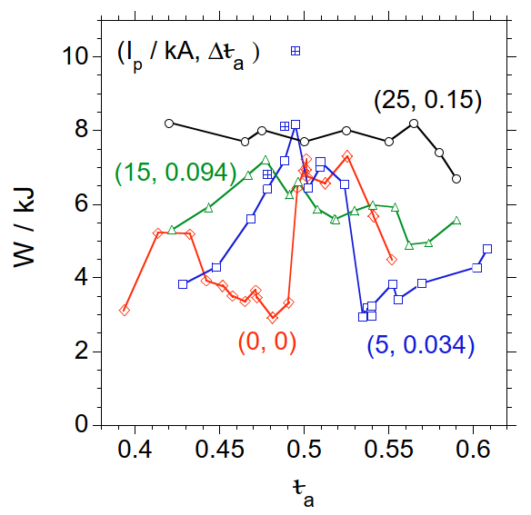
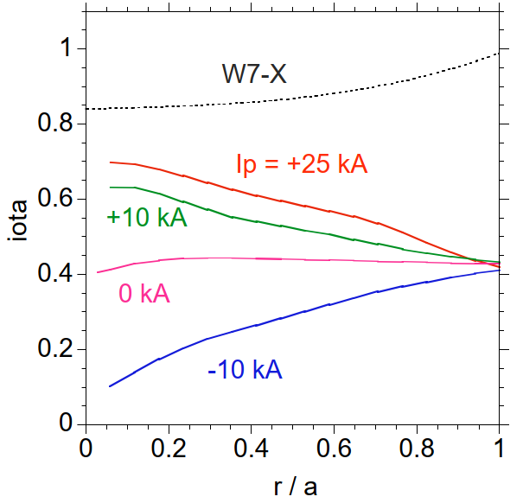
magnetic shear (from low Ip) heals the poor confinement
iota scans with shear / Ohmic current
Brakel and W7AS team 2002 Nucl. Fusion
iota scans around iot=1/2 with different Ohmic current
Ip<+-30kA induced Ohmic transformer does not provide significant heating
P_{ECRH}=450kW, 4 10¹⁹m⁻³, W mainly from elctrons Te~2keV ,Ti<450eV
inward shifted limiters to get constant minor radius by cutting edge islands and inhibit H-mode
right: expectations according model l
-> by increasing shear (“radially squeezing the islands”) the dependency is smoothed
-> independent on the sign of the shear

Slide 7
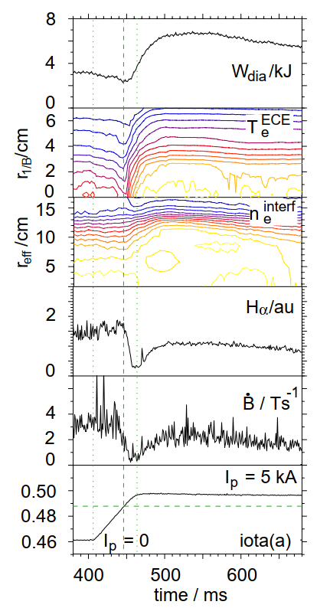
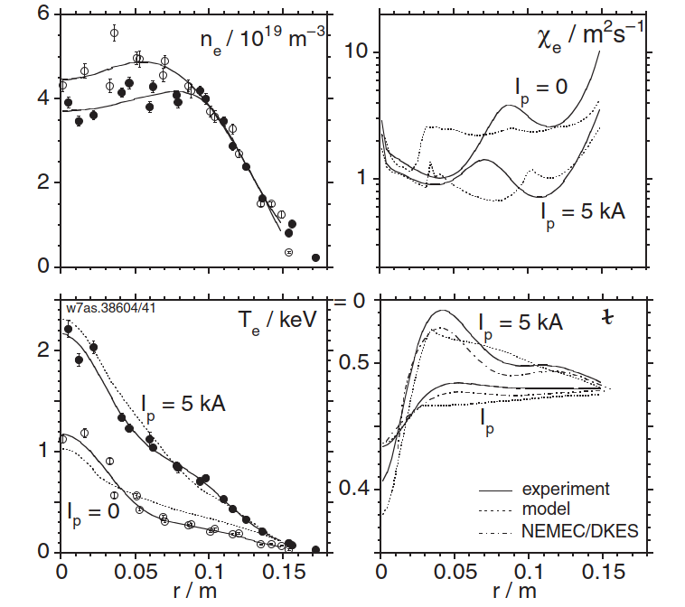
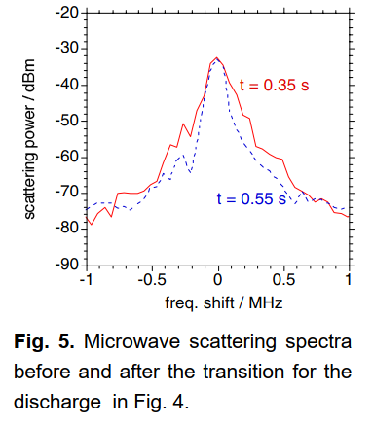
magnetic shear (from low I_{p}~5kA) reduces χ_{e}
dynamic shear scan
Brakel and W7AS team 2002 Nucl. Fusion
dotted:
NMEC+DKES
-> chi_e reduces by up to factor 5
-> independent on the sign of the shear
-> increased fluctuation level found ! (?)
-> not clear which particular perturbations associated with the rationals are responsible

Slide 8
without current control : confinement bifurcation
dynamic shear scan
Brakel and W7AS team 2002 Nucl. Fusion
iota scans around iot=1/2 with different Ohmic current
Ip<+-30kA induced Ohmic transformer does not provide significant heating
P_{ECRH}=450kW, 4 10¹⁹m⁻³, W mainly from elctrons Te~2keV ,Ti<450eV
inward shifted limiters to get constant minor radius by cutting edge islands and inhibit H-mode
right: expectations according model l
-> by increasing shear (“radially squeezing the islands”) the dependency is smoothed
-> independent on the sign of the shear
-> not clear which particular perturbations associated with the rationals are responsible
-> increased fluctuation level found ! (?)

Slide 9
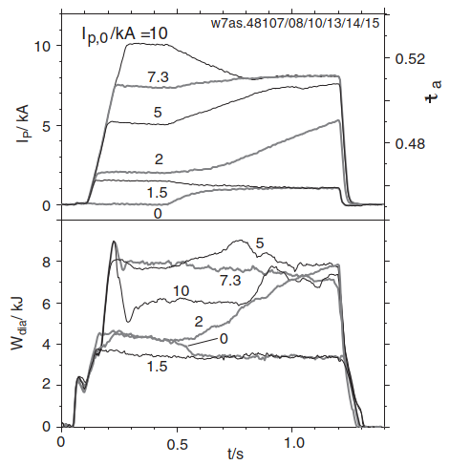
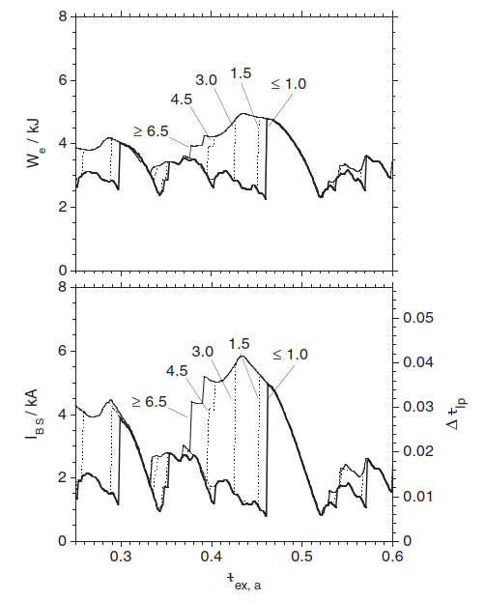
magnetic shear (from low Ip) heals the poor confinement
Brakel and W7AS team 2002 Nucl. Fusion
evolving plasma current
evolving bootstrap current literally may bootstrap confinement ... model calcutations
I_{BS} of initial state
4 10¹⁹ m⁻³, 400kW ECRH
-> slow timescale following current redistribution time and confinement timescales <-> H-mode

Slide 10
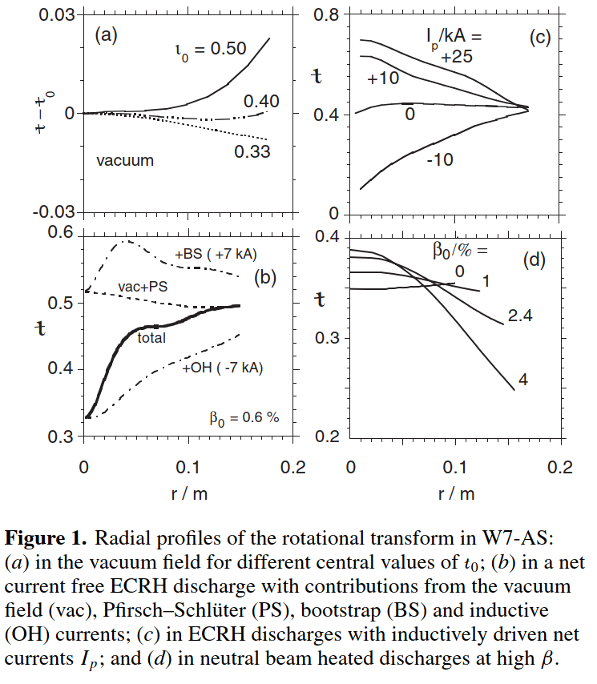
magnetic shear
vacuum
Brakel and W7AS team 2002 Nucl. Fusion
iota scans around iot=1/2 with different Ohmic current
Ip<+-30kA indiced achived by Ohmic transformer does not provide significant heating
P_{ECRH}=450kW, 4 10¹⁹m⁻³, W mainly from elctrons Te~2keV ,Ti<450eV
inward shifted limiters to get constant minor radius by cutting edge islands and inhibit H-mode
right: expectations according model l
ECRH + currents
high-beta NBI
-> by increasing shear (“radially squeeze the islands”) the dependency is smoothed
-> independent on the sign of the shear
-> not clear which particular perturbations associated with the rationals are responsible

Slide 11
-> what happens with higher beta / NBI ?
-> iota dependencis from TJ-II and Heliotron-J ?
-> What about the H-mode iota windows ?

