Slide 1
Yacora meets Eirene:
Inclusion of molecular source term
F.Cianfrani

Slide 2
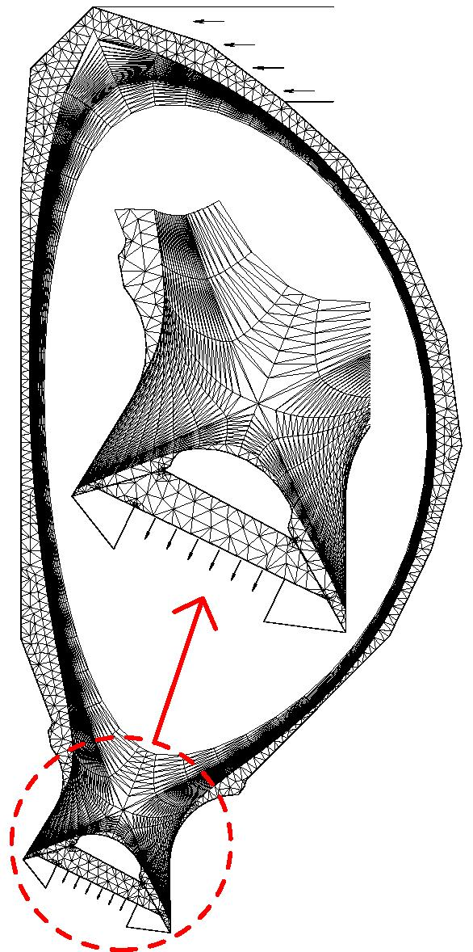
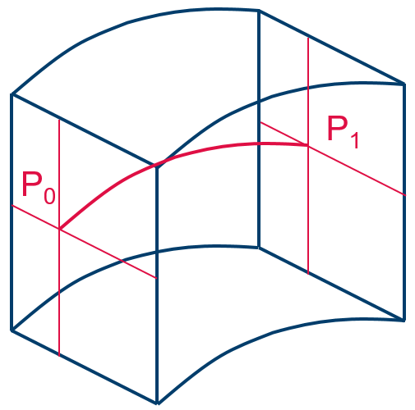
What is EIRENE in a nutshell (e.g. in SOLPS)?
Macroscopic:
Microscopic:
Plasma flow parameters
EIRENE-NGM: a 3D3v MC multi-species transport code incl. radiation transfer, kinetic
or F-K hybrid.
CFD codes (computational fluid dynamic):
B2, Edge2D, EMC3, SOLEdge3X, etc…
3D EIRENE volume cell
2D or 3D Volume grid (e.g. tetraeder) adopted for current magnetic configuration
Source terms (Particle, Momentum, Energy)
CRMs
(HYDKIN, AMJUEL, ADAS, …)
for atomic and molecular neutrals H,H*,H₂,H₂(v),H₂*,H⁻,H₂⁺,…, impurities
Ionisation, CX, recombination etc.

Slide 3
ITER: (semi-)detached regime is foreseen
ITER Divertor is highly dissipative (mainly by radiation)
Detachment means that both heat and ion fluxes are extinguished at the wall (divertor target)
Heat conduction zone
Impurity radiation zone
H⁰/D⁰/T⁰ ionization zone (T_{e} > 5 eV)
Neutral friction zone
Recombination zone (T_{e} < 1 eV)
This general picture of the detachment onset is partially a result of decades-long studies including systematic EIRENE modelling.
Courtesy R.A.Pitts

Slide 4
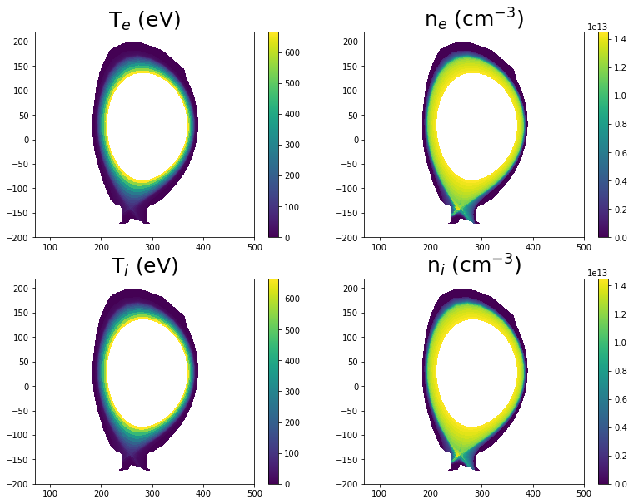
Eirene: edge2D JET simulations
2D simulations from JET runs
Particle species

Slide 5
Eirene: edge2D JET simulations
2D simulations from JET runs
Particle species
inclusion molecular deuterium
source term
Gas puffing

Slide 6
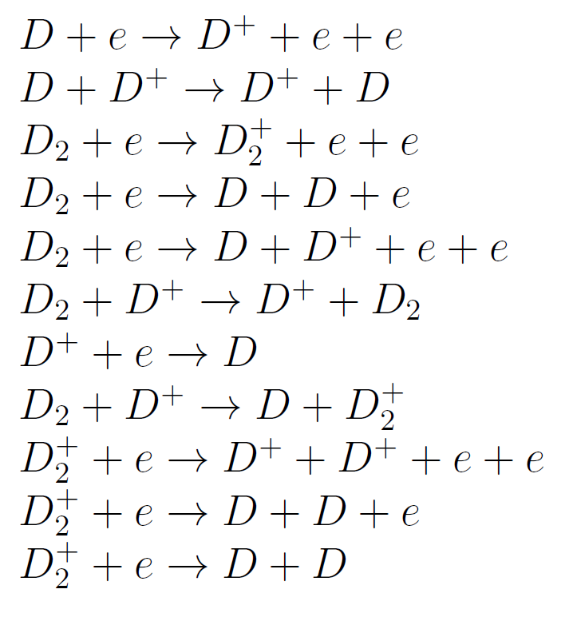
Eirene: edge2D JET simulations
2D simulations from JET runs
Reactions

Slide 7
Eirene: edge2D JET simulations
2D simulations from JET runs
Reactions
electron ionization

Slide 8
Eirene: edge2D JET simulations
2D simulations from JET runs
Reactions
molecular dissociation

Slide 9
Eirene: edge2D JET simulations
2D simulations from JET runs
Reactions
charge exchange

Slide 10
Eirene: edge2D JET simulations
2D simulations from JET runs
Reactions
recombination

Slide 11
Eirene: edge2D JET simulations
2D simulations from JET runs
Reactions
Molecular ions react.

Slide 12
Eirene: edge2D JET simulations
2D simulations from JET runs
Reactions
AMJUEL, ADAS, HYDEL

Slide 13
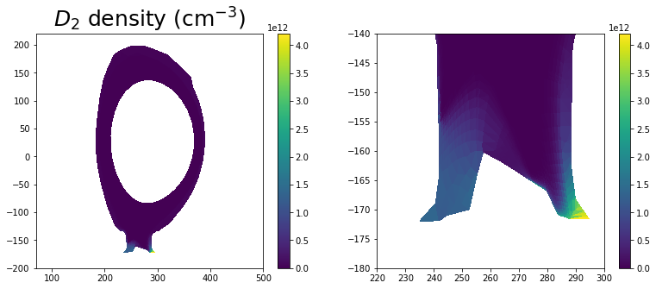
Eirene: edge2D JET simulations
2D simulations from JET runs
results:

Slide 14
Eirene: edge2D JET simulations
2D simulations from JET runs
results:
maximal density near targets

Slide 15
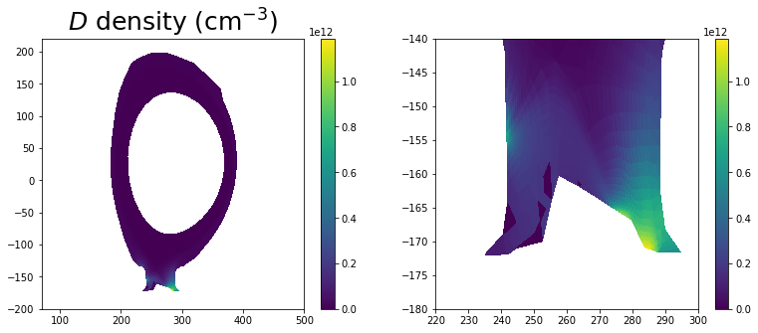
Eirene: edge2D JET simulations
2D simulations from JET runs
results:
maximal density more internal

Slide 16
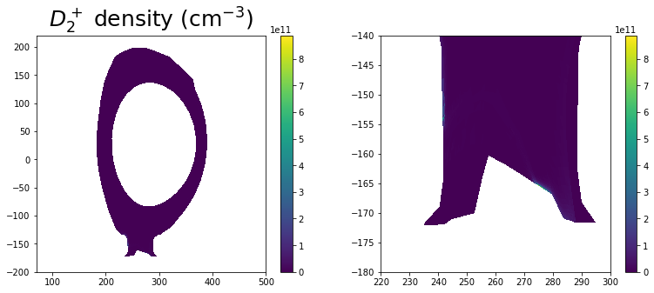
Eirene: edge2D JET simulations
2D simulations from JET runs
results:

Slide 17
Yacora: inclusion molecular source term
Stationary Yacora run with:

Slide 18
Yacora: inclusion molecular source term
Stationary Yacora run with:
Particle species

Slide 19
Yacora: inclusion molecular source term
Stationary Yacora run with:
Particle species
Bulk ion (fixed density)

Slide 20
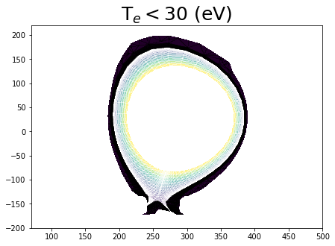
Yacora: inclusion molecular source term
Stationary Yacora run with:
Particle species
Bulk ion (fixed density)

Slide 21
Yacora: inclusion molecular source term
Stationary Yacora run with:
Particle species
fixed vanishing density

Slide 22
Yacora: inclusion molecular source term
Stationary Yacora run with:
Particle species
Source term (see below)

Slide 23
Yacora: inclusion molecular source term
Stationary Yacora run with:
Particle species
Reactions

Slide 24
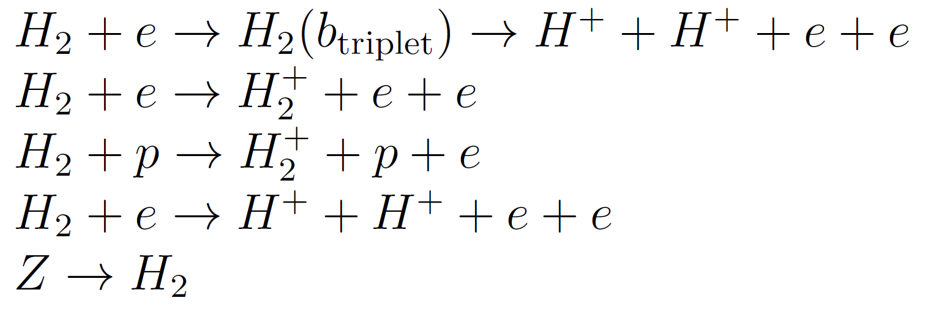
Yacora: inclusion molecular source term
Stationary Yacora run with:
Particle species
Reactions
fixed density
H₂ source term

Slide 25
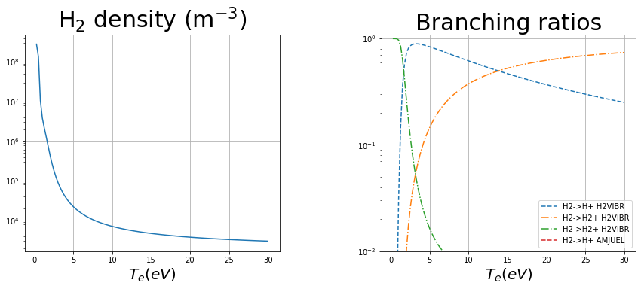
Yacora: inclusion molecular source term
Stationary Yacora run:
results
source= 10²¹ m⁻³s⁻¹

Slide 26
Yacora: inclusion molecular source term
Stationary Yacora run:
results
source= 10²¹ m⁻³s⁻¹
Density peak at small temperature

Slide 27
Yacora: inclusion molecular source term
Stationary Yacora run:
results
source= 10²¹ m⁻³s⁻¹
Density peak at small temperature
dissociation by proton impact

Slide 28
Eirene: edge2D JET simulations
2D simulations from JET runs vibrationally resolved
Particle species

Slide 29
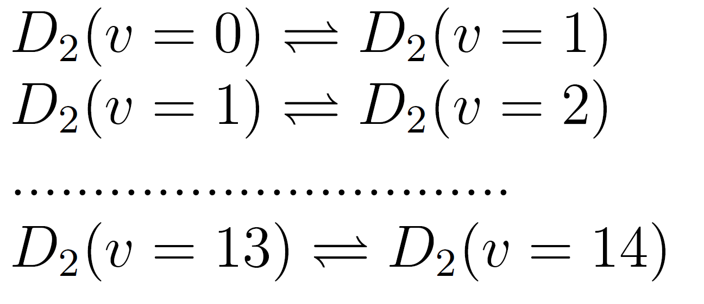
Eirene: edge2D JET simulations
2D simulations from JET runs vibrationally resolved
Reactions

Slide 30
Eirene: edge2D JET simulations
2D simulations from JET runs vibrationally resolved
Reactions
H2VIBR

Slide 31
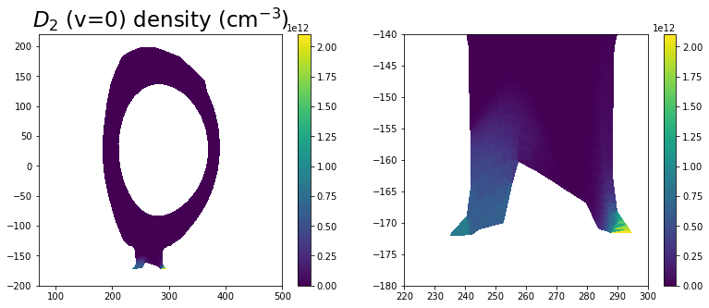
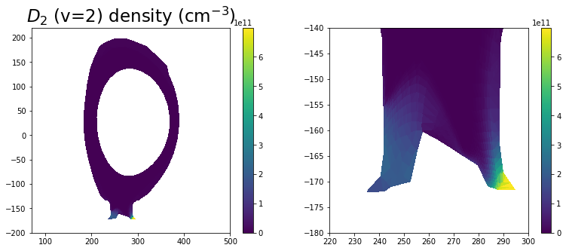
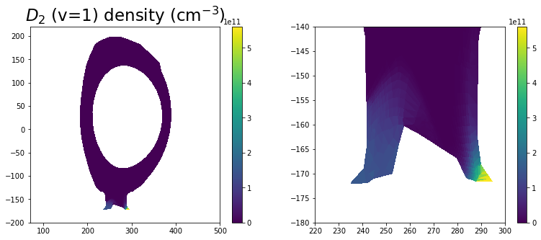
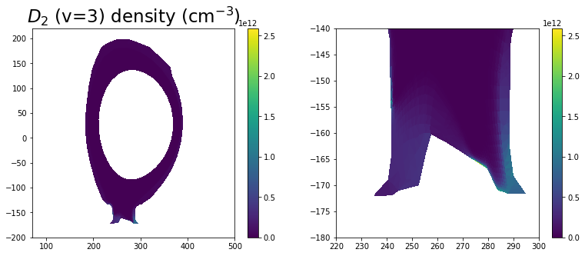
Eirene: edge2D JET simulations
2D simulations from JET runs vibrationally resolved:
results:

Slide 32
Eirene: edge2D JET simulations
2D simulations from JET runs vibrationally resolved:
results:
Population inversion

Slide 33
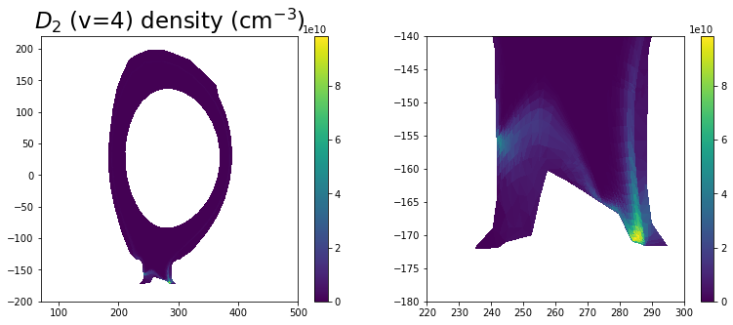
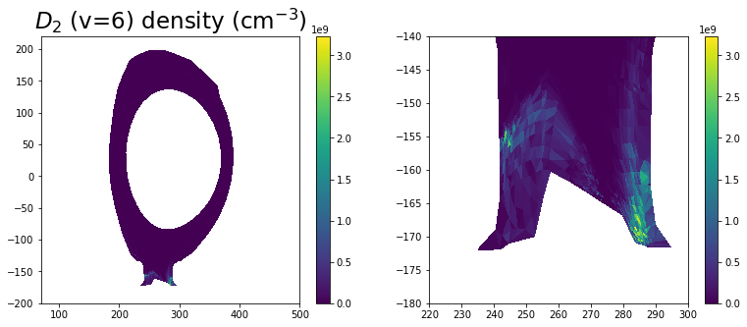
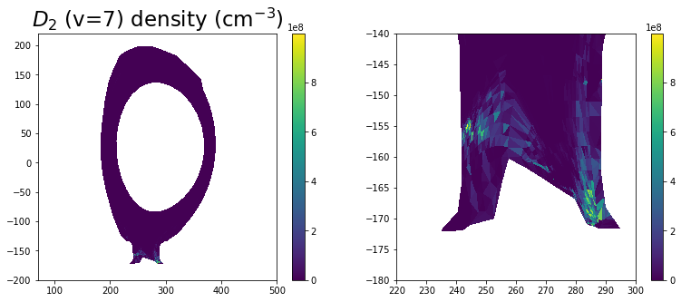
Eirene: edge2D JET simulations
2D simulations from JET runs vibrationally resolved:
results:

Slide 34
Yacora: inclusion molecular source term
Stationary Yacora run vibrationally resolved with:
Particle species

Slide 35
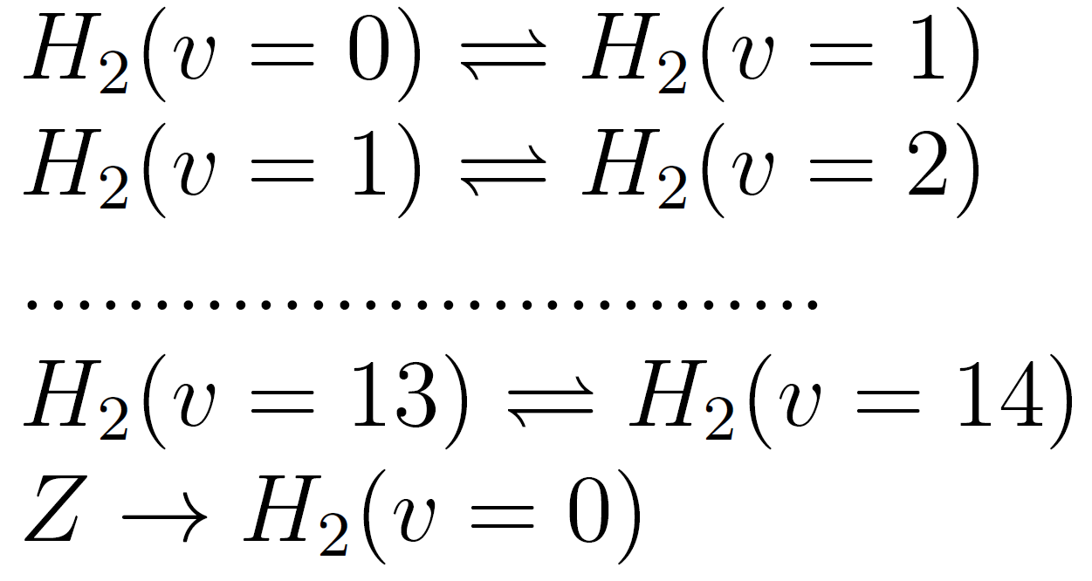
Yacora: inclusion molecular source term
Stationary Yacora run vibrationally resolved with:
Particle species
Reactions

Slide 36
Yacora: inclusion molecular source term
Stationary Yacora run vibrationally resolved with:
Particle species
Reactions
only ground state source

Slide 37
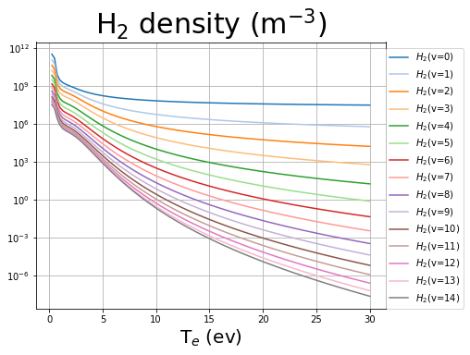
Yacora: inclusion molecular source term
Stationary Yacora run vibrationally resolved with:
results
source= 10²¹ m⁻³s⁻¹

Slide 38
Yacora: inclusion molecular source term
Stationary Yacora run vibrationally resolved with:
results
source= 10²¹ m⁻³s⁻¹
Density peak at small temperature

Slide 39
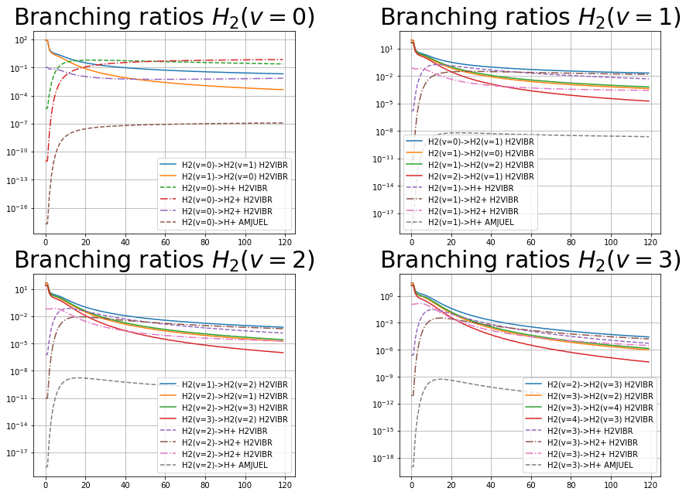
Yacora: inclusion molecular source term
Stationary Yacora run vibrationally resolved with:
results
source= 10²¹ m⁻³s⁻¹

Slide 40
Yacora: inclusion molecular source term
Stationary Yacora run vibrationally resolved with:
results
source= 10²¹ m⁻³s⁻¹
Vibrational transitions relevant at low temperature

Slide 41
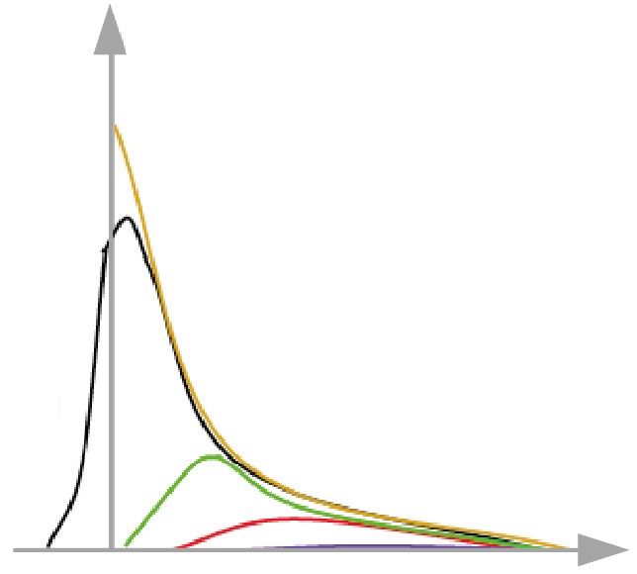
Outlook
Predictive modelling set of cases for ITER and DEMO detachment control
detached/semi-detached/detached cases?
q||
Adapted from A. Kallenbach et al., Nucl. Fusion 55 (2015) 053026
Midplane
Attached
Strongly detached
Fully detached
Partially detached
r – r_{sep} (omp)

Slide 42
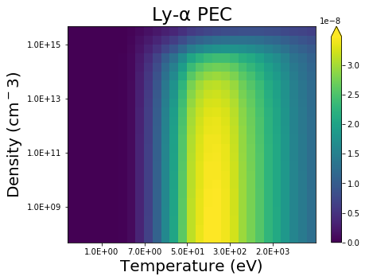
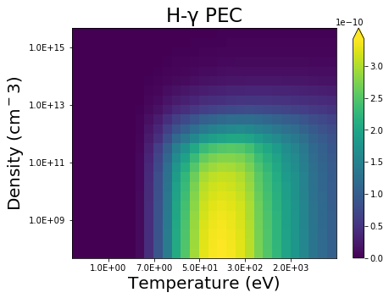
Outlook
Predictive modelling set of cases for ITER and DEMO detachment control
detached/semi-detached/detached cases?
Simulate Ly-α/D-γ for a set of sightlines?.. Other hydrogenic spectroscopy incl. molecular? …
$$I\left[\frac{ph}{{cm}^{3}∙sr∙s}\right]=\frac{1}{4π}ε$$
$$ε_{i→j}≈$$
$$≈n_{e}∙{PEC }_{i→j}^{excit}∙N^{H}+$$
$$+ n_{e}∙{PEC }_{i→j}^{recomb}∙N^{H^{+}}$$
Neglecting
MS, CX, MAR, MAD, etc.

Slide 43
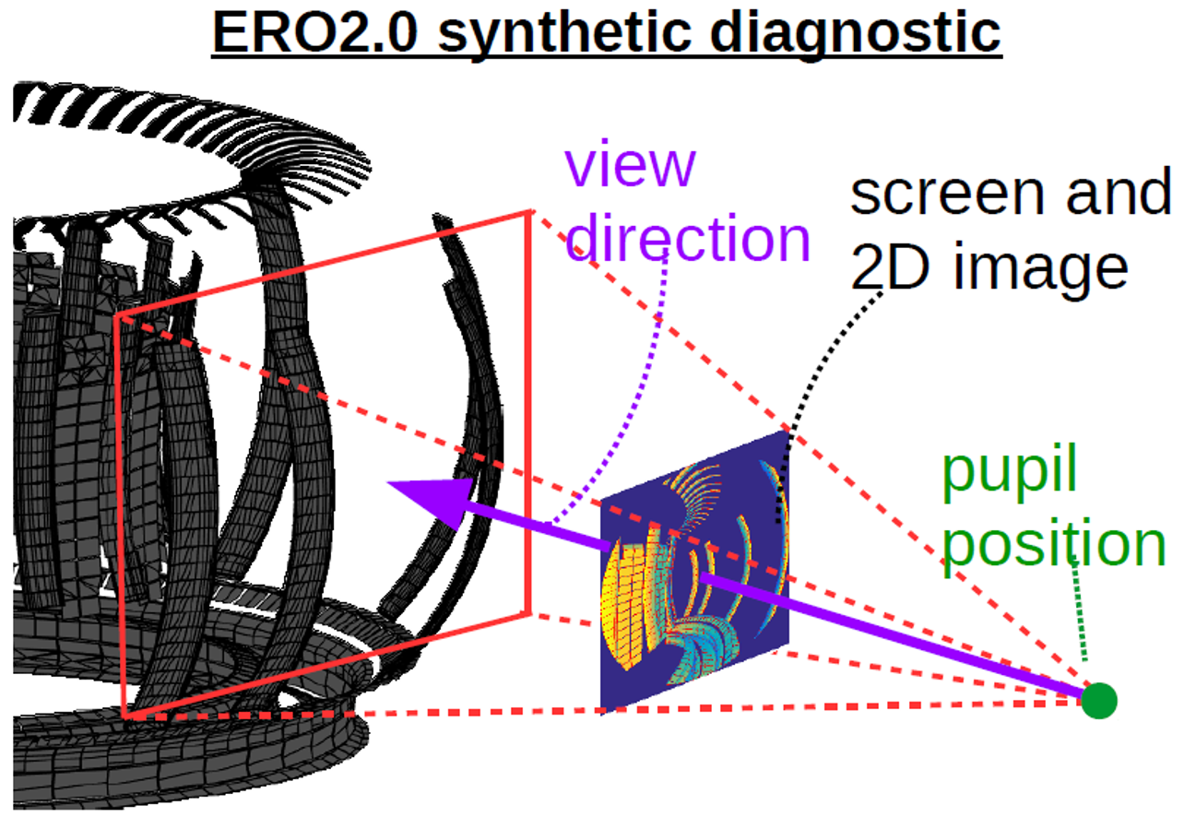
Outlook
Predictive modelling set of cases for ITER and DEMO detachment control
detached/semi-detached/detached cases?
Simulate Ly-α/D-γ for a set of sightlines?.. Other hydrogenic spectroscopy incl. molecular? …
Test impact of opacity (also with and w/o with reflection)
3D-integration of line intensities for 2D cameras

Slide 44
Thanks for the attention!

