Slide 1
Detachment subgroup
Kick-off meeting

Slide 2
Detachment
Status of the OP1.2 results
Experiments for OP2
Input for proposals

Slide 3
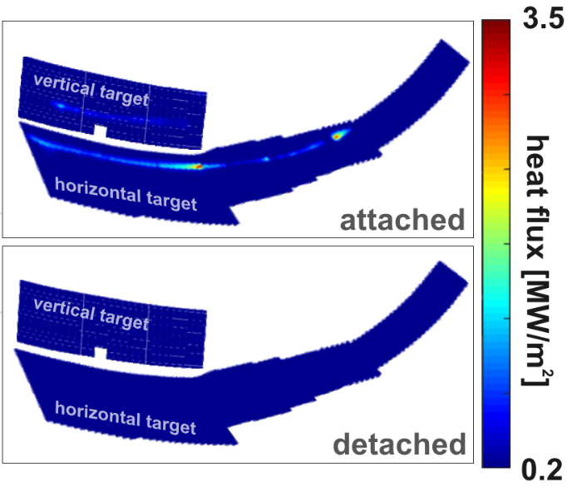
Stable detachment regime
Radiated power fraction of 80-90%
Drop in diamagnetic energy ≲10 %
Constant Z_{eff} ≈ 1.5
Sufficient sub-divertor pressure
Virtually no convective loads to the target.
detachment
Notes:
Detachment at W7-X can be achieved by increasing plasma radiation to the level ca. 80% of total input power by raising the plasma density. This is very reliable mechanism. In fact, the most successful detached discharge run on the uncooled W7-X divertor till now, remained stable, completely detached for 26s. The peak power load was reduced to about 1/10th such that without rescaling of the colour code one can’t make out the strike line anymore. ….

Slide 4
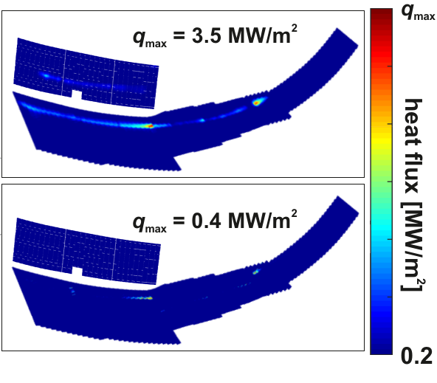
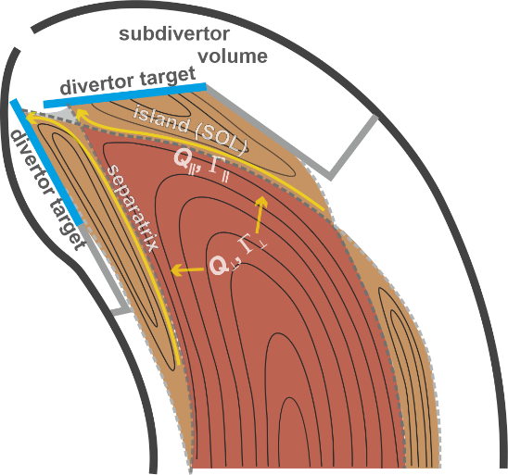
Stable detachment regime
Radiated power fraction of 80-90%
Drop in diamagnetic energy ≲10 %
attached
Constant Z_{eff} ≈ 1.5
detached
Sufficient sub-divertor pressure
Virtually no convective loads to the target.
detachment
[O. Schmitz, et al., Nucl. Fusion 61 (2021) 016026]
Notes:
After reducing the scaling by nearly an order of magnitude, one can just about see the remains of the strike lines. The discharge was run at 5.5 MW ECRH heating in O2-mode with feedback controlled line integrated density of about 1 1020 m-2. Zeff remained constant at 1.5. The radiated power fraction stayed at about 80-90 % and the diamagnetic energy dropped only by about 10%. The sub-divertor neutral pressure measured at the entrance to the pumping gap rose slightly to comfortable 0.07 Pa with the compression factor between 20 and 30. This level of neutral compression enabled stable density control as shown in the next slide.

Slide 5
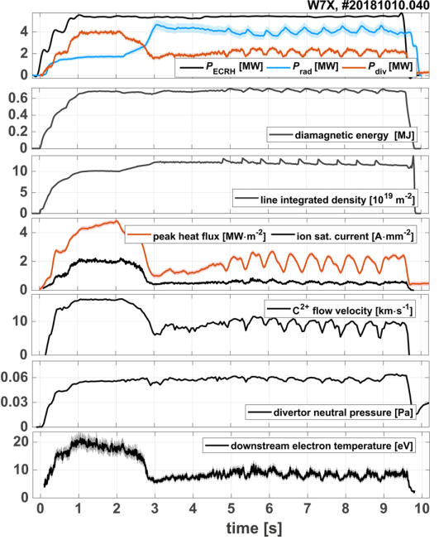
Neutral pressure sufficient for steady-state density control at W7-X
detachment
Notes:
we plan to use pellet injection as a main tool to control plasma density in a steady-state discharges. Therefore, it was important to achieve stable detachment in plasmas fuelled with pellets. In the previous campaign our pellet injector could inject only few tens of pellets in one program as presented in this discharge. Here, the transition to detachment occurs between 2 and 3 s. Starting from ca. 5 s 9 pellets were injected with 2 Hz frequency into the plasma. As you can each pellet increased plasma radation from ca. 70% to 80-90% and by that affected all downstream parameters, peak heat and recycling flux, bulk plasma flow, plasma temperature at the target, which dropped to ca. 5 eV and to only small extent neutral pressure at the divertor entrance

Slide 6

Neutral pressure sufficient for steady-state density control at W7-X
detachment
Notes:
. This shows that neutral density near divertor target is to large degree detached from the upstream plasma. This is encouraging and lead to the particle balance close to what we need in the next campaign. Namely total fueling rate, which in discharge consist of fueling rate by divertor gas injection (dashed line) and pellet injector (each pellet is indicate as a square point) was on the level of the total pumping rate. In the next campaign we plan to increase our pumping capabilities by more than a factor of four by instaling cryo-pumps. This will give us more flexibility to develop steady-state detached scenarios. Now let‘s have a look in more details what happens in SOL as we transition to detachment.

Slide 7
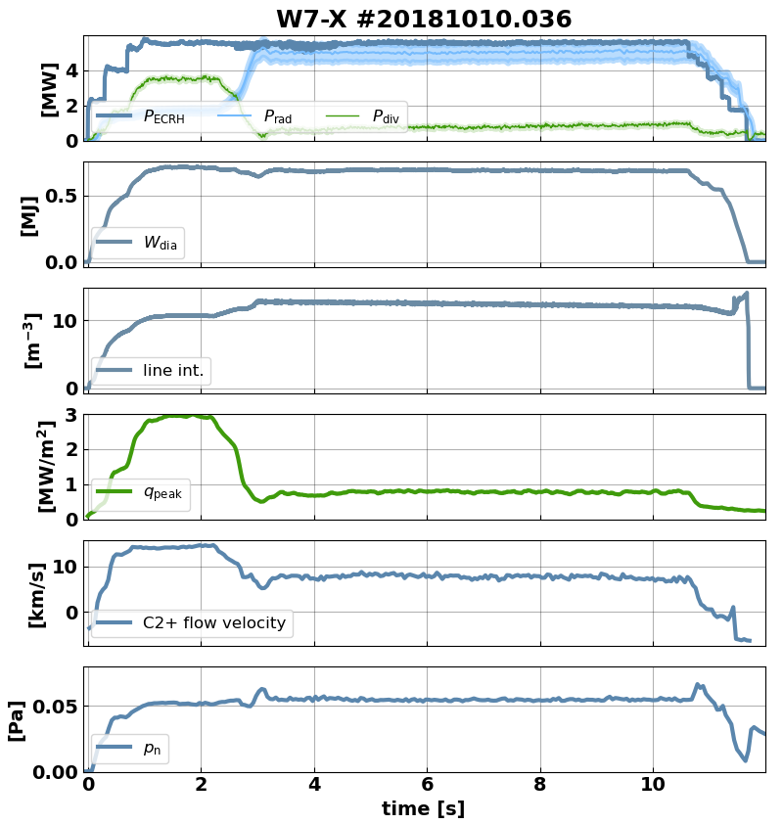
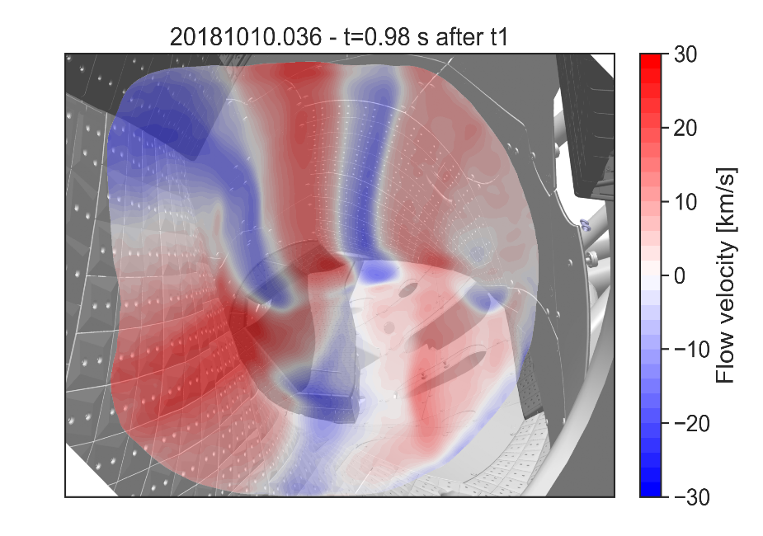
Plasma flows en-route to detachment
detachment
attached, C2+ flow
V. Perseo, this conference,
[V. Perseo, et al., Nuclear Fusion 59, 124003 (2019)]
Notes:
The flow measurement at W7-X is perfrormed by coherence image spectroscopy. In a toroidal view, it measures the Doppler shift of carbon ions, which serve as a proxy for the bulk plasma flow. A typical picture from CIS diagnostic shows a set of counter streaming flows, which are strongly realted to island geometry. This is taken at t = 1 s, still in the attached phase. ….

Slide 8
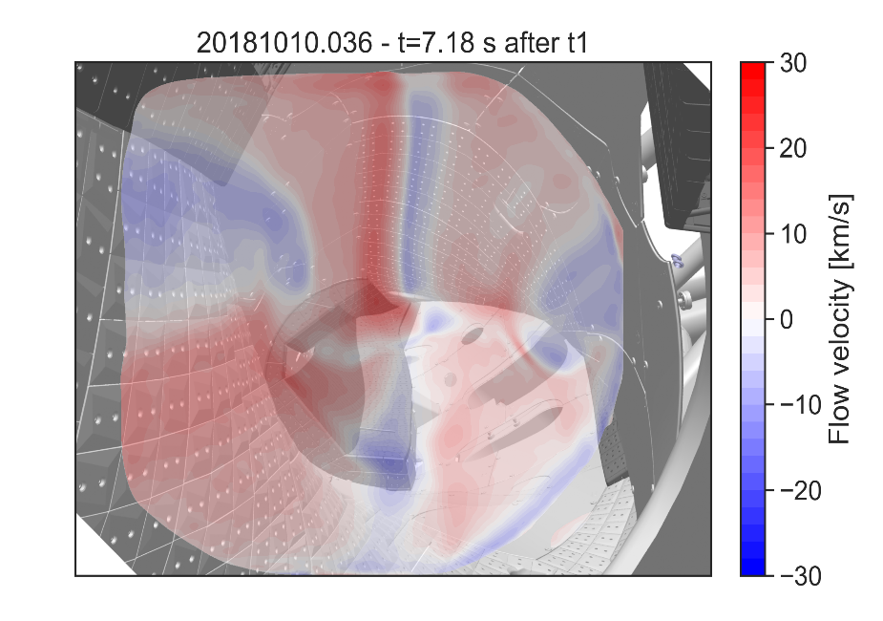
Plasma flows en-route to detachment
detachment
attached, C2+ flow
detached , C2+ flow
[V. Perseo, et al., Nuclear Fusion 59, 124003 (2019)]
Notes:
… During transition to detachment , which happens in this discharge at t ca. 3 s, we have observed that the counter streaming flows are decreasing (as shown in this graph). Please note that the measurement follows C3 spectral line intensity emitted in the electron temperature range between 10 and 20 eV. This means that CIS image of flows during detachment shows region closer to the upstream region folowing the region og hydrogen ionization. Contrary to our predecessor W7-AS, at W7-X islands are large enough , therefore those counter-streaming flows do not contribute to the momentum dissipation in the scrape-off layer.

Slide 9
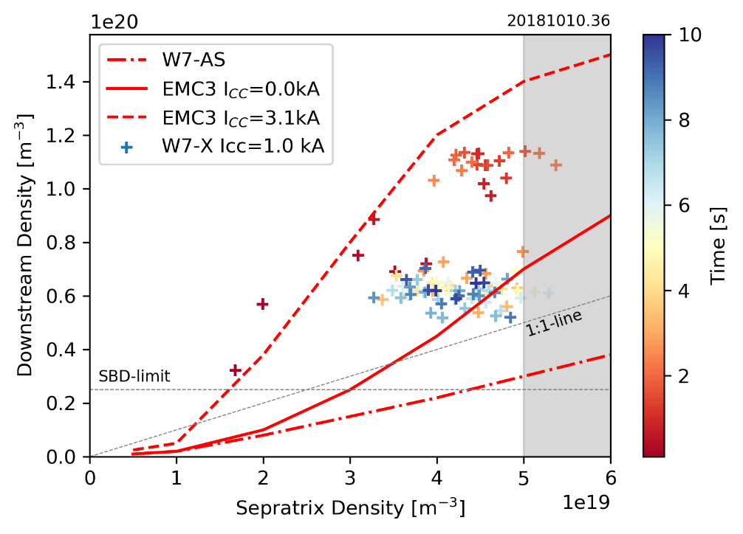
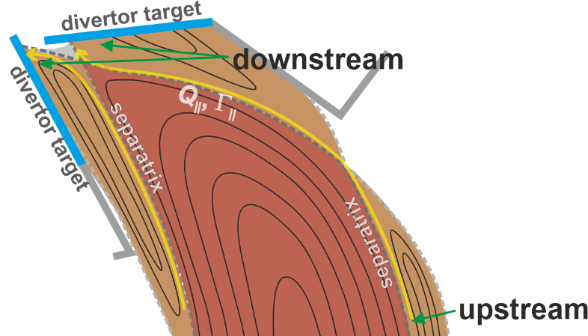
Higher recycling on transition to detachment
detachment
F. Reimold, this conference
Notes:
This enabled access to higher recycling en-route to detachment. On this graph downstream plasma density is plotted against separatrix density. The data of downstream density was obtained from spectroscopy of Balmer-alpha series (for more details visit poster of Felix Reimold). Here we see that downstream density is twice as high as compared to upstream. Such behaviour has been well predicted by EMC3-Eirene a Monte Carlo 3D fluid transport code. The high divertor densities are favorable for further power losses from impurity radiation.
At separatrix density close to 5e19 m-3 rollover and transition into detachment took place. Line ratio analysis of the Balmer lines shows that the divertor plasma during detachment is ionization dominated in virtually all cases.

Slide 10
Distribution of neutrals defines neutral influx into pumping domain
#20180814.025
detached
j_{sat} [A/mm²]
Notes:
Optimum divertor performance requires not only mitigating divertor heat loads, but also maximising sub-divertor neutral pressures and thereby particle exhaust. You see here experimental data for neutral pressure at the pumping gap (blue points) and ion saturation current measured by Langmuir probes (red points). As one can see, the highest neutral pressure behind the pumping gap is not reached at the maximum of the particle flux at frad=0.5-0.6, but at frad of 80% to 85 %. In order to understand that we need to look into simulation analysis.

Slide 11
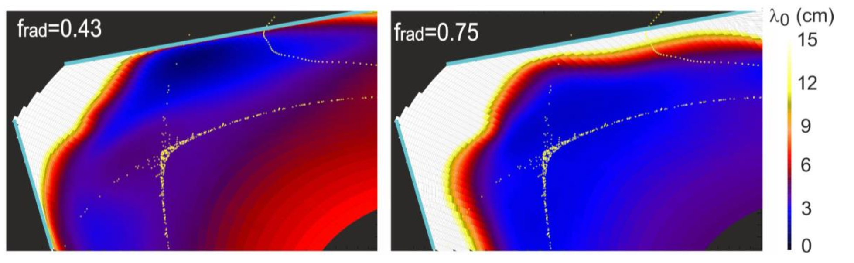

Distribution of neutrals defines neutral influx Γ_{in, H°} into pumping domain
EMC3-Eirene, Y. Feng, NF (submitted)
#20180814.025
neutral penetration length at frad = 0.43 (left) and 0.75 (right)
detached
j_{sat} [A/mm²]
attached
detached
Two effects increase neutral pressure:
Longer penetration length mainly due to lower plasma temperature (5 eV) in the islands
Notes:
As the temperatures near the divertor target drops to the level of ca. 5 eV, neutral penetration length, which is a function of plasma parameters, but also cross sections for charge exchange and ionization is changed. Results of EMC3-Eirene show that neutral penetration length near the target during detachment is much longer when compared to attached state across whole target.

Slide 12
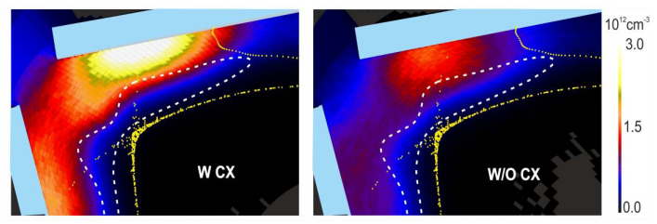
Distribution of neutrals defines neutral influx Γ_{in, H°} into pumping domain
EMC3-Eirene, Y. Feng, NF (submitted)
#20180814.025
neutral penetration length at frad = 0.43 (left) and 0.75 (right)
detached
j_{sat} [A/mm²]
attached
detached
neutral density with (left) and w/o (right) CXRS processes
detached
detached
Two effects increase neutral pressure:
Longer penetration length mainly due to lower plasma temperature (5 eV) in the islands
CXRS processes between fast ions coming from upstream and slow neutrals downstream.
Question: can we trace molecules downstream?
Notes:
Also CXRS processes of low energetic neutrals with higher temperature ions coming from the upstream lead to trajectories change of neutrals and in the effect higher concentration of neutrals near the pumping gap. To summarize: longer neutral penetration length and charge exchange interaction with ions coming from upstreams allows to increase nuetral pressure although recycling flux decreases during detachment.

Slide 13
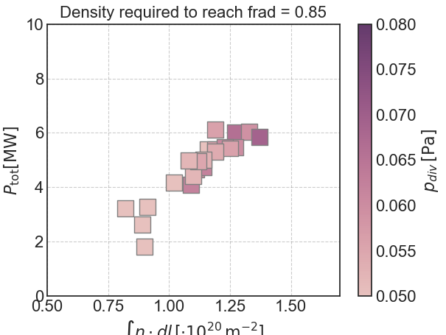
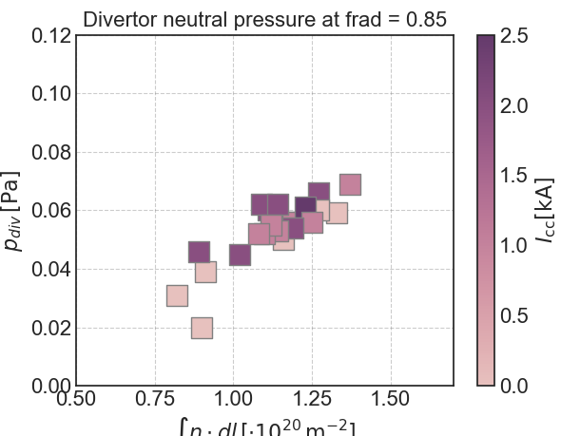
Intrinsic detachment
f_{rad} >0.8 yields detachment
Heat and particle flux detachment with large enough neutral source access to pump domain for steady state exhaust
Input power level defines density, Φ_{rec} and f_{rad} level
Φ_{rec} builds p_{n} with λ_{n} tuned by local T_{e}

Slide 14
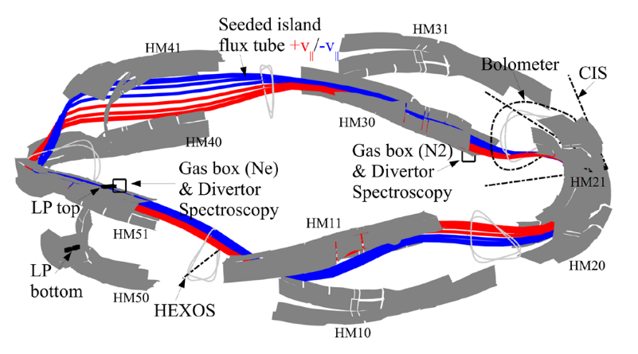
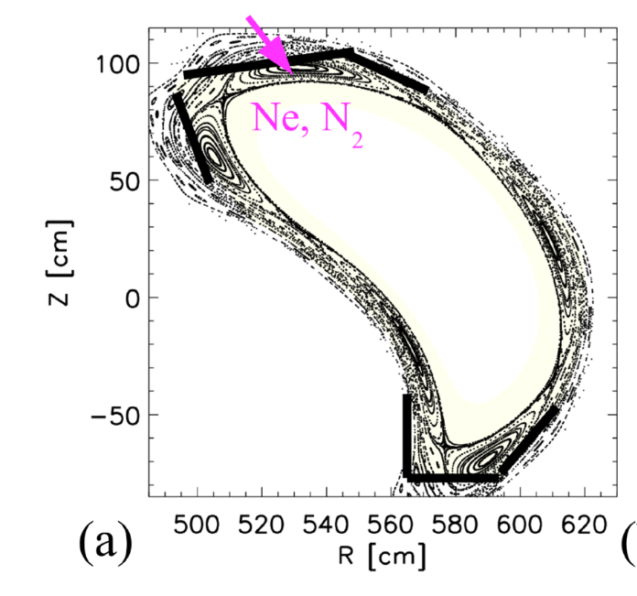
Experiments for OP2 (seeding)
Experiments were made with neon (Ne) and nitrogen (N2).
High radiative power losses (~80%) were found to reduce the divertor heat loads globally by 2/3 with both seeding gases injected at a single toroidal location into one of five magnetic islands.
Heat flux detachment was achieved for the price of a loss of (~ −15%) in the stored energy.

Slide 15
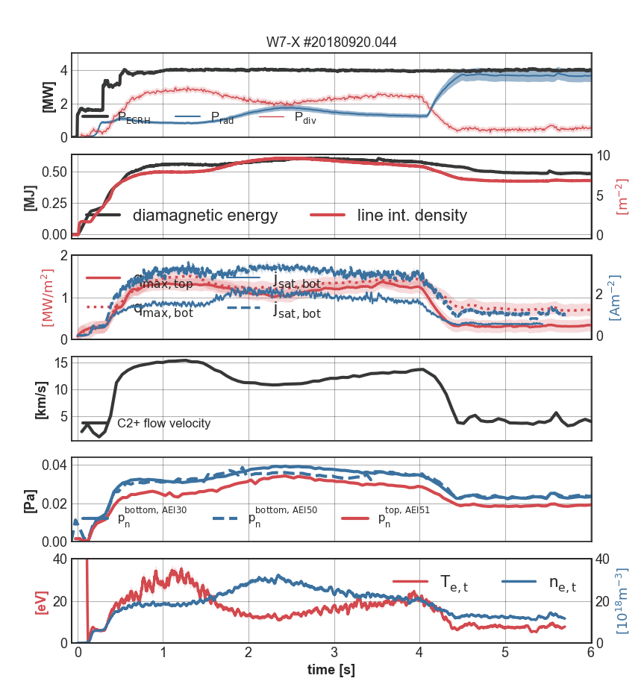
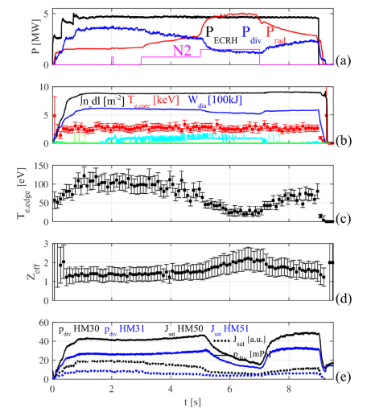
Results of the experiments
Neon seeding
Nitrogen seeding

Slide 16
f_{rad} >0.8 yields detachment
Heat and particle flux detachment with large enough neutral source access to pump domain for steady state exhaust
Input power level defines density, Φ_{rec} and f_{rad} level
Φ_{rec} builds p_{n} with λ_{n} tuned by local T_{e}

Slide 17
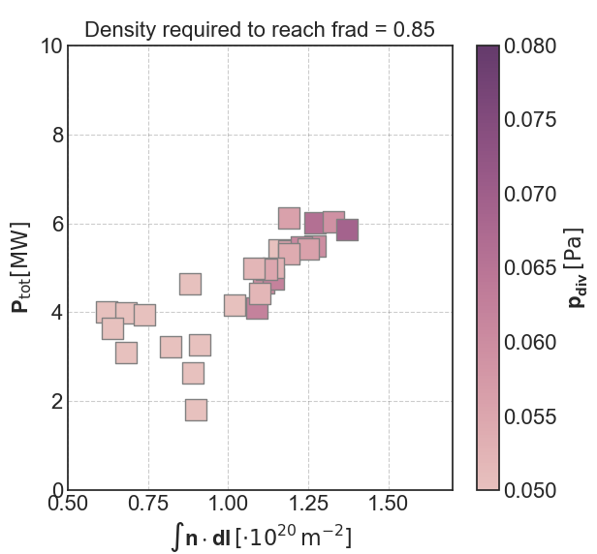
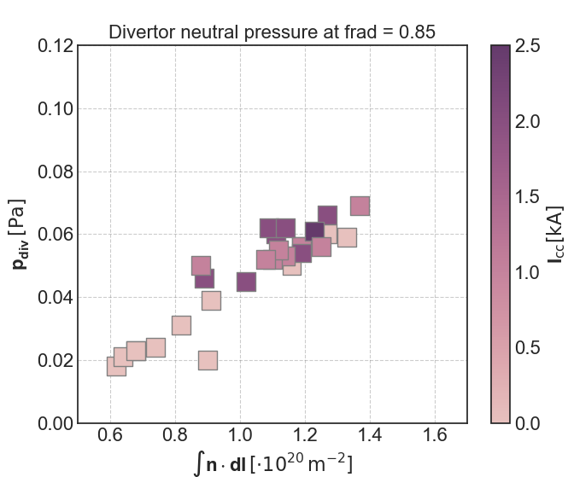
Performance in seeded discharges similar to intrinsic detachment.
seeded
seeded

Slide 18
How can I contribute?
Write down your experimental idea and send it to me.
Write down your analysis capabilities (diagnostic, code runs,…)
We will discuss the experimental ideas during in the consecutive meetings and prepare the proposals.
Input from Task Forces important.
Mind map with the experimental ideas https://mm.tt/1918710383?t=3vVL0Ox9so
Where to start:
  F. Effenberg et al., Nuclear Fusion 59, 106020 (2019). (seeding)
  O. Schmitz et al., Nuclear Fusion (2020). (experimental detachment)
  Y. Feng et al., Nuclear Fusion 61, 086012 (2021). (modelling detachment)
  M. Jakubowski et al., Nuclear Fusion 61, 106003 (2021). (experimental detachment)

