Slide 1
Core Instabilities (ETG, ITG, TEM) and Configuration Effects
Gavin M. Weir, Marc Beurskens
On behalf of the W7-X Team

Slide 2
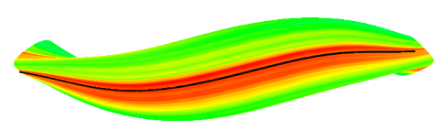
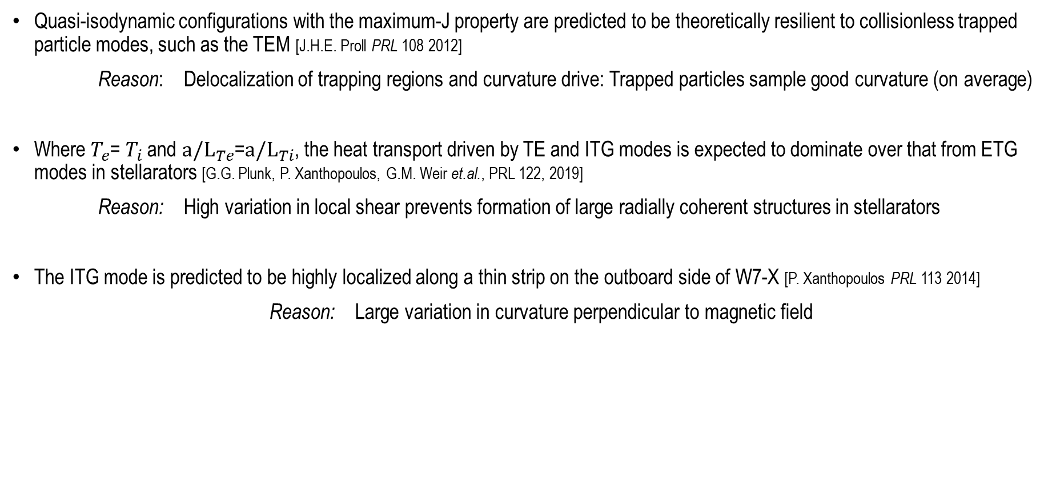
Three dimensional magnetic geometry significantly modifies the stability properties of microturbulence
Quasi-isodynamic configurations with the maximum-J property are predicted to be theoretically resilient to collisionless trapped particle modes, such as the TEM [J.H.E. Proll PRL 108 2012]
Reason: Delocalization of trapping regions and curvature drive: Trapped particles sample good curvature (on average)
Where $T_{e}$= $T_{i}$ and $a/L_{Te}$=$a/L_{Ti}$, the heat transport driven by TE and ITG modes is expected to dominate over that from ETG modes in stellarators [G.G. Plunk, P. Xanthopoulos, G.M. Weir et.al., PRL 122, 2019]
Reason: High variation in local shear prevents formation of large radially coherent structures in stellarators
The ITG mode is predicted to be highly localized along a thin strip on the outboard side of W7-X [P. Xanthopoulos PRL 113 2014]
Reason: Large variation in curvature perpendicular to magnetic field
RMS potential fluctuations in W7-X,
driven non-linearly by the ITG mode.
Courtesy P. Xanthopoulos

Slide 3
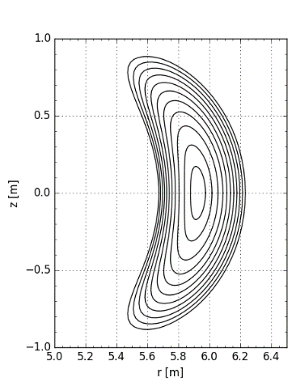
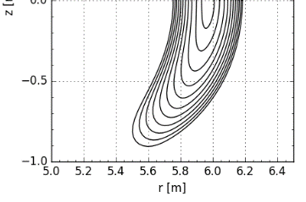
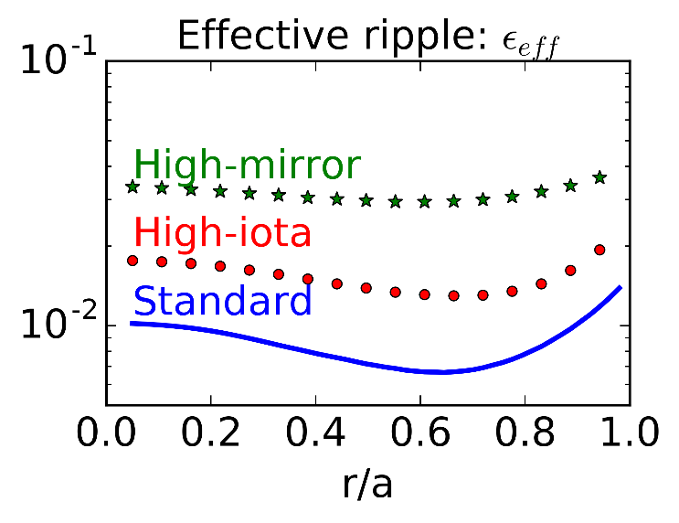
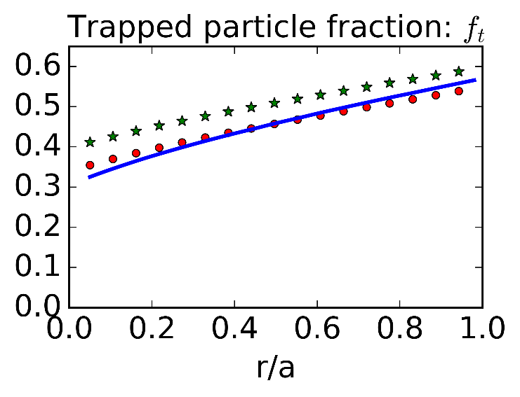
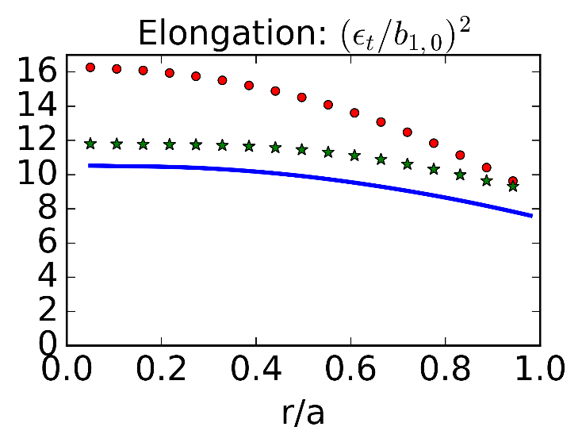
The neoclassical optimization of W7-X modifies the turbulent transport
Low-iota
Approximate quasi-isodynamicity (maximum-J) :
"high-mirror", "high-iota" > "standard" (within r/a<0.7)
Flux-surface compression (~Elongation):
  Directly modifies neoclassical transport coefficients
  Modifies real-space gradients (d/dx)
  Highly correlated with rotational-transform in W7-X
  Weakly correlated with trapped particle fraction
J.A. Alcusón et.al., PPCF, 2019.
High-iota
Notes:
Additionally, the elongation of W7-X can significantly modify the heat transport.

Slide 4
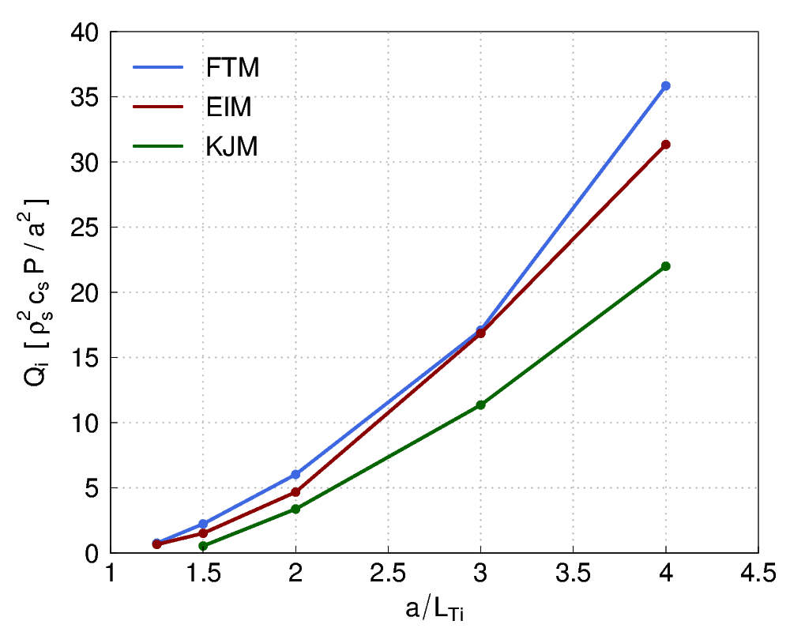


ITG driven transport is expected at low ion temperature gradient drive a/L_{Ti}~1.4
Low-iota
Approximate quasi-isodynamicity (maximum-J) :
"high-mirror", "high-iota" > "standard" (within r/a<0.7)
Flux-surface compression (~Elongation):
  Modifies real-space gradients (d/dx)
  Weakly correlated with trapped particle fraction
J.A. Alcusón et.al., PPCF, 2019.
High-iota
Standard
High-mirror
High-iota
Nonlinear electrostatic gyrokinetic simulations (GENE):
Flux surface simulations, radially local
$T_{e}=T_{i}, a/L_{n}=0, a/L_{Te}=0$
Adiabatic electrons
Turbulent ion heat flux driven by ITG turbulence
Courtesy P. Xanthopoulos
  The Gyrokinetic Electromagnetic Numerical Experiment [Jenko et al. PPCF 47 (2005)]
$$a/L_{Ti}$$
Notes:
Additionally, the elongation of W7-X can significantly modify the heat transport.

Slide 5
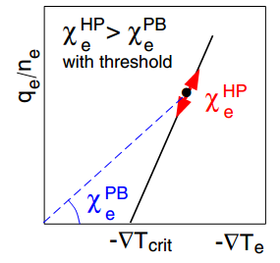

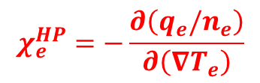

Profile resiliency is observed in tokamaks, but not in conventional stellarators
Profile resiliency is the manifestation of stiffness in the electron heat flux
  The ratio of the heat pulse to power balance diffusivity quantifies profile resiliency:
Gyrokinetic modeling indicates that stiffness is driven by turbulent microinstabilities such as the ETG, ITG, and TEM
→ Characterizing electron heat transport via heat pules propagation: Stiffness in the electron heat flux?
→ Characterizing ion heat transport via power balance measurements: Stiffness in the ion heat flux?
  Tokamaks with profile resiliency:
  $$χ_{e}^{HP}/χ_{e}^{PB}≥4$$
  Conventional stellarators:
  $$χ_{e}^{HP}/χ_{e}^{PB}≤2$$
$$χ_{e}^{PB}=−\frac{q_{e}}{n_{e}∇T_{e}}$$
$$χ_{e}^{HP}=−\frac{∂\left(q_{e}/n_{e}\right)}{∂\left(∇T_{e}\right)}$$
Reproduced from Ryter, PPCF 52 (2010)

Slide 6
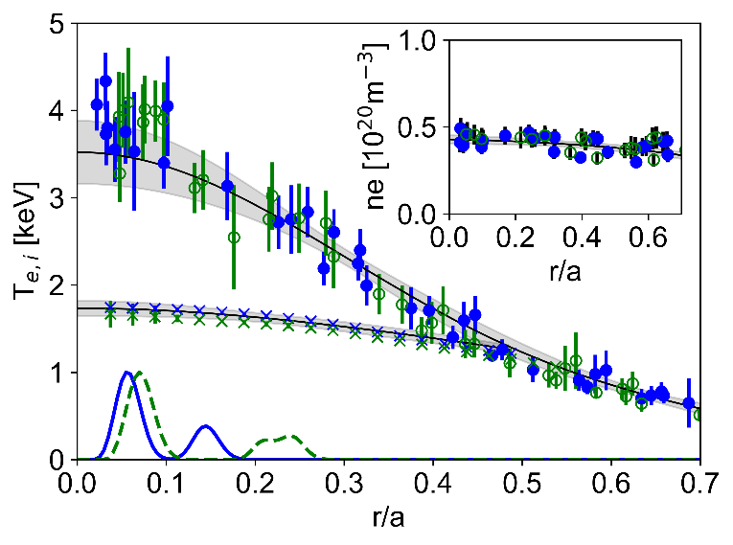
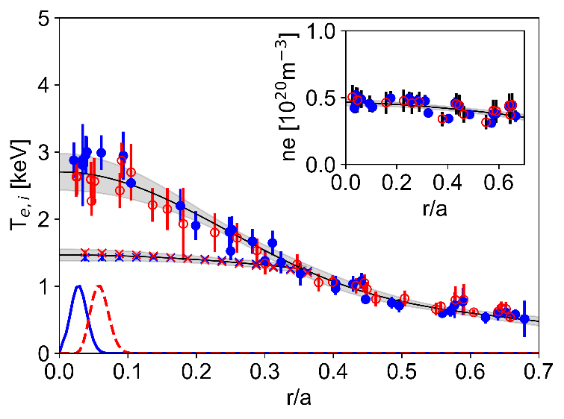
Matched kinetic profile experiments in three configurations of W7-X with varying degrees of approximate quasi-isodynamicity
Matched kinetic profile experiments are necessary to identify magnetic configuration effects on anomalous electron heat transport
Varied the ECRH power deposition location and launched power to match kinetic profiles
Standard / High-mirror
Standard / High-iota
G.M. Weir et al., Submitted to NF (2020)

Slide 7
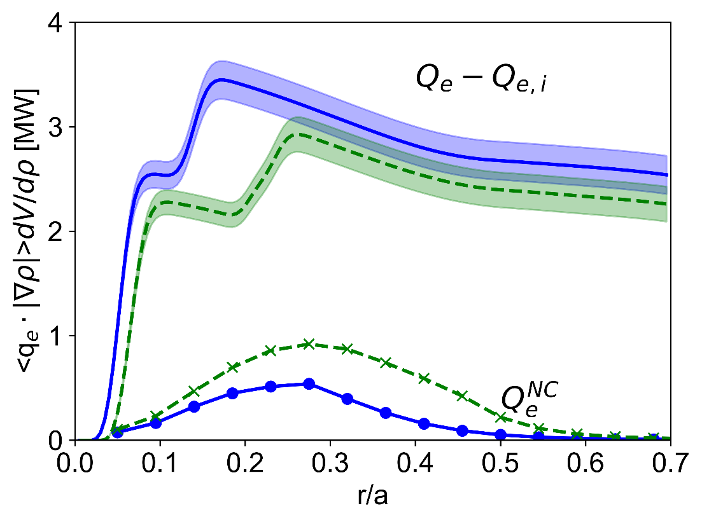
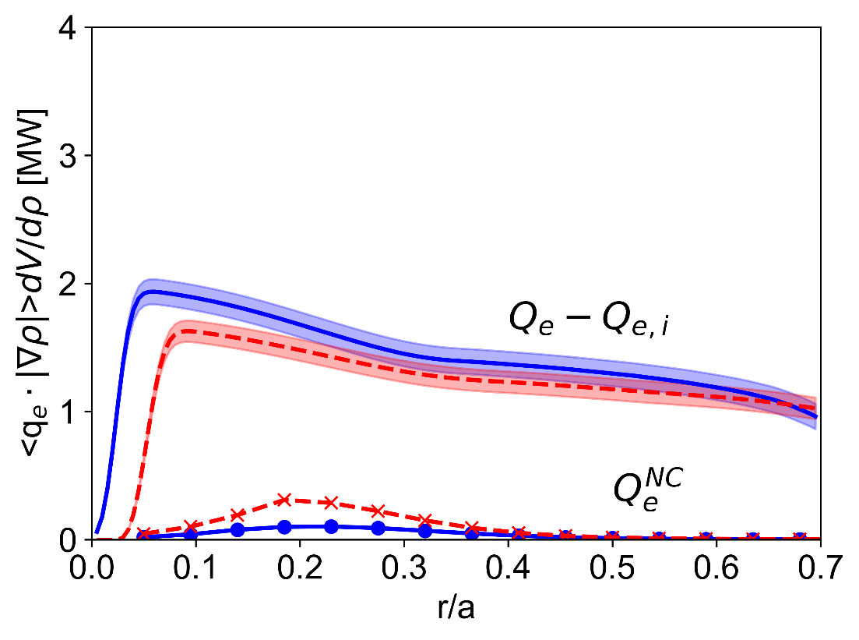
Matched kinetic profile experiments in three configurations of W7-X with varying degrees of approximate quasi-isodynamicity
Matched kinetic profile experiments are necessary to identify magnetic configuration effects on anomalous electron heat transport
Varied the ECRH power deposition location and launched power to match kinetic profiles
  The off-axis heating location corresponds approximately to the peak in the neoclassical heat flux (Standard / High-mirror)
Standard / High-mirror
Standard / High-iota
G.M. Weir et al., Submitted to NF (2020)

Slide 8
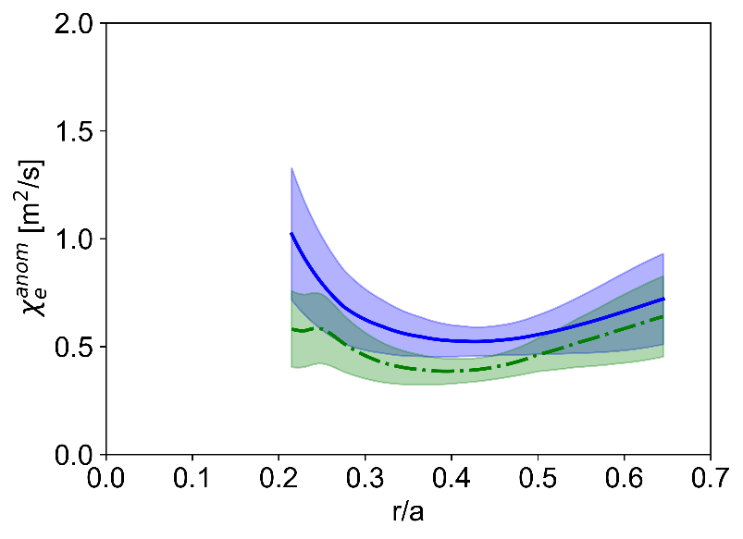
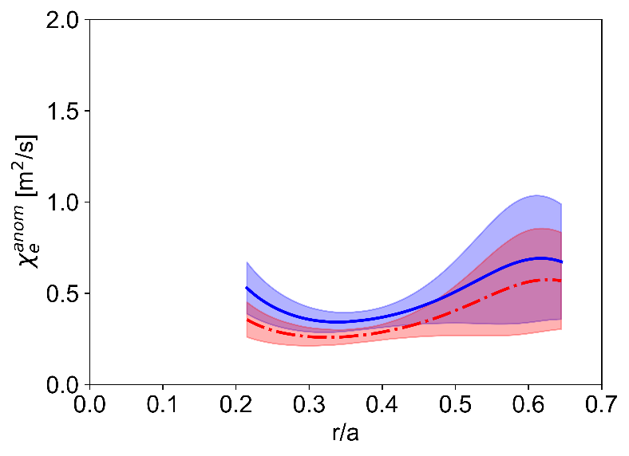





Matched kinetic profile experiments in three configurations of W7-X with varying degrees of approximate quasi-isodynamicity
The anomalous core electron heat transport increases with $∇T_{e}$, with a stiffness $1<χ_{e}^{HP}/χ_{e}^{ANO}≤1.5$
Core anomalous electron heat transport is quantitatively similar to non-linear gyrokinetic calculations of the ETG-driven heat transport where T_{e}>T_{i} and a/L_{Te} > a/L_{Ti}
Standard / High-mirror
Standard / High-iota
(0.35<r/a<0.5)
$χ_{e}^{HP}/χ_{e}^{ANO}$=1.4$±$0.2
(0.35<r/a<0.5)
$χ_{e}^{HP}/χ_{e}^{ANO}$=1.0$±$0.1
$χ_{e}^{HP}/χ_{e}^{ANO}$=1.5$±$0.2
$χ_{e}^{HP}/χ_{e}^{ANO}$=1.3$±$0.1
G.M. Weir et al., Submitted to NF (2020)

Slide 9
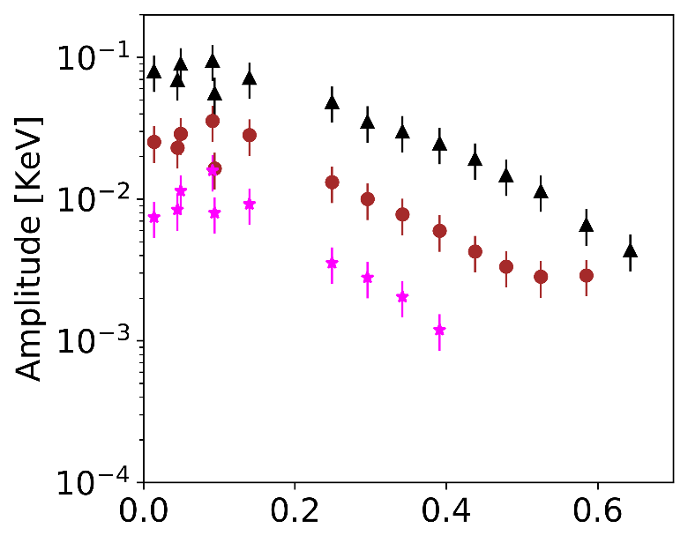
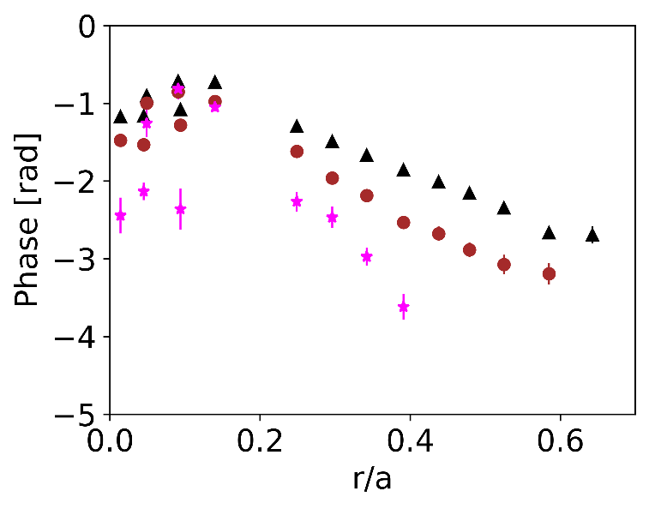
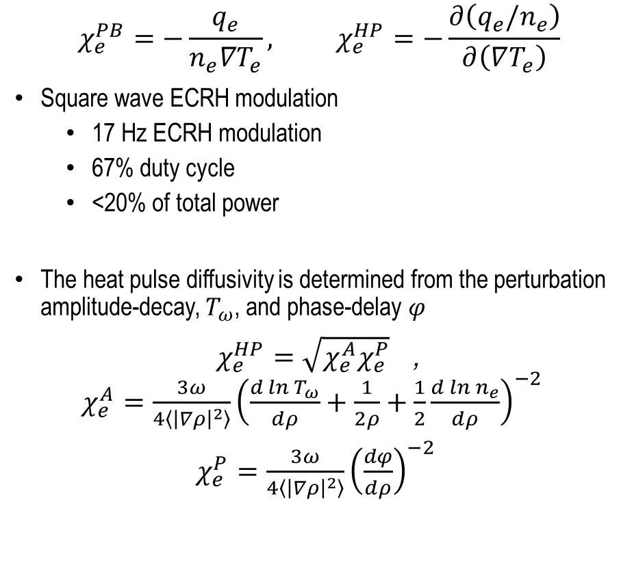
The heat pulse diffusivity is more sensitive to changes in turbulence drive than steady-state, power balance analysis
$$χ_{e}^{PB}=−\frac{q_{e}}{n_{e}∇T_{e}}, χ_{e}^{HP}=−\frac{∂\left(q_{e}/n_{e}\right)}{∂\left(∇T_{e}\right)}$$
Square wave ECRH modulation
  17 Hz ECRH modulation
  67% duty cycle
  <20% of total power
The heat pulse diffusivity is determined from the perturbation amplitude-decay, $T_{ω}$, and phase-delay $φ$
$χ_{e}^{HP}=\sqrt{χ_{e}^{A}χ_{e}^{P}}$,
$χ_{e}^{A}=\frac{3ω}{4\left\langle {\left|∇ρ\right|}^{2}\right\rangle }{\left(\frac{d\ln{T_{ω}}}{dρ}+\frac{1}{2ρ}+\frac{1}{2}\frac{d\ln{n_{e}}}{dρ}\right)}^{−2}$
$χ_{e}^{P}=\frac{3ω}{4\left\langle {\left|∇ρ\right|}^{2}\right\rangle }{\left(\frac{dφ}{dρ}\right)}^{−2}$
"Standard"-3.7
Jacchia et al., Phys. Fluids 3 (1991)

Slide 10
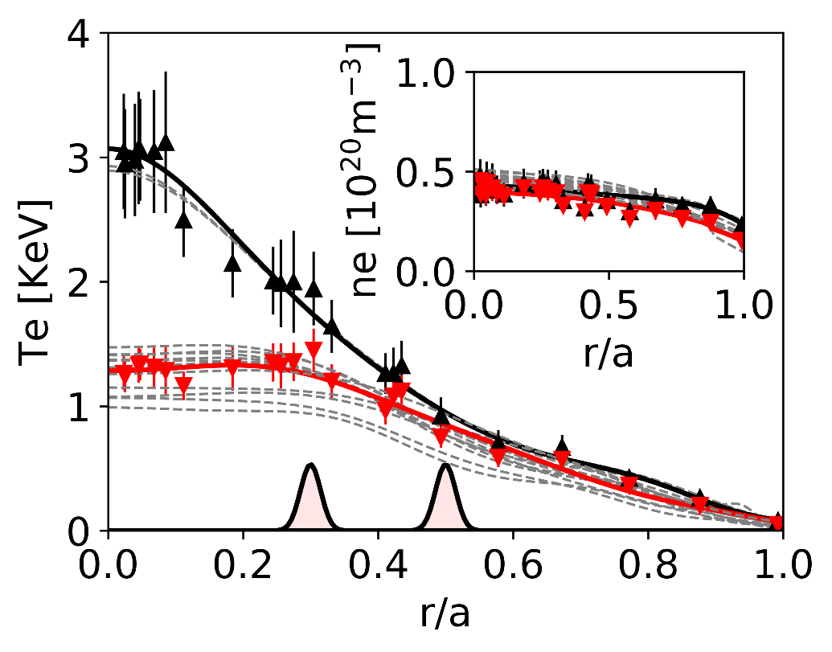
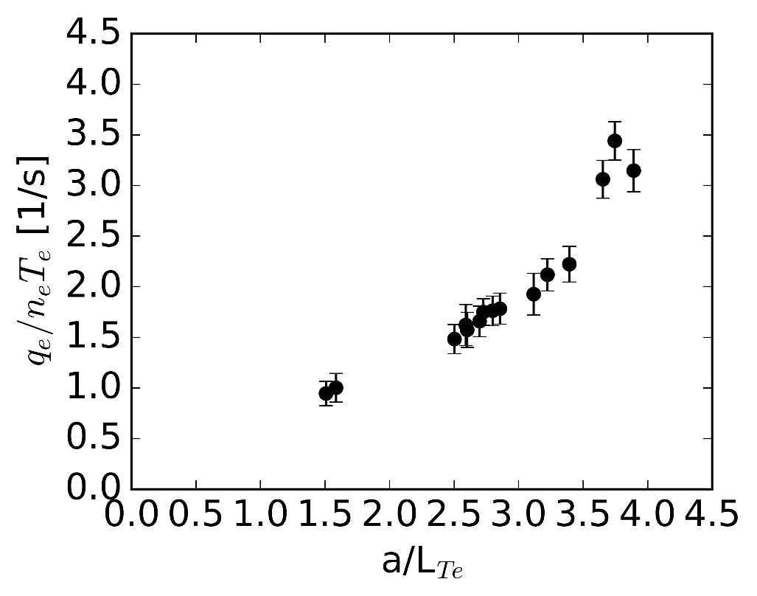


The electron heat transport is not stiff in low-$\left\langle β\right\rangle$ W7-X plasmas
The electron heat transport is not stiff in low-$\left\langle β\right\rangle$ W7-X plasmas, but it is dominated by anomalous sources
Measured stiffness is consistent with previous measurements in conventional stellarators, $χ_{e}^{HP}/χ_{e}^{PB}≤2$
The heat flux scales linearly with $∇T_{e}$ at low a/L_{Te}. With on-axis, intense ECRH the apparent stiffness increases.
$q_{e}/n_{e}=∫χ_{e}^{HP}d∇T_{e}$
[keV]
[m/s]
Electron
Temperature
Profiles
0.0 1.0 2.0 3.0 4.0
G.M. Weir et.al., Presented at ISHW (2019)
Notes:
Electron temperature

Slide 11
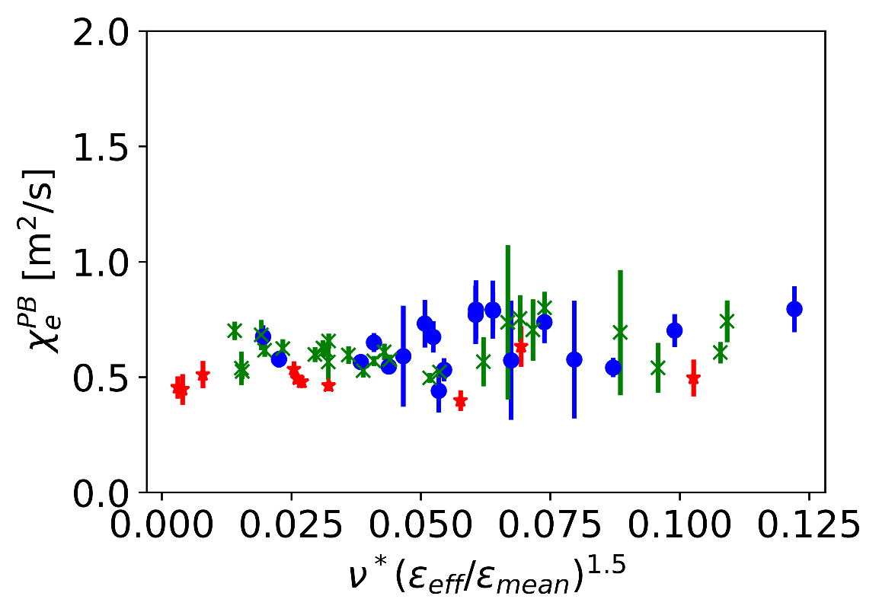
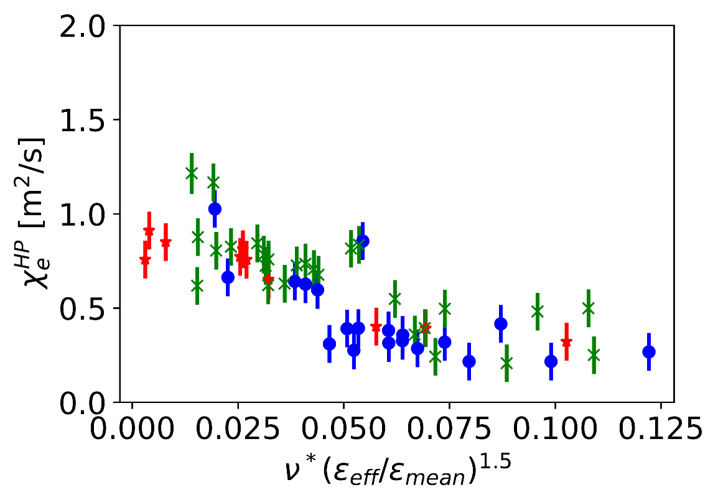

TEM modes are stabilized by collisional detrapping, while the ITG/ETG modes are unaffected by collisions
There is a change in stiffness versus effective collisionality: it is mostly due to a change in $χ_{e}^{HP}$ ($χ_{e}^{PB}$ is approximately constant),
$$ν_{eff}=\frac{ν^{∗}}{ω_{B}}=2πa\frac{ν_{ei}/ε_{eff}}{f_{tr}\left(c_{s}/a\right)ιr_{eff}}$$
The trend in $χ_{e}^{PB}$ and $χ_{e}^{HP}$ versus collisionality is similar in three magnetic configurations with varying levels of quasi-isodynamicity
(0.35<r/a<0.5)
(0.35<r/a<0.5)
High-iota
High-mirror
Standard
G.M. Weir et al., Submitted to NF (2020)

Slide 12
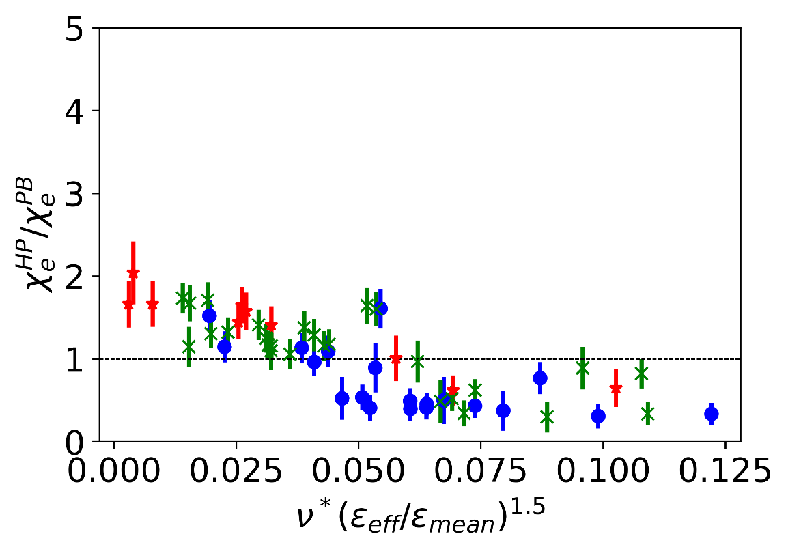
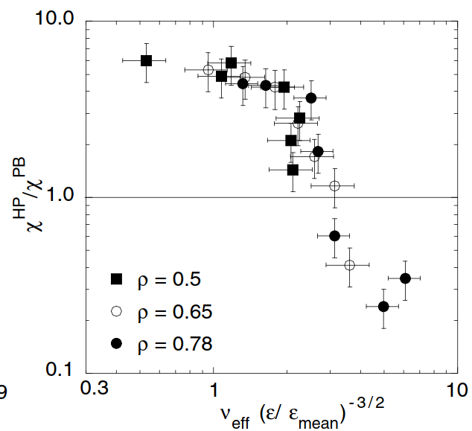

The stiffness trends downwards with increasing collisionality in W7-X
The TEM mode is stabilized by collisional detrapping; ITG/ETG modes are unaffected
The change in stiffness with collisionality is mostly due to a change in $χ_{e}^{HP}$ ($χ_{e}^{PB}$ is approximately constant)
  → Attributed to a transition from TEM to ITG driven electron heat transport in similar experiments on ASDEX-Upgrade
Wendelstein 7-X
ASDEX Upgrade
(0.35<r/a<0.5)
High-iota
High-mirror
Standard
G.M. Weir et al., Submitted to NF (2020)
F. Ryter et al., PRL 95 (2005)

Slide 13
Ion turbulent heat transport
→ Ion temperature clamping
Wendelstein 7-X and ASDEX Upgrade

Slide 14
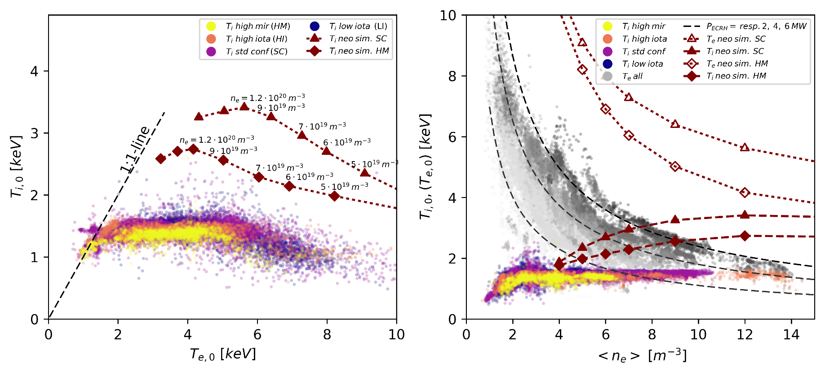
Ion temperature clamping in electron heated W7-X plasmas
P_{ECRH} = 0.5-7 MW
n_{e} = 1-14·10¹⁹ m⁻³
T_{e} = 1-10 keV
Ion temperature T_{i,0} clamped at ~ 1.5keV
No strong configuration dependence
Experimental T_{i} well below neoclassical predictions
W7-X Stellarator transport

Slide 15
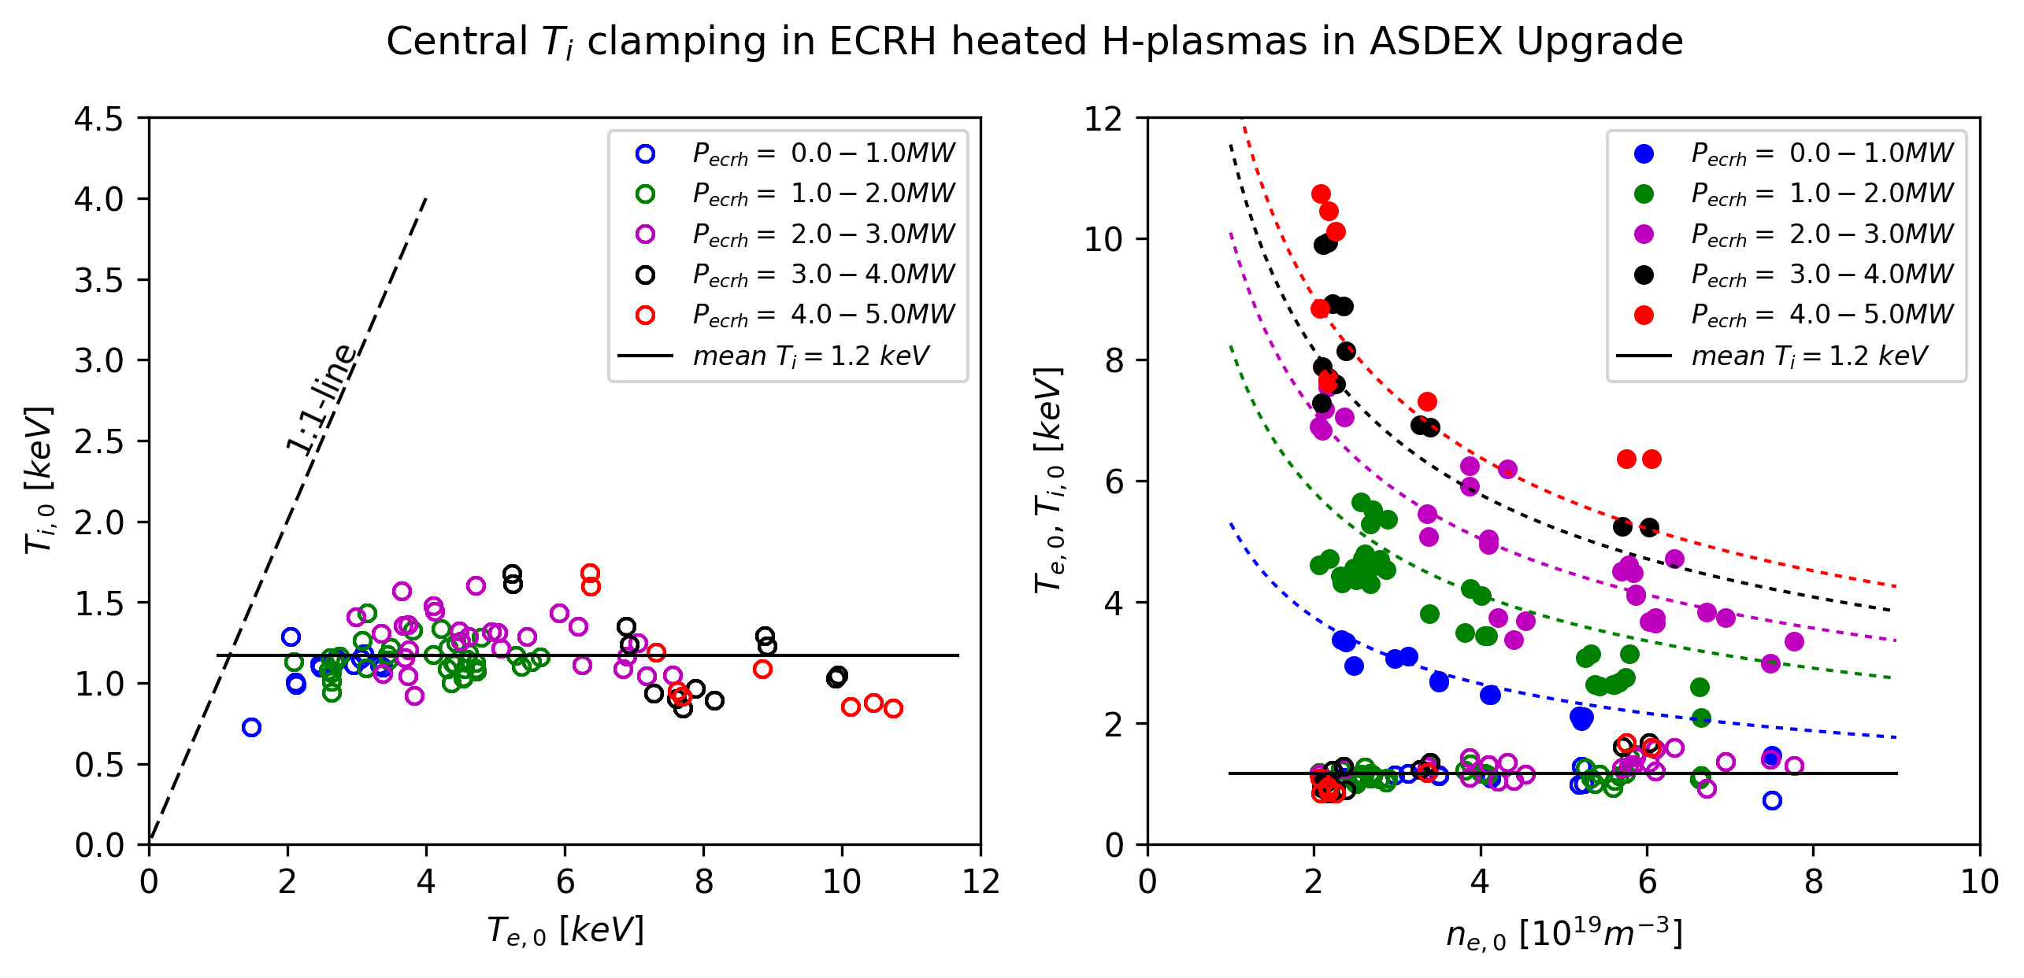
Ion temperature clamping in AUG L-mode plasmas
P_{ECRH} = 0.5-5 MW
n_{e} = 2-8·10¹⁹ m⁻³
T_{e} = 1-11 keV
Ion temperature T_{i,0} clamped at < 1.5keV
L-mode or weak H-mode plasmas (0.8 MA, q₉₅ = 5)
What causes the clamping in both devices?
AUG Tokamak transport
AUG T_{i} clamping

Slide 16
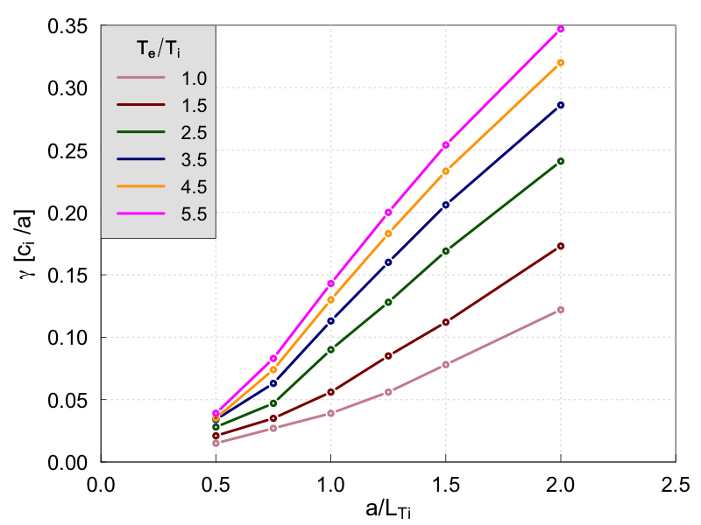
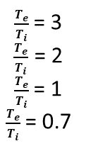
Expectations for ion turbulent heat transport from linear calculations
Ion heat transport is largely driven by Ion Temperature Gradient driven turbulence (ITG)
Both devices feature a strong additional drive for T_{e}/T_{i}
Stellarator
Linear calculations
Linear calculations
$\frac{T_{e}}{T_{i}}$ = 3
$\frac{T_{e}}{T_{i}}$ = 2
$\frac{T_{e}}{T_{i}}$ = 1
$\frac{T_{e}}{T_{i}}$ = 0.7
Tokamak
W7-X stellarator
Tokamak
(ITG)
(ITG)
[Zocco, Xanthopoulos et al. JPP 84 (1), 2018]

Slide 17
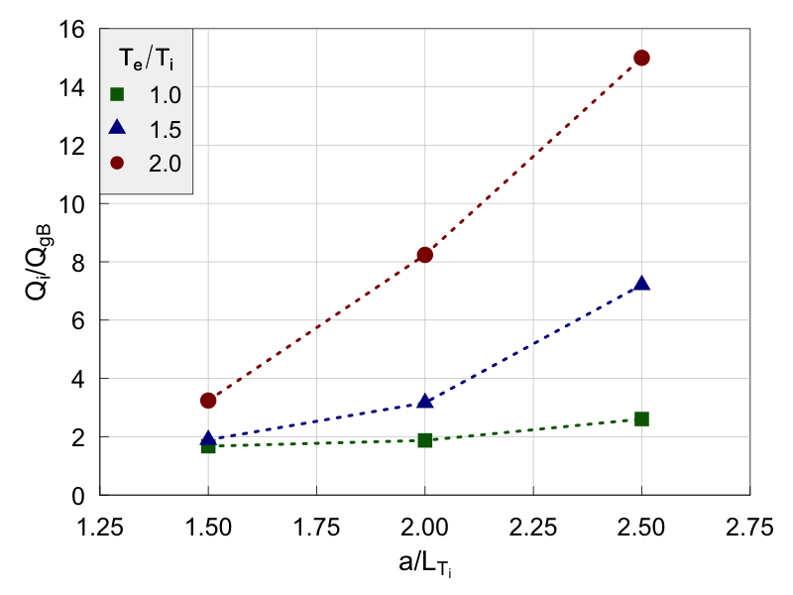
Effect ot T_{e}/T_{i} on profile stiffness in stellarators: W7-X
Linear calculations
Non-linear calculations
W7-X stellarator
W7-X
T_{e}/T_{i}
W7-X Stellarator transport
(ITG)
For T_{e}/T_{i} = 1, no strong degree of stiffness
But T_{e}/T_{i} exacerbates transport stiffness stronger for nonlinear calculations than linear calculations

Slide 18
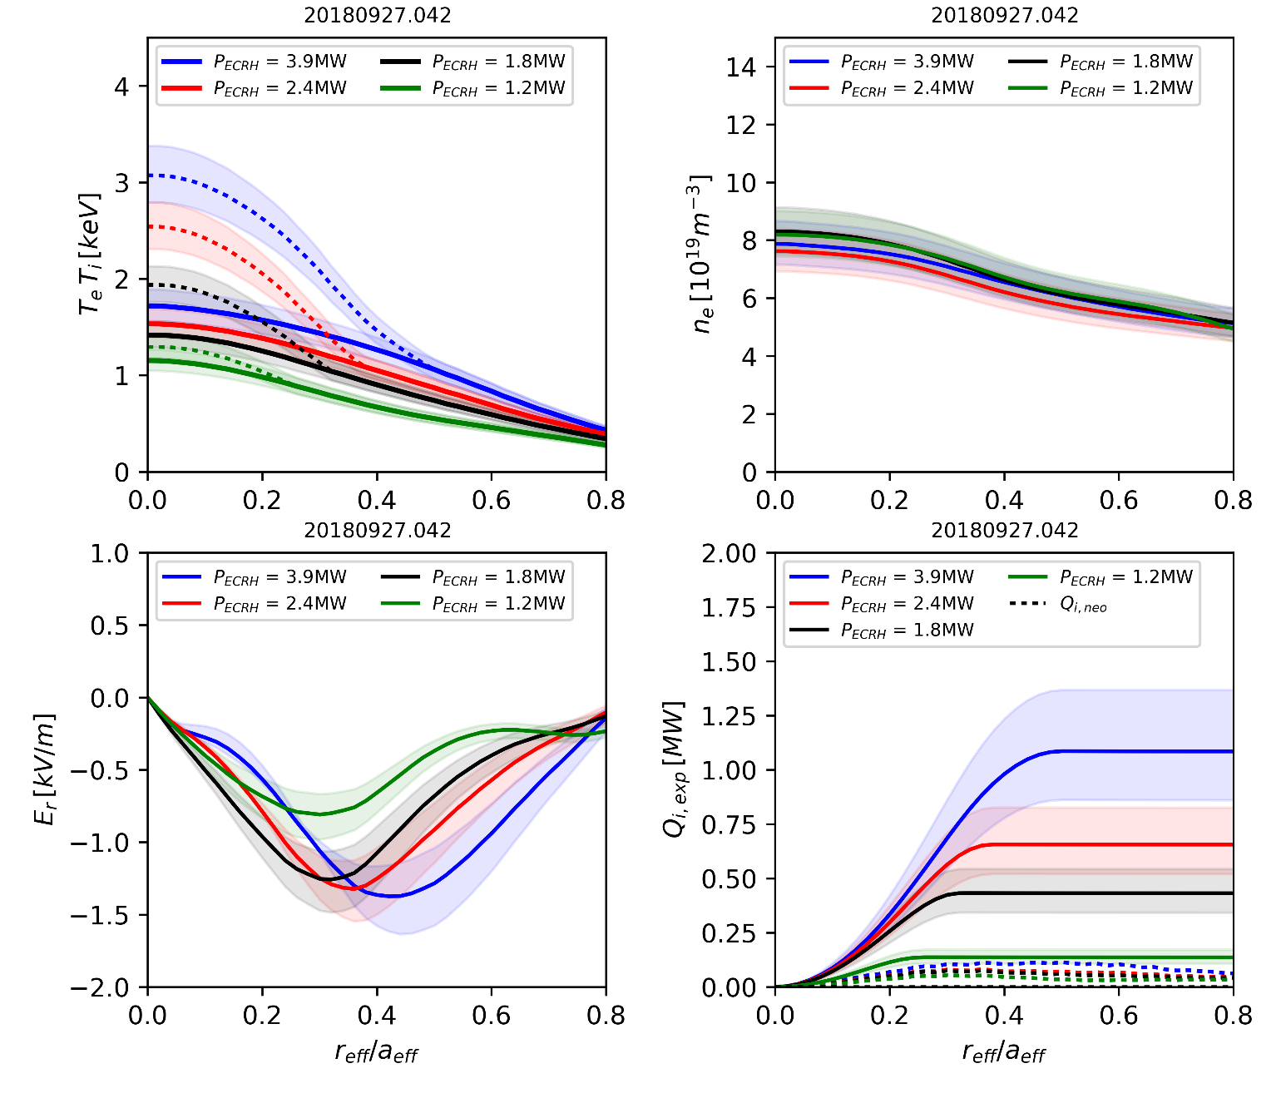
W7-X power balance for ECRH power-scan in Helium
Power scan in helium plasma at n_{e,0} = 8 10¹⁹ m⁻³
Vary P_{ECRH}: 1.2 to 3.9 MW
T_{e,0} = 1.2 – 3 keV
T_{i,0} = 1.2 – 1.8 keV
Er < 0 → ion root.
Variation of Q_{i} by a factor 8 in this single power step experiment
Q_{i,anom} >> Q_{i, NC} (Q_{i,anom} = Q_{i,exp} - Q_{i, NC} )
T_{e,0} = 1.2 – 3 keV
T_{i,0} = 1.2 – 1.8 keV
n_{e,0} = 8 10¹⁹ m⁻³
W7-X Stellarator transport
Er < 0 → ion root
Q_{i,anom} >> Q_{i, NC}

Slide 19
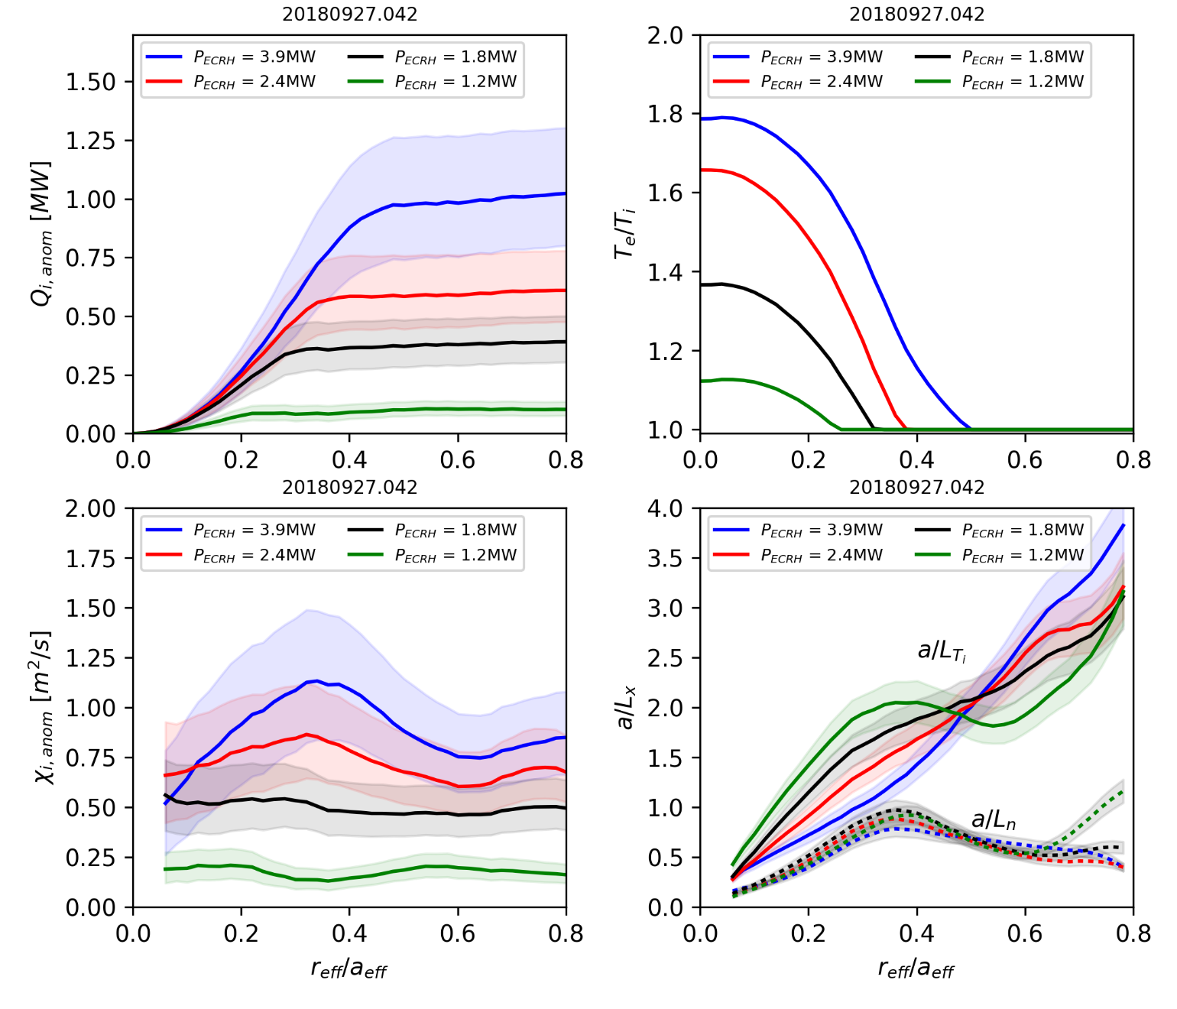

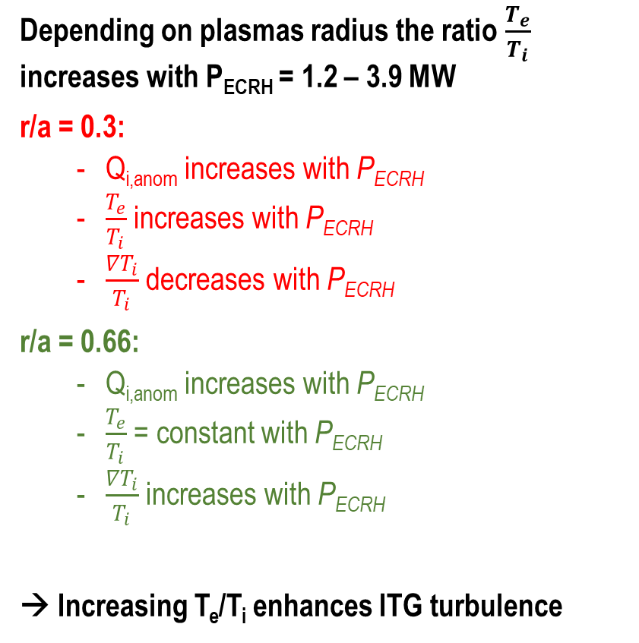



Interplay between heatflux Q_{i}, ratio T_{e}/T_{i} and gradient 1/L_{Ti}
Depending on plasmas radius the ratio $\frac{T_{e}}{T_{i}}$ increases with P_{ECRH} = 1.2 – 3.9 MW
r/a = 0.3:
  Q_{i,anom} increases with P_{ECRH}
  $\frac{T_{e}}{T_{i}}$ increases with P_{ECRH}
  $\frac{{∇T}_{i}}{T_{i}}$ decreases with P_{ECRH}
r/a = 0.66:
  Q_{i,anom} increases with P_{ECRH}
  $\frac{T_{e}}{T_{i}}$ = constant with P_{ECRH}
  $\frac{{∇T}_{i}}{T_{i}}$ increases with P_{ECRH}
→ Increasing T_{e}/T_{i} enhances ITG turbulence
Q_{i,anom}
x10
Q_{i,anom}
x7
$\frac{T_{e}}{T_{i}}$ increases with P_{ECRH}
$\frac{T_{e}}{T_{i}}$ = 1
W7-X Stellarator transport
$\frac{{∇T}_{i}}{T_{i}}$ decreases with P_{ECRH}
$\frac{{∇T}_{i}}{T_{i}}$ increases with P_{ECRH}

Slide 20
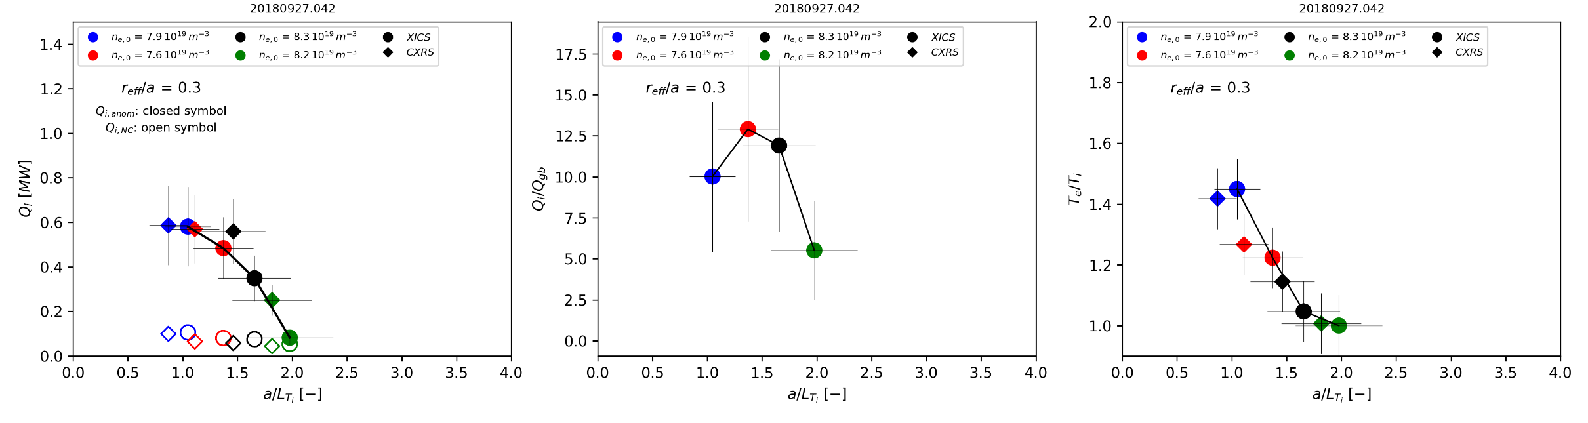
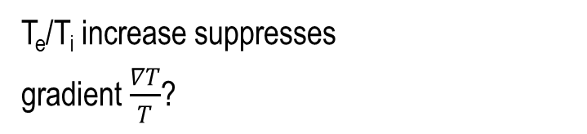


W7-X achievable ion temperature gradient at r/a = 0.3
W7-X Stellarator transport
T_{e}/T_{i} increase suppresses
gradient $\frac{∇T}{T}$?
$\frac{T_{e}}{T_{i}}$ increases with P_{ECRH}
$\frac{{∇T}_{i}}{T_{i}}$ decreases with P_{ECRH}

Slide 21
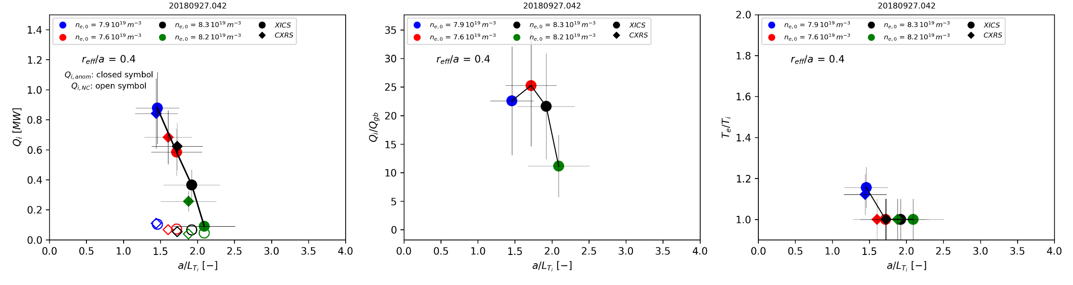
W7-X achievable ion temperature gradient at r/a = 0.4
W7-X Stellarator transport
T_{e}/T_{i} increase suppresses
gradient $\frac{∇T}{T}$?
$\frac{T_{e}}{T_{i}}$ increases with P_{ECRH}
$\frac{{∇T}_{i}}{T_{i}}$ decreases with P_{ECRH}

Slide 22
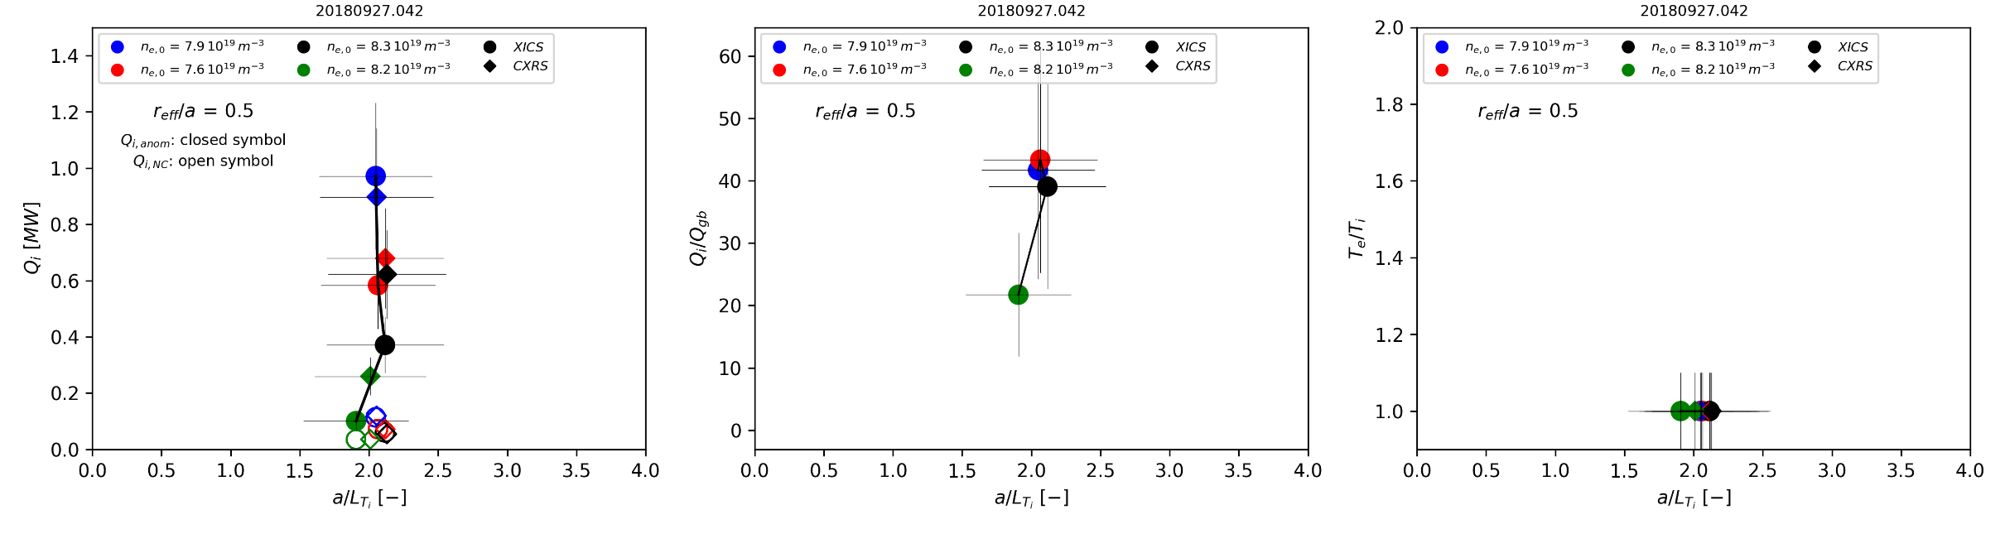


W7-X achievable ion temperature gradient at r/a = 0.5
W7-X Stellarator transport
T_{e}/T_{i} increase suppresses
gradient $\frac{∇T}{T}$?
$\frac{{∇T}_{i}}{T_{i}}$ ~ const. with P_{ECRH}
$\frac{T_{e}}{T_{i}}$ =1

Slide 23
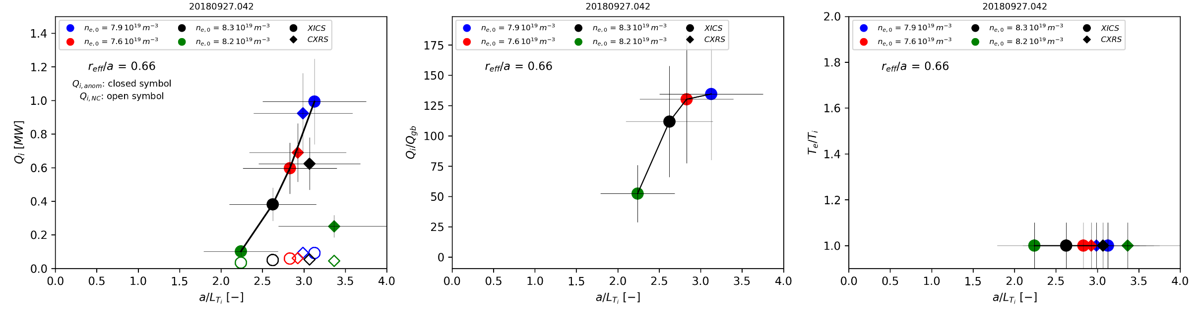
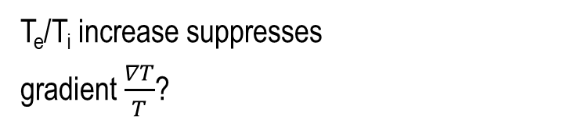


W7-X achievable ion temperature gradient at r/a = 0.66
W7-X Stellarator transport
T_{e}/T_{i} increase suppresses
gradient $\frac{∇T}{T}$?
$\frac{{∇T}_{i}}{T_{i}}$ increases P_{ECRH}
$\frac{T_{e}}{T_{i}}$ =1

Slide 24
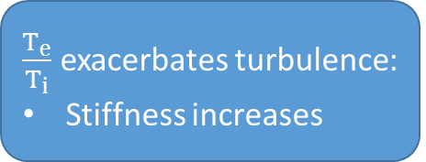
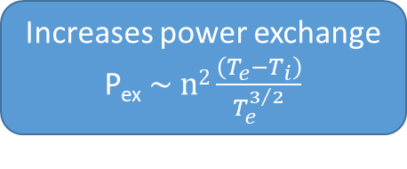
So what may be behind the so-called clamping of T_{i}?
Stellarator transport
Increases power exchange
P_{ex} $\sim n2\frac{\left(T_{e}−T_{i}\right)}{T_{e}^{3/2}}$
P_{ECRH}
Heats electrons
Increases
T_{e}/T_{i}
Clamping of T_{i}
gradients
Clamping of central T_{i}
$\frac{T_{e}}{T_{i}}$ exacerbates turbulence:
Stiffness increases
Tokamak transport

Slide 25
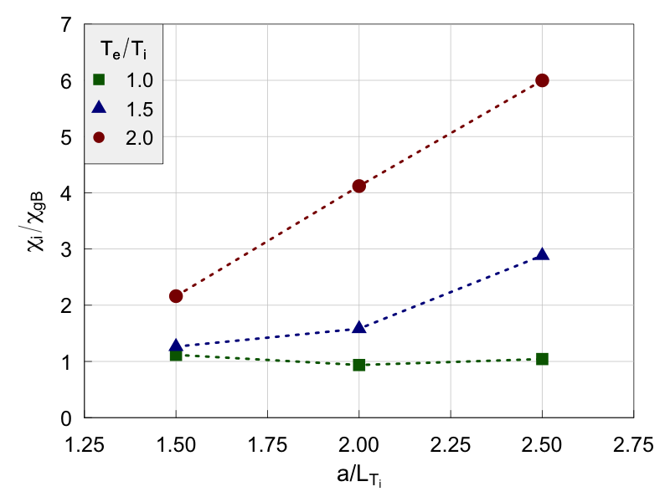
(1) How can we raise T_{i,0} with dominant electron heating?
Non-linear calculations (kinetic electrons)
χ_{turb} ~ χ_{GB}
T_{e}/T_{i} increase
= clamping
Low T_{e}/T_{i}
= Low Stiffness!
W7-X Stellarator transport
increasing T_{e}/T_{i} makes the ITG scaling jump to curves of apparent stiffness.
Thus keeping T_{e}/T_{i} = constant avoids clamping and keeps the degree of apparent stiffness low.
Raise P_{ECRH} and n_{e} together whilst T_{e}/T_{i} = constant (Recipe for ECRH enhancement) → high density operation

Slide 26
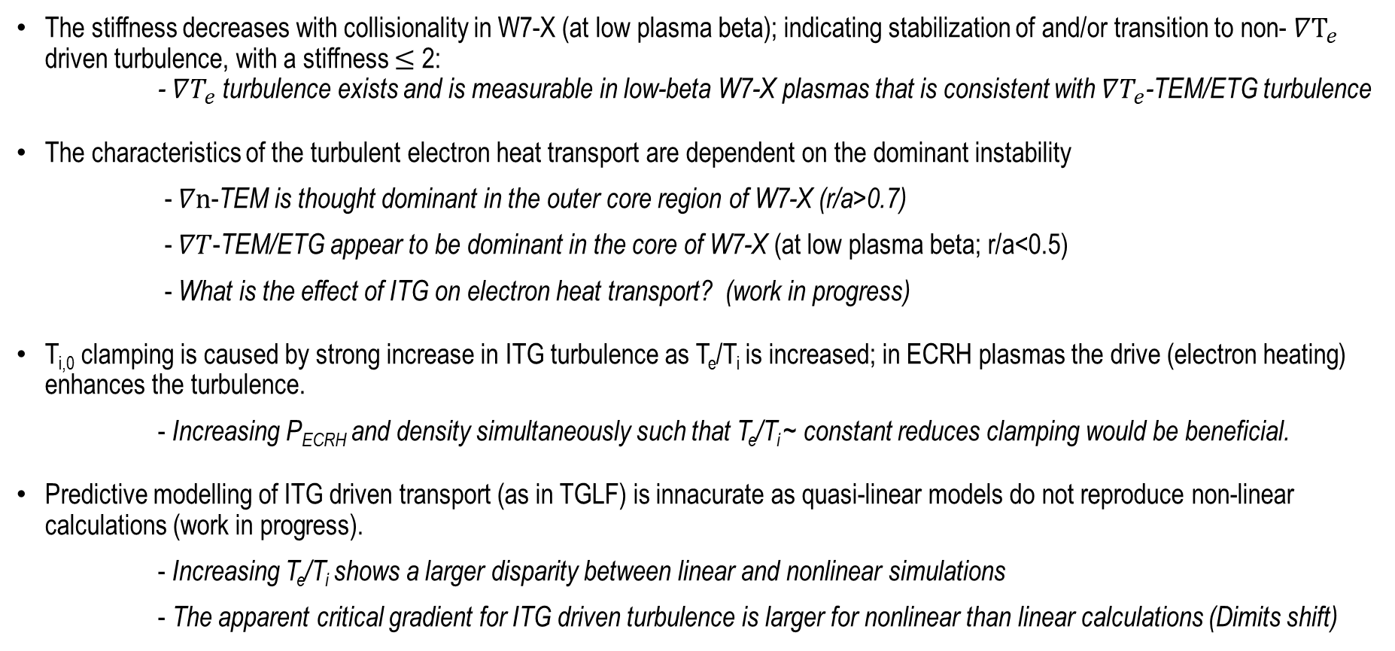
Conclusions
The stiffness decreases with collisionality in W7-X (at low plasma beta); indicating stabilization of and/or transition to non- $∇T_{e}$ driven turbulence, with a stiffness $≤$ 2:
- $∇T_{e}$ turbulence exists and is measurable in low-beta W7-X plasmas that is consistent with $∇T_{e}$-TEM/ETG turbulence
The characteristics of the turbulent electron heat transport are dependent on the dominant instability
- $∇n$-TEM is thought dominant in the outer core region of W7-X (r/a>0.7)
- $∇T$-TEM/ETG appear to be dominant in the core of W7-X (at low plasma beta; r/a<0.5)
- What is the effect of ITG on electron heat transport? (work in progress)
T_{i,0} clamping is caused by strong increase in ITG turbulence as T_{e}/T_{i} is increased; in ECRH plasmas the drive (electron heating) enhances the turbulence.
- Increasing P_{ECRH} and density simultaneously such that T_{e}/T_{i} ~ constant reduces clamping would be beneficial.
Predictive modelling of ITG driven transport (as in TGLF) is innacurate as quasi-linear models do not reproduce non-linear calculations (work in progress).
- Increasing T_{e}/T_{i} shows a larger disparity between linear and nonlinear simulations
- The apparent critical gradient for ITG driven turbulence is larger for nonlinear than linear calculations (Dimits shift)
Jan. 14, 2021
Core turbulence and configuration effects in OP1
26

Slide 28

Synthetic modelling of energy exchange and its saturation
Use truncated Gaussian profiles
n_{e} = 7x10¹⁹ m⁻³, T_{i} = 1.5 keV
T_{e} = 2-6 keV, T_{e}=T_{i} where T_{e}<T_{i}
p_{ex} saturates at T_{e} ~ 4 keV
Q_{ex} continues to rise due to V increase
Best ion heating through energy exch. at T_{e} ~ 3-4 keV (for T_{i} = 1.5 keV!).
(No benefit from additional e-heating)
n_{e} scan shows that at n_{e} ~ 1.5x10¹⁹m⁻³ the ion heat flux is ~5MW at r/a ~ 0.3

Slide 29

(2) Can we reduce the stiffness further? Optimise configuration!
Nonlinear gyrokinetic simulations (GENE)
Adiabatic electrons
Flux surface simulations, ITG radially local
Elongation enhances ITG drive
But reduces neoclassical transport …
W7-X Stellarator transport
electrostatic potential fluctuations
caused by ITG turbulence
[Xanthopoulos PRL 2014]

Slide 30

(3) ITG supression: geometry affects the turbulence onset
W7-X standard configuration
Tokamak (positive shear)
Stellarator transport
“Stability valley“
TEM
[Alcusón,
Xanthopoulos et al
Plasma Phys.
Control. Fusion 2020]
ITG
TEM
ITG
Tokamak transport
ITG grows with a/L_{Ti}
TEM grows with a/L_{n}
“Stability valley“ when a/L_{Ti} ~ a/L_{n}
Thanks to maximum-J property
ITG grows with a/L_{Ti}
TEM grows with a/L_{n}
No “Stability valley“
As no maximum-J property
Seen in pellet
experiments

Slide 31

Sharp transitions to turbulent heat transport are a general observation in fluids
Onset of convection in a large tank heated from the bottom for a variety of neutral fluids (silicone oils, ethylene, glycol, heptane and water)
    Nu ~ Convection / Conduction
    Ra ~ Dimensionless temperature gradient
Critical gradients are a general characteristic of drift-wave driven turbulence and transport!
Reproduced from Stroth (1998), adapted from Chandrasekhar (1961)
S. Chandrasekhar, Hydrodynamic and Hydromagnetic Stability. Dover Pub., 1961
U. Stroth, PPCF 40 (1998)

Slide 32




Electron temperature fluctuations in W7-X are consistent with expectations from drift wave driven turbulence
|B| [T]
The "ZOOM" device is a 16-channel, high-resolution extension to the ECE diagnostic
Adapted for use as a CECE diagnostic during turbulence studies
2.5 cm
~6 cm
Z [m]
r/a
5-25 kHz
R [m]
L_{r}~7-9 mm
L_{r}~3-5 $ρ_{s}$
G.M. Weir et al., EPS (2016, 2017, 2018)
G.M. Weir et al., TTF (2018)
M. Hirsch et al., Proc. ECE/ECRH Workshop EPJ WoC 203 (2019)
U. Hoefel et al., Rev. Sci. Instrum. 90 (2019)

Slide 33



Looking forward …
For OP2: A new CECE radiometry diagnostic
CECE
AEA21 Port Plug-in on W7-X
Looking past OP2:
Multi-dimensional plasma density / electron temperature fluctuation measurements are necessary in W7-X
Further development of microwave diagnostics
Near edge → $∇n$ driven turbulence
(<nT> cross phase and correlation reflectometry meas.)
Core region → $∇T$ driven turbulence
(multi-dimensional correlation radiometry meas.)

Slide 34

Conclusions up to now:
The stiffness decreases with collisionality in W7-X (at low plasma beta); indicating stabilization of and/or transition to non- $∇T_{e}$ driven turbulence, with a stiffness $≤$ 2:
$∇T_{e}$ turbulence exists and is measurable in low-beta W7-X plasmas that is consistent with $∇T_{e}$-TEM and ETG turbulence
Core electron temperature fluctuations are present in W7-X; further comparisons with modeling is necessary
$L_{r}$~ 3-5 $ρ_{s}$ in the core of W7-X
The characteristics of the turbulent electron heat transport are dependent on the dominant instability
$∇n$-TEM is thought dominant in the outer core region of W7-X (r/a>0.7)
$∇T$-TEM/ETG appear to be dominant in the core of W7-X (at low plasma beta; r/a<0.5)
  Multi-dimensional (non-invasive) fluctuation measurements are necessary to develop an understanding of the spatial distribution of turbulence and its dependencies in stellarators

Slide 35






Maximum-J, quasi-isodynamic configurations are resilient to collisionless Trapped Electron Modes
The neoclassical optimization of W7-X modifies the turbulent transport
Trapped particles sample on-average good curvature due to delocalization of trapping regions and bad curvature regions
High-mirror Configuration
unstable
$$ω_{de}ω_{∗e}>0$$
Standard Configuration
stable
Standard
High-iota
High-mirror
$$ω_{de}ω_{∗e}<0$$
High-iota Configuration
J.H.E. Proll et.al., PRL 108, 2012
G.G. Plunck, JW. Connor, P. Helander, J. Plasma Phys. 83, 2017
J.A. Alcusón et.al., PPCF, 2019.
Notes:
Theoretically, the neoclassical optimization of W7-X modifies the turbulent transport in W7-X.
On the left I am showing the local magnetic field strength and curvature as a function of distance along a field line for three magnetic configurations in W7-X. The trapping regions for deeply trapped particles and bad curvature regions are delocalized in the High-mirror configuration, while they coincide for the standard and high-iota configurations. Another way of saying this is that the

Slide 36



Maximum-J, quasi-isodynamic configurations are resilient to collisionless Trapped Electron Modes
The neoclassical optimization of W7-X modifies the turbulent transport
Trapped particles sample on-average good curvature due to delocalization of trapping regions and bad curvature regions
The maximum-J property of W7-X improves with plasma beta
High-mirror configuration
High-mirror Configuration
Standard Configuration
$$β=0\%$$
$$β=2\%$$
$$β=4\%$$
High-iota Configuration
$$β$$
J.H.E. Proll et.al., PRL 108, 2012
G.G. Plunck, JW. Connor, P. Helander, J. Plasma Phys. 83, 2017
J.A. Alcusón et.al., PPCF, 2019.
Notes:
On the left I am showing the local magnetic field strength and curvature as a function of distance along a field line for three magnetic configurations in W7-X. The trapping regions for deeply trapped particles and bad curvature regions are delocalized in the High-mirror configuration, while they coincide for the standard and high-iota configurations. Another way of saying this is that the

Slide 37



Turbulent transport in tokamak and stellarator
Tokamak: ITER Physics Basis 1998 (IPB98):
Stellarator: International Stellarator Scaling (ISS04)
Both scalings indicate gyroBohm transport due to microinstabilities
χ_{GB}~ T^{3/2}
Stellarator transport
Tokamak:
$χ_{turb}$ > D_{NC}
Stellarator:
$χ_{turb}$ > D_{NC}
depending on T, ε_{eff}
Tokamak transport

Slide 38

Effect ot T_{e}/T_{i} on profile stiffness in stellarators: W7-X
Non-linear calculations
Increase of stiffness
W7-X
W7-X
Non-linear ← Linear
T_{e}/T_{i}
W7-X Stellarator transport
For T_{e}/T_{i} = 1, no strong degree of stiffness
But T_{e}/T_{i} exacerbates transport stiffness ~(T_{e}/T_{i})²

Slide 39
Ion profile stiffness and its mitigation
on ASDEX Upgrade

Slide 40
ASDEX Upgrade TGLF simulations: ECRH deposition radius scan
Simulations with Trapped gyro-Landau-fluid model (TGLF) [Kinsey et al, Phys. Pl. 2008]
The model solves for the linear eigenmodes of ITG, ETG, TEM, TIM and KBM turbulence
Simple quasilinear saturation rule for eigenmodes. Benchmarked on Gyro and experiments
index | r/a= 0.1 | r/a = 0.75
0% | 5 MW | 0 MW
25% | 3.75 | 1.25
50% | 2.5 | 2.5
75% | 1.25 | 3.75
100% | 0 | 5
P_{ECRH} = 5 MW
ECRH deposition
scan r_{dep}/a= 0.1
and r_{dep}/a = 0.75
T_{e}
Simulation
T_{e}
Simulation
AUG Tokamak transport
(T_{ped} = 500 eV
= constant)
(T_{ped} = 500 eV
= constant)

Slide 41

ASDEX Upgrade TGLF simulations: ECRH deposition radius scan
Simulations with Trapped gyro-Landau-fluid model (TGLF) [Kinsey et al, Phys. Pl. 2008]
T_{e,0} varies widely, but T_{i,0} saturates.
→ Typical ITG behaviour where Increase of T_{e}/T_{i} enhances turbulence and leads to “T_{i}-clamping“
T_{i}
Simulation
AUG Tokamak transport
ion heatflux Q_{i}
simulation

Slide 42



Mitigating the effect of stiff profiles in tokamaks: pedestal versus core confinement
If pedestal is increased, the core follows suit
Beurskens-NF-2013
$−\frac{∇T}{T}=$1/L_{T} = constant
Core and pedestal strongly coupled
in a wide range of H-mode plasmas
pedestal normalised pressure (β_{p})
Tokamak transport
Tokamak confinement
T_{ped}/T_{core} = constant
Total thermal pressure (β_{p})
In H-mode plasmas the pedestal mostly sets the confinement for the “stiff“ core
In L-mode plasmas ion temperature clamping may occur
Fast ions may also mitigate the core transport stiffness

Slide 43

Conclusions
Tokamaks and Stellarators:
T_{i,0} clamping is caused by strong increase in ITG turbulence as T_{e}/T_{i} is increased.
In ECRH plasmas the drive (electron heating) is enhancing the turbulence.
→ Increase P_{ECRH} and density simultaneously such that T_{e}/T_{i} ~ constant reduces clamping.
Tokamaks:
The stiff core confinement can be lifted by a pedestal as P_{ped}/P_{core} ~ constant in H-mode.
Predicitive core transport modelling possible as linear eigenmode propagation (TGLF) matches experiment.
Stellarators:
3D configuration can be optimised by e.g. reducing the elongation, to decrease stiffness further.
Density profile control such that $\frac{∇n}{n}$ ~ $\frac{∇T}{T}$ is enhanced can supress ITG sustainably?
Predictive modelling as in TGLF difficult as linear eigenmode propagation does not match non-linear calculations (work in progress).

Slide 44



ETG modes can become important in W7-X where the drive for TE and ITG modes is reduced
Where $T_{e}$= $T_{i}$ and $a/L_{Te}$=$a/L_{Ti}$, the heat transport driven by TE and ITG modes is expected to dominate over that from ETG modes in stellarators
G.G. Plunk, P. Xanthopoulos, G.M. Weir et.al., PRL 122, 2019
Nonlinear gyrokinetic simulations (GENE)
Electrostatic simulations ($\left\langle β\right\rangle$=0) assuming adiabatic ions and kinetic electrons
Flux tube simulations, radially local, “standard” magnetic configuration at r/a=0.4
Setting $a/L_{Te}$= 3.6, $a/L_{n}$= 0, $a/L_{Ti}$ = 0. Varying $τ=Z_{eff}T_{e}/T_{i}$
F. Jenko et.al., Phys. Plasmas 7, 2000, F. Jenko et.al., PPCF 47, 2005,
P. Xanthopoulos et.al., Phys. Plasmas 16, 2009
Configuration-P_{ech} | $$τ=Z_{eff}T_{e}/T_{i}$$ | 1.0 | 1.5 | 2.0
“Standard”-3.7 | $χ_{e}^{ETG}$ [m²/s] | 0.7 | 0.5 | 0.4
“Standard”-2.0 | $χ_{e}^{ETG}$ [m²/s] | 0.35 | 0.25 | 0.2

Slide 45




ETG modes can become important in W7-X where the drive for TE and ITG modes is reduced
Nonlinear electrostatic ($\left\langle β\right\rangle$=0) gyrokinetic simulations (GENE)
Assuming adiabatic ions / kinetic electrons
Radially local flux tube simulations,
“standard” magnetic configuration (r/a=0.4)
Setting $a/L_{Te}$= 3.6, $a/L_{n}$= 0, $a/L_{Ti}$ = 0. Varying $τ=Z_{eff}T_{e}/T_{i}$
Configuration-P_{ech} | $$τ=Z_{eff}T_{e}/T_{i}$$ | 1.0 | 1.5 | 2.0
“Standard”-3.7 | $χ_{e}^{ETG}$ [m²/s] | 0.7 | 0.5 | 0.4
“Standard”-2.0 | $χ_{e}^{ETG}$ [m²/s] | 0.35 | 0.25 | 0.2
Standard / High-mirror
Standard / High-iota
T_{e}>T_{i}
a/L_{Te}>a/L_{Ti}
T_{e}>T_{i}
a/L_{Te}>a/L_{Ti}
$$τ$$
1.0
1.5
$$τ$$
2.0
Simulations

Slide 46

The stiffness trends downwards with increasing collisionality in W7-X
The TEM mode is stabilized by collisional detrapping; ITG/ETG modes are unaffected
The change in stiffness with collisionality is mostly due to a change in $χ_{e}^{HP}$ ($χ_{e}^{PB}$ is approximately constant)
$$ν_{eff}=\frac{ν^{∗}}{ω_{B}}=2πa\frac{ν_{ei}/ε_{eff}}{f_{tr}\left(c_{s}/a\right)ιr_{eff}}$$
(0.35<r/a<0.5)
High-iota
High-mirror
Standard
G.M. Weir et al., Submitted to NF (2020)

