Slide 1


Status Report for WPPrIO Preparation of ITER Operation
Project Board#3 2022-03-14

Slide 2
Project Board presentation topics
1. WP main objectives and Organization
2. 2021 main achievements, Status of Grant Milestones & Grant Deliverables
3. Risk & Mitigation Register: Current Status
4. Project Change Requests & Other Items for Decision/Approval by PB
5. AOB:
  Requests for Advanced Computing hubs support
  2022 International Collaboration

Slide 3
1. WP main objectives and Organization

Slide 4
Implementation in 5 Sub-Projects
Implement some of the recommendations from 2020 GA report on “EUROfusion role in ITER operation and scientific exploitation”
5 Sub-Projects
  SP-1. Project management
  SP-2. Preparation of ITER first experimental campaigns
  SP-3. Plant systems and plasma operation
  SP-4. ITER Neutral Beam Test Facility and R&D
  SP-5. Neutronics, Nuclear waste and Safety

Slide 5
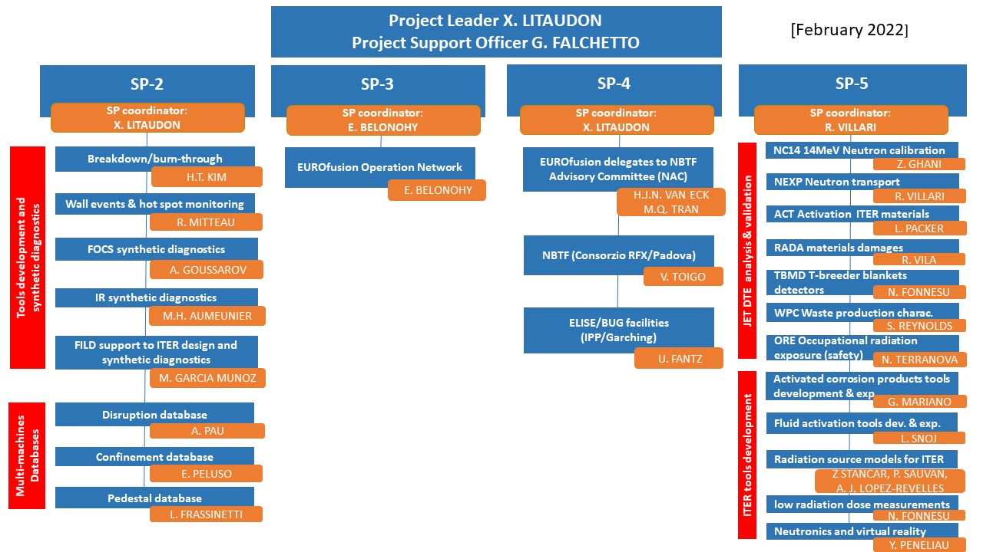
PrIO organisation and coordinators as in Feb. 2022
Project Change Requests for 2022

Slide 6
2. 2021 main achievements

Slide 7
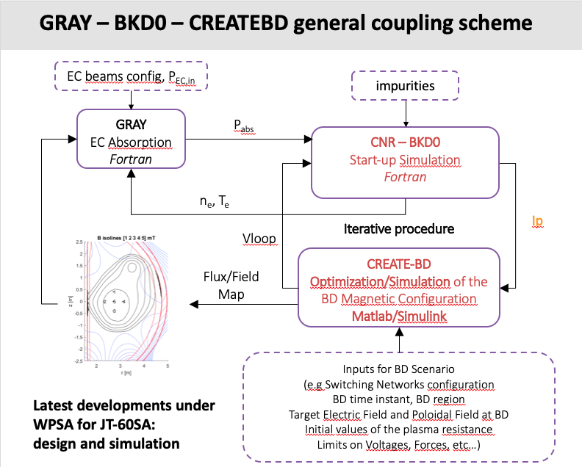
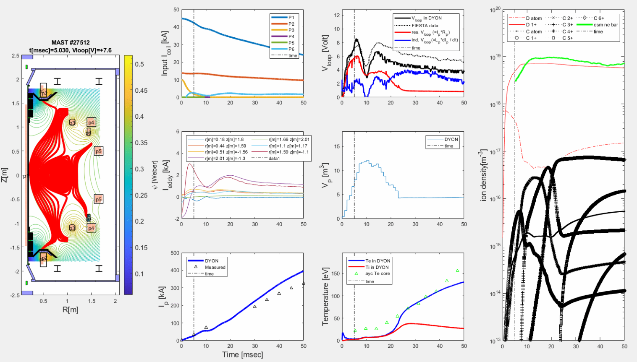
Plasma breakdown/burn-through simulation tools
A complete set of tools for simulation of ITER plasma start-up
  DYON Upgraded with full circuit equation system
  Simulation of initial magnetic scenario (CREATE-BD), the EC beam reflection models in GRAY for and the BKD0 code for time evolution of the main plasma parameters in IMAS
Upgraded DYON simulation for MAST #27512

Slide 8
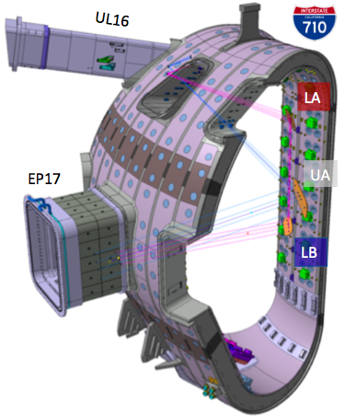

Absorption of EC waves in ITER first plasma start-up conditions
GRAY code implemented in IMAS has been upgraded to include multi-pass EC absorption via a simple reflection model at the first wall
EC beam injected from the UL is redirected towards the null region by means of dedicated mirrors of the First Plasma Protection Components
Fraction of absorbed EC power as a function of ne and Te , for O and X polarization modes for ITER first plasmas start-up conditions

Slide 9
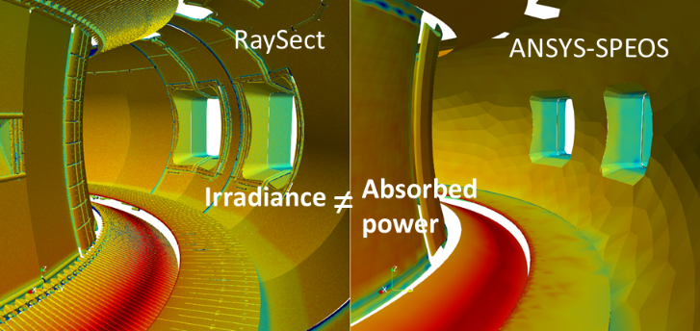
IR temperature synthetic diagnostic
Benchmark of two ray-tracing codes RaySect versus ANSYS-SPEOS
comparing radiative power on plasma facing components
WEST

Slide 10
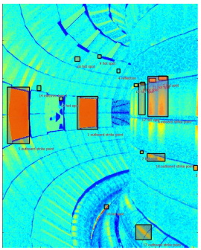
First wall/divertor hot-spots monitoring system for real time protection
Hot spot object detection algorithm, trained on infrared WEST data: able to detect hot spots in simulated images from ITER
ITER
Automatic Hot-spot detection in simulated IR images from ITER
Good generalization performance, thanks to the use of a specific inference technique called test-time augmentation

Slide 11
EUROfusion Operations Network (EON)
EON established in 2021 with 18 members from 9 EUROfusion beneficiaries with the long term objectives:
  (i) facilitate stronger connection between the operational groups of EUROfusion facilities;
  (ii) share operational experience;
  (iii) support development and training of operators, creation of a joint knowledge base;
  (iv) contribute to the (integrated) commissioning and operation of ITER.
Volontary Contributions

Slide 12
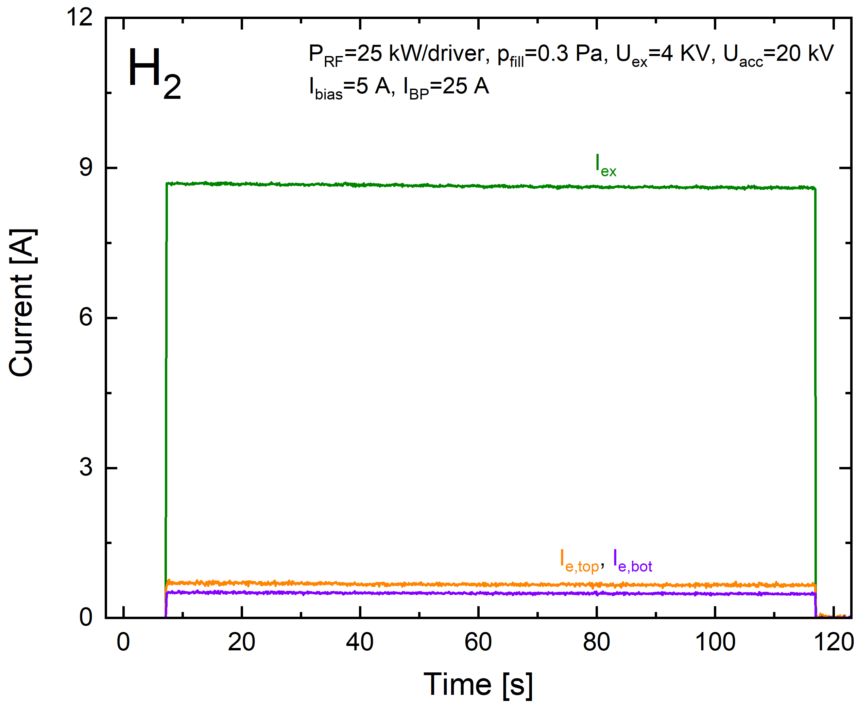
ITER Neutral Beam Test Facility and R&D for the ITER Neutral Beam
20 experts participate in an integrated manner to the operation, diagnostics design, operation, simulation programme, and engineering design of the facilities
  NBTF: SPIDER and MITICA (14 professionals) and BATMAN Upgrade and ELISE (6 professionals)
ELISE: new CW High Voltage power supply commissioned and first 110s long pulses
SPIDER ion source significant progress towards the first caesium injection and operation campaign
MITICA integrated commissioning has started
  Difficulties occurred during the 1MV integrated tests due to HV breakdowns that damaged two components of the power supply system

Slide 13
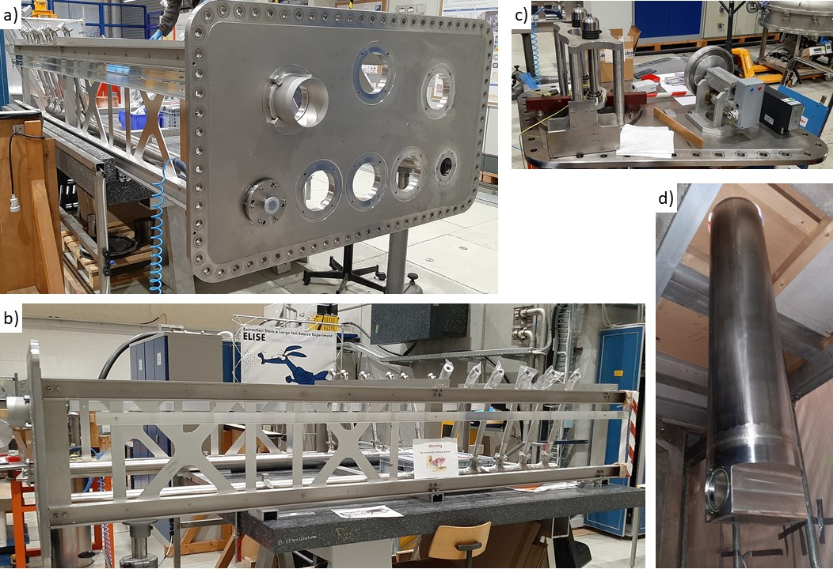
Installation and commissioning of CW diagnostic calorimeter on ELISE
Delivery of the CW calorimeter is delayed by about 3 months. This is caused by technical problems with the cooling cycle, very recent machining errors at the manufacturer´s premises and delays of subcontractors (due to the COVID-19 pandemic).
The completion is now expected in March with the start of experiments in April.
CW calorimeter support structure and IR camera immersion tube being assembled.
Calorimeter flange of vacuum tank with the calorimeter support structure and cooling pipes, laying horizontally for easier assembly
side view of the calorimeter support structure and cooling pipes.
Top of immersion tube flange, with guides for IR camera
bottom view of immersion tube.

Slide 14
Neutronics in support to ITER
Working Group to define the 2022-2025 activities in support to ITER with active participation of IO and F4E
  R. Villari (ENEA) Chair, Y. Peneliau (CEA), L. Packer (CCFE), R. Juarez (CIEMAT), M. Angelone (ENEA), J. Mietelski (IPPLM) , L. Snoj (JSI), D. Leichtle (KIT) , Th. Vasilopoulou (NCSRD) , A. Hjalmarsson (VR), M. Loughlin (IO), M. Fabbri (F4E)
great interest and active participation from IO and F4E
4 Workshops on 4 topics in sept 2021: High participation and interest
  Neutronics code simulations and development
  Neutron activation and damage in materials
  Nuclear measurements and instrumentation
  Nuclear safety and waste
High interest from EU labs and oversubscription by a factor 5 vs SP-5 resources : 35 proposals from EU beneficiaries– > requested 705 PM+ hardware/facility 450 k€!!!

Slide 15
Status of Grant Deliverables and Milestones (2021)
GA Deliverable No. | Title | Due Date | Status | Details on Status (in case of delays or issues)
D06.11 | Report on EUROfusion participation in ITER NBTF, ELISE and BUG activities | 31/12/2021 | Completed
GA Milestone No. | Title | Due Date | Status | Details on Status (in case of delays or issues)
M06.08 | Assessment of the EUROfusion human resources requirements and their implementation for the efficient EUROfusion participation in the NBTF Completed | 30/06/2021 | Completed
M06.09 | Commissioning of the new CW power supply on ELISE facility Completed | 30/06/2021 | Completed
M06.01 | All existing components of the European Plasma Simulator (Python workflow) hosted on the EUROfusion Git (TSVV11 responsibility) | 31/12/2021 | completed
M06.02 | First release of a user friendly interface for the European Plasma Simulator (Python workflow) (ACH and TSVV11 responsibility) | 31/12/2021 | Delayed (30/06/2022) | The milestone is delayed due to the delayed start of the ACH. The User interface is available (identical to the JINTRAC one) and is being improved now to become more user friendly and be ready for a general EF training on the HFPS (pending on Gateway CPU resources though to launch such numerous runs).
M06.10 | Installation and commissioning of CW diagnostic calorimeter on ELISE facility Completed | 31/12/2021 | Delayed (30/04/2022) | Delay is due to COVID.
M06.13 | Prioritisation programme for 2022-2025 of activities in support of neutronics and safety for ITER | 31/12/2021 | completed

Slide 16
3. Risk & Mitigation Register: Current Status

Slide 17
Risk & Mitigation Register: Current Status
Description of Risk | Severity | Likely hood | Proposed Mitigation Action | Risk materialized? | Mitigating Measures applied? | Comments
European Plasma Simulator not sufficient to provide answers required for ITER | H | M | Increase resources for code development | No | No | Not relevant for 2021
Lack of EU involvement in the participation in the EUROfusion Operation Network | M | L | Increase coordination and resources on specific funded tasks. Prioritise activities | No | No
Reduced EUROfusion participation in the NBTF and ELISE/ BATMAN Upgrade facilities | M | M | Reprioritization, and reallocate resources to development of other sources | No | No | Two Interviews took place in 2021 to select 3 candidates
Delay in the achievement of long pulse operation (up to 3600s) extraction on ELISE facility | H | M | Focus EU effort to understanding (including modelling) the limiting factors and consequences for ITER | No | No
JET DT does not provide enough data for neutronics analysis | H | H | Revise the objectives in terms of irradiation of ITER materials and radiation damage. Revise resources on the related modelling activities. | No | No | DTE2 completion in 2021
Low level of coordination between WPPrIO and ITER-IO on common topics (IMAS development, ITER simulation, neutronics, NBTF…) | M | M | Increase the coordination level between WPPrIO and ITER-IO/F4E by setting-up specific coordination meetings. | No | No | Regular meetings with IO

Slide 18
4. Project Change Requests & Other Items for Decision/Approval by PB

Slide 19
Project Change Requests & Other Items for Decision/Approval by PB
PCR Number | PCR Title | PCR Status | Comments
2022-1a | ITER - FILD: simulations in support to ITER design and synthetic diagnostic | SP-2 New task (10.2PM +2.5PM UKAEA) and task coordinator to be approved | New task following IO decision in 2021.
2022-1b | Ind. Resources (IR) 2022 - 2024 NA FILD moved from PrIO-3 to PrIO-2 | Move IR NA FILD 2022-2024 from SP-3 to SP-2 | Task moved from SP-3 to SP-2 since focus on modelling
2022-2a | JET DT technological exploitation | SP-5.3 New tasks (53.8PM + 15.8 UKAEA PM in 2022) and task coordinators to be approved | Follow-up of JET3 following successful JET DTE2
2022-2b | PrIO-5.3 2022 resources moved to 2023 (PRIO.M.14-M17 & PRIO.D.22-D24 ) | Shift of resources (51.34PM) to SP-5 2023. | Shift of DTE2 & analysis (initially foreseen to be initiated under JET3)
2022-3 | Supporting neutronics activities in preparation of ITER nuclear phase | PrIO-5.2 New tasks (35PM + 5PM UKAEA in 2022) and tasks coordinators to be approved | Following 2021 working group proposal
2022-4 | 2022 preparation of water activation JET experiment (DTE3) | Pending extra-resources - WTE call has been issued. | Following 2017 feasibility study. To support the EUROfusion preparation of the experiment in 2022

Slide 20
Deliverables, resources and PCRs (all beneficiaries, IMS 01/03/2022)
 | Total PM | Total Resources [k€] | Total Cons. Contr. [k€]
PrIO-1 | 12.4 | 181.2 | 126.8
Management | 12.4 | 118.7 | 83.1
Missions (EU + Int.) 46.9k€ for Inter. Collaboration total resources | 0.0 | 62.5 | 43.8
PrIO2 | 54.2 | 425.0 | 212.5
Breakdown/burn-through | 8.5 | 67.9 | 33.9
EUROfusion multi-machines database | 6.0 | 56.2 | 28.1
FILD support to ITER design and synthetic diagnostics | 12.7 | 85.2 | 42.6
FOCS synthetic diagnostics | 2.0 | 19.3 | 9.6
IR synthetic diagnostics | 22.0 | 167.8 | 83.9
IR Wall events & hot spot monitoring | 3.0 | 28.7 | 14.4
PrIO-3 | 2.0 | 15.5 | 7.7
EUROfusion operation network & coord. | 2.0 | 15.5 | 7.7
PrIO-4 | 249.6 | 2692.1 | 1550.1
Secondment | 0.0 | 495.0 | 495.0
Support EUROfusion experts at ELISE/BUG | 72.0 | 902.5 | 425.9
Support EUROfusion experts at NBTF | 177.6 | 1294.6 | 629.3
PrIO-5 | 111.6 | 767.7 | 362.3
Management SP-5 | 2.0 | 14.2 | 7.1
ITER:Activated corrosion products tools development & exp | 5.0 | 40.5 | 20.2
ITER: Activated corrosion products tools development & exp | 1.0 | 7.7 | 3.9
ITER: Fluid activation tools development and experiment | 15.0 | 97.0 | 48.5
ITER: Radiation source model (FPO, Be-photo neutrons & NBI source) | 13.0 | 82.2 | 41.1
ITER: Techniques for low radiation dose level measurement | 3.0 | 20.4 | 10.2
ITER: Neutronics and Virtual Reality coupling for maintenance operations | 3.0 | 26.9 | 13.4
JET-ACT-Activation measurements for ITER material & data validation | 25.6 | 157.6 | 60.3
JET-NC14 - Calibration of neutron detectors at 14-MeV neutron energy | 2.0 | 15.5 | 7.7
JET-NEXP-Neutron streaming and shutdown dose rate experiments for code validation | 25.0 | 186.0 | 90.3
JET-ORE - Occupational Radiation Exposure | 4.0 | 29.7 | 14.8
JET-RADA - Functional material damage studies | 5.0 | 30.0 | 14.7
JET-TBMD - n/T detectors testing for Test Blanket Module | 5.0 | 36.8 | 18.4
JET-WPC Waste production charac. | 3.0 | 23.2 | 11.6
Sum | 429.8 | 4081.4 | 2259.5
PCR
PCR
PCR

Slide 21
FILD: simulations in support to ITER design and synthetic diagnostics (PCR 2022-1a&1b)
Coordinator: Manuel Garcia-Munoz (CIEMAT-UoS)
with Antti Snicker (VTT) & Michael Fitzgerald (UKAEA)
  Define ITER reference scenarios jointly with IO
  Thermal plasma loads on FILD probe (SMITER)
  Fast ion losses (ASCOT code and UKAEA tools)
    improve ASCOT with “backwards method” starting from FILD location
    fast ion losses induced by MHD (AE) modes
  Simulate FILD measurements (FILDSIM) for design optimisation
    scintillators and Faraday cups, optics, new materials, detectors and photo-multipliers, head geometry, radial position, nuclear noise.
  Assess activity for reading FILDSIM’s inputs and outputs into IMAS format
Activity under SP2 instead of SP3
  focus is on the simulation rather than engineering activities under IO responsibilities
Issue: resources limited for 3 years (2022-2024) to be extended to 2025
10.2 PM in 2022 + 2.5 PM UKAEA

Slide 22
DTE2 analyses and code validation [1/2] as a follow-up of JET3 (PCR 2022-2a&2b)
Resources assuming JET operation ends in 2021 with DTE2
ACT Activation measurements for ITER material & data validation (UKAEA, ENEA, IPPLM, JSI, NCSRD)
  Retrieval of sample materials dosimetry foils and detectors in long-term irradiation station (Sept. 22)
  Distribution to EU labs and analyses Gamma spectrometry; Cross-checking measurements
  Calculation of sample activities on real neutron irradiation history
RADA Functional material damage studies (CIEMAT, NCSRD, JSI)
  Assess the degradation of the physical properties in optical fibers and in insulator materials due to fast neutrons
NC14 Calibration of neutron detectors at 14-MeV neutron energy (UKAEA)
  Final assessment of 14 MeV calibration factors and operational relevance
  Lesson learnt from the in-vessel calibration and their suitability for ITER calibrations
2022: 45.4PM + 8.4PM AR-IPPLM + 15.8PM UKAEA

Slide 23
DTE2 analyses and code validation [2/2] as a follow-up of JET3 (PCR 2022-2a&2b)
NEXP Neutron streaming and shutdown dose rate experiments for code validation (ENEA, CIEMAT, CEA, IPPLM, JSI, KIT, NCSRD, UKAEA)
  Analysis and calculations of TT and DTE2 neutron streaming and shutdown dose rates experiment
  Validate the state-of-art codes, nuclear data and tools used in ITER nuclear analyses
  Model and analysis of gas baking plant activation due to a water leak
ORE Occupational Radiation Exposure (ENEA, CIEMAT, JSI, NCSRD UKAEA)
  Collect and process JET ORE data corresponding to specific activities and operations to meet specific ITER safety needs
  Develop well-structured work-effort database for ITER-like ORE applications
TBMD n/T detectors testing for Test Blanket Module (ENEA, UKAEA)
  Analysis of the measurements with diamond detectors in vertical port and TBM mock-up and activation foils in KN2 following DTE2 and TT campaigns
WPC Waste production and characterization (UKAEA)
  Analysis of the production and characterisation of solid and soft waste following DTE2 for validation of tools and processes required by ITER

Slide 24
JET Water Activation Experiment DTE3, supported by ITER (PCR 2022-4)
Validate of the full methodology for water activation assessment for ITER
Reduce the safety factors applied to the calculations which have large impact on schedule, commissioning and licensing
IO (Michael LOUGHLIN)
  “It is essential to the success of the ITER program that the strength and spatial distribution is predicted as well as possible. It is also crucial for the safety case of ITER that this source is well understood to ensure the protection of the public and the environment. It will have an impact on the licensing process. The radiation from activated water could affect the performance of the superconducting magnets (as a source of nuclear heating), could render safety electronics inoperable (because of neutrons from ¹⁷N), or damage the tokamak cooling water system itself, unless suitable amelioration steps are not taken. All these could severely limit the ITER operation program. A thorough knowledge of this source term is therefore of paramount importance.”

Slide 25
Preparation of JET water activation exp. should take place in 2022 (PCR 2022-4)
Water activation measurement in NBI scraper cooling loop following feasibility study
  Estimated resources are limited for 2022- 2025: 2.5 -3.5 ppy and 50k€ Eurofusion resources. JET operator 144 ppd and 20k£ for goods. A real opportunity
Preparation should take place NOW in 2022:
  2022 Pre-analysis, design of experimental assembly
  2023 Installation & Measurements
  2024-2025 Post-analyses, conclusions and implications to ITER
A call for Implementation of Enhancements has been issued within WPTE on 02/03 with a deadline 23 March
PB to support the EUROfusion preparation of the Water activation experiment in 2022 within PrIO

Slide 26
Neutronics tools development & validation for ITER/DEMO (PCR 2022-3)
2002: 35 PM + 5PM UKAEA
Activated corrosion products tools development and experiments (ENEA, CCFE, CEA, CIEMAT-UNED)
  Develop methodology for assessment of dose contribution due to ACP
  Design (2022), carry-out and analyse experiments at FNG to validate OSCAR-Fusion and the methodological approach for ITER estimates of the radiation field due to the ACPs
Fluid activation tools development and experiments (ENEA, CCFE, IPPLM-IPPLM, CEA, CIEMAT-UNED, JSI, VR, NCSRD, KIT)
  Develop of simulation tools for the determination of water activation considering complex flow pattern
  Design (2022) and perform water activation experiments at JSI TRIGA fission reactor to validate ITER prediction
Radiation source model development and simulation of the radiation field (CIEMAT-UNED, JSI, VR)
  Develop neutron and gamma sources for Monte Carlo neutronic calculations of the radiation fields in early ITER phase (PFPO)
  Develop source of photoneutrons from Be and perform Shutdown Dose rate assessment in ITER
  Develop DD and DT neutron sources in NBI and perform calculation of nuclear responses due to neutrons produced in ITER NB cell
Techniques for low radiation dose level measurements (ENEA, CEA, IPPLM-IFJ)
  Develop methodology for low dose measurements during ITER operation and shutdown
Neutronics and virtual reality coupling for maintenance operations (CEA, CCFE)
  Develop of Virtual Reality (VR) tool coupled with on-line dose rate calculation

Slide 27
5. AOB:
Requests for Advanced Computing Hubs support
2022 International collaboration

Slide 28
Requests for Advanced Computing Hubs support
Cat. 1 High Performance Computing: Breakdown/burn-through DYON code ~3PM
  parallelizing DYON to shorten the computation time and improve application for ITER parameter scan predictions
Cat. 2 Integrated Modelling and Control: EUROfusion databases ~2-4PM
  Support Extend python’s scripts to include 1D profiles.
  Develop/update a GUI to download the EUROfusion databases from IMAS in specific user-friendly formats
  Support to version control project (on Git/Gitlab) with all the various Gateway routines
  Common for all databases including the ones in the TSVVs
Cat. 3 Data management: EUROfusion databases & IR Wall monitoring - Hot spot database ~4PM
  IA for automatic clustering of the data allowing the user to extract specific parts of the DB satisfying "not trivial" criteria in terms of the parameter space.
  Optimising the data process for wall hot spots database as recorded by infrared diagnostic system with IA technics
  Common for all databases including the ones in the TSVVs

Slide 29
2022 International collaboration
South Korea, Seoul National University (SNU), Korea Institute of Fusion Energy
  DYON code development and validation with KSTAR data and VEST (SNU)
Japan QST and NIFS
  test facilities of Negative Neutral Beam, Negative Neutral Beam operation
US DOE, ORNL
  Benchmark and validation of Neutronics Simulation Computer Codes
  Existing agreement to be extended in 2022
ITPA
  WPrIO is taking initiative to develop the link between EU members of the ITPA Topical Group (TG) and the EUROfusion programme
  Meeting organized with the PL/TFLs and EU ITPA-TG

Slide 30
End of PB-Presentation slides

Slide 31
Back-up

Slide 32
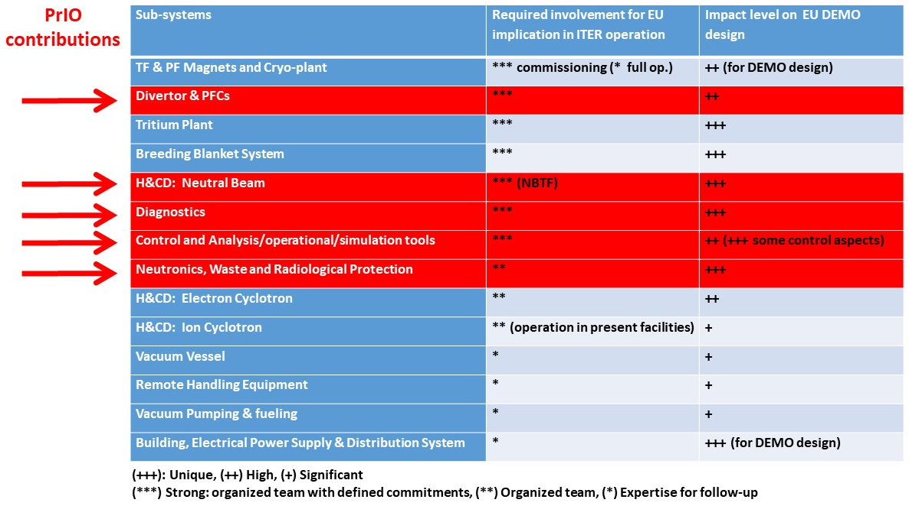
Recommendations on “EUROfusion role in ITER op. & scientific exploitation”

Slide 33
Deliverables and resources all beneficiaries (IMS 01/03/2022)
 | Total PM | Total Resources [k€] | Total Cons. Contr. [k€]
PrIO-1 | 12.4 | 181.2 | 126.8
Management | 12.4 | 118.7 | 83.1
Missions (EU + Int.) 46.9k€ for Inter. Collaboration total resources | 0.0 | 62.5 | 43.8
PrIO-2 | 54.2 | 425.0 | 212.5
Breakdown/burn-through | 8.5 | 67.9 | 33.9
EUROfusion multi-machines database | 6.0 | 56.2 | 28.1
FILD support to ITER design and synthetic diagnostics | 12.7 | 85.2 | 42.6
FOCS synthetic diagnostics | 2.0 | 19.3 | 9.6
IR synthetic diagnostics | 22.0 | 167.8 | 83.9
IR Wall events & hot spot monitoring | 3.0 | 28.7 | 14.4
PrIO-3 | 2.0 | 15.5 | 7.7
EUROfusion operation network & coord. | 2.0 | 15.5 | 7.7
PrIO-4 | 249.6 | 2692.1 | 1550.1
Secondment | 0.0 | 495.0 | 495.0
Support EUROfusion experts at ELISE/BUG | 72.0 | 902.5 | 425.9
Support EUROfusion experts at NBTF | 177.6 | 1294.6 | 629.3
PrIO-5 | 111.6 | 767.7 | 362.3
Management SP-5 | 2.0 | 14.2 | 7.1
ITER:Activated corrosion products tools development & exp | 5.0 | 40.5 | 20.2
ITER: Activated corrosion products tools development & exp | 1.0 | 7.7 | 3.9
ITER: Fluid activation tools development and experiment | 15.0 | 97.0 | 48.5
ITER: Radiation source model (FPO, Be-photo neutrons & NBI source) | 13.0 | 82.2 | 41.1
ITER: Techniques for low radiation dose level measurement | 3.0 | 20.4 | 10.2
ITER: Neutronics and Virtual Reality coupling for maintenance operations | 3.0 | 26.9 | 13.4
JET-ACT-Activation measurements for ITER material & data validation | 25.6 | 157.6 | 60.3
JET-NC14 - Calibration of neutron detectors at 14-MeV neutron energy | 2.0 | 15.5 | 7.7
JET-NEXP-Neutron streaming and shutdown dose rate experiments for code validation | 25.0 | 186.0 | 90.3
JET-ORE - Occupational Radiation Exposure | 4.0 | 29.7 | 14.8
JET-RADA - Functional material damage studies | 5.0 | 30.0 | 14.7
JET-TBMD - n/T detectors testing for Test Blanket Module | 5.0 | 36.8 | 18.4
JET-WPC Waste production charac. | 3.0 | 23.2 | 11.6
Sum | 429.8 | 4081.4 | 2259.5

Slide 34
Deliverables and resources without UKAEA and EPFL (IMS 01/03/2022)
 | Total PM | Total Resources [k€] | Total Cons. Contr. [k€]
PrIO-1 | 12.40 | 169.02 | 118.31
Management | 12.40 | 118.70 | 83.09
Missions (EU + Int.) | 0.00 | 50.31 | 35.22
PrIO-2 | 44.70 | 336.66 | 168.33
Breakdown/burn-through | 4.50 | 31.97 | 15.98
EUROfusion multi-machines database | 4.00 | 30.83 | 15.42
FILD support to ITER design and synthetic diagnostics | 10.20 | 65.80 | 32.90
FOCS synthetic diagnostics | 2.00 | 19.27 | 9.64
IR synthetic diagnostics | 21.00 | 160.06 | 80.03
IR Wall events & hot spot monitoring | 3.00 | 28.72 | 14.36
PrIO-4 | 213.60 | 2295.23 | 1351.69
Secondment | 0.00 | 495.00 | 495.00
Support EUROfusion experts at ELISE/BUG | 72.00 | 902.50 | 425.88
Support EUROfusion experts at NBTF | 141.60 | 897.73 | 430.81
PrIO-5 | 90.80 | 600.43 | 279.30
Management SP-5 | 2.00 | 14.21 | 7.10
ITER:Activated corrosion products tools development & exp | 5.00 | 40.46 | 20.23
ITER: Fluid activation tools development and experiment | 13.00 | 81.55 | 40.78
ITER: Radiation source model (FPO, Be-photo neutrons & NBI source) | 12.00 | 74.42 | 37.21
ITER:Techniques for low radiation dose level measurement | 3.00 | 20.44 | 10.22
ITER: Neutronics and Virtual Reality coupling for maintenance operations | 2.00 | 19.15 | 9.57
JET-ACT-Activation measurements for ITER material & data validation | 20.80 | 114.19 | 39.18
JET-NEXP-Neutron streaming and shutdown dose rate experiments for code validation | 23.00 | 170.53 | 82.52
JET-ORE - Occupational Radiation Exposure | 2.00 | 14.21 | 7.10
JET-RADA - Functional material damage studies | 5.00 | 29.97 | 14.73
JET-TBMD - n/T detectors testing for Test Blanket Module | 3.00 | 21.31 | 10.66
Sum | 361.50 | 3401.33 | 1917.63

Slide 35
UKAEA and EPFL (IMS 01/03/2022)
 | Total PM | Resources [k€] | Cons. Contr. [k€]
PrIO-1 | 0.00 | 12.19 | 8.53
Missions (EU + Int.) | 0.00 | 12.19 | 8.53
PrIO-2 | 9.50 | 88.31 | 44.15
Breakdown/burn-through | 4.00 | 35.89 | 17.94
EUROfusion multi-machines database | 2.00 | 25.33 | 12.67
FILD support to ITER design and synthetic diagnostics | 2.50 | 19.35 | 9.67
IR synthetic diagnostics | 1.00 | 7.74 | 3.87
PrIO-3 | 2.00 | 15.48 | 7.74
EUROfusion operation network & coord. | 2.00 | 15.48 | 7.74
PrIO-4 | 36.00 | 396.88 | 198.44
Support EUROfusion experts at NBTF | 36.00 | 396.88 | 198.44
PrIO-5 | 20.80 | 167.23 | 82.99
ITER: Activated corrosion products tools development & exp | 1.00 | 7.74 | 3.87
ITER: Fluid activation tools development and experiment | 2.00 | 15.48 | 7.74
ITER: Radiation source model (FPO, Be-photo neutrons & NBI source) | 1.00 | 7.74 | 3.87
ITER: Neutronics and Virtual Reality coupling for maintenance operations | 1.00 | 7.74 | 3.87
JET-ACT-Activation measurements for ITER material & data validation | 4.80 | 43.40 | 21.08
JET-NEXP-Neutron streaming and shutdown dose rate experiments for code validation | 2.00 | 15.48 | 7.74
JET-ORE - Occupational Radiation Exposure | 2.00 | 15.48 | 7.74
JET-TBMD - n/T detectors testing for Test Blanket Module | 2.00 | 15.48 | 7.74
JET-NC14 - Calibration of neutron detectors at 14-MeV neutron energy | 2.00 | 15.48 | 7.74
JET-WPC Waste production charac. | 3.00 | 23.22 | 11.61
Sum | 68.30 | 680.08 | 341.85

Slide 36
Overview per Beneficiaries (IMS 01/03/2022)
Beneficiaries | Total PM | Total Resources [k€] | Total Cons. Contr. [k€]
CEA | 35.4 | 338.9 | 193.2
CIEMAT | 40.7 | 244.2 | 122.0
ENEA | 122.9 | 894.4 | 445.1
EPFL | 27.0 | 342.0 | 171.0
IPPLM | 39.0 | 225.4 | 104.7
IST | 12.0 | 119.1 | 87.7
JSI | 19.4 | 97.4 | 48.7
KIT | 3.0 | 26.9 | 13.5
LPP-ERM-KMS | 2.0 | 19.3 | 9.6
MPG | 72.0 | 902.5 | 425.9
NCSRD | 8.6 | 47.4 | 23.1
Not Allocated (missions/secondment) | 0.0 | 432.9 | 417.8
UKAEA | 41.3 | 338.1 | 170.9
VR | 4.0 | 33.3 | 16.6
VTT | 2.5 | 19.8 | 9.9
Sum | 429.8 | 4081.4 | 2259.5

Slide 37
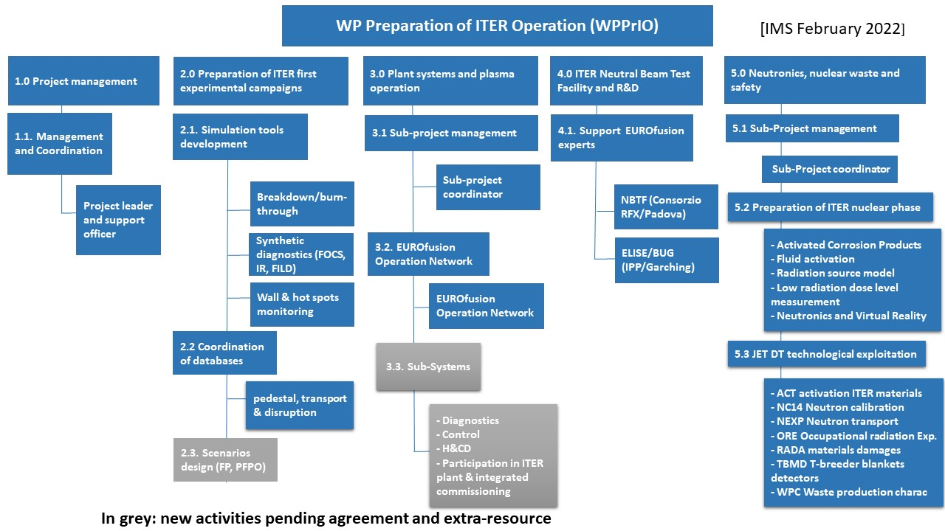
Work Breakdown Structure as in IMS

Slide 38
ITER FILD diagnostic design – Background
Following IO review :
  select reciprocating scintillator detector vs dedicated IR based solution
Design activity will be initiated by IO in 2022
  Q2/2022: design team forming
  10/2022: CDR
Proposal: EUROfusion takes responsibility of the development of the ITER FILD simulation programme
  Simulation of fast ion flux to ITER FILD detector
  Synthetic ITER FILD signal & scintillator images including collimator geometry, optical transfer system and camera sensor
While IO leads the engineering design
Shift by one year the 2021-2023 pre-allocated EUROfusion resources and develop synergy with SA

