Slide 1
TSVV-5: DIFFER 2021 report
J. Gonzalez, E. Westerhof; 22-12-2021

Slide 2
Reference cases of Magnum-PSI solved with SOLPS-ITER

Slide 3
Similar plasma solutions in low and high density cases
SOLPS-ITER can produce results close to experimental data (and previous B2.5-Eunomia simulations) in high a low density Magnum-PSI cases.
High Density Case
Comparison with TS profiles near the target
Low Density Case
Comparison with TS profiles near the target
3

Slide 4
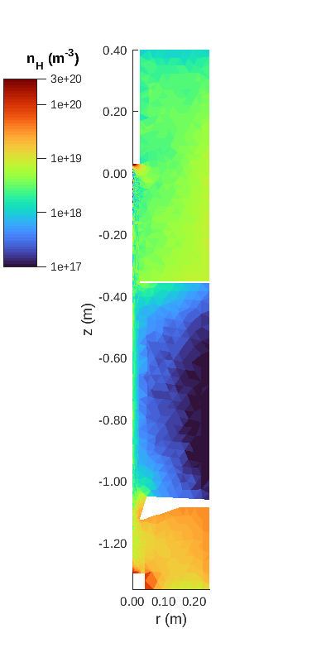
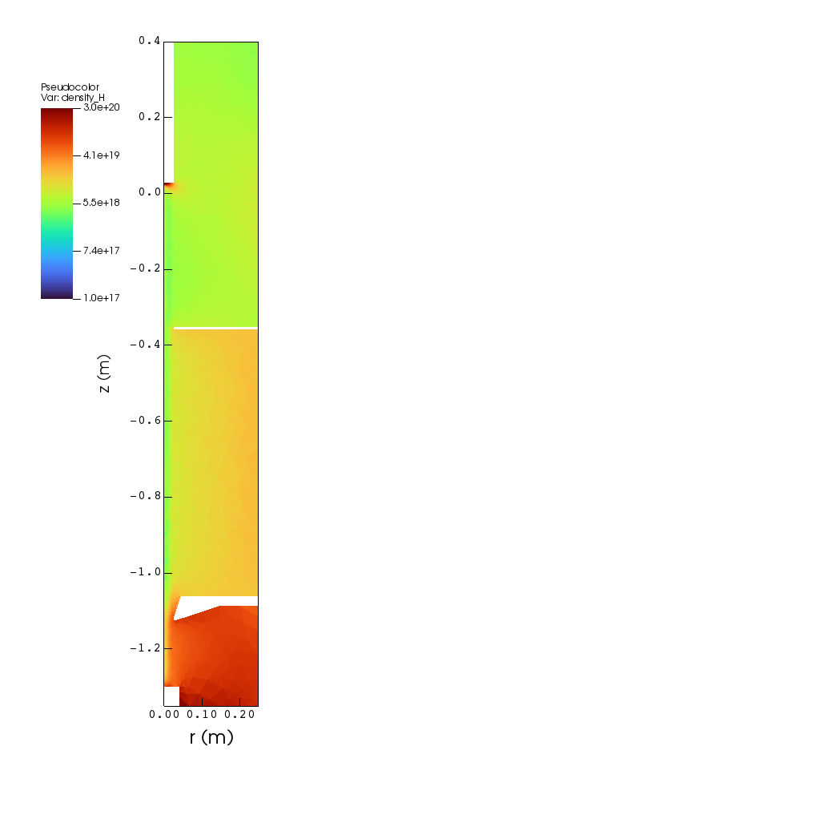
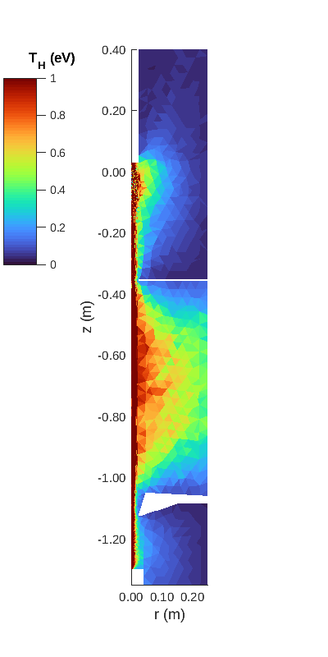
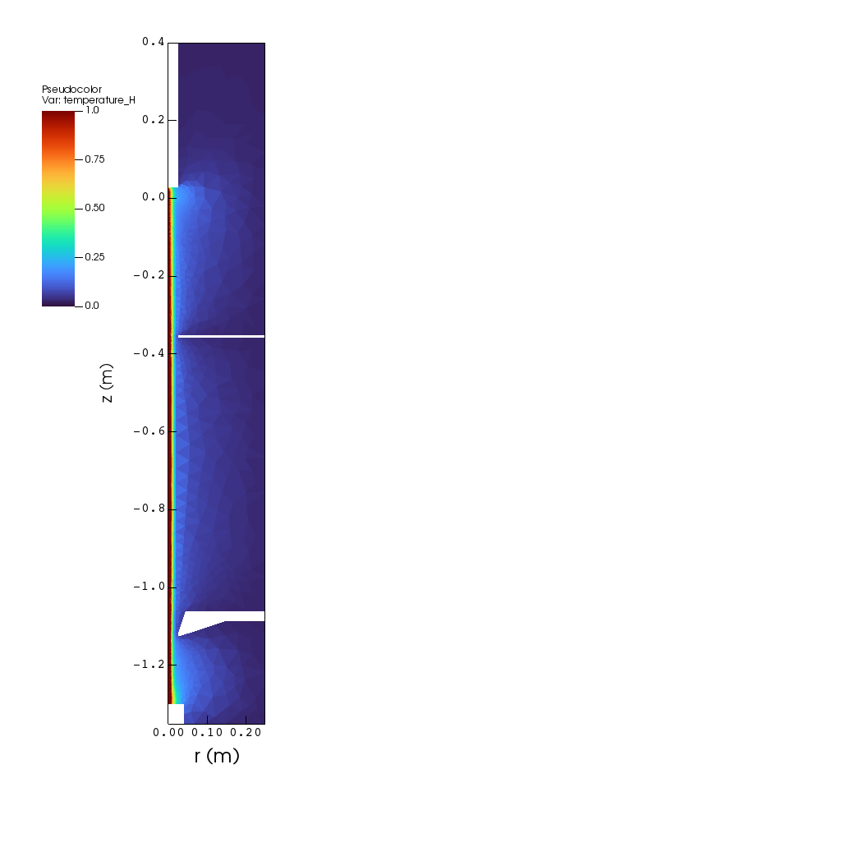
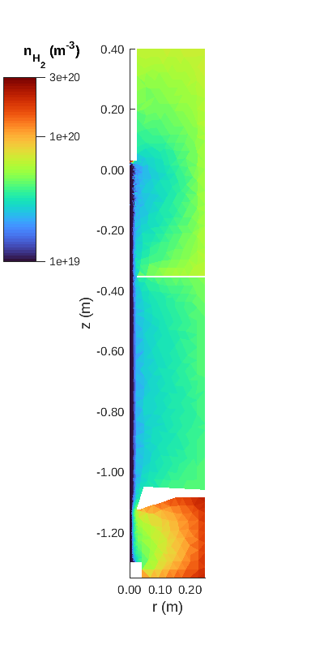
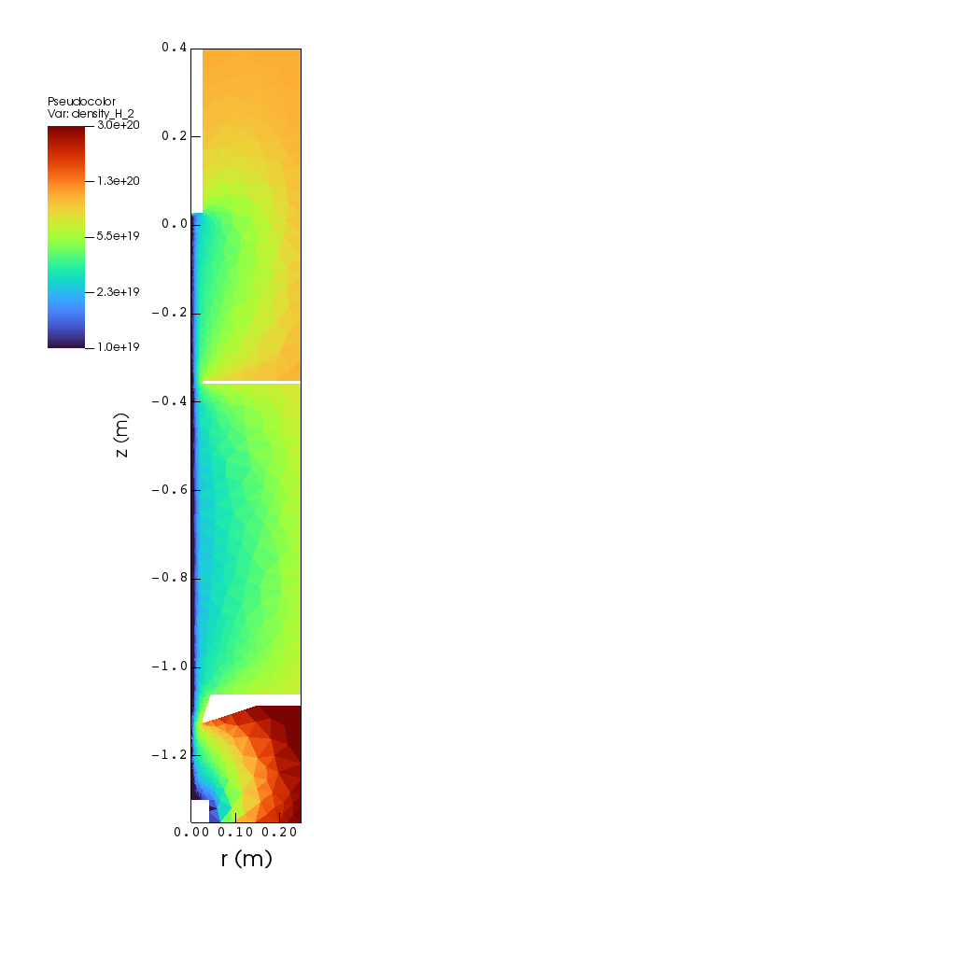
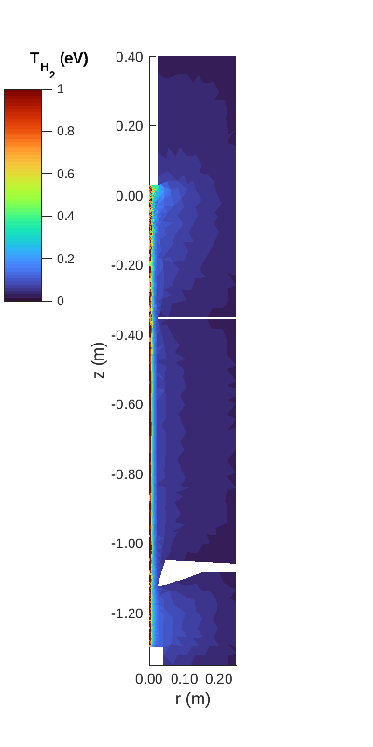
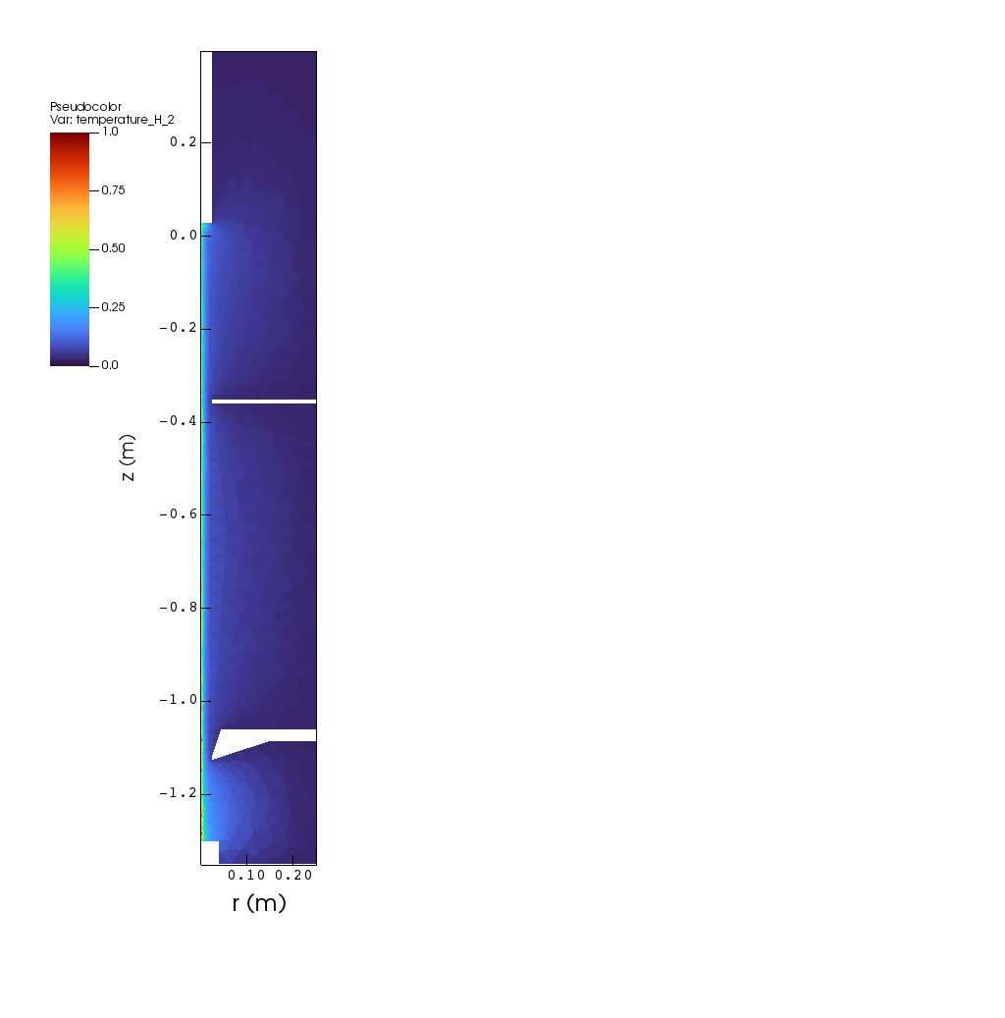
Difference in implementation of processes
A significant number of differences between Eunomia and Eirene regarding the implementation of collision processes have been identified.
These include EI, MAR and plasma-neutral elastic interaction.
These results in completely different neutral distribution between the two codes.
Fig. 3: H density for Eirene (left) and Eunomia (right).
Fig. 4: H temperature for Eirene (left) and Eunomia (right).
Fig. 5: H₂ density for Eirene (left) and Eunomia (right).
Fig. 6: H₂ density for Eirene (left) and Eunomia (right).
4

Slide 5
Future works
Analyse the relevance of collision process in high target pressure (detachment).
Reduce the free parameters to simulate Magnum-PSI:
  Potential boundary condition at the source (experiments)
  Transport coefficients for low density cases (kinetic simulations)
  Distribution of neutrals (experiments)
  Axial plasma profiles (experiments)
Time-dependent simulations.
5

Slide 6
Coupling SOLPS-ITER with Finite Element Wall Model
5

Slide 7
Developing of new Finite Element Wall model coupled with SOLPS-ITER
Currently being developed with the collaboration of Giuseppe Nallo (Politecnico di Torino).
Only takes into account B2.5 fluxes, but extension to Eirene neutral fluxes is in development.
This will self-consistently solve the target temperature and overwrite Eirene input parameters for recycling, evaporation, surface temperature…
Currently the exchange of information is being done in plain text files. Plans to move towards IMAS structure and (possibly) HDF5.
First steps to make the FEW model to communicate with B2.5 and Eirene.
Iterative coupling in the next months.
J. Gonzalez; TSVV VC
7
2021-12-10

Slide 8
Planning for FEW model
Extract relevant neutral fluxes from Eirene and pass them to the wall model.
Use a tungsten simplified 2D axial-symmetrical model to check that plasma and neutral fluxes are being correctly read.
Check overwriting of Eirene/B.25 parameters.
Simple coupled run with Magnum-PSI based on ITER’s Monoblock:
  Self-consistent temperature and sputtering.
  Implement absorption and outgassing.
  Involved recycling could be implemented too.
J. Gonzalez; TSVV VC
8
2021-12-10

Slide 9
Thank you for your attention
J. Gonzalez, E. Westerhof | TSVV-5 2021

